Slide 1



EGU General Assembly 2020
Understanding co-occurrence and mobility of uranium and arsenic
sources in groundwater flow systems in semi-arid zones in the
Mexican Altiplano
PhD Student: Dario del Angel Cauich Kau
dario.cauich@Gmail.com
Univ. Prof. Dr. Thomas R. Rüde
Dr. Antonio Cardona Benavides
Dr. Javier Castro Larragoitia

Slide 2
Introduction
Figure 1. Arsenic contamination of drinking water in different parts of the world (Ahmad et al., 2020)

Slide 3
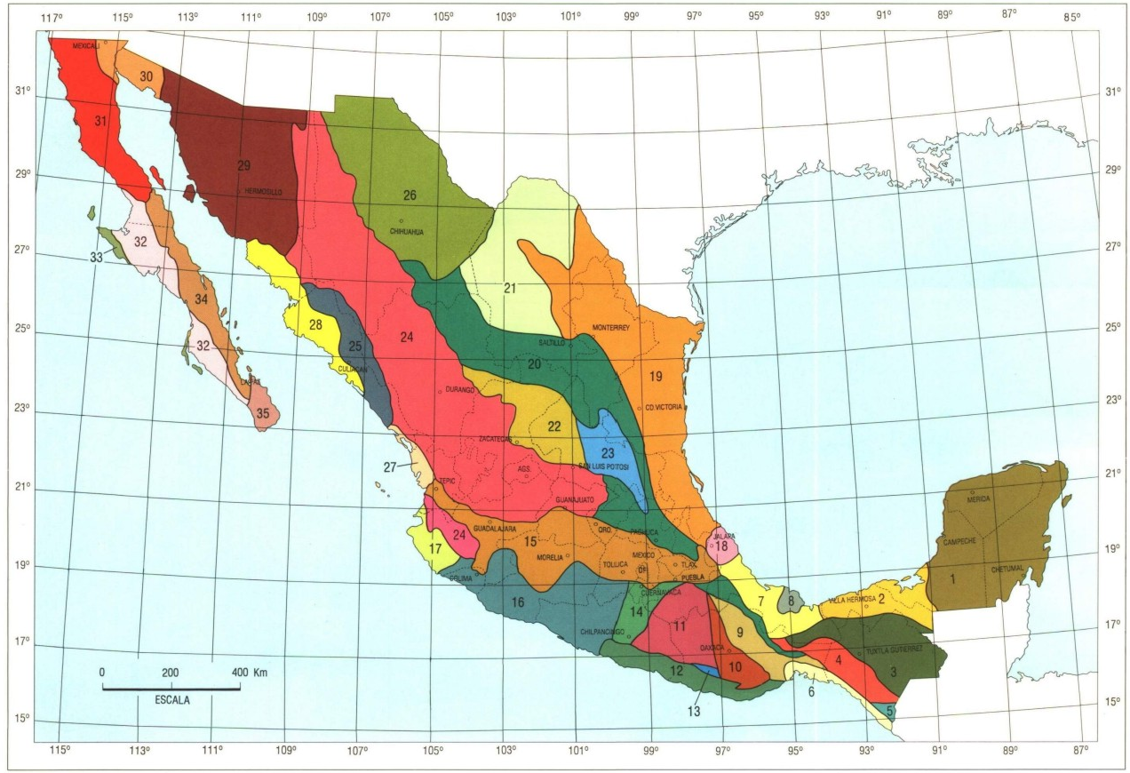
Introduction
Cerritos is located into the “Plataforma de Valles-San Luis Potosí” Province into a calcareous rocks.
Cerritos area
Villa de Reyes area
Villa de Reyes is located into the “Faja Ignimbrítica Mexicana” Province into a volcanic area
Figure 2. Mexican geological provinces

Slide 4
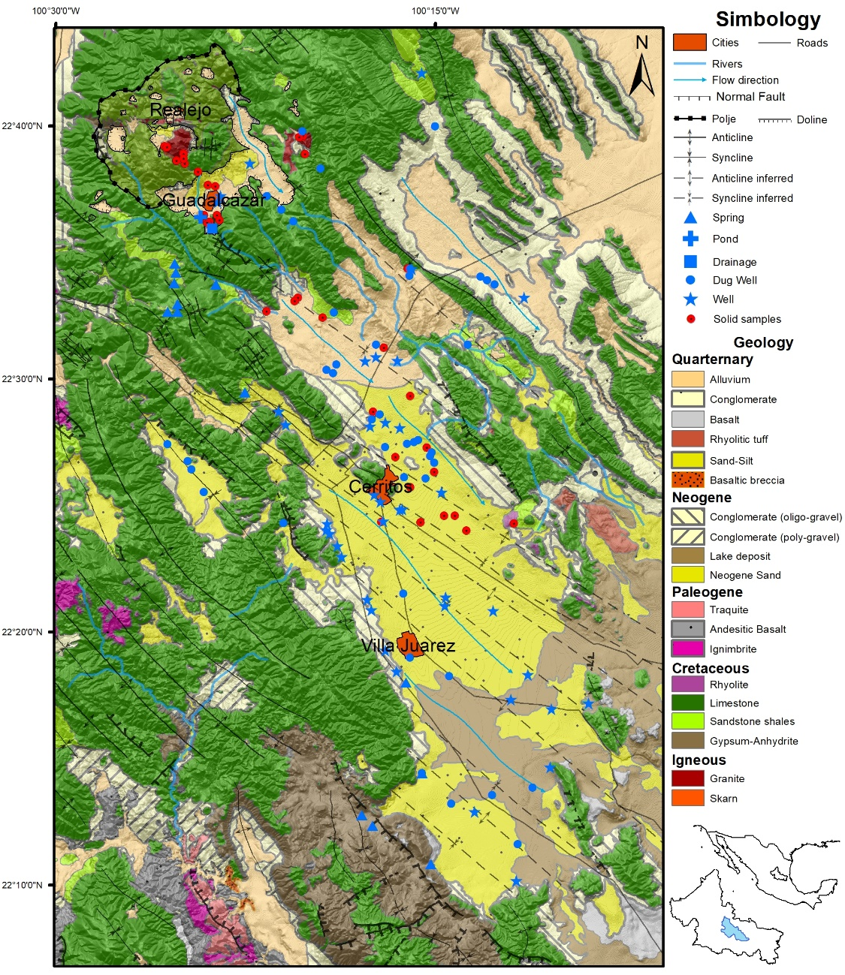
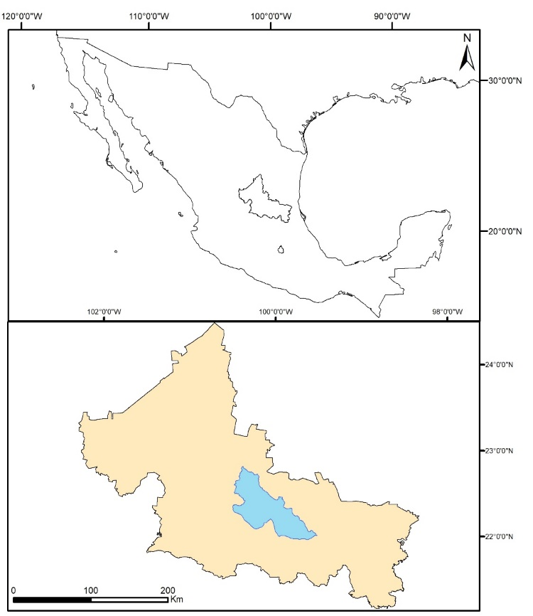
Introduction
United States of America
Background: Cerritos study area
San Luis Potosí State
Mexico City
Figure 3. General overview of the Cerritos study area including the sampling points from Konefke (2018) and Palm (2008).
Study area
Figure 4. Location of the study area.

Slide 5
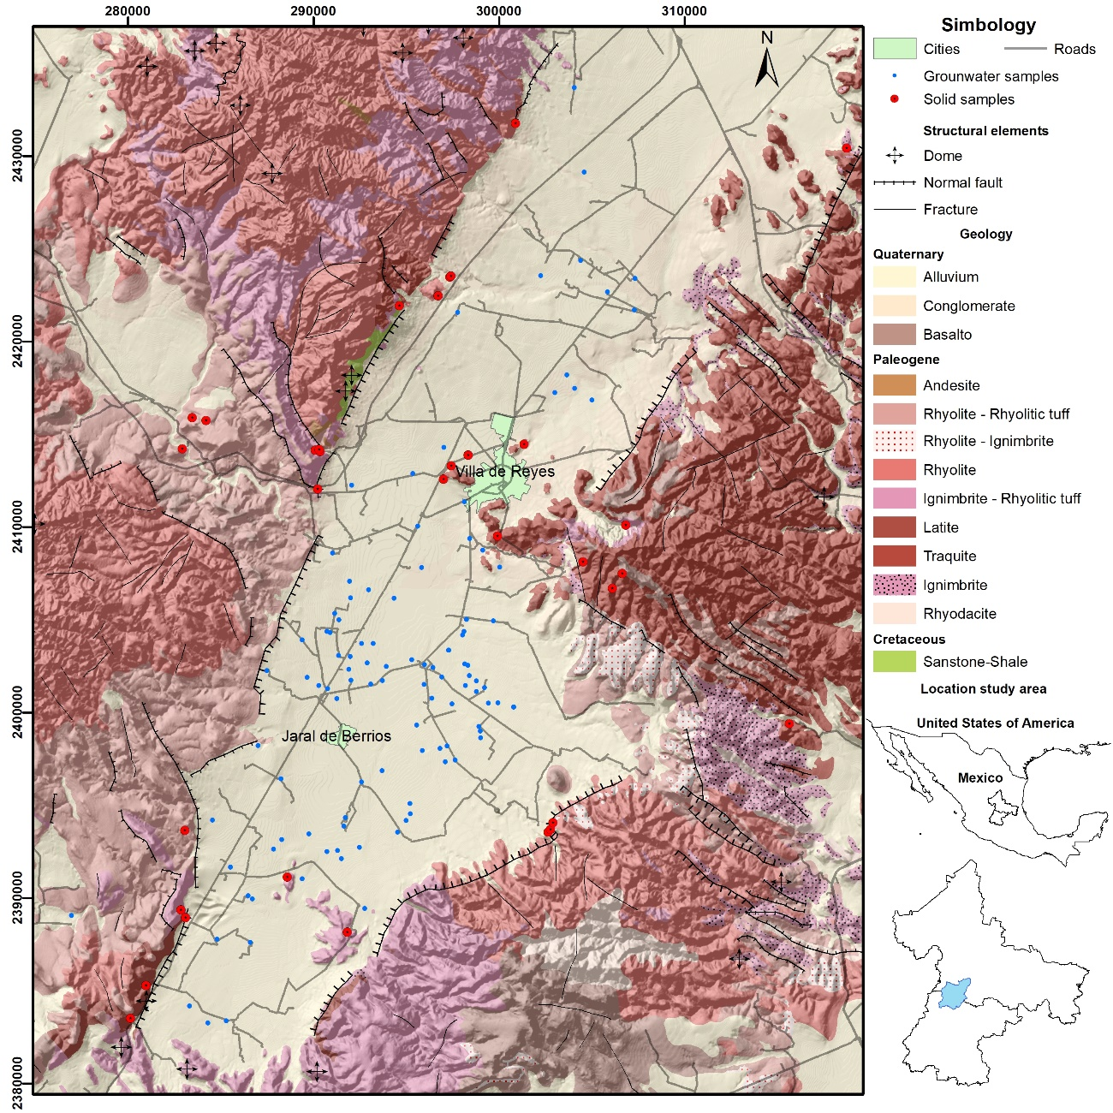
Introduction
Background: Villa de Reyes study area
Figure 5. Relationship between As and U (Banning 2012).
The gray zone indicates an area defined by average volcanic rock As/U ratio +2 standard deviations (lower line) and -2 standard deviations (upper line).
Figure 6. General overview of the Villa de Reyes study area.

Slide 6
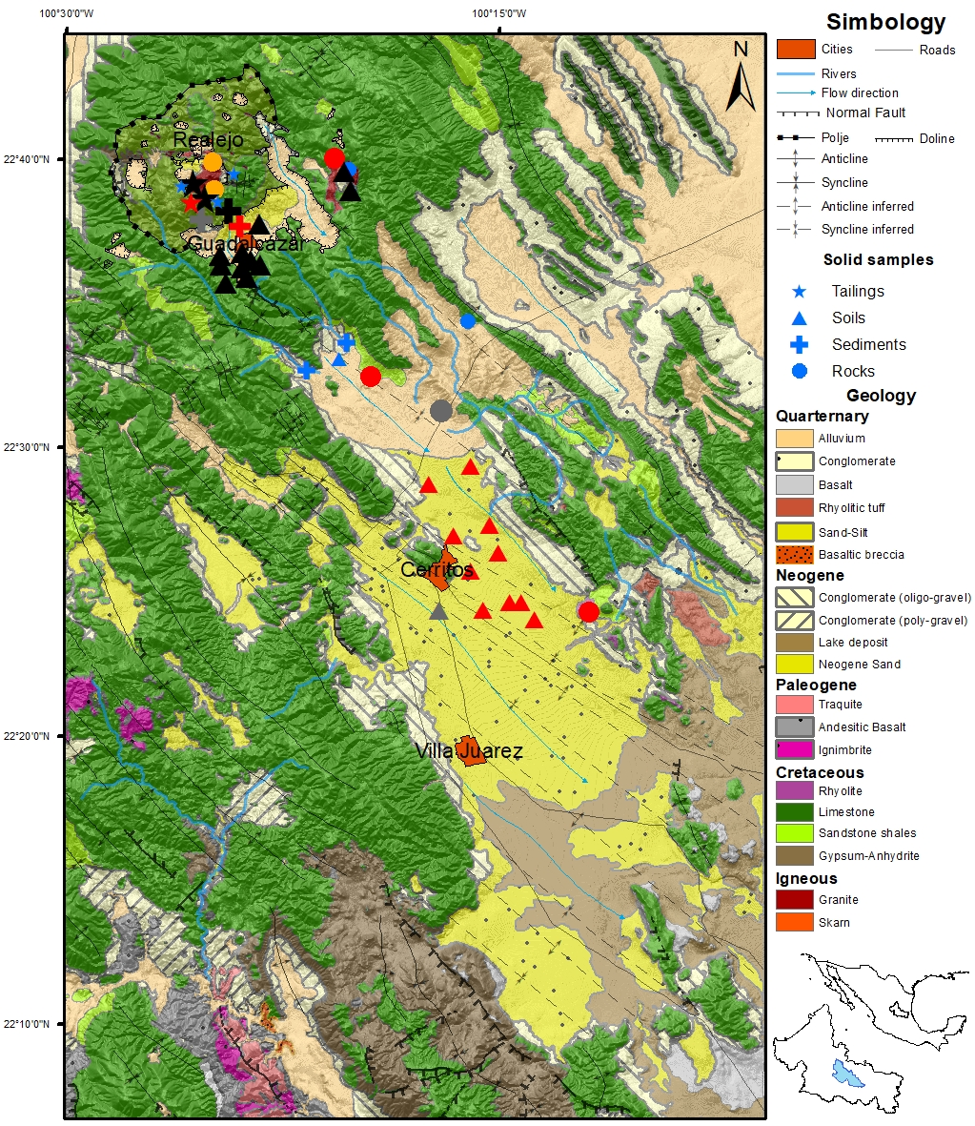
Results: Cerritos
As background values
Rocks:
1.5-2 [mg/kg] (Matschullat 1999)
1.8 [mg/kg] (Taylor 1964)
Soils:
1-30 [mg/kg] (Kabata-Pendias 2011)
  Figure 7. Distribution of the Arsenic concentrations in solid samples.

Slide 7
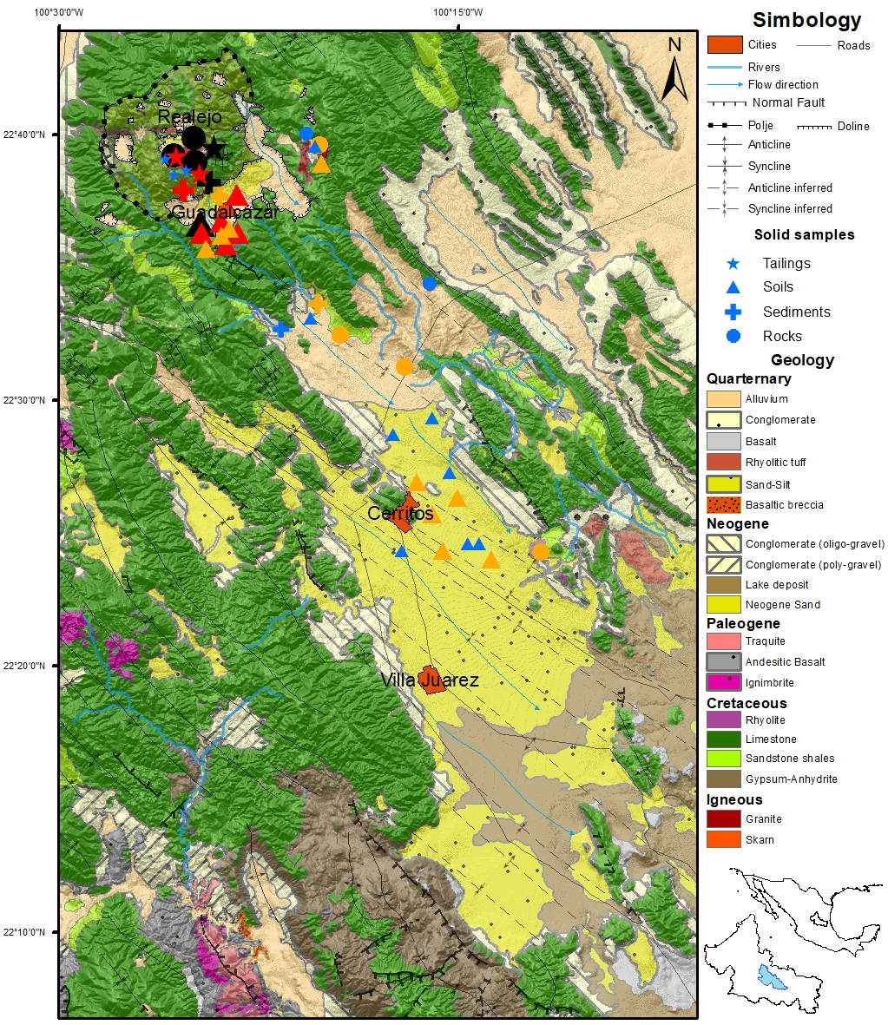
Results: Cerritos
U background values:
Rocks:
2.7 [mg/kg] (Taylor 1964)
  Figure 8. Distribution of the Uranium concentrations in solid samples.

Slide 8
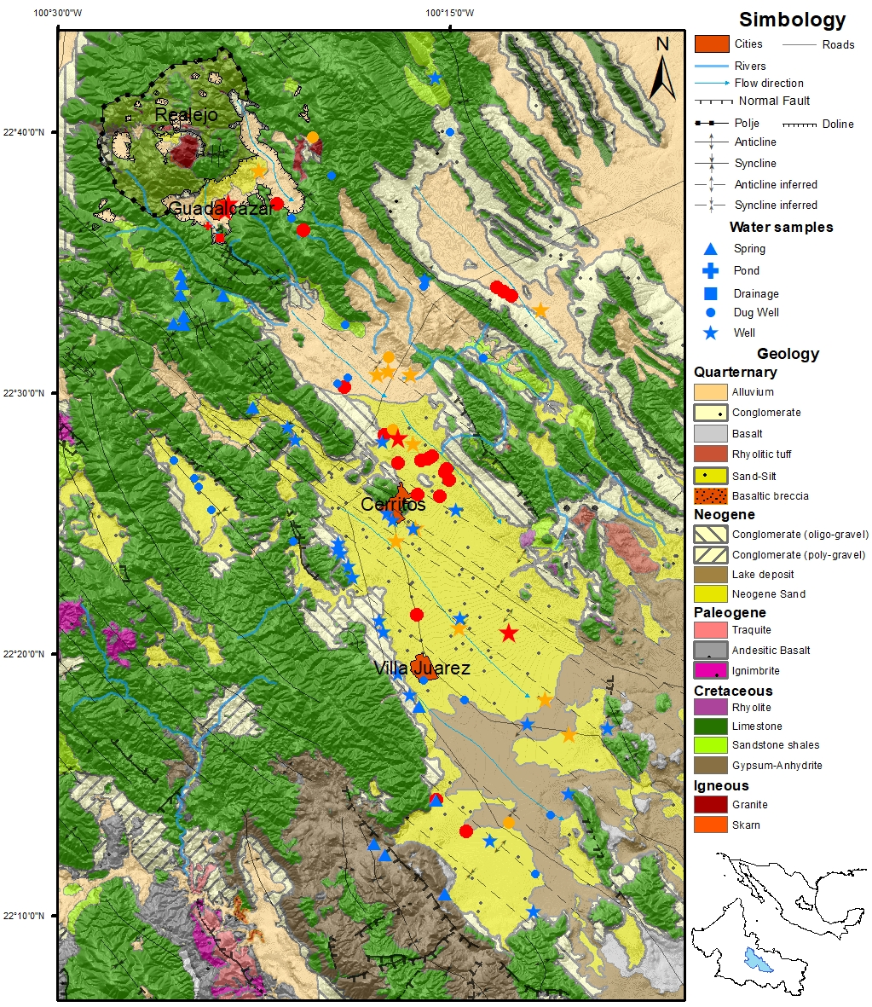
Results: Cerritos
Arsenic Limit values
Mexican Law:
25 [µg/L]
German Law:
10 [µg/L]
WHO:
10 [µg/L]
US-EPA:
10 [µg/L]
  Figure 9. Distribution of the Arsenic concentrations in water samples.

Slide 9
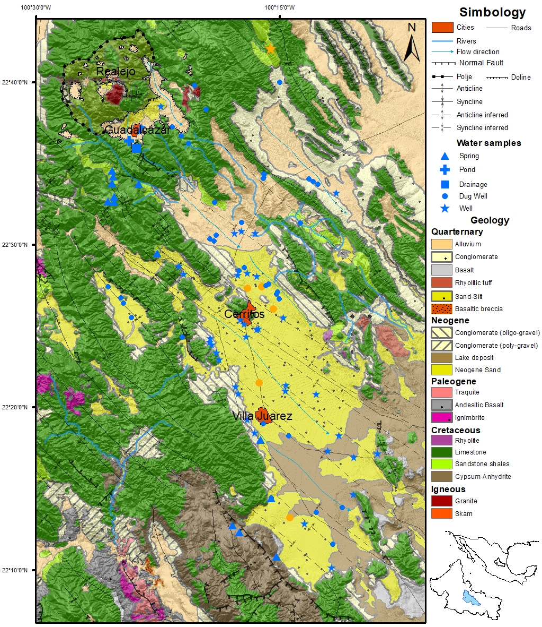
Results: Cerritos
Uranium Limit values
Mexican Law:
Not considered
German Law:
10 [µg/L]
WHO:
30 [µg/L]
US-EPA:
30 [µg/L]
  Figure 10. Distribution of the Uranium concentrations in water samples.

Slide 10
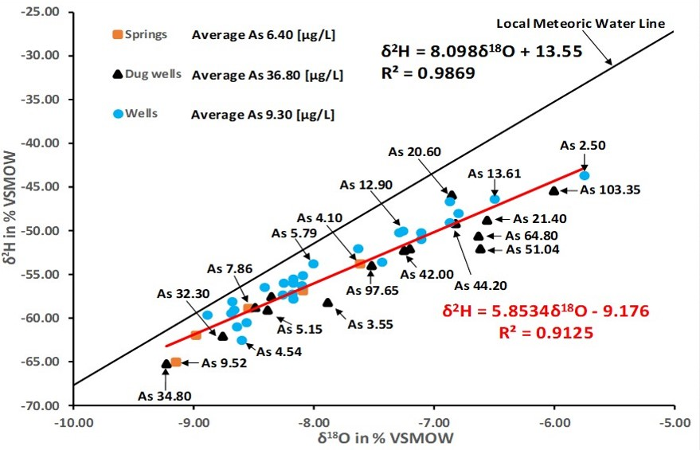
Results: Cerritos Isotopes
Springs located at the limestone units does not have evaportation influence
  Figure 11. Distribution of the Arsenic concentrations in groundwater samples.
47 % of the Dug Wells placed at the basin fill have evaportation influence
2 Wells placed at the basin fill have evaportation influence

Slide 11
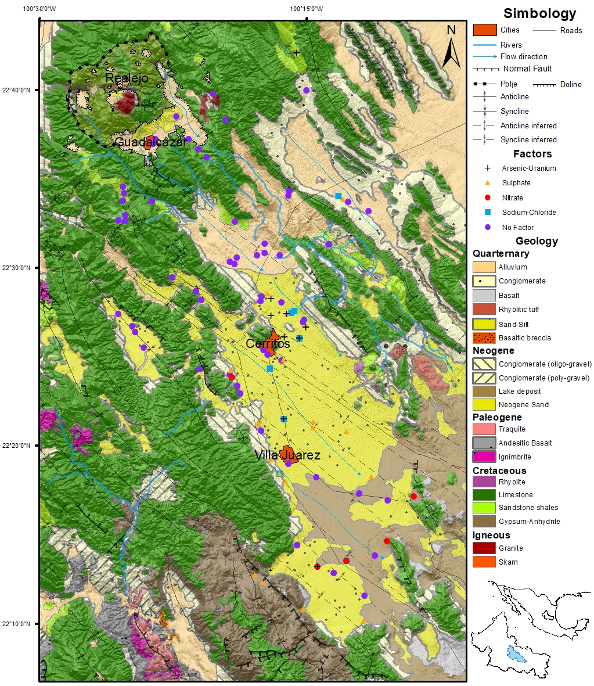
Results: Statistical analysis
With 4 factors is possible to explain 80 % of the Varience
Arsenic – Uranium factor related to the evaporation process
Sulphate factor related to the Gypsum - Anhydrite
Nitrate factor related to agricultural influence
Sodium – Chloride factor related to deep groundwater
  Figure 12. Distribution of the Arsenic concentrations in water samples.

Slide 12
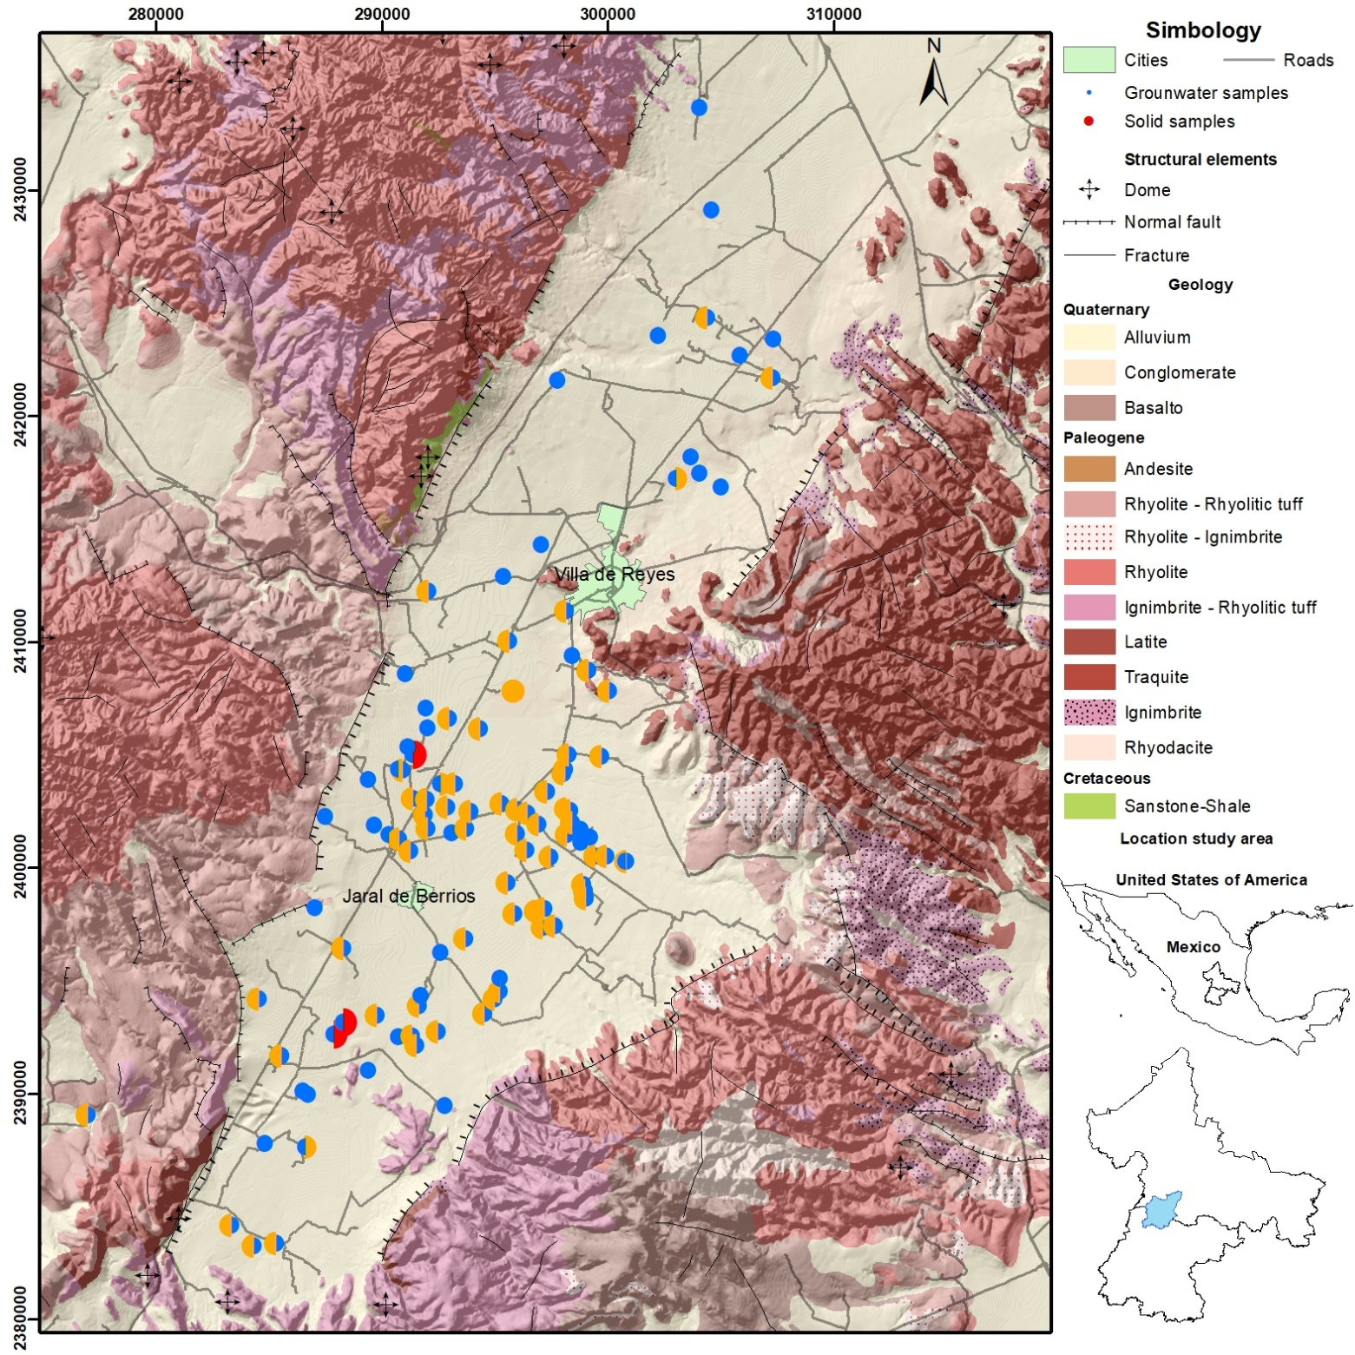
Results: Villa de Reyes
Arsenic values
Mexican Law:
25 [µg/L]
German Law:
10 [µg/L]
WHO:
10 [µg/L]
US-EPA:
10 [µg/L]
Uranium values
Mexican Law:
Not considered
German Law:
10 [µg/L]
WHO:
30 [µg/L]
US-EPA:
30 [µg/L]
  Figure 13. Distribution of the Arsenic concentrations in solid samples.

Slide 13
Results: Villa de Reyes
  Figure 14. Plot Ge vs Li.

Slide 14
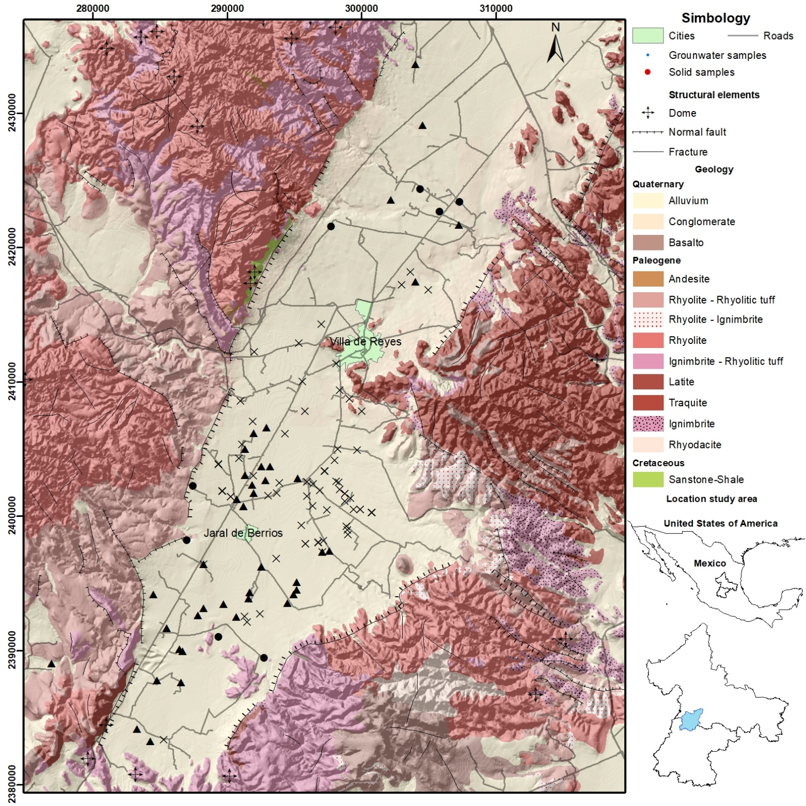
Results:
The Regional Flow could be related to a major fault system
  Figure 15. Plot Ge vs Li.

Slide 15
WHO:
10 [µg/L]
Mex Law:
25 [µg/L]
Results: Villa de Reyes
Arsenic values
Mexican
Law:
25 [µg/L]
German
Law:
10 [µg/L]
WHO:
10 [µg/L]
US-EPA:
10 [µg/L]
Uranium values
Mexican
Law:
Not considered
German
Law:
10 [µg/L]
WHO:
30 [µg/L]
US-EPA:
30 [µg/L]
Regional flow
Intermediate flow
Local flow
  Figure 16. Plot Ge vs Li.

Slide 16
What´s next?
Cerritos area:
Column test from soils and tailings of the Cerritos area.
After the Columnt test I will correlate the information from the solid samples.
Publication of the information.
Villa de Reyes area:
Statistical evaluation of the groundwater results.
Interpretation of the information of the 31 solid samples, keeping special attention to the vitreous matrix.
Evaluate the information and create a model.
Publication of the information.
I appreciate your attention!!!

Slide 17
References
Arslan Ahmada, Patrick van der Wense, Kirsten Bakena, Luuk de Waala,Prosun Bhattacharyab, Pieter Stuyfzanda. 2020. Arsenic reduction to <1 μg/L in Dutch drinking water. Environment International 134.
Andre Banning, Antonio Cardona, Thomas R. Rüde. 2012. Uranium and arsenic dynamics in volcano-sedimentary basins – An exemplary
study in North-Central Mexico. Applied Geochemistry 27.
Kabata-Pendias, A. 2011. Trace Elements in Soils and Plants. Taylor and Francis Group, LLC, USA.
Konefke, L. 2018. Causes for elevated concentrations of arsenic and uranium in the northern Cerritos Basin, San Luis Potosí, México. RWTH Aachen University, MSc Thesis.
María T. Alarcón-Herrera, Daniel A. Martín-Alarcón, Mélida Gutiérrez, Liliana Reynoso-Cuevas, Alejandra Martín-Domínguez, Mario A. Olmos- Márques, Jochen Bundschuh. 2020. Co-occurrence, possible origin, and health-risk assessment of arsenic and fluoride in drinking water sources in Mexico: Geographical data visualization. Science of Total Environment 698.
Palm, J. 2008. Hydrogeological mapping of the Cerritos aqui fer system. RWTH Aachen University, Diploma mapping thesis.
Tóth J (1998) Groundwater as a geological agent: an overview of the causes, processes, and manifestations. Hydrogeol J 7:1–14

