Slide 1






A case study of 5th generation district heating and cooling based on foundation pile heat exchangers (Vejle, Denmark)
VIA University College, Horsens
Abstract: EGU2020-4626
Søren Erbs Poulsen, Maria Alberdi-Pagola, Karl Woldum Tordrup, Davide Cerra, Theis Raaschou Andersen
Vejle Fjernvarme

Slide 2
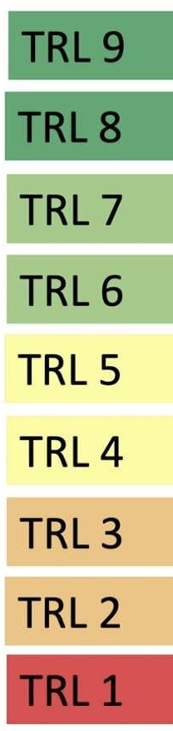


Abstract
EGU2020-4626
VIA R&D Buildings, Energy, Water & Climate
FULLY COMMERCIAL
“Sustainable, building-integrated heating and cooling supply for future resilient cities”, EUDP, 400,000 euro
https://www.ucviden.dk/portal/da/publications/bygningsintegreret-varme-og-koeleforsyning-til-fremtidens-resiliente-byer(a182ae4e-f4cb-4a57-a7eb-d4923e75176f).html
FIRST DEMO
DEMO SYSTEM
“Design and performance of energy pile foundations”, industrial Ph.D. project, 340,000 euro
SYSTEM PROTOTYPE
LARGE PROTOTYPE
SMALL PROTOTYPE
Energy piles for 5th generation district
heating and cooling (5GDHC)
APPLIED RESEARCH
CONCEPTUALIZATION
BASIC RESEARCH
IDEA
2015
2016
2017
2018
2019
2020
2021
2022
2023
2024

Slide 3
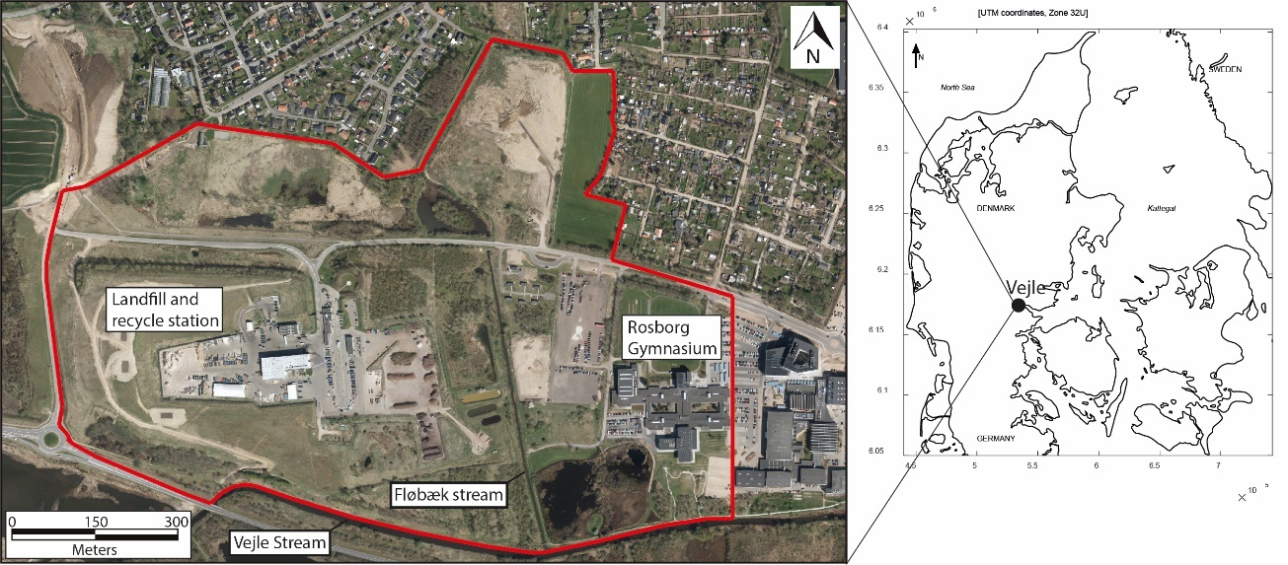
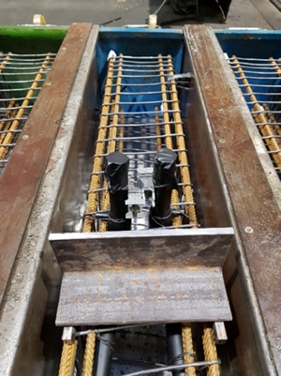
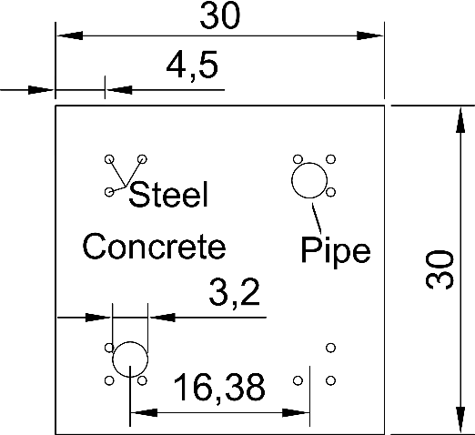
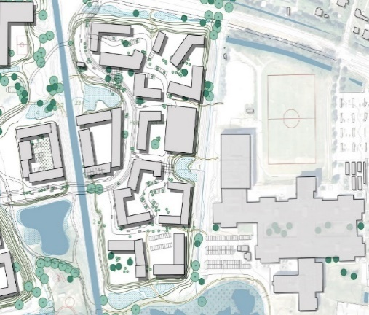
Case study area: Rosborg Ø
Abstract
EGU2020-4626
Energy piles for 5GDHC
Ny Rosborg: Future residential area to be developed
Building footprint
16,950 m2
Rosborg Ø
a) | b)

Slide 4
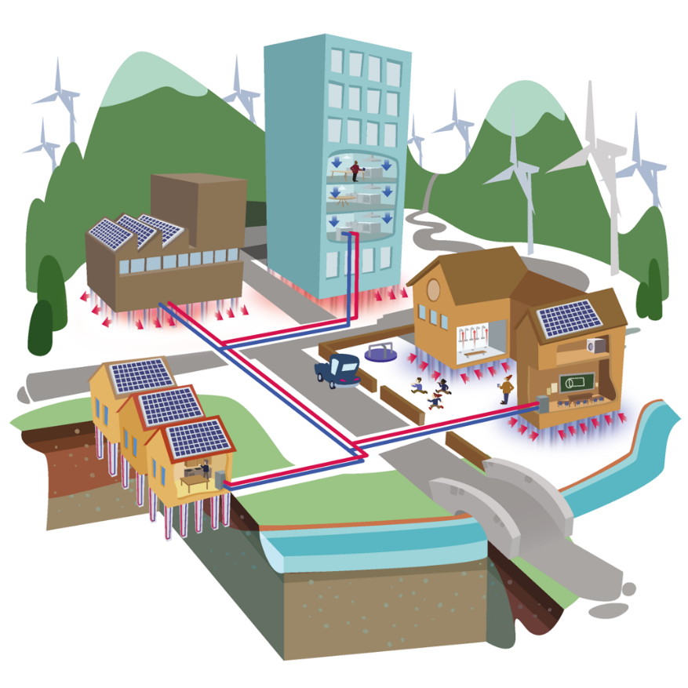
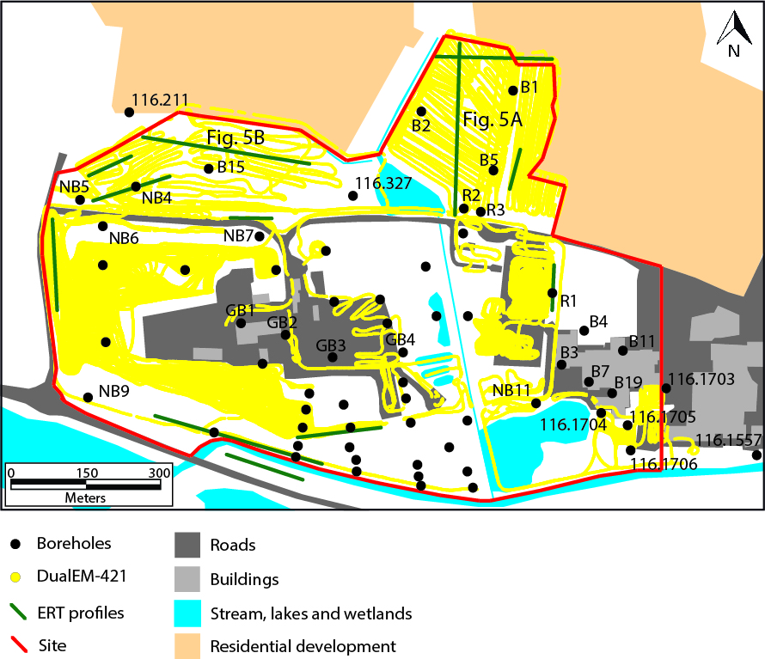
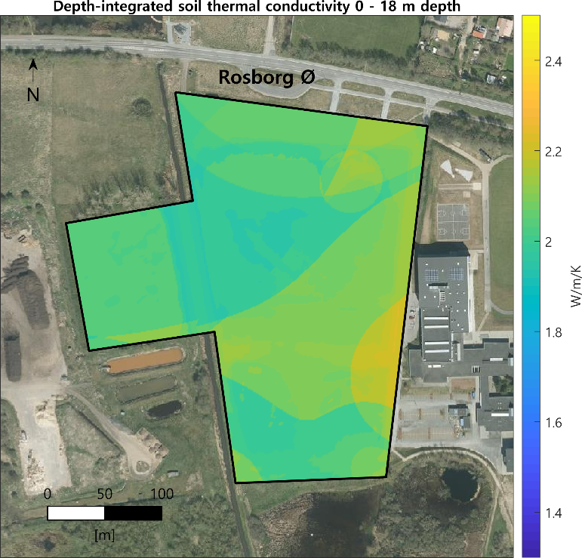
Geothermal screening for 5GDHC
Abstract
EGU2020-4626
Boreholes and geophysical surveys
Geological model
Soil thermal properties
Thermogeological model
Dimensioning of 5GDHC

Slide 5
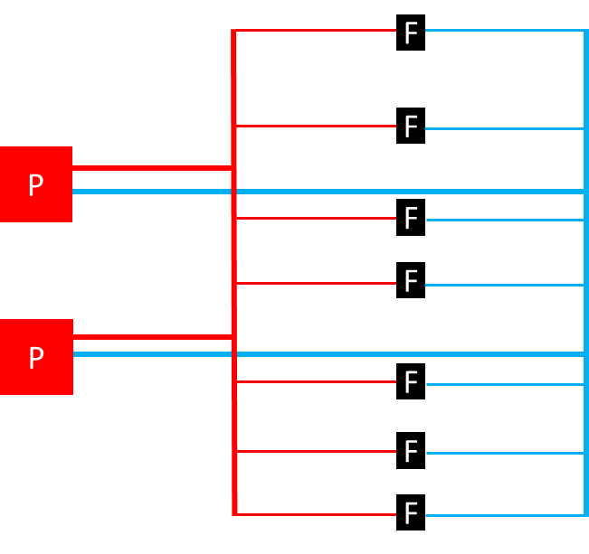
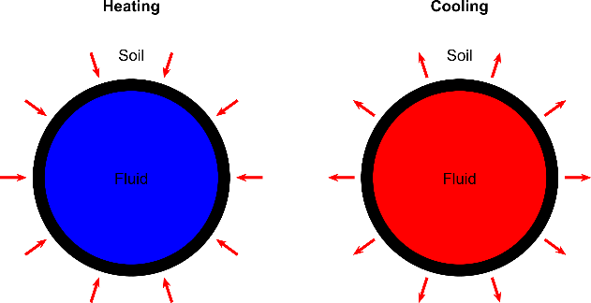
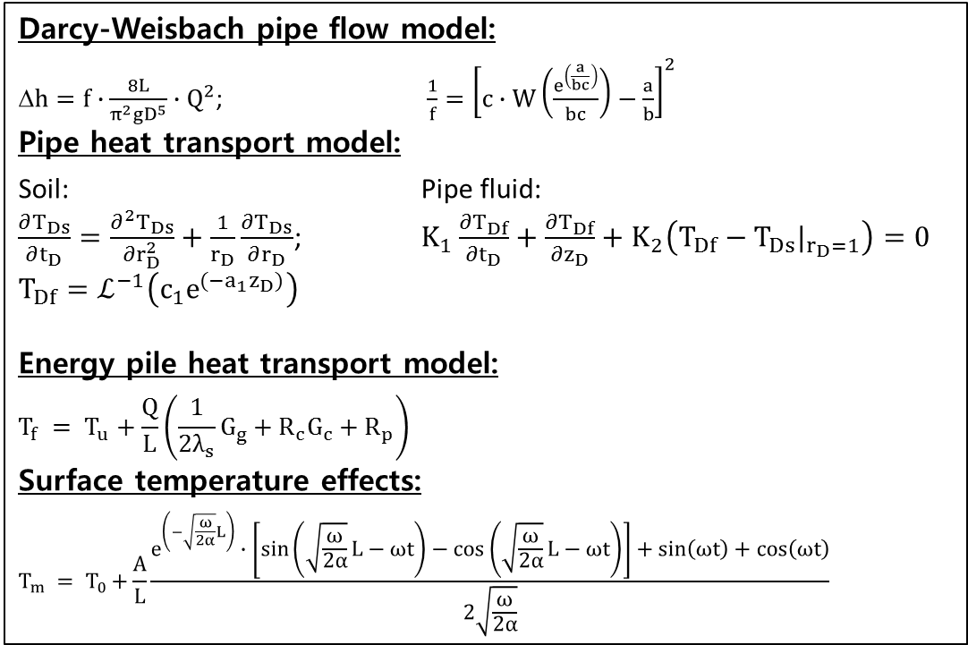
5GDHC modular temperature model
Abstract
EGU2020-4626
Topology
Mathematical model
Darcy-Weisbach pipe flow model:
$h=f∙\frac{8L}{π^{2}gD^{5}}∙Q^{2}$; $\frac{1}{f}={\left[c∙W\left(\frac{e^{\left(\frac{a}{bc}\right)}}{bc}\right)−\frac{a}{b}\right]}^{2}$
Pipe heat transport model:
Soil: Pipe fluid:
$\frac{∂T_{Ds}}{∂t_{D}}=\frac{∂^{2}T_{Ds}}{∂r_{D}^{2}}+\frac{1}{r_{D}}\frac{∂T_{Ds}}{∂r_{D}}$; $K_{1}\frac{∂T_{Df}}{{∂t}_{D}}+\frac{∂T_{Df}}{{∂z}_{D}}+K_{2}\left(T_{Df}−T_{Ds}|_{r_{D}=1}\right)=0$
$$T_{Df}=ℒ^{−1}\left(c_{1}e^{(−a_{1}z_{D})}\right)$$
Energy pile heat transport model:
$$T_{f} = T_{u}+\frac{Q}{L}\left(\frac{1}{2λ_{s}}G_{g}+R_{c}G_{c}+R_{p}\right)$$
Surface temperature effects:
$${T_{m} = T}_{0}+\frac{A}{L}\frac{e^{\left(−\sqrt{\frac{ω}{2α}}L\right)}∙\left[\sin\left(\sqrt{\frac{ω}{2α}}L−ωt\right)−\cos\left(\sqrt{\frac{ω}{2α}}L−ωt\right)\right]+\sin\left(ωt\right)+\cos\left(ωt\right)}{2\sqrt{\frac{ω}{2α}}}$$

Slide 6
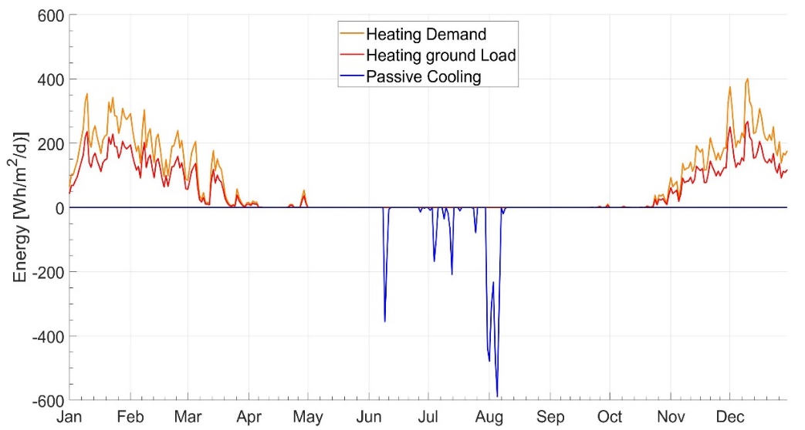
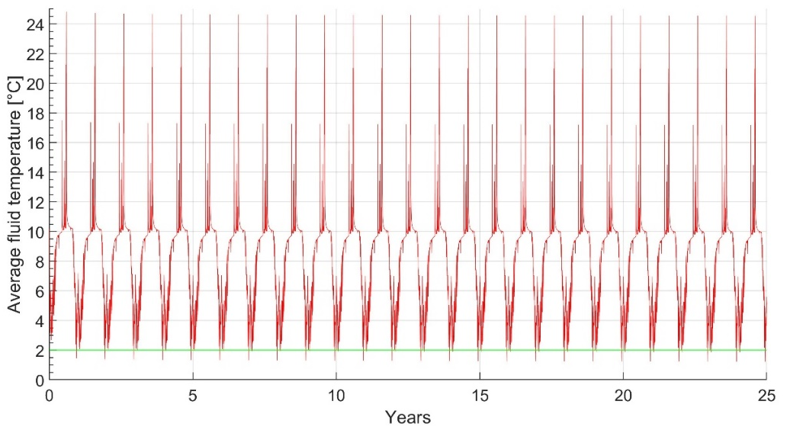
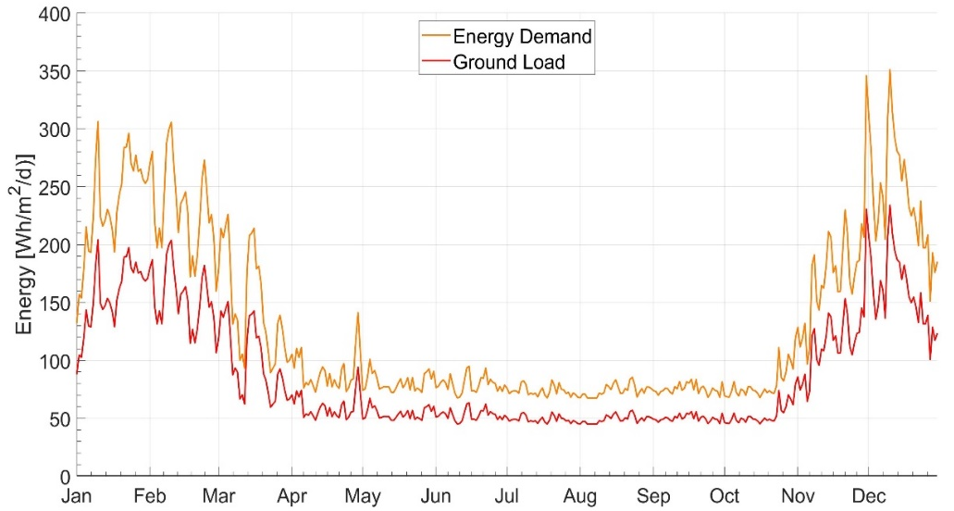
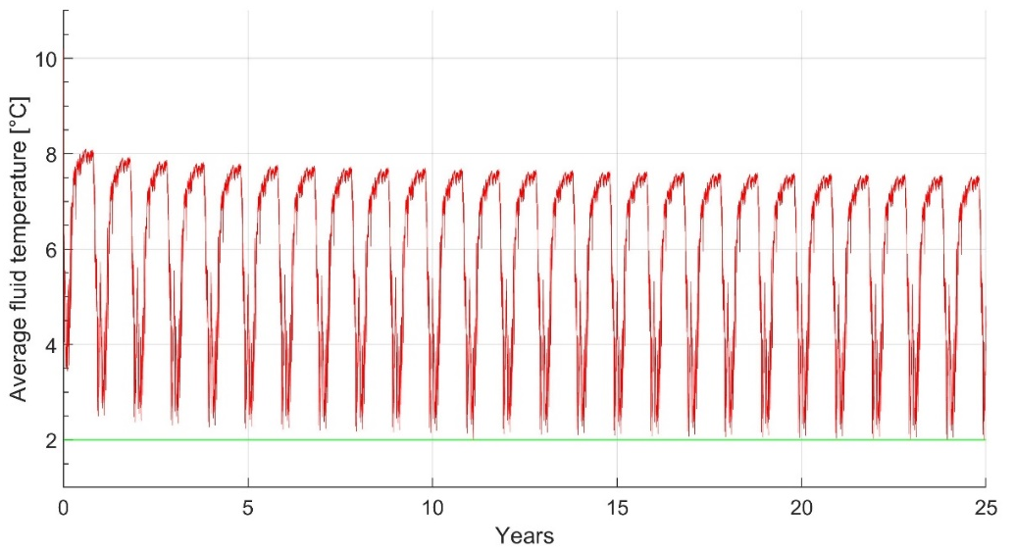
Building energy demand
Abstract
EGU2020-4626
5GDHC fluid temperatures
Office buildings
Supportable liveable area 65,000 m²
3 floors
Residential buildings
Supportable liveable area 75,000 m²
4 floors
Geotechnical limit

Slide 7
Business case
Abstract
EGU2020-4626
Business case | Case 1: Office buildings | Case 2: Residential buildings
Energy piles cost per year | € 35,321.00 | € 99,638.76
District heating cost per year | € 232,360.96 | € 341,705.00
Savings from energy piles per year | € 197,039.96 | € 242,066.24
Total capital costs energy piles* | € 2,950,742.60 | € 3,057,727.40
Total capital costs district heating* | € 2,209,261.60 | € 1,535,601.60
Payback period | 3.76 years | 6.29 years
Traditional district heating and air conditioning serve as reference when calculating the payback period

