Slide 1
2020 EGU
Debris flows: advances on mechanics, monitoring, modelling and risk management
Debris flow monitoring in China
Xiaojun Guo
IMHE, CAS
2020-5-5

Slide 2
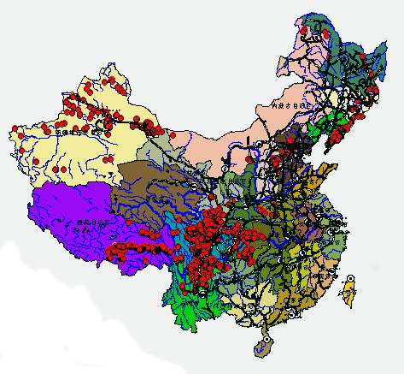
Debris flow in China and the monitoring sites
4. Ergou, 2013-2019
Post-earthquake debris flow
3. Bomi, 2011-now
Glacial debris flow
1. JJG, 1960s-now
viscous debris flow
2. Hunshui, 1974-1976, Mud flow like viscous debris flow

Slide 3
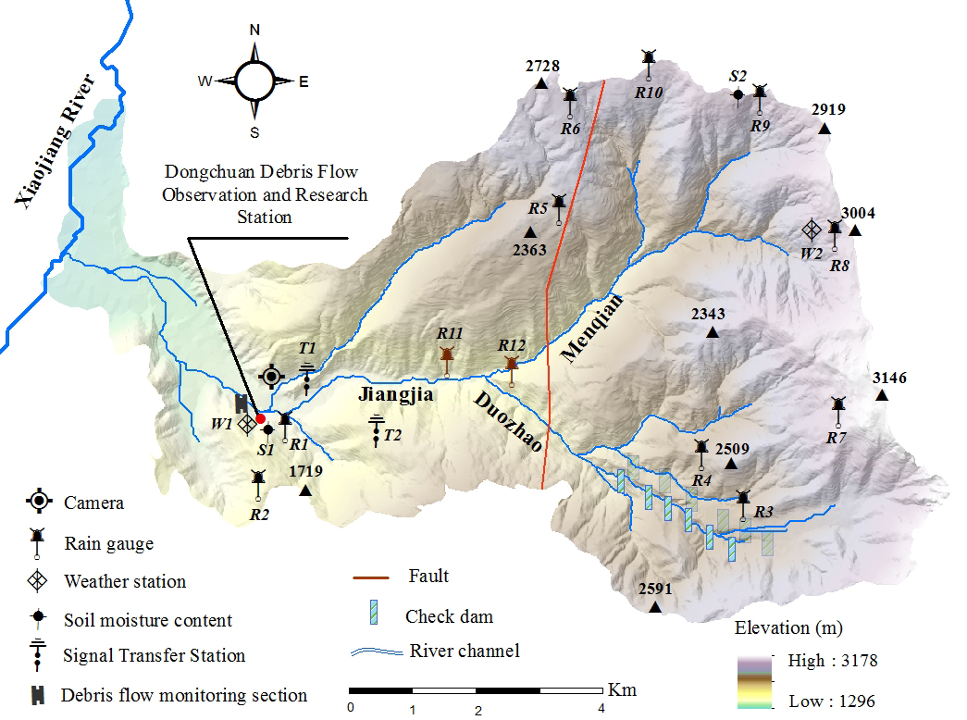
1. Debris flow in Jiangjia Gully (JJG)
Since 1960s, more than 500 debris flow events and more than 5000 surges were recorded
DDFORS is a Ministerial-level key field monitoring station
Area: 33 km² (upstream DDFORS)
10 Rain gauges, from the DDFORS to the headwater region
Flow height, flow velocity, discharge, volume, sediment volume concentration of each surge were recorded
Moving flow body were collected to analyze the density and rheological property

Slide 4
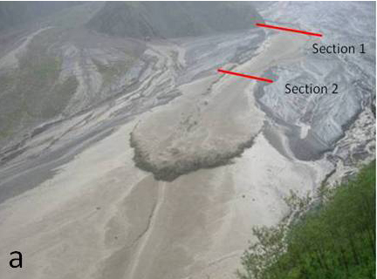
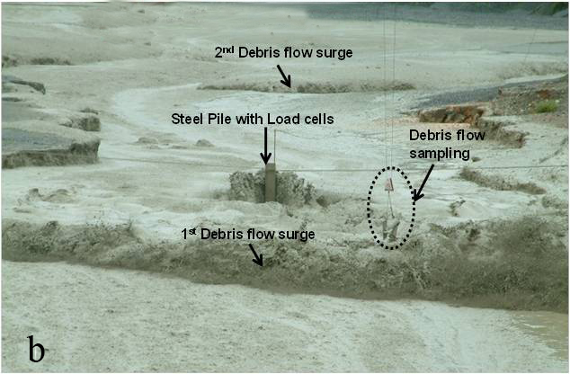
Debris flow parameters
The flow velocity (v) was determined using a stopwatch to measure the duration of the passage of the flow front through two sections within a 200-m-long channel
Flow height (h) and width (W) were estimated by well-experienced experts
Samples of the moving debris flow bodies, which were collected using a volume-calibrated sampling container controlled by electronic devices
The discharge (Q) was calculated using: Q = vh

Slide 5
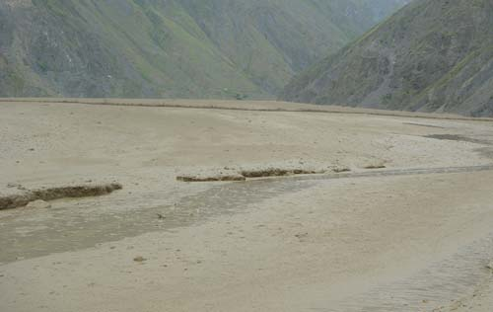
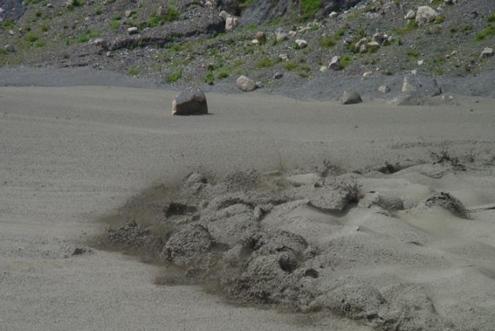
Debris flow properties
The flows were typical high-density (>2.0 g/cm³), viscous debris flows with evident fronts and tails.
Each debris flow event comprised intermittent surges and continuative flows between the surges and after the end of the surges as a tail.
The highest numbers of surges recorded in a single event were 126 surges
The discharge of the surges fluctuates by up to three orders of magnitude from <10 to >1000m³/s.
Time interval
Discharge
Time interval (s)
Discharge (m³/s)
Surge

Slide 6
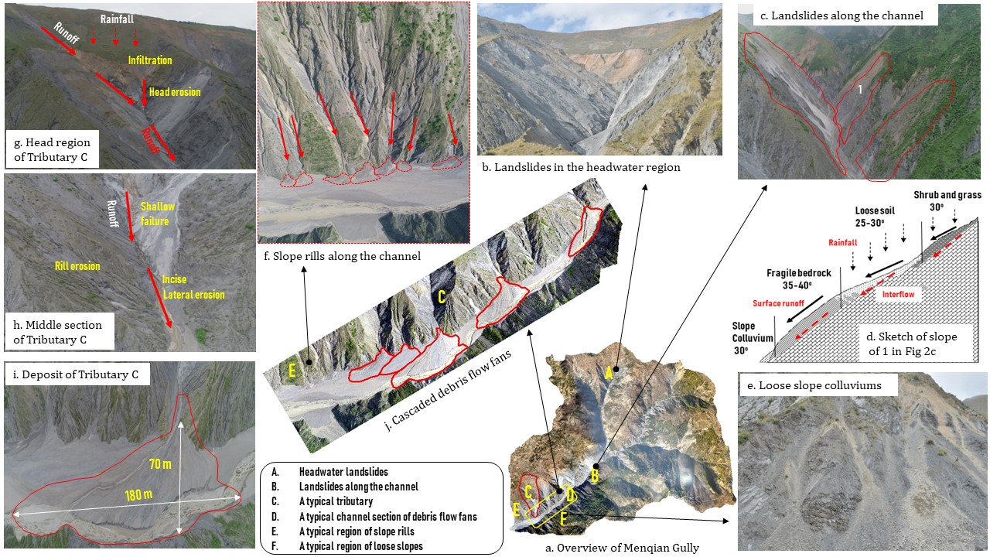
Debris flow source materials

Slide 7
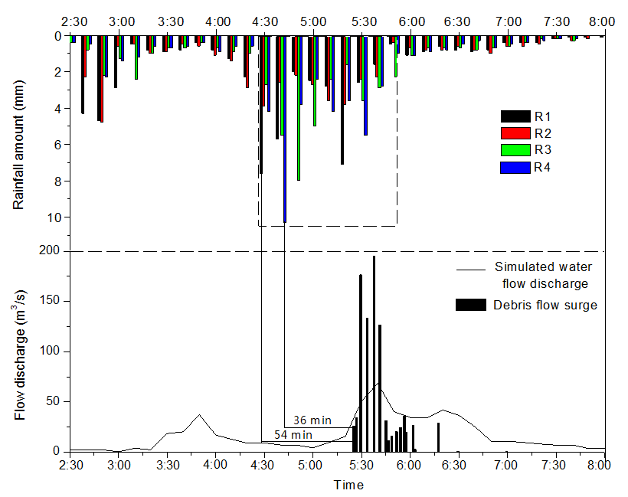
Monitoring flow discharge
Time lag (τ): from the time of the triggering rainfall to debris flow appearance at the monitoring section is a principal index that represents the propagation process.
τ ≤1 h
Ratio (ϒ) : between the debris flow discharge and water flow discharge
ϒ ≤ 3.3 h
Case 1: normal condition

Slide 8
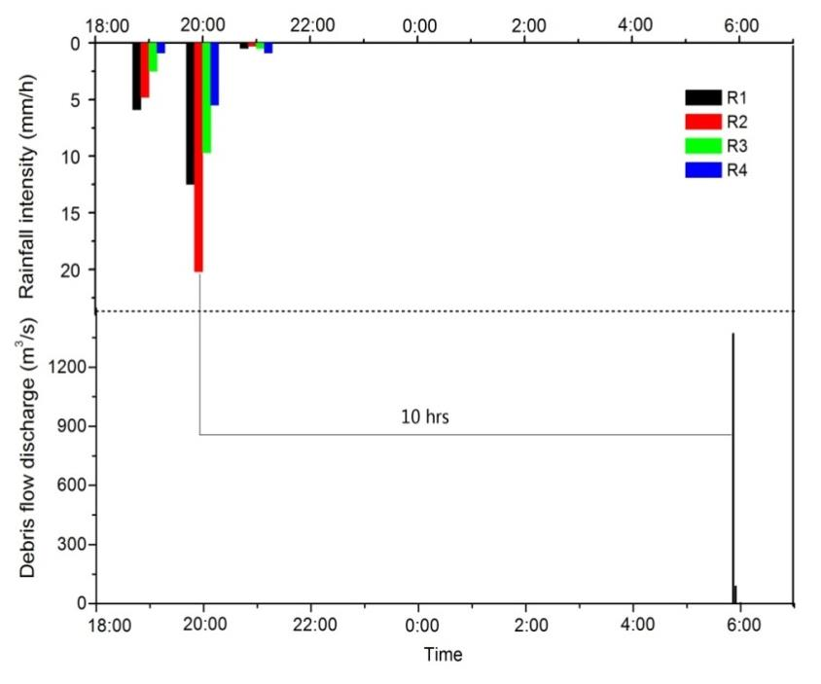
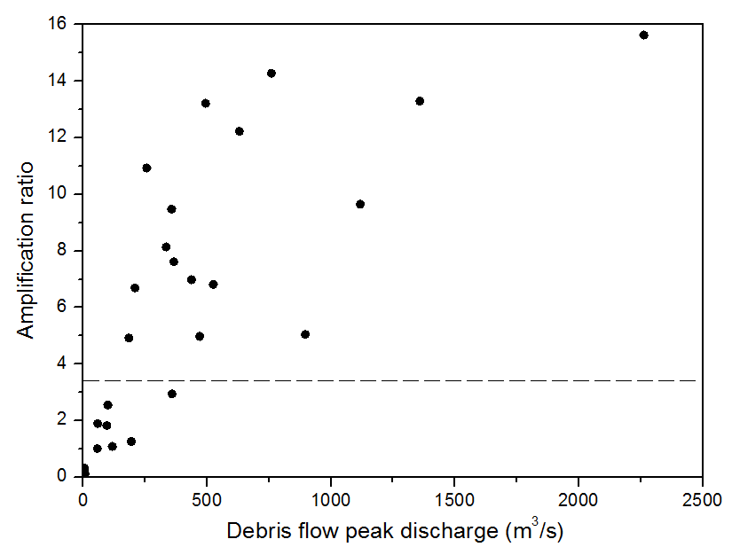
Case 2: abnormal condition
τ > >1 h
ϒ > 3.3 h
52% debris flows in 2006-2017 with a ϒ > 3.3 h
ϒ = 10 h

Slide 9
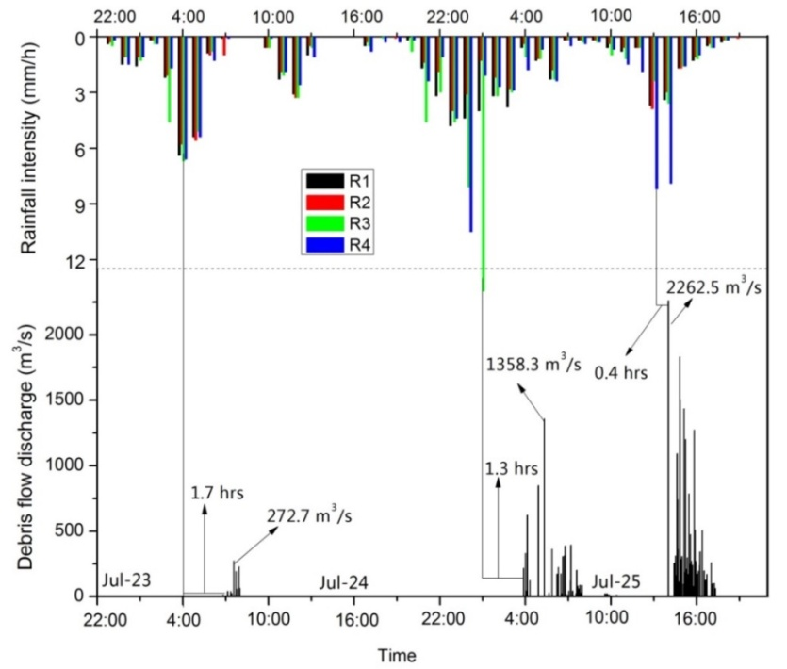
All circumstances happened in one rainfall event

Slide 10
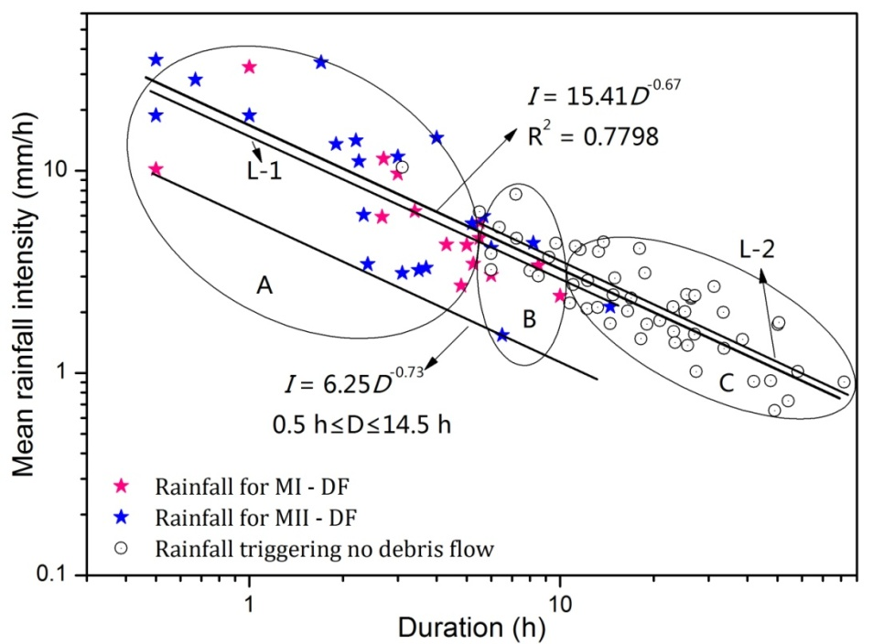
Rainfall threshold
Rainfall threshold: I = 6.25 D^{−0.73} (0.5 ≤ D ≤ 14.5 h)
The rainfall conditions suitable for normal and abnormal debris flows are similar.
A: Short duration (0-5.5 h) with high mean intensity
Highly prone to triggering debris flows
B: Medium duration (5.5–10.0 h) with medium mean intensity
Debris flows occurred in 44% events with this type of rainfall
C: Long-duration (>10 h) with low mean intensity
Debris flows were rarely triggered

Slide 11
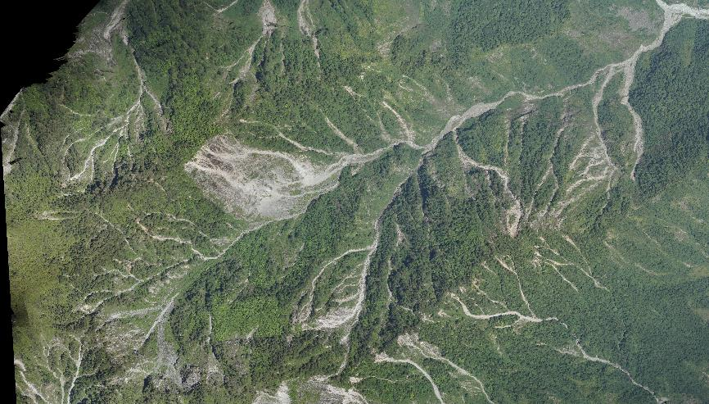
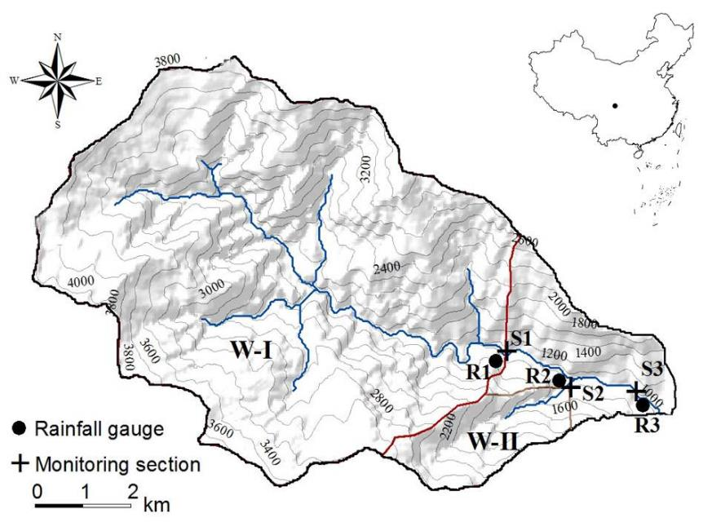
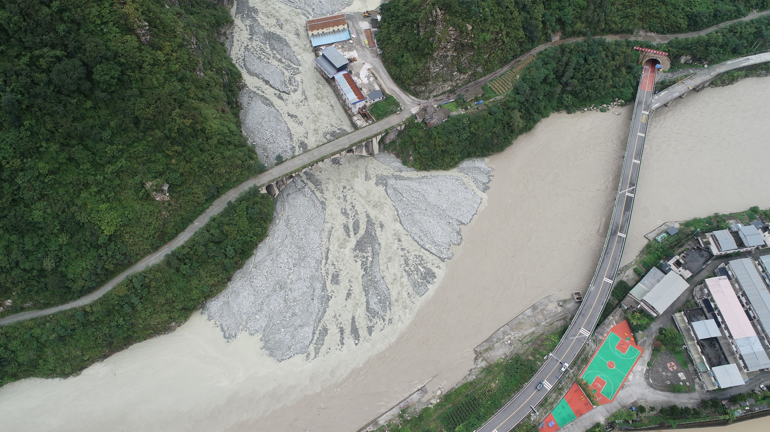
2. Debris flow in the Wenchuan Earthquake area
Ergou: 39.4 km²; W-I: 32.4 km²; W-II: 2.36 km²
Flow parameter stations:
Velocity × 3; Flow height × 3; Density × 1； video × 3
  Objective: the characteristics, formation and evolution of post-earthquake debris flows

Slide 12
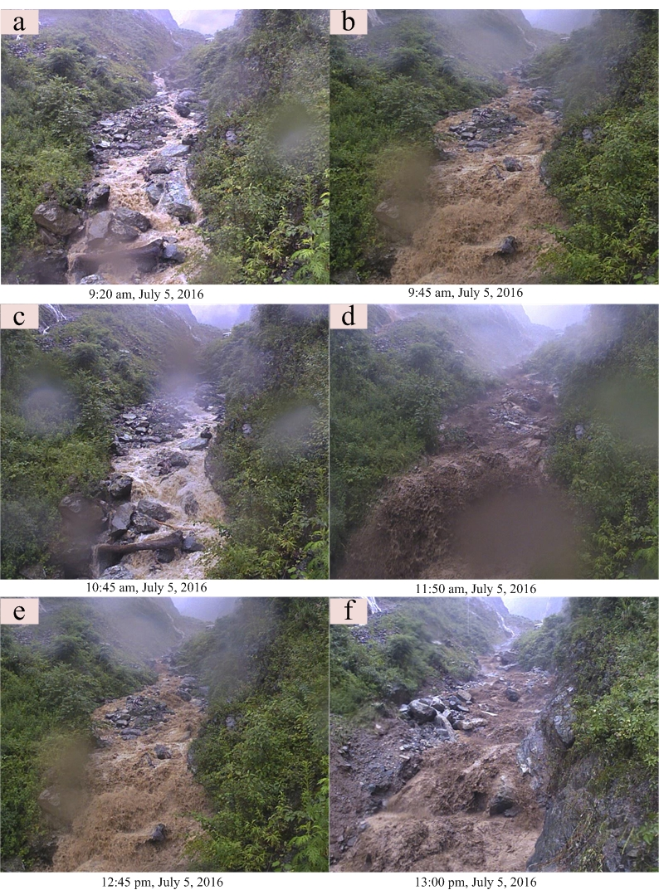
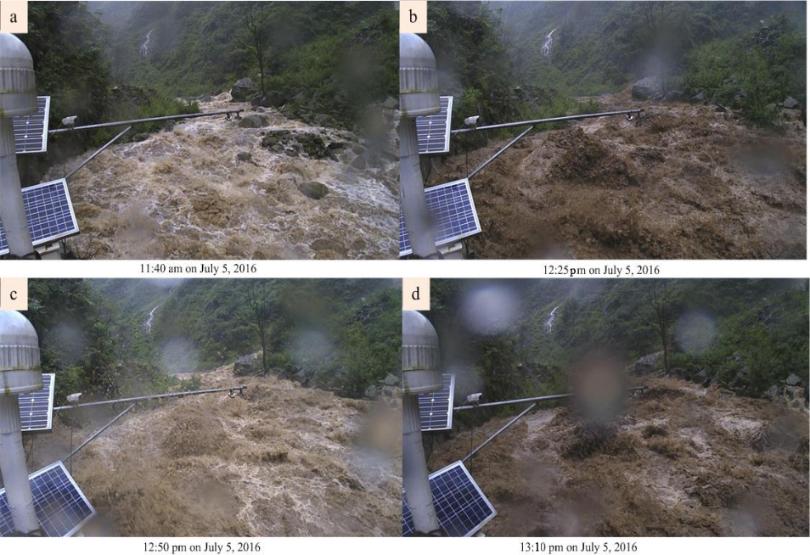
W-II
Flow property
The flows were turbulent mixtures of water, slurry, moving boulders and mud
The muddy surges are evident, with steep and sharp fronts
In most of the time, the flow density is > 1.3 g/cm³, but < 1.85 g/cm³;
Deposits can be found in the fans after the event.
W-I

Slide 13
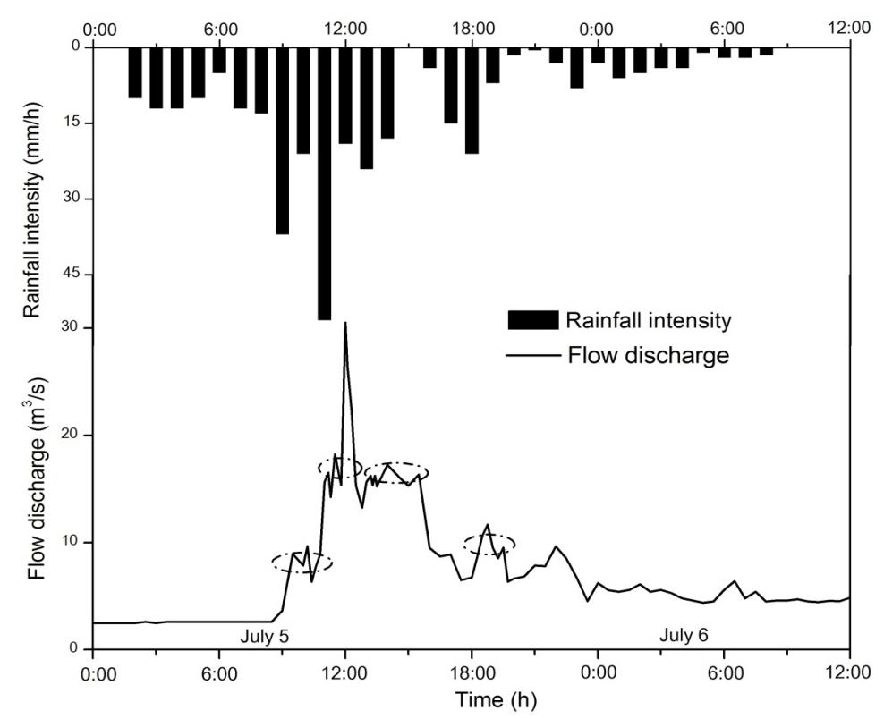
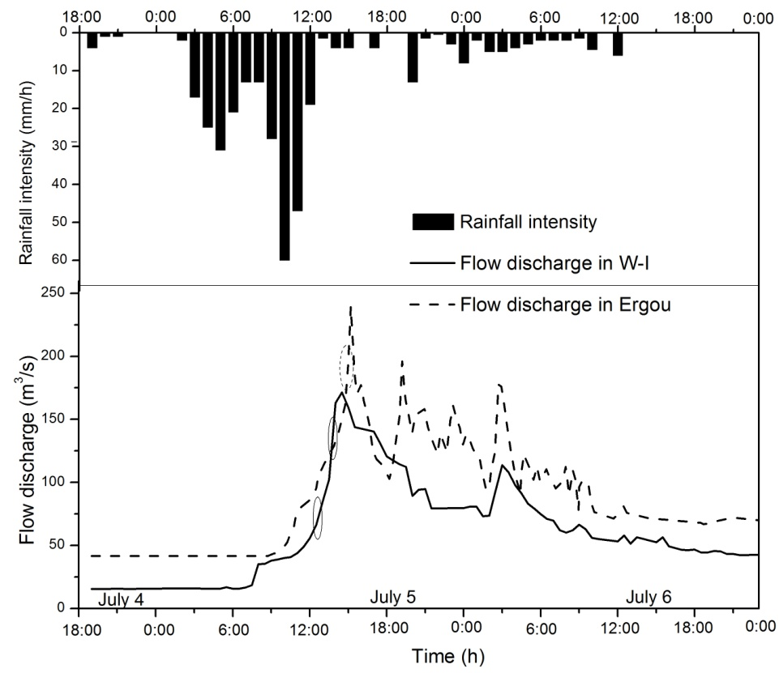
Flow discharge
Debris flood period
Debris flood period
W-I and Ergou
W-II

Slide 14
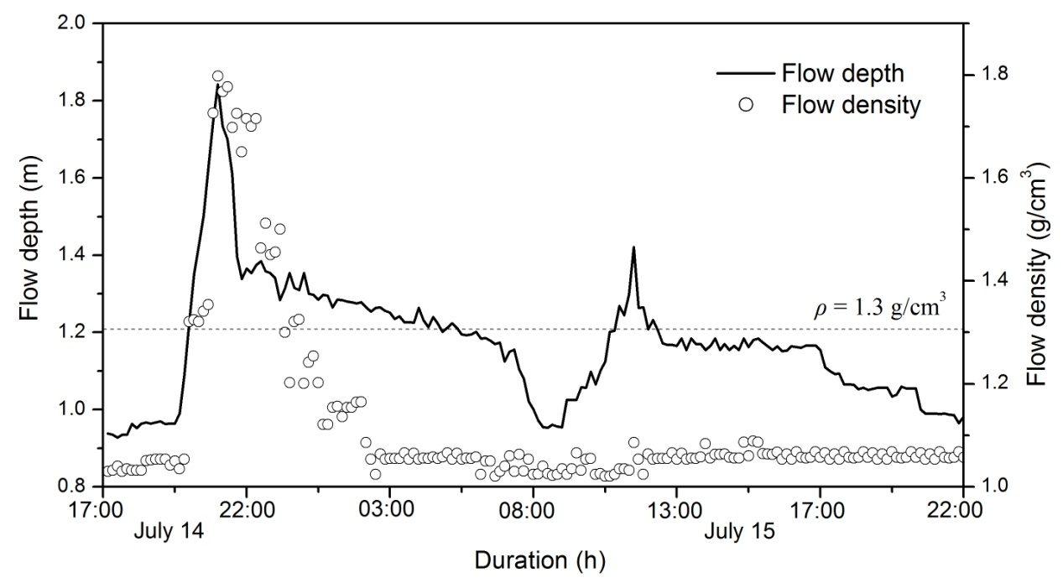
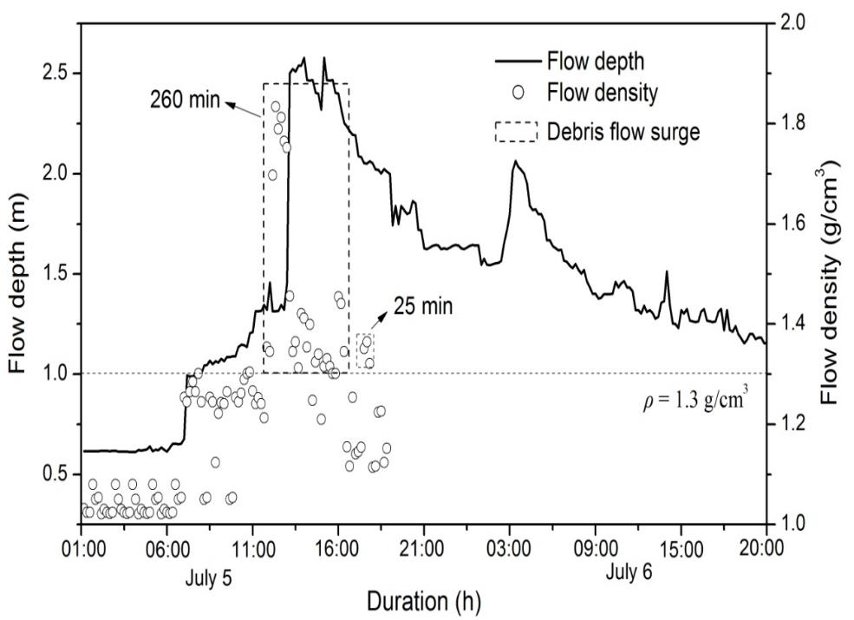
Flow density
2016-7-5
2016-7-26

Slide 15
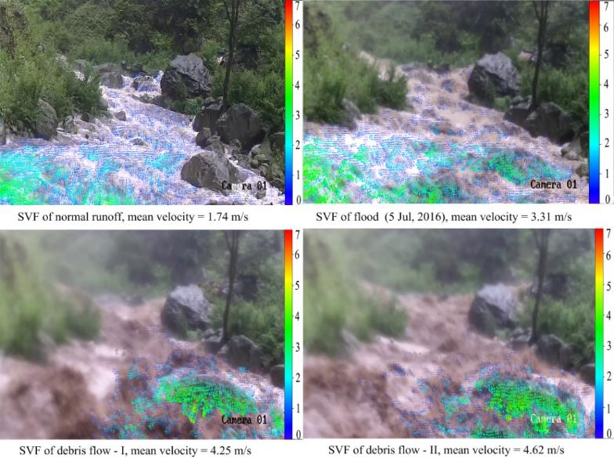
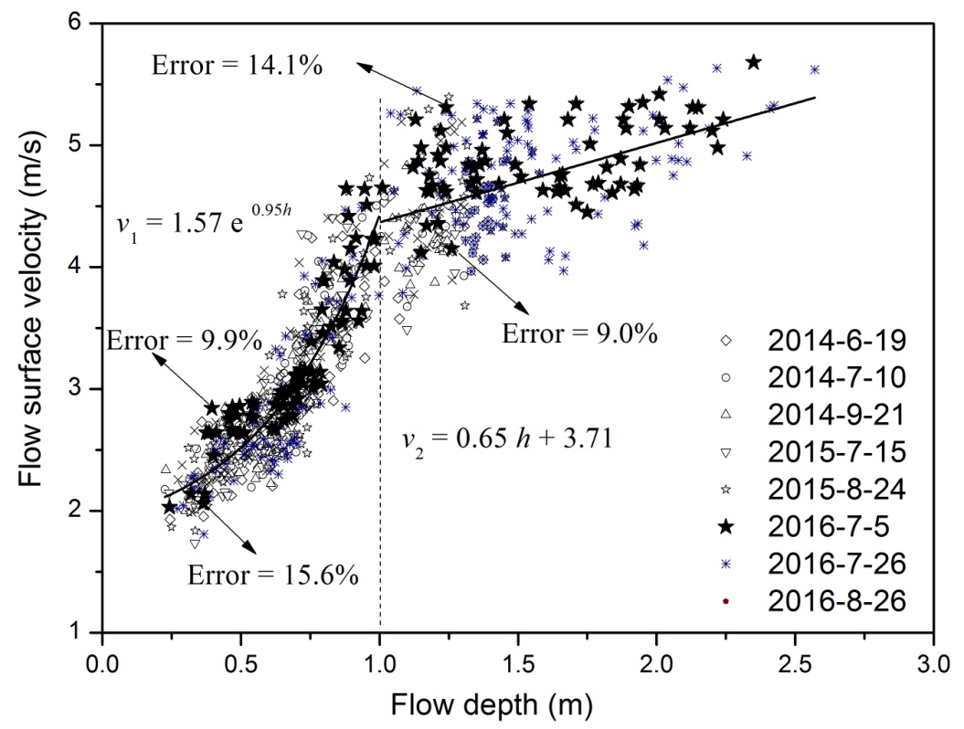
Flow velocity
W-II:
The velocity before debris flows: 2.3-4.4 m/s
The velocity of debris flows: > 5.0 m/s
W-I and Ergou:
The velocity before debris flows: 2.0-4.0 m/s
The velocity of debris flows: 3.6-5.6 m/s
demarcation velocity range: 3.6-4.0 m/s
The relation changes at h = 1 m
The flow property changes at h = 1 m, water flood vs debris flow

Slide 16
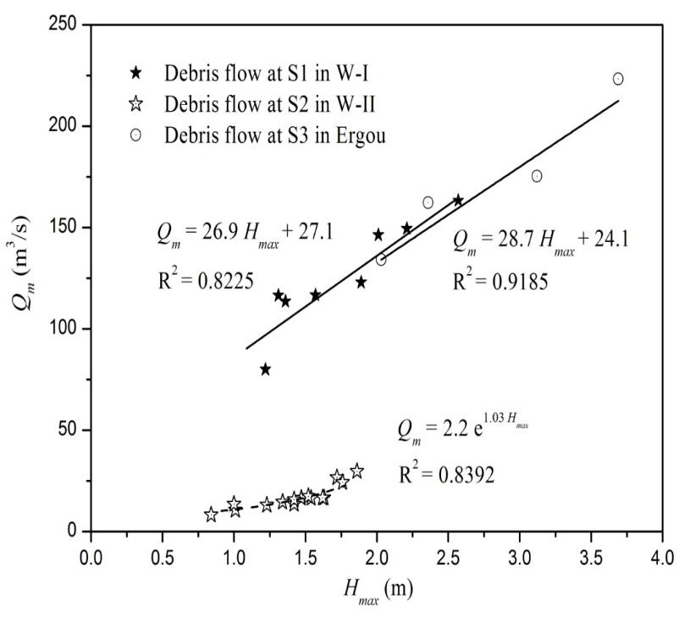
Debris flow volume
Marcel et al., 2020
The relation can help the volume estimation via the field-investigated maximum flow height
The relations varies with the watershed size
Close to the relation of Marchi et al. 2018 and higher than other sites
The sites are with a similar watershed sizes (< 5 km²)

Slide 17
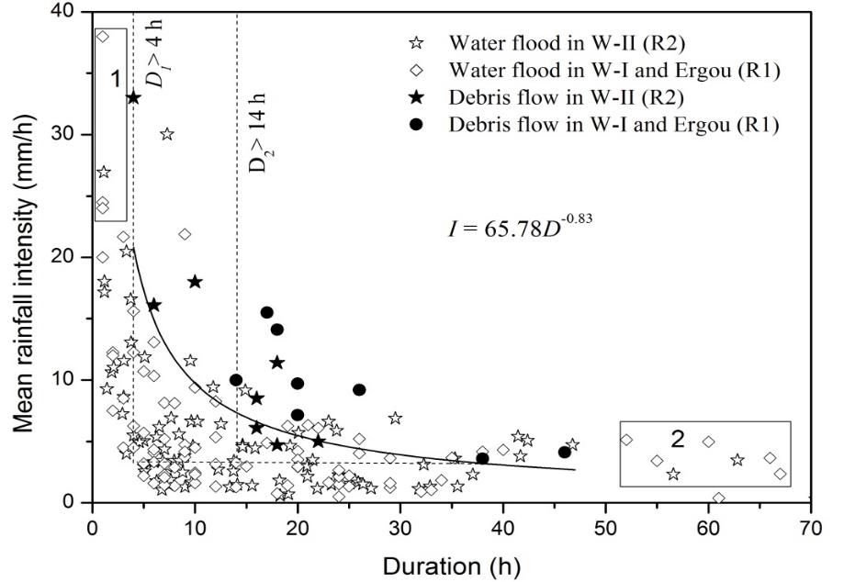
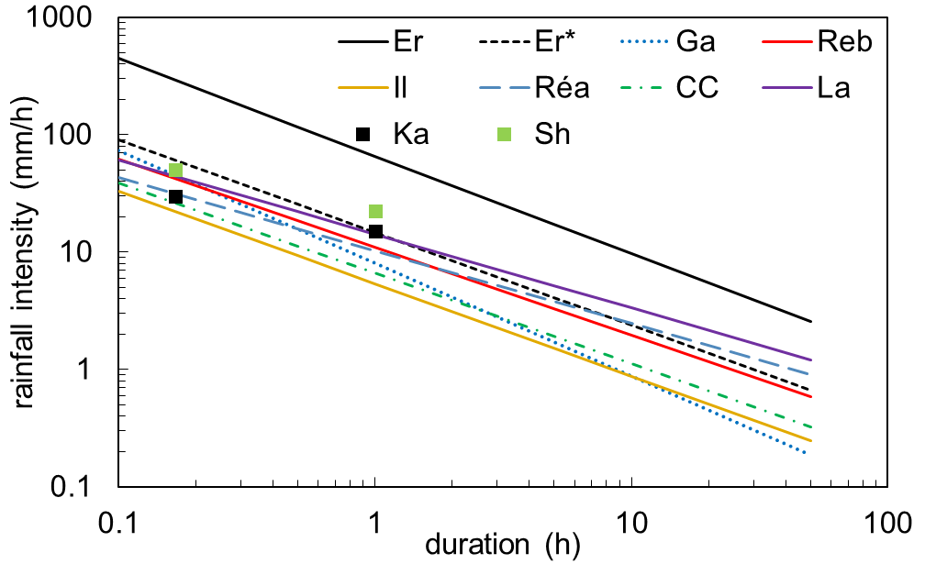
Rainfall threshold
Marcel et al., 2020
The threshold is much higher than those proposed in 2008-2013.
The rain gauges employed before were those out the watershed
Reflect a increasing tendency of rainfall conditions
The threshold is much higher than other sites because the much larger watershed size
The threshold for 2008-2013, shortly after the earthquake, is similar with other sites

Slide 18
Thanks for attention!
Aaron Guo: aaronguo@imde.ac.cn

