Slide 1
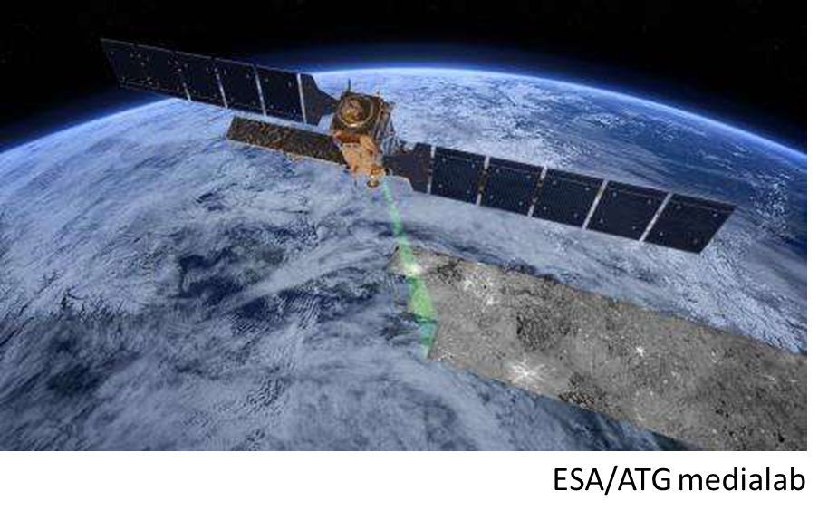
Monitoring growth and subsidence of tropical peatlands: a novel approach using ISBAS-InSAR
Martha Ledger
University of Nottingham, Department of Biosciences
martha.ledger@nottingham.ac.uk @marthajledger

Slide 2
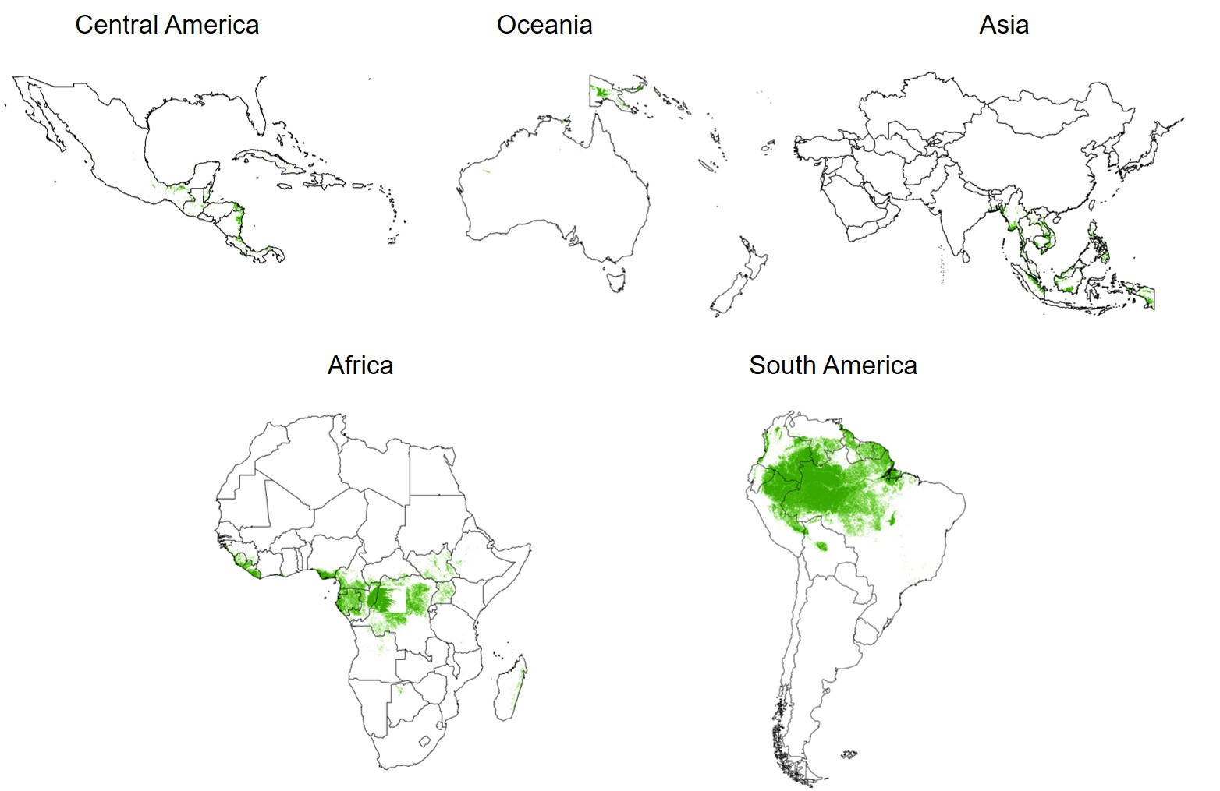
Tropical peatlands - importance
Peatlands store >x2 more C than forests globally
Globally significant terrestrial carbon store (~105Gt: Dargie et al., 2017)
Water storage and flooding regulation
Biodiversity
Local livelihoods

Slide 3
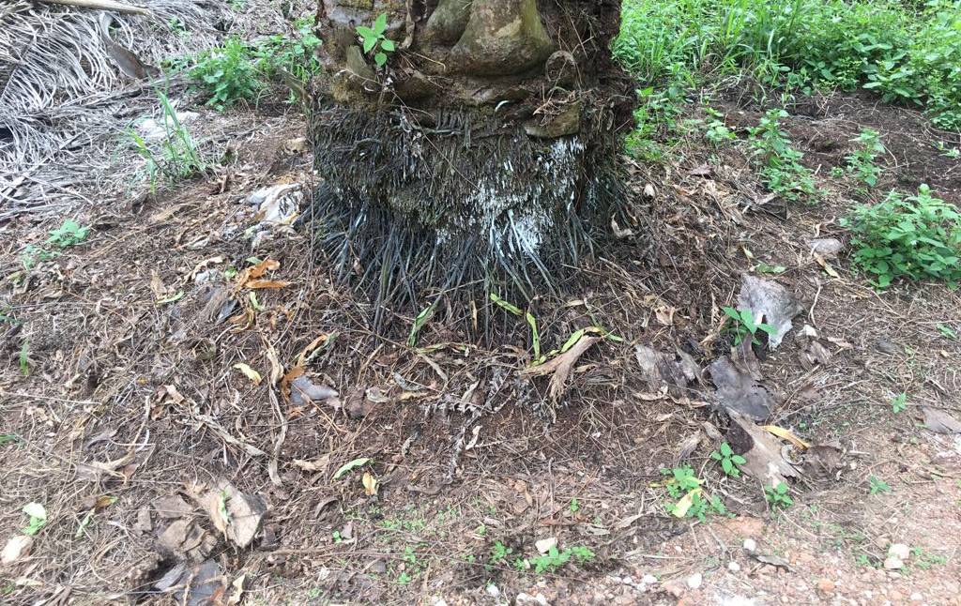
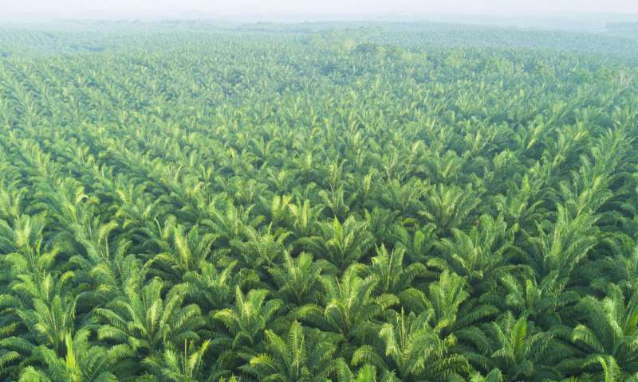
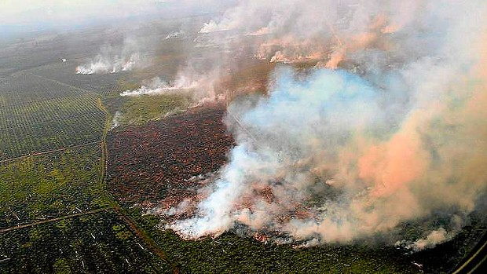
Tropical peatland subsidence
Two key threats: agriculture and climate change.
SE Asian peatland carbon loss: 2.5Gt C emissions since 1990 from Peninsular Malaysia, Sumatra and Borneo (Miettinen et al., 2017).
Cooper et al. (2020): conversion to palm oil across SE Asia ~ 0.8% of total global GHG emissions.
Challenging to determine emissions on a regional scale – subsidence measurements could act as proxy.
Notes:
87% of the world’s palm oil from Malaysia and Indonesia
Published data from Wosten and Hooijer… but not much else for ground data. A new set for Riau in Indonesia published over Xmas.
Oxidation, compaction, consolidation.
Caused by: intensive agriculture, drainage, fires.

Slide 4
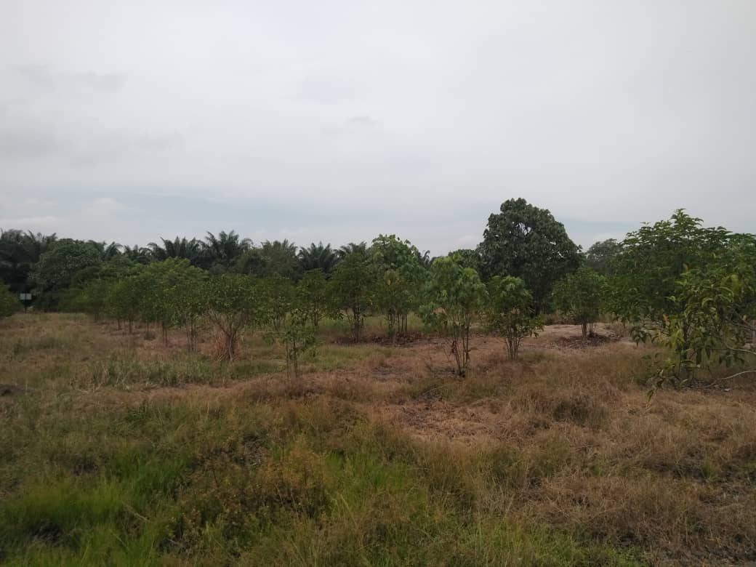
Peatland restoration and growth
Raising water table
Fire prevention methods
Replanting native species (e.g. Macaranga)
… but little can be done to completely restore physical and chemical peat properties without long-term commitments to restoration.

Slide 5
Location
North Selangor Peat Swamp Forest (NSPSF)
Moratorium on logging since 1990.

Slide 6
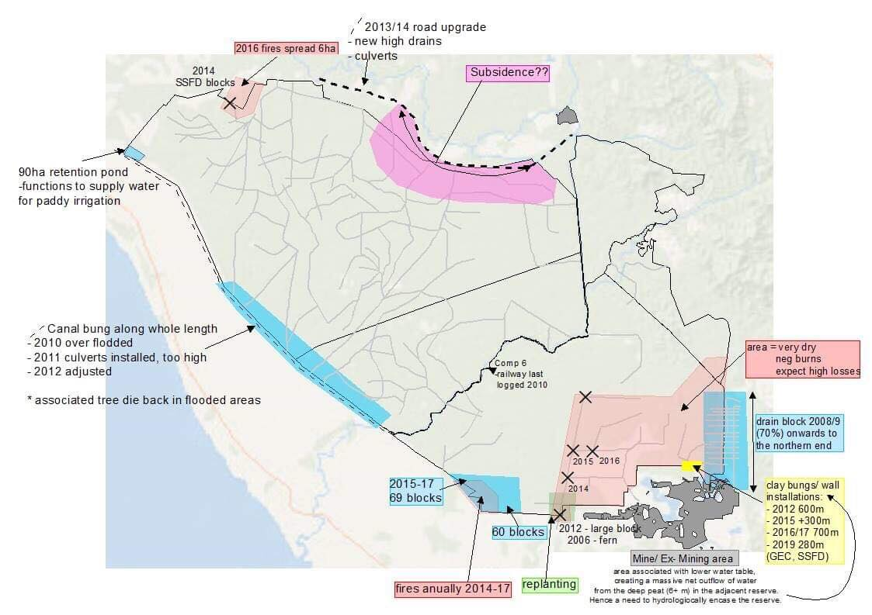
Site history of NSPSF
Compiled by Chloe Brown (2019)

Slide 7
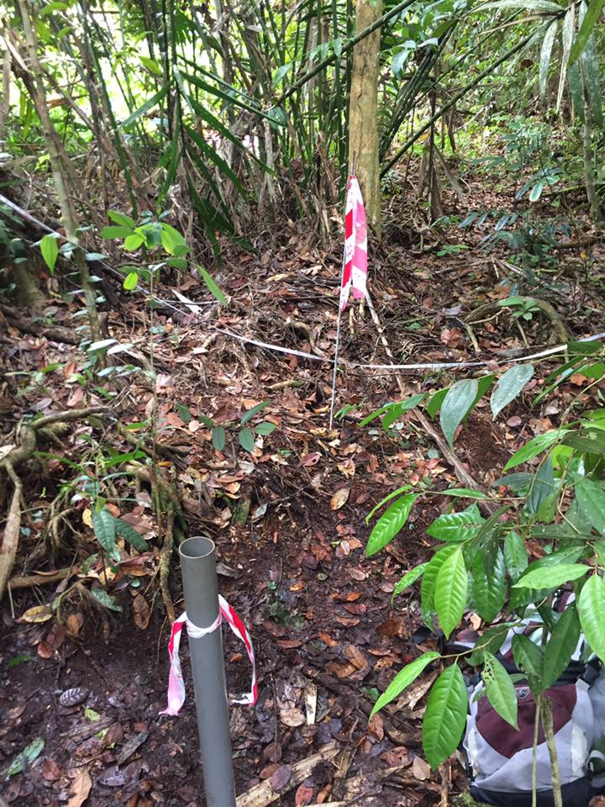
Satellite vs ground data
Regional scale monitoring capabilities
Regular data collection (every 12 days at Equator)
Spatially limited
Challenging data collection – dense forest, waterlogged peat, dependent on weather, fire and animal activity.
Notes:
Field based measurements limited by extreme locality and accessibility.

Slide 8
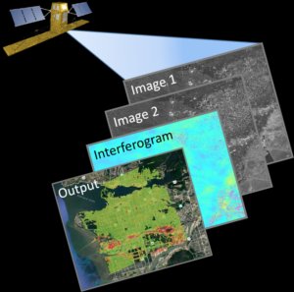
InSAR
Interferometric Synthetic Aperture Radar
Powerful tool for tracking regional-scale subsidence over time
Sub-centimetre rates of motion using C-band radar
http://canarysystems.com/solutions/insar-monitoring-data-sheet/
Notes:
InSAR determines the change in vertical surface positioning between two observations by calculating the phase difference in the radar return signal between them. This can allow for sub-centimetre rates of motion to be determined across large regions

Slide 9
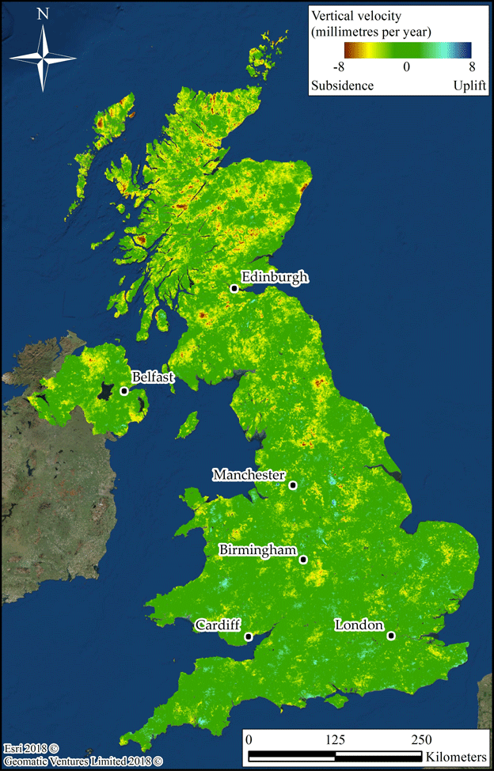
The ISBAS processing method
Intermittent Small Baseline Subset
Provides vertical surface motion values
Mapping of subsidence patterns
Adapted from previous processing methods (PSI and SBAS)
Represents lower coherence areas (e.g. forested areas) as well as high coherence areas (e.g. urban areas)
Need to validate on different ground cover types
https://www.bbc.com/news/science-environment-43721223
Notes:
SBAS method only considers image pixels with consistent high coherence between observations, whereas ISBAS includes pixels with a wider range of coherence. This is achieved by reducing noise by averaging pixels, which reduces resolution but produces a product that can provide information on land motion over a larger amount of land cover classes, including the majority of vegetated and forested areas.
ISBAS recognised by the Environmental Protection Agency in Ireland as a useful technology.

Slide 10
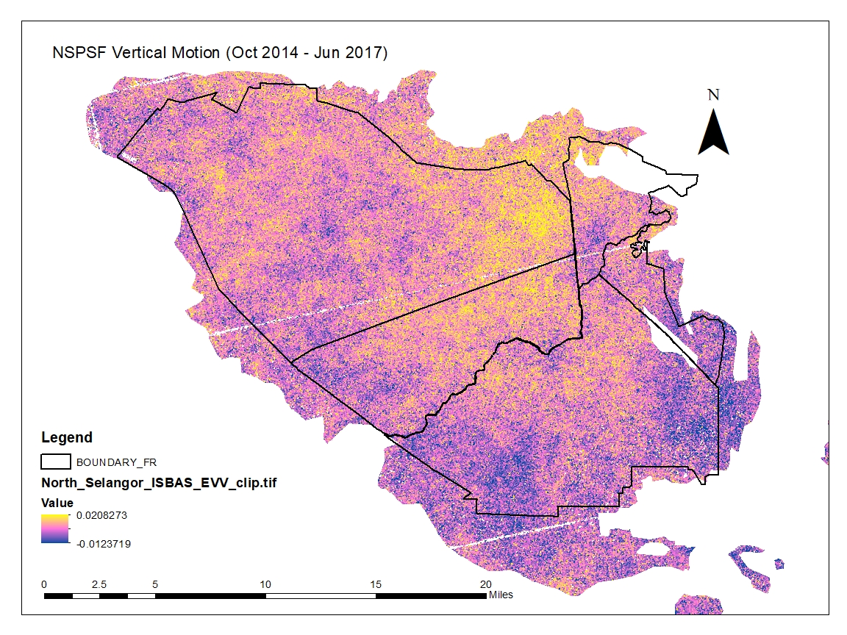
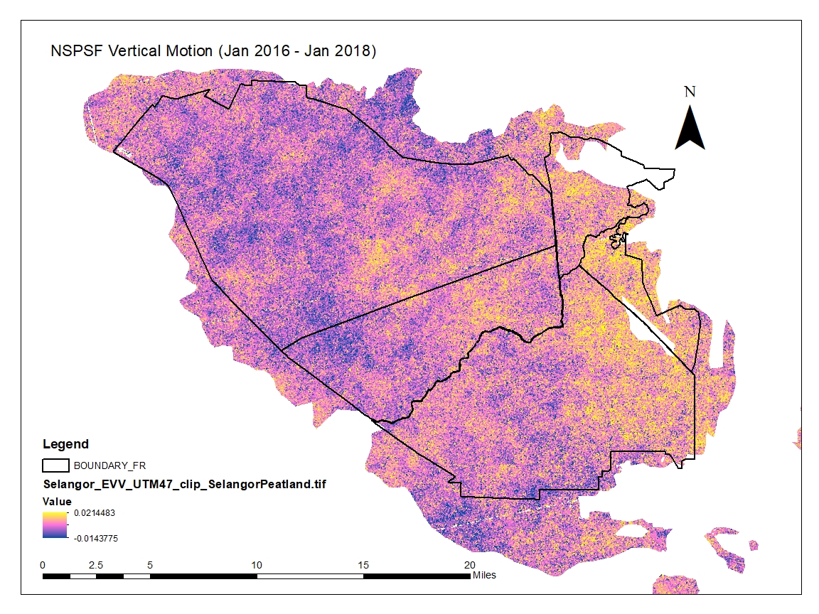
Preliminary results – net surface movement
Replanting efforts, but burned in 2014. Subsidence seen as a result?
Blocking implemented in 2009, 2016-2017. Growth shown in response?
Oct 2014 – June 2017
Jan 2016 – Jan 2018
Notes:
Linear processing results show average change for each pixel. Only local qualitative data can be used so far.

Slide 11
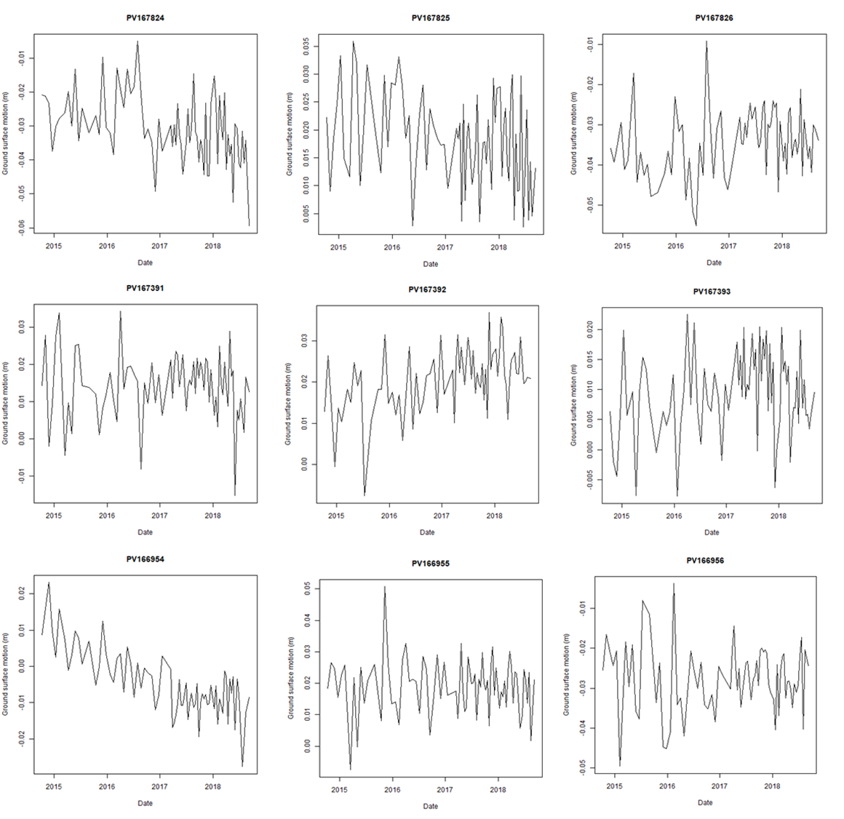
Preliminary results – time series of surface movement
Too noisy!
Dataset too short! Need at least two years to derive a reliable seasonal signal.
Low signal to noise ratio – to be improved by applying Singular Spectrum Analysis to data set (returns smoothed trends by detecting regular and deterministic components).

Slide 12
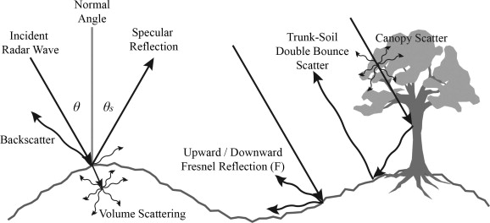
Radar and the tropical peat swamp
Assumption that radar signal is hitting the peat swamp surface due to high moisture content… but what about drained peatlands?
Little known about volume scattering within peat surface. Signal could penetrate surface by a few cms if dry enough (<10% moisture).
Surface moisture documented as low as 18% so far (Mar 2019, dry season).
Complex microtopography of tropical peat surface, including hummocks and hollows, buttress roots, leaf litter cover… could all contribute to signal scattering.
Kornelsen and Coulibaly (2013)
Notes:
Can we be sure that the pulse reflects the peat swamp surface?

Slide 13
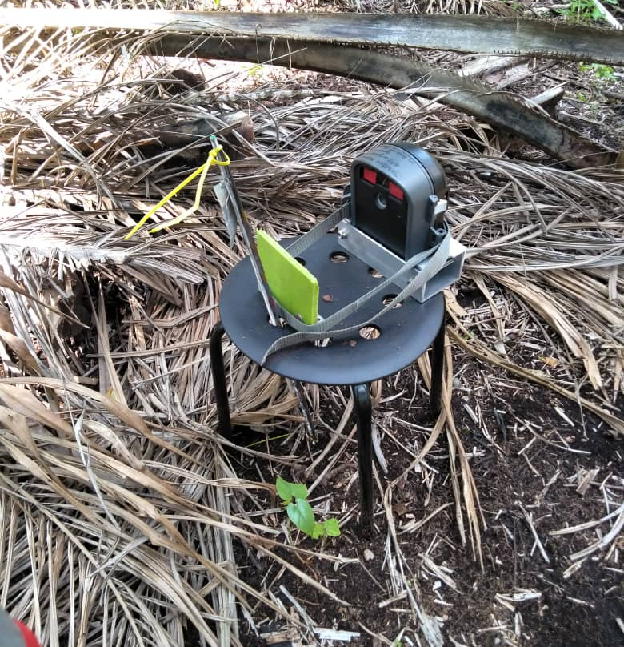
Satellite vs ground data – compatible?
Spatial incompatibility… challenging to set up enough ground sites to monitor regional-scale dynamics on a consistent basis.
Temporal incompatibility… cannot measurement subsidence poles every 12 days to match satellite acquisitions.
Potential solution: cameras!

Slide 14
Water table change and peat surface motion
Six automated cameras and water loggers set up in pairs around North Selangor.
Significant relationship between change in water table height and direction and magnitude of peat surface motion (R² = 0.943, p < 0.001).

Slide 15
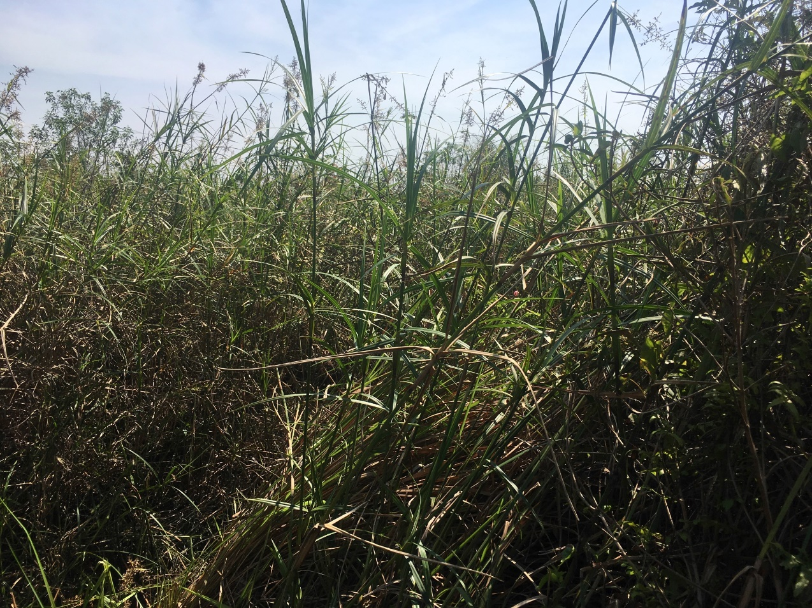
Future work
Radar signal attenuation:
Field experiment: portable radar system
Signal scattering within peat profile
Effect of microtopography and leaf litter cover
ISBAS-InSAR time series investigation:
Compare satellite time series (seasonal) data (3 year dataset!) with ground data.
Process-based modelling:
How does a changing water table influence the direction and magnitude of vertical peat surface movement in different tropical peatland environments?
Notes:
Attenuation of signal through canopy and peat profile.
Inclusion of optical data with spectral response curves for context?

Slide 16
Summary
ISBAS-InSAR - must validate for tropical peatland forests
Clear evidence that change in water table height leads to growth and subsidence the tropical peat surface
Confidence in direction, but not absolute value of vertical displacement of tropical peat surface derived from ISBAS-InSAR
Radar attenuation and tropical peat profiles… TBC
Powerful visual and data production tool for tropical peatland management
Notes:
Responsibility to impart knowledge and this tool to locals, the forestry department, scientists of the future in Malaysia

Slide 17
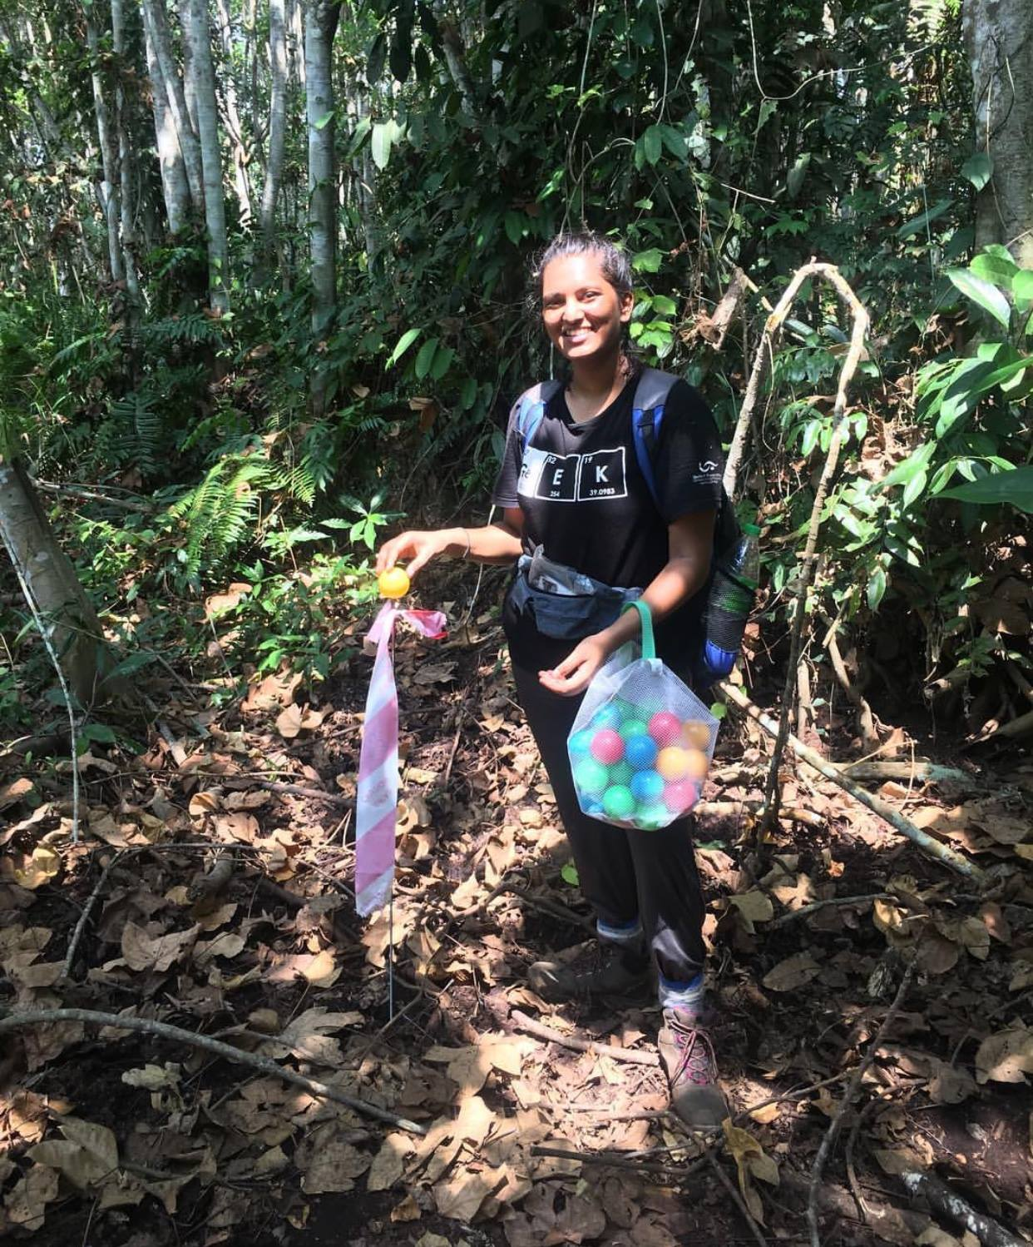
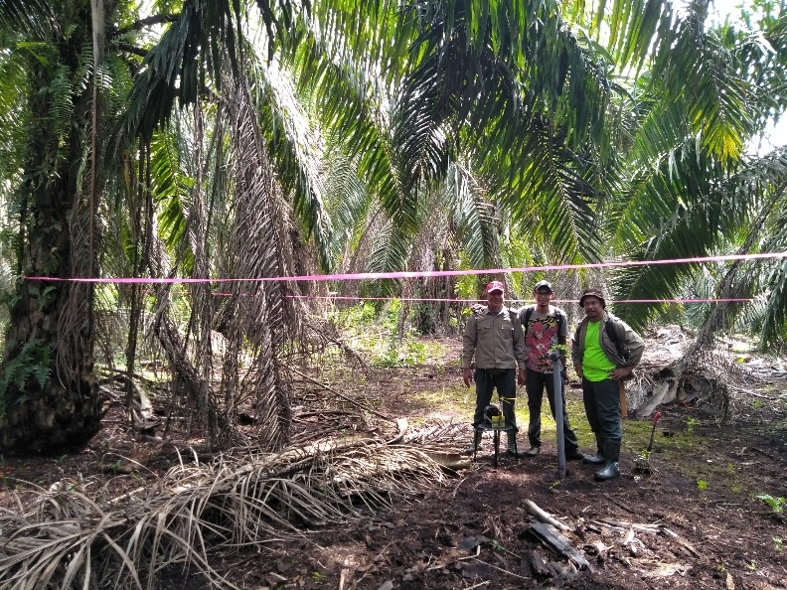
With special thanks to: Sofie Sjögersten, Andy Sowter, David Large, Chris Evans, Keith Morrison, Chris Gibbins, Chloe Brown, Abi Baskaran, Chris Marshall, Sungai Karang and Raja Musa Forestry Departments

