Slide 1




Global Near-Surface Wind Speed Changes over the Last Decades Revealed by Global Reanalyses and CMIP6 Model Simulations
EGU General Assembly 2020. Online 05 May 2020
Kaiqiang Deng¹, Cesar Azorin-Molina^{1,2}, Lorenzo Minola¹, Gangfeng Zhang³, & Deliang Chen¹
¹Regional Climate Group, Department of Earth Sciences, University of Gothenburg, Sweden
²Centro de Investigaciones sobre Desertificación, (CIDE-CSIC), Montcada, Valencia, Spain
³State Key Laboratory of Earth Surface Processes and Resource Ecology, Beijing Normal University, Beijing 100875, China
2020/05/05

Slide 2
Outline
Introduction
Data and methods
Results
— Wind speed trends in reanalysis data
— Wind speed trends in CMIP6 historical simulations
— Possible causes of the global wind speed changes
Summary and conclusions
References

Slide 3

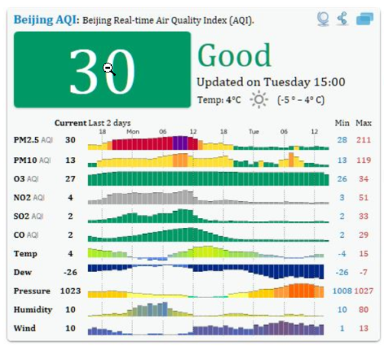
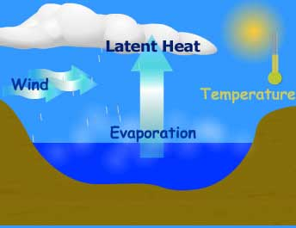
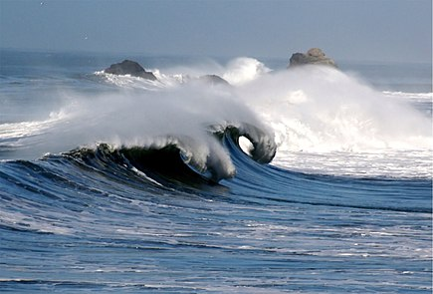
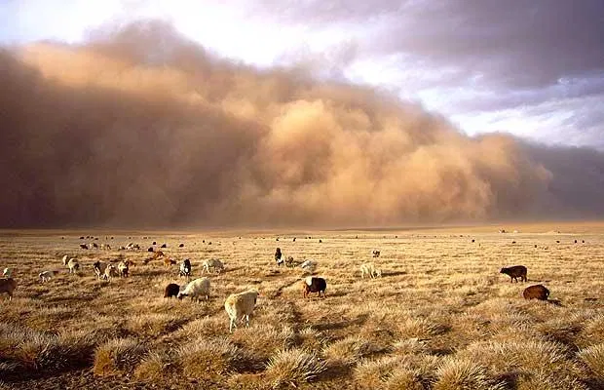
The importance of wind speed changes
Wind power industry (Zeng et al. 2019).
Air pollution (Tian et al. 2014) and dust storms (Alizadeh-Choobari et al. 2014)
Hydrological cycles due to changes in evaporation rate (McVicar et al. 2012)
Storm surges, high tides, and extreme sea levels (Muis et al. 2016).

Slide 4
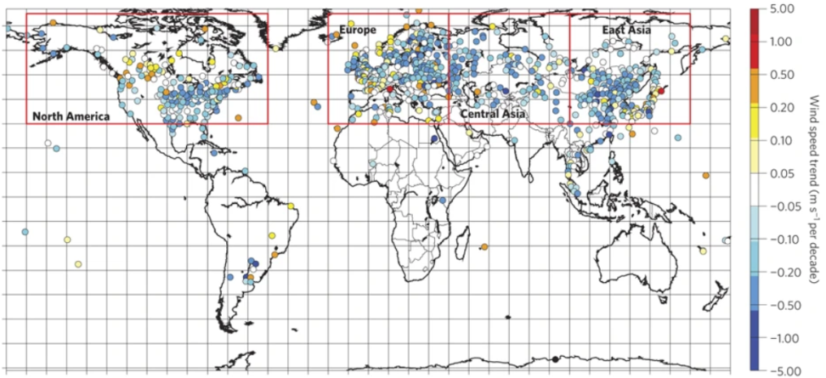
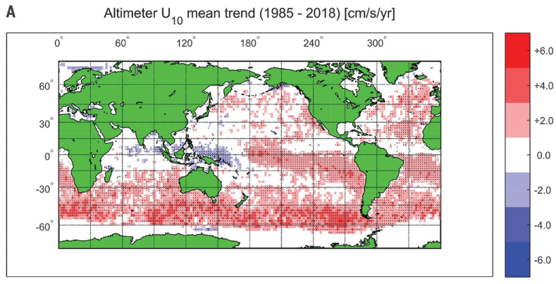
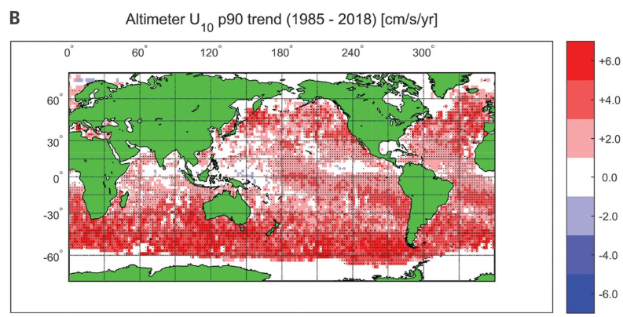
Wind speed trends over land and oceans
Terrestrial wind stilling over the Northern Hemisphere (NH)
Marine wind strengthening, especially over the Southern Hemisphere (SH)
(Vautard et al. 2010. Nature Geosci.)
(Young and Ribal 2019. Science)

Slide 5
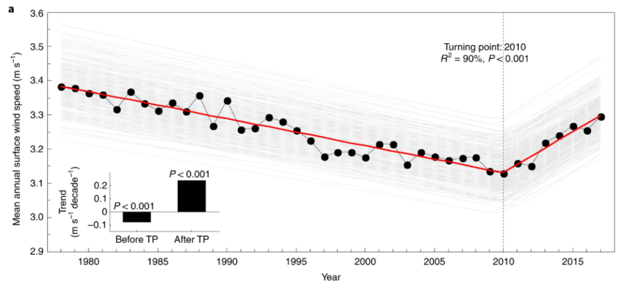
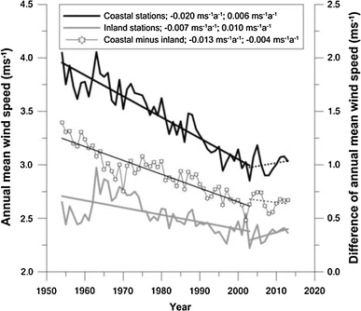
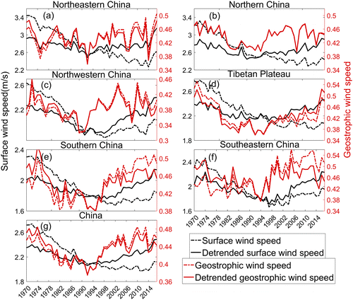
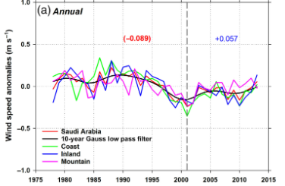
Recent reversal of global terrestrial stilling
NH
(Zeng et al. 2019. Nature Clim. Change)
China
S. Korea
Saudi Arabia
(Azorin‐Molina et al. 2018. Int. J. Climatol.)
(Kim and Paik 2015. Clim. Dyn.)
(Zhang and Wang 2020. J. Clim.)

Slide 6
Some of the key issues about global wind speed trends remain to be explored
Characteristics and physical mechanisms of the interhemispheric asymmetry in global wind speed trends.
Possible causes of the recent reverse of global wind speed.
Relationships of global wind speed trends with natural and human-induced climate variability.

Slide 7
Data and methods
Reanalysis datasets
Reanalyses | Institution | Time period | Resolution
NOAA-20C | NOAA-CIRES-DOE | 1900–2015 | 180×360
ERA-20C | ECMWF | 1900–2010 | 180×360
NCEP-R1 | NOAA/NCEP-NCAR | 1948–2018 | 73×144
JRA-55 | JMA | 1958–2018 | 145×288
ERA-I | ECMWF | 1979–2018 | 181×360
ERA-5 | ECMWF | 1979–2018 | 181×360
CFSR | NCAR-UCAR | 1979–2018 | 73×144
MERRA-2 | NASA-GMAO | 1980–2018 | 361×576
Centennial
Satellite era
Model simulations
Models | Institution | Time period | Resolution | Ens. #
CanESM5 | CCCma | 1900–2014 | 64×128 | 10
CNRM-CM6-1 | CNRM-CERFACS | 1900–2014 | 128×256 | 10
IPSL-CM6A-LR | IPSL | 1900–2014 | 142×144 | 10
CanESM5 | CCCma | Apr 2000–May 2001 | 64×128 | 10
CMIP6
PAMIP

Slide 8
Data and methods
Methods
All of the datasets are interpolated into the same 1°×1° (360×181) grid resolution using bilinear interpolation method.
The linear trends in near surface wind speed are estimated by the ordinary regression method. Trends are calculated from the anomaly series (i.e., deviation from the 1980–2010 mean)
Empirical orthogonal function (EOF) analysis is conducted on the wind speed trends (360×181) during 1980–2010 for the 8 reanalysis datasets (i.e. 360×181×8), to assess the data discrepancies.
The statistical significances of the trends and correlations are tested by Student’s t-test.

Slide 9
Result 1: Wind speed trends in reanalysis data

Slide 10
Trends in near-surface wind speed (NWS) during 1980-2010
General agreements
Negative trends: North Atlantic and North Pacific, SH middle latitudes (40°S-30°S), and NH land
Positive trends: SH subtropical regions (30°S-0) and SH high latitudes (around 60°S)

Slide 11
EOF analysis on NWS trends during 1980-2010
Discrepancies among reanalyzed datasets
Largest discrepancies appear over the Central Pacific and the Antarctic regions.
The discrepancies across land areas and middle latitude oceans are relatively small.

Slide 12
Zonal means of NWS trends during 1980-2010
Over land: widespread negative trends in the NH (0-70°N)
Over ocean: there are two peaks in positive trends, one in the SH subtropical trade winds (30°S -0) and the other in the SH surface westerly winds (70°S-40°S)
Interhemispheric asymmetry

Slide 13
Year-to-year variations of NWS
NH land: Significant (P<0.05) and consistent decreasing trends during 1980-2010. Reverse of NWS since 2010.
SH land: no significant trends.
NH ocean: no significant trends.
SH ocean: Significant (P<0.01) and consistent increasing trends during 1980-2010.

Slide 14
NWS trends during 1980-2010
 | NWS Trends during 1980–2010
 | Land (NH) | Land (SH) | Ocean (NH) | Ocean (SH)
NOAA-20C | -0.011 | +0.004 | -0.018 | +0.079
ERA-20C | -0.011 | +0.03 | -0.001 | +0.123
NCEP-1 | -0.017 | +0.014 | -0.010 | +0.097
JRA-55 | -0.039 | -0.005 | +0.023 | +0.106
ERA-5 | -0.009 | +0.02 | +0.026 | +0.073
ERA-I | -0.020 | +0.009 | +0.019 | +0.087
MERRA-2 | -0.023 | -0.006 | +0.038 | +0.116
CFSR | -0.024 | -0.008 | -0.013 | +0.018
Average | -0.019 | +0.007 | +0.008 | +0.087
Agreements of NWS trends over the NH land and the SH ocean
Discrepancies of NWS trends over the SH land and the NH ocean.
What factors control the consistent and significant NWS trends over the NH land and the SH ocean?
The trends significant at levels of p<0.05/0.01 are marked by yellow/orange, respectively

Slide 15
Zonal means of NWS trends during 2010-2018
Reverse of NWS trends
NH: positive trends appear over both land and the ocean
SH: Negative trends occur in subtropical regions (30°S -0)
Physical causes for the recent reverses of global NWS are unclear

Slide 16
Result 2: NWS trends in CMIP6 historical simulations

Slide 17
CMIP6 historically simulated NWS
All-forcing simulations
NH: negative trends, especially over the land
SH: positive trends, especially over the ocean
CMIP6 models are generally able to reproduce the NWS trends over NH land and SH ocean.

Slide 18
CMIP6 historically simulated NWS
Individual-forcing simulations
GHG-only forcing: decreasing WS over NH land and increasing WS over SH ocean, consistent with the reanalyzed results
Aerosol-only forcing: decreasing WS over the whole globe, the NH is more prominent than the SH
Natural-only forcing: failure in simulating significant NWS trends

Slide 19
CMIP6 simulated NWS trends during 1980-2010
All-forcing simulations reproduced a similar spatial pattern to those from the reanalysis data
Negative NWS trends over NH are attributed to aerosol and GHG forcings, while the positive NWS trends over SH are mainly related to the GHG forcing.

Slide 20
Result 3: Possible causes of global NWS trends

Slide 21
Intensification of SH Hadley cell during 1980-2010
Ascending (descending) trends in tropical (SH mid-latitude) regions.
Enhanced tropical convection and suppressed SH mid-latitude rainfall (warmer SST).

Slide 22
Intensification of SH Hadley cell due to GHG forcing
GHG-induced warming
Enhanced tropical convection & SH Hadley cell
Strengthening NWS over the SH

Slide 23
Arctic warming amplification during 1980-2010
Accelerating warming over the Arctic
Decreased meridional temperature gradient
Weakening mid-latitude atmospheric circulation

Slide 24
Recent reversal of global NWS
Recent increase in equator-to-pole air temperature gradient over the mid-troposphere
Recent changes in Hadley cell
Overall, recent changes in Hadley cell could be more effective than the break in polar warming amplification.

Slide 25
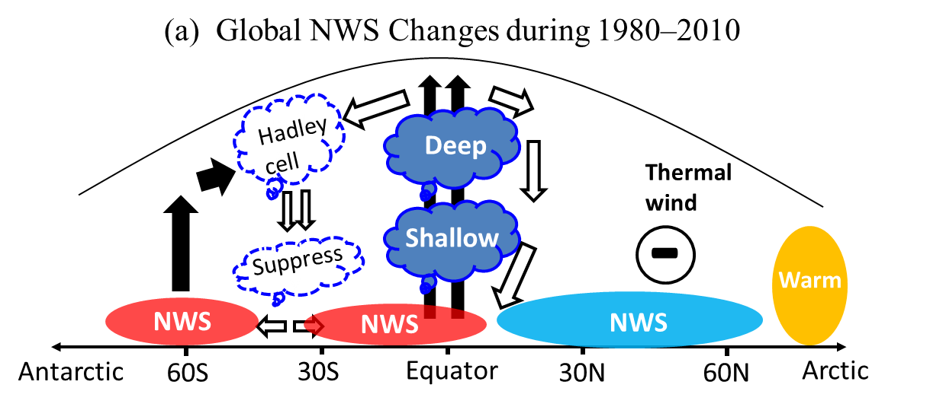
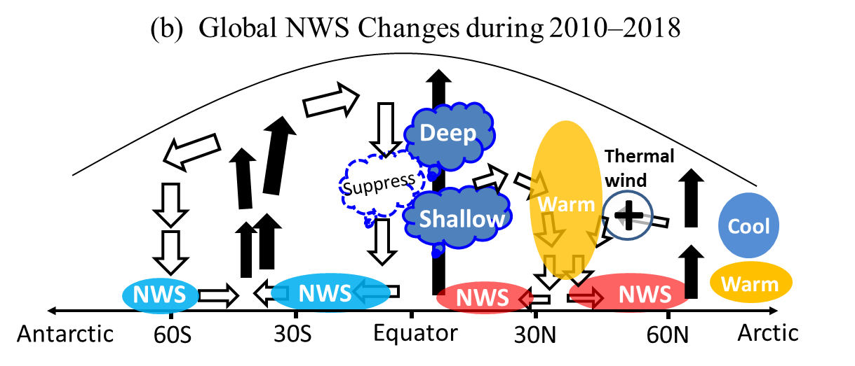
Summary and conclusions
From the 8 reanalysis data during common period (1980-2010), general agreements on NWS trends are found in most areas, with relatively large discrepancies in the central Pacific and the Antarctic regions.
The significant (p<0.01) decreasing (increasing) trends in NH (SH) NWS during the common period are primarily attributed to the strengthened SH Hadley cell (Arctic warming amplification) related to GHG-induced forcing.
The recent reversal of global NWS since 2010 could be linked to the weakening (strengthening) of the SH (NH) Hadley cell as well as the enhanced equator-to-pole air temperature gradient.

Slide 26
References
Alizadeh-Choobari, O., P. Zawar-Reza, and A. Sturman, 2014: The ‘‘wind of 120 days” and dust storm activity over the Sistan Basin. Atmos. Res., 143, 328–341.
Azorin‐Molina C., et al., 2018: Recent trends in wind speed across Saudi Arabia, 1978–2013: A break in the stilling. Int. J. Climatol., 38, 966–984.
Kim, J., and K. Paik, 2015: Recent recovery of surface wind speed after decadal decrease: a focus on South Korea. Climate Dyn., 45, 1699–1712.
McVicar, T. R., et al., 2012a: Global review and synthesis of trends in observed terrestrial near-surface wind speeds: Implications for evaporation. J. Hydrol., 416-417, 182–205.
Muis, S., et al., 2016: A global reanalysis of storm surges and extreme sea levels. Nat. Commun., 7, 11969.
Tian, G., Z. Qiao, and X. Xu, 2014: Characteristics of particulate matter (PM10) and its relationship with meteorological factors during 2001–2012 in Beijing. Environ. Pollut., 192, 266–274.
Vautard, R., et al., 2010: Northern Hemisphere atmospheric stilling partly attributed to an increase in surface roughness. Nat. Geosci., 3, 756–761.
Young, I. R., and A. Ribal, 2019: Multiplatform evaluation of global trends in wind speed and wave height. Sci, 364, 548–552.
Zeng, Z., A. D. Ziegler, T. Searchinger, and Coauthors, 2019: A reversal in global terrestrial stilling and its implications for wind energy production. Nat. Climate Change, 9, 979–985.
Zhang, Z. T., and K. C. Wang, 2020: Stilling and recovery of the surface wind speed based on observation, reanalysis, and geostrophic wind theory over China from 1960 to 2017. J. Climate. https://doi.org/10.1175/JCLI-D-19-0281.1.

Slide 27

Acknowledgments. This study was supported by Swedish Research Council (VR-2017-03780 and VR-2019-03954), the Ramon y Cajal fellowship (RYC-2017-22830), and the grant no. RTI2018-095749-A-I00 (MCIU/AEI/FEDER, UE).

