Slide 1
Artificial Water Reservoir Triggered Seismicity (RTS)
Harsh K. Gupta
CSIR-National Geophysical Research Institute,
Seismology,
Hyderabad- 500007
India
(harshg123@gmail.com)

Slide 2
Over 300 sites globally where RTS has been observed
Earthquakes exceeding M 6 occurred at:
- Hsingfengkiang, China
- Kariba, Zambia-Zimbabwe border
- Kremasta, Greece and
- Koyna, India
Koyna 1967 M 6.3 is the largest
Over 100 sites where earthquakes of M>= 4 have occurred

Slide 3
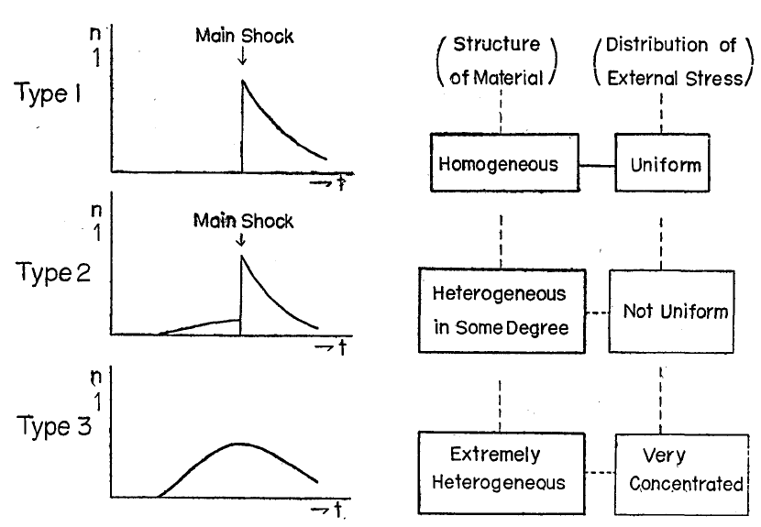
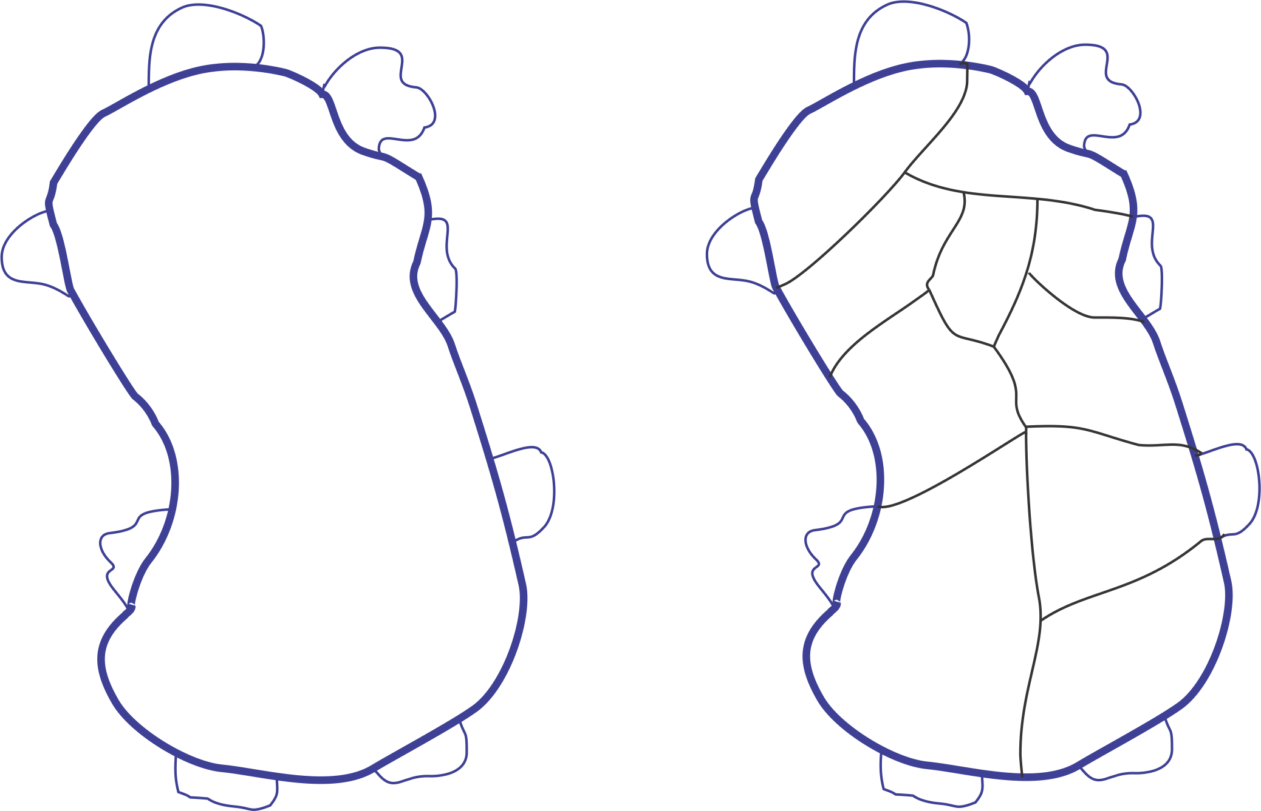
Common Characteristics of RTS
Log N =a-b m
Largest aftershock to mainshock magnitude
Foreshock-aftershock pattern
Aftershock continue for a long time
Mogi’s classification of
foreshock-aftershock patterns

Slide 4
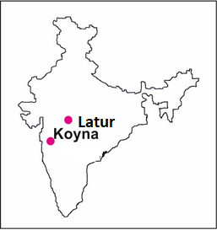
LATUR Earthquake September 29, 1993 M 6.2
~ 300 km south-east of Koyna
~ 11000 human lives lost
Thrust Fault Focal Mechanism
Deccan Volcanic Province- basically thrust fault environment.
Koyna – left lateral strike slip
LATUR: b value – 0.36; foreshock-aftershock pattern: Type I of Mogi’s model; earthquakes ceased to occur after a few months.
Largest aftershock – main-shock ratio: 0.6

Slide 5
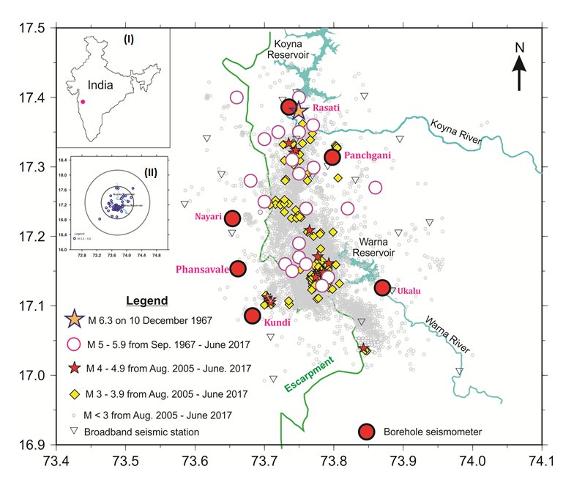
Seismicity of the Koyna-Warna region, existing seismograph network

Slide 6
A UNIQUE SITE TO INVESTIGATE RTS & NEAR FIELD STUDY OF EARTQUAKES
Earthquakes occur in a small area (20 km x 30 km)
Shallow (2-9 km mostly)
No other source within 50 km of Koyna Dam
Accessible for experimentation
Continued activity over the past 55 years as of 2017.

Slide 7
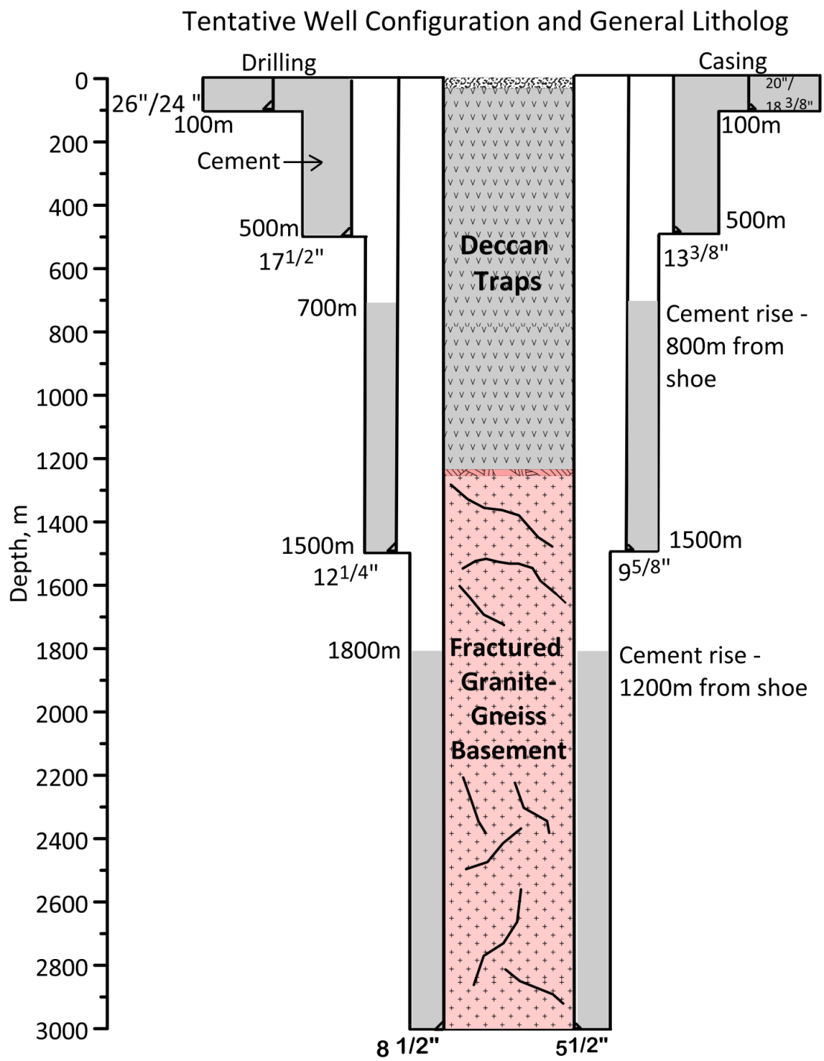
Well Configuration for the pilot boreholes
Drilling to start by 30 November, 2016

Slide 8
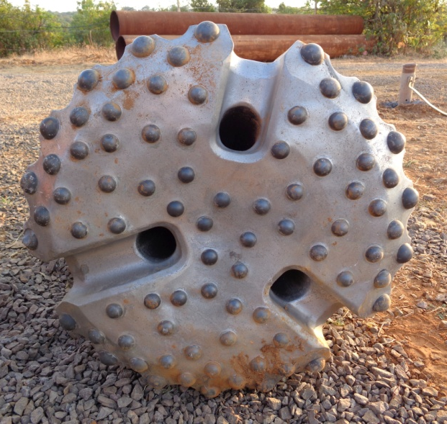
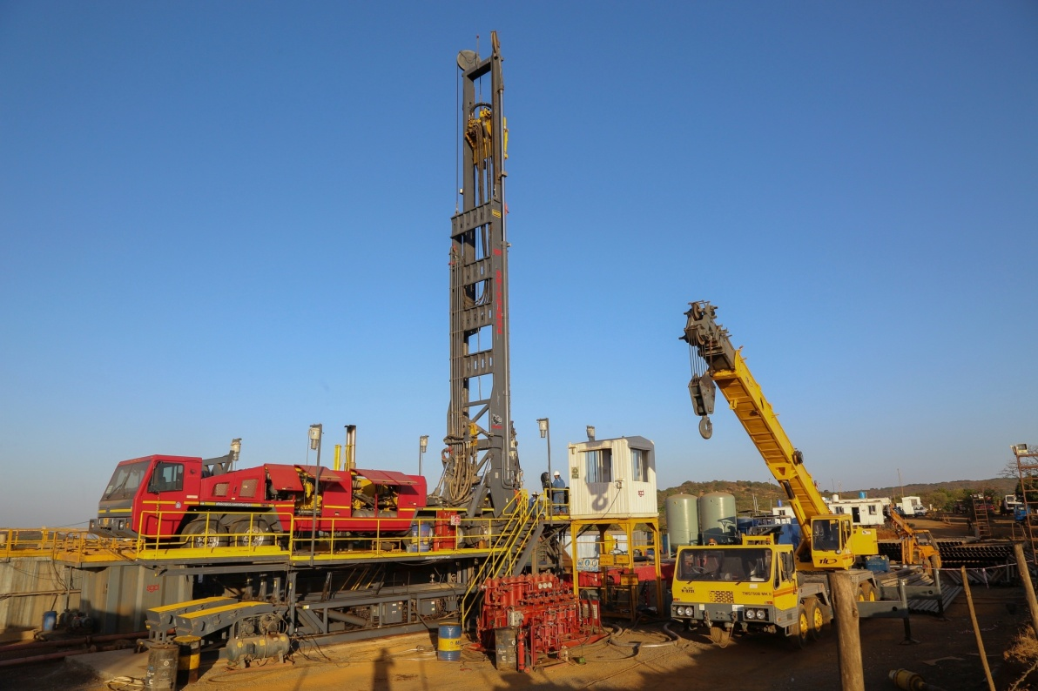
Drill rig

Slide 9
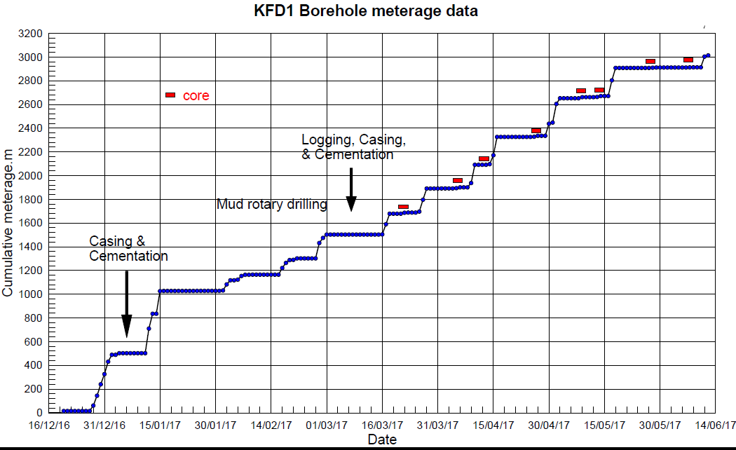
Progress of drilling KFD-1

Slide 10
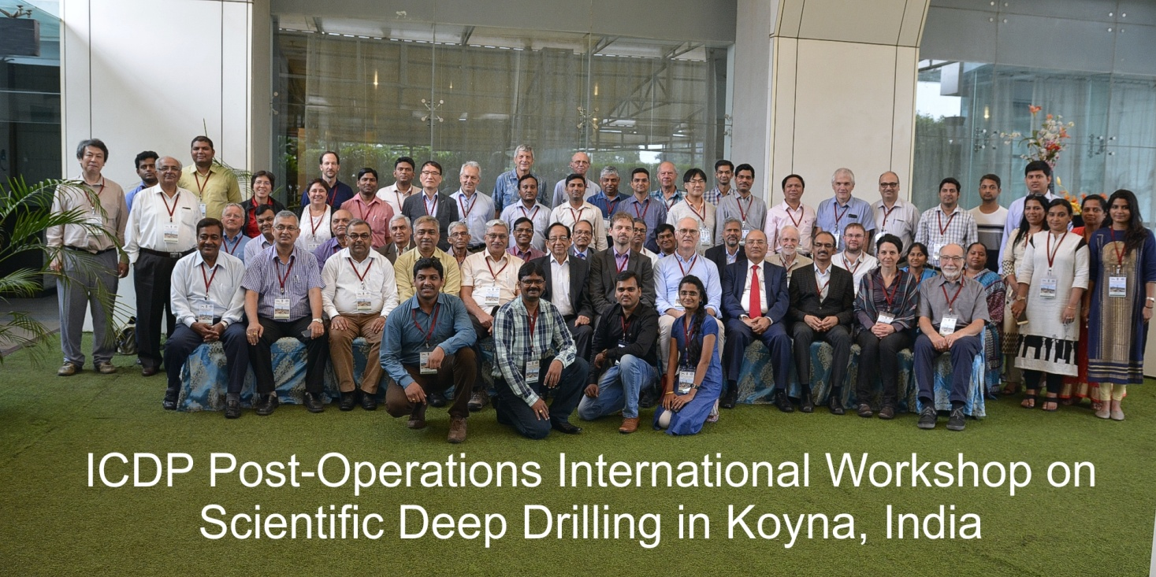
Koyna International Workshop (Oct 14-16, 2017)
THEMES
Reservoir Triggered Seismicity in Koyna vis-à-vis Global Scenario
Review of Pilot Borehole Operations and Associated Studies
Design of Deep Borehole Observatory
Key Knowledge Gaps: Areas for Further Work
Field Visit to BGRL-MoES, Karad (Core Repository)
India
Germany
USA
France
Italy
Canada
Czech Republic
Spain
South Korea
Switzerland
Japan
Abroad: 20
India: 45

Slide 11
Lessons so far …
Granite-gneiss basement underlies ~1250 m Deccan Trap cover
Fault & fracture zones with altered / secondary minerals
Lab tests show low and variable rock strength
Downhole logs constrain physico-mechanical properties to 3 km
Temperature; heat flow
First direct evidence for stress regime
Future monitoring plan and planning of ~ 7 km deep laboratory

Slide 12
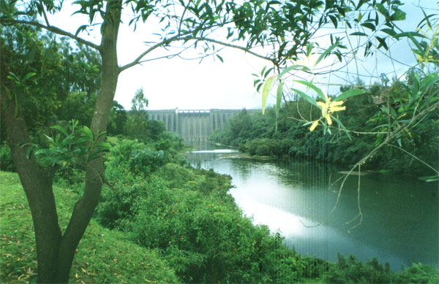
Thank you…

