Slide 1

Reducing uncertainty in emission estimates using perturbed emissions ensembles and novel observations: A focus on Beijing
Le Yuan¹, David Carruthers², Christina Hood², Roderic L. Jones¹, Olalekan A.M. Popoola¹, Jenny Stocker², Alexander T. Archibald^{1,3}
¹Department of Chemistry, University of Cambridge, UK
²Cambridge Environmental Research Consultants, Cambridge, UK
³National Centre for Atmospheric Science, UK
04/05/2020
ly299@cam.ac.uk

Slide 2
Background
Why are there uncertainties in emissions inventories?
  Inherent uncertainties, e.g. input data, spatial proxies
  Uncertainties in emission trends, particularly in regions undergoing rapid changes
Why is reducing such uncertainties important?
  Uncertainties in emissions → uncertainties in air quality simulations → uncertainties in health/policy impact assessments
ly299@cam.ac.uk

Slide 3
What is a perturbed emissions ensemble (PEE)?
Determine emission parameters and their uncertainty ranges (via expert elicitation)
Parameter | Initial PEE |  | Optimised PEE
 | Min. | Max. | Min. | Max.
Industry sector ground level CO emissions* | 0.3 | 1.8 | 0.1 | 1.8
Industry sector elevated CO emissions* | 0.3 | 1.4 | 0.1 | 1.4
Power sector CO emissions* | 0.2 | 1.5 | NA | NA
Power sector CO emissions below 150 m* | NA | NA | 0.1 | 1.8
Power sector CO emissions upper 150 m* | NA | NA | 0.1 | 1.8
Residential sector CO emissions* | 0.3 | 1.5 | 0.1 | 1.5
Transport sector CO emissions* | 0.4 | 2 | 0.1 | 1.5
Industry sector, ground level NO_{X} emissions* | 0.4 | 1.6 | 0.05 | 1.6
Industry sector, elevated NO_{X} emissions* | 0.4 | 1.4 | 0.05 | 1.4
Power sector NO_{X} emissions* | 0.2 | 1.4 | NA | NA
Power sector NO_{X} emissions below 150 m* | NA | NA | 0.05 | 1.6
Power sector NO_{X} emissions upper 150 m* | NA | NA | 0.05 | 1.6
Residential sector NO_{X} emissions* | 0.4 | 1.5 | 0.05 | 1.5
Transport sector NO_{X} emissions* | 0.4 | 2 | 0.05 | 1.5
Transport sector night-time NO_{X} emissions✦ | 0.1 | 0.5 | 0.1 | 0.3
Transport sector night-time NO_{X} emissions✦ | 0.1 | 0.4 | 0.1 | 0.3
*Defined relative to the base emissions
✦Defined as fraction of the daily total
ly299@cam.ac.uk

Slide 4
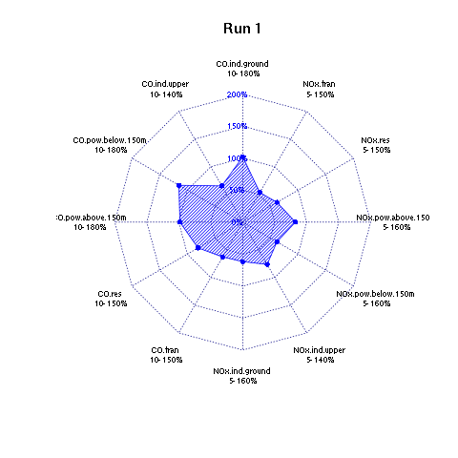
What is a perturbed emissions ensemble (PEE)?
Determine emission parameters and their uncertainty ranges (via expert elicitation)
Sample the parameter space (e.g. using maximin Latin hypercube design)
ly299@cam.ac.uk

Slide 5
What is a perturbed emissions ensemble (PEE)?
Determine emission parameters and their uncertainty ranges (via expert elicitation)
Sample the parameter space (e.g. using maximin Latin hypercube design)
Base emissions
Input the perturbed emissions inventories to an air quality model
ly299@cam.ac.uk

Slide 6
How can a PEE be used to constrain emissions uncertainties?
ly299@cam.ac.uk

Slide 7
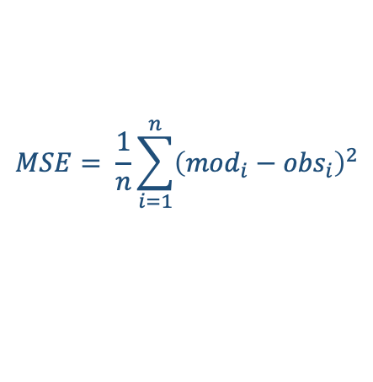
How can a PEE be used to constrain emissions uncertainties?
Use the median mean square error (MSE) of a PEE member to represent its average performance across the model domain
MSEs of the top performing PEE members dominated by min. achievable MSE, related to the observed variance
$$MSE= \frac{1}{n}\sum_{i=1}^{n}{{\left({mod}_{i}−{obs}_{i}\right)}^{2}}$$
$= {\left(\overline{mod}−\overline{obs}\right)}^{2}+$ ${\left(σ_{mod}−{rσ}_{obs}\right)}^{2}+ {σ_{obs}}^{2}×\left(1−r^{2}\right)$
bias²
variance
Min. achievable
MSE
ly299@cam.ac.uk

Slide 8
How can a PEE be used to constrain emissions uncertainties?
Smaller parameter ranges determined by the top performing PEE members
Not all parameters can be constrained
ly299@cam.ac.uk

Slide 9
Next steps
Evaluate PEE performance by season and site type – different results?
Make use of other observations: vertical and ground based low-cost sensor measurements
ly299@cam.ac.uk

