Slide 1
Seaward Dipping Reflectors sequences (SDRs) mapping in the field of the Mendeleev Rise
Elizaveta Rodina (rodina_liza@mail.ru)
Anatoly Nikishin (nikishin@geol.msu.ru)
Ksenia Startseva (kfstartseva@gmail.com)
Eugene Petrov (ep4813102@gmail.com)
Lomonosov Moscow State University
Geological Faculty
Department of Regional Geology and Earth History

Slide 2
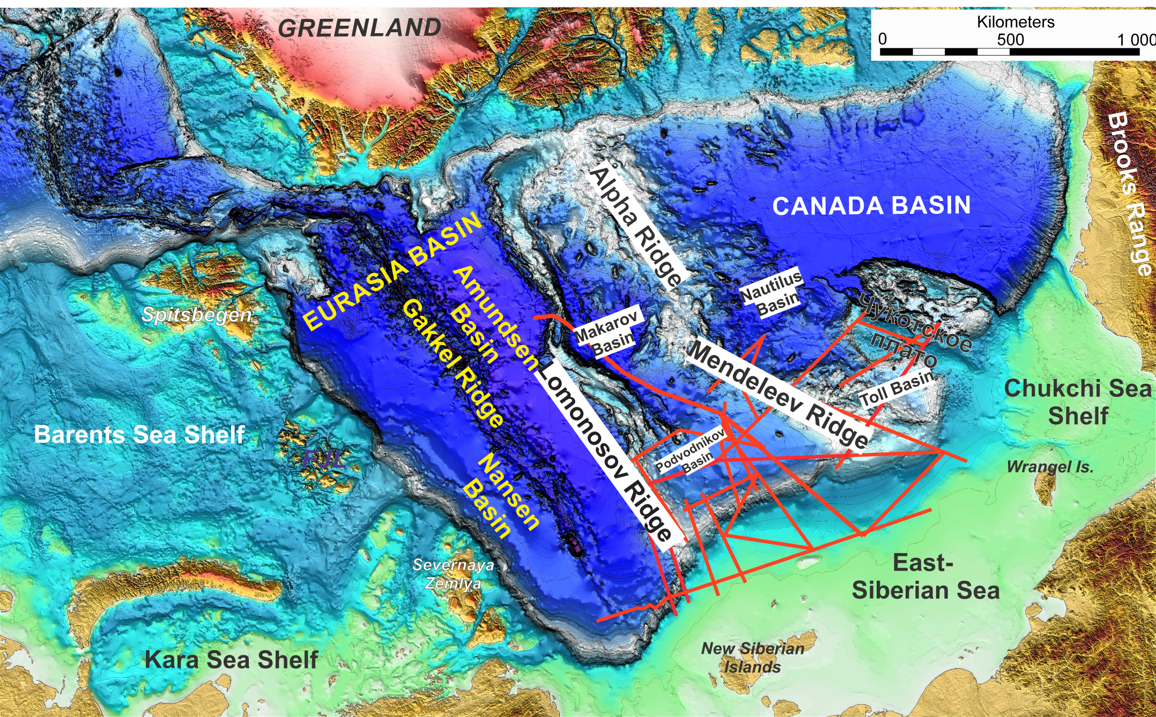
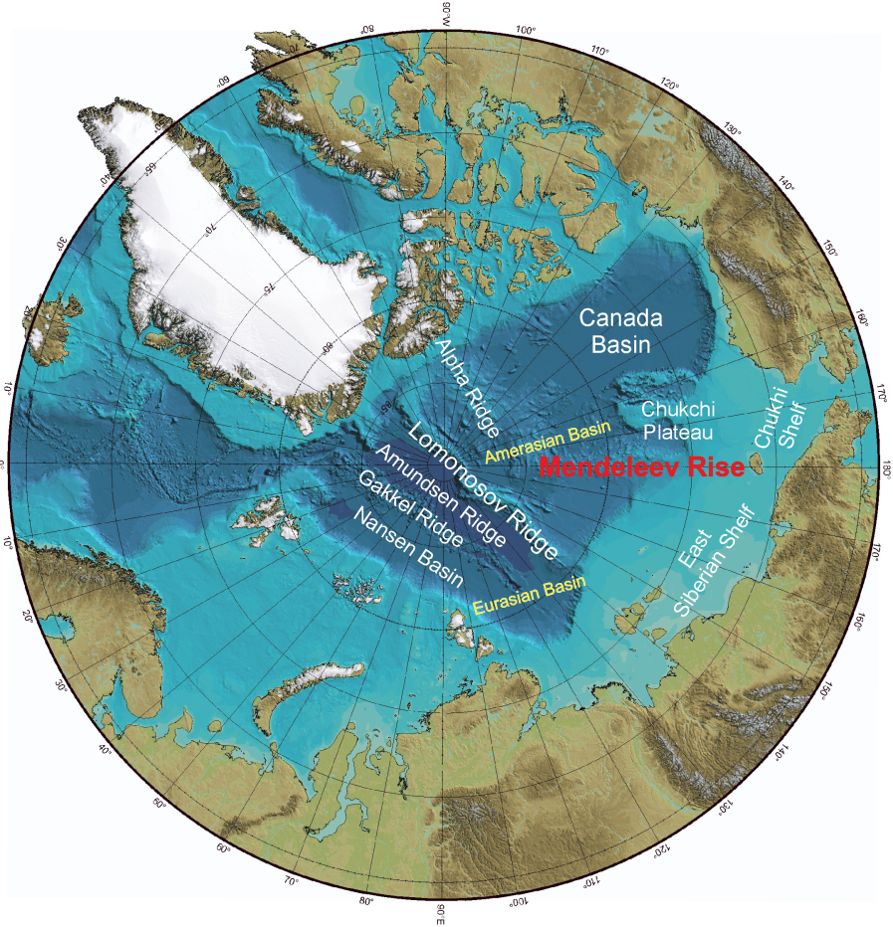
Place of work and Data
The report focuses on the strata of the Mendeleev Rise and adjacent Podvodnikov Basin, Makarov Basin, Toll Basin, and North Chukchi Basin together with Lomonosov Ridge and Chukchi Plateau. Eleven 2-D regional seismic profiles with a total length of 7540 km were interpreted.
1

Slide 3
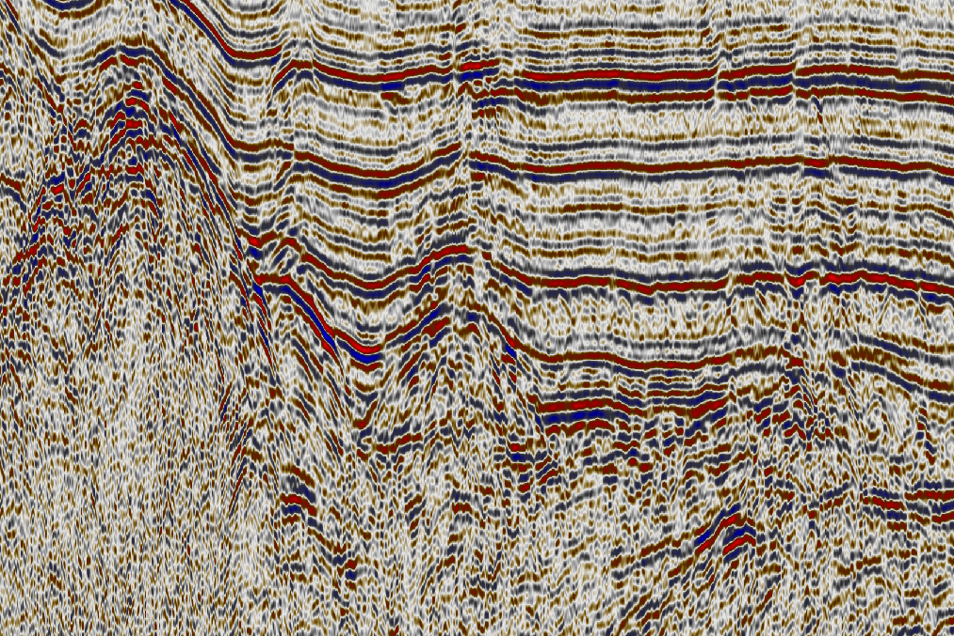
TOLL Basin’s SDR
In Toll Basin lower part we discovered packages of high-amplitude dipping reflectors.
B
SDR
A
B
SDRs top is bright. The internal structure of the wedges is convex-up, expanding towards Mendeleev Rise, the character of seismic recording becomes more chaotic towards Mendeleev Rise. The relationship with underlying complexes is uncertain.
Highs, similar to volcanic structures are often associated with the top of SDR.
2

Slide 4
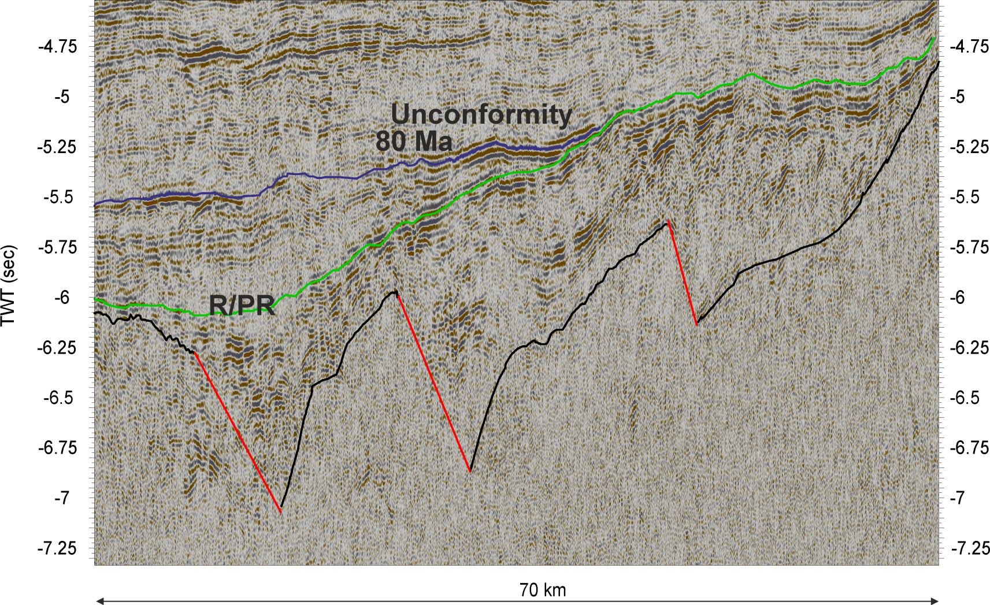
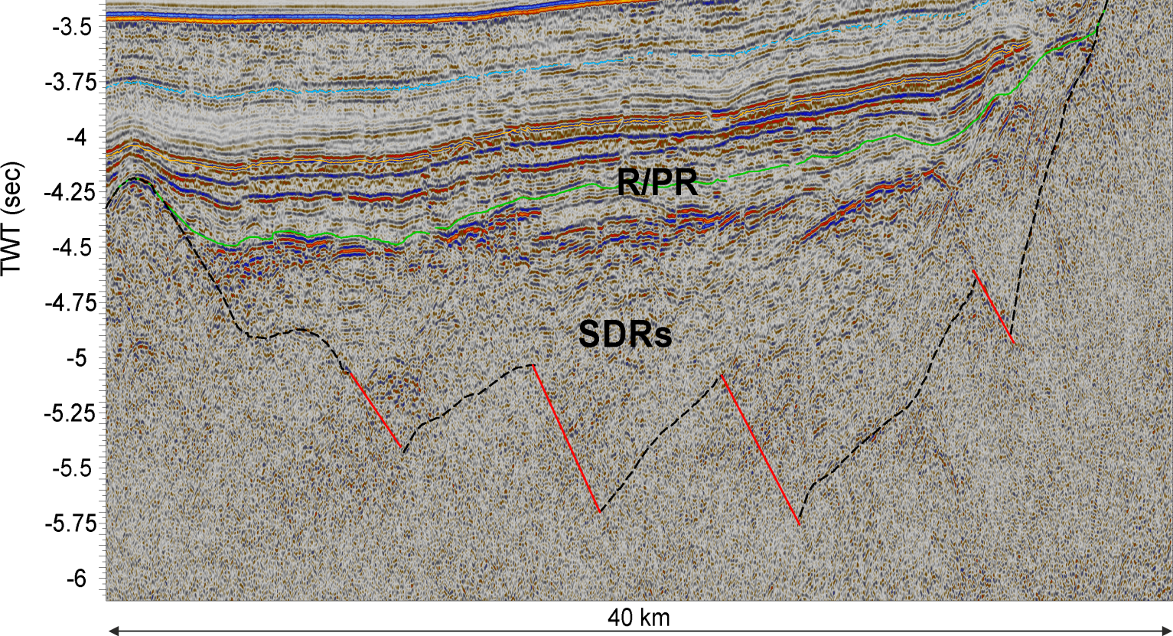
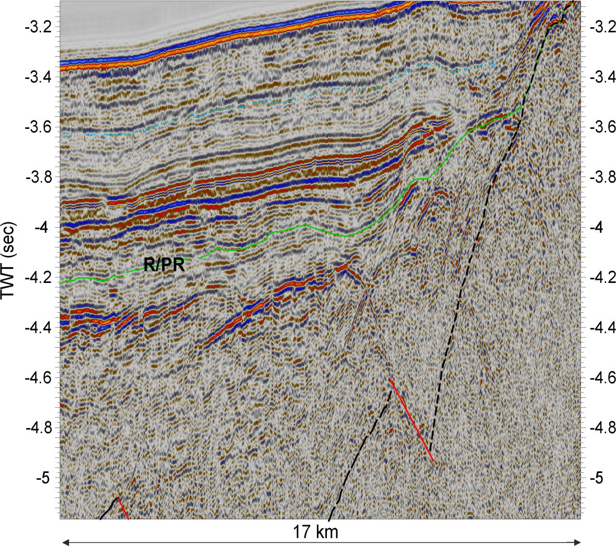
Examples of other SDR in the Mendeleev Rise area
SDRs dip from the central axis of Mendeleev Ridge in opposite directions – in this case, toward to Podvodnikov basins.
Rift-Postrift boundary is dated as ~100 Ma.
3
Notes:
SDRs dip from the central axis of Mendeleev Ridge in opposite direction – in this case, toward to Podvodnikov basins.
Rift-Postrift boundary is dated as ~100 Ma.

Slide 5
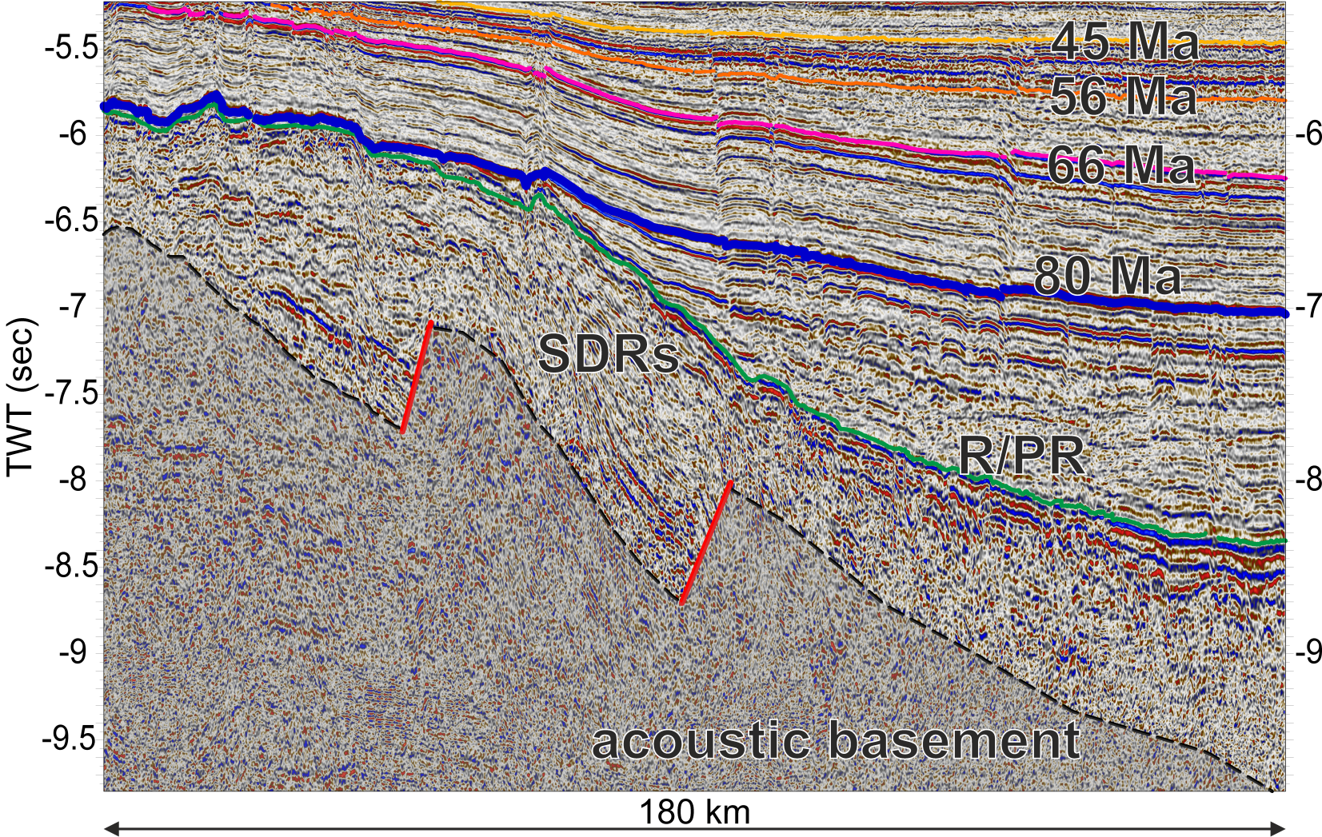
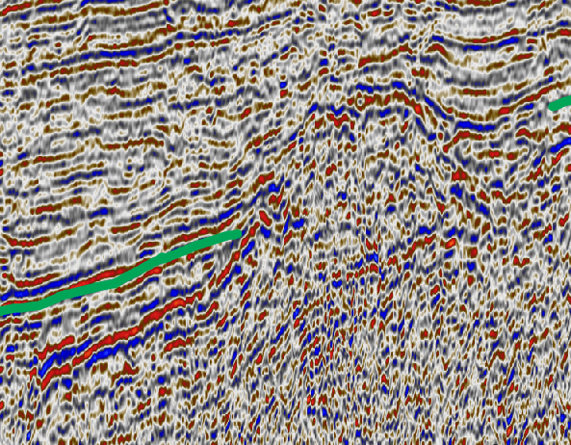
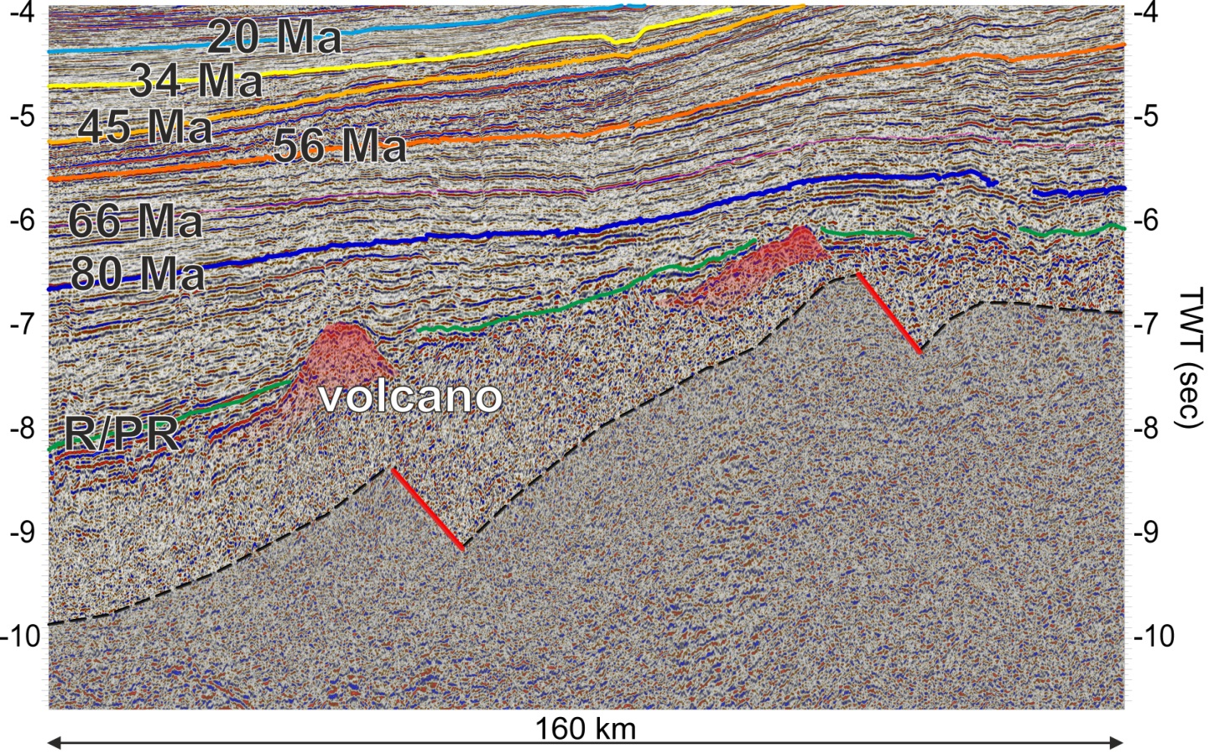
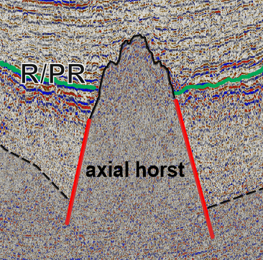
Podvodnikov Basin’s SDR and half-grabens
C
uncomfortable
Two-directional SDRs occur in Podvodnikov basin. They dip from the Mendeleev Rise and from the Lomonosov Terrace. In the central part of Podvodnikov basin is recognized small raised block of continental crust to which anti-directional SDRs converge.
C
4

Slide 6
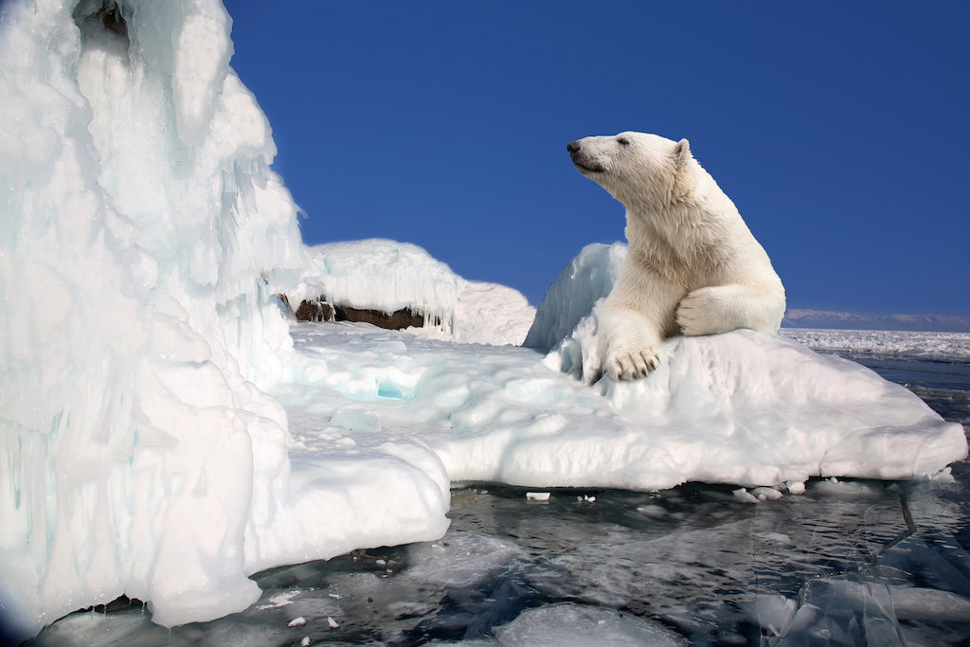
Thank you for attention!

