Slide 1
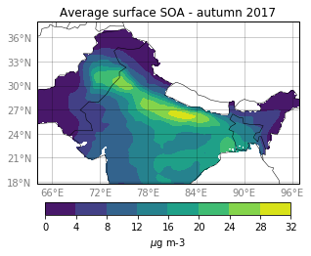
What drives seasonal variations of organic aerosol
over the Indo Gangetic Plain (IGP)?
Caterina Mogno ¹ (c.mogno@ed.ac.uk), Paul Palmer¹, Christroph Knote²
¹ School of GeoSciences, University of Edinburgh, UK
² Meteorological Institute, Ludwig Maximilian University, Munich, Germany
CONTEXT
IGP home to more than 400 million people and one of the most polluted areas in the world.
Organic aerosol (OA) constitutes a dominant fraction of particulate matter over IGP, both primary (POA) and secondary (SOA).
THIS STUDY
We use the WRF-Chem model with Volatility Basis Set (VBS) for OA to study:
Seasonal spatial distribution of POA and SOA over the IGP.
Seasonal chemical properties changes in SOA analysing the seasonal volatility distribution of SOA over the IGP.
Seasonal sensitivity of OA to different emissions sources (anthropogenic, biogenic, biomass burning ) of IGP through a perturbative approach.

