Slide 1
Global cooling effect from hindering homogeneous ice nucleation under cirrus conditions
Geoengineering——artificially modify the planet’s climate
Jiaojiao Liu¹ and Xiangjun Shi¹
¹ School of Atmospheric Sciences, Nanjing University of Information Science and Technology, Nanjing, China
Contact: liujj@nuist.edu.cn

Slide 2
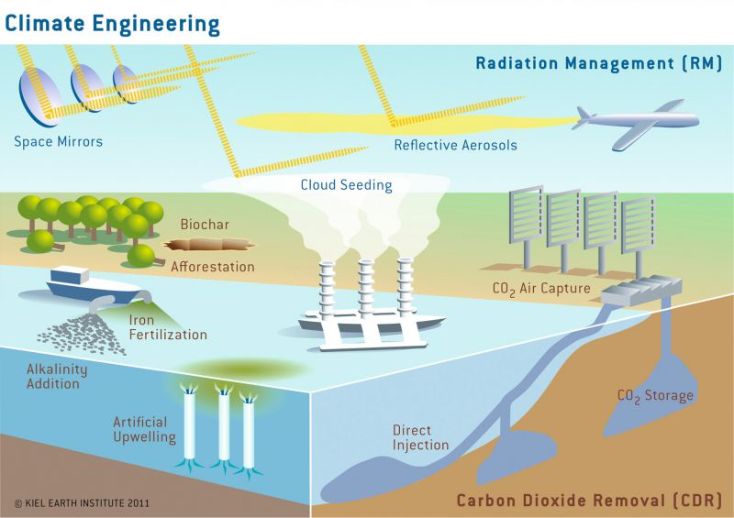
Approaches of Geoengineering
Rickels et al., (2011)
Radiation Management (RM): Reflect more solar radiation or increase outgoing longwave radiation
Carbon Dioxide Removal (CDR): Remove CO₂ from the atmosphere

Slide 3
Cirrus thinning—New approach of RM
incoming solar radiation
Outgoing longwave radiation
TOA
reflected by clouds and atmosphere
emitted by clouds and atmosphere
Atmosphere window
absorbed by clouds
absorbed by atmosphere
Previous approaches of RM aim to enhance it
absorbed by atmosphere
Cirrus thinning aims to weaken it in cirrus
reflected by surface
Surface
Drawback:
Lead to reduce this
absorbed by surface
emitted by surface

Slide 4
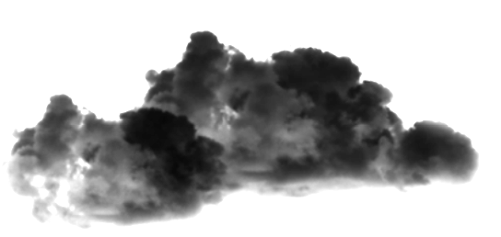
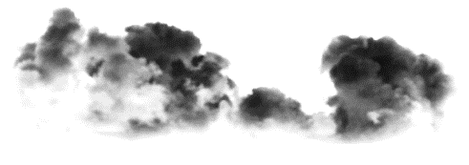
Cirrus thinning by seeding
Cirrus cloud show a net warming effect on earth, i.e. absorption overweighs reflection (Hong et al., 2016; Matus and L’Ecuyer, 2017)
solar radiation
Schematic diagram of cirrus thinning
Seeding INPs
longwave radiation

Slide 5
Review of cirrus seeding
 | Cooling effect （W m⁻²） | Seeding Methods | Model and Ice nucleation parametrization | Host model homogeneous nucleation occurrence frequency
Storelvmo et al. (2014) | -2.22 Over-estimated | Seeding with fixed number of INPs | CESM1.0.4; BN (Barahona and Nenes, 2009) | Over-estimated (Probably >20%)
Penner et al. (2015) | -0.74±0.25 | Seeding with fixed number of INPs | CAM5; BN | Reasonable or under-estimated (Take pre-existing ice crystals into account)
Gasparini & Lohmann (2016) | -0.25±0.34 | Seeding with fixed number of INPs | ECHAM-HAM; KL (Kärcher et al., 2006) | Seems reasonable (Lower dust INP concentrations in the upper troposphere)
Is this the maximum potential cooling effect by cirrus seeding?
The fixed number of INPs is easy for coding, but not good.

Slide 6
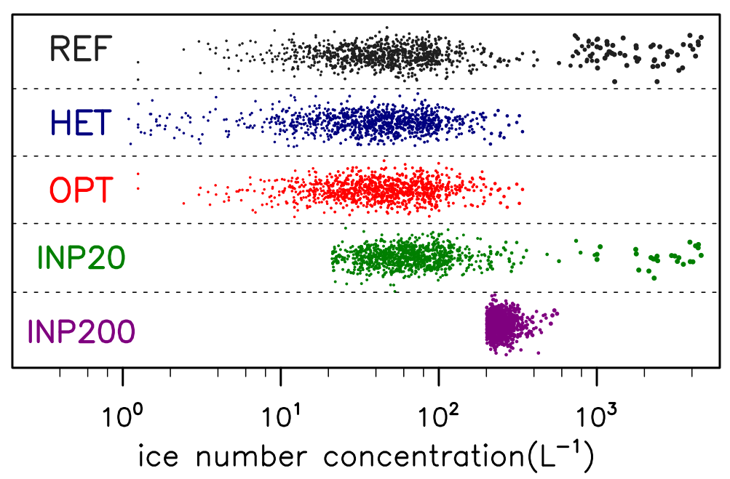
New method—Optimal seeding scheme
To explore maximum cooling effect of cirrus seeding, we present a new method
REF: Reference, simulation without seeding
HET: Idealized, only heterogeneous nucleation occurs
OPT: New method, seeding by optimal method
INP20: Old method, seeding INPs with 20L⁻¹ (underseeding)
INP200: Old method, seeding INPs with 200L⁻¹ (overseeding)
Close to HET
Fig.1 1000 offline tests of newly ice crystals formation (one dot means one nucleation event) by using LP parameterization. The horizontal coordinate-axis is the sum number concentrations of newly formed ice crystals from any pathways. The vertical coordinate-axis is without any meanings.

Slide 7
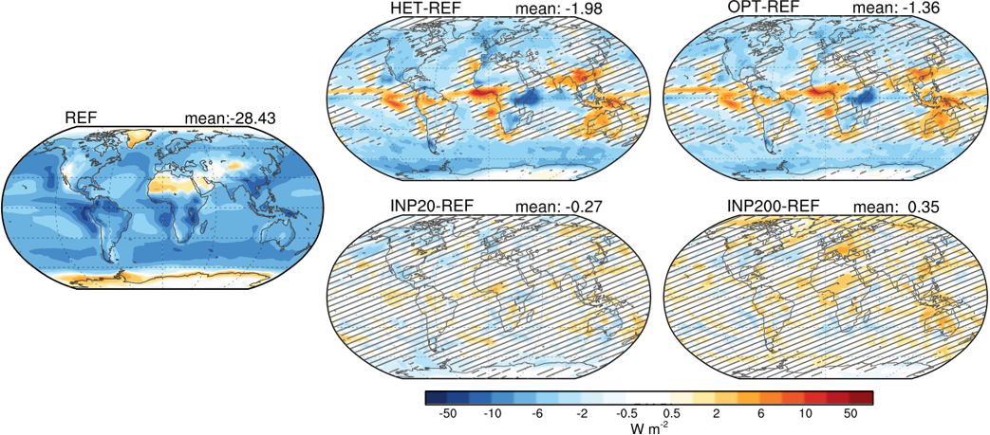
Simulation results with CAM5
Cooling effect on global
Idealized Experiment
Optimal seeding method
Insignificant!
Warming effect on global
The fixed number of INPs
The fixed number of INPs
Fig.2 The global annual mean distribution of reference simulations (REF) and the anomalies for HET,OPT, INP20 and INP200 simulations with respect to REF of net cloud forcing(NCF, units: W m⁻²). Global mean values are shown in the upper right corner. The shadow denotes the differences between two simulations are not significant at 95% level by student’s t-test.

Slide 8
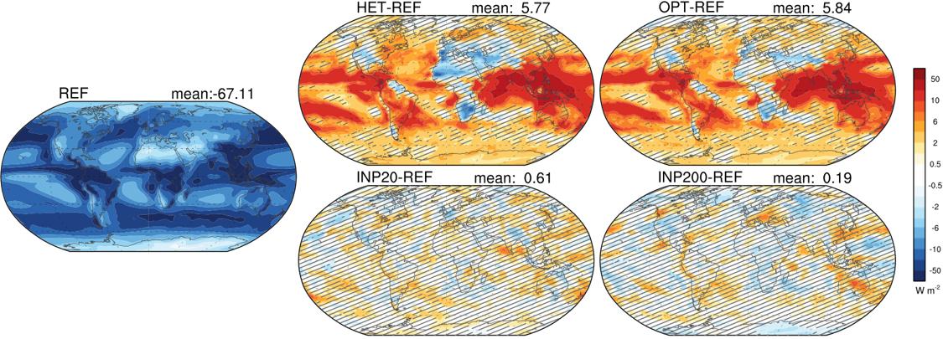
Interesting finding
More downwelling surface solar radiation in Cirrus seeding, which is different from any other approaches of RM.
Fig.3 The global annual mean distribution of reference simulations (REF) and the anomalies for HET,OPT, INP20 and INP200 simulations with respect to REF of downwelling surface shortwave forcing(DSSF, right-most column, units: W m⁻²).

Slide 9
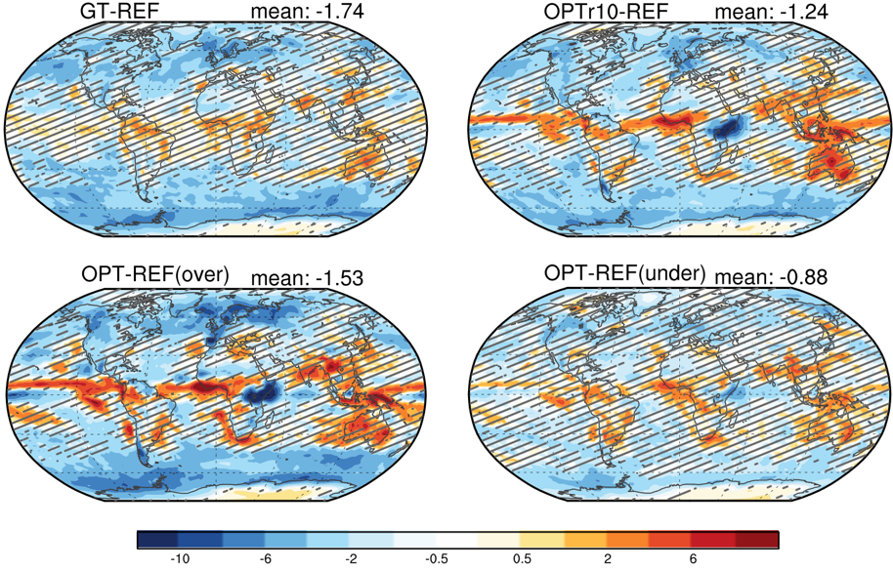
Sensitivity tests
Seeding in specific geographical target
Seeding with different radius of INPs
Over-estimate occurrence frequency of homogeneous nucleation
Under-estimate occurrence frequency of homogeneous nucleation
Fig.4 The global annual mean distribution of the anomalies for sensitive simulations with respect to REF of net cloud forcing(NCF, units: W m⁻²).

Slide 10
Conclusions
The maximum cooling effect potential of cirrus thinning (turn off homogeneous ice nucleation) is -1.98 W m⁻², using optimal seeding method can reach up 2/3 of it (-1.36 W m⁻²)
Cirrus seeding can offset the drawback in other radiation managements that less solar at surface
Also, the sensitivity tests show the cooling effect is depend on radius of seeding ice crystals, seeding areas, and homogeneous ice nucleation occurrence frequency
Contact: liujj@nuist.edu.cn

Slide 11
References
Barahona D. and A. Nenes (2009), Parameterizing the competition between homogeneous and heterogeneous freezing in ice cloud formation - polydisperse ice nuclei. Atmospheric Chemistry and Physics, 9, 5933-5948.
Gasparini B. and U. Lohmann (2016), Why cirrus cloud seeding cannot substantially cool the planet, Journal of Geophysical Research: Atmospheres, 121, 4877-4893.
Hong Yulan, et al. (2016), Assessing the Radiative Effects of Global Ice Clouds Based on CloudSat and CALIPSO Measurements, Journal of Climate, 29.
Kärcher B., et al. (2006), Physically based parameterization of cirrus cloud formation for use in global atmospheric models, Journal of Geophysical Research: Atmospheres, 111.
Matus, A. V. and T. S. L’Ecuyer (2017), The role of cloud phase in Earth’s radiation budget. Journal of Geophysical Research Atmospheres, 122: 2559–2578.
Penner J. E., et al. (2015), Can cirrus cloud seeding be used for geoengineering?, Geophysics Research Letter, 42.
Rickels et al., (2011), Large-Scale Intentional Interventions into the Climate System? Assessing the Climate Engineering Debate. Scoping report conducted on behalf of the German Federal Ministry of Education and Research (BMBF), Kiel Earth Institute.
Storelvmo T., et al. (2014), Cirrus cloud seeding: a climate engineering mechanism with reduced side effects?, Philosophical Transactions of the Royal Society of London A: Mathematical, Physical and Engineering Sciences, 372 (2031).

