Slide 1
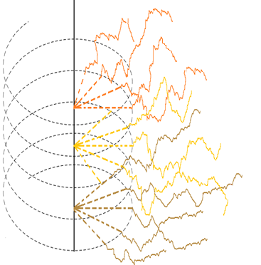
A physically based Lagrangian procedure for the push-pull test analysis
in heterogeneous aquifer
EGU2020-4947
Maria Rita Maggi, Anna di Gialleonardo, Laura Perrotta, Giovanni Petrella, Federico Sperati and Antonio Zarlenga
mariarita.maggi@uniroma3.it
© Authors. All rights reserved

Slide 2
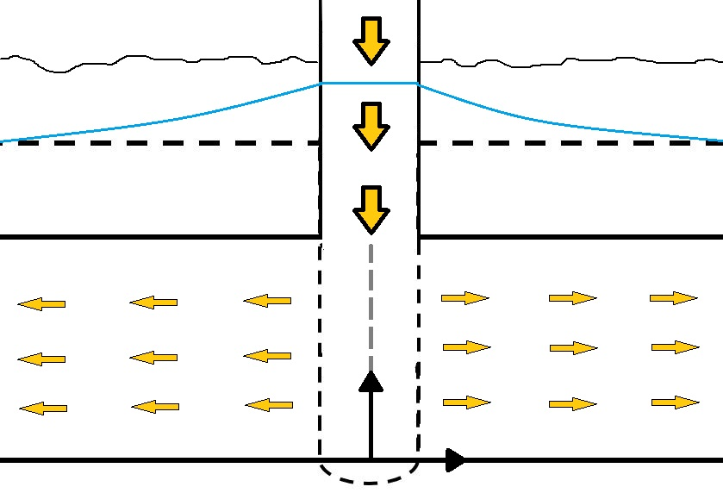
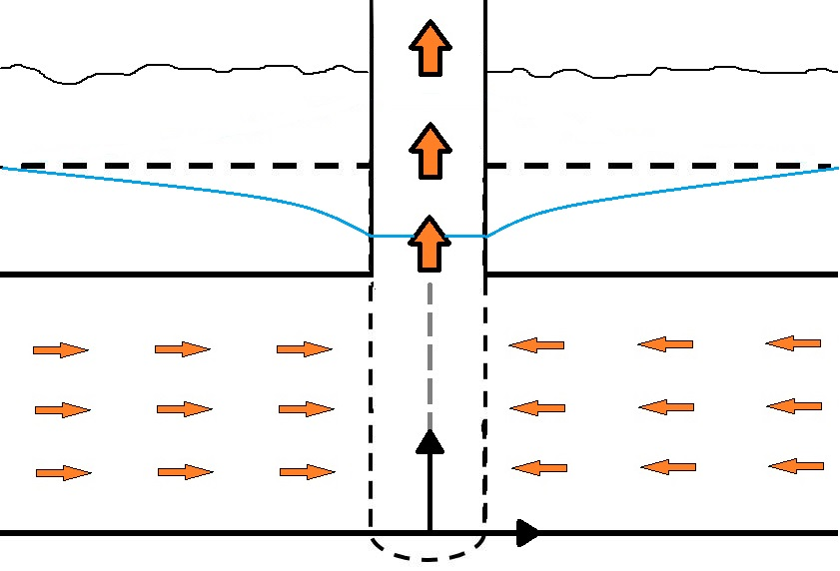
Single Well Push-Pull (SWPP)
The single well push-pull (SWPP) tracer test is a widely used approach to define the aquifer characteristics in situ. The SWPP test consists of 2 phases:
Push phase: water marked with a tracer with given concentration is pumped into the well and then injected into the aquifer.
Pull phase: water is extracted from the well and the tracer concentration is continuously monitored.
z
z
r
r
Indeed by the analysis breakthrough curves (BTCs) obtained in the pull phase is possible to estimate significant aquifer and transport parameters such as the dispersion, sorption or reaction coefficients.
BACK
NEXT
© Authors. All rights reserved

Slide 3
Aims
Observed BTCs interpretation based on the ADE usually assumes an homogeneous media
(e.g. Gelhar and Collins, 1971).
We propose a semi-analytical physically based Lagrangian procedure for the SWPP analysis, mimicking the transport processes taking place in heterogeneous aquifer.
BACK
NEXT
© Authors. All rights reserved

Slide 4
Model
DOMAIN
The flow domain is constituted by a layered formations each layer $i \left(i=1:n\right)$
is homogeneous and isotropic with random log-hydraulic conductivity normally distributed
$$Y_{i}=\ln{ \left({K_{i}}/{K_{G}}\right)}$$
$Y_{i}$ $∈N\left(0,σ_{Y}^{2}\right)$
The thickness $I$ of each layer is given while the domain is unbounded laterally.
We consider the well fully penetrating the stratified confined aquifer.
Model Sketch
Confined
aquifer
z
r
BACK
NEXT
© Authors. All rights reserved

Slide 5
Model
FLOW
Steady state flow is assumed for both the push phase and the pull phase
The radially diverging and converging flow is ruled by the $\text{Darcy}\text{′}\text{s} \text{law}$
$$q=−K {∂h}/{∂r}$$
q is the specific discharge [L/T]
${∂h}/{∂r}$is the hydraulic gradient
K is the hydraulic conductivity [L/T]
Furthermore it is assumed that the regional flow is negligible compared to the well induced flow.
z
z
r
r
BACK
NEXT
© Authors. All rights reserved

Slide 6
Model
TRANSPORT
We perform a Lagrangian tracking procedure:
The particle trajectory can be regarded as the sum of 3 terms:
the initial position
the advective component depending on the local flow velocity $v(x)$
the pore scale dynamics are modelled as Wiener process
The final BTC is obtained by sum, during the extraction phase,
the particles that arrive at the well.
$dX\left(t\right)=x\left(t_{0}\right)+v\left(X\left(t\right),Y\left(t\right)\right)dt+dX_{d}$ $dY(t)= y(t_{0} ) +dY_{d}$
BACK
NEXT
© Authors. All rights reserved

Slide 7
Application examples
$$t$$
𝑡
$$Pe$$
𝑃𝑒
$$σ_{Y}^{2}$$
𝜎_𝑌^2
$t$ The injection duration
$Pe$ Peclet Number
$σ_{Y}^{2}$ Heterogeneity degree
The resulting BTCs depend on:
$$t$$ | $$Pe$$ | $σ_{Y}^{2}$
10 | 100 | 0.2
10 | 100 | 1
10 | 100 | 2
125 | 100 | 0.2
125 | 100 | 1
125 | 100 | 2
125 | 1000 | 1
250 | 100 | 1
750 | 100 | 0.2
750 | 100 | 1
750 | 100 | 2
SWPP-1
SWPP-1b
The tracer is continuously injected throughout the push phase on a stretch of 1000 layers
SWPP-1c
SWPP-2
SWPP-2b
We fixed the number of particles introduced during the test equal to 10000 assuming that they are uniformly distributed over the whole input area.
As regards the recovery phase of the tracer (pull phase), the duration was set according to the duration of the injection (push phase). (recovery ranges from the 95% up to the 100%)
SWPP-2c
SWPP-2d
SWPP-3
SWPP-4
SWPP-4a
SWPP-4b
BACK
NEXT
© Authors. All rights reserved

Slide 8
$$t$$
𝑡
$$Pe$$
𝑃𝑒
$$σ_{Y}^{2}$$
𝜎_𝑌^2
Results: Duration $(t)$
For short push duration the BTC
observed during the pull phase
exhibits a fairly Gaussian/Fickian behavior.
For longer push duration the tracer experiences more formations, the behavior is typically non Gaussian and mainly characterized by a long tail.
The long tail is due to the solute retention in the slow formations.
The duration required for the full recovery of the injected tracer can be very high.
$t=10$
$t=125$
$t=250$
BACK
NEXT
© Authors. All rights reserved

Slide 9
$$t$$
𝑡
$$Pe$$
𝑃𝑒
$$σ_{Y}^{2}$$
𝜎_𝑌^2
Results Peclet number $(Pe)$
The effects of the pore scale
processes manifest on the longer
tail associated to the lower
Peclet number.
In spite of the small direct contribution on the tracer spreading associated to the pore scale process the differences observed in the tails are enormous.
The BTC tails are determined by particles trapped in the slow layers.
The pore scale processes determine the vertical displacement of the solute particle triggering the mass exchange between the adjacent layers. This mass exchange determines the longitudinal spreading and the longer tails.
$$Pe=100$$
$$Pe=1000$$
BACK
NEXT
© Authors. All rights reserved

Slide 10
$$t$$
𝑡
$$Pe$$
𝑃𝑒
$$σ_{Y}^{2}$$
𝜎_𝑌^2
Results heterogeneity${ (σ}_{Y}^{2})$
Heterogeneity exerts a significant impact on the BTC spreading.
Despite the BTCs show a quite similar behavior at the beginning of the pull phase the effect of $σ_{Y}^{2}$becomes important on the tail development.
Due to the higher probability associated to the slower formations a significant quantity of tracer is trapped resulting on heavier tails associated to the higher heterogeneity degree.
The practical implications of this behavior is of paramount importance on the BTC analysis, on the pull duration planning and on the field test design.
© Authors. All rights reserved

Slide 11
Conclusions
The single well push-pull tracer test is an useful resource for the aquifer characterization.
We developed a semi-analytical framework for heterogeneous aquifer correlating the aquifer parameters with the BTC.
The analysis shows how the heterogeneity and the pore scale dynamics have a significant impact on the BTC.
PS processes have an indirect effect on the solute spreading: due to the PS dynamics the particles experience more formations.
The tail of the BTC depends on the particles that are trapped on the low hydraulic conductivity formations.
The solute mass pertaining to the tail of the BTC is proportional to the test duration and to the
log-conductivity variance and inversely proportional to $Pe$.
BACK
NEXT
© Authors. All rights reserved

Slide 12
Thanks for your attention
If you have any questions please do not hesitate to contact me at:
mariarita.maggi@uniroma3.it
Start from the beginning
© Authors. All rights reserved

