Slide 1
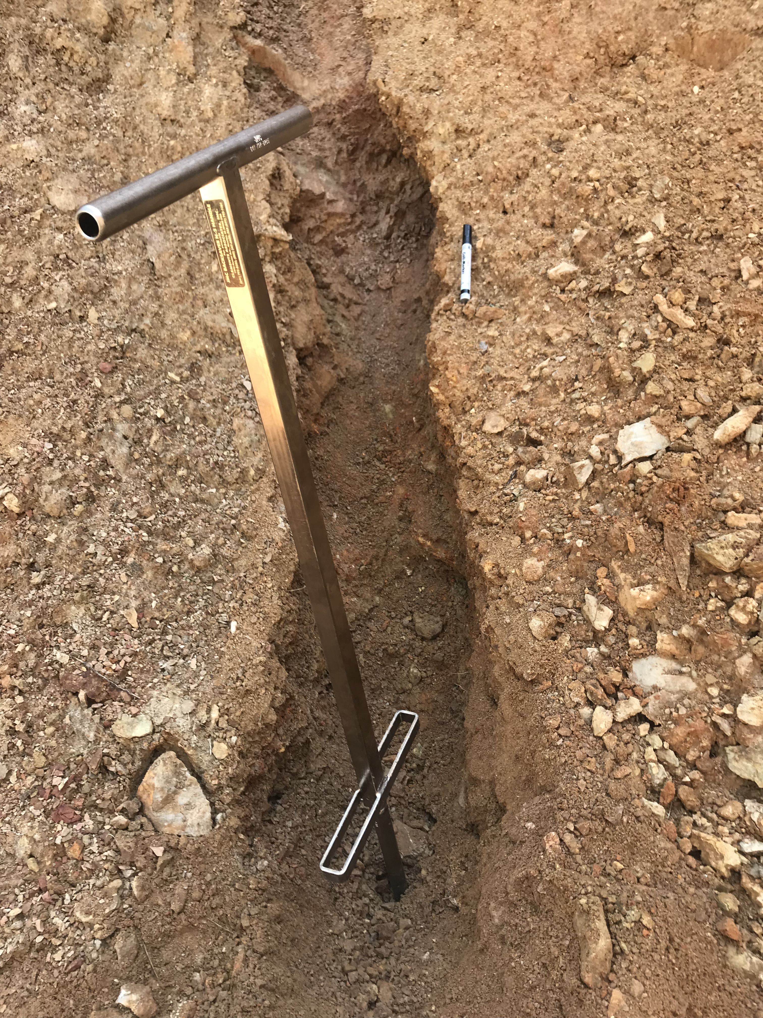

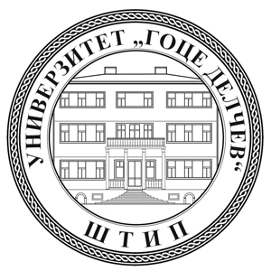






Thallium mobility in mining wastes at the Crven Dol locality, Allchar deposit,
North Macedonia
Tamara Đorđević
Institut für Mineralogie und Kristallographie, Universität Wien, Wien, Austria
tamara.djordjevic@univie.ac.at
Uwe Kolitsch
Mineralogisch-Petrographische Abteilung, Naturhistorisches Museum, Wien, Austria
Petr Drahota, Magdaléna Peřestá
Institute of Geochemistry, Mineralogy and Mineral Resources, Faculty of Science, Charles University, Czech Republic
Juraj Majzlan, Stefan Kiefer
Institute of Geosciences, Department of Mineralogy, Friedrich-Schiller-Universität, Jena, Germany
Tomáš Mikuš
Earth Science Institute, Slovak Academy of Sciences, Geological Division, Banská Bystrica, Slovakia
Todor Serafimovski, Goran Tasev, Blažo Boev
Department of Mineral Deposits, Faculty of Natural and Technical Sciences, University “Goce Delčev”-Štip, Macedonia

Slide 2
Objectives
Characterization of the crystalline primary and secondary Tl-minerals
Characterization of amorphous and poorly crystalline secondary Tl-minerals
Quantify the distribution of thallium and evaluete geochemical controls on dissolved Tl and As
2

Slide 3
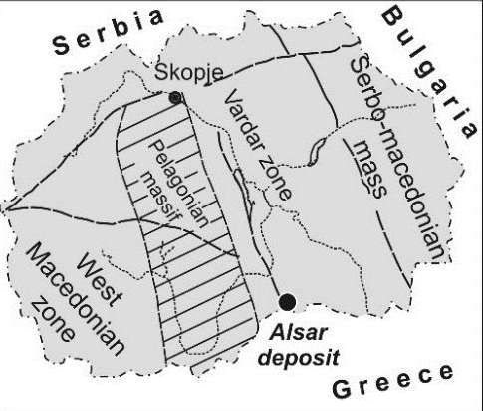
Allcahr deposit: position
Allchar
deposit
3

Slide 4
from 1881 to 1913: excavation of arsenic ore
from 1953 to 1965 and from 1970-1973: excavation of
low-grade antimony ore
late 1980s: discovery of thallium minerals (lorandite, vrbaite etc.) as constituents of the arsenic-antimony ore
special interest for thallium from lorandite as a possible solar neutrino detector → systematic investigations of thallium mineralization in the northern part of the Allchar deposit (Crven Dol ore body)
geological, geochemical, mineralogical and hydrothermal alteration features are similar to Carlin-type mineralization of the Western United States.
Allcahr deposit: generalities
4

Slide 5
Geological map of the Allchar ore deposit after Boev et al. (2016)
Crven Dol
(edit 21)
Allchar and Crven Dol: Geology
Geological profile of Crven Dol after Amthauer et al. (2012)
Boev, B. et al. (2016): Geologica Macedonica, 30, 115-127; Amthauer et al. (2016): Miner. Petrol., 105, 157-169.
5

Slide 6
Hydrothermal alteration
  Modereate to strong agrilic alteration is widesprad
  Dolomitization
  Weak, localized silification
Types of mineralization
  Abundant thallium mineralization (mostly Tl-sulfosalts)
  Abundant arsenic mineralization (realgar, orpiment, sulfosalts)
  Oxidation zone scarcely investigated
Crven Dol (edit 21): site description
Geochemical characteristic
  As + Tl >> Sb + Hg + SiO₂
  As:Sb, Tl:Sb → increasing
  SiO₂, Au+Sb → decreasing
6

Slide 7
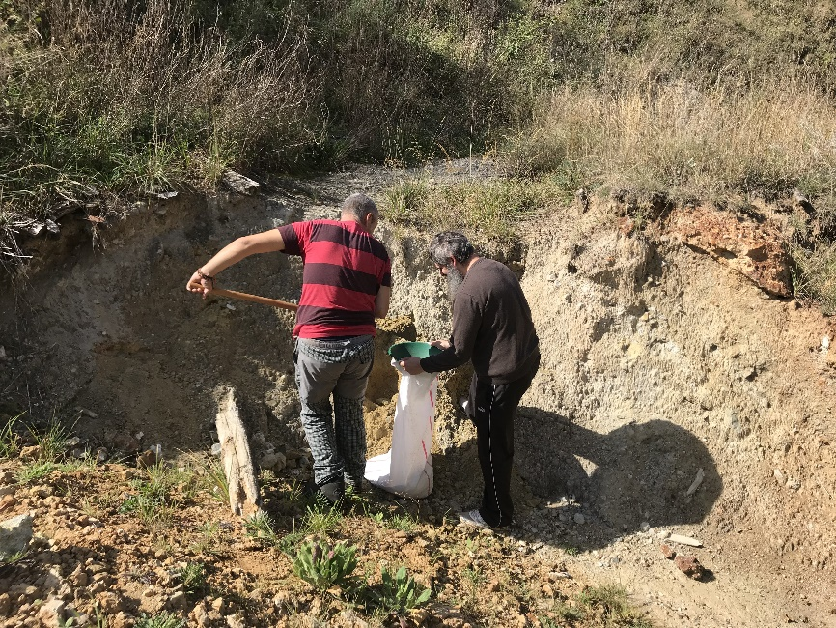
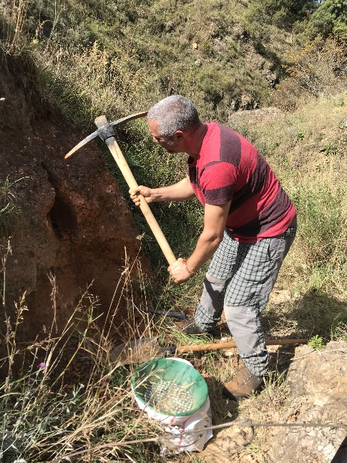
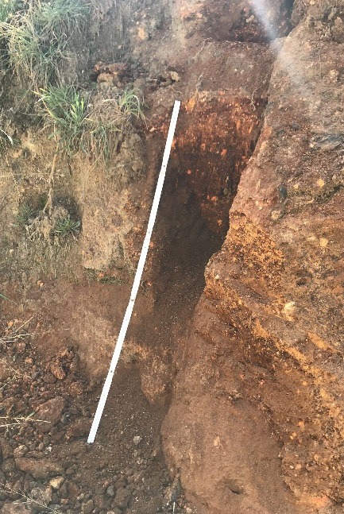
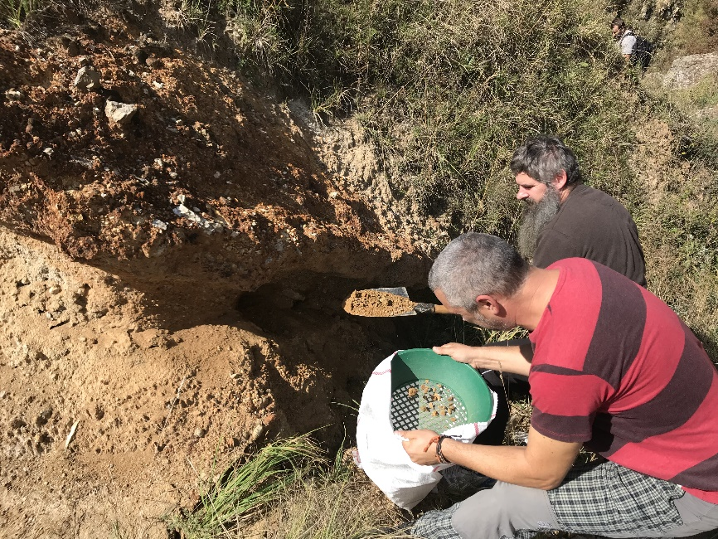
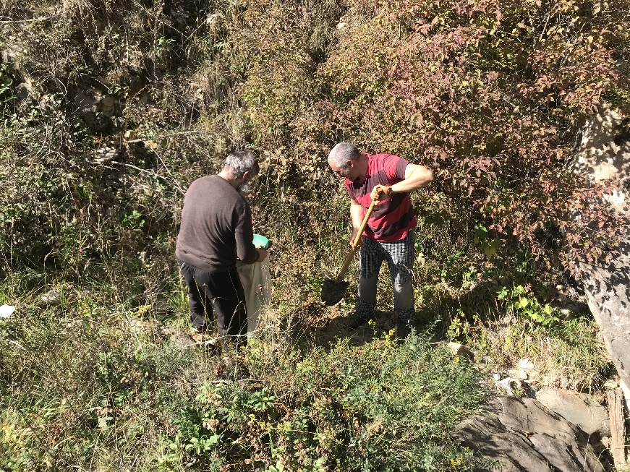
Waste dumps at Crven Dol: 41°15′95″N, 21°95′14″E
CD-18-1
CD-18-3
CD-18-3
Sampling
CD-18-2
CD-18-4
7

Slide 8
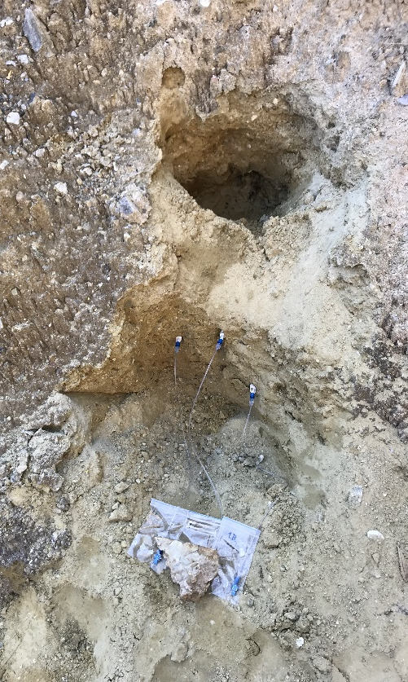
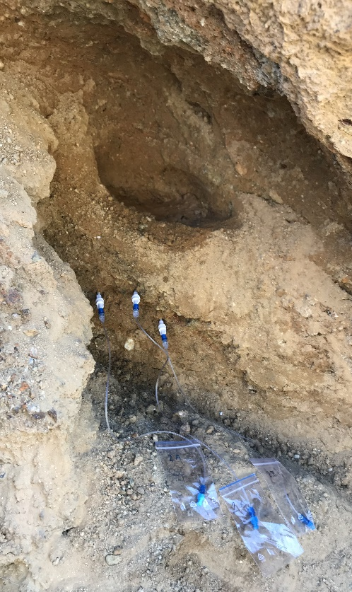
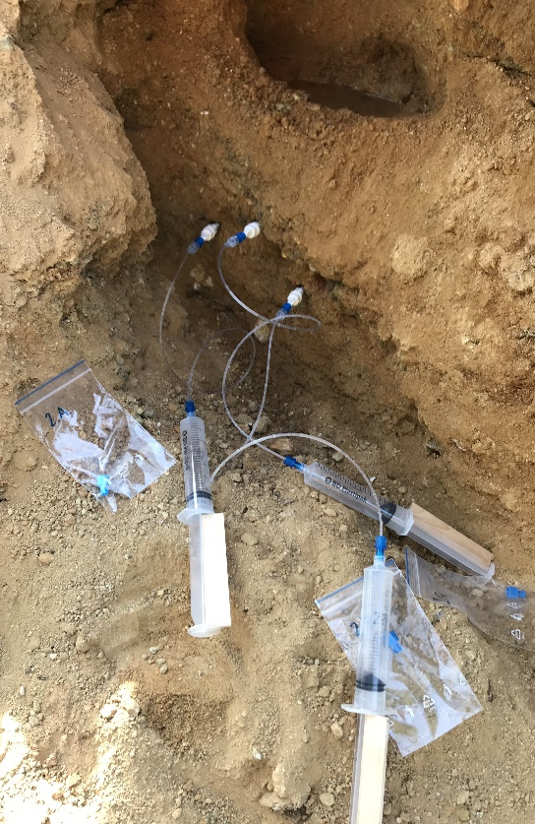
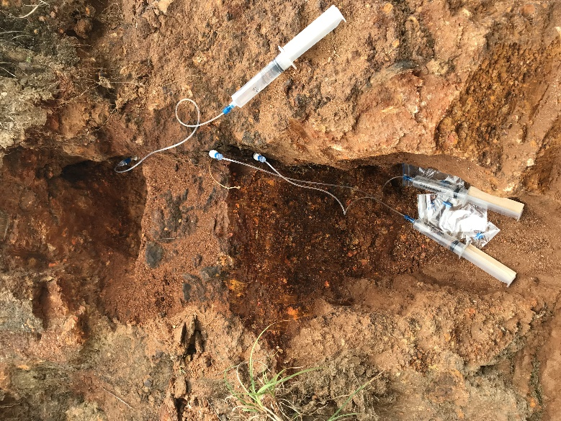
Pore-water sampling at the waste dumps of Crven Dol:
41°15′95″N, 21°95′14″E
CD-18-1A,B,C
CD-18-2A,B,C
CD-18-2A,B,C
CD-18-3A,B,C
Sampling
8

Slide 9
Chemistry: ICP-OES and ICP-MS
9

Slide 10
Mineral name | Formula
Sulfides and sulfosalts
Pyrite^{1–4} | FeS₂
Marcasite^{3,4} | FeS₂
Pyrrhotite³ | Fe_{1-x}S
Realgar^{1–5} | As₄S₄
Oripiment^{1–5} | As₂S₃
Raguinite^{1,2} | TlFeS₂
Picotpaulite^{1,2} | TlFe₂S₃
Cinnabar¹ | HgS
Lorandite^{1–5} | TlAsS₂
Fangite^{1,2} | Tl₃AsS₄
Jankovićite | Tl₅Sb₉(As,Sb)₄S₂₂
Oxides
Quartz¹⁻⁴ | SiO₂
Magnetite¹ | Fe²⁺Fe³⁺₂O₄
Ulvöspinel¹ | Fe²⁺₂Ti⁴⁺O₄
Ilmenite | Fe²⁺TiO₃
Goethite³ | FeO(OH)
Fe-oxyhydrohides^{1,2}
Mn-oxides^{1,2,3}
Anatanse³ | TiO₂
Carbonates
Calcite^{1–4} | CaCO₃
Dolomite^{1–4} | CaMg(CO₃)₂
Siderite¹ | FeCO₃
Mineral name | Formula
Sulfates
Barite^{1,2} | BaSO₄
Gypsum^{1–3} | CaSO₄·2H₂O
Dorallcharite^{1–3} | Tl_{0.8}K_{0.2}Fe₃(SO₄)₂(OH)₆
Jarosite^{1,2} | KFe³⁺₃(SO₄)₂(OH)₆
Hydroniumjarosite^{1–3} | (H₃O)Fe³⁺₃(SO₄)₂(OH)₆
Phosphates
Fluorapatite^{1,2} | Ca₅(PO₄)₃F
Xenotime-(Y)¹ | Y(PO₄)
Arsenates
Scorodite^{1–3} | Fe³⁺AsO₄·2H₂O
Pharmacosiderite^{1,2} | KFe³⁺₄(AsO₄)₃(OH)₄·6-7H₂O
Natropharmacosid.^{1,2} | (Na,K)Fe³⁺₄(AsO₄)₃(OH)₄·6-7H₂O
Thallium arsenate^{1–4} | new Tl mineral
Talmessite^{1–3} | Ca₂Mg(AsO₄)₂ · 2H₂O
Wallkilldellite^{1,2} | Ca₂Mn²⁺₃(AsO₄)₂(OH)₄·9H₂O
Arseniosiderite^{1,2} | Ca₂Fe³⁺₃(AsO₄)₃O₂·3H₂O
Silicates
Muscovite^{1,3} | KAl₂(AlSi₃O₁₀)(OH)₂
Flogopite¹ | KMg₃(AlSi₃O₁₀)(OH)₂
K-feldspar¹ | K(AlSi₃O₈)
Albite¹ (Ca-rich) | Na(AlSi₃O₈)
Kaolinite¹ | Al₂(Si₂O₅)(OH)₄
Spessartine³ | Mn²⁺₃Al₂(SiO₄)₃
Mineralogy of Crven Dol
¹SEM-EDS, ²EPMA, ³Raman, ⁴PXRD, ⁵SXRD
Newly identified within this study
Italic: type locality
10

Slide 11
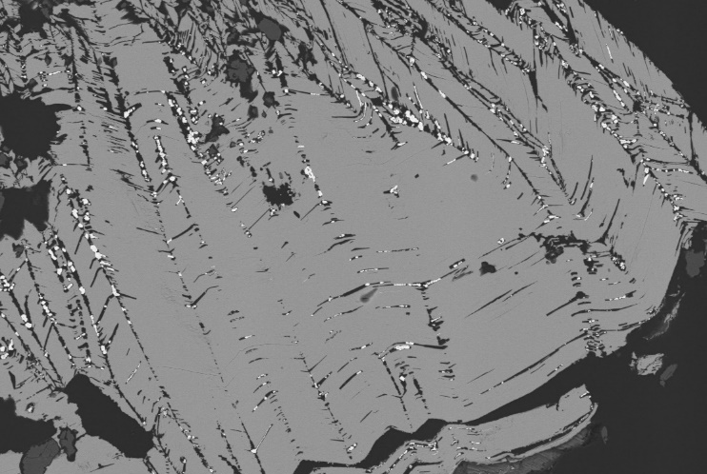
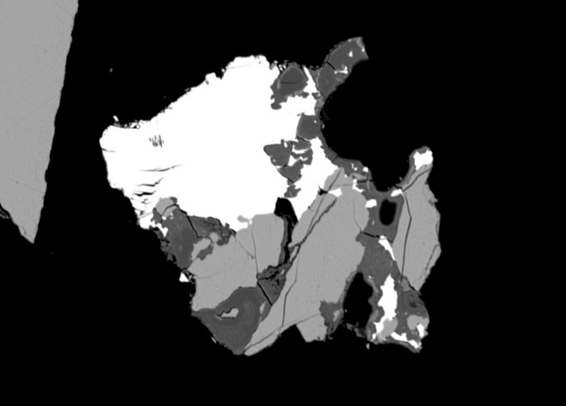
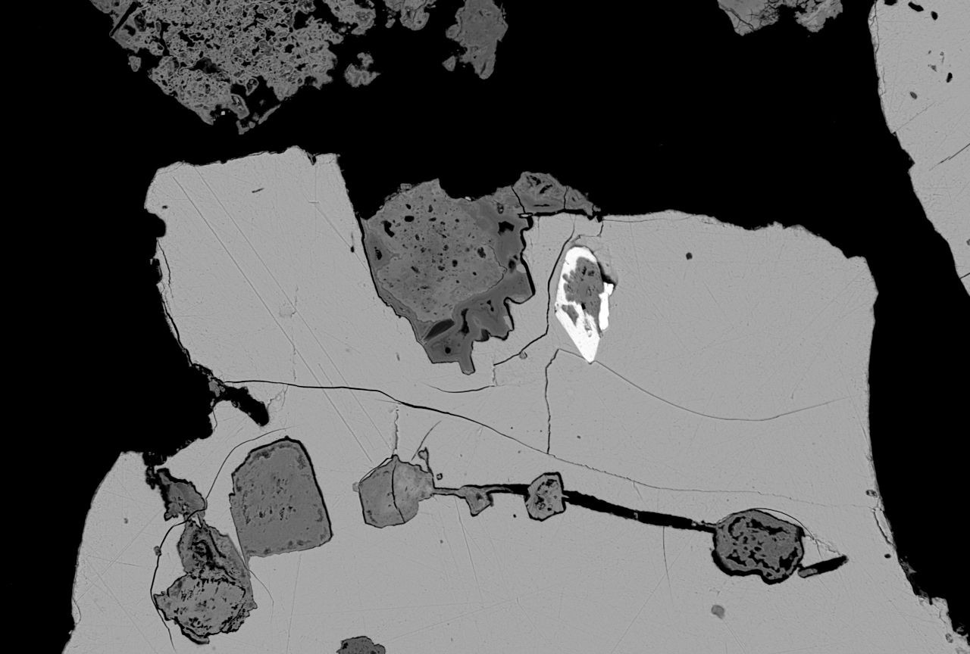
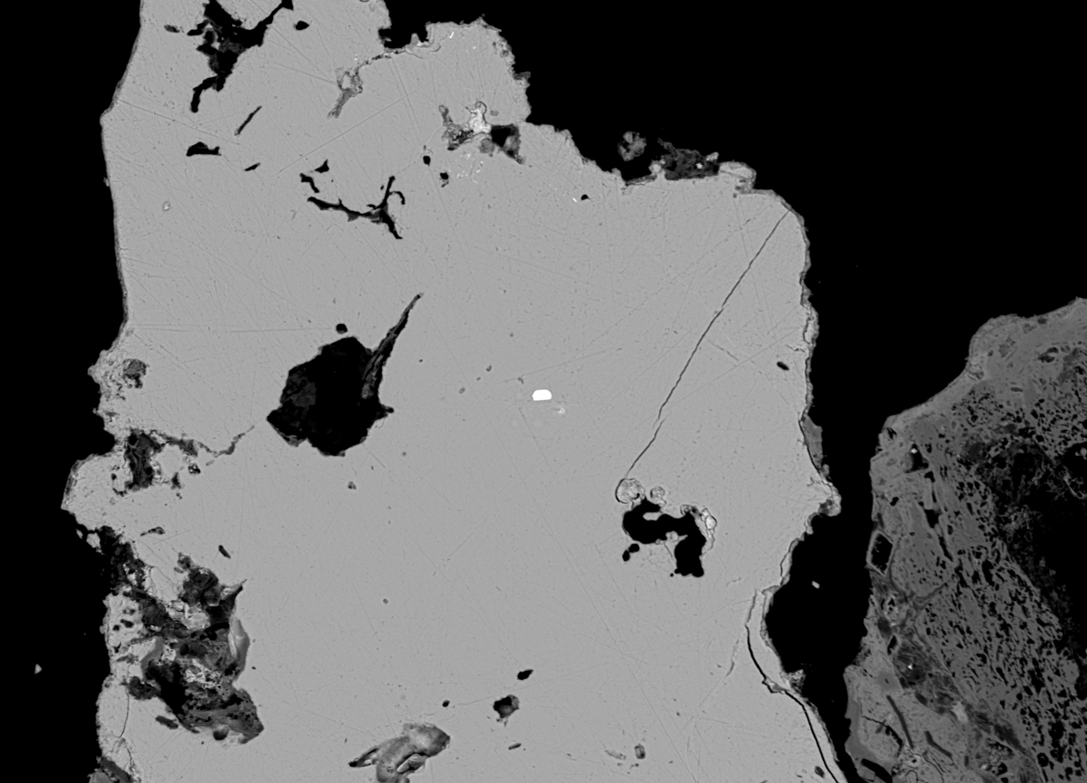
Thallium sulfosalts: SEM and microprobe
lor
fng
sco
orp
rel
100 μm
10 μm
Mineralogy: primary thallium minerals
Fangite (Tl₃AsS₄) filling the cracks in orpiment
Lorandite (TlAsS₂) intergrown with realgar and scorodite
lim
rag
Py
ppaul
rel
rel
100 μm
10 μm
Picotpaulite (TlFe₂S₃) and As-bearing pyrite in realgar
Raguiniter (TlFeS₂) embedded in realgar
11

Slide 12
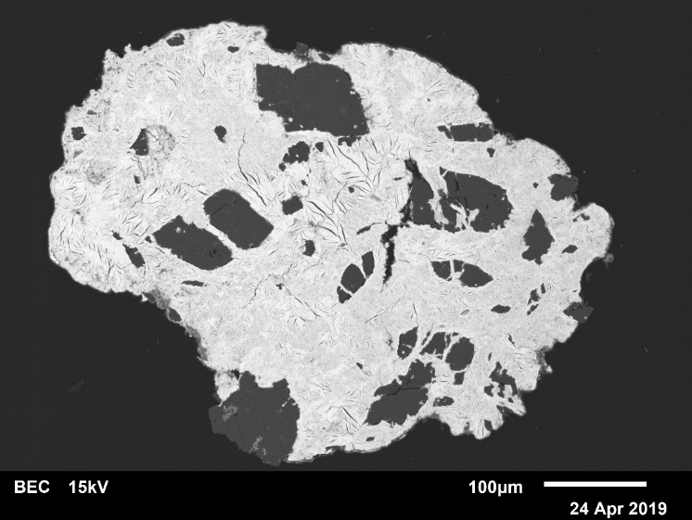
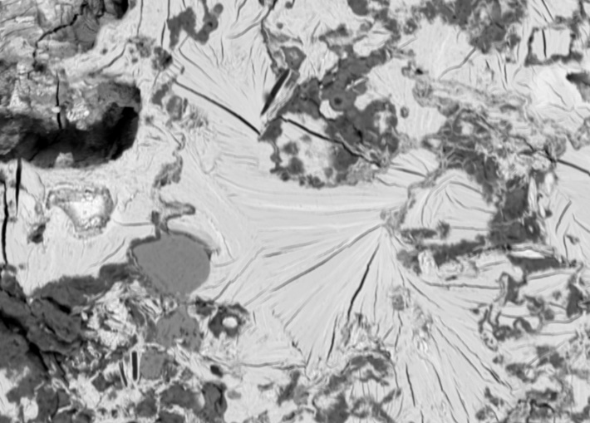
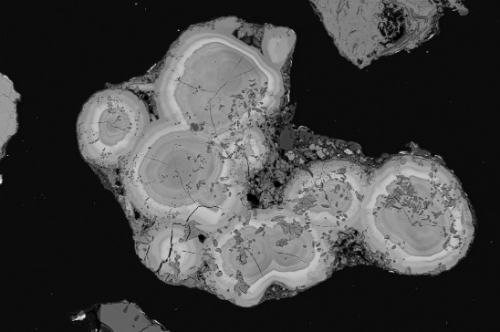
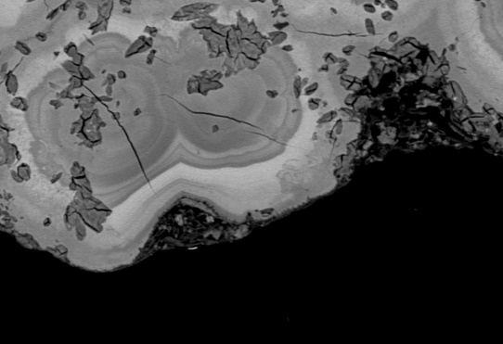
New thallium arsenate: SEM and microprobe
dol
asid
Tl-arsenate
asid
100 μm
10 μm
Mineralogy: thallium sources
Two generations of thallium arsenate (lighter and darker) intergrown with dolomite and arseniosiderite.
asid
Tl-arsenate
100 μm
10 μm
Zone builing of thallium arsenates intergrown with arseniosiderite.
12

Slide 13
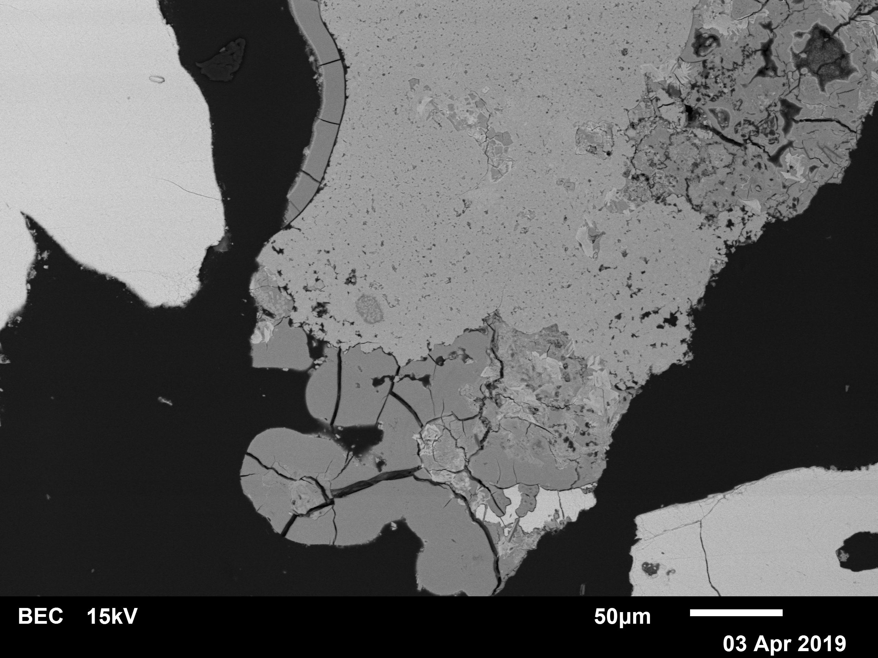
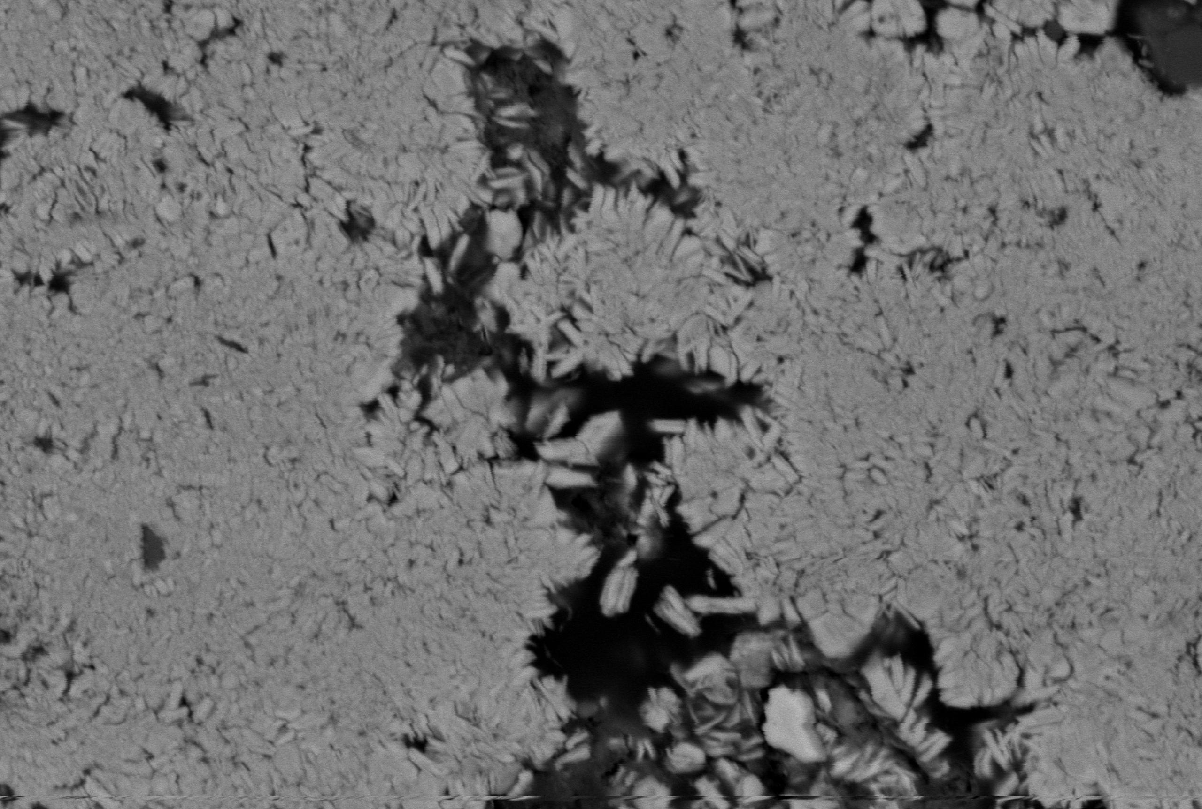
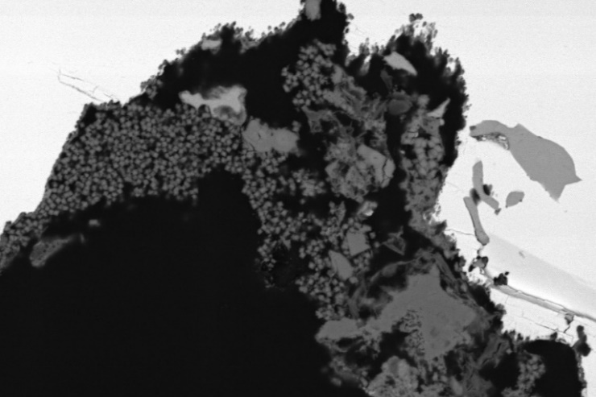
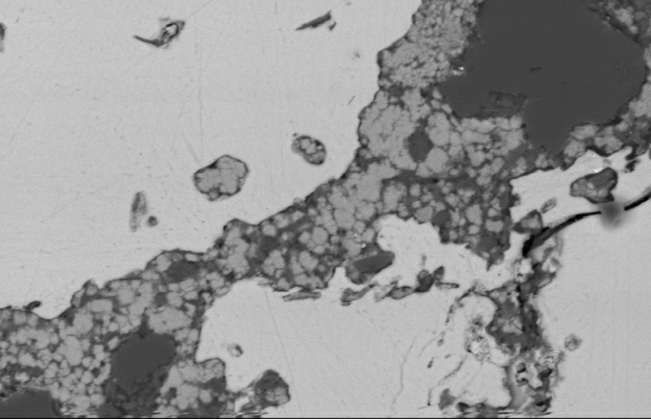
Dorallcharite and hydroniumjarosite: SEM and microprobe
doral
doral
FOH
10 μm
10 μm
Mineralogy: secondary thallium minerals
Fine-grained aggregates of dorallcahrite intergrown with Fe-oxo-hydroxides.
Dorallcharite, Tl_{0.8}K_{0.2}Fe₃(SO₄)₂(OH)₆ platelets
lor
dol
rel
doral
rel
hjar
sco
10 μm
10 μm
Tiny crystals of Tl-bearing hydroniumjarosite, (H₃O,Tl)Fe³⁺₃(SO₄)₂(OH)₆
Spherulitic aggreagtes of dorallcahrite in realgar.
13

Slide 14
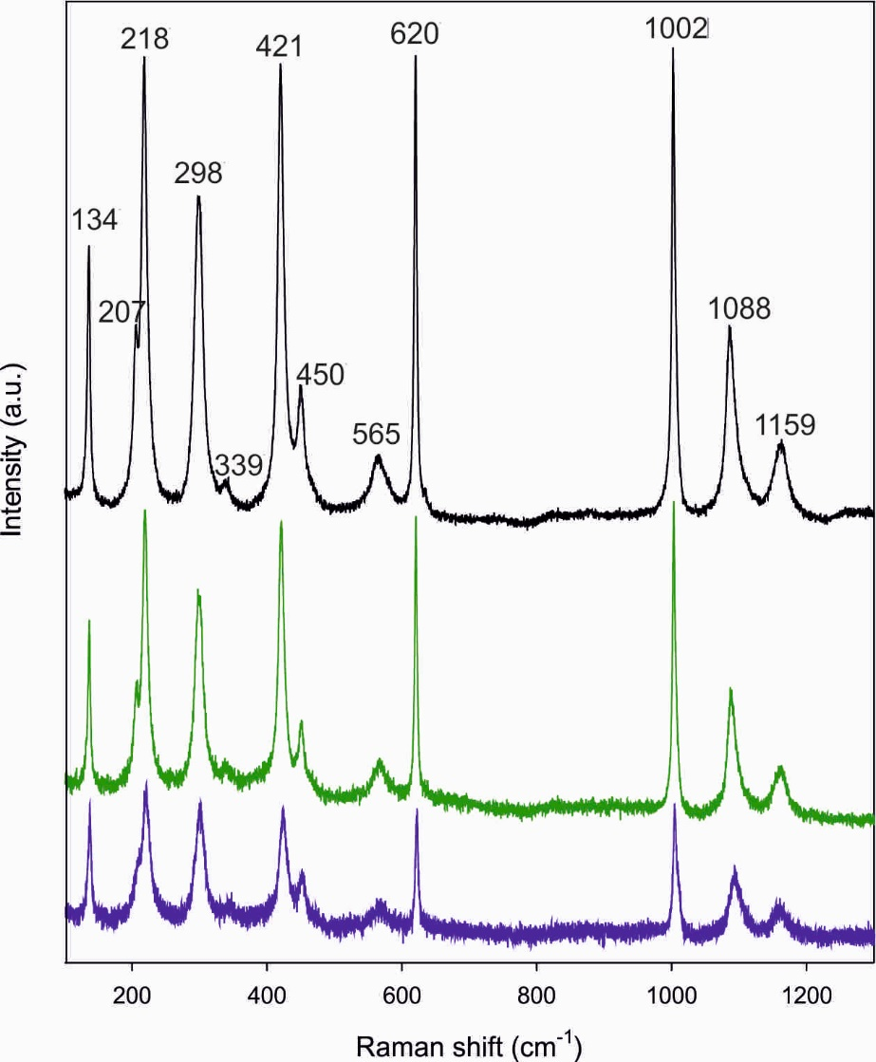
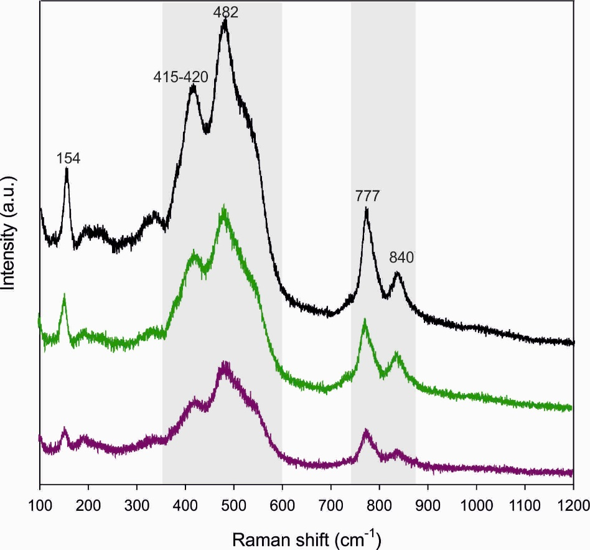
Raman spectra of thallium secondary minerals
Mineralogy: secondary thallium minerals
Thallium arsenate:
unknown mineral species
Dorallcharite-hydroniumjarosite,
Tl_{0.8}K_{0.2}Fe₃(SO₄)₂(OH)₆-(H₃O)Fe₃(SO₄)₂(OH)₆
14

Slide 15
Geochemistry: pore water
15

Slide 16
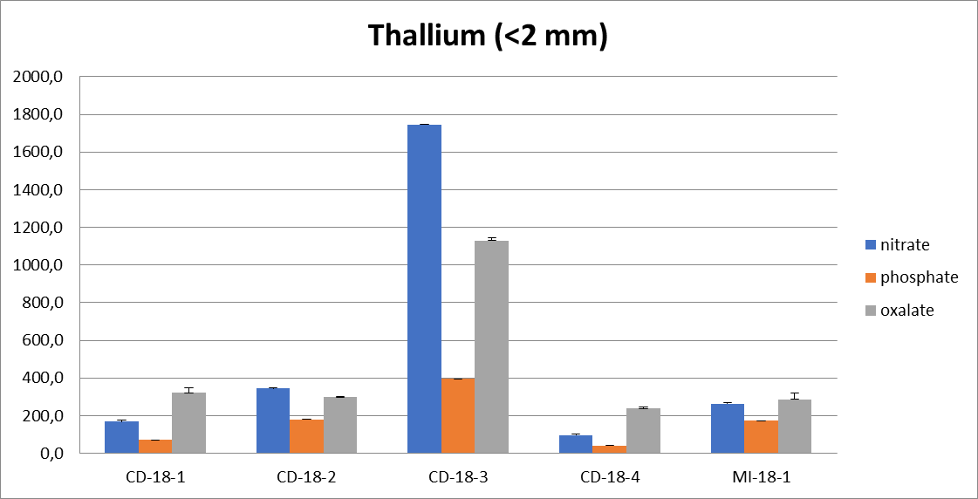
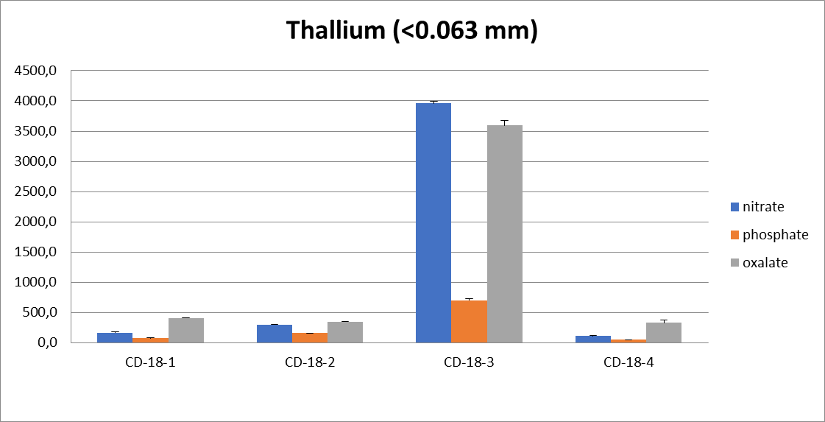
Geochemistry: extractions
16

Slide 17
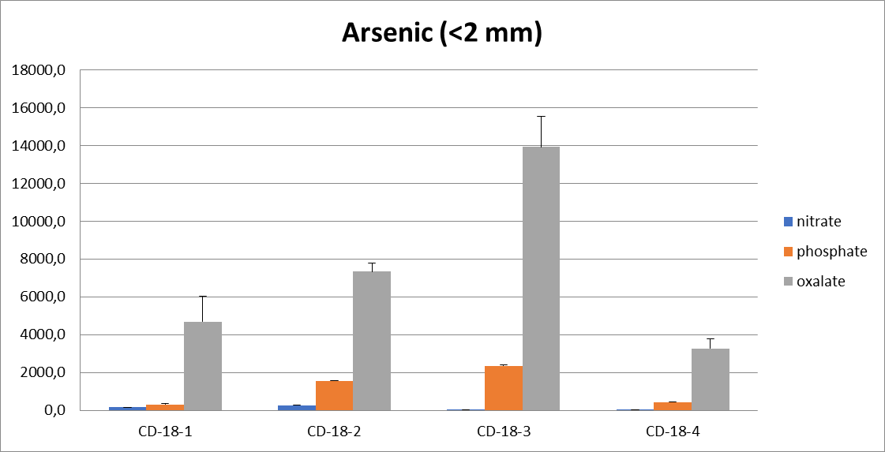
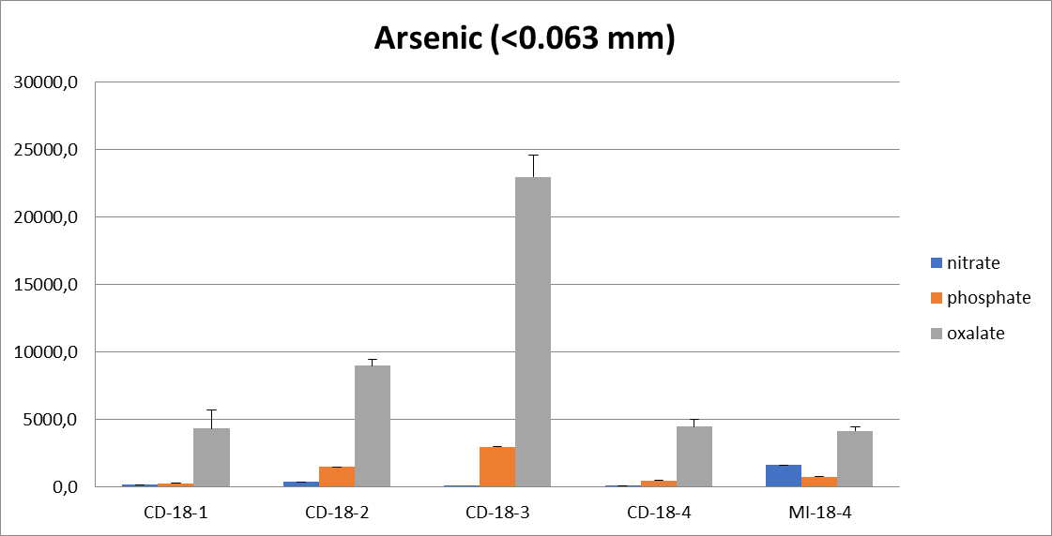
Geochemistry: extractions
17

Slide 18
Takeaways
weathering of primary Tl-minerals in the near-surface oxidizing, partly acidic and temporarily wet environment releases significant amounts of As and Tl which are hosted differently in the secondary minerals
thallium occured in several secondary forms (dorallcahrite, new thallium arsenate, Tl-bearing hydroniumjarosite and Tl-bearing pharmacosiderite) and is also associated with Mn-oxides
pore water contained high aqueous concentrations
of thallium and arsenic
mild extractions mobilized up to 44% of the total Tl and 23% of the total As, indicating that a large amount of these toxic elements is bound weakly to solids and can be easily mobilized into the pore water
18

Slide 19
Thank you for your interest!
Feel free to contact me for your comments and questions.
19
Financial support of the Austrian Science Fund (FWF) [P 30900-N28] is gratefully acknowledged

Slide 20

About the presenting author:
Tamara Đorđević is senior postdoctoral researcher and lecturer at the Institute of Mineralogy and Crystallography, University of Vienna. Her scientific interest focuses on: implementation of hydrothermal and ionothermal techniques for the synthesis of different classes of hydroxyl oxo- salts and hydrated oxo-salts; on the transformation of sulfidic mine wastes under environmentally relevant conditions; and on the development of structure-based hierarchies of various synthetic mineral-like oxo-salts in relationship to their environmental stability. She mostly teaches and mentors students in subjects associated with mineral synthesis and environmental mineralogy.
Her research topics encompass work implementing synthesis and crystallization techniques (hydrothermal/ionothermal crystal growth, solid-state synthesis), characterization of static and dynamic structures (electron microscopy including TEM and SEM, sXRD and pXRD, micro-Raman and IR spectroscopy) and geoscientific fieldwork. She was involved in fifteen scientific projects, in eleven of which she was a project leader.
Contact: tamara.djordjevic@univie.ac.at
www.univie.ac.at/Mineralogie/djordjevic.htm
20

