Slide 1
MHD simulation of solar flare by applying analytical energetic fast electron model
Wenzhi Ruan, Rony Keppens, Chun Xia

Slide 2
Introduction

Slide 3
Solar flare:
A large amount of energy (up to 10^32 erg) is released in a short time (several minutes)
SDO/AIA 131: 10 MK
https://svs.gsfc.nasa.gov/cgi-bin/details.cgi?aid=11043

Slide 4
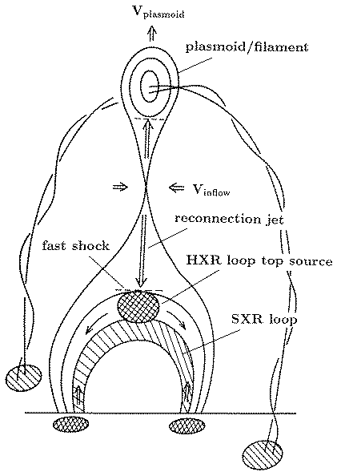
From Shibata (1995)
Standard flare model (CSHKP flare model)
Magnetic reconnection
SXR
Hot and fast outflows
and
Hot coronal loop

Slide 5
Hard X-ray (HXR) and high energy electrons
HXR (>10 keV) emission mechanism: Non-thermal electrons collide with ions/electrons in solar atmosphere (bremsstrahlung)
X-ray spectrum
From Veronig et al. (2010)
From Su et al. (2013)
HXR sources:
Footpoint sources and looptop source

Slide 6
Looptop HXR source: Non-thermal electrons are produced near the looptop
Bremsstrahlung efficiency ~
plasma density x non-thermal electron flux
Footpoint density >> looptop density
Fig from Kontar et al. (2017)
Why the Looptop source is comparable to the footpoint sources?
Looptop is thick target for fast electrons? (Krucker, 2008)
HXR emission is released by super-hot plasmas up to and beyond 100 million K? (Cheung et al., 2018)
Footpoint HXR sources:
The electrons move to footpoints along field lines

Slide 7
Method

Slide 8
Including the influence of non-thermal electron into 2.5D MHD simulation
The reconnection process and the evolution of flare loop is simulated with MHD model.
Multiple magnetic field lines (~1000) in the MHD model are tracing during the simulation.
We assume that some non-thermal electrons are produced in the reconnection outflow region.
The behaviors that the fast electrons in the field lines are analyzed with an analytic model.
The MHD model get feedback from the non-thermal electron model.
Acceleration site
Pitch angle ~ ${18}^{°}/{30}^{∘}$
Non-thermal electron deposition (for initial pitch angle of ${18}^{°}$)
Similar to what has been done in Bakke et al. (2018)

Slide 9
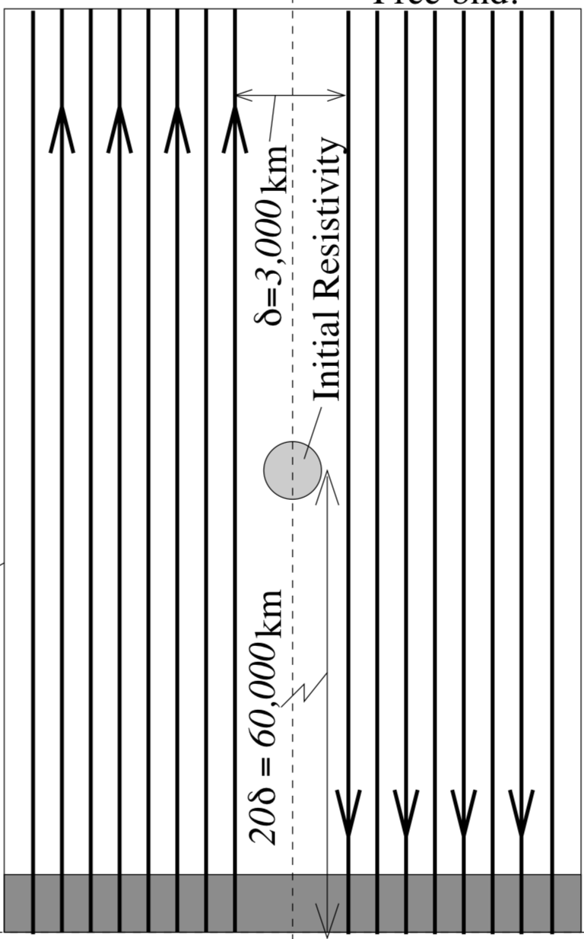
MHD reconnection model
We used the magnetic configuration in Yokoyama & Shibata (2001).
Reconnection is triggered with anomalous resistivity.
Thermal conduction, VAL-C temperature profile, gravity, radiative cooling and heating due to non-thermal electron deposition are included.
Analytic fast electron model
Similar to the model in Emslie (1978) but the pitch angle is given by

Slide 10
Results

Slide 11
Density $[{cm}^{−3}]$
Temperature $[MK]$
Velocity $[100 km/s]$

Slide 12
Initial pitch angle ~ ${18}^{°}$
Initial pitch angle ~${30}^{°}$
Color: Soft X-ray. Contour: Hard X-ray

Slide 13
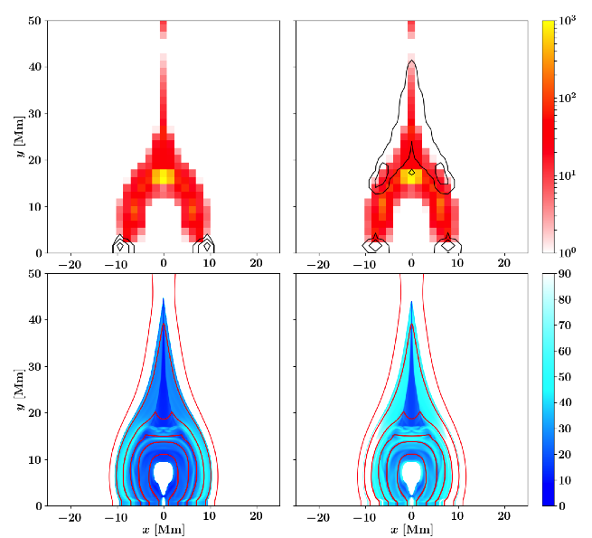
Initial pitch angle ~ ${18}^{°}$
Initial pitch angle ~${30}^{°}$
Looptop HXR source as a result of non-thermal particle trapping
Corresponding pitch angle of the fast electrons

Slide 14
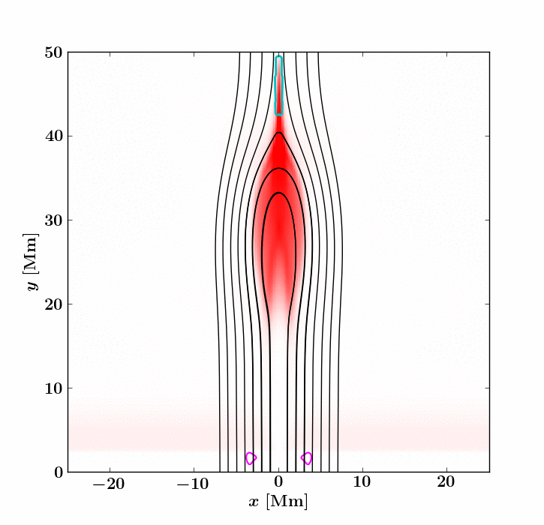
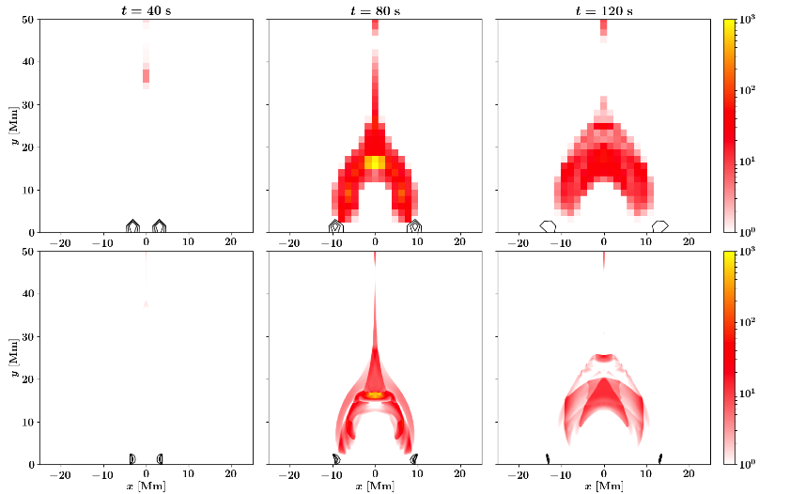
Initial pitch angle = ${18}^{°}$:Motion of footpoint HXR sources
Color: Soft X-ray. Contour: Hard X-ray
Motion of magnetic field lines
Acceleration site
Field lines
HXR sources moves in opposite directions
Deposition site

Slide 15
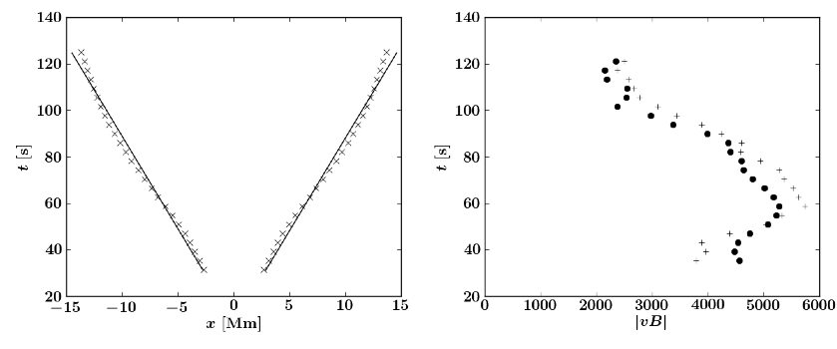
Initial pitch angle = ${18}^{°}$:HXR sources motion and reconnection inflow
inflow
$$v_{HXR}{ B}_{chrom}=v_{inflow}{ B}_{inflow}$$
It is possible to estimate the reconnection rate in solar flares with this equation. Similar equation has been proposed by Qiu et al. (2002).

Slide 16
Conclusions
The generation of looptop HXR source is a result of non-thermal electron trapping.
The footpoint HXR sources move in the opposite direction during the flare. The motion of the footpoint HXR sources can be used to estimate the reconnection rate.

Slide 17
Thank you for your attention!!

