Slide 1
Session GMPV9.5 – Volcanic processes: tectonics, deformation, geodesy, unrest
Unravelling rift development: a key study from the Northern Volcanic Zone of Iceland
Russo E.^{1,2*}, Tibaldi A.^{1,2}, Bonali F.L.^{1,2}, Pasquaré Mariotto F.³, Einarsson P.⁴, Hjartadottir A.R.⁴, Corti N.¹
¹ Department of Earth and Environmental Sciences, University of Milan-Bicocca, Milan, Italy
² CRUST- Interuniversity Center for 3D Seismotectonics with Territorial Applications, Italy
³ Department of Human and Innovation Sciences, Insubria University, Varese, Italy
⁴ Nordic Volcanological Center, Institute of Earth Sciences, University of Iceland, Reykjavík, Iceland

Slide 2
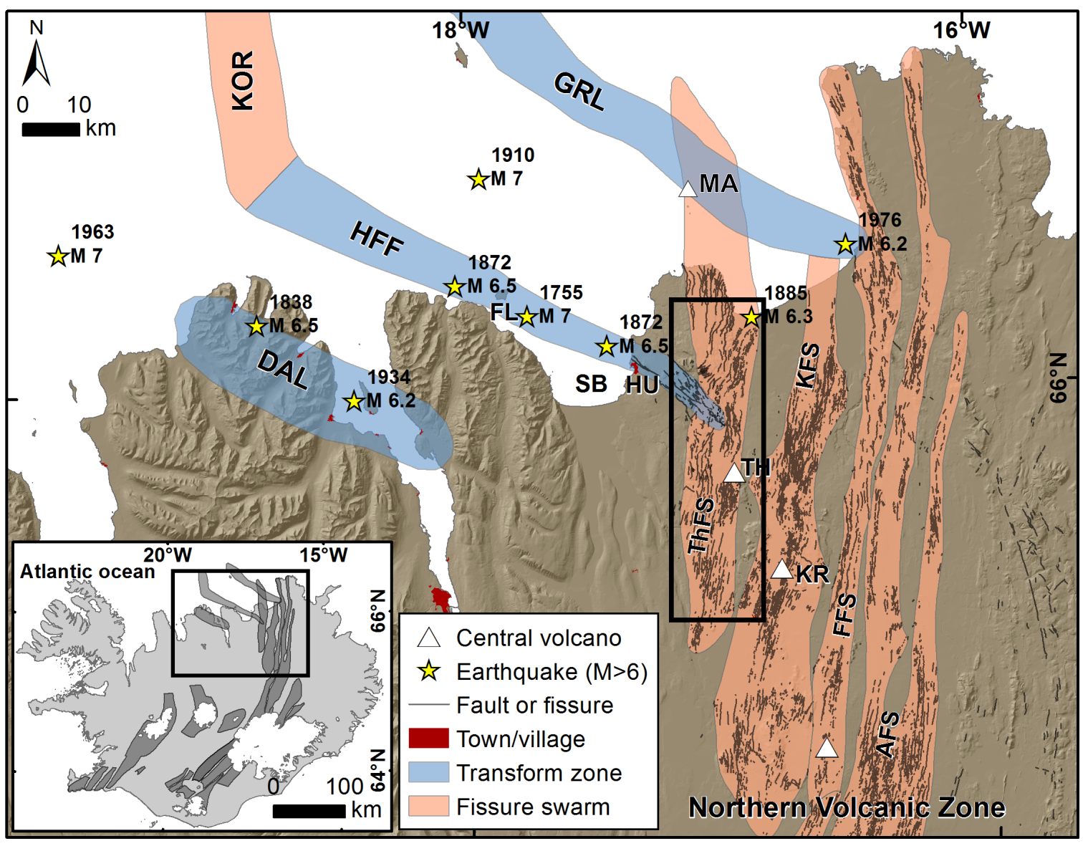
Research outline
Objectives
Perform an extremely detailed survey of the Holocene
deformation field along the Theistareykir Fissure Swarm (ThFS; Fig.A);
Investigate spatial changes on extension direction;
Detect lateral components of motion along structures
parallel and coeval to rift zones;
Study the interaction of normal faults and extension fractures
with the HFF.
Methodology
Classical field and Unmanned Aerial Vehicles surveys (performed over four years!)
focused on fault strike, dip and offset, and fracture strike, dip, dilation
direction and dilation amount (Fig.B).
6000 measurements at 1600 sites!!
A
B
© Authors. All rights reserved
Bonali et al., 2019

Slide 3
Conclusions
We identified a strong predominance of right-lateral component of motions at extension fractures parallel and coeval to the rift zone, with deviations as much as 40° from pure extension (Fig.C). This could be due to:
Horizontal (lateral) propagation of vertical dykes from the Theistareykir magma chamber;
Dragging along the Husavik Flatey Fault and the transtensional right-lateral Grimsey Lineament;
The regional least principal stress slightly oblique respect to the rift.
C
© Authors. All rights reserved

Slide 4
Conclusions
We observed a decrease of the cumulated dilation outward from the central volcano and of the number of structures could be explained by outward dykes propagation from the Theistareykir magma chamber: magma pressure decreases when magma is drawn away from the chamber, and thus the number of dykes that can reach far distances decreases;
Maximum uplift induced by magma inflation
(Metzger et al., 2011)
D
The northward and southward directions of faults propagation outward from the Theistareykir central volcano can be related to the inflating magma volume modeled as a Mogi source (magma chamber) at a depth of about 8.5 km, located at the centre of the area of maximum uplift (Metzger et al., 2011).
© Authors. All rights reserved
Tibaldi et al., 2019

Slide 5
Bibliography
Bonali, F. L., Tibaldi, A., Marchese, F., Fallati, L., Russo, E., Corselli, C., & Savini, A. (2019). UAV-based surveying in volcano-tectonics: An example from the Iceland rift. Journal of Structural Geology, 121, 46-64.
Metzger, S., Jónsson, S., & Geirsson, H. (2011). Locking depth and slip-rate of the Húsavík Flatey fault, North Iceland, derived from continuous GPS data 2006-2010. Geophysical Journal International, 187(2), 564-576.
Tibaldi, A., Bonali, F. L., Mariotto, F. P., Russo, E., & Tenti, L. R. (2019). The development of divergent margins: Insights from the North Volcanic Zone, Iceland. Earth and Planetary Science Letters, 509, 1-8.
Thank you!

