Slide 1
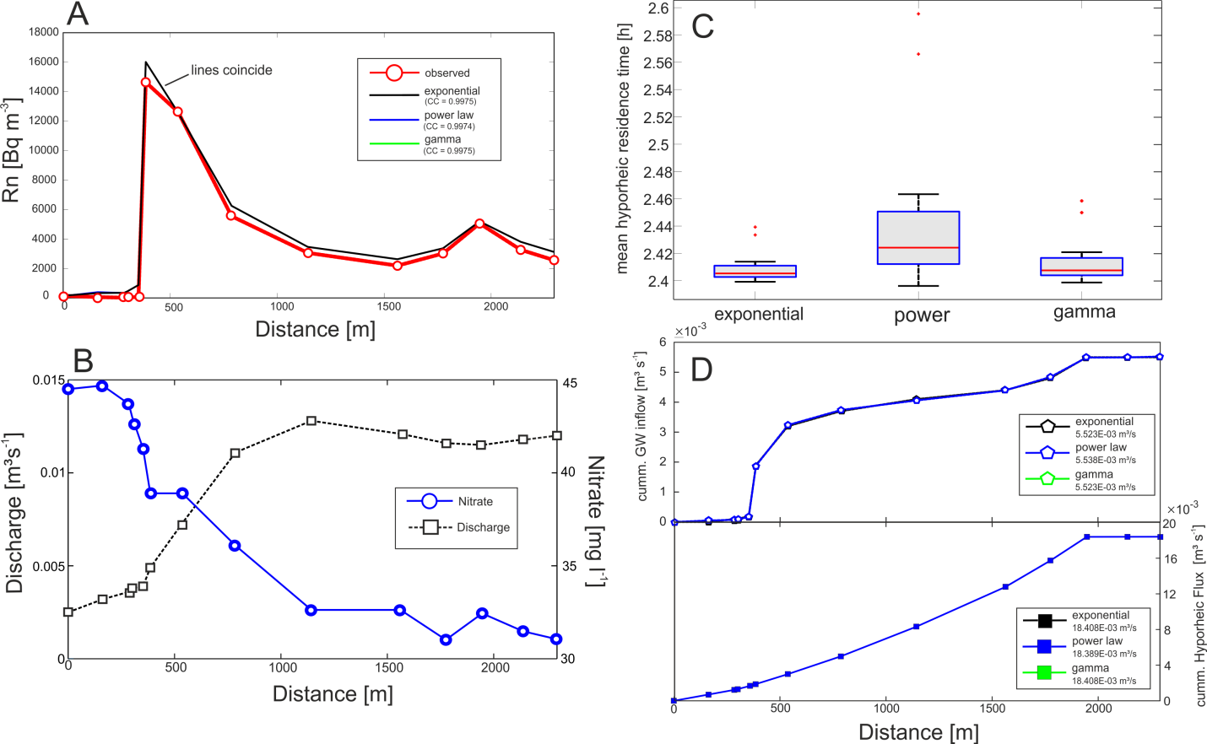
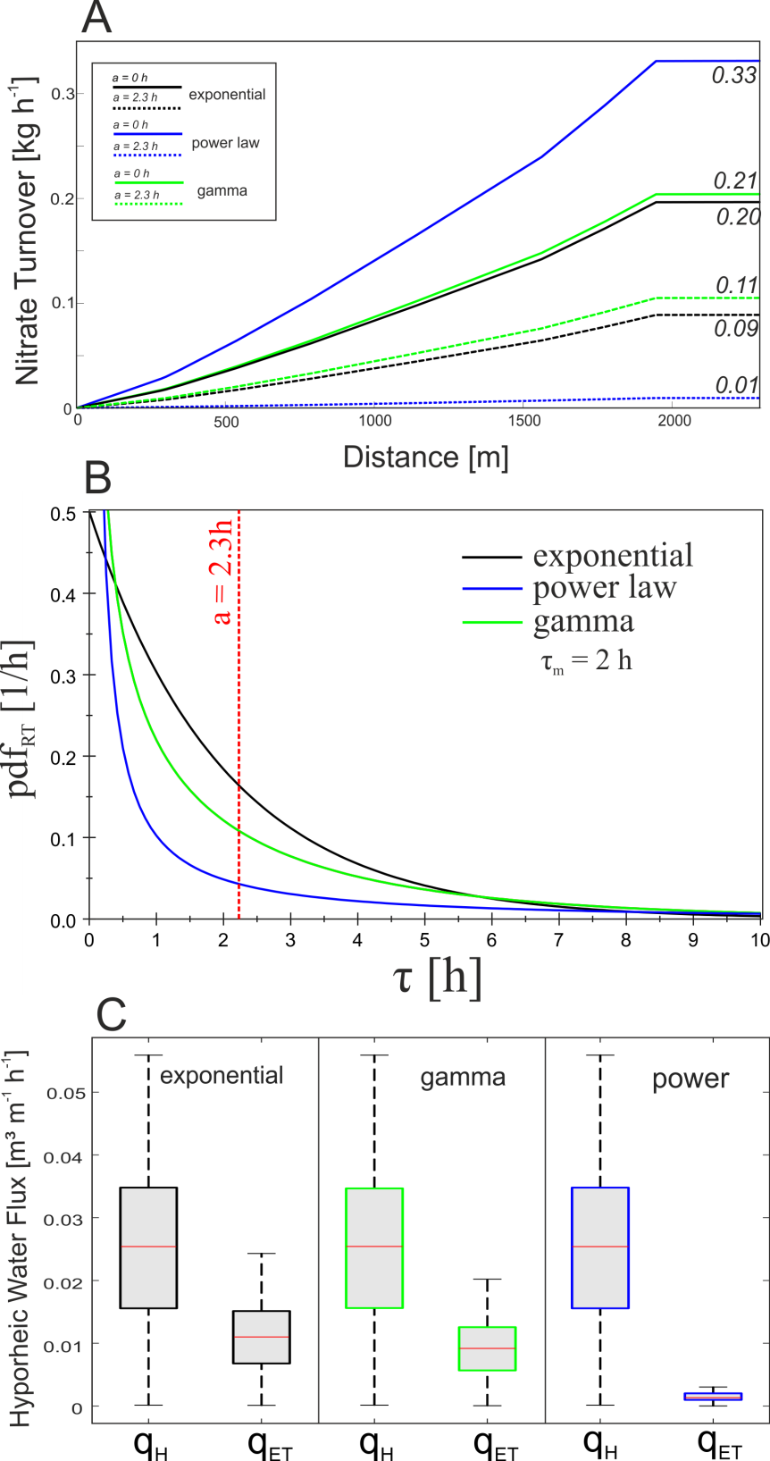
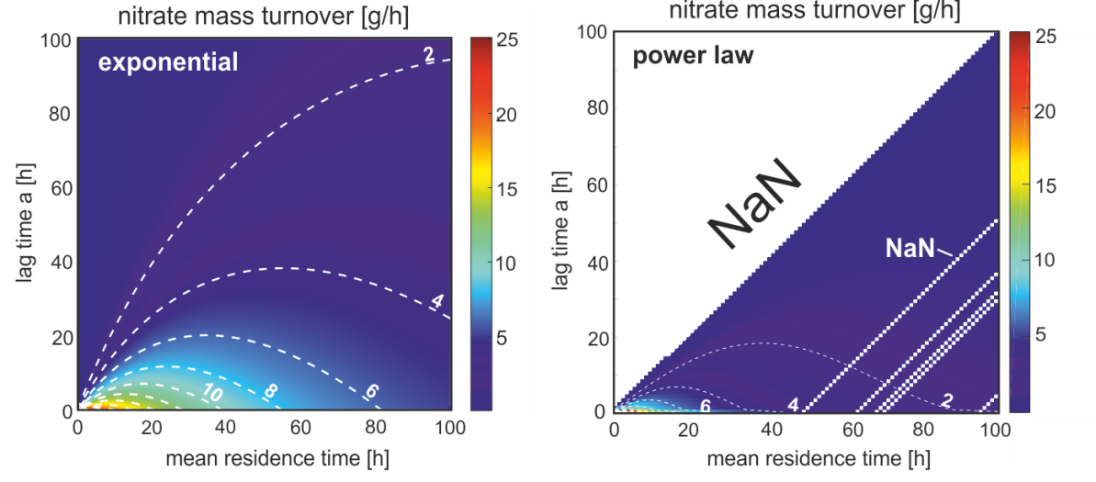
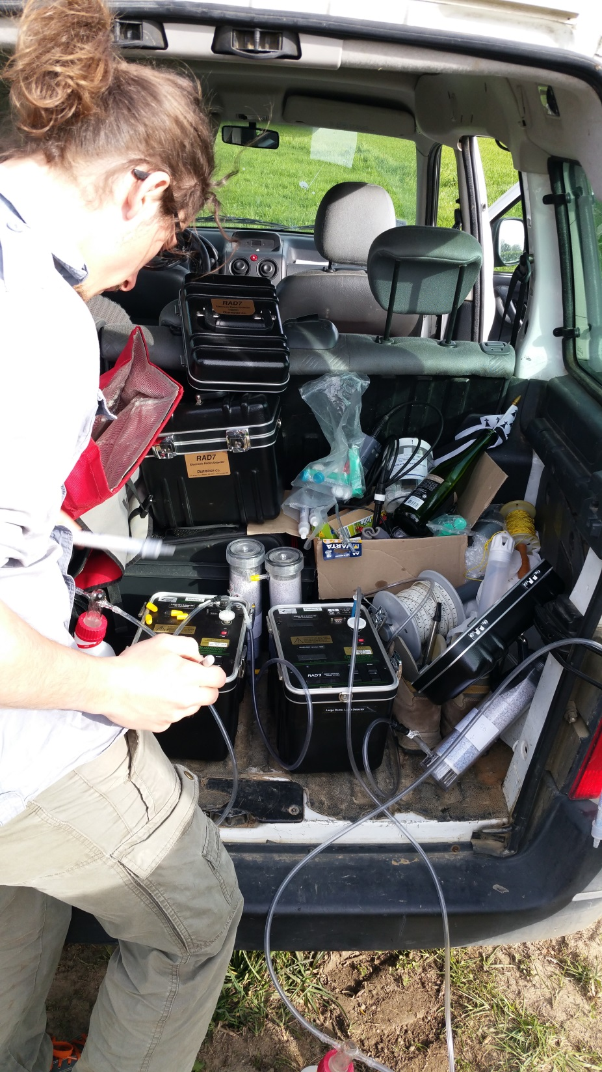
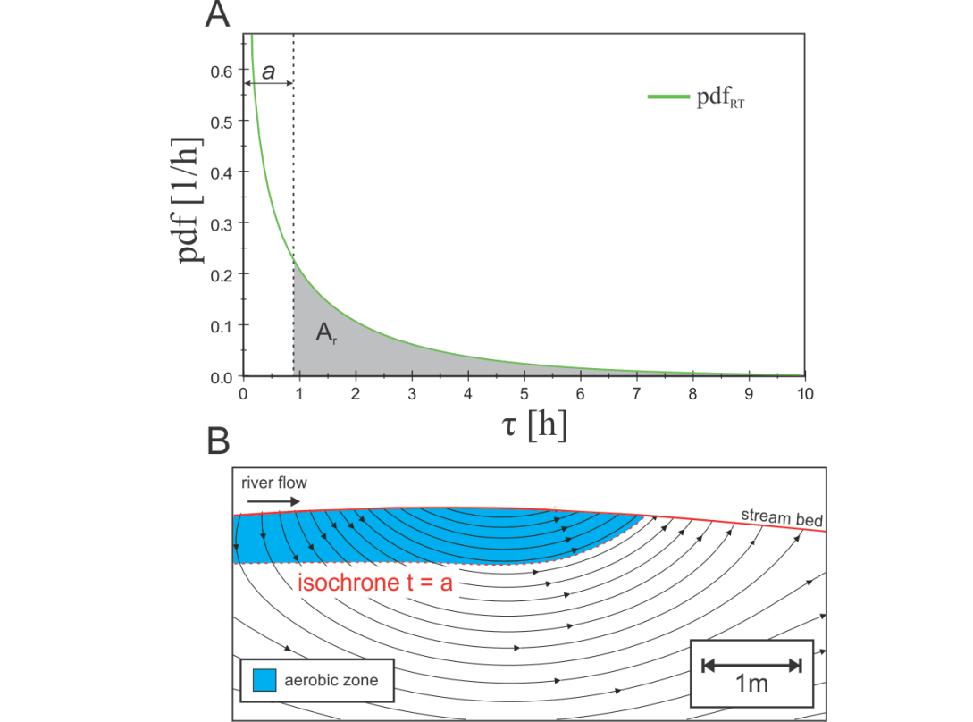
Exposure time vs. residence time in upscaling hyporheic nitrate loss
Benjamin Gilfedder¹, Stefan Durejka¹, Zahra Thomas², Hugo Le Ley² & Sven Frei¹
1. Limnologische Forschungsstation & Department of Hydrology, Universität Bayreuth, 2. UMR SAS, AGROCAMPUS OUEST, INRA, 35000 Rennes, France
benjamin-silas.gilfedder@uni-bayreuth.de
Questions
Answers
Can we use radon river surveys at catchment scale to estimate 1. Groundwater discharge, 2. Hyporheic parameters e.g. residence times?
How can we calculate nitrate loss in the HZ using this data?
What is the difference between residence times and exposure times for nitrate loss?
Radon sensitive tracer for detecting groundwater discharge to streams. Quantitative flux using mass-balance
Residence times (RT) and hyporheic exchange volume estimated in the fitting process using PEST
The RT distribution as a significant effect on the mean RT as well as nitrate loss in the hyporheic zone
Using the exposure time rather than RT reduces the hyporheic nitrate loss due to removal of large part of oxic flow paths
Hyporheic zone and nitrate reduction
Results and discussion
Hyporheic zone reactive area between groundwater and stream or river
Exchange of water and nutrients drives biogeochemistry
May act as a natural filter for redox sensitive elements such as NO₃⁻
Most measurements on small scales using tracer additions or pure modelling.
Previous studies assume RT=exposure time
Groundwater flux dominated by a single spring (Rn peak)
Residence time influenced by residence time distribution(pdf)
Hyporheic flux insensitive to pdf
Aims
Use radon as a natural tracer to:
Quantify groundwater discharge to Vilqué, a stream near Rennes
Estimate hyporheic parameters e.g. residence time (RT) of stream water in HZ
Use RT to calculate nitrate loss over reach scales using residence time distribution
Calculate nitrate loss by extending RT distribution to an exposure time distribution using a ‚lag‘ before NO₃⁻ reduction starts
Nitrate loss over 2.5 km reach 0.1-0.3 kg h⁻¹ using RT. Depends on pdf
Loss reduced to 0.01-0.2 kg h⁻¹ when incorporating exposure time due to O₂ availabiliy at top of hyporheic zone, limits nitrate reduction
Power law distrubuion effected most by exposure times due to large power weighting in short residence times
Methods
Field work
Radon mapping
Nitrate sampling
Discharge
Mass-loss only significant in small
area of RT-lag combinations
due to exposure timeslimiting reduction
Radon mass-balance
Solved inversly using PEST for I (groundwater flux) and hyporheic parameters α₁ and α_{2.} and fitted to Rn measurements.
Quantification of nitrate loss
Frei, S; Durejka, S; Le Lay, H; Thomas, Z; Gilfedder, B (2019): Quantification of Hyporheic Nitrate Removal at the Reach Scale: Exposure Times vs. Residence Times, Water Resources Research, DOI: https://doi.org/10.1029/2019WR025540

