Slide 1

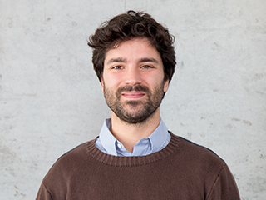

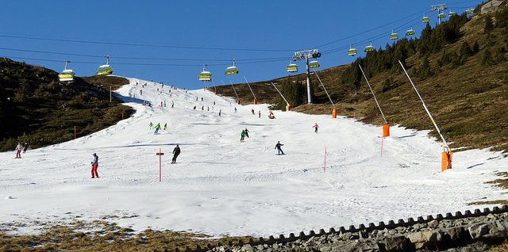
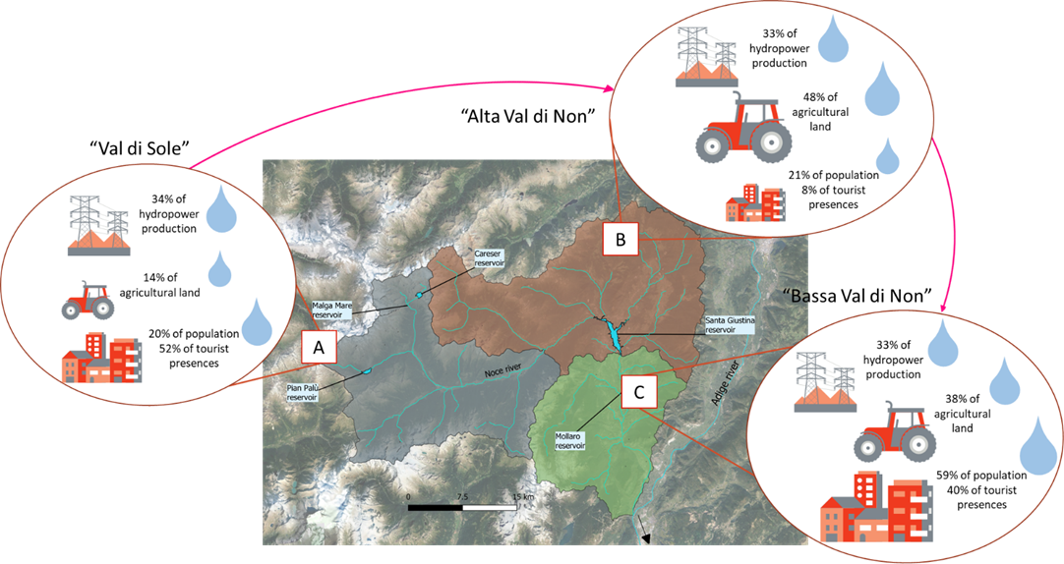
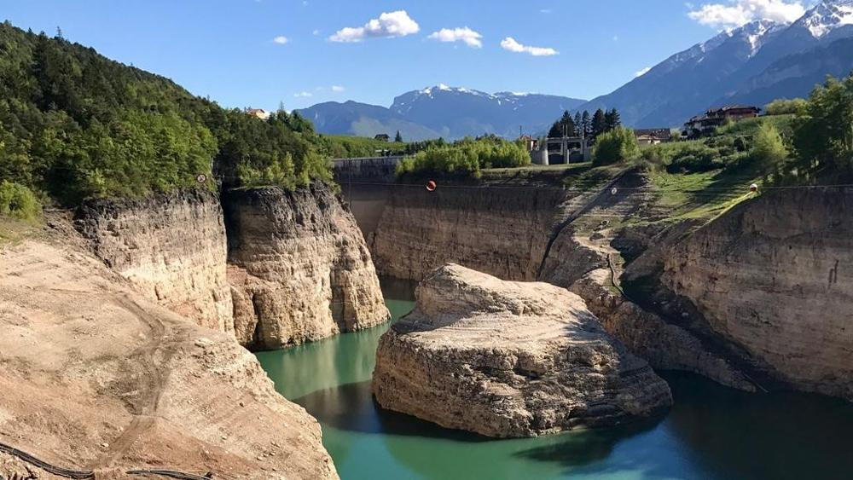
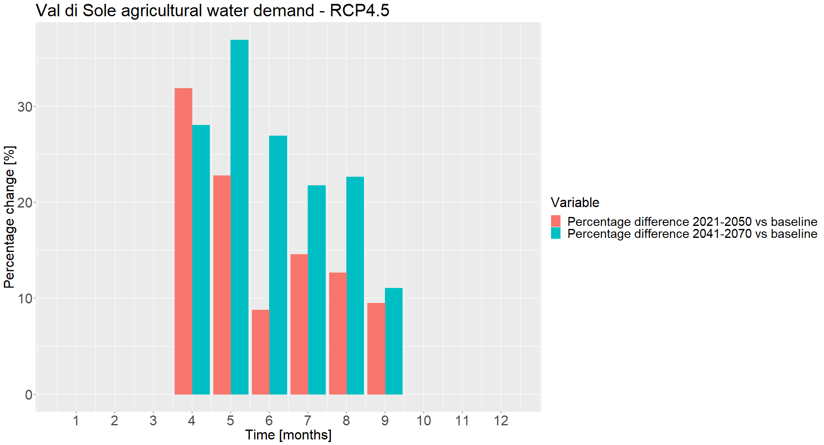
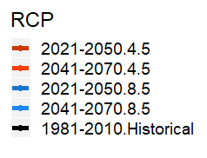
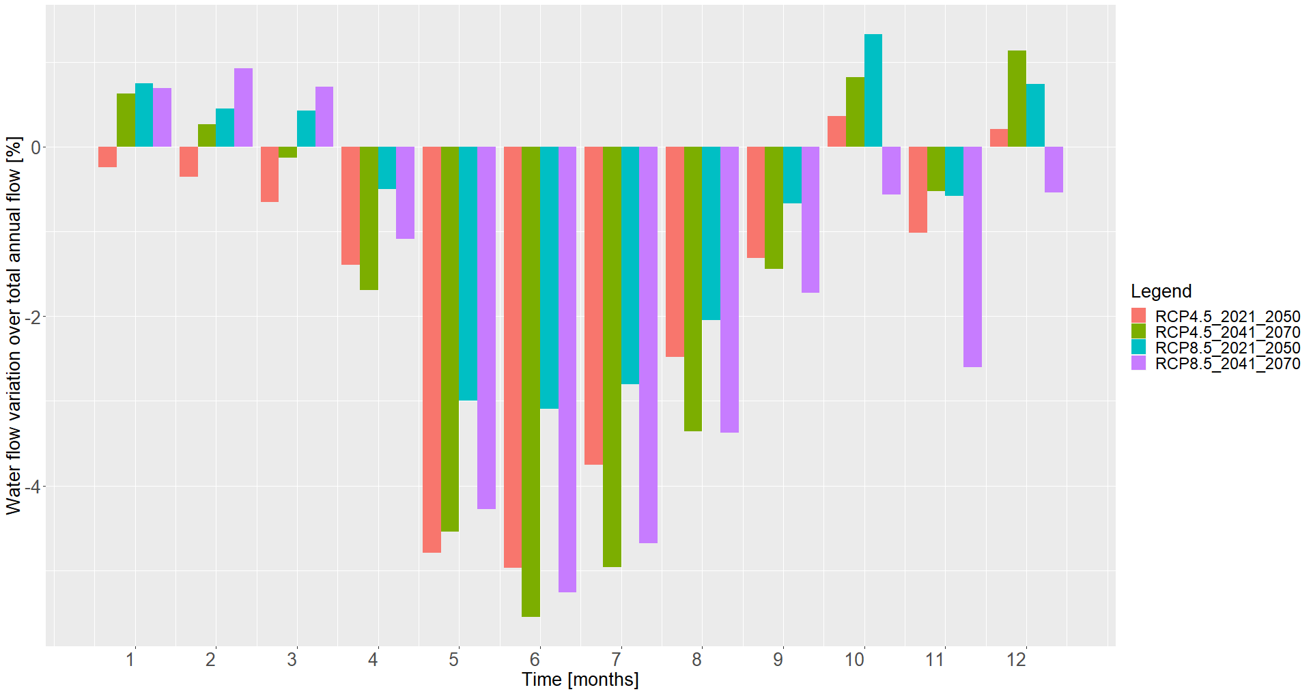
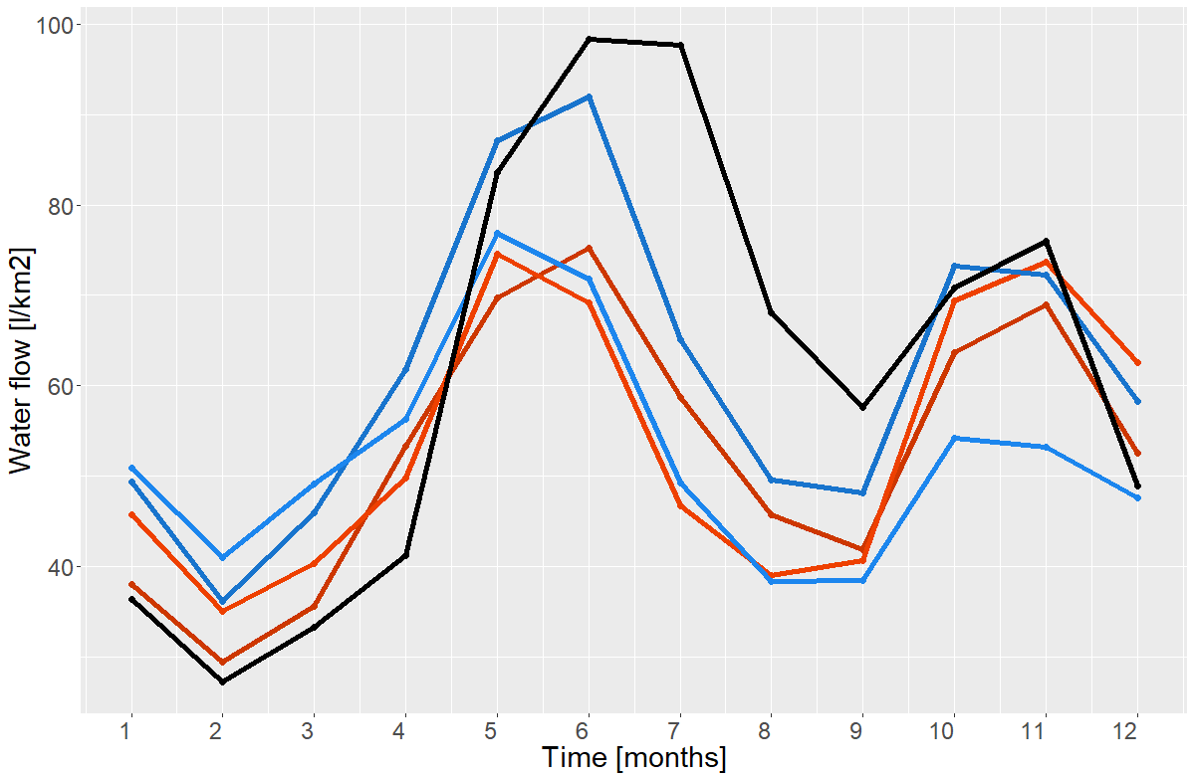
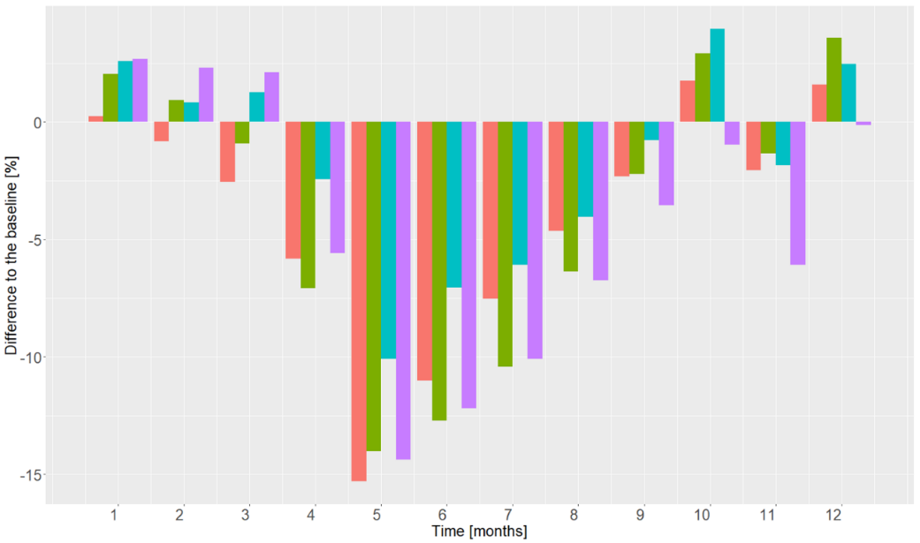
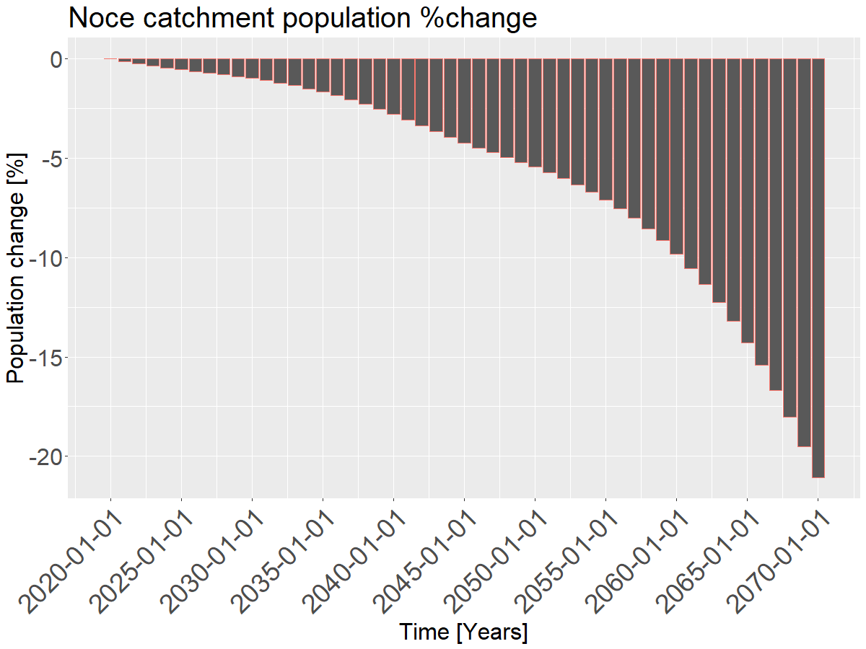


A multi-risk assessment of water scarcity in the south-eastern Italian Alps using a System Dynamics approach
Stefano Terzi
PhD candidate
stefano.terzi@eurac.edu
Terzi S.1,2, Sušnik J.3, Masia S. 3, Schneiderbauer S.2, Torresan S.4, Critto A.1,4
1Department of Environmental Sciences, Informatics and Statistics, University Ca' Foscari Venice, Via Torino 155, I-30172 Venezia-Mestre, Venice, Italy
2Eurac Research, Institute for Earth Observation, Viale Druso 1, 39100, Bolzano, Italy
3Integrated Water System and Governance Department, IHE Delft Institute for Water Education, 2601DA, Delft, Netherlands
4 Fondazione Centro-Euro Mediterraneo sui Cambiamenti Climatici (CMCC), via Augusto Imperatore 16, I-73100, Lecce, Italy
❶ Water scarcity in the Alps
❷ The Noce river case study (Italy)
Recent events mainly due to:
Contribute to improve water management and preparation for future conditions
From high water availability upstream to high water demand areas downstream:
Hydropower, agriculture, domestic and ecology are the main users at risk
Decreasing snowfall and relatively mild temperature in winter
Objectives
High water demand for agricultural, hydropower and domestic uses during spring and summer
Problem
Evaluate water availability and demand for climate scenarios
Anthropogenic pressures on water demand
Climate change effects on water availability
Case study subdivision in three areas with different water availability and demands
❸ System Dynamics Modelling
❹ Future scenarios
System dynamics models (SDM) describe how a complex system evolves during time representing variables accumulation and their fluxes variations through mass balance equations.
The integrated framework is bringing together different modelling approaches to quantify climate change effects on water availability and demand from different sectors.
Preliminary results from assessment of water availability and demand in different parts of the catchment.
4.2
Preliminary results!
Water demand
3.1
Hydropower:
Future reduction of turbined water (1 reservoir) up to
-5.6% for RCP 4.5 (2041-2070)
Agriculture: RCP4.5 scenario
+17% average percentage increase of RCP4.5 (2041-2070) for irrigation periods
Climate projections
COSMO-CLM - RCP 4.5 and 8.5,
Medium term: 2021-2050
Long term: 2041-2070
4.1
Water availability
GeoTransf hydrological model
3.3
Precipitation
System Dynamics modelling
Streamflow:
Peaks reduction
and
anticipation
Temperature
Hydropower
statistical model
(linear mixed effect model)
Reservoir volume
Water turbined
3.2
Hydropower demand
Hydrological modelling
GeoTransf model
(Noce catchment)
Agriculture
SIMETAW model
(soil and water balance)
Net water application
Agriculture demand
Streamflow
Population
statistical model
(linear mixed effect model)
Inhabitants
Tourists
Domestic
demand
Reservoirs volume: (1 reservoir)
Decrease up to -15% RCP4.5(2021-2050)
General decrease April-September
Minimum ecological flow
Domestic:
Projected population decrease
up to 21% over the whole
catchment could
counterbalance increase
of agricultural water
demand.
Ecology
threshold mechanisms
Ecological
demand
Total water availability
Total water demand
EGU – Online 4-8th May 2020
Follow me on Twitter to get updates on my research

