Slide 1






Polar Mesosphere Winter Echoes and their relation to infrasound
EGU Online General Assembly 2020 session AS1.21 - "Infrasound, acoustic-gravity waves, and atmospheric dynamics"
Evgenia Belova¹, Johan Kero¹, Sven Peter Näsholm², Ekaterina Vorobeva^{2,3}, Oleg A. Godin⁴, Victoria Barabash⁵,
Rita Kajtar⁵, and Alexis Le Pichon⁶
1 Swedish Institute of Space Physics, Kiruna, Sweden
2 NORSAR, Kjeller, Norway
3 Norwegian University of Science and Technology (NTNU), Tronheim, Norway
4 Naval Postgraduate School, Monterey, USA
5 Luleå University of Technology, Division of Space Technology, Kiruna, Sweden
6 CEA, DAM, DIF, Arpajon, France
© Authors
All rights reserved

Slide 2
Outline
  1. Introduction
  2. Recent PMWE cases with a high travel speed
  3. Mechanisms of PMWE generation related to infrasound
  4. Characteristics of microbaroms (0.1 – 0.3 Hz) observed at I37NO and with Kiruna microbarometers for the selected periods:
    amplitude
    trace velocity
    back azimuth
  5. Atmospheric and geophysical conditions in the mesosphere for the PMWE events
  6. Conclusions
© Authors
All rights reserved

Slide 3
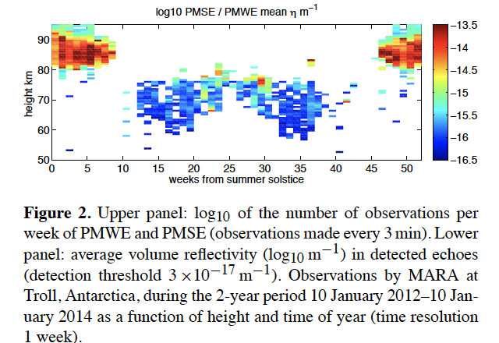
Polar Mesosphere Summer / Winter Echoes
PMSE/PMWE are strong signals observed by VHF/UHF radars from the mesospheric heights at polar latitudes during summer/non-summer seasons.
PMSE
PMSE
PMWE
Atmospheric radar MARA at Troll, Antarctica, 2012-2013 (Kirkwood et al, 2015)
© Authors
All rights reserved

Slide 4
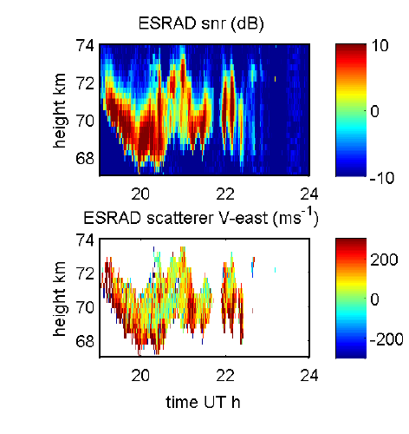
Polar Mesosphere Winter Echoes with high horizontal travel velocity
Some strong PMWE have high horizontal travel speed. Below there are PMWE as observed on 11 November 2004 with the ESRAD atmospheric radar in Kiruna, Swedish Arctic. The zonal velocity is > 300 m/s.
Kirkwood et al. 2006
© Authors
All rights reserved

Slide 5
Physical mechanisms of generation of PMWE with high horizontal travel velocity
  Scatterers moving at speeds of hundreds of m/s cannot be attributed to atmospheric turbulence or microparticles moving with wind.
  Hypothetical EM scattering mechanisms related to infrasound:
  -------------------------------------------------------
  1. Bragg scattering by viscous and thermal waves generated at infrasound reflection from temperature or wind velocity jumps (Hocking et al., 1991).
  2. Bragg scattering by viscous and thermal waves generated at microbarom propagation through regions with large wind shear or temperature gradients.
  3. Scattering by the Bragg component of the continuous spatial spectrum of an acoustic wave in a stratified atmosphere, particularly in the vicinity of caustics and turning points.
PRO and CONTRA arguments
-----------------------------------------------------
Atmosphere does not support stationary discontinuities in either temperature or wind velocity.
The speed and anisotropy of the scatterers are readily explained. Explanation of the observed PMWE strength requires very large gradients in the background neutral atmosphere or electron concentration.
The speed and anisotropy of the scatterers are readily explained. Explanation of the observed PMWE strength is achieved with realistic microbarom amplitudes.
© Authors
All rights reserved

Slide 6
Recent observations of PMWE with high horizontal speed > 300 m/s with the atmospheric radar ESRAD
ESRAD is located near Kiruna, northern Sweden.
© Authors
All rights reserved

Slide 7
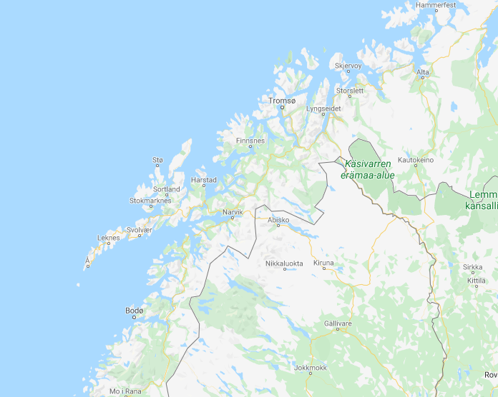
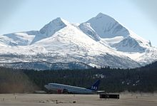
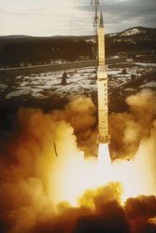
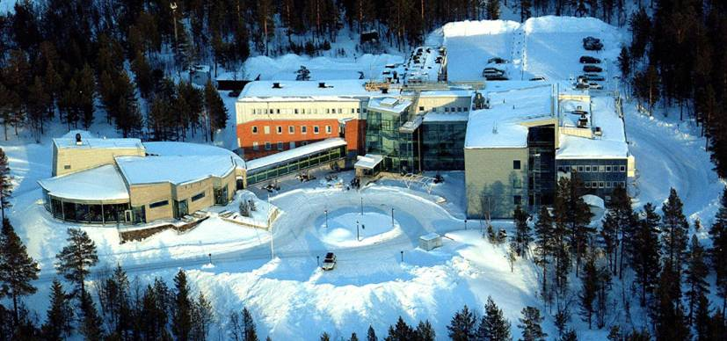
Observation geography
IS37@Bardufoss
Norway
ESRAD radar@Esrange
microbarometers@IRF
Sweden
© Authors
All rights reserved

Slide 8
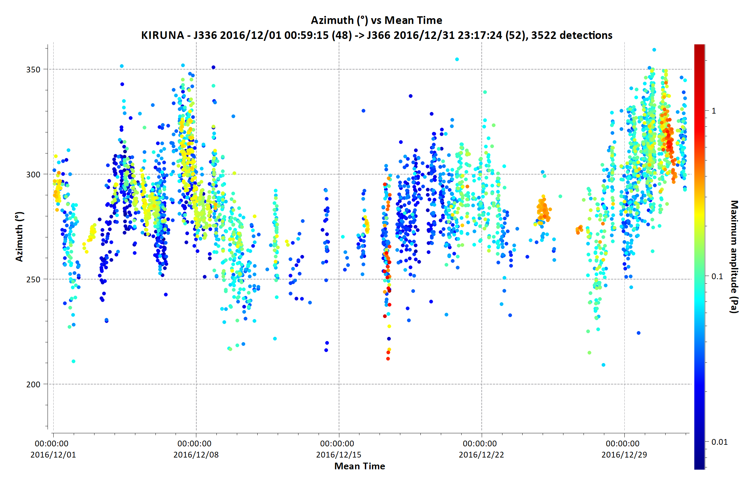
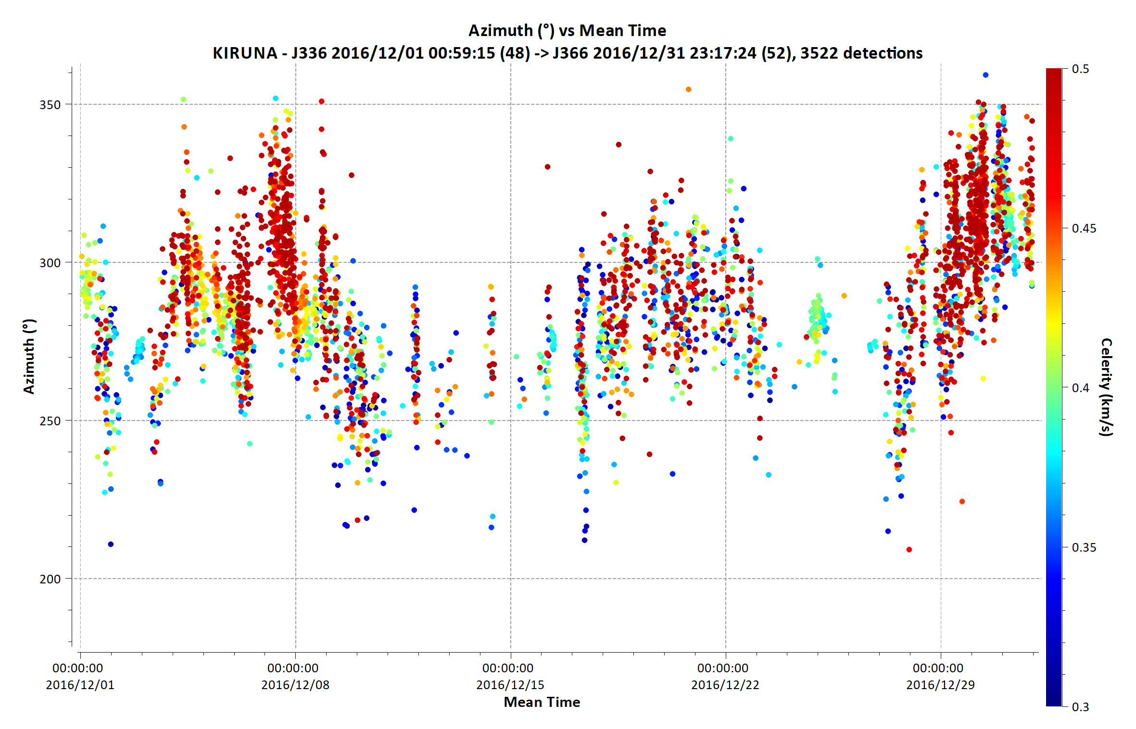
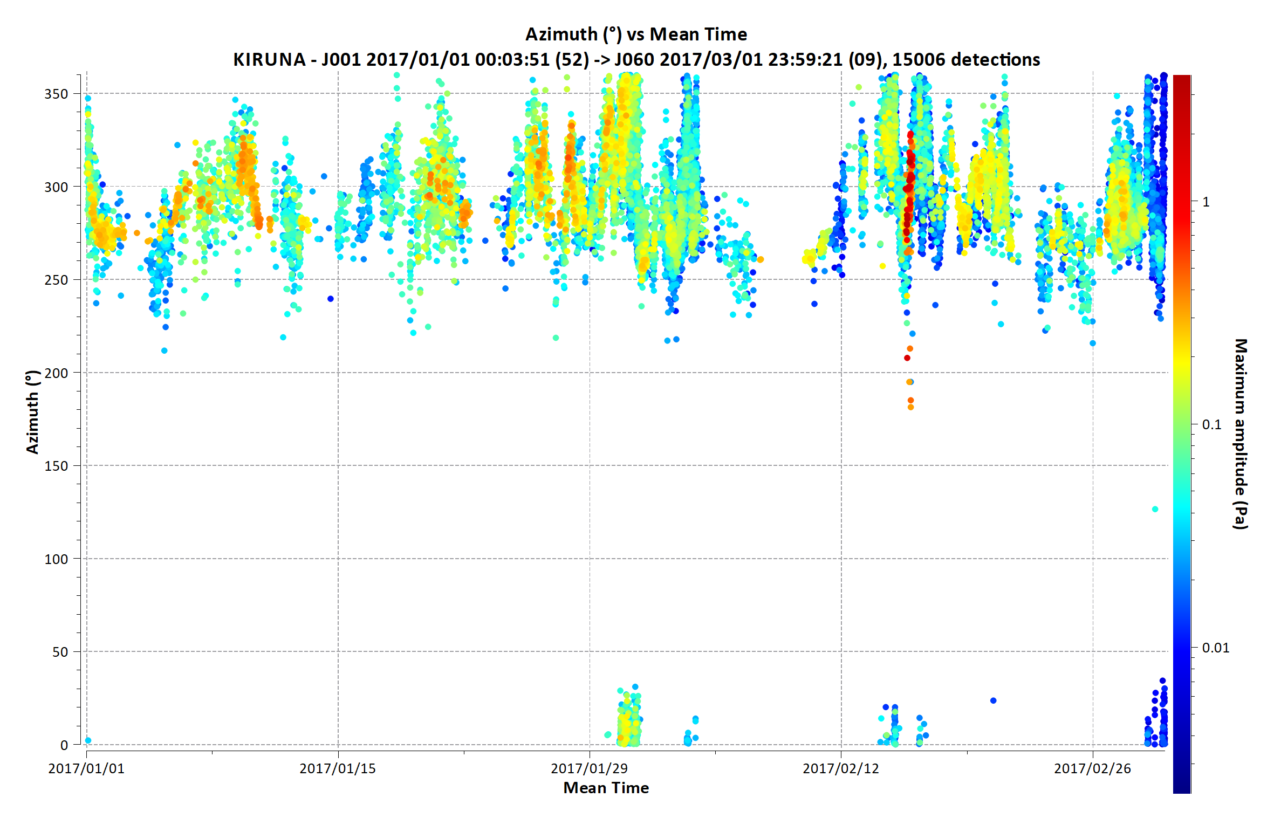
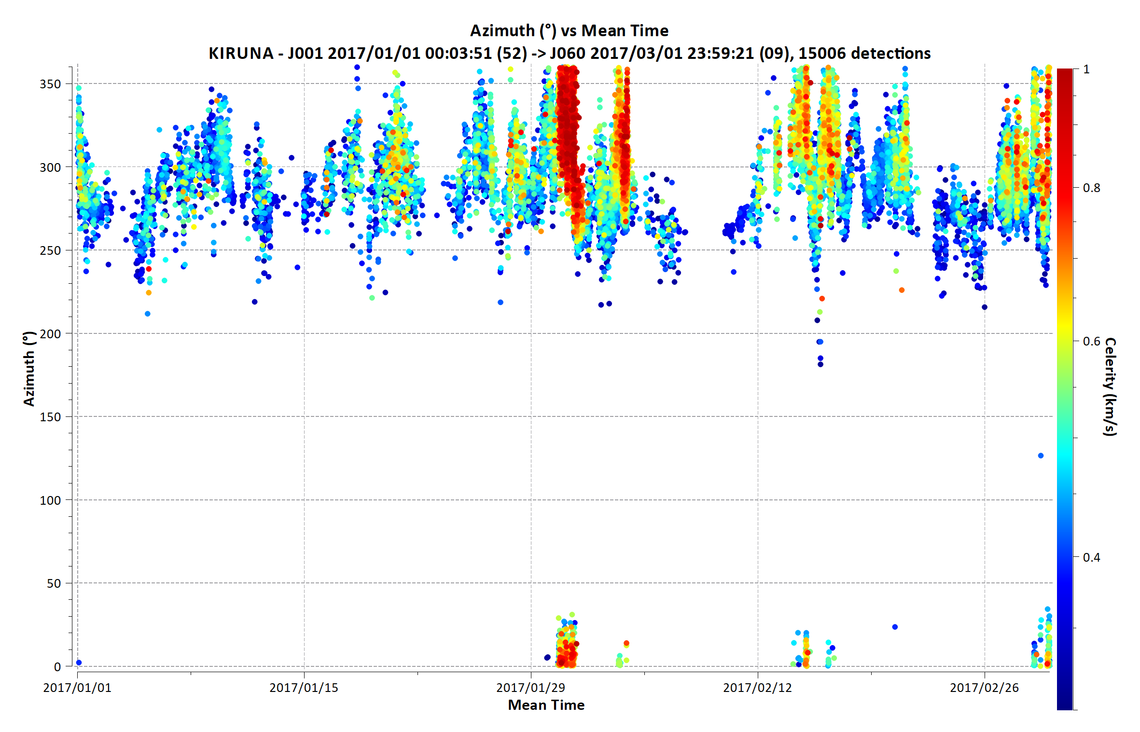
Amplitude, back-azimuth and trace velocity of microbaroms at 0.1-0.3 Hz at Kiruna station (67.5°N 20.1°E)
Amplitude >0.1 Pa
Trace velocity >0.4 km/s
22 Dec 2016
Amplitude 1 Pa
Trace velocity >0.5 km/s
27 Jan 2017
© Authors
All rights reserved

Slide 9
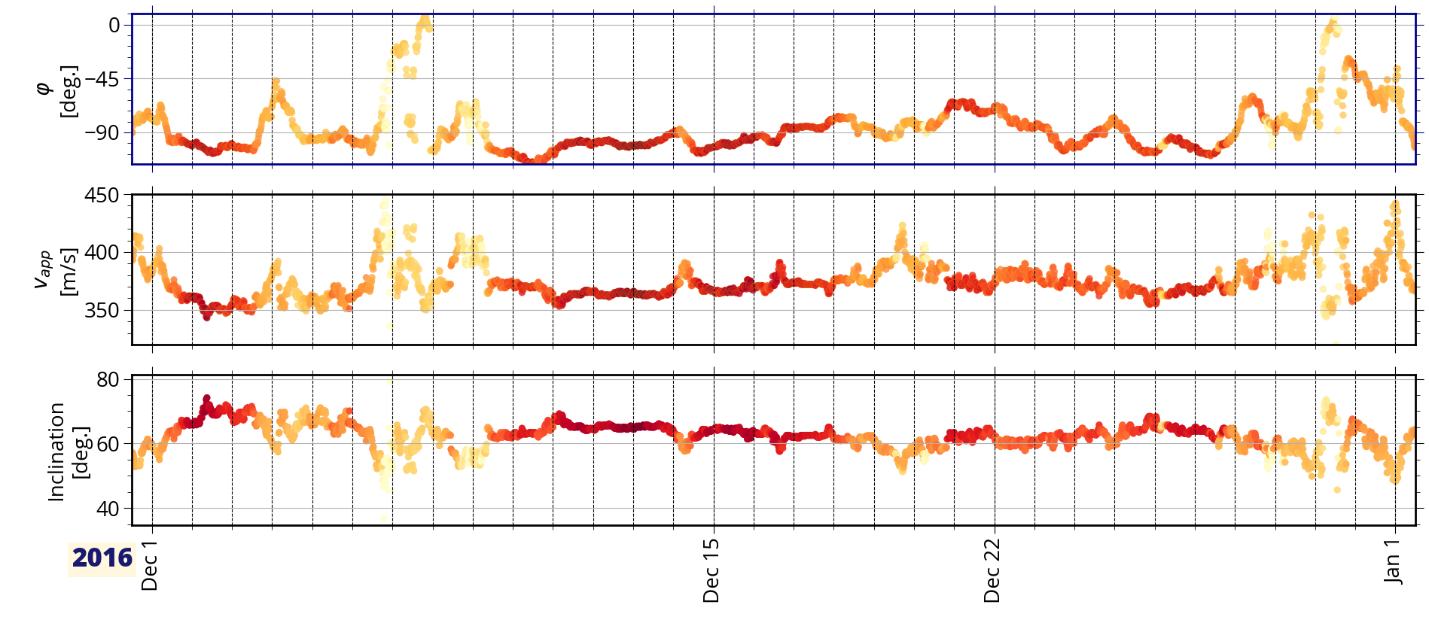
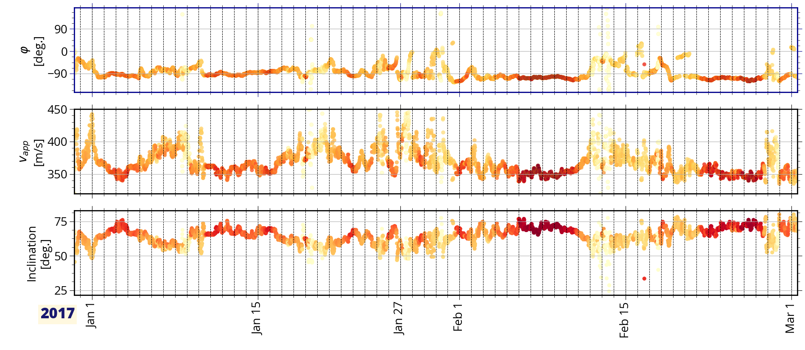
Back-azimuth, trace velocity and inclination angle of microbaroms at 0.15-0.25 Hz at IS37 (69°N 18°E)
22 Dec 2016
27 Jan 2017
© Authors
All rights reserved
Color indicates coherence over the array

Slide 10
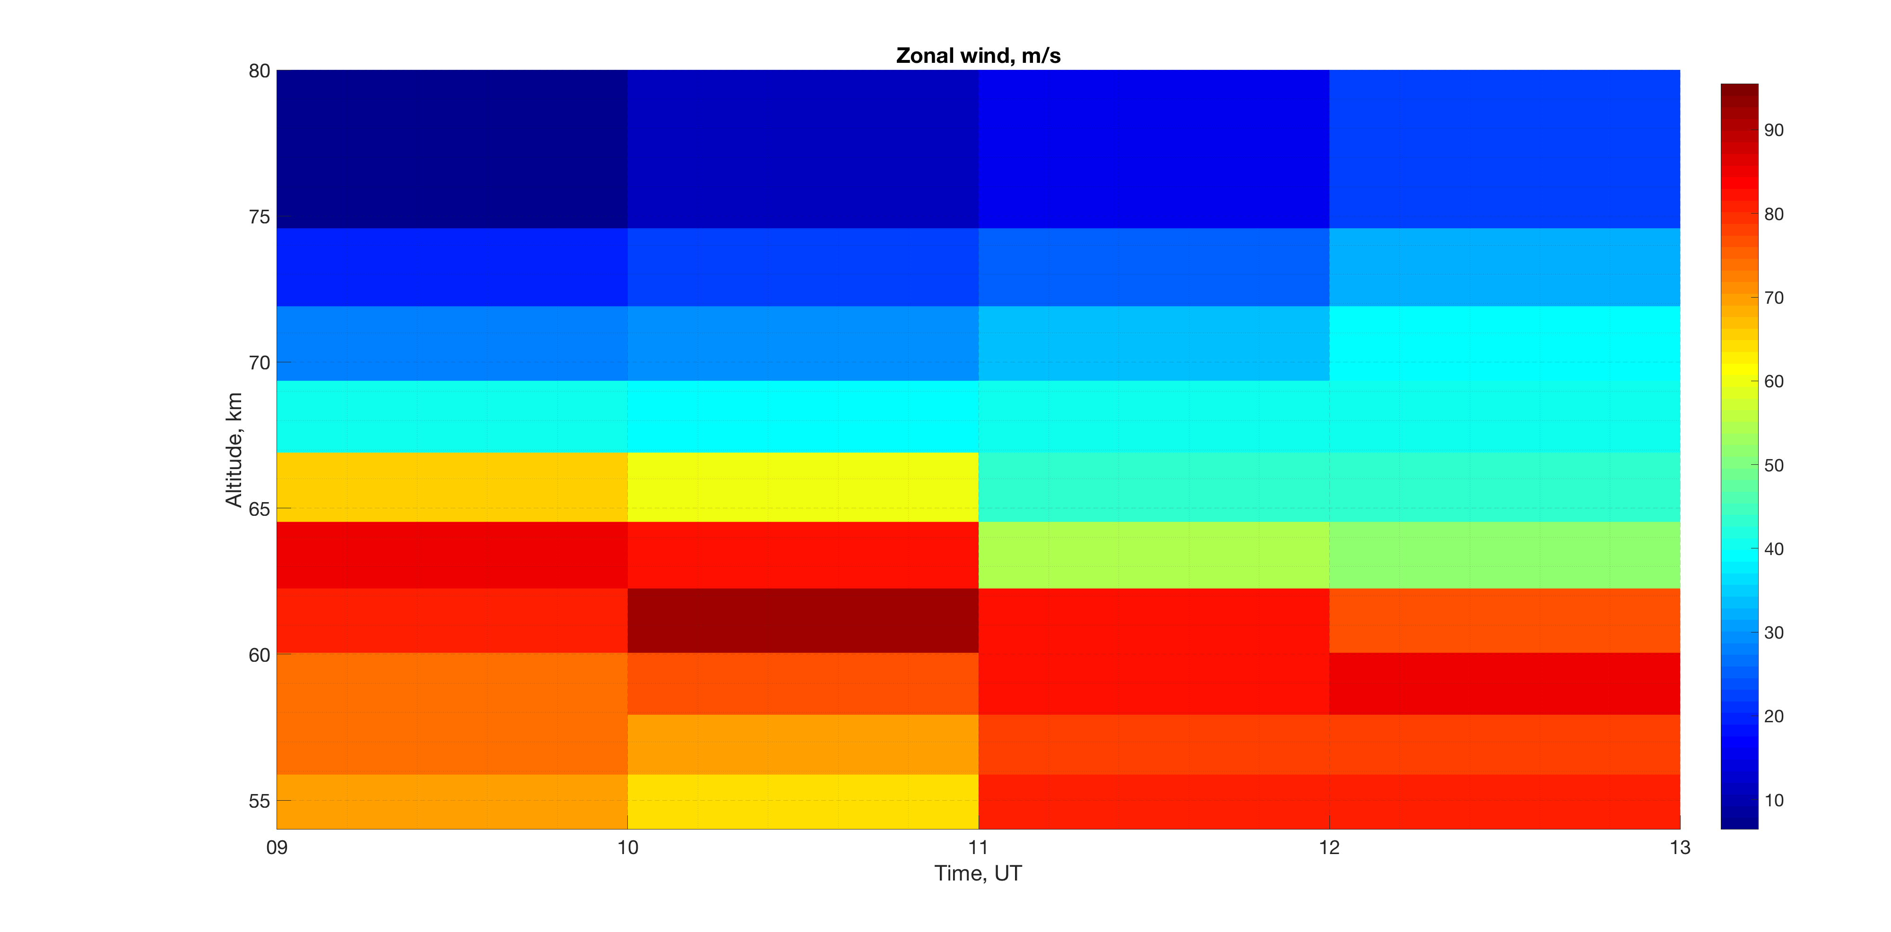
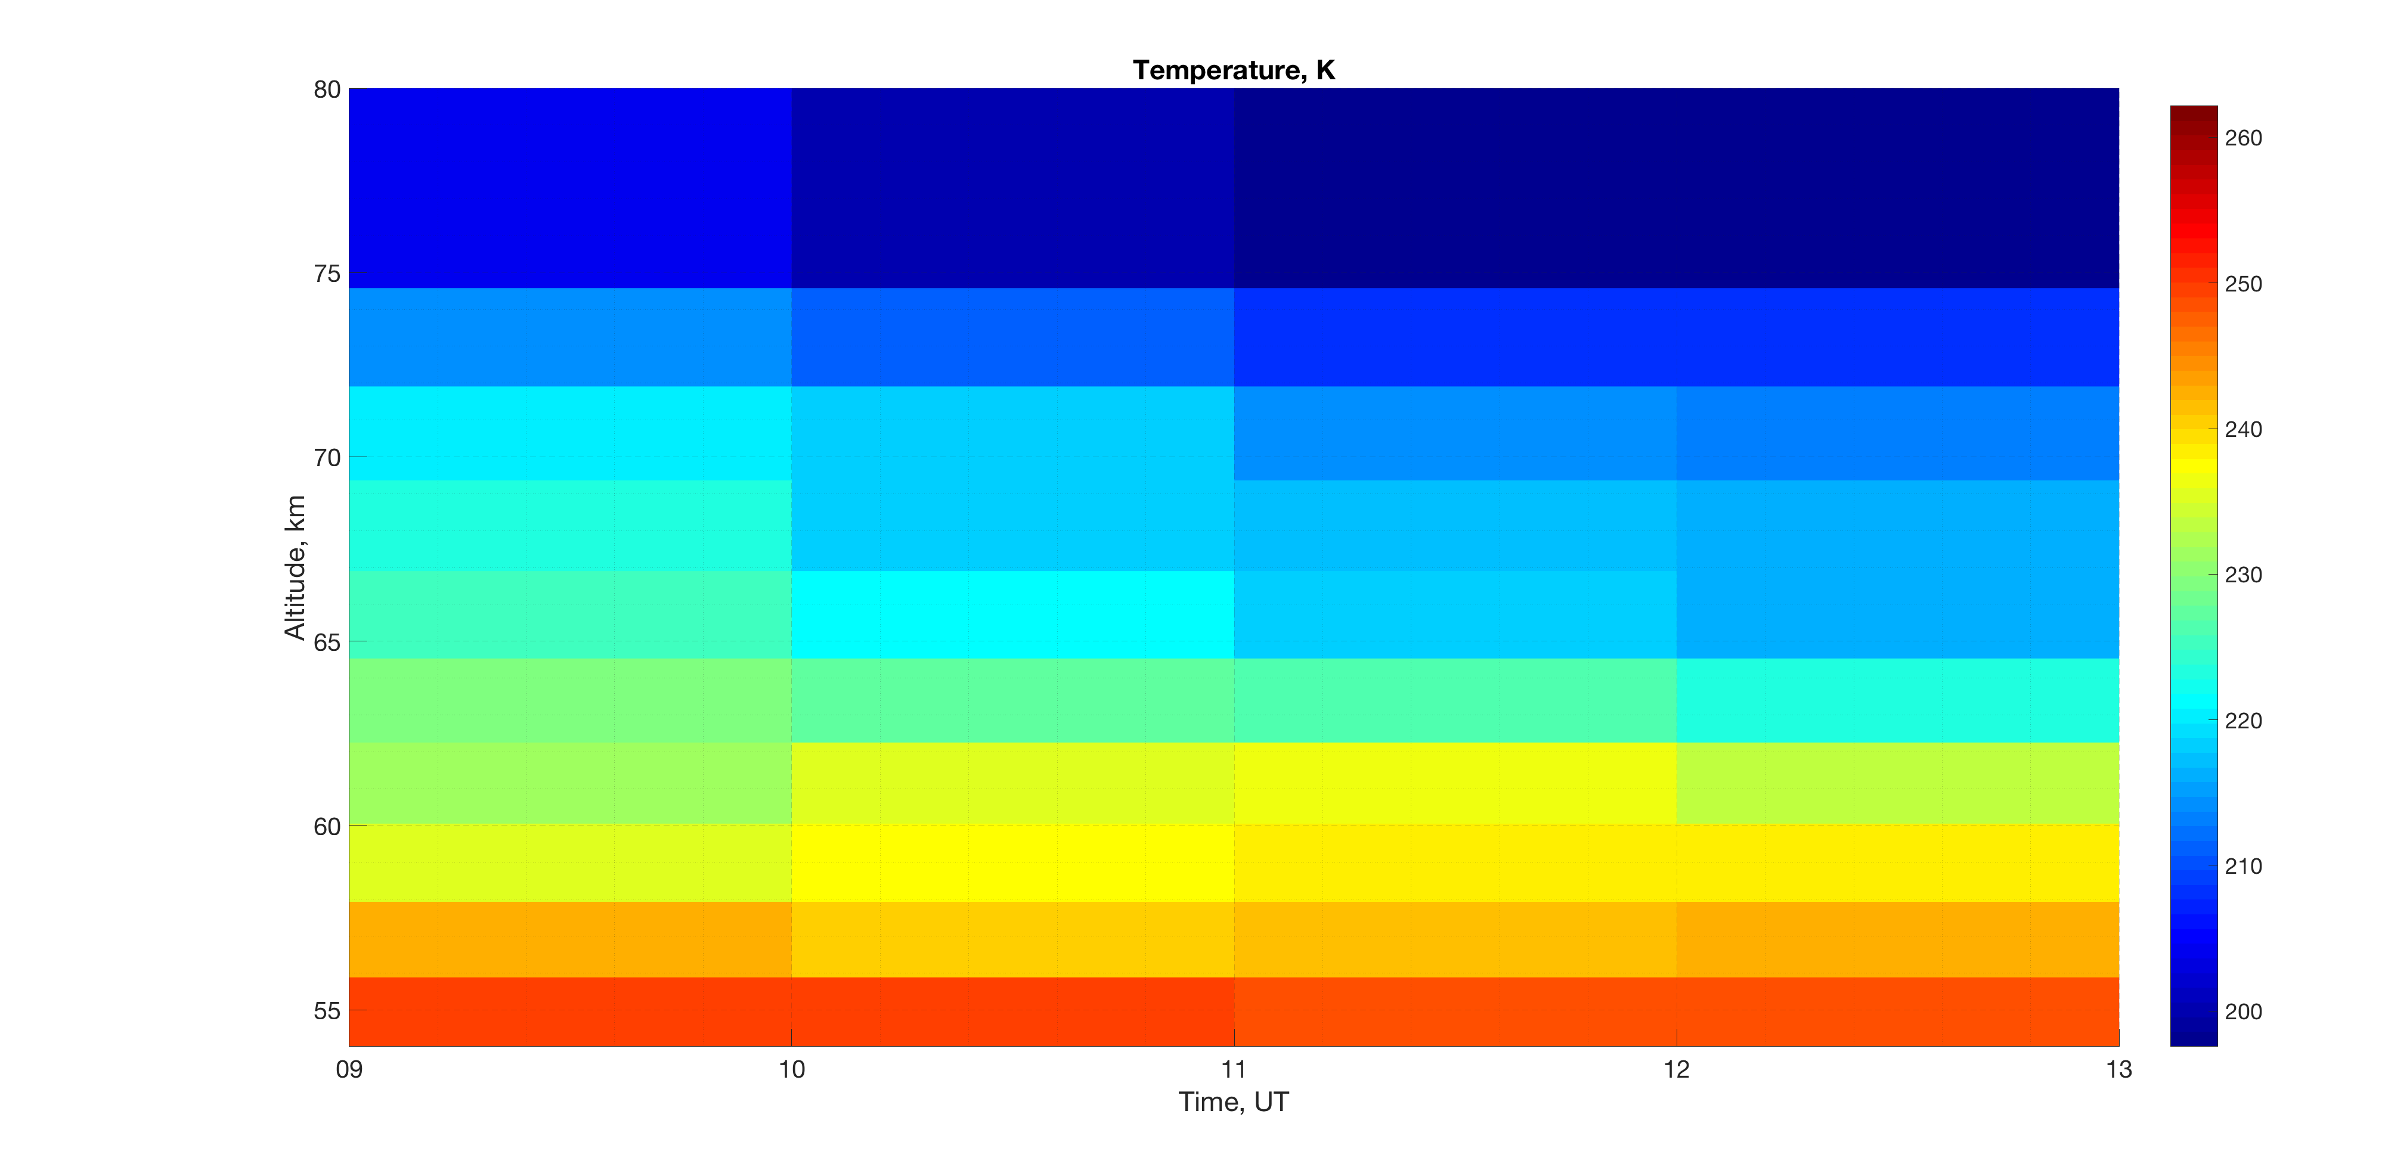
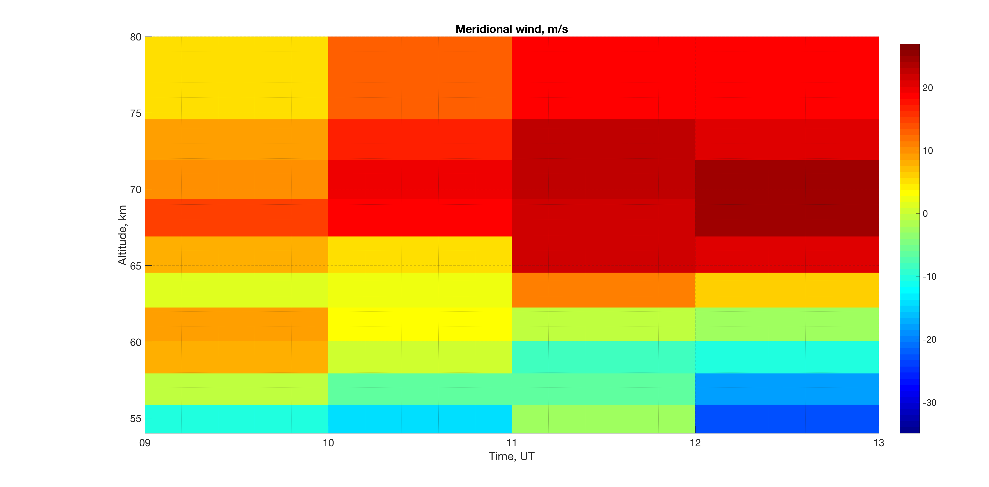
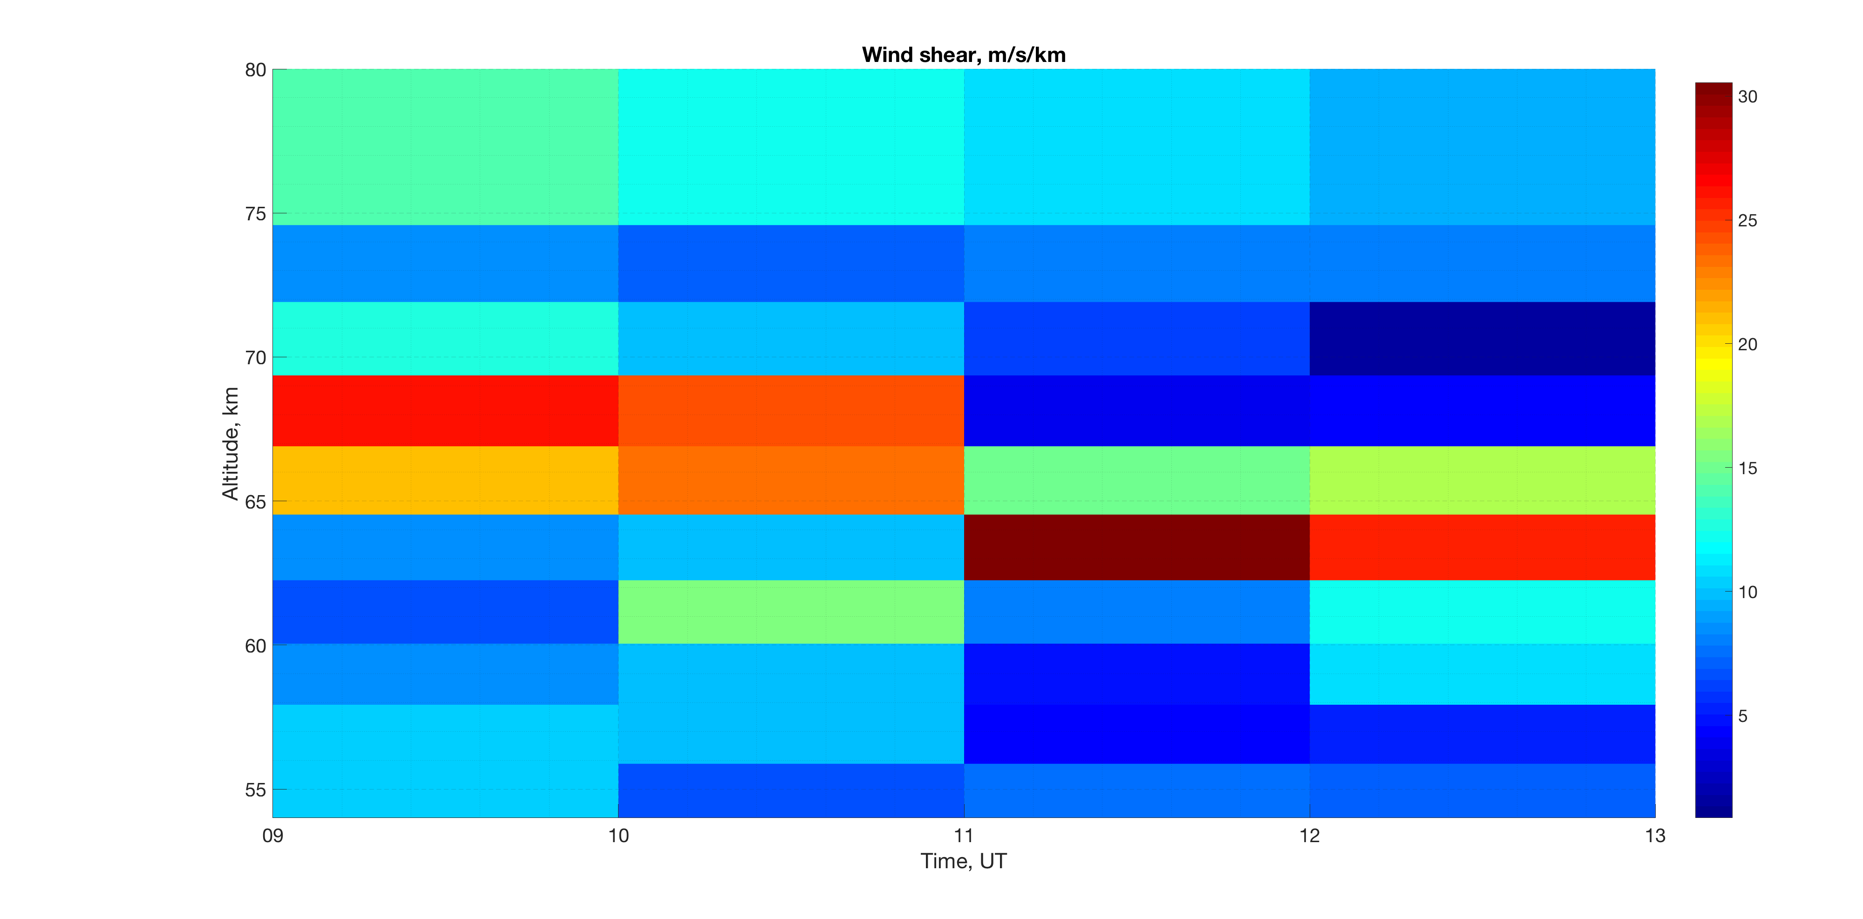
State of the mesosphere over Kiruna from the ECMWF ERA5 reanalysis during PMWE on 22 December 2016
Zonal wind (m/s)
Temperature (K)
PMWE
PMWE
PMWE
Meridional wind (m/s)
Wind shear (m/s/km)
PMWE
PMWE
© Authors
All rights reserved

Slide 11
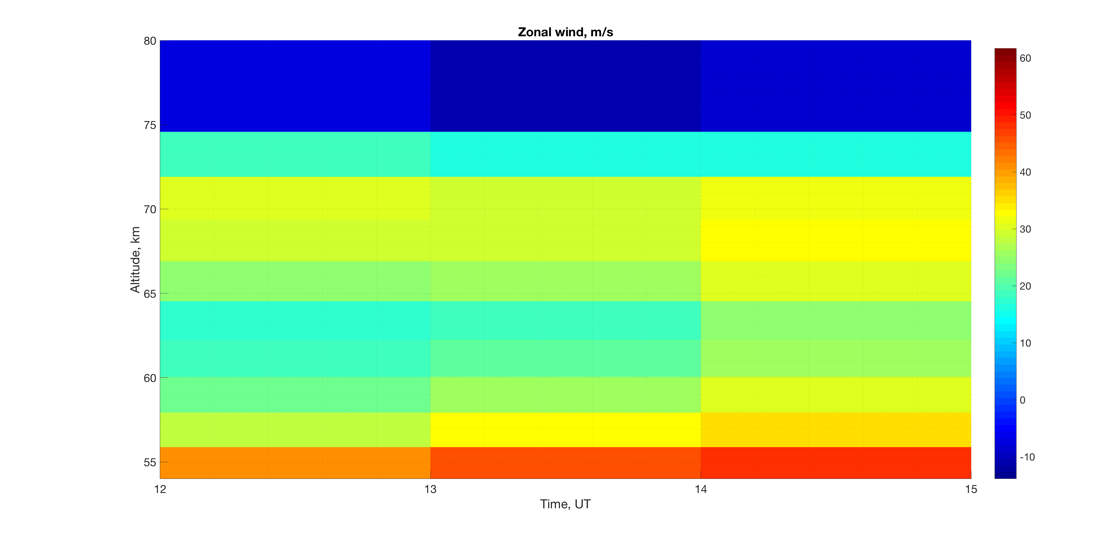
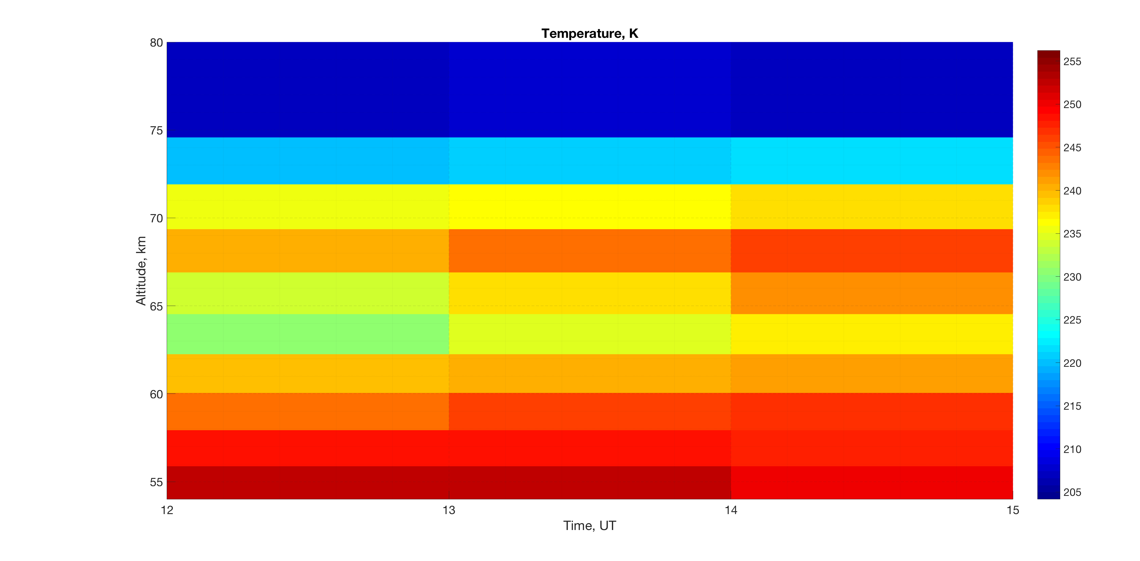
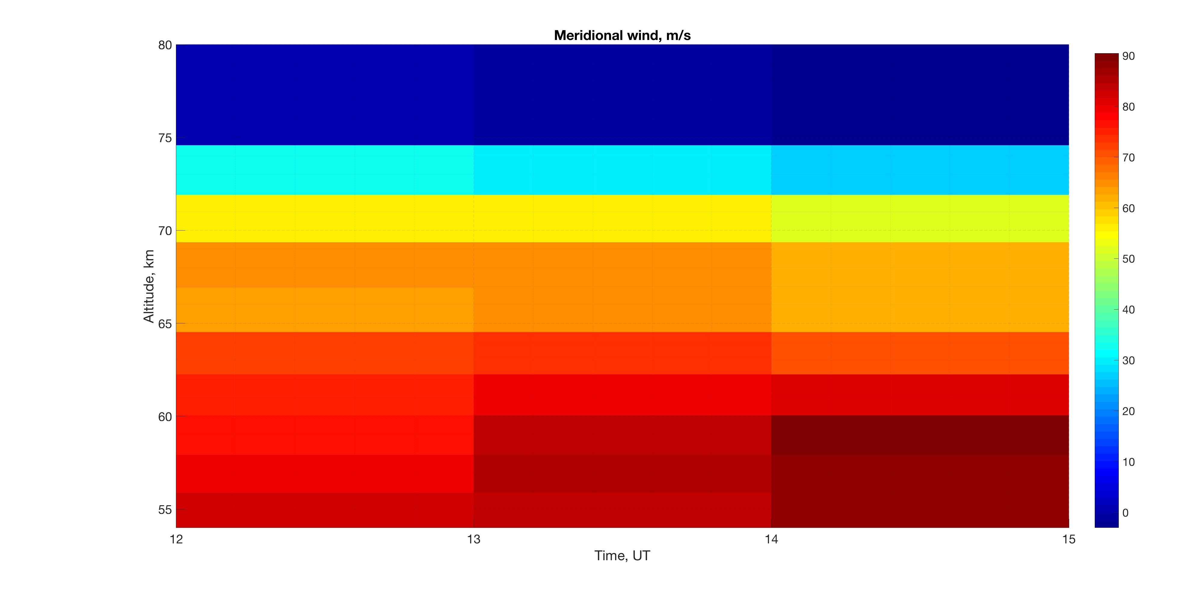
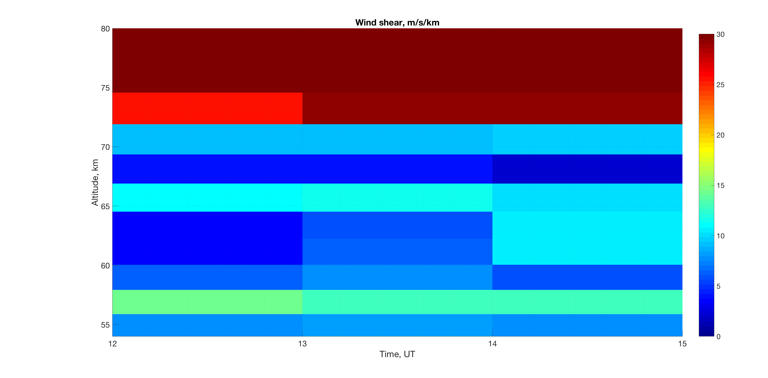
State of the mesosphere over Kiruna from the ECMWF ERA5 reanalysis during PMWE on 27 January 2017
Zonal wind (m/s)
Temperature (K)
PMWE
PMWE
Meridional wind (m/s)
Wind shear (m/s/km)
PMWE
PMWE
© Authors
All rights reserved

Slide 12
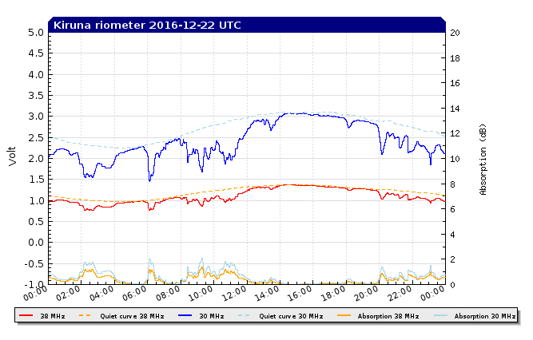
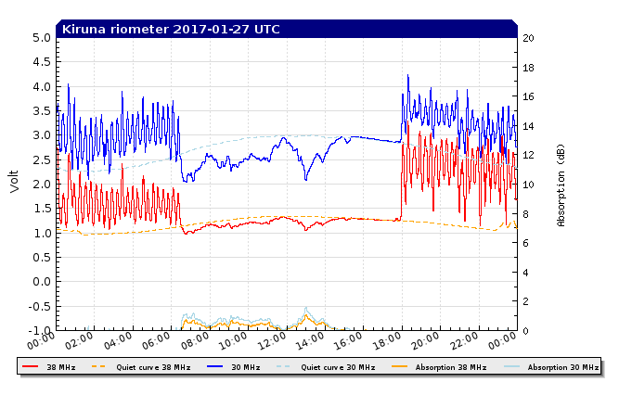
Geophysical conditions in Kiruna during PMWE events
22/12/2016
Cosmic noise absorption CNA~
electron density N_{e}
CNA is up to 2 dB => N_{e} is enhanced
27/01/2017
CNA is up to 1 dB => N_{e} is slightly enhanced
© Authors
All rights reserved

Slide 13
Conclusions
Two cases of strong polar mesosphere winter echoes (PMWE) moving with high horizontal speed (>400 m/s) as observed with atmospheric radar ESRAD located near Kiruna, have been studied.
Generation mechanisms of such PMWE related to infrasound are proposed.
Analysis of microbaroms detected near Kiruna during the PMWE events reveals:
- amplitudes are 0.1-1 Pa
- trace velocities > 400 m/s indicate that IS signals might come from mesospheric heights
- backazimuth values indicating the arrival from west – northwest suggest a source location in Northern Atlantic
There are appreciable temperature gradients and/or horizontal wind shear derived using the ECMWF ERA5 reanalysis, at the altitudes and during periods where and when PMWE were observed
The ionosphere was disturbed during the events implying that the electron concentration and may be its gradients were enhanced
Thus we can suggest that infrasound waves (microbaroms) propagated into the disturbed mesosphere generate disturbances in the atmospheric parameters at the radar Bragg scale that, in turn, result in plasma disturbances which scatter the radar EM waves
© Authors
All rights reserved

