Slide 1
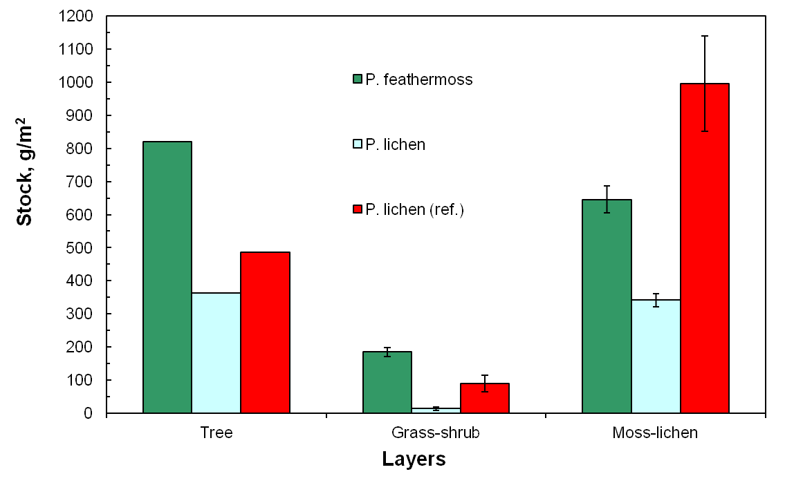
Photosynthesis in a widespread and important sub-Arctic moss and lichens species in pine ecosystems of the ZOTTO tower footprint area
EGU2020-5066
Daria Polosukhina , Oxana Masyagina and Anatoly Prokushkin dana_polo@mail.ru
The aim of this work was to determine the stocks of moss-lichen stratum and photoassimilation activity of its dominant species during the growing season.
The study has been conducted in Central Siberia near Zotino tall tower observatory (ZOTTO, 60 ° N, 89 ° E) in lichen- and feathermoss-dominated pine forests.
First, to assess the phyto (bio) mass stocks the grass-shrub and moss-lichen layers were sampled in 100 replicates in each type of forest from 20x25 cm subplots (S = 50 cm² ).
The intensity of CO₂ photoassimilation was determined in situ by Walz GFS-3000 (Heinz Walz GmbH, Effeltrich, Germany) infrared gas analyzer.
Photosynthetic activity of lichens and feathermosses was measured during the growing season of 2018 in June, July, August and September around the mid-day time.
For every time point we also analyzed CO₂ exchange dependence from temperature, photosynthetically active radiation (PAR) and CO₂ concentration.
The moss-lichen layer accounted for 78-96% of the total phytomass of ground floor in studied pine forests and comparable (486 g/m² ) to the photosynthetic phytomass of the tree canopy (pine needles)
EGU General Assembly 2020

Slide 2
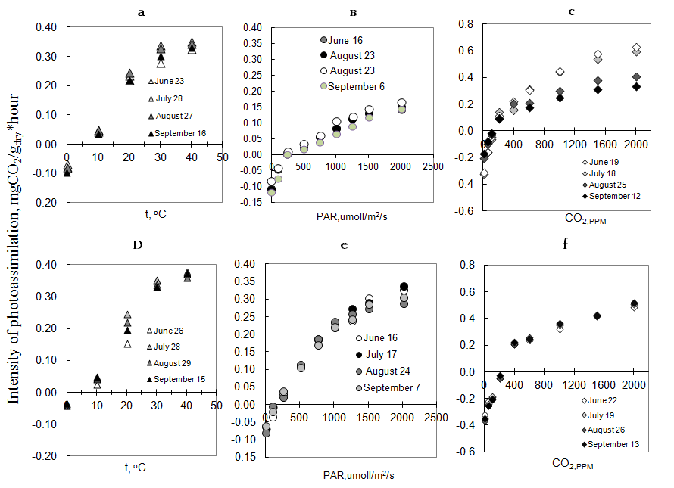
EGU2020-5066
Temperature increased the intensity of CO ₂ assimilation and no inhibition was observed at maximum T used in our study (+40 ° C).
There were no differences in the temperature dependence of CO₂ photoassimilation between feathermosses and lichens.
However, they differed in dependence from PAR.
Mosses showed 2-fold larger response of CO₂ assimilation intensity to increase of PAR comparatively to lichens.
The rate of photosynthesis of both moss and lichen showed log growth with increasing CO 2 levels up to 2000 ppm.
Compensation point was varying
from 170 to 284 ppm.
Photoassimilation intensity of Cladonia stellaris (Opiz) and Pleurozium schreberi (Brid.) Mitt. depending on changes in environmental factors: a and d - PAR, b and e - air temperature, c and f - CO₂ concentration, respectively.
EGU General Assembly 2020
The study was supported by RFBR grant № 18-05-60203-Arctika

