Slide 1

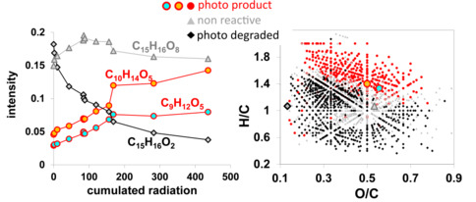
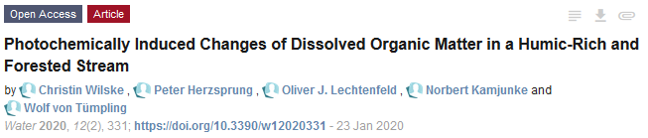
Resolution of photo chemically induced changes of dissolved organic matter as function of cumulated radiation in a sample of a humic-rich and forested stream
Peter Herzsprung, Christin Wilske, Wolf von Tümpling, Norbert Kamjunke, Oliver J. Lechtenfeld

Slide 2
Introduction
Photochemical processing is a major transformation pathway for allochthonous and autochthonous dissolved organic matter (DOM). DOM consists of thousands or even millions of different molecules and the isomer-resolved identification molecular structures is still far from any analytical realization. The highest analytical resolution of DOM can be achieved on a molecular mass basis via Fourier-transform ion cyclotron resonance mass spectrometry (FT-ICR-MS). With this technique, the molecular elemental compositions of thousands of DOM components can be assessed, given that they are extractable from water (via e.g. solid phase extraction, SPE-DOM) and ionizable (e.g. via electrospray ionization).
Increasing levels of DOC in drinking water reservoirs pose serious challenges for drinking water processing. Photochemical processes potentially influence the DOM quality in the reservoir water. The photo degradation and / or the photo production of DOM components in surface freshwater as function of cumulated radiation was rarely investigated. In order to fill this gap we performed an irradiation experiment with water from a shaded forest stream flowing into a large reservoir (Muldenberg, Germany).

Slide 3
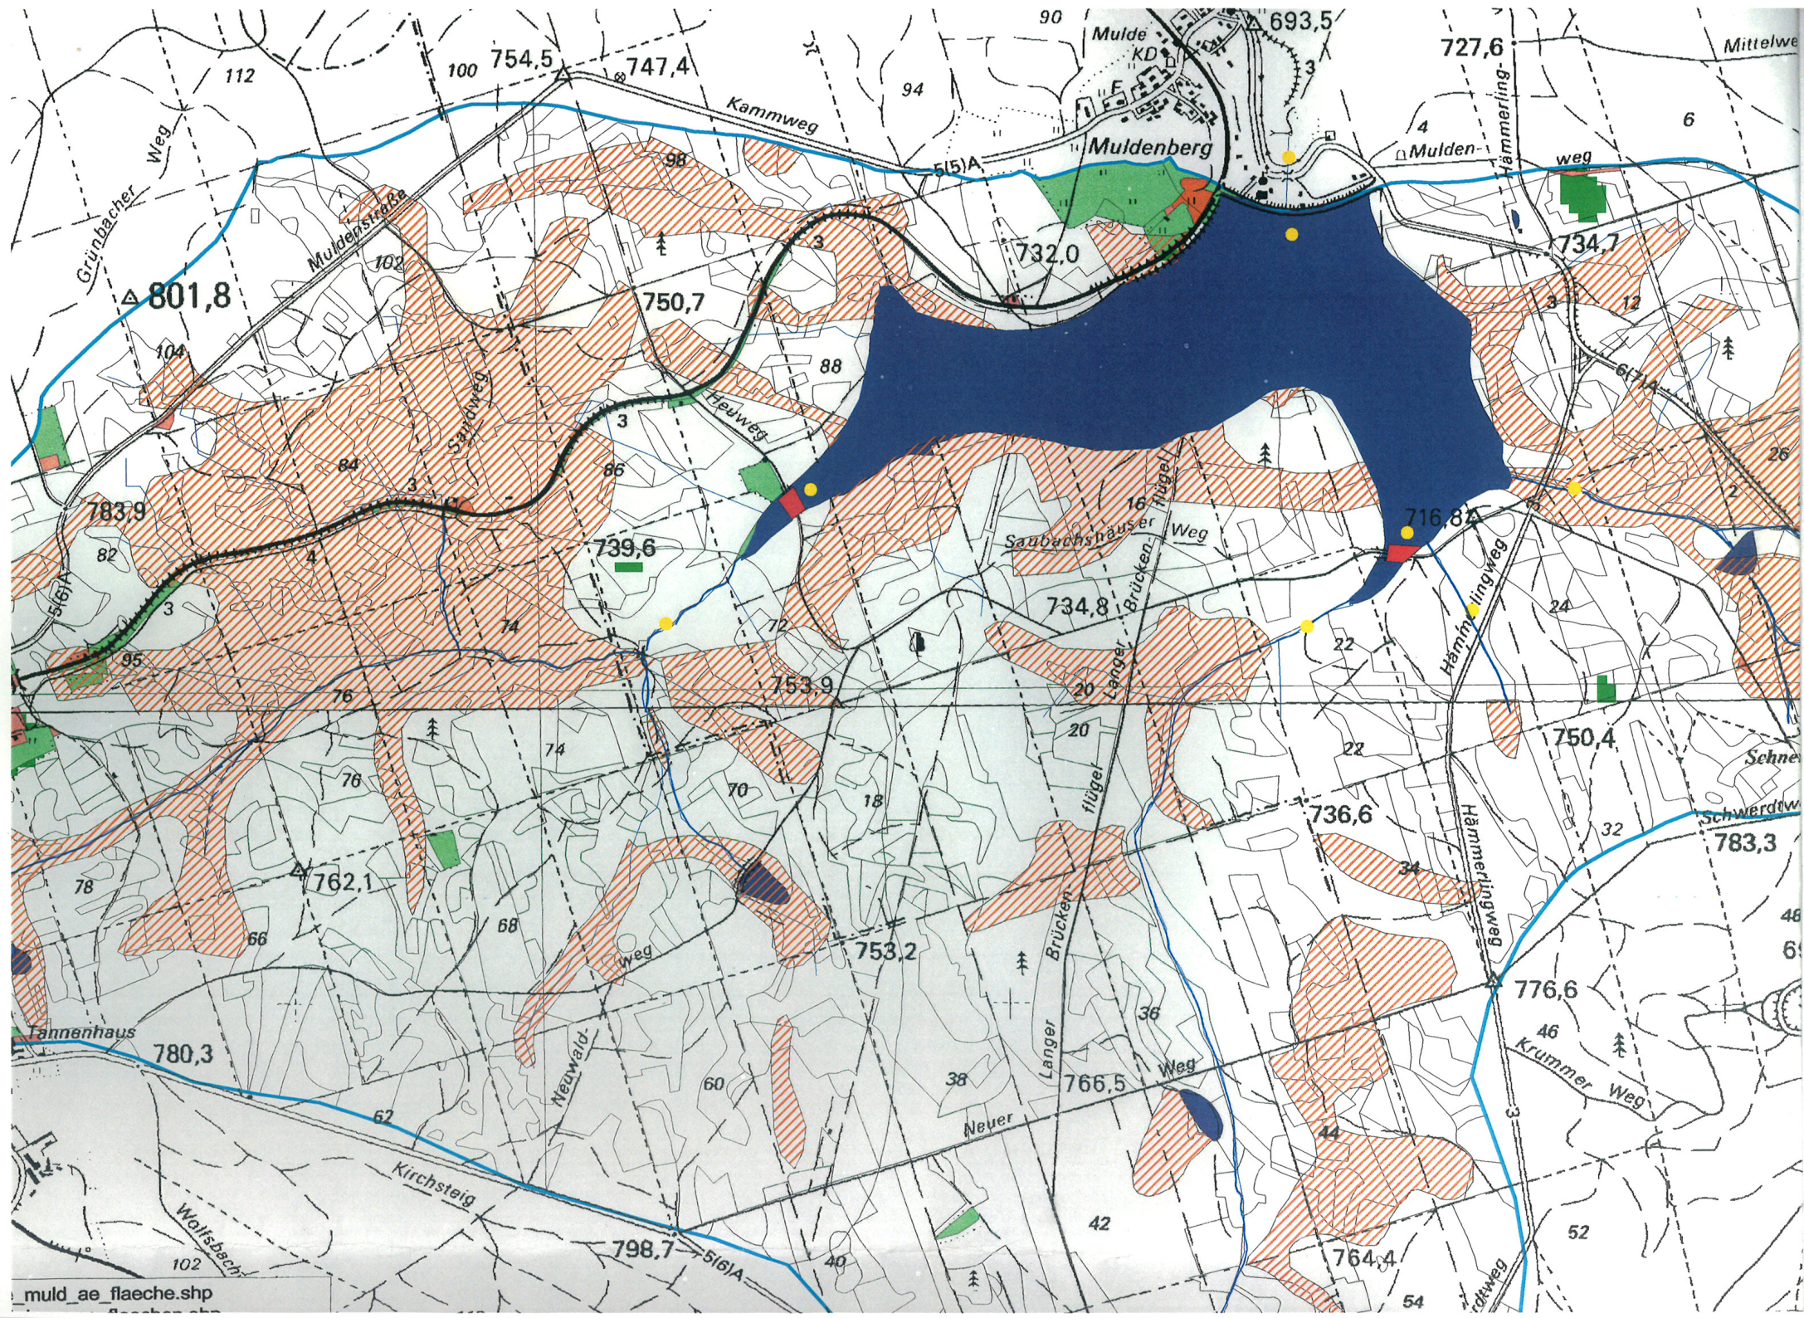
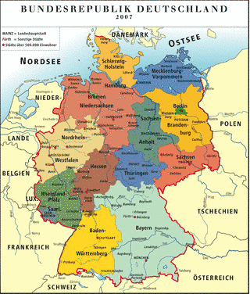
Catchment area of reservoir Muldenberg
Forested
Sampling: Red Mulde River
Germany
Saxony
N
Muldenberg
W
E
1 km
S

Slide 4
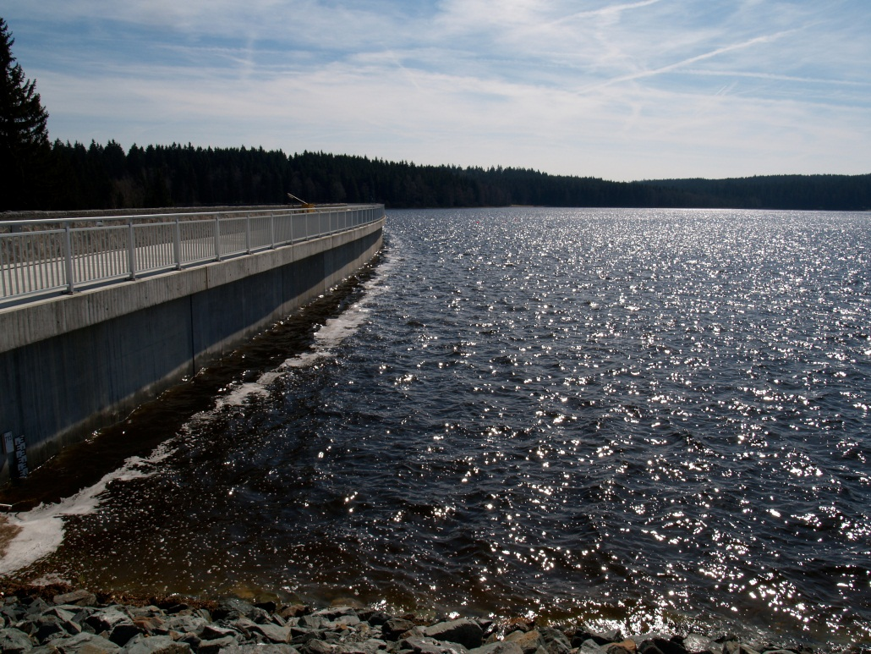
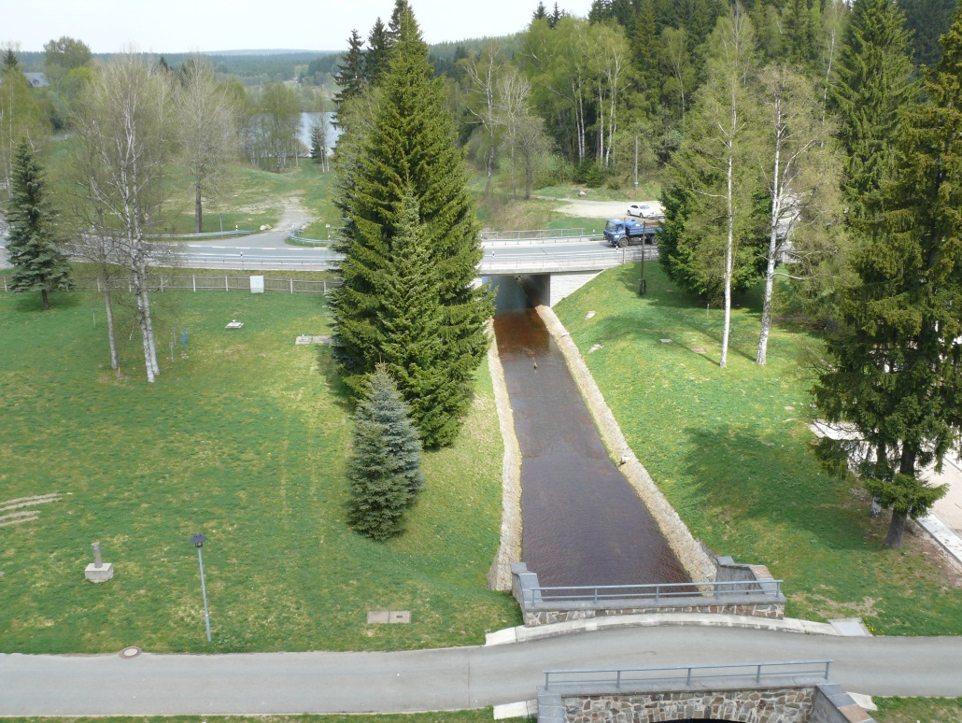
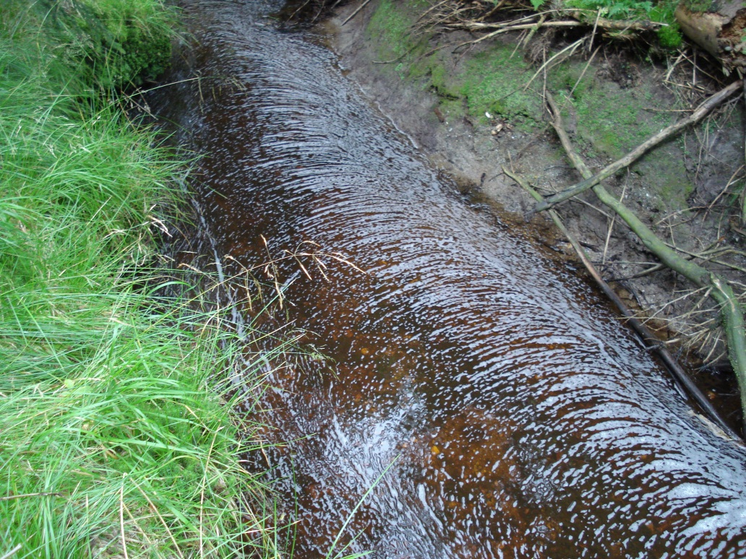
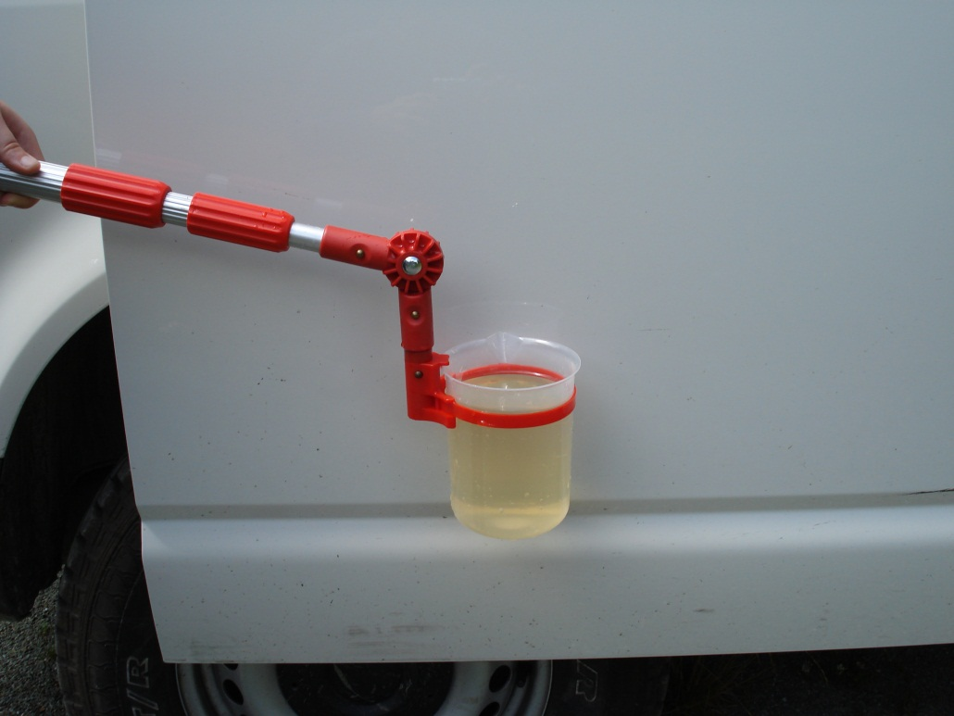
Reservoir
Effluent
Coloured water

Slide 5
Methods, measurements
Round-bottom quartz flasks have been used, so that the largest possible surface area of the contained water is irradiated with sunlight, to exclude shadows and reflections, according to [56]. The round-bottom flasks were placed (both groups) with about 1.5 m space in between on the flat house roof to exclude shadows of one to other placed flasks. The space between the different triplicates was about 30 cm. Air exchange in the flasks was ensured and the global radiation was logged. On 31 July 2018 the experiment began with the sunrise at 5:30 am. At the first two days, water samples alternating from the replicates were taken after two, four, eight and sixteen hours (20 mL for DOC, 2D fluorescence and bacterial production; 50 mL for the FT-ICR MS measurements). The total experiment runs for 6 d (for details see Wilske et al., 2020).
The global radiation was measured with a LI-1400 dataLogger of LI-COR (LI-COR, Lincoln, NE, USA). Every 5 min the average was logged. The single values (W/m2) were summed over the entire time period.
DOC concentration, UV absorption, excitation-emission-matrices (EEMs) including calculated PARAFAC components and fluorescence indices, and FT-ICR MS derived molecular formulas of SPE-DOM were recorded at 13 different time points (each time point in triplicate). The cumulated radiation was recorded during six days of solar irradiation (sunny days in August at 50.401847 deg. latitude and 12.380528 deg. longitude). Changes in relative peak intensity of DOM components as function of cumulated radiation were evaluated by Spearman`s rank correlation as demonstrated on the next pages.

Slide 6
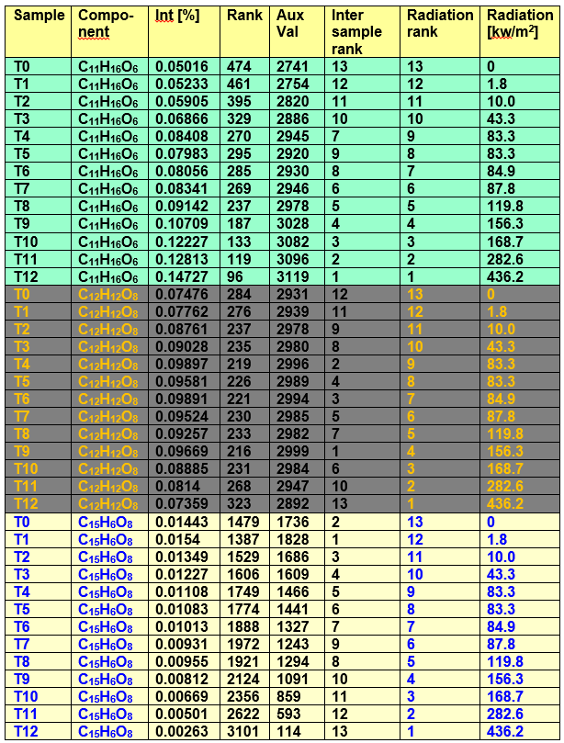
Data preparation for Spearman`s rank correlation
All components are considered which are present in all 13 samples. For those components the intensity ranks are calculated (Rank column; 3214 components → 3214 ranks).
Aux. Val. = 3215 – Rank
For each component the inter sample ranks are calculated from the Aux. Val. ranking (13 samples → 13 ranks). From inter sample ranks and radiation ranks the rank correlation coefficients r_{s} are calculated for each component. The levels of significance can be assigned to r_{s} as function of sample number n (n=13) as shown on the next page.

Slide 7
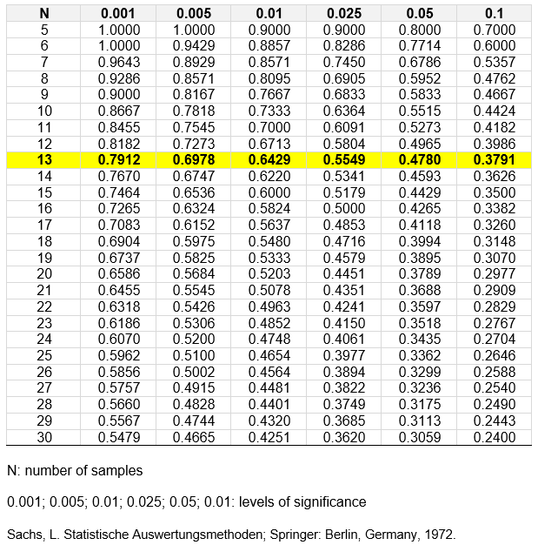
The level of significance is a function of r_{s} and the number of samples
Examples:
r_{s} for C₁₁H₁₆O₆ = +0.984; N = 13;
since |+0.984| ≥ 0.7912
sign. = 0.001
r_{s} for C₁₂H₁₂O₈ = +0.115; N = 13;
since |+0.115| < 0.3791
sign. = non significant (non reactive)
r_{s} for C₁₅H₆O₈ = -0.989; N = 13;
since |-0.989| ≥ 0.7912
sign. = 0.001
Equation in excel:
If |r_{s}| ≥ 0.7912; sign. = 0.001;0
If 0.7912 > |r_{s}| ≥ 0.6978; sign. = 0.005;0 …
If 0.4780 > |r_{s}| ≥ 0.3791; sign. = 0.1;0
If 0.3791 > |r_{s}|; sign. = 1;0
for sign. = 1 → non significant

Slide 8
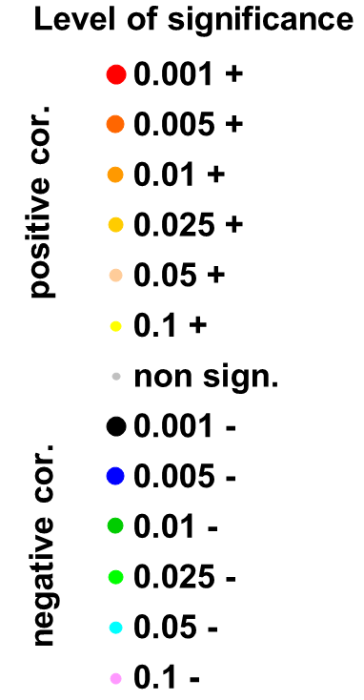
Results
Rank correlation of CHO and CHNO components intensities with cumulated radiation

Slide 9
Examples for reaction sequences
C₁₀H₁₆O₅ photo product; sign. = 0.001
C₁₁H₁₆O₆ photo product; sign. = 0.001
C₁₂H₁₂O₈ non reactive; non sign.
C₁₆H₂₇O₇ photo product; sign. = 0.001

Slide 10
Examples for reaction sequences
C₁₀H₄O₆ photo degraded; sign. = 0.001
C₁₅H₆O₈ photo degraded; sign. = 0.001
C₂₁H₁₂O₉ photo degraded; sign. = 0.001

Slide 11
Our observations:
We found components with different types of photo reaction behavior. Relative aliphatic components like C₁₀H₁₆O₅; C₁₁H₁₆O₆; C₁₆H₂₆O₇ were identified as photo products showing a monotonous mass peak intensity increase with irradiation time. Highly unsaturated and oxygen-rich components like C₁₀H₄O₆; C₁₅H₆O₈; C₂₁H₁₂O₉ showed a more or less monotonous intensity decrease indicating photo degradation. Many similar components were positively correlated to the humic-like fluorescence intensity and the humification index (HIX). The strong degradation of these components can explain the high loss of fluorescence intensity and the drop of the HIX in our experiment (further details see in Wilske et al., 2020). As a result of the high temporal resolution in our experiment (i.e. intensity change as function of cumulated irradiation) we found another type of photo reaction. Components like C₁₂H₁₂O₈ showed first increasing and then decreasing intensity indicating the formation of intermediate products. However such components were regarded (preliminarily) as non-reactive considering their r_{s} values after calculation of rank correlation.
In general, the river DOM from the forested catchment area showed high potential for photochemical transformations which probably occur in the sunlight exposed pre-dam of the drinking water reservoir.

Slide 12
Associated literature:
Photochemically Induced Changes of Dissolved Organic Matter in a Humic-Rich and Forested Stream
By: Wilske, C (Wilske, Christin) ; Herzsprung, P (Herzsprung, Peter) ; Lechtenfeld, OJ (Lechtenfeld, Oliver J.) ; Kamjunke, N (Kamjunke, Norbert) ; von Tumpling, W (von Tuempling, Wolf)
WATER
Volume: 12
Issue: 2
Article Number: 331
DOI: 10.3390/w12020331
Published: FEB 2020
Abstract
Photochemical processing is an important way to transform terrestrial dissolved organic matter (DOM) but was rarely investigated by ultra-high resolution mass spectrometry. We performed an irradiation experiment with water from a shaded forest stream flowing into a lit reservoir. Bacterial activity explained only 1% of dissolved organic carbon (DOC) decline in a combined bacterial and photodegradation approach. Photodegradation decreased the DOC concentration by 30%, the specific ultraviolet (UV) absorption by 40%-50%, and fluorescence intensity by 80% during six days. The humification index (HIX) decreased whereas the fluorescence index (FI) did not change. Two humic-like components identified by parallel factor analysis (PARAFAC) of excitation emission matrices followed the decrease of fluorescent DOM. Changes of relative peak intensities of Fourier transform-ion cyclotron resonance mass spectroscopy (FT-ICR MS) elemental formula components as a function of cumulated radiation were evaluated both by Spearman's rank correlation and linear regression. The FT-ICR MS intensity changes indicate that high aromatic material was photochemically converted into smaller non-fluorescent molecules or degraded by the release of CO₂. This study shows the molecular change of terrestrial DOM before the preparation of drinking water from reservoirs.

