Slide 1
Stochastic generator of earthquakes in French mainland Corentin Gouache^{1*}, Pierre Tinard², François Bonneau¹, Jean-Marc Montel³
¹ Université de Lorraine, CNRS, ASGA, GeoRessources, Nancy, 54000, France
² Caisse Centrale de Réassurance, R&D Modélisation, Paris, 75008, France
³ Université de Lorraine, CRPG/CRNS, Vandoeuvre-lès-Nancy, 54500, France
* corentin.gouache@univ-lorraine.fr
#shareEGU20 online meeting
Session SM3.2 – Analysis and modeling of spatiotemporal earthquake occurrence: challenges and perspectives
EGU2020-5150

Slide 2
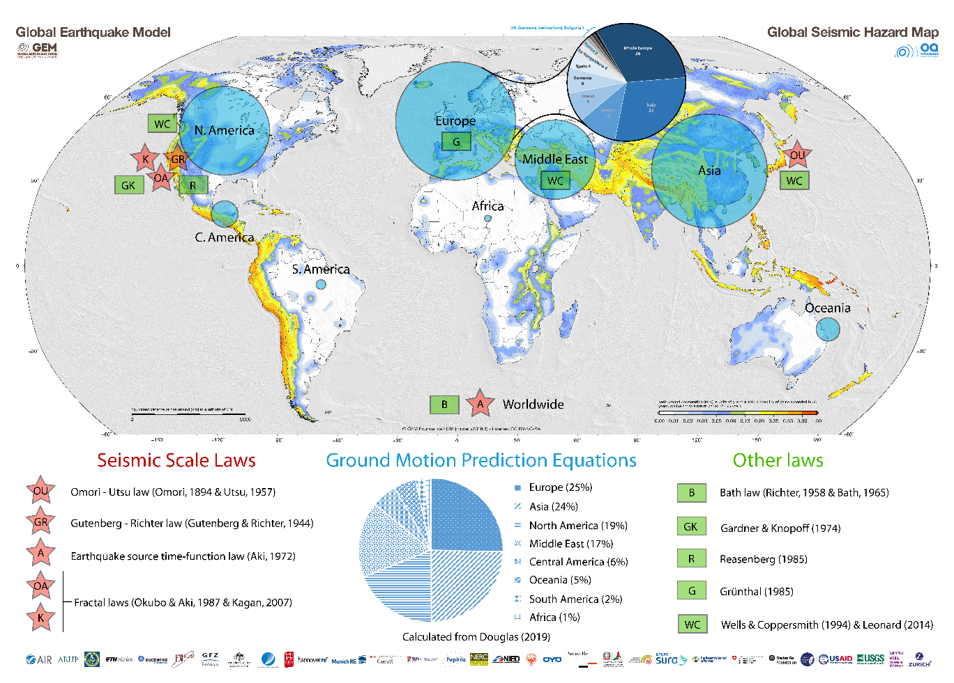
Low seismicity context
French mainland = low seismicity area
Not adapted classical laws / methods?
→ Nonparametric normalized inter event time method
Lack of data
→ Creation of realistic data through a generator of earthquakes
Notes:
In order to overcome the lack of seismic data in French mainland, we propose to generate plausible synthetic earthquakes from recurrence rates computed thanks to the nonparametric normalized inter event time method.

Slide 3
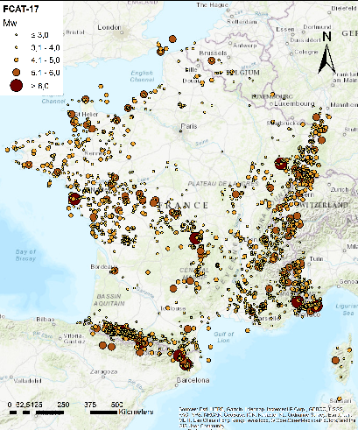
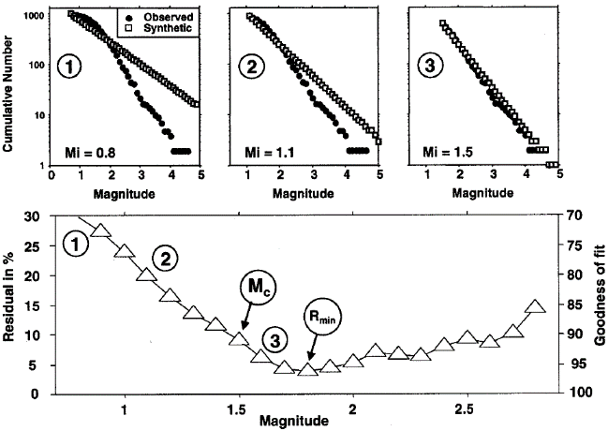
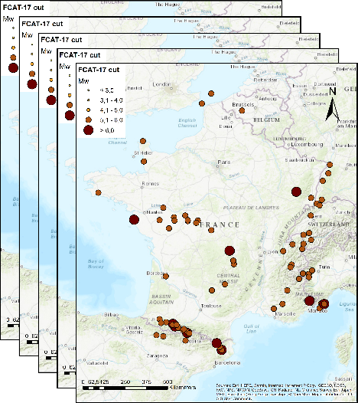
Data pre-processing
Catalogue
FCAT-17
Magnitude uncertainty
propagation
Monte Carlo Markov Chain
N_{MCMC} = 1,000
Catalogue completeness
Goodness of fit method
Exhaustive catalogues
N_{MCMC} = 1,000
[Manchuel et al., 2017]
[Traversa et al., 2017]
[Baumont et al., 2018]
[Wiemer and Wyss, 2000]
1
1
B_{i}
S_{i}
2
2
3
3
…
…
N_{MCMC}-2
N_{MCMC}-2
N_{MCMC}-1
N_{MCMC}-1
N_{MCMC}
N_{MCMC}
4,165 earthquakes
1356 - 1964
M_{w} = [0,4 – 6,7]
Looking for couple of
cut-off magnitude (Mc)
& cut-off year (Yc)
Notes:
From the initial Catalogue the minimization of a residual between observed GR and computed one is applied (Catalogue completeness) in order to find the better couple of cut-off magnitude (Mc) and year (Yc). Cutting this initial catalogue by Yc and Mc leads to an exhaustive one (Exhaustive catalogues). Applying a Monte Carlo Markov Chain (Magnitude uncertainties propagation) aims to generate 1,000 stochastic initial catalogues of which only magnitudes differ. Thess last are drawn in an uniform law in M_{w}±Err_M_{w}. In the end, 1,000 stochastic Exhaustive catalogues are found.

Slide 4
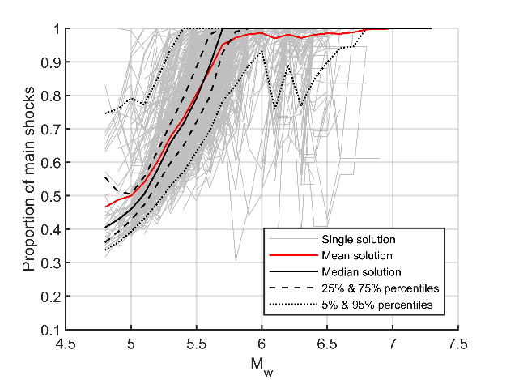
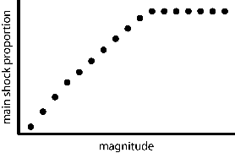
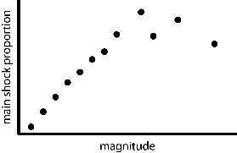
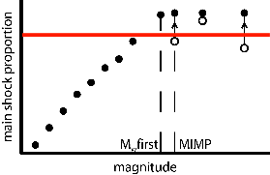
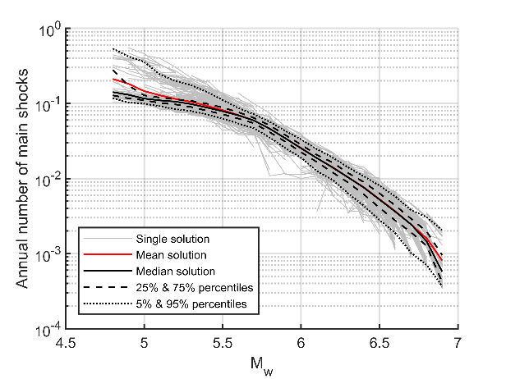
Frequency – magnitude distributions
Exhaustive catalogues
N_{MCMC} = 1,000
Normalized inter event time method
Main shock proportion distribution
$$τ_{i}=\left(t_{i}−t_{i+1}\right)∗N/{(t_{N}−t_{1})}, ∀i∈[2,N]$$
$$γ={\overline{τ}}/{σ_{τ}^{2}}+△=main shock proportion$$
[Molchan, 2005] [Hainzl et al., 2006]
Expected
Lack of data
→ Inaccurate results
Calculated
Main shocks FMD
Uncertainties threshold
Corrected
Magnitude of Inferred Main shock Proportion (MIMP) implementation
$$F_{main shock}\left({≥M}_{w}\right)=γ∗\frac{nb(≥M_{w})}{T}$$
[Gouache et al., submitted]
[Hainzl et al., 2006]
Notes:
From the 1,000 stochastic Exhaustive catalogues the Normalized inter event time method (N = number of earthquakes ; △ = 0,044 * ( 1 – 4 * ( γ – 0,5 ) ^ 2 ) ; T = number of years) updated by our MIMP implementation is applied. This implementation’s gaol is to stabilize the main shock proportion above an uncertainties threshold (here 0.9), avoiding inconsistent values when data is sparse. From these unbiased Main shock proportion distributions, Main shock frequency – magnitude distributions are computed.

Slide 5
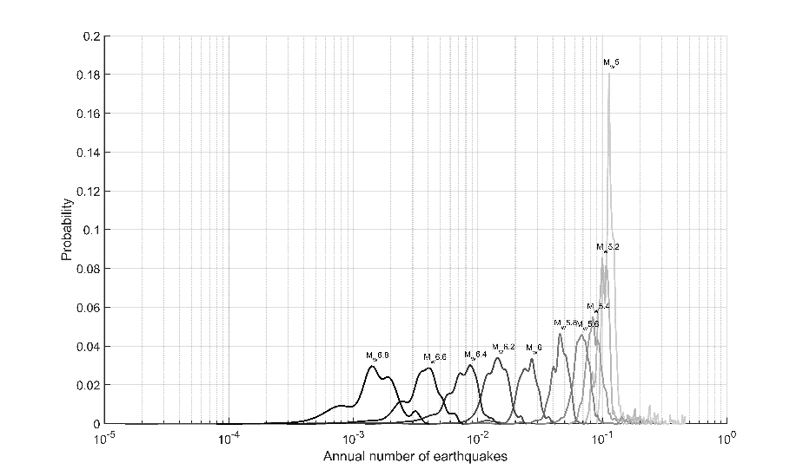
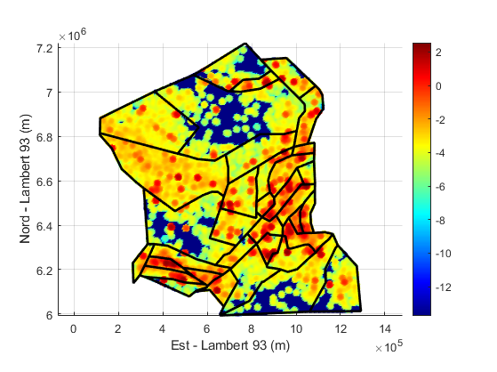
Generator of main shocks
Temporal input
Spatial input
≈ 390 M_{w}≥4.8
Pdf of annual number of main shocks per M_{w} step
log₁₀( Cumulative M₀ )
[Martin et al., 2002]
For each zone:
Maximal magnitude
Depth interval
Frequencies drawn through rejection sampling
First: Time & Magnitude draws
Then: Spatial draw conditioned by Magnitude
Notes:
From the pdf of annual number of main shocks per magnitude step (Temporal input), year of occurrence and magnitude of the generated main shocks are drawn. Form the log₁₀ of the cumulative seismic moment (M₀) of the past seismicity and from a seismotectonic model (Martin et al., 2002) (Spatial input) (X,Y) of the generated main shocks are drawn. The magnitude of the main shocks, drawn previously, limits the location of these main shocks because each zone is characterised by a maximal magnitude. Those are assumed from FCAT-17 catalogue and Ameri et al. (2015). Depths of the generated main shocks are drawn uniformly in an interval depending on the location (zone).

Slide 6
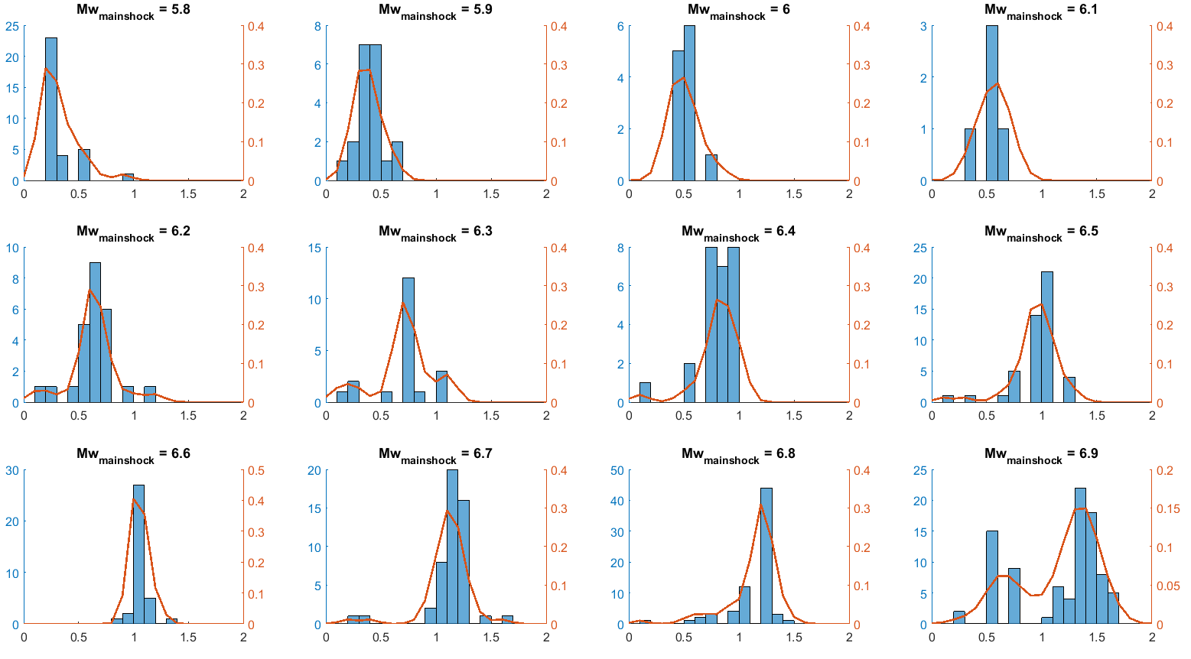
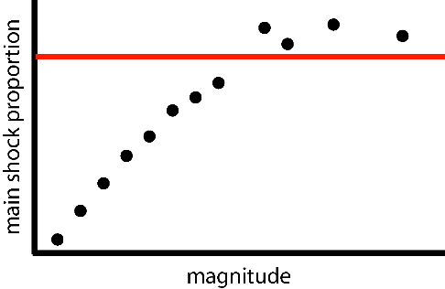
Generator of aftershocks
B$\dot{a}$th law
$${M_{s}}_{main shock}−\max\left({M_{s}}_{aftershocks}\right)=α$$
[Richter, 1958] [B$\dot{a}$th, 1965]
Number
Probability
α
Aftershocks generation:
→ Main shock generated with a magnitude M_{w}
$α$ drawn through the distribution associated to M_{w}
→ One aftershock with a magnitude $M_{w}−α$ is generated
$$α$$
≈ 115 M_{w}≥4.8 each 2,000 years (22%)
Notes:
For each of the 1,000 main shock proportion calculations, the largest magnitude (red) is considered as the main shock magnitude and the largest magnitude which is below the uncertainties threshold (red line) is assumed to be the maximal magnitude of aftershocks (blue). Knowing that, it is possible to analyse the distribution of α (B$\dot{a}$th law) for each main shock magnitude.

Slide 7
Conclusions
Recurrence rate method adapted for low seismicity areas
Earthquake generator based on these objective recurrence rates
Temporal and Spatial draws are linked through the Magnitude
One aftershock generated by B$\dot{a}$th law per main shock
Issue = Low seismicity | Adapted solution
Sparse data | National scale, no spatial discretization
Sparse knowledge | Nonparametric method
Large uncertainties | Avoiding declustering algorithms & GR regression, sources of uncertainties

Slide 8
References
Båth M (1965) Lateral inhomogeneities of the upper mantle. Tectonophysics 2:483–514. https://doi.org/10.1016/0040-1951(65)90003-X
Baumont D, Manchuel K, Traversa P, et al (2018) Intensity predictive attenuation models calibrated in Mw for metropolitan France. Bulletin of Earthquake Engineering 16:2285–2310. https://doi.org/10.1007/s10518-018-0344-6
Gouache C, Bonneau F, Tinard P, Montel J-M (submitted) Estimation of main shock frequency – magnitude distributions by adapting the inter event time method for low-to-moderate seismicity areas. Application to French mainland
Hainzl S, Scherbaum F, Beauval C (2006) Estimating Background Activity Based on Interevent-Time Distribution. Bulletin of the Seismological Society of America 96:313–320. https://doi.org/10.1785/0120050053
Manchuel K, Traversa P, Baumont D, et al (2017) The French seismic CATalogue (FCAT-17). Bulletin of Earthquake Engineering 16:2227–2251. https://doi.org/10.1007/s10518-017-0236-1
Martin Ch, Combes Ph, Secanell R, et al (2002) Révision du zonage sismique de la France
Molchan G (2005) Interevent time distribution in seismicity: a theoretical approach. Pure and Applied Geophysics 162:1135–1150. https://doi.org/10.1007/s00024-004-2664-5
Richter CF (1958) Elementaty seismology. Freeman
Traversa P, Baumont D, Manchuel K, et al (2017) Exploration tree approach to estimate historical earthquakes Mw and depth, test cases from the French past seismicity. Bulletin of Earthquake Engineering 16:2169–2193. https://doi.org/10.1007/s10518-017-0178-7
Wiemer S, Wyss M (2000) Minimum Magnitude of Completeness in Earthquake Catalogs: Examples from Alaska, the Western United States, and Japan. Bulletin of the Seismological Society of America 90:859–869. https://doi.org/10.1785/0119990114

