Slide 1
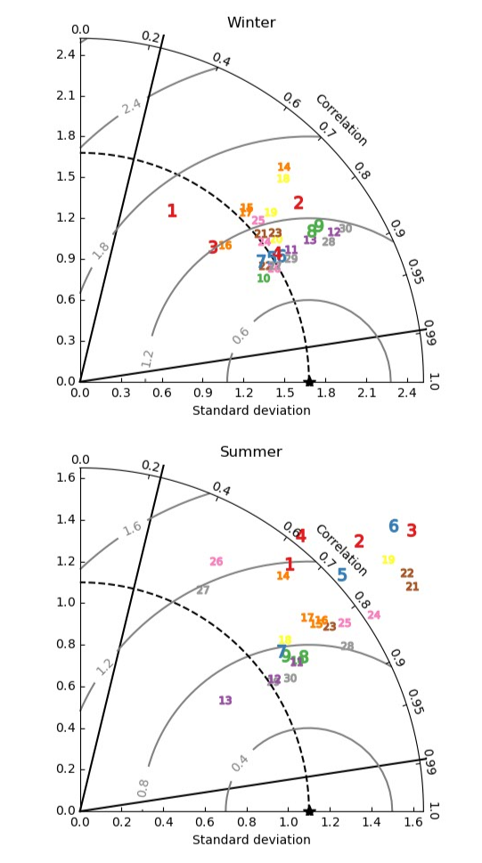
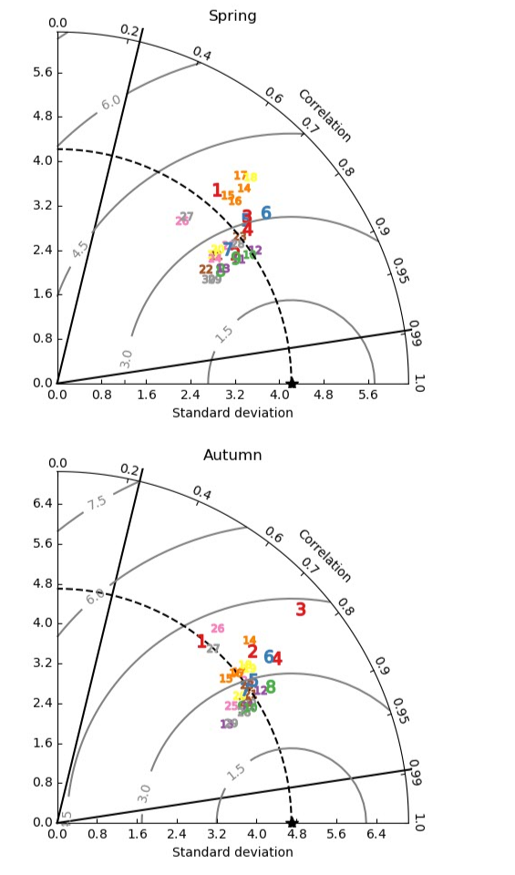
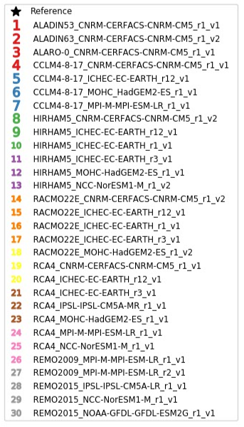
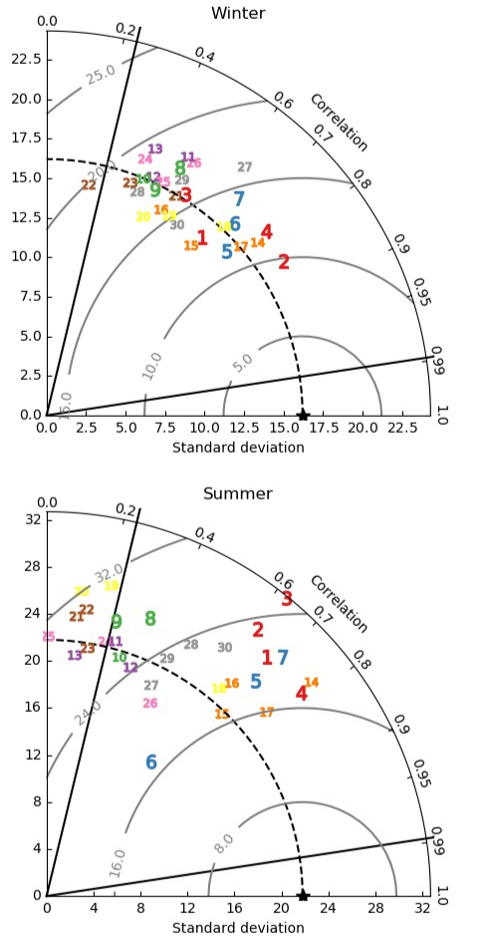
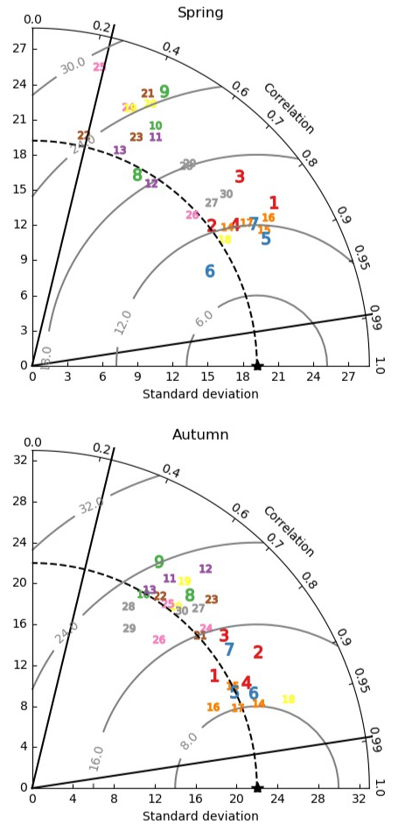
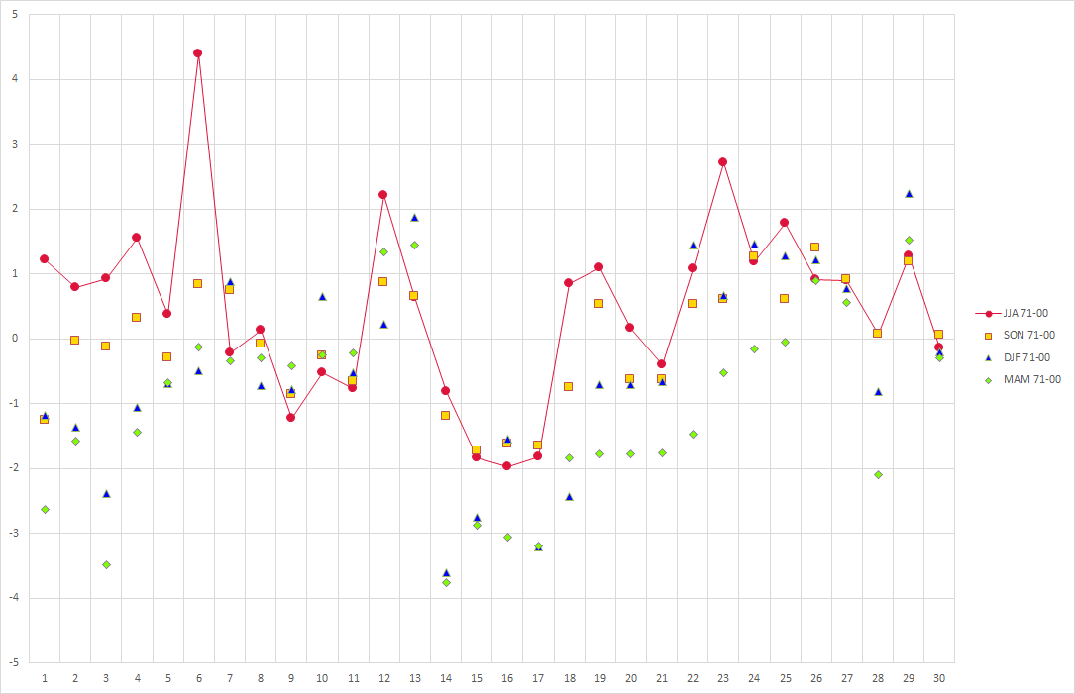
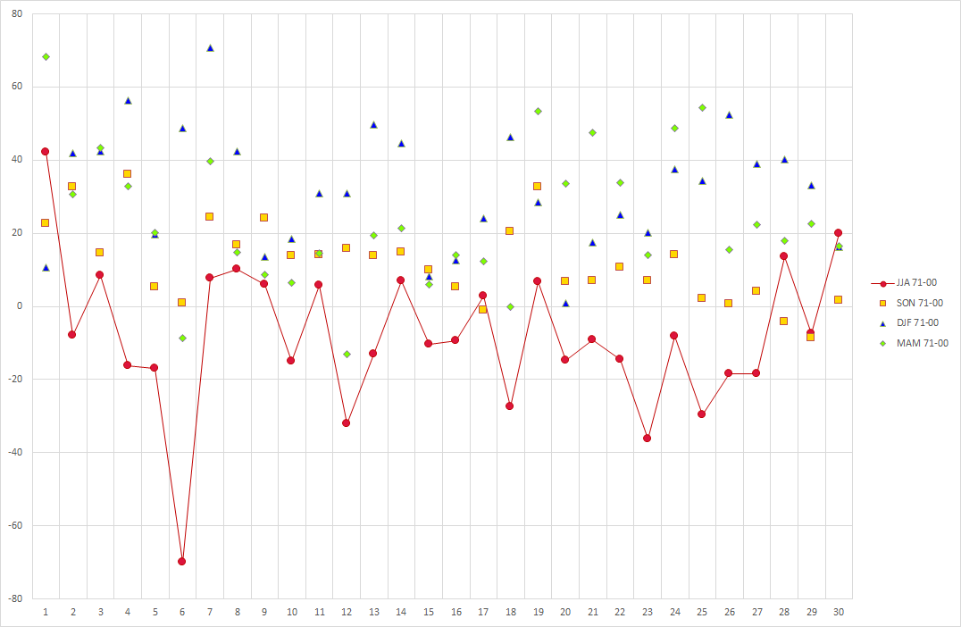
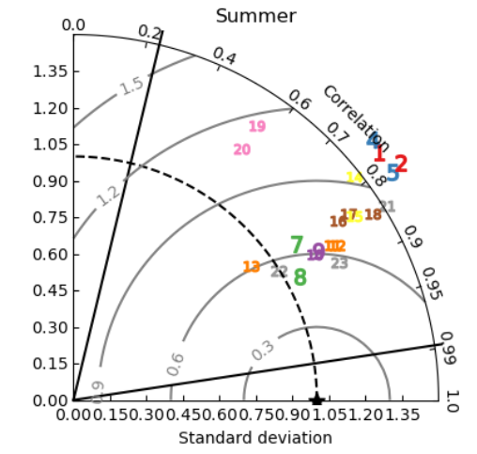
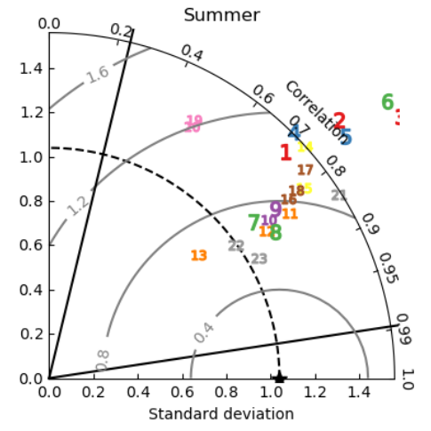
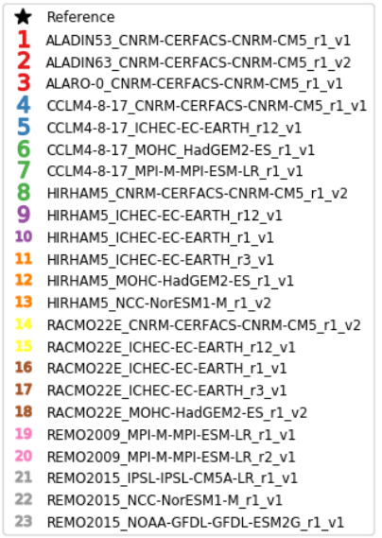
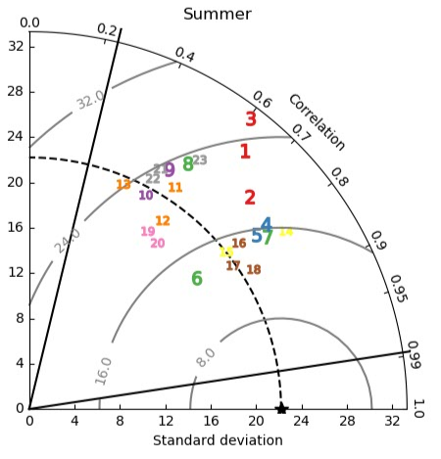
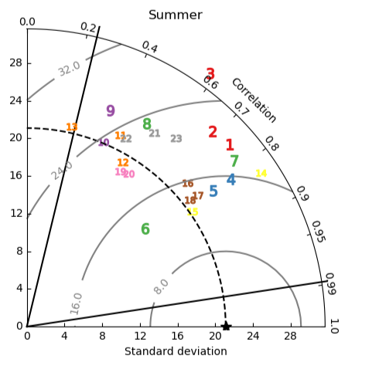
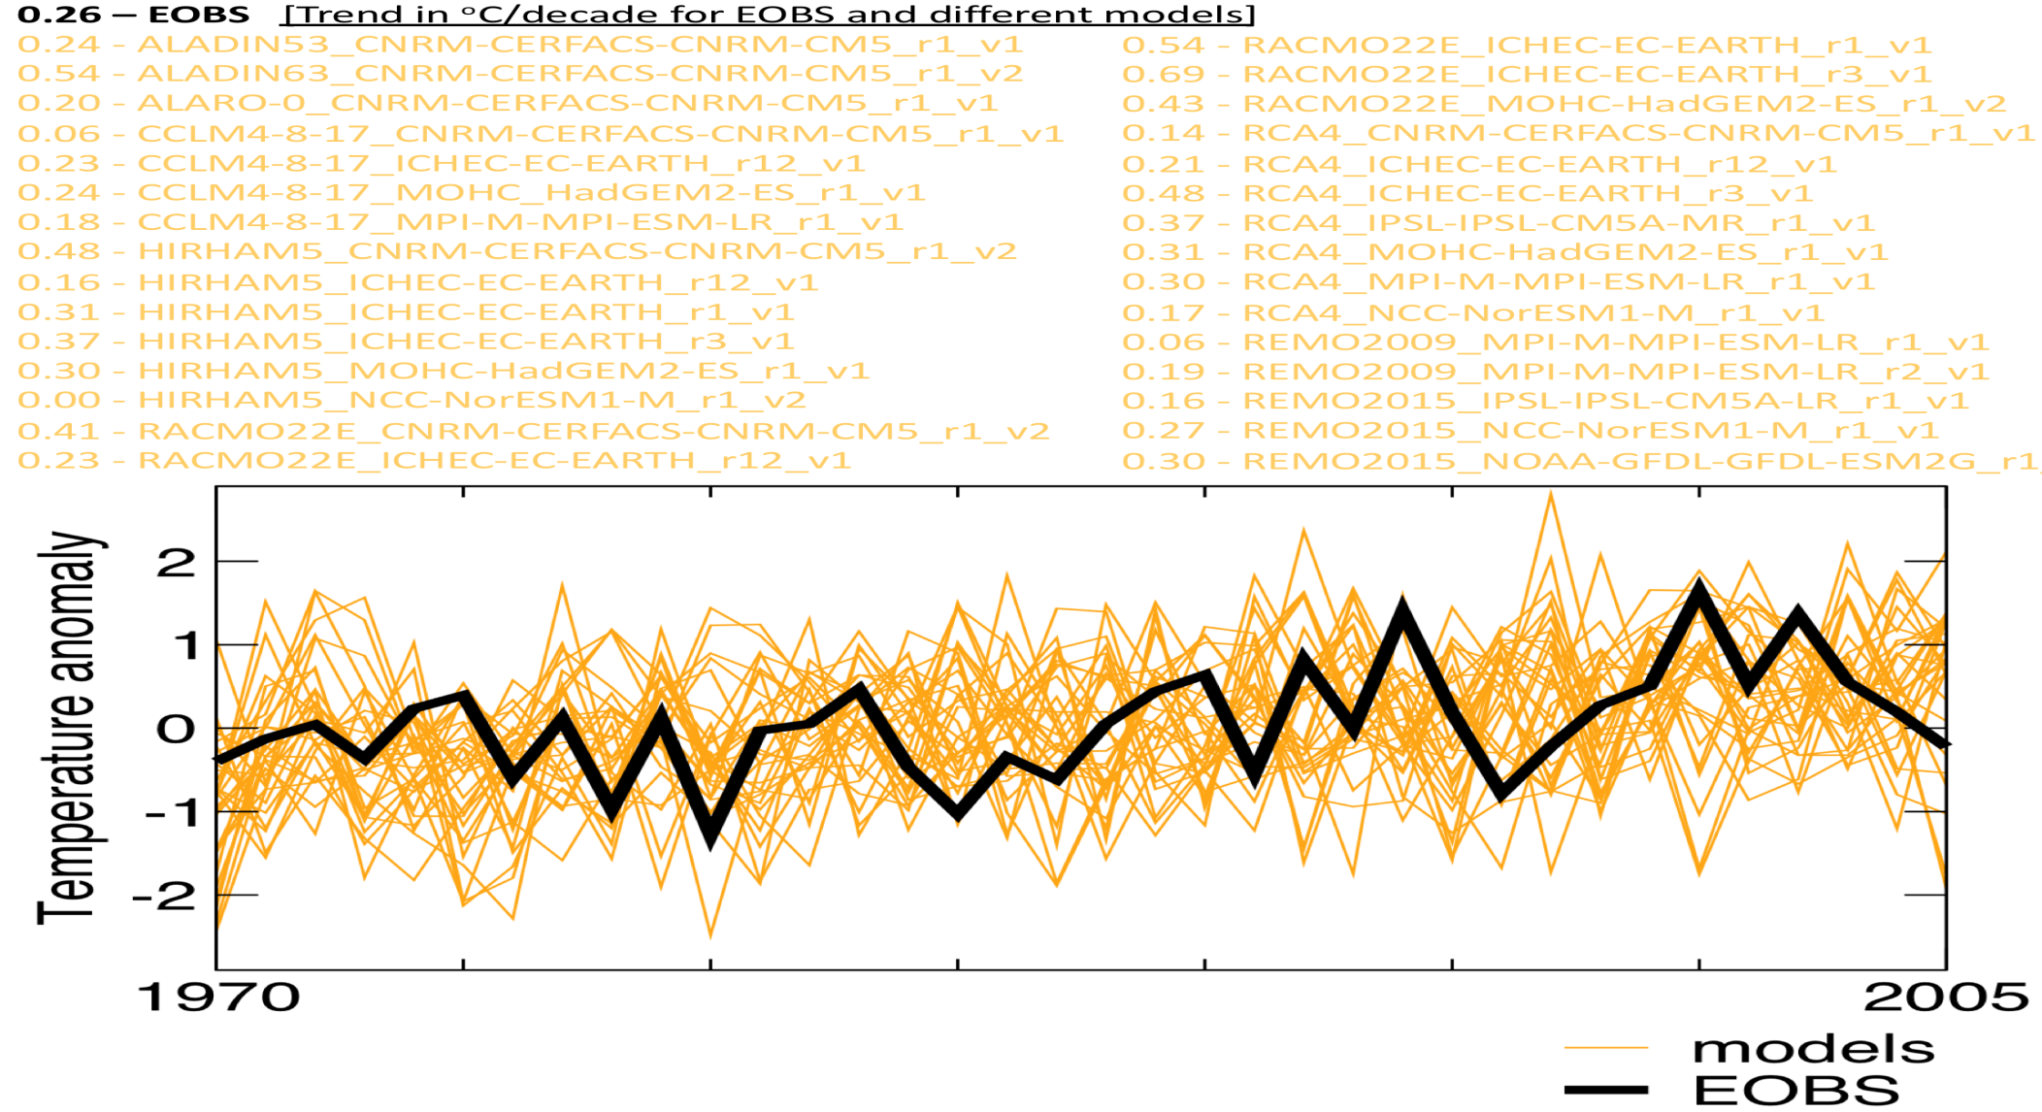
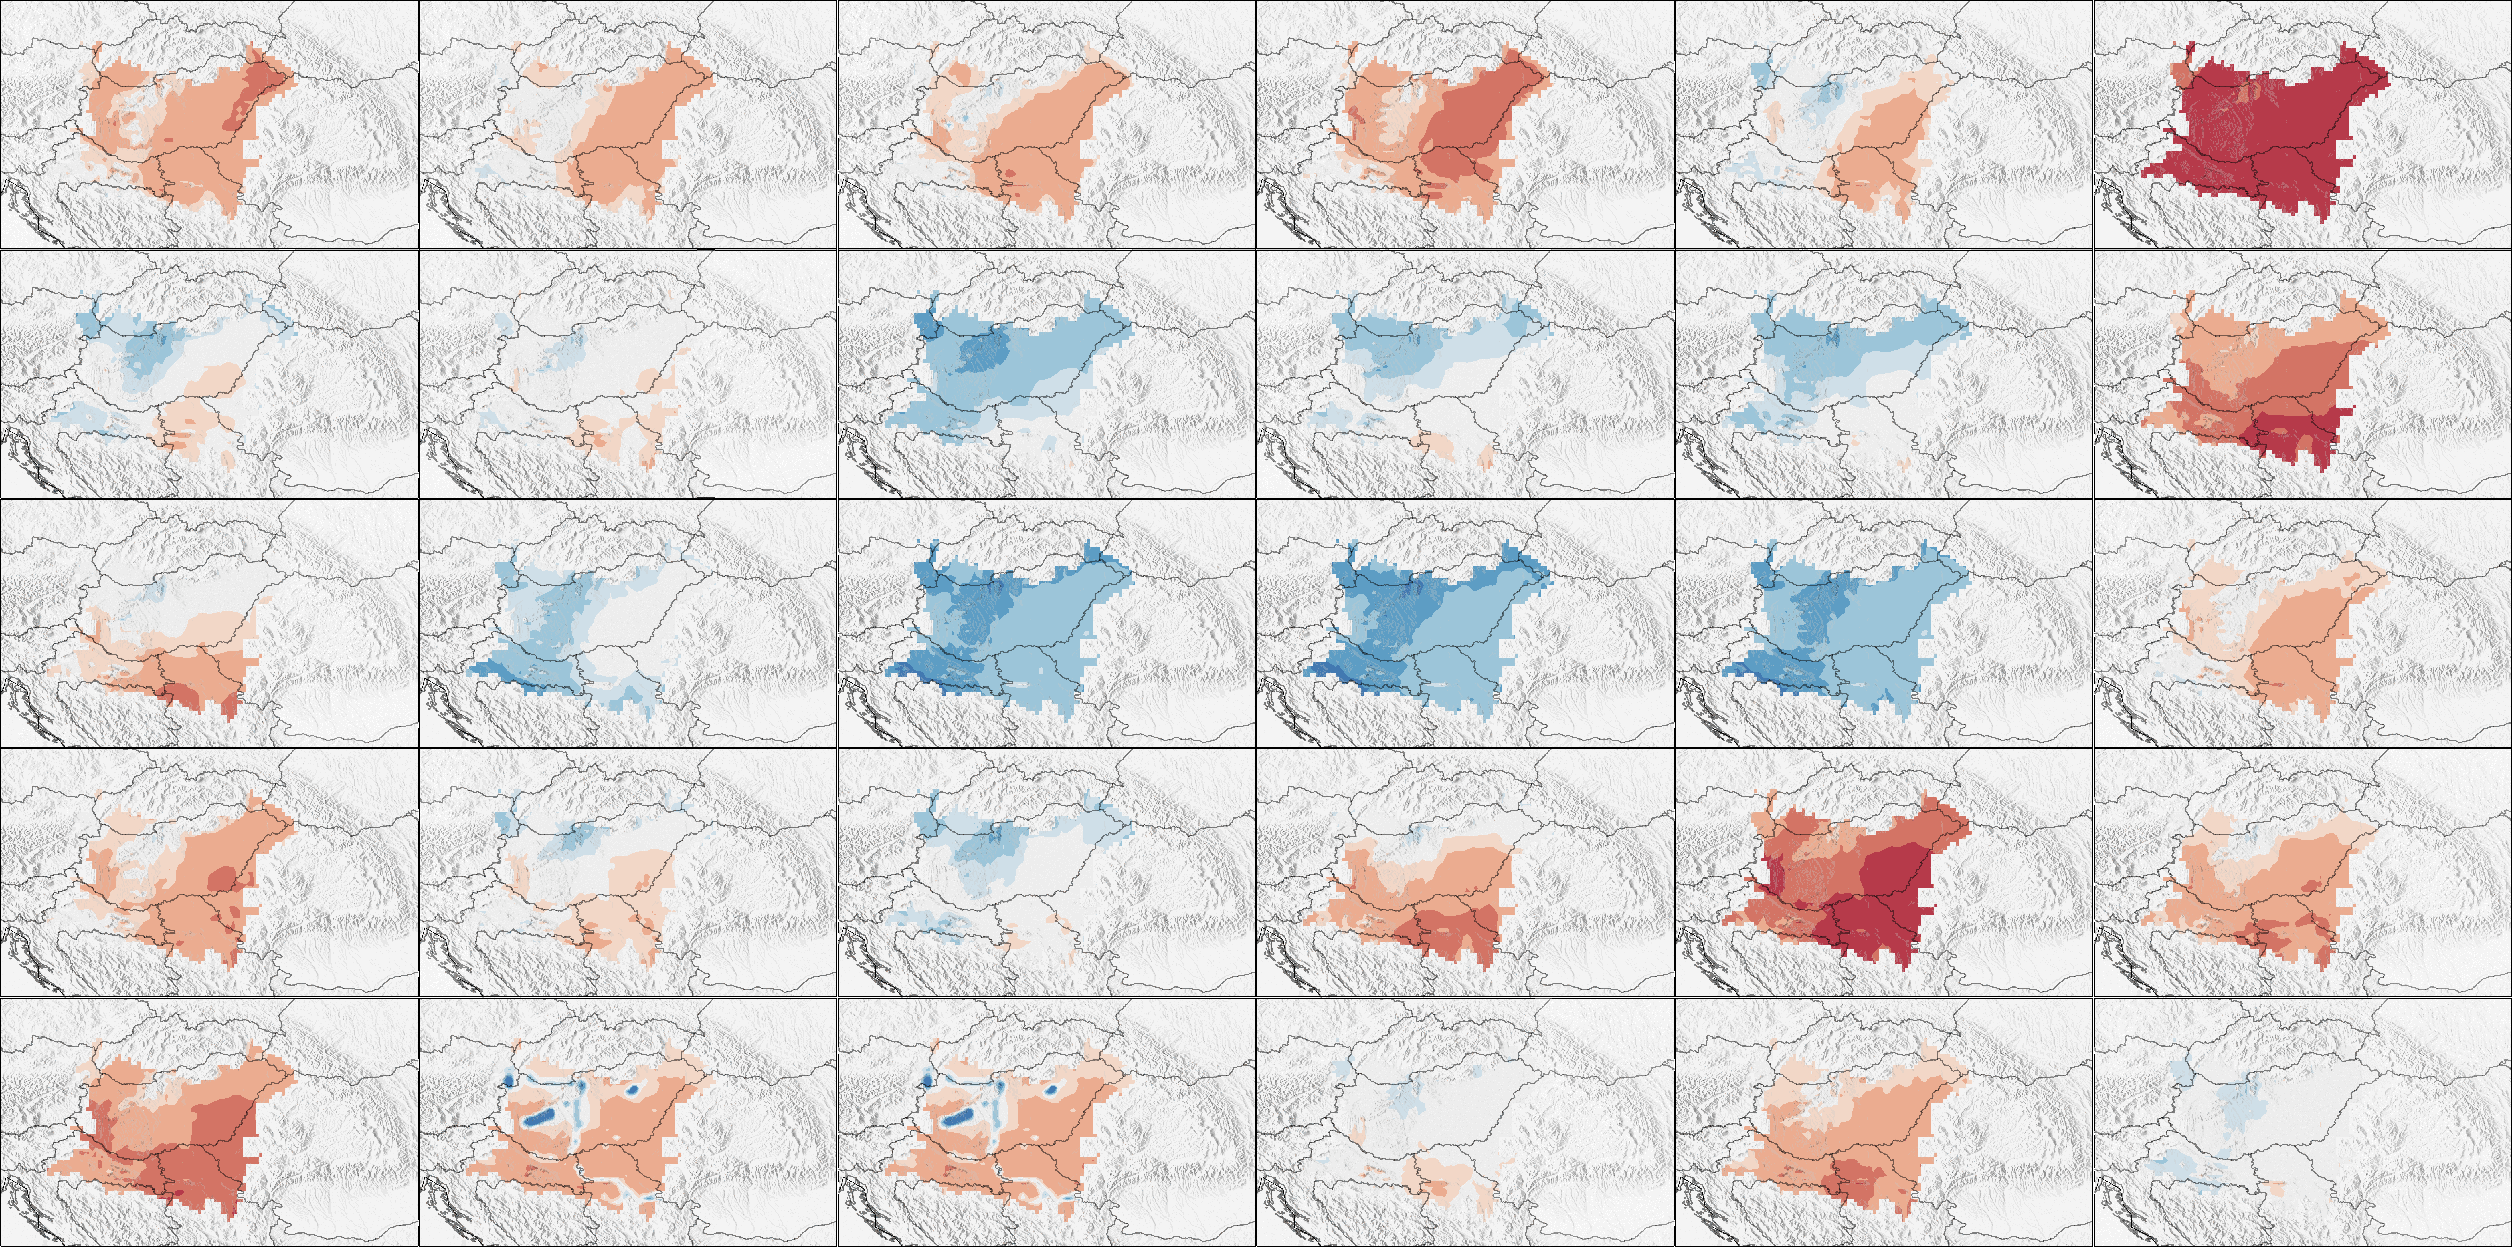
Temperature and precipitation verification over Pannonian Basin in EURO-CORDEX simulations during summer season
Irida Lazic, Vladimir Djurdjevic
University of Belgrade – Faculty of Physics, Institute of Meteorology
irida.lazic@ff.bg.ac.rs, vdj@ff.bg.ac.rs
Introduction
Materials and Methods
The verification of regional climate models (RCMs) is a standard methodology that help us to check credibility of RCMs’ results, and to tells us more about models' ability to reproduce the present-day climate.
In previous studies, it was noticed that many of the RCMs tend to overestimate the mean near surface air temperature in the Pannonian Basin during summer. Our intention for this study is to check does warm bias is also present in the state of the art EURO-CORDEX multi-model ensemble results.
Verification of EURO‐CORDEX regional climate models was carried out using E-OBS gridded data set of daily mean near surface air temperature and total precipitation amount with horizontal resolution 0.1 degree (approximately 11 km).
Model results from 9 different RCMs with horizontal resolution of 11 km, for daily mean near surface air temperature and precipitation were extracted from EURO-CORDEX database and verified over three different time periods: 1951-1980, 1961-1990 and 1971-2000. Since that some of RCMs were initialized and forced by lateral boundary conditions from different Global Climate Models (GCM) or with different realization of same GCM, there were 30 verified integrations in total.
Models’ skill for selected time periods was expressed in term of three verification scores: BIAS, root mean square error (RMSE) and spatial correlation coefficient. Finally the calculated scores are averaged over Pannonian Basin. Visualization of the verification result was done using Taylor diagram. Also, we estimate ability of models to reproduce temperature trends in Pannonian Basin during 1970-2005 time period.
Results and Discussion
We conclude from fig. 3 that 16 models from EURO-CORDEX ensemble tend to overestimate the mean near surface air temperature, 8 models tend to underestimate the mean near surface air temperature and 6 models tend to estimate near surface air temperature around E-OBS gridded data set during summer. The mean temperature BIAS for all 30 models for 1971-2000 time period in summer season over Pannonian Basin is 0.49$℃.$
The lowest temperature BIAS was found in results of REMO2015_NOAA-GFDL-GFDL-ESM2G_r1_v1 and this model has BIAS for all three time periods in summer season over Pannonian Basin around -0.13$℃$.
From fig. 4 we conclude that most of the models that overestimate the temperature, underestimate the precipitation in Pannonian Basin during summer. The mean precipitation BIAS for all 30 models for 1971-2000 time period in summer season over Pannonia Basin is -8.19 %.
The standard deviation is a valid measure of variability regardless of the distribution. For each model in Taylor diagram, three statistics are plotted: the Pearson correlation coefficient, the centered RMS error and the standard deviation. From fig. 1 and fig. 2 we notice that for the summer season presented scores show highest variability in comparison to other three seasons for both temperatures and precipitation. According to the presented diagrams in summer season for three time periods over Pannonian Basin standard deviation is in the range from 0.89$℃$ to 1.99$℃$, centered RMS error is in the range from 0.5$℃$ to 1.3 $℃$ and correlation coefficient is in the range from 0.52 to 0.86.
Fig. 1 – Taylor diagram for mean near surface air temperature in Pannonian Basin for 1971-2000 time period.
Fig. 2 – Taylor diagram for precipitation in Pannonian Basin for 1971-2000 time period.
Fig. 3 – Models’ skill in term of BIAS for mean near surface air temperature in Pannonian Basin for 1971-2000 time period.
Fig. 4 – Models’ skill in term of BIAS for precipitation in Pannonian Basin for 1971-2000 time period.
a)
b)
a)
b)
Fig. 5 – Taylor diagram for mean near surface air temperature in Pannonian Basin for time period a) 1951-1980, b)1961-1990.
Fig. 6 – Taylor diagram for precipitation in Pannonian Basin for time period a) 1951-1980, b)1961-1990.
2
3
4
6
Conclusions
1
5
According to the results, most of the models from EURO-CORDEX ensemble tend to overestimate the mean near surface air temperature and underestimate amount of precipitation in summer season in Pannonian Basin.
7
8
9
10
11
12
13
14
15
16
17
18
19
20
21
22
23
24
25
26
27
28
29
30
Fig. 7 – Temperature trends of the models from EURO-CORDEX ensemble and E-OBS during 1970-2005 time period. The number follows the list from fig. 1.
Fig. 8 – Models’ skill in term of BIAS for mean near surface air temperature in Pannonian Basin during summer for 1971-2000 time period. The numbers follows the list from fig. 1.

