Slide 1


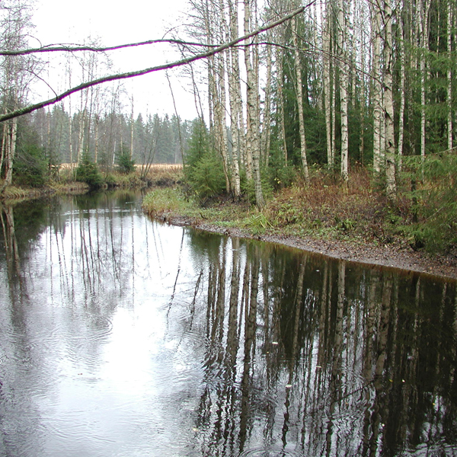
Long term brownification process at the Lammi LTER site in Finland
(INCA-C and MyLake modelling)
Katri Rankinen, Seppo Hellsten, Ninni Liukko, Maria Holmberg, Seppo Hellsten, Lauri Arvola and Juha Riihimäki

Slide 2
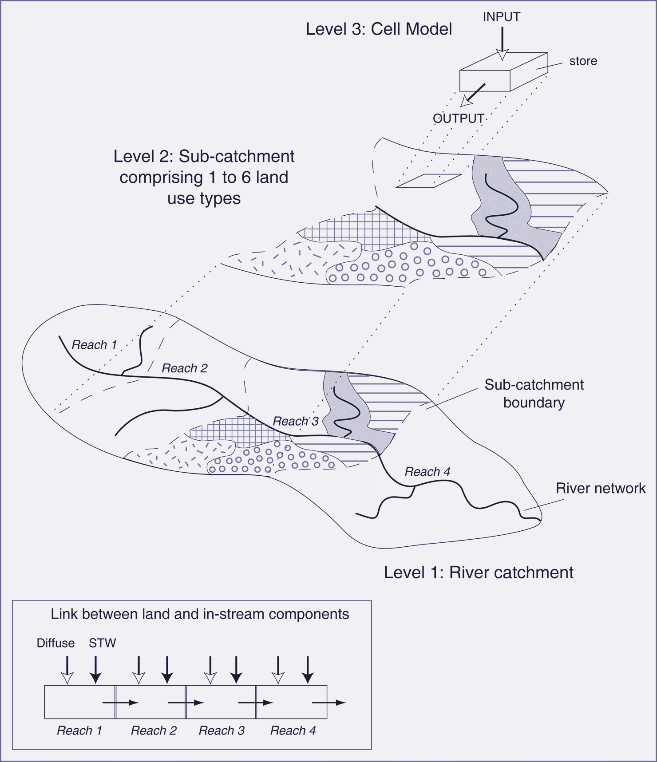
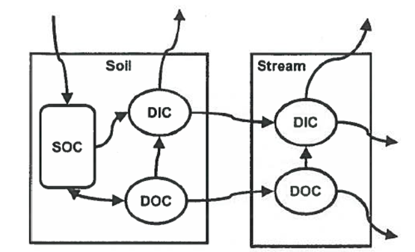
Dynamic and process based models
INCA-C: Calculates carbon transport from terrestrial environment to waters
MyLake / FOKEMA: Simulates lake water temperature and stratification and calculates DOC and its mineralization (both microbial and photochemical)

Slide 3
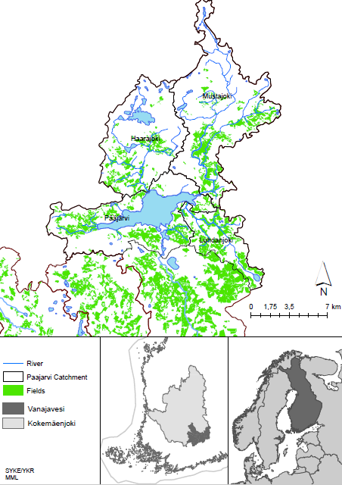
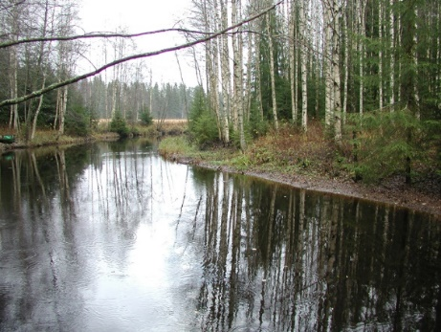
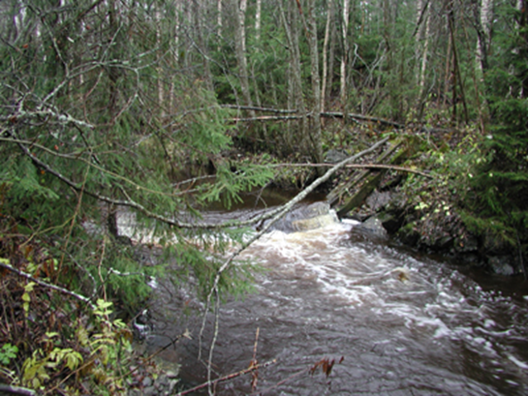
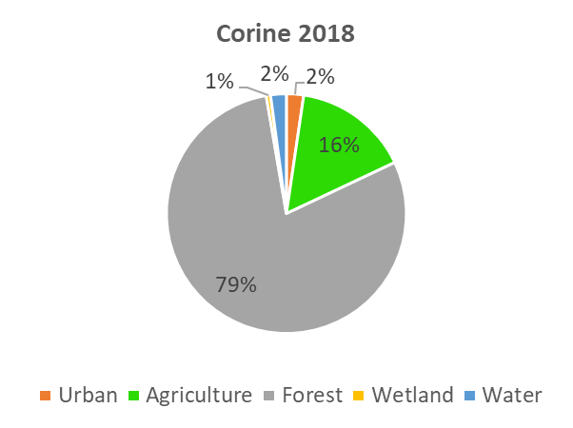
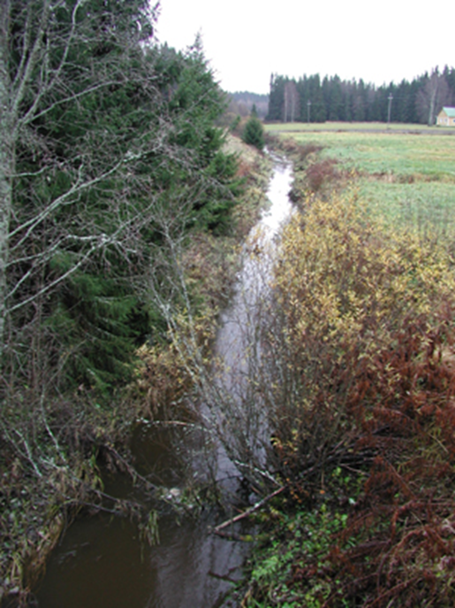
Lammi LTER site
Southern Boreal Aquatic and Terrestrial Long-Term Ecological Research Area
Lake Pääjärvi
3 well-monitored catchments

Slide 4
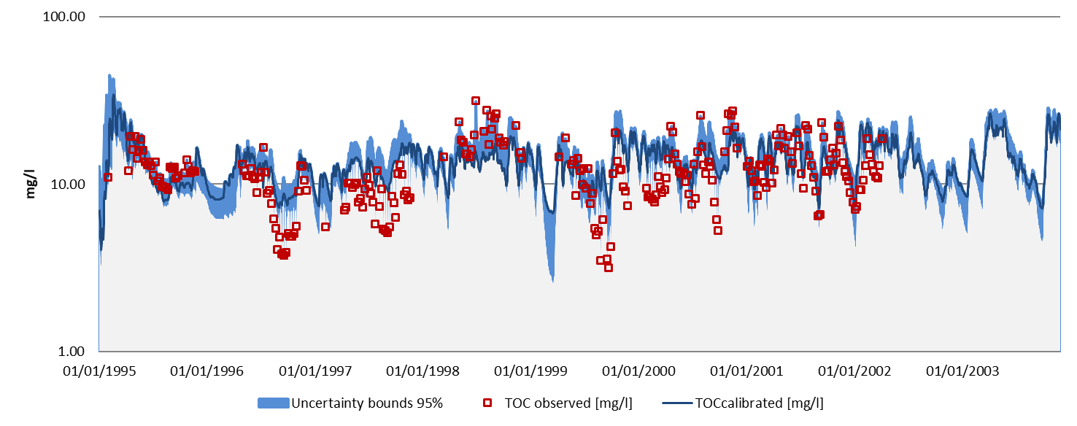
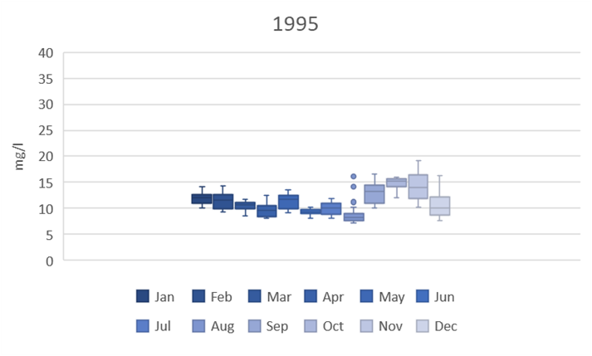
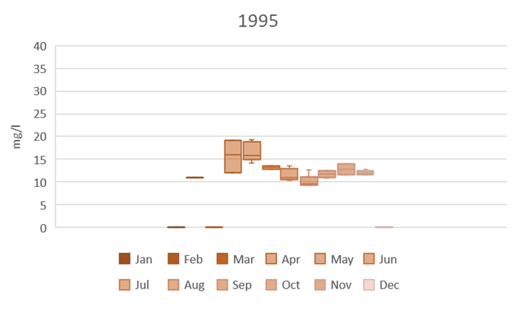
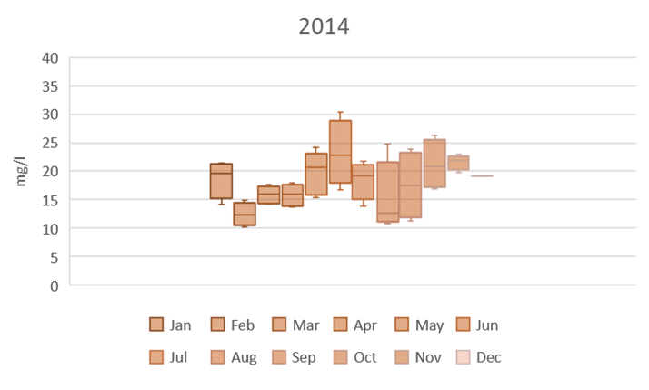
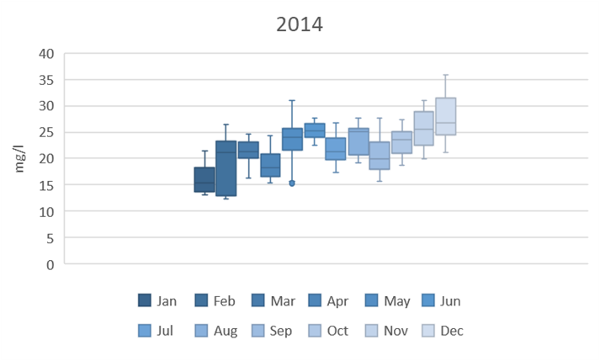
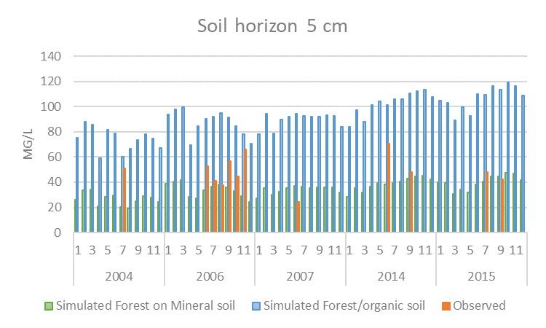
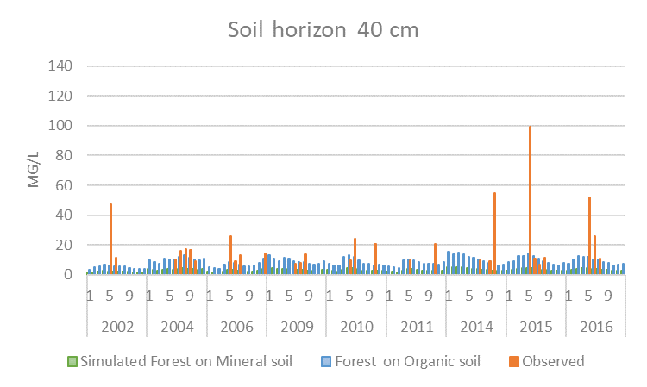
INCA-C:
Calibration/validation
Calibration against discharge and TOC concentration in river and soil water
Model is most sensitive to the amount of litterfall

Slide 5
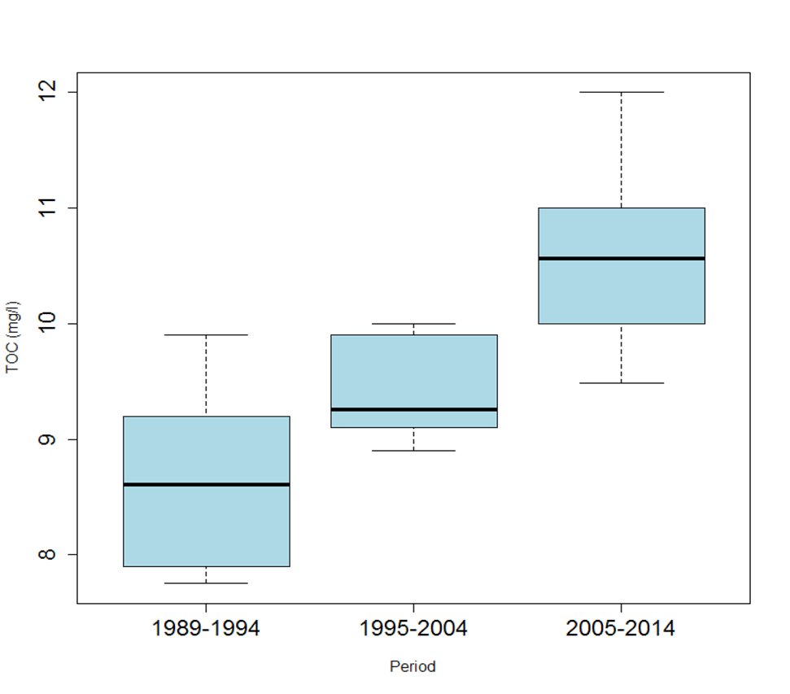
Lake Pääjärvi observations
Increase of TOC in the lake
MyLake modelling of TOC in the lake, input from INCA-C
Source of TOC is in organic soils at the catchment
Decay is increased due to increased temperature by 2 degrees since 1985

Slide 6
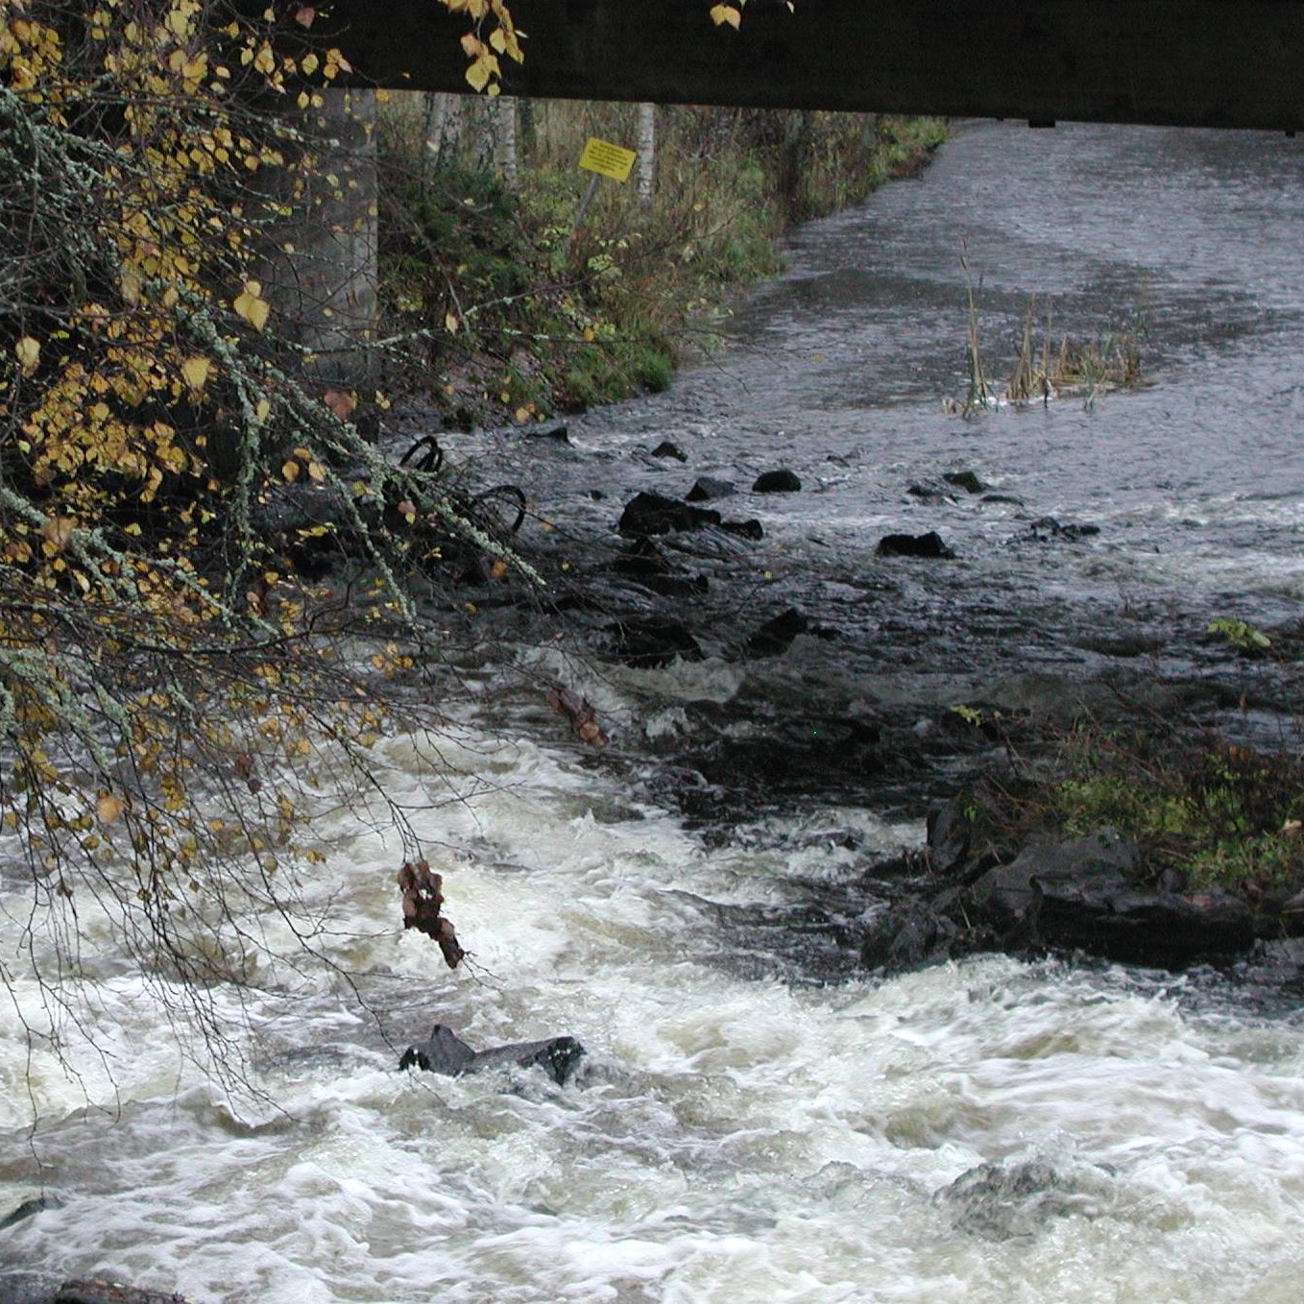
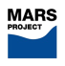

Next steps
1) Upscaling to larger basin
2) Connecting to biodiversity
Thank you for attention!

