Slide 1
A Monte Carlo Approach to Determine the Sensitivity of Bedform Analysis Methods
EGU – Session HS9.3, 6 May 2020
Julius Reich, German Federal Institute of Hydrology
Department M3: Fluvial Morphology, Sediment Dynamics and Management
reich@bafg.de

Slide 2
Introduction
Bedform geomteries can be derived from multibeam echo sounding data. There are methods to identify the individual attributes (length, height and shape) and to discriminate the geometries into several layers. The calculated results, however, strongly depend on the setting of various input parameters. For choosing the values for these parameters there are mostly no theoretically sound criteria and the process itself is also strongly influenced by the individual experience of the researcher. If repeated several times by several researchers the analysis of the same data set would ultimately lead to different results. Only by means of a structured and traceable approach the level of inherent subjectivity and uncertainties can be reduced.
For this purpose, we developed an algorithm in which a Monte Carlo-like simulation is performed. This way, the sensitivity of all input parameters can be analyzed and the possible range of results is quantified.
(taken from abstract, submitted to session HS9.3)

Slide 3
Outline
1
Bedform Analysis Method
2
Monte Carlo Approach - Example Data Record Parana River
All data from Parana River downloaded from https://sourceforge.net/projects/bedforms-atm/

Slide 4
1
Bedform Analysis Method

Slide 5
Bedform Analysis Method A Combination of two existing software tools
Bedform Analysis Method
Bedforms-ATM (1)
Rheno BT (2)
Wavelet analysis & Detrending
Zerocrossing procedure for determination of bedform geometries & statistical evaluation
The existing tools were combined in an R-script and in places slightly modified and extended
Steps 1 and 2 are assigned to Bedforms ATM, steps 3 and 4 to Rheno BT, while step 5 has been newly added

Slide 6
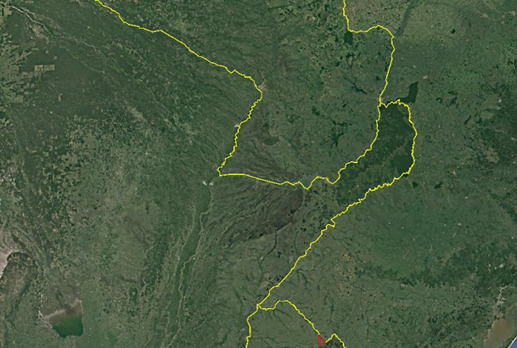
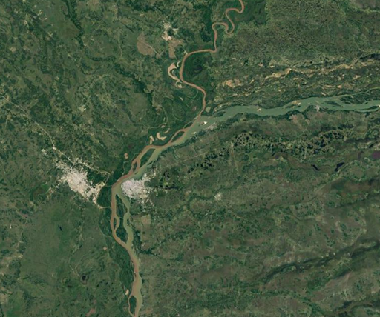
Bedform Analysis Method Location of example data record from Parana River
Paraguay River
Paraguay
Parana River
Argentina
Corrientes
Brazil
Uruguay
Source: Google Earth

Slide 7
Bedform Analysis Method References for software and data
Bedforms-ATM
(1) Gutierrez, R.R., Mallma, J.A., Núñez-González, F., Link, O. and Abad, J.D., 2018. Bedforms-ATM, an open source software to analyze the scale-based hierarchies and dimensionality of natural bed forms. SoftwareX, 7, pp.184-189.
Gutierrez, Ronald & Abad, Jorge & Parsons, Daniel & Best, James. (2013). Discrimination of bed form scales using robust spline filters and wavelet transforms: Methods and application to synthetic signals and bed forms of the Río Paraná, Argentina. Journal of Geophysical Research: Earth Surface. 118. 10.1002/jgrf.20102.
Rheno BT
(3) Frings, R.M., Gehres, N., de Jong, K., Beckhausen, C., Schüttrumpf, H. and Vollmer, S., 2012. Rheno BT, User Manual, Institute of Hydraulic Engineering and Water Resources Management, RWTH Aachen University.
Example Data Record Parana River
(4) https://sourceforge.net/projects/bedforms-atm/

Slide 8
Bedform Analysis Method Step 1 – Wavelet analysis
Provides information about predominant wavelengths in a given profile
Initial indication of the dimensions of the present bedforms
If several bedform layers are in superposition, several wavelengths are identified
Determined wavelengths are used as window sizes in the zerocrossing procedure (Step 3)

Slide 9
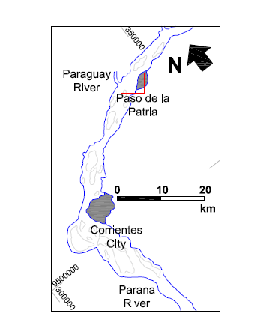
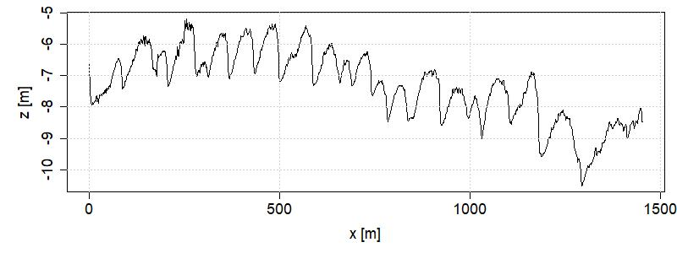
Bedform Analysis Method Step 1 – Wavelet analysis
Location of example data record
Selected profile
Source:
Guitierrez et al. (2)
Uruguay
Source: Google Earth

Slide 10
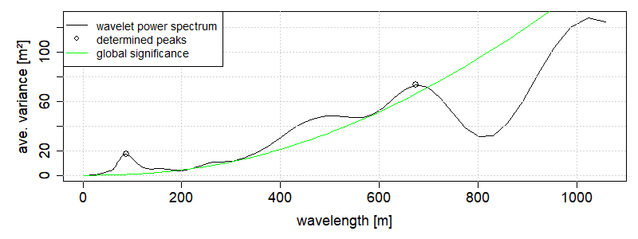
Bedform Analysis Method Step 1 – Wavelet analysis
Profile
window size layer 1: 87 m
window size layer 2 : 674 m
window size layer 2: 674 m
Wavelet Analysis
window size layer 1: 87 m

Slide 11
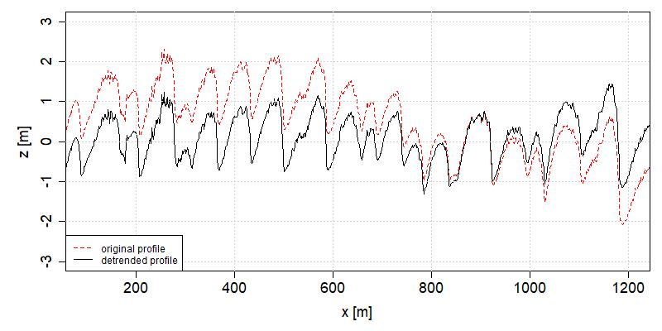
Bedform Analysis Method Step 2 – Detrending
In order to eliminate the influence of the slope and large-scale structures the initial profile is detrended
Robust spline filter procedure

Slide 12
Bedform Analysis Method Step 3 - Zerocrossing
Objective
Discrimination of the profile into separate bedform layers
Determination of individual bedform geometries
Procedure
Calculation of a moving average over the detrended profile (window size according to wavelet analysis)
Calculation of the intersection points of moving average and profile (zerocrossings)
Determination of the local minima between two zerocrossings
Creation of a buffer area around the moving average (setting a zc-threshold), in order to prevent the identification of very small-scale bedform geometries
Connection of the filtered minima to a baseline
Repeat procedure for second bedform layer

Slide 13
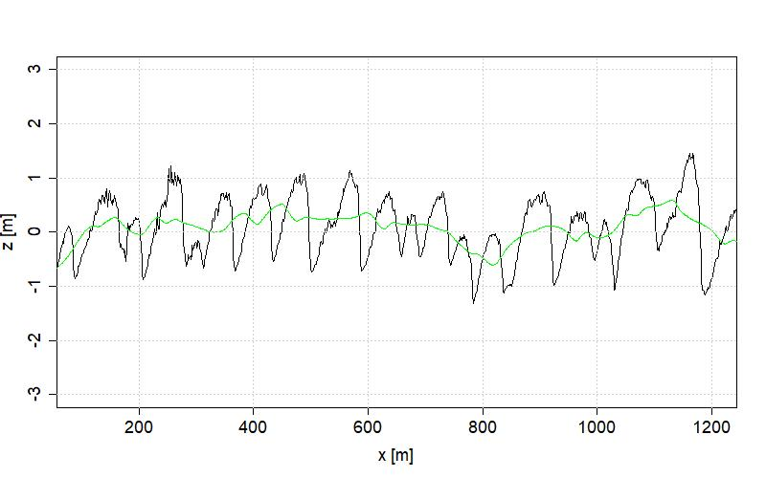
Bedform Analysis Method Step 3.1 – Calculation of a moving average
chosen window size: 87 m
43.5 m
43.5 m
Window size 1: Input parameter for Monte Carlo Simulation →
2

Slide 14
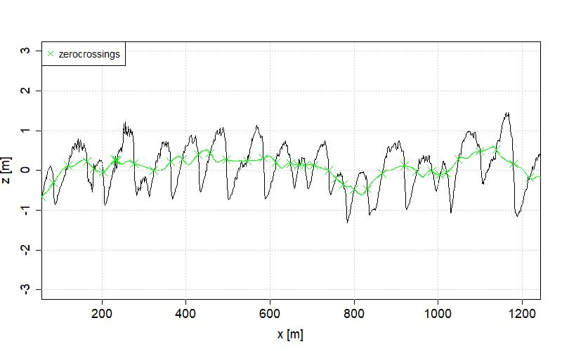
Bedform Analysis Method Step 3.2 – Determination of the zerocrossings

Slide 15
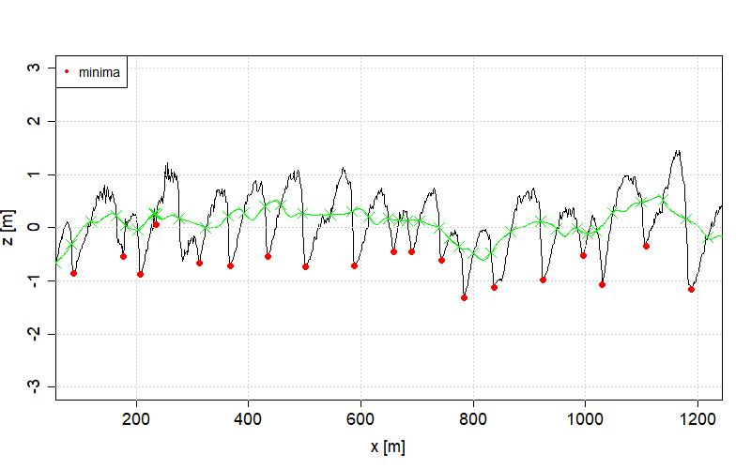
Bedform Analysis Method Step 3.3 – Calculation of the local minima

Slide 16
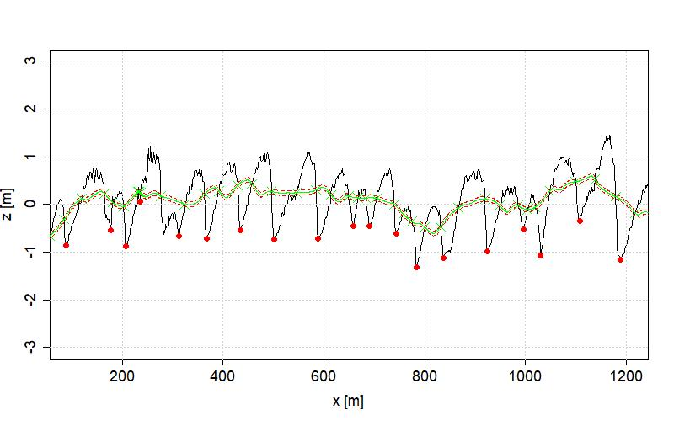
Bedform Analysis Method Step 3.4 – Setting zc-threshold
buffer area = 2 * zc-threshold
zc-threshold: Input parameter for Monte Carlo Simulation →
2

Slide 17
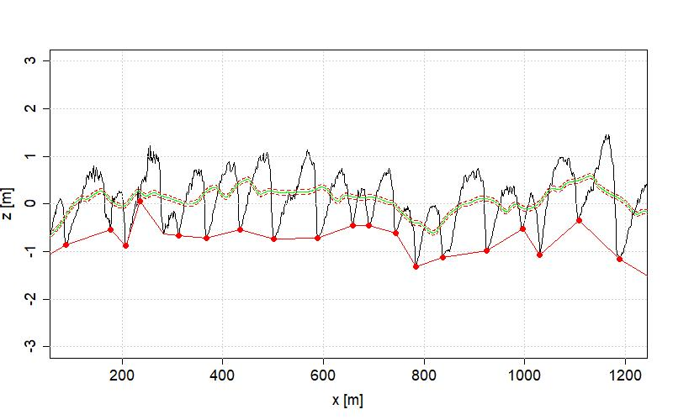
Bedform Analysis Method Step 3.5 – Connection of filtered minima

Slide 18
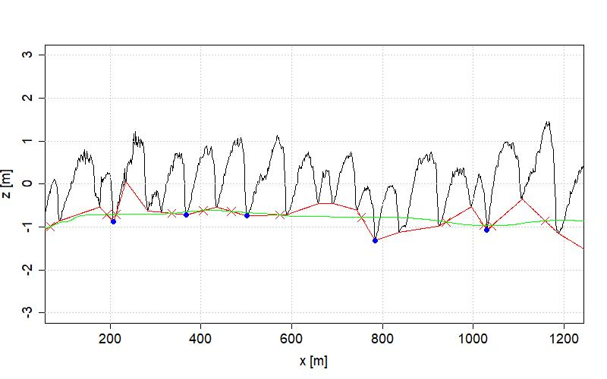
Bedform Analysis Method Step 3.6 – Repeat procedure for the next layer

Slide 19
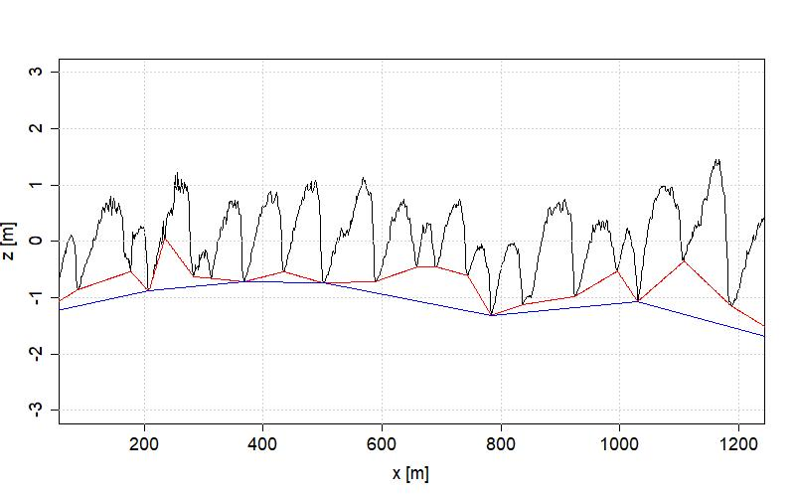
Bedform Analysis Method Step 3 – Final discrimination
Layer 1
Layer 2

Slide 20
Bedform Analysis Method Step 4 – Calculation of individual bedform parameters
H
L
H
L
H = Heigth
L = Length

Slide 21
Bedform Analysis Method Step 4 – Calculation of individual bedform parameters
Layer 1
ID | x_start | x_end | z_start | z_end | zc_threshold | window_length | length | heigth | points | area | shape_factor
1 | 7 | 24 | -1.337 | -1.272 | 0.05 | 87 | 17 | 0.241 | 18 | 1.545 | 0.753
2 | 24 | 88 | -1.272 | -0.86 | 0.05 | 87 | 64 | 1.042 | 65 | 31.172 | 0.935
3 | 88 | 177 | -0.86 | -0.534 | 0.05 | 87 | 89 | 1.449 | 90 | 71.102 | 1.102
4 | 177 | 207 | -0.534 | -0.88 | 0.05 | 87 | 30 | 1.044 | 31 | 22.127 | 1.413
5 | 211 | 235 | -0.792 | 0.056 | 0.05 | 87 | 24 | 0.403 | 25 | 3.263 | 0.674
6 | 235 | 283 | 0.056 | -0.628 | 0.05 | 87 | 48 | 1.474 | 49 | 43.087 | 1.218
7 | 283 | 313 | -0.628 | -0.657 | 0.05 | 87 | 30 | 0.489 | 31 | 8.361 | 1.141
8 | 313 | 368 | -0.657 | -0.717 | 0.05 | 87 | 55 | 1.433 | 56 | 50.647 | 1.285
9 | 368 | 435 | -0.717 | -0.538 | 0.05 | 87 | 67 | 1.484 | 68 | 60.145 | 1.21
10 | 435 | 501 | -0.538 | -0.741 | 0.05 | 87 | 66 | 1.787 | 67 | 70.705 | 1.199
11 | 501 | 589 | -0.741 | -0.714 | 0.05 | 87 | 88 | 1.861 | 89 | 85.522 | 1.045
12 | 589 | 658 | -0.714 | -0.459 | 0.05 | 87 | 69 | 1.288 | 70 | 47.809 | 1.076
13 | 658 | 691 | -0.459 | -0.452 | 0.05 | 87 | 33 | 0.773 | 34 | 15.239 | 1.194
14 | 691 | 744 | -0.452 | -0.606 | 0.05 | 87 | 53 | 1.319 | 54 | 40.405 | 1.156
15 | 744 | 784 | -0.606 | -1.312 | 0.05 | 87 | 40 | 0.981 | 41 | 24.19 | 1.232
16 | 784 | 837 | -1.312 | -1.122 | 0.05 | 87 | 53 | 1.149 | 54 | 39.495 | 1.297
17 | 837 | 924 | -1.122 | -0.979 | 0.05 | 87 | 87 | 1.756 | 88 | 92.028 | 1.204
18 | 925 | 996 | -0.974 | -0.527 | 0.05 | 87 | 71 | 1.098 | 72 | 45.252 | 1.161
19 | 996 | 1030 | -0.527 | -1.069 | 0.05 | 87 | 34 | 1.04 | 35 | 21.55 | 1.219
20 | 1030 | 1108 | -1.069 | -0.351 | 0.05 | 87 | 78 | 1.67 | 79 | 86.426 | 1.327
21 | 1108 | 1187 | -0.351 | -1.145 | 0.05 | 87 | 79 | 2.387 | 80 | 98.004 | 1.039
22 | 1188 | 1294 | -1.151 | -1.833 | 0.05 | 87 | 106 | 1.967 | 107 | 122.313 | 1.173
23 | 1295 | 1333 | -1.822 | -0.811 | 0.05 | 87 | 38 | 0.335 | 39 | 5.657 | 0.89
24 | 1333 | 1414 | -0.811 | -0.196 | 0.05 | 87 | 81 | 0.848 | 82 | 37.926 | 1.105
25 | 1414 | 1432 | -0.196 | 0.104 | 0.05 | 87 | 18 | 0.342 | 19 | 3.62 | 1.176
26 | 1432 | 1453 | 0.104 | 0.335 | 0.05 | 87 | 21 | 0.49 | 22 | 5.129 | 0.996

Slide 22
Bedform Analysis Method Step 5 – What is the total bedform heigth?
In order to determine the total bedform height in the considered section two statistical parameters are calculated*:
T90 parameter: 90%-percentile of differences between the height of the initial profile and the position of the lowest baseline in each profile point
H50+90 parameter: 50%-percentile of the heigths of the first layer + 90%-percentile of the heigths of the second layer
* Idea based on discussions with Tobias Schruff, RWTH Aachen

Slide 23
Bedform Analysis Method Step 5 – Calculation of total bedform heigth (T90)
Ti
Ti-1
Ti+1
∆x
∆x
T90
90%-percentile of all Ti along profile with spatial distance ∆x
For this profile T90 = 1.84 m, ∆x = 1 m

Slide 24
Bedform Analysis Method Step 5 – Calculation of total bedform heigth (H50+90)
Layer 1
ID | heigth [m]
21 | 2.387
22 | 1.967
11 | 1.861
10 | 1.787
17 | 1.756
20 | 1.67
9 | 1.484
6 | 1.474
3 | 1.449
8 | 1.433
14 | 1.319
12 | 1.288
16 | 1.149
18 | 1.098
4 | 1.044
2 | 1.042
19 | 1.04
15 | 0.981
24 | 0.848
13 | 0.773
26 | 0.49
7 | 0.489
5 | 0.403
25 | 0.342
23 | 0.335
1 | 0.241
Layer 2
ID | heigth [m]
6 | 0.944
2 | 0.907
4 | 0.672
5 | 0.575
7 | 0.492
1 | 0.414
3 | 0.191
90%-percentile = 0.92
For this profile H50+90 = 2.04 m
50%-percentile = 1.12

Slide 25
Bedform Analysis Method Workflow
Module 1
Bedforms-ATM
Wavelet analysis
Detrending
Window sizes
Zerocrossing
Profile
Baseline for bedform layer 1
Zerocrossing
Module 2
Module 2
Rheno BT
Rheno BT
Baseline for bedform layer 2
Calculation of individual attributes & total bedform heigths

Slide 26
2
Monte Carlo Approach – Example Data Record Parana River

Slide 27
Monte Carlo Approach Introduction
Research questions
How to define the input parameters when running modules 1 and 2?
How does the definition influence the results?
How great are the uncertainties in terms of total bedform heights?
Monte Carlo Approach
Covers all relevant input parameters
1000 calculation runs with varying input values
By performing a Monte Carlo Simulation, the sensitivity (in terms of total bedform heigth) of each parameter can be evaluated

Slide 28
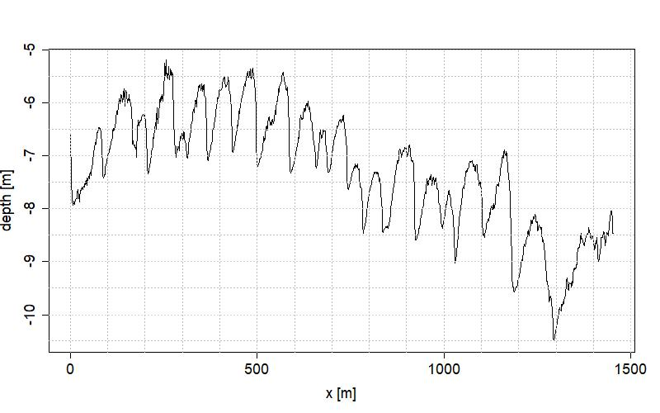
Monte Carlo Approach Example Data Record - Parana River (selected profile)
Notes:
Profile

Slide 29
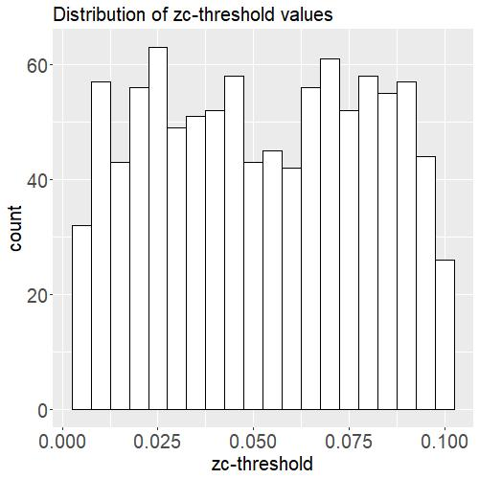
Monte Carlo Approach Example Data Record – Parana River Varying zc-threshold values
No theoretically sound criteria for choosing a value
Generation of 1000 random values between 1 cm and 10 cm
Equal distribution
Notes:
Distribution of ZC-Threshold

Slide 30
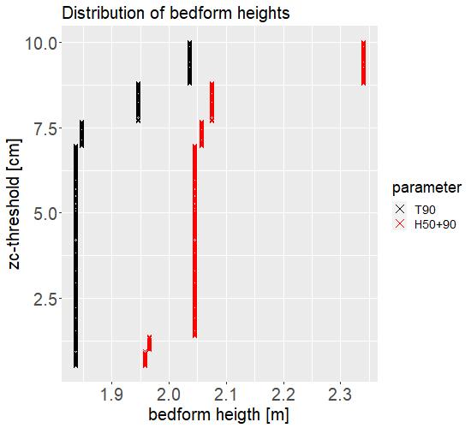
Monte Carlo Approach Example Data Record – Parana River Varying zc-threshold values
Results:
T90: Abrupt changes occur for zc-thresholds > 7 cm
H50+90: Abrupt changes occur for even smaller values
Notes:
results of ZC-Threshold

Slide 31
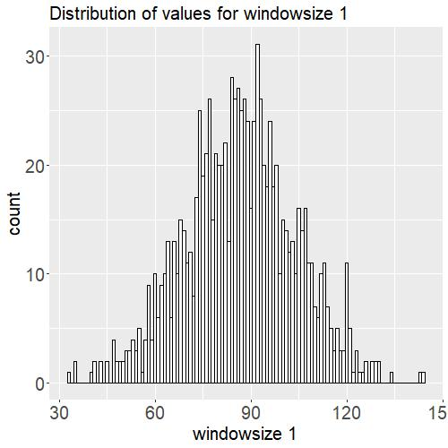
Monte Carlo Approach Example Data Record - Parana River Varying values for window size 1
The wavelet analysis provides an orientation, but is not a definitive measure
Indication from wavelet analysis at 87 m
Normal distribution around this value
Notes:
Distribution of WS1

Slide 32
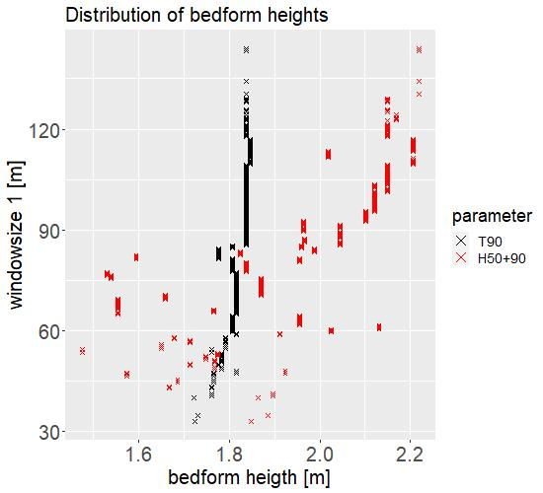
Monte Carlo Approach Example Data Record - Parana River Varying values for window size 1
Results:
T90: Fluctuates in a range between 1.70 m and 1.85 m
H50+90: Fluctuates in a much wider range between 1.50 m and 2.20 m
This shows that the H50+90 parameter is unsuitable due to dispersion, while the T90 parameter behaves much more robust
Notes:
results of WS1

Slide 33
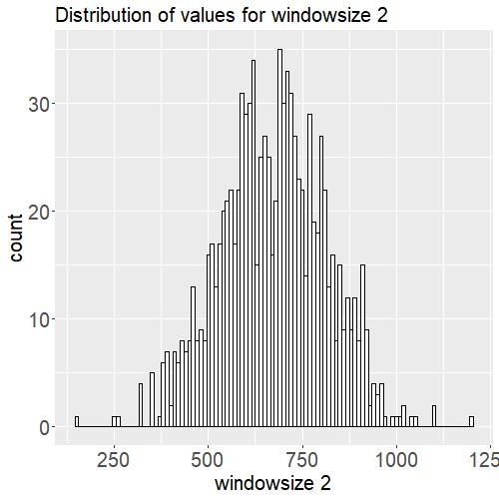
Monte Carlo Approach Example Data Record - Parana River Varying values for window size 2
Indication from wavelet analysis at 674 m (almost half of the profile length!)
Normal distribution around this value
Notes:
Distribution of WS2

Slide 34
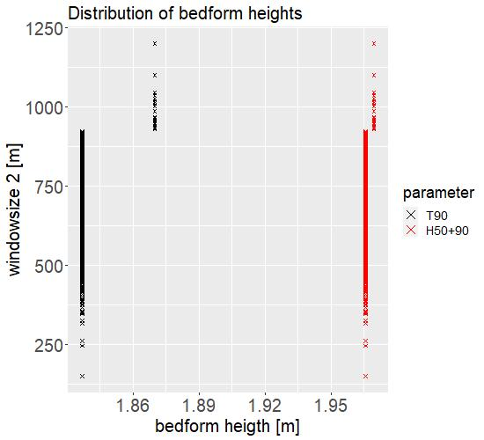
Monte Carlo Approach Example Data Record - Parana River Varying values for window size 2
Results:
No variations for values smaller than 900 m
Reason in extent of initial window size (almost half of the profile length)
Notes:
Results of WS2

Slide 35
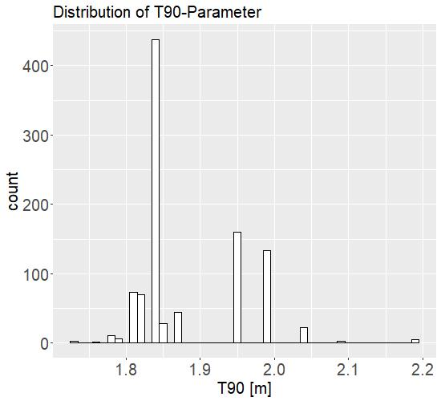
Monte Carlo Approach Example Data Record - Parana River Variation of all parameters at the same time
Range of the T90-parameter can be found between 1.65 m and 2.20 m
More than 40% of the results are at a value of 1.84 m
Notes:
Results for full MC

Slide 36
Conclusions
A software tool has been developed with which it is possible to perform a Monte Carlo Simulation for the calculation procedure of bedform parameters
In some cases there are no definitive criteria for defining the input parameters - Here, the Monte Carlo Simulation reveals a wide range of results
By applying the Monte Carlo approach, the chosen values for the input parameters can be validated, resulting in a robust estimate of the total bedform heights
In the course of dimensioning waterways, bedform height is a decisive factor (ensuring the navigable depth especially in low/mean flow conditions)

