Slide 1
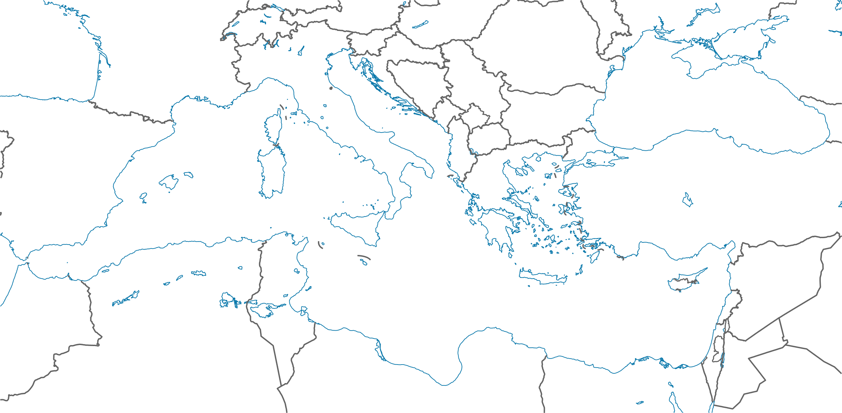
Sustainable management of politically and economically relevant water resources in highly dynamic carbonate aquifers of the Mediterranean
Project duration: July 2017 – December 2020
Paul Hepach, M.Sc.
Project coordination: Prof. Dr. Irina Engelhardt
Technische Universität Berlin – Hydrogeology Department

Slide 2
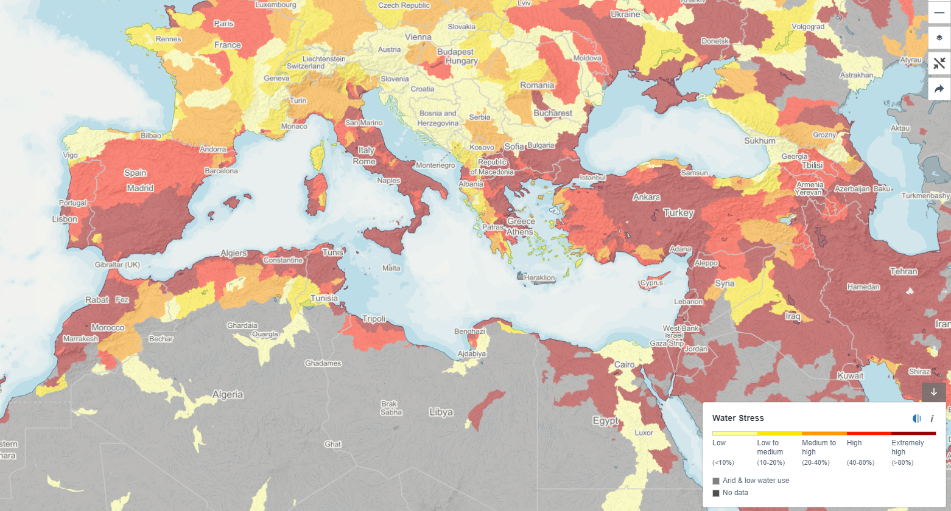
Water stress in the Mediterranean
Projected water stress (water demand by human society divided by available water) in the Mediterranean in 2040 (Business as usual scenario) (Water Risk Atlas, World Resources Institute)
Paul Hepach
Notes:
The Mediterranean region is a “hotspot” for climate change: erratic precipitation & temperature increase
Expected population growth and increase in density

Slide 3
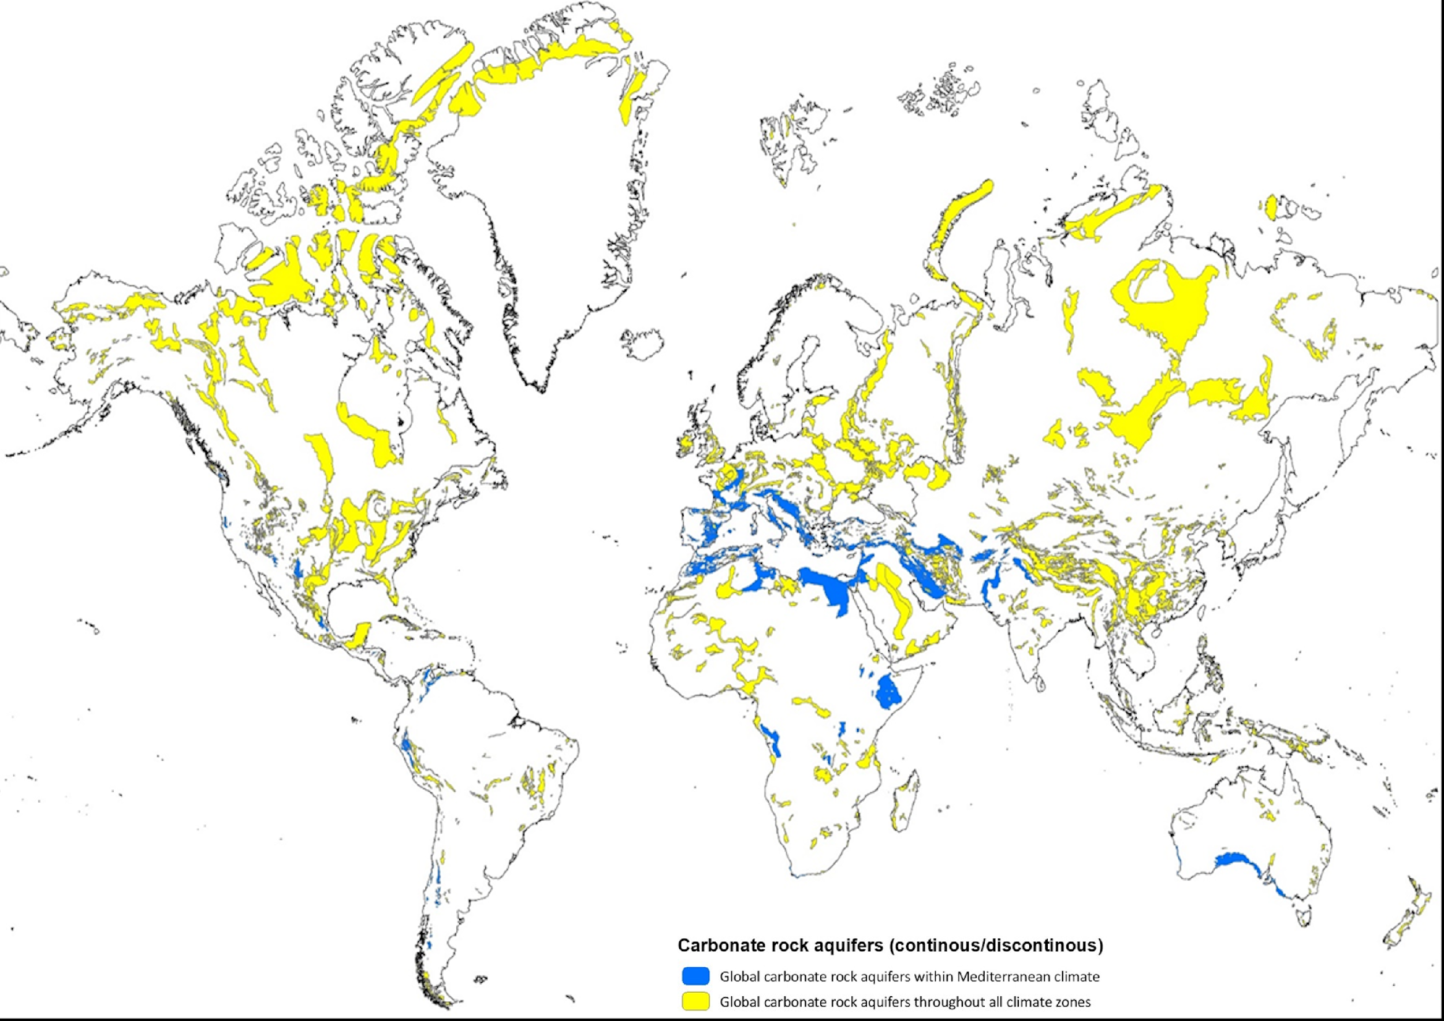
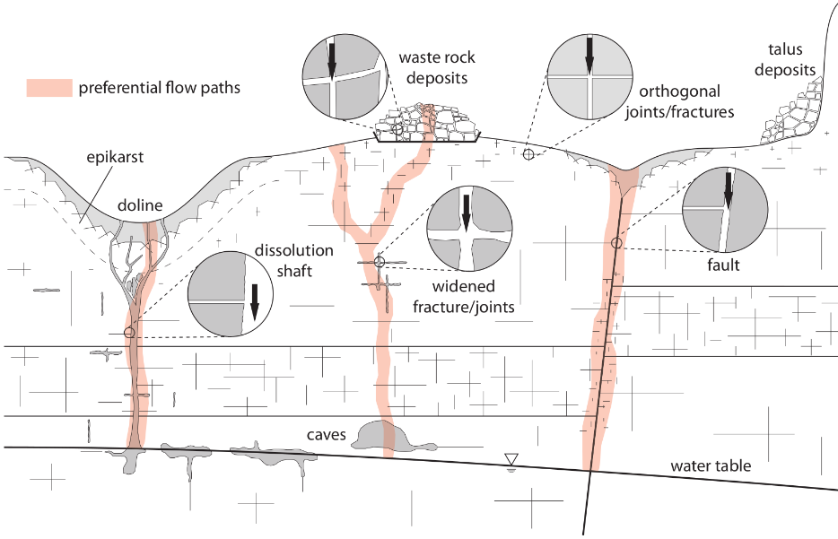
Motivation
Karst aquifers supply circa 10% of the world population with drinking water (Stevanović, 2018)
They show highly variable hydraulic responses to hydrological events
Karst aquifers need more dedicated & flexible management concepts
Karst aquifers (yellow) under Mediterranean climates (blue) (University of Würzburg, 2019)
Conceptual representation of vadose flow in fractured and karstic rocks (Kordilla et al., 2017)
Paul Hepach

Slide 4
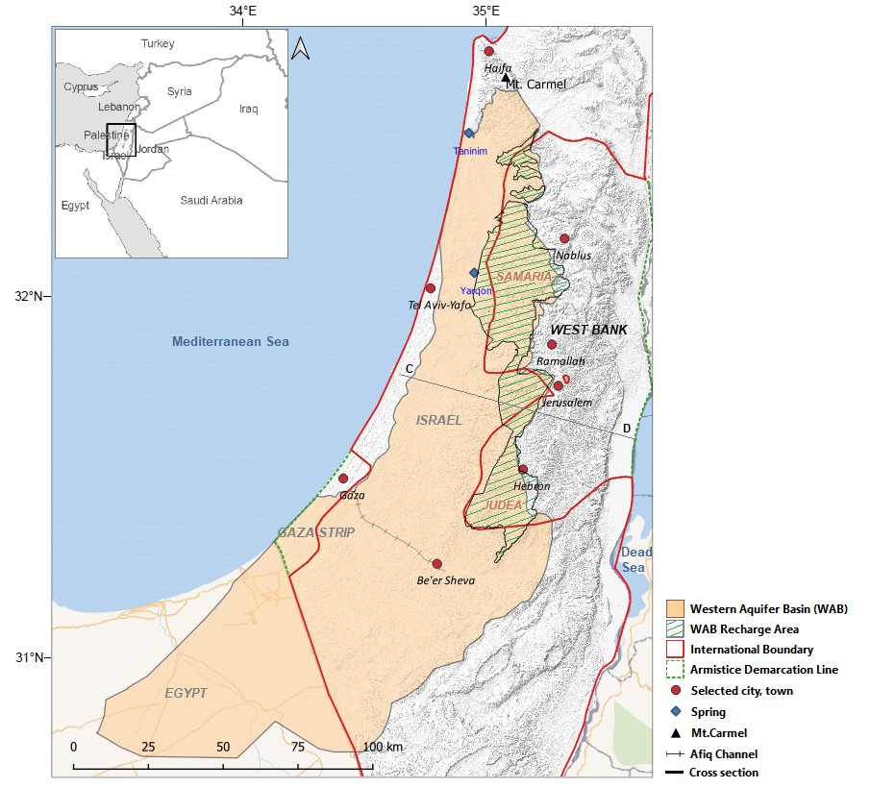
MedWater - Project overview & study site
MedWater develops new strategies and management tools for the sustainable use of scarce groundwater resources from karst aquifers in the Mediterranean
Contribution to SDG 6 – Ensure availability and sustainable management of water and sanitation for all
Study Site:
Western Mountain Aquifer (Israel & Palestinian territories)
Hydrological „active“ region: 6,000km² (Abusaada, 2011)
Recharge area / study site: 1,800 km²
Well-developed karst aquifer, structure and response to recharge uncertain
Actively managed since the 1950s
Paul Hepach

Slide 5
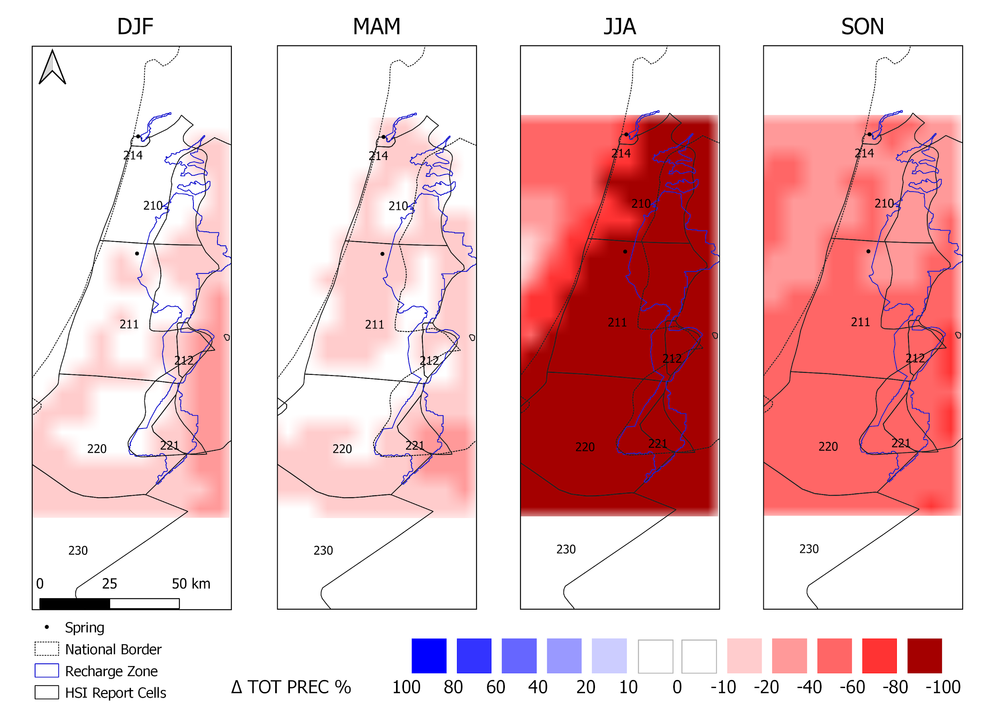
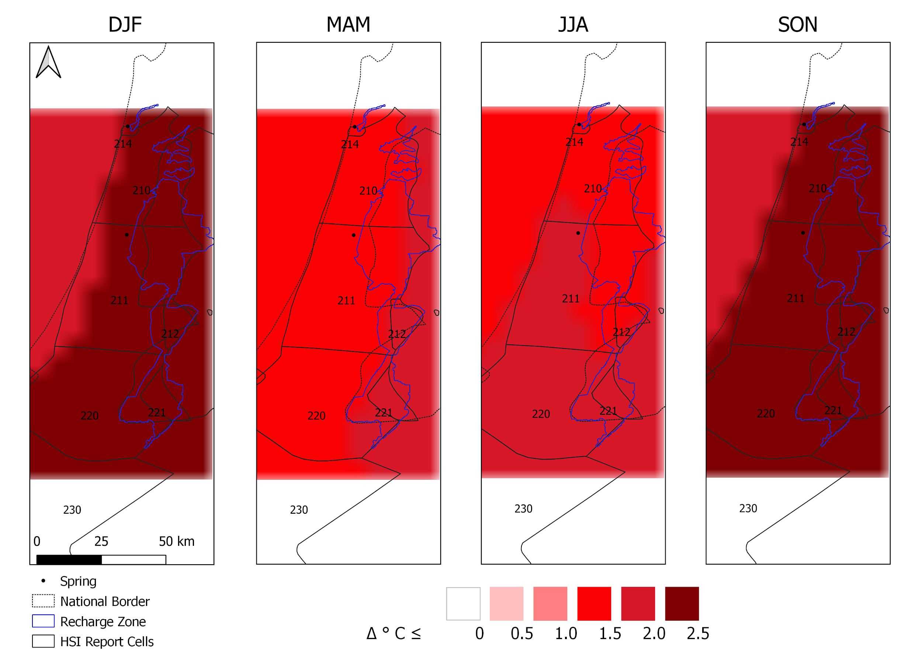
Climate projections & relevance to groundwater resources
Projected change in seasonal mean temperatures & precipitation
Data & Simulation period
Simulations performed by the CMCC for the RCP4.5 scenario (8 km daily resolution) (Hochman et al., 2018)
Parameters of interest: temperature (mean, min, max) & total precipitation
Climate data from 1981 – 2071
Projected change as a difference between 2041-2070 and 1981-2010
Paul Hepach

Slide 6
Climate projections & relevance to groundwater resources
Projected change in seasonal mean temperatures & precipitation
Results
General increase in mean temperature predicted for the recharge zone
Largest increase in autumn (SON) & winter (DJF) with peaks up to ~2.2°
General decrease in mean precipitation predicted for the recharge zone
Largest decrease in autumn (SON) with reducing up to ~50%
During the summer (JJA), no precipitation
large differences between the two periods, small changes present large percentage differences
Paul Hepach

Slide 7
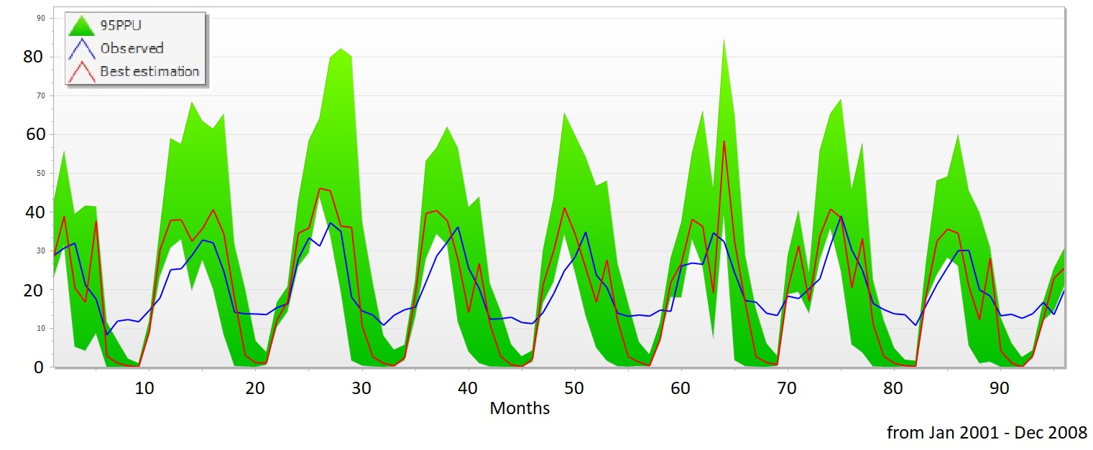
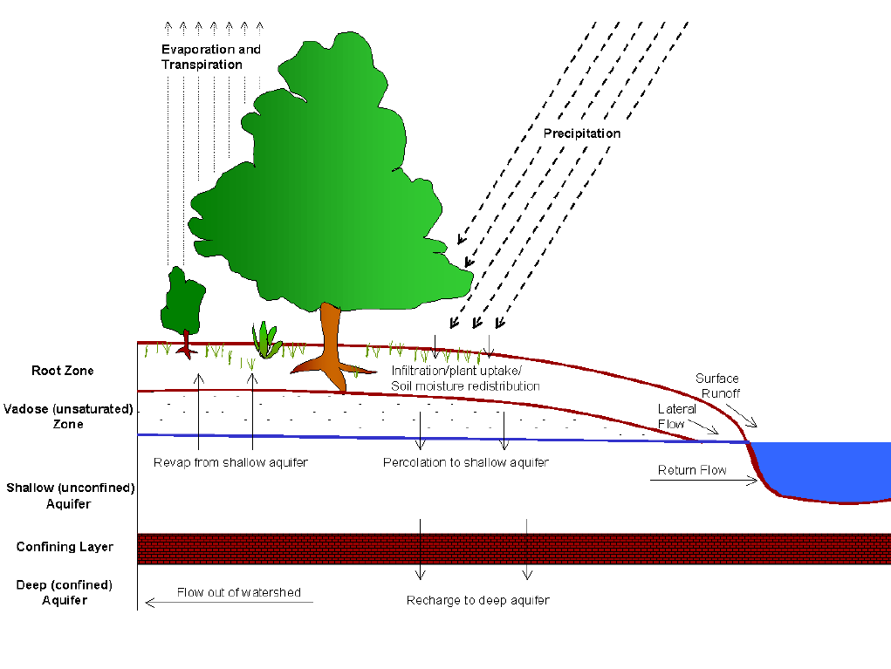
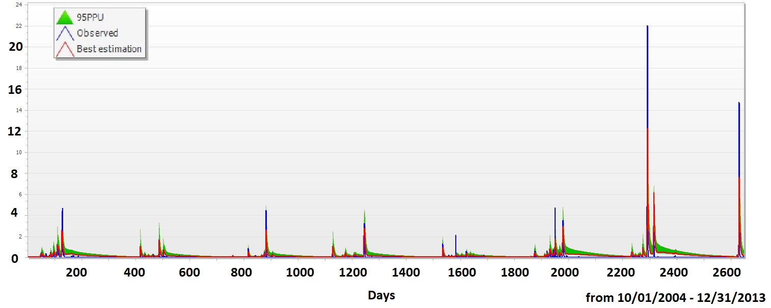
Calculating groundwater recharge – SWAT
Program: Soil & Water Assessment Tool
hydraulic-hydrological model, based on physical processes
manages topographic watersheds
delineates watersheds to Subbasins and HRUs
Calibration with SWAT-CUP
Evapotranspiration:
MOD16A2GF
mm/mon
Input:
Local weather stations
Climate Model (-2070)
Surface Discharge:
hydrometric measuring stations
m³/s
Paul Hepach

Slide 8
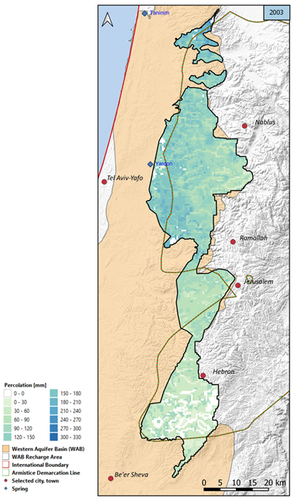
Hydro-Pedotransfer Functions (HPTF)
Mean annual percolation map for 2003 of the WMA recharge area (created in QGIS)
Developed by Wessolek et al. (2008), approach of “Hydropedology”
Empirical functions to predict annual percolation rates on a regional scale
Only limited number of input data needed: soil properties, land-cover, precipitation, potential evapotranspiration
Suitable for calculation of groundwater recharge in karst aquifers under Mediterranean climate?
Challenges in semi-arid regions:
High natural variability in precipitation
Extreme values of evapotranspiration
Karst features intensify these dynamics
Paul Hepach
Notes:
-The descriptive term “Hydro-Pedotransfer Function” is first introduced by Wessolek (2008), following the approach of “Hydropedology”: the integration of methods from soil, plant and water science
-The applications of the empirically developed functions are limited to Central European climate and flat topography
-The approach of this study is to test the suitability and to adapt the concept of the Wessolek’s (2008) approach for HPTF to the Western Aquifer Basin
-(FIGURE) The study provides, besides groundwater recharge estimations, an overview of the mean annual percolation of the Western Aquifer Basin recharge area from 2001 to 2015. Spatial and temporal distribution is provided in the form of annual percolation maps

Slide 9
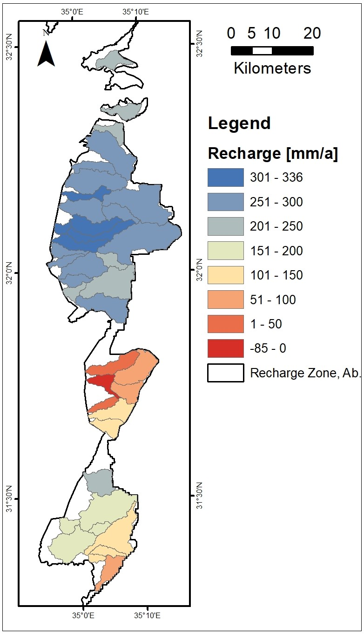
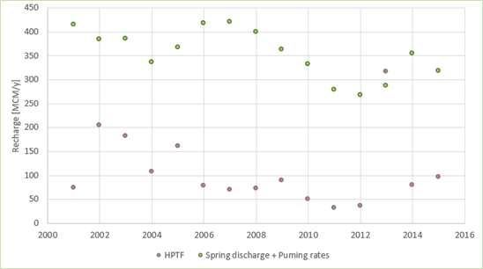
Groundwater Recharge Calculations
SWAT / SWAT-CUP:
able to calibrate the model with the available measured data
erratic discharge events simulated
winter peaks of AET
R² = 0.39 currently
high transmission loss in the channel-network
rapid and seasonal groundwater recharge
great differences between years (factor 2-3)
HPTF: underestimate recharge, do not account for rapid flow components of recharge in karst groundwater systems, key values are correct estimates of actual evapotranspiration
Examination of SWAT Input and Calibration Data based on the water cycle
Paul Hepach
Notes:
HPTF:
-Study period due to the limitation of available input data: 2001 – 2015
-The results indicate that HPTF are not able to capture the rapid flow component and thus underestimate groundwater recharge rates for karst aquifers
-Key values are correct estimates of actual evapotranspiration, while factors, such as soil characteristics or land use, have limited relevance for annual averages of recharge rates

Slide 10
References
Abusaada, M.J. (2011). Flow dynamics and management options in stressed carbonate aquifer system, the Western Aquifer Basin, Palestine (Doctoral dissertation). Retrieved from Georg-August-Universität Göttingen eDiss. (http://hdl.handle.net/11858/00-1735-0000-0006-B2FD-2)
Hochman, A., Mercogliano, P., Alpert, P., Saaroni, H., & Bucchignani, E. (2018). High-resolution projection of climate change and extremity over Israel using COSMO-CLM. International Journal of Climatology, 38(14), 5095-5106. doi:10.1002/joc.5714
Kordilla, J., Noffz, T., Dentz, M., Geyer, T., & Tartakovsky, A.M. (2017). Effect of unsaturated flow modes on partitioning dynamics of gravity-driven flow at a simple fracture intersection: Laboratory study and three-dimensional smoothed particle hydrodynamics simulations. Water Resources Research, 53(11), 9496-9518. doi:10.1002/2016WR020236
Neitsch, S.L., Arnold, J.G., Kiniry, J.R., & Williams, J.R. (2011). Soil & Water Assessment tool: Theoretical documentation: Version 2009 (TR-406). Retrieved from the Texas A&M University website: https://swat.tamu.edu/media/99192/swat2009-theory.pdf
Stevanović, Z. (2018). Global distribution and use of water from karst aquifers. Geological Society London Special Publications, 466, 217-236. doi:10.1144/SP466.17
Wessolek, G., Duijnisveld, W.H.M., & Trinks, S. (2008). Hydro-pedotransfer functions (HPTFs) for predicting annual percolation rate on a regional scale. Journal of Hydrology, 356(1-2), 17-27. doi:10.1016/j.jhydrol.2008.03.007
Paul Hepach

Slide 11
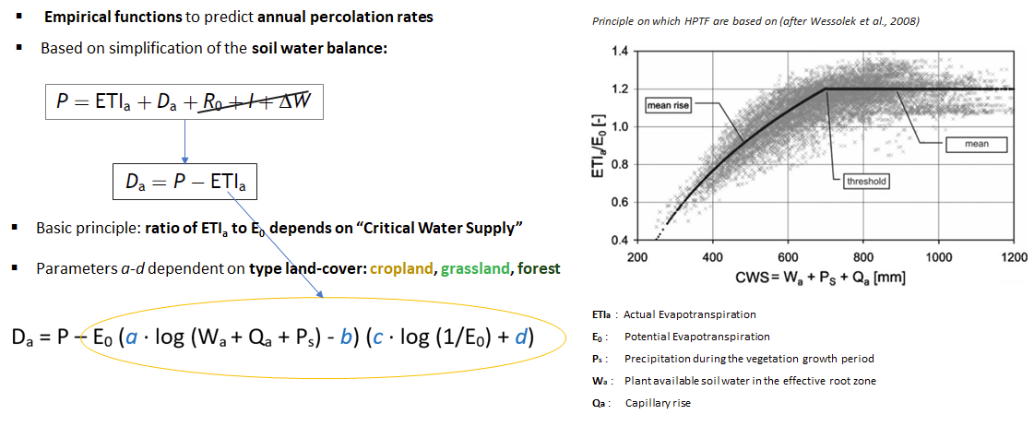
Appendix - HPTF
Paul Hepach

Slide 12
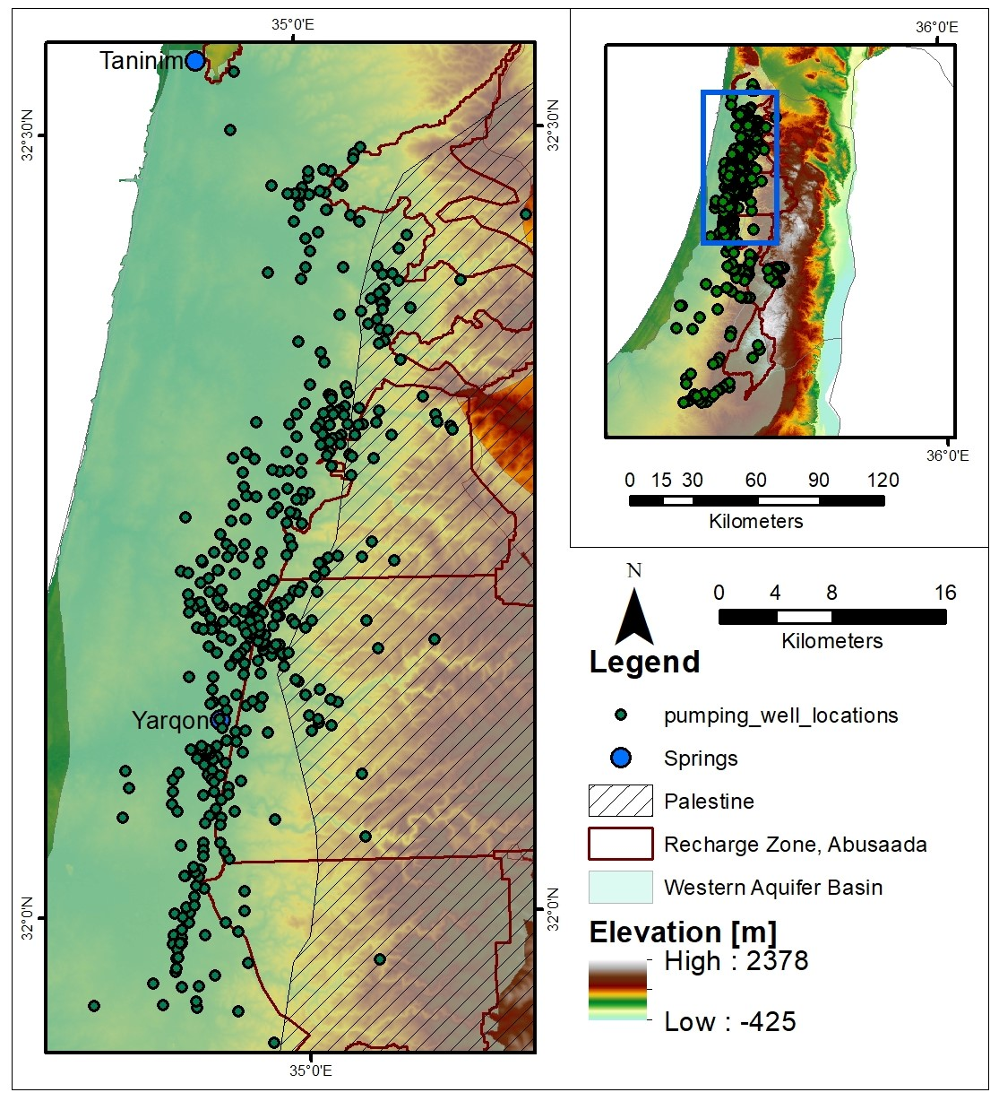
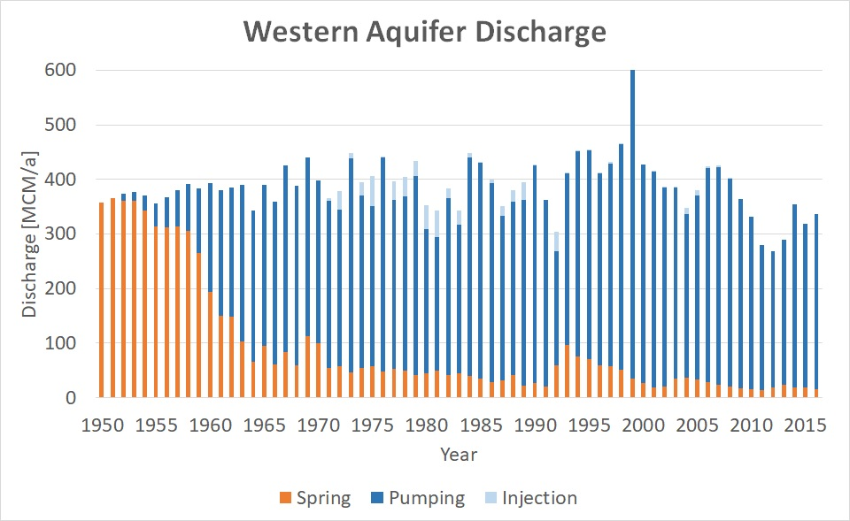
Appendix – Aquifer Discharge
Paul Hepach

Slide 13
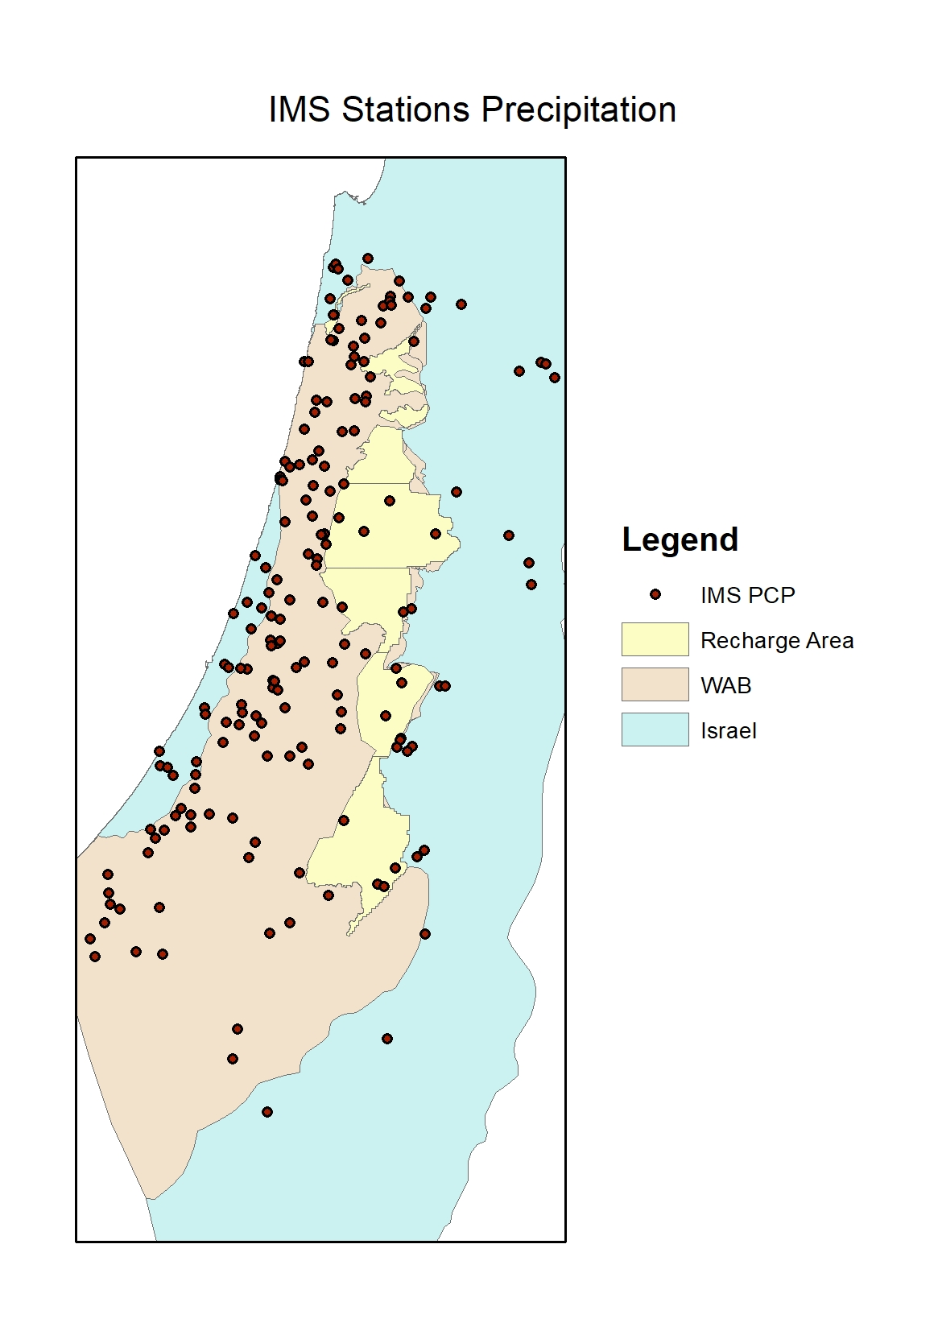
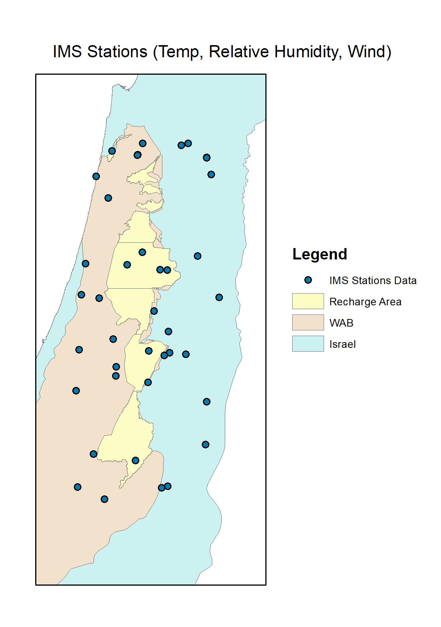
Appendix – Local Weather Stations
Paul Hepach

Slide 14
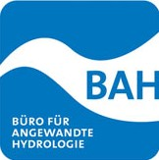
German partners
TU Berlin, Hydrogeology Prof. Dr. Irina Engelhardt
University of Göttingen, Applied Geology Prof. Dr. Martin Sauter
University of Bayreuth, Ecology and the Environmental Sciences Prof. Dr. Thomas Koellner
University of Würzburg, Remote Sensing Prof. Dr. Christopher Conrad (since 2019 at Halle University)
VisDat geodatentechnologie GmbH Dr. Micha Gebel
BAH Berlin Dr. Ruben Müller
Federal Institute for Geosciences and Natural Resources
Paul Hepach

Slide 15
International partners – Research institutions
Bureau de Recherches Géologiques et Minières Dr. Jean-Christophe Maréchal
Università degli Studi di Napoli Federico II, Earth, Environmental and Resources Science Prof. Dr. Pantaleone De Vita
Centro Euro-Mediterraneo sui Cambiamenti Climatici Dr. Edoardo Bucchignani
Ariel University, Eastern R&D Center Dr. Yaakov Anker
Ben-Gurion University of the Negev, Geography and Environmental Development Prof. Dr. Meidad Kissinger
Hebrew University of Jerusalem, Institute of Earth Sciences Prof. Dr. Efrat Morin
Paul Hepach

Slide 16
International partners – Stakeholder
Montpellier Méditerranée Metropole Dr. Arnaud Vestier
Israel Hydrological Service Dr. Yakov Anker
Mekorot Water Company Ltd. Dr. Yossi Guttman
Palestinian Water Authority Dr. Subhi Saham
Paul Hepach

Slide 17
MedWater website
Paul Hepach

