Slide 1

Back-propagating super-shear rupture in the 2016 M7.1 Romanche transform fault earthquake
Stephen Hicks
Imperial College London
Ryo Okuwaki, Andreas Steinberg, Kate Rychert,
Nick Harmon, Rachel Abercrombie, Petros Bogiaztis, David Schlaphorst, Jiri Zahradnik, Mike Kendall,
Yugi Yagi, Kousuke Shimizu, Henriette Sudhaus

Slide 2
Growing evidence for multi-fault ruptures
1997 M7.1 Harnai, Pakistan earthquake (Nissen et al., 2019, Nat. Geosci.)
2011 M7.1 Araucania, Chile quake (Hicks & Rietbrock, 2015, Nat. Geosci.)
~20 faults ruptured
~20 faults ruptured
2016 M7.9 Kaikōura, New Zealand earthquake
(Wang et al., 2018, EPSL)
2019 M6.4 & M7.1 Ridgecrest, California sequence
(Ross et al., 2019, Science)

Slide 3
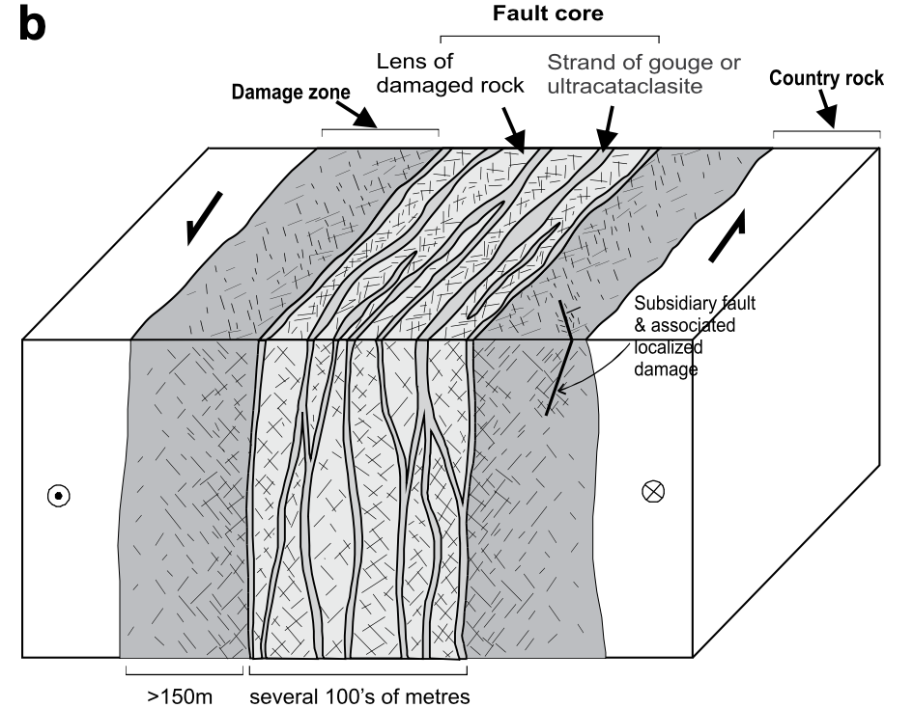
Shedding light on the fault damage zone
What are the frictional properties inside the fault damage zone?
How does the fault damage zone control seismic slip?
Mitchell & Faulkner (2009, JSG)

Slide 4
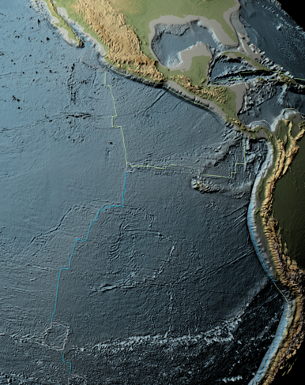
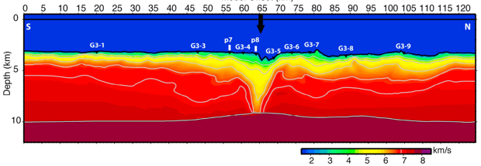
Earthquake processes along ocean transform faults
What are the fundamental fault zone controls on seismic slip during large quakes?
Simplest large-scale faults on Earth
Thermally controlled seismogenic width
Large offsets, well-defined ridge-controlled slip rates
Bi-material composition controlled by plate age
How complex are large (M7+) ruptures along a single fault zone?
What is the role of the low-velocity zone in rupture processes? (hydrothermal alteration / serpentinisation?)
Froment et al., (2014, JGR)
Roland et al., (2012, JGR)
v_{p}

Slide 5
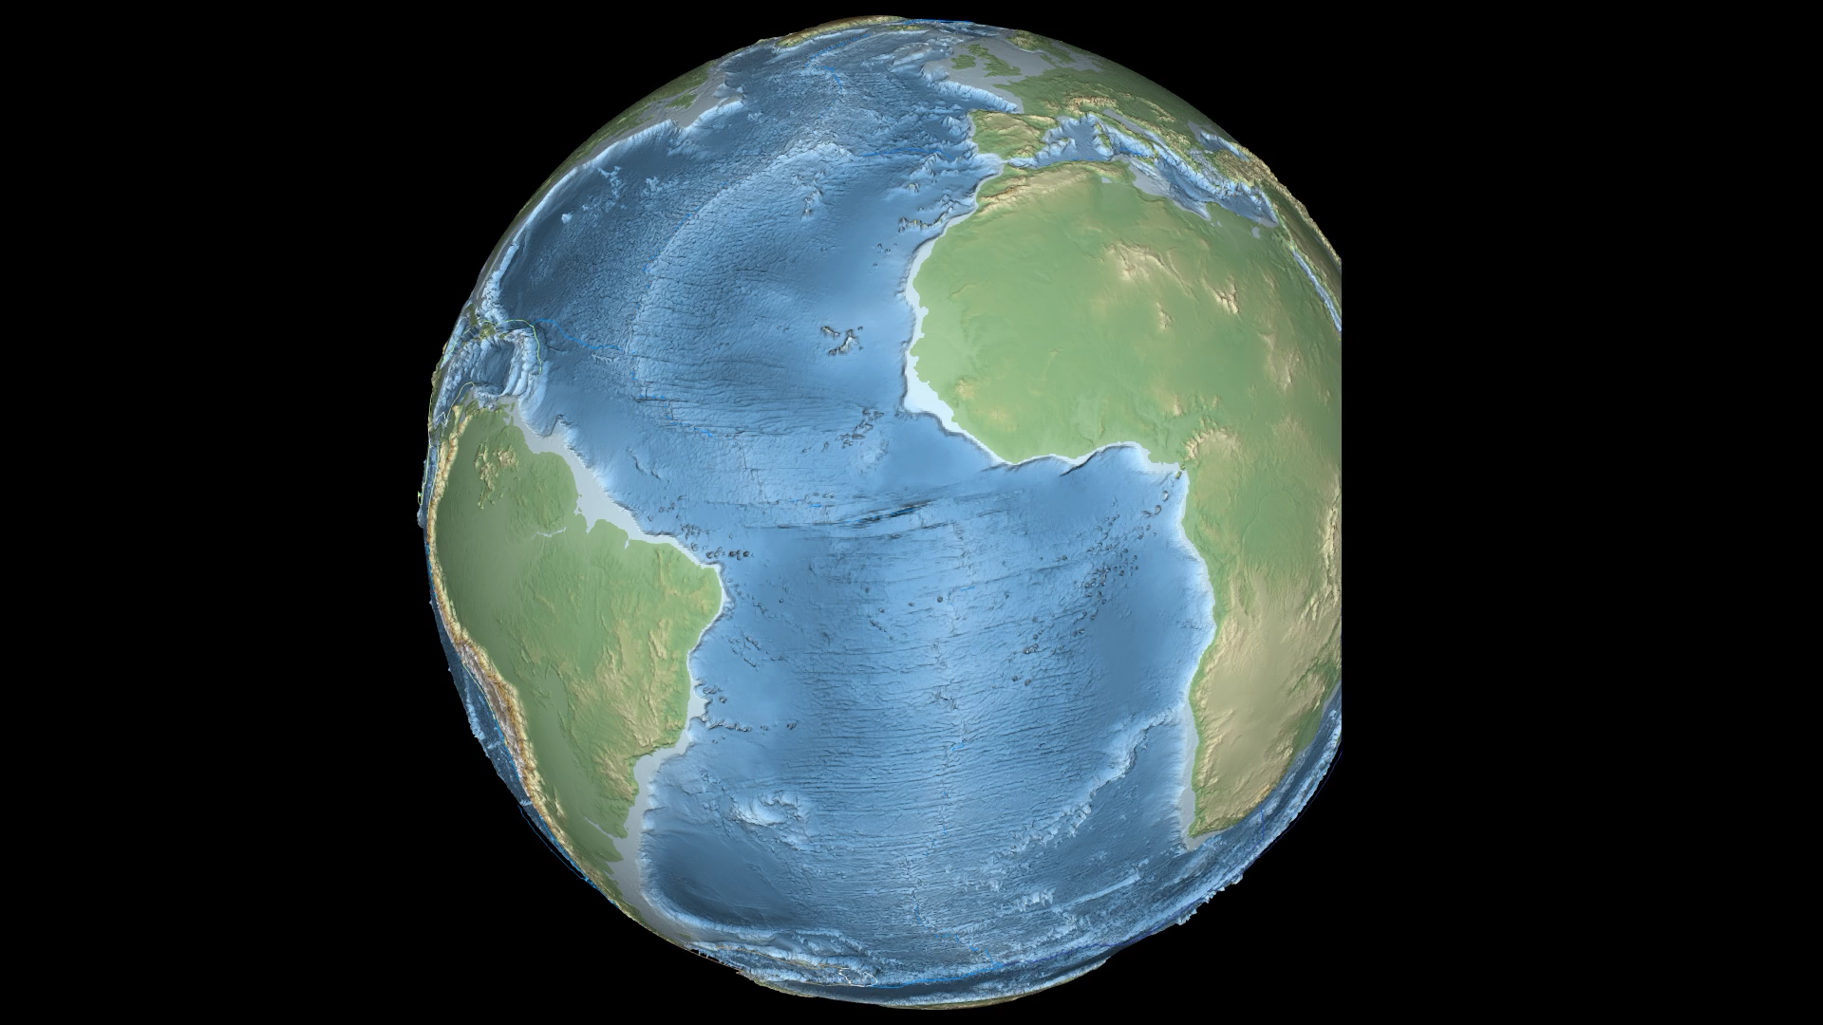
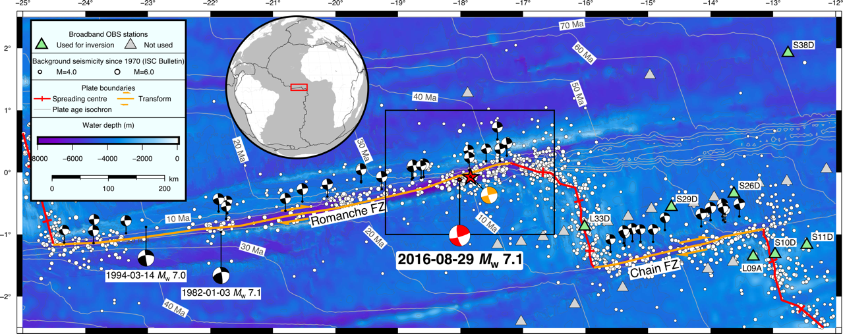
Romanche Fracture Zone
PI-LAB OBS network
(38 stations)
Agius et al. (2018), GRL
Harmon et al. (2018), JGR
Rychert et al., In Review.
Waveform data @ IRIS-DMC

Slide 6
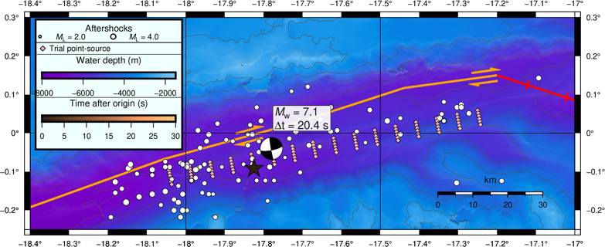
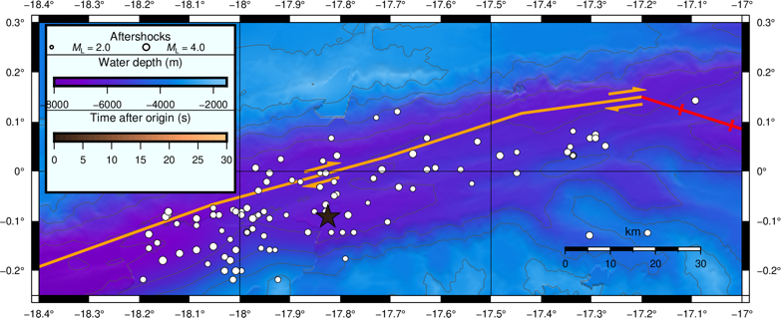
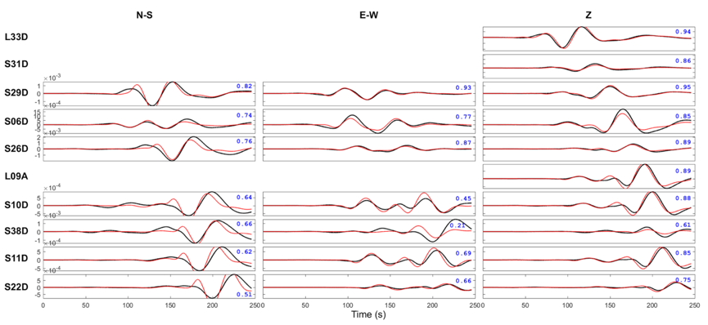
Key source parameters
Mainshock relocation
Aftershock detection and relocation
Low frequency regional moment tensor (RMT) analysis
Waveforms filtered between 100 s and 33 s period
Black = observed
Red = synthetic fits

Slide 7
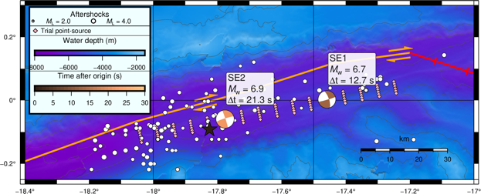
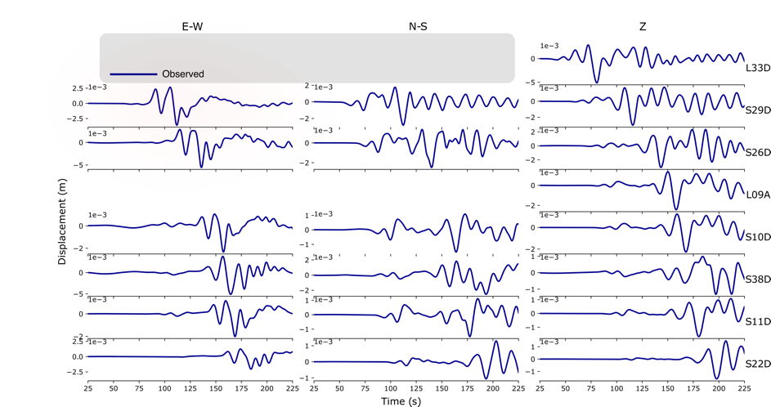
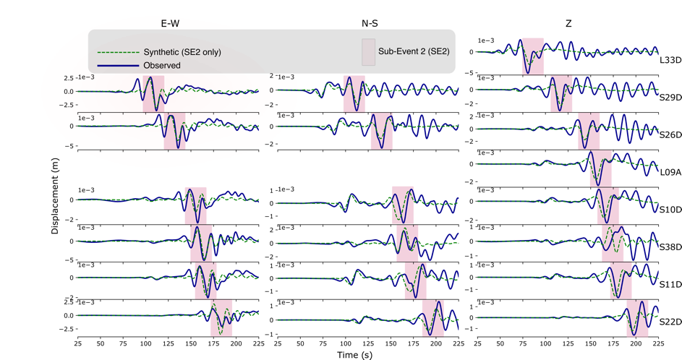
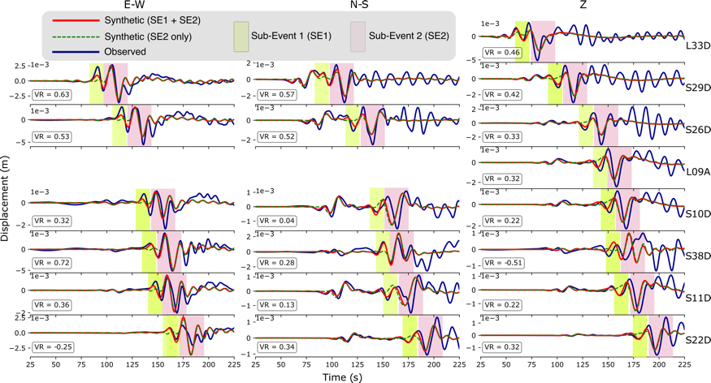
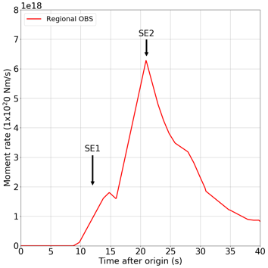
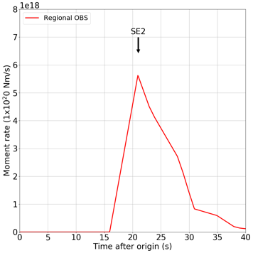
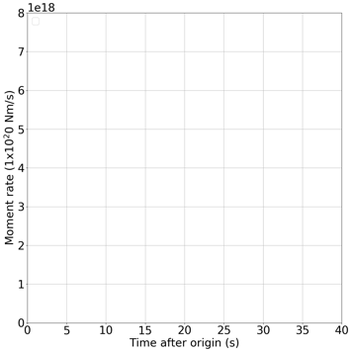
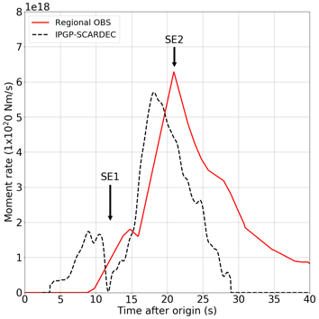
Rupture segmentation from OBS waveforms
Waveform fits
Source-time function
Waveforms filtered
100 s – 10 s
Improving azimuthal coverage …

Slide 8

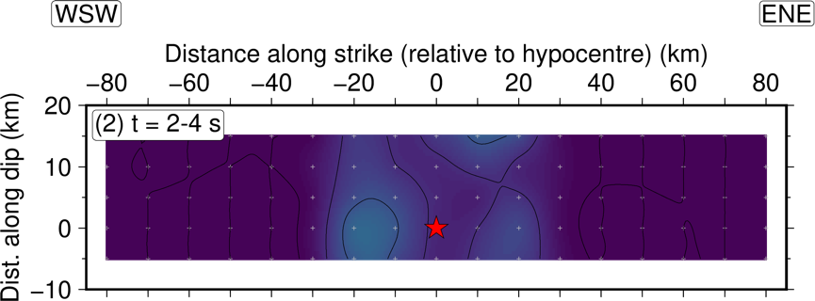
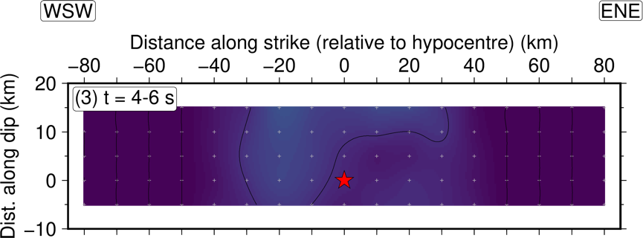
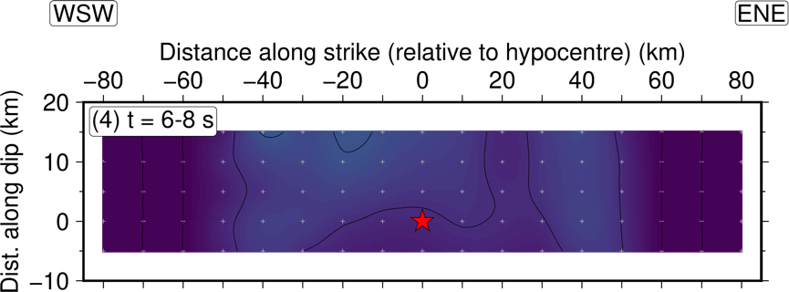
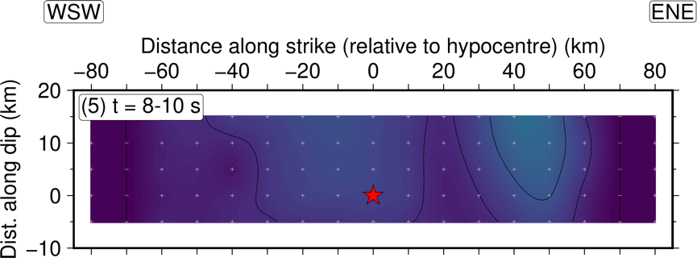
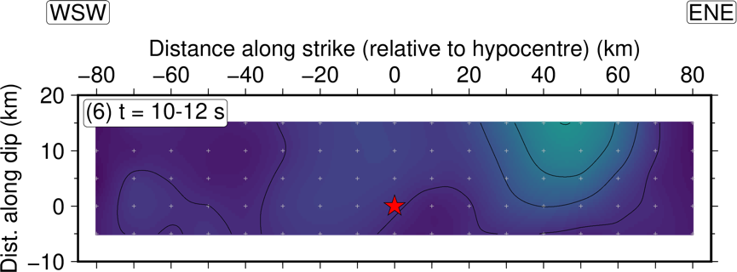
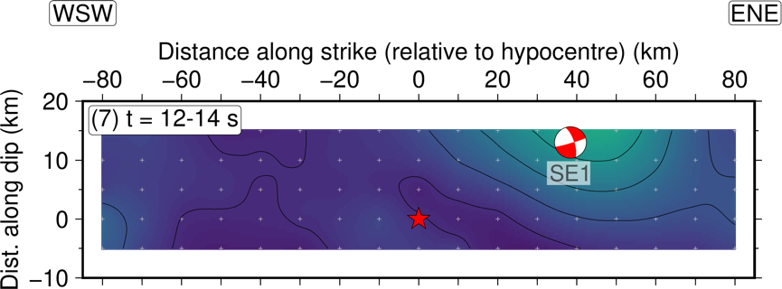
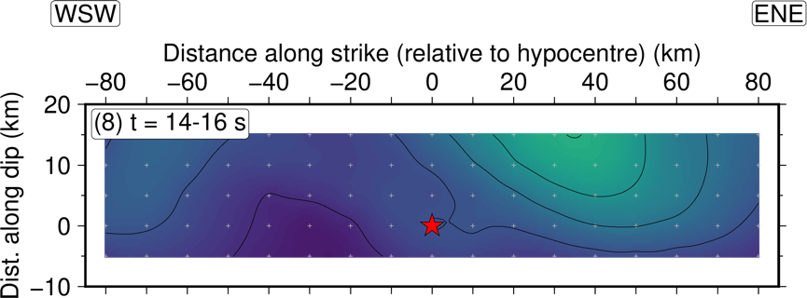
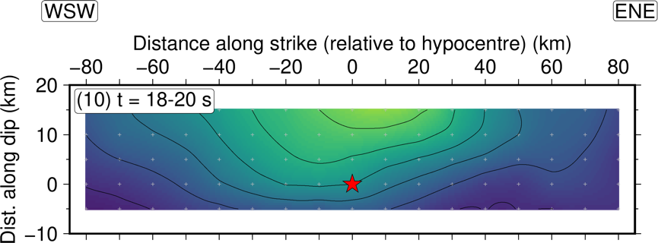
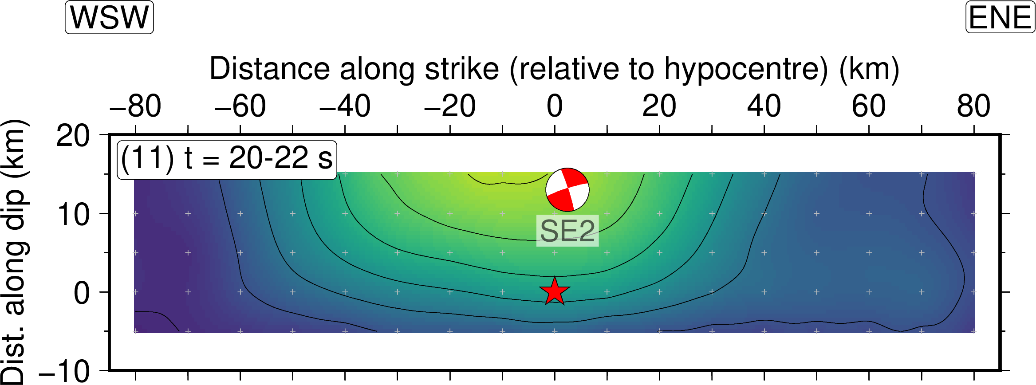
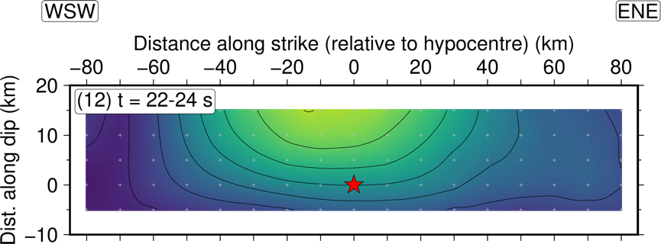
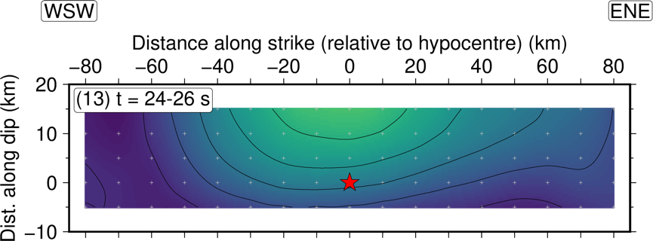
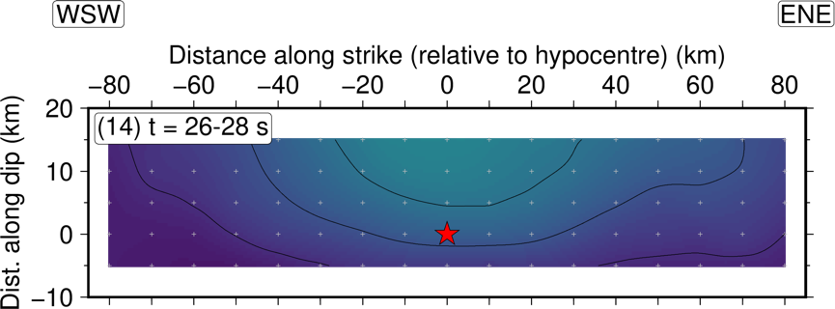
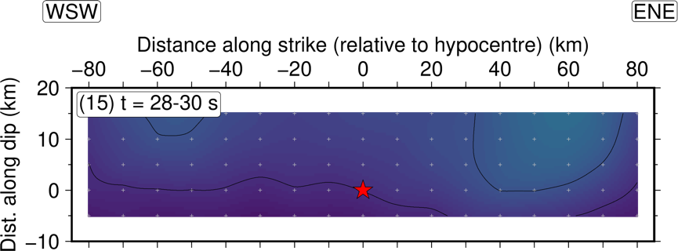
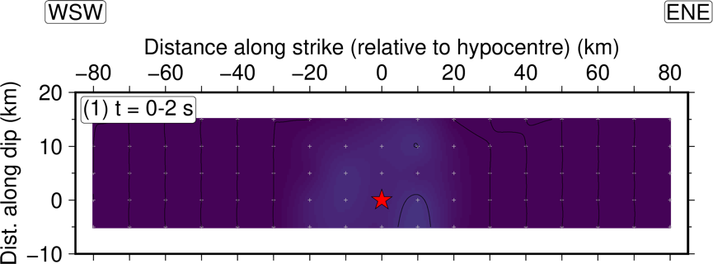

Evolution of seismic slip rate
Rupture travels ~60 km in 10-12 s = rupture velocity of 5-6 km/s (super-shear)

Slide 9
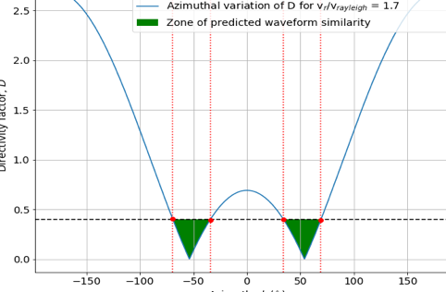

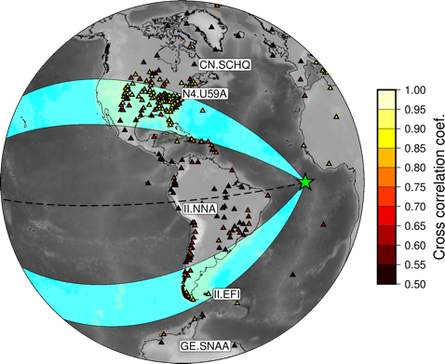
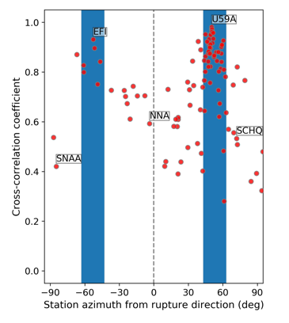
Hunting for a supersonic quake
Theory & observation (2001 Kokolixi quake) - Vallee & Dunham (2012)
Observation (2018 Palu quake) – Bao et al. (2019)

Slide 10
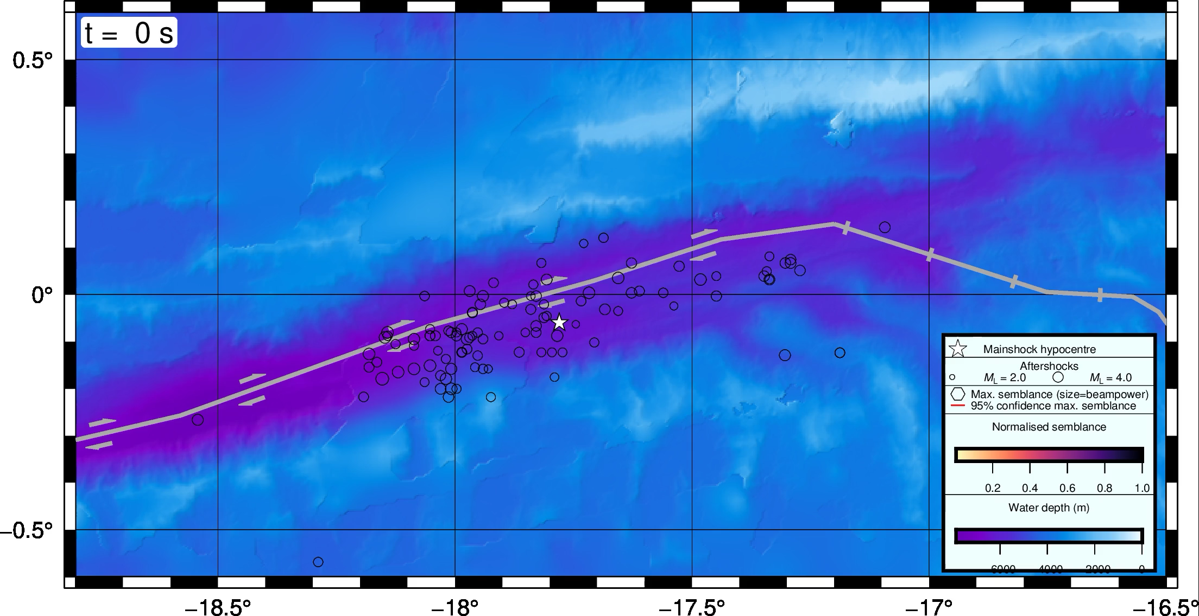
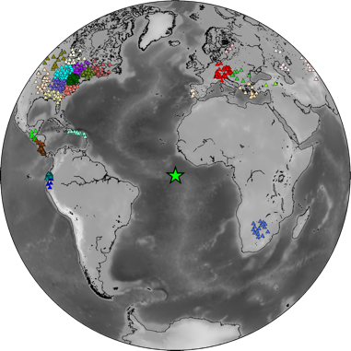
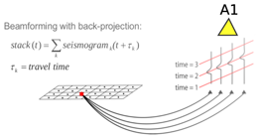
Tracking the
rupture front
Semblance stacking: measuring the fraction of the radiated energy released as coherent waves

Slide 11
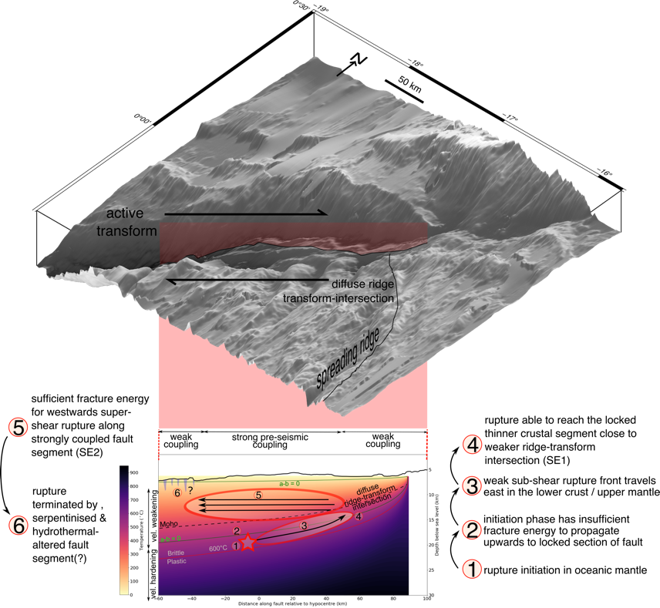
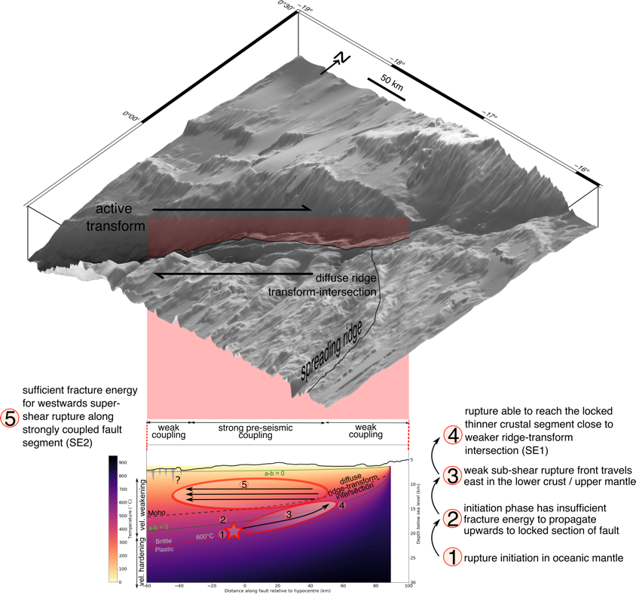
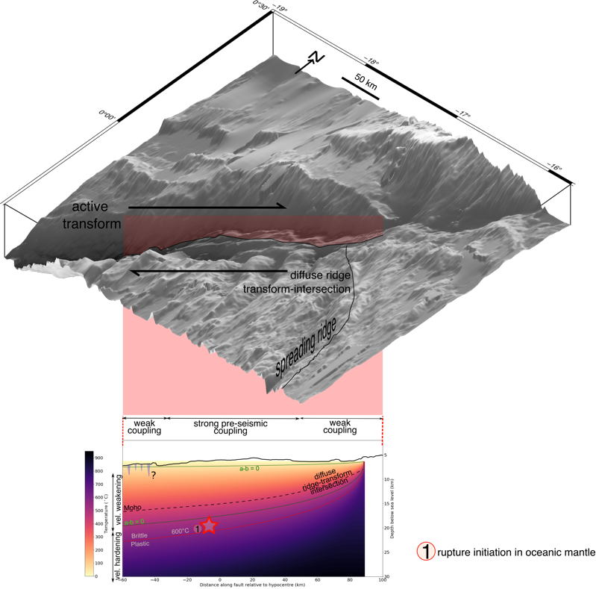
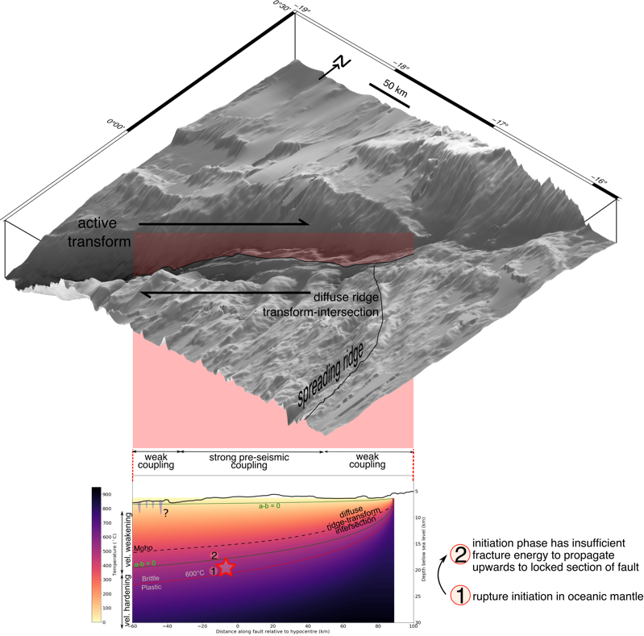
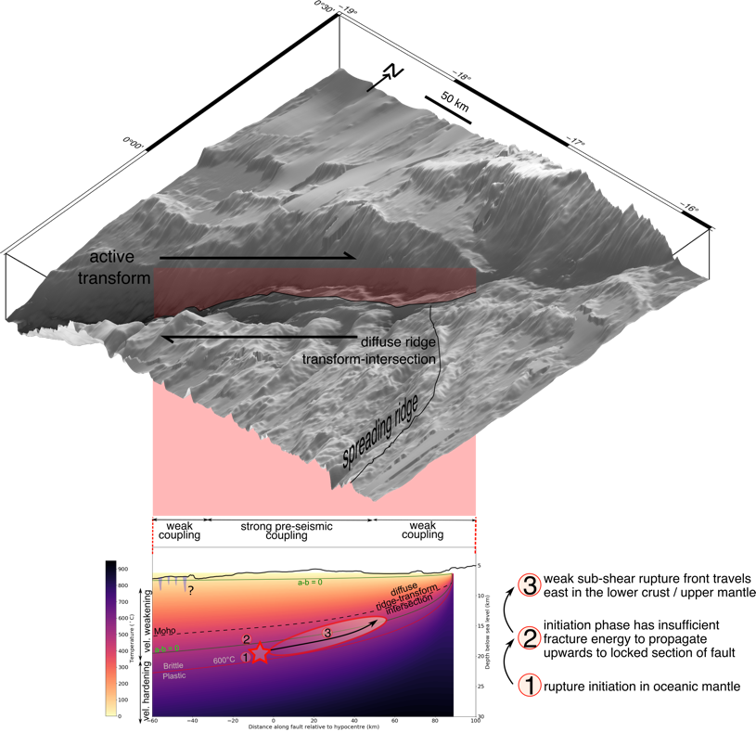

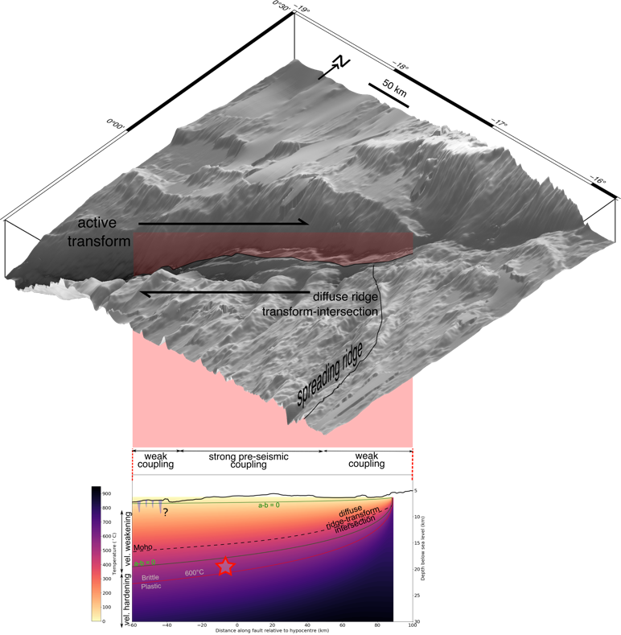
Interpretation

Slide 12
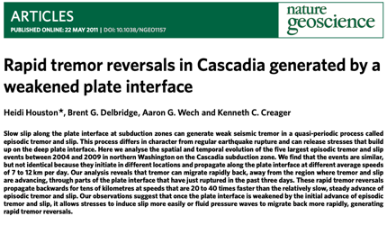
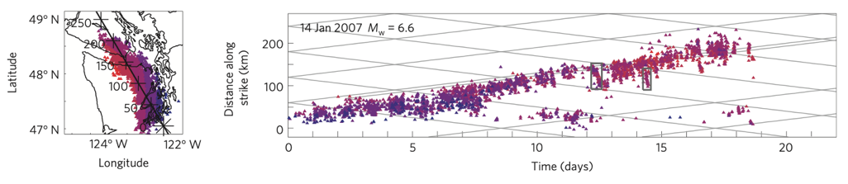
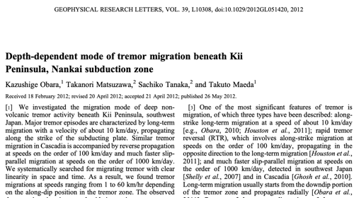
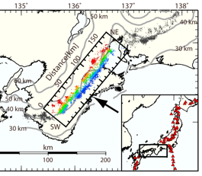
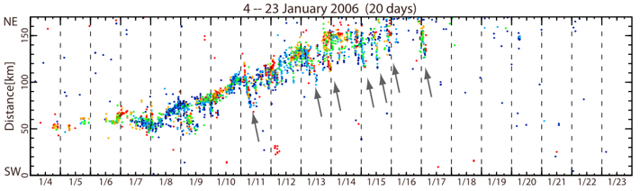
Can earthquake ruptures reverse?
Rapid tremor reversals

Slide 13

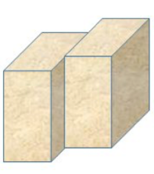
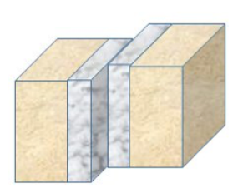
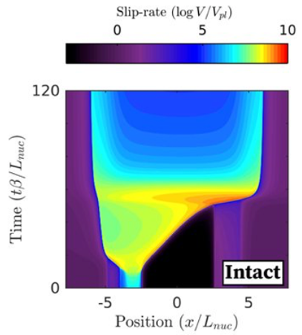

Idini & Ampuero (2019, pre-print doi: 10.31223/osf.io/v8xr2)
Can earthquake ruptures reverse?
Numerical predictions
Without fault damage zone
With low velocity fault damage zone
Conventional crack-like rupture
Pulse-like rupture + secondary reverse pulses

Slide 14

Implications & outstanding questions
Rupture directionality depends on interplay between nucleation points, strain release history and fracture energy variations along the fault.
Ruptures along single faults may be just as complex as those involving interaction between orthogonal faults.
A growing rupture in one direction may not be deterministic of a later emerging rupture in the opposite direction
Reversing ruptures may affect ground shaking amplitude and duration – they are not currently accounted for in seismic hazard estimates, earthquake-early warning or ground motion simulations
Outstanding questions:
Did the Romanche earthquake involve re-rupture of the seismogenic zone, or were the two different phases of rupture at different depths?
What is the state of coupling / friction along transform faults? Is there any transient slip?
  We need detailed microseismic observations across Atlantic Transform Faults
What are the properties of the transform fault zone? E.g. are there multiple fault stands?
  We need seismic images across different segments of transform faults
Find our pre-print on
https://eartharxiv.org/bs7na/

