Slide 1
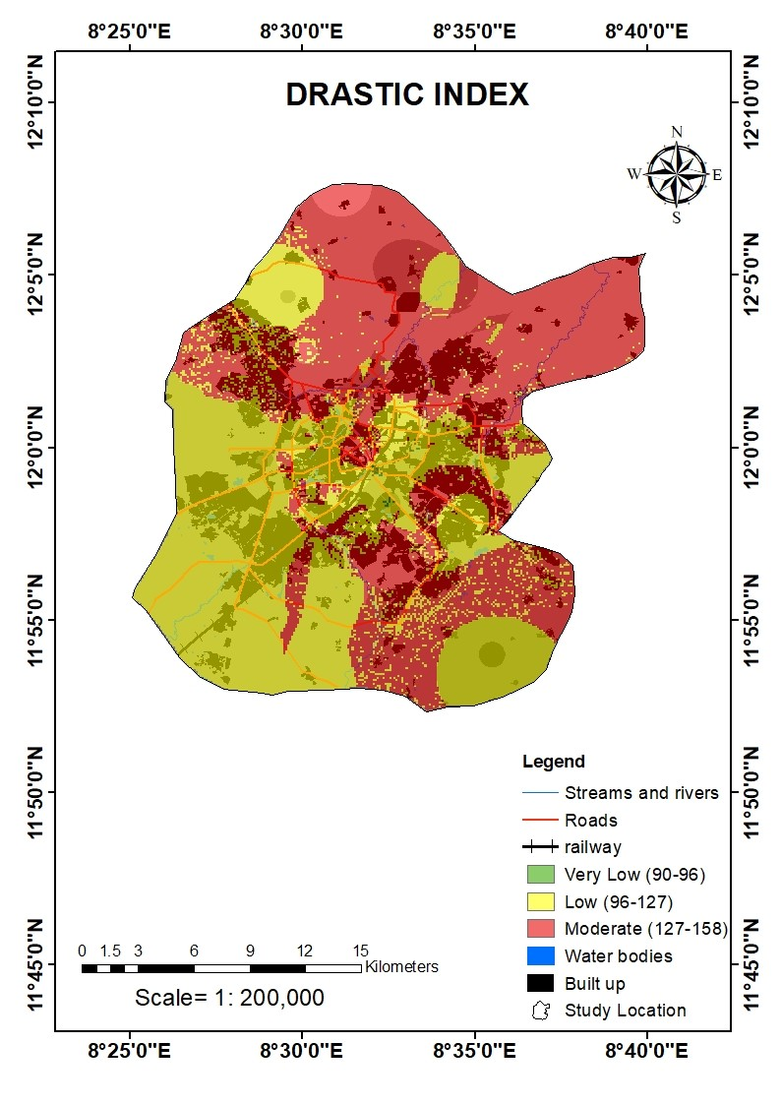
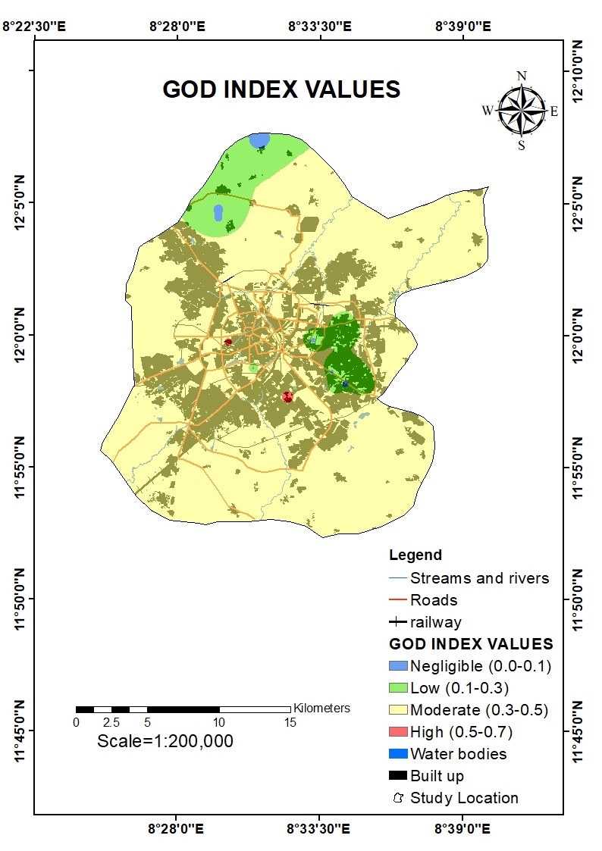
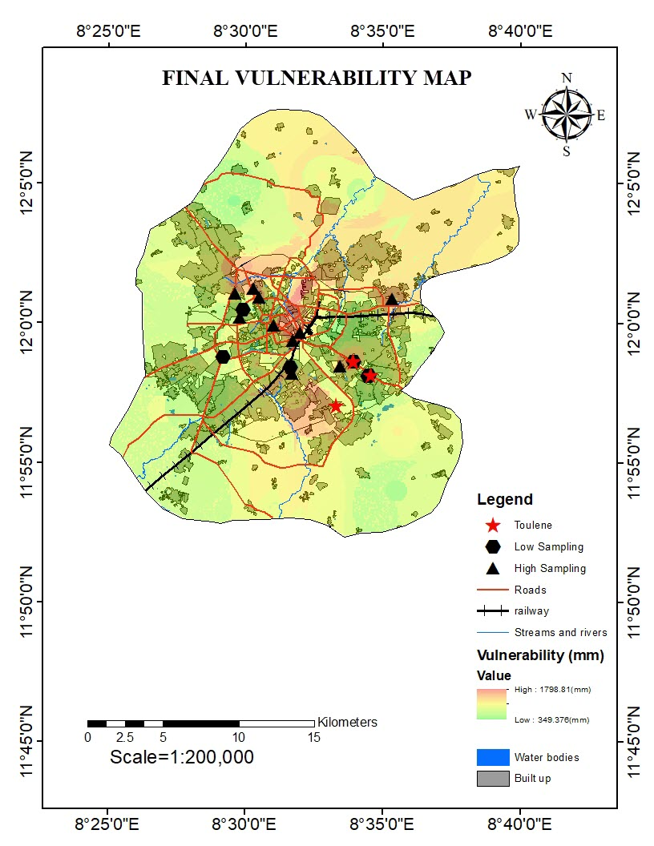
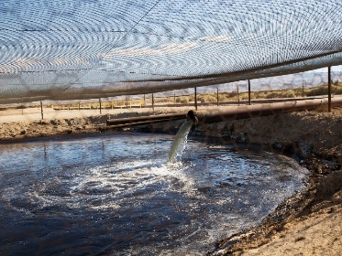
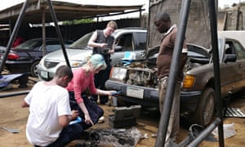
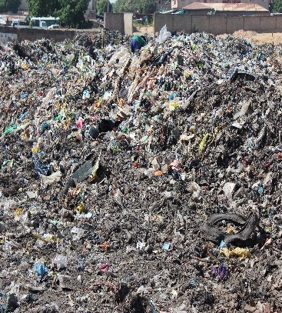
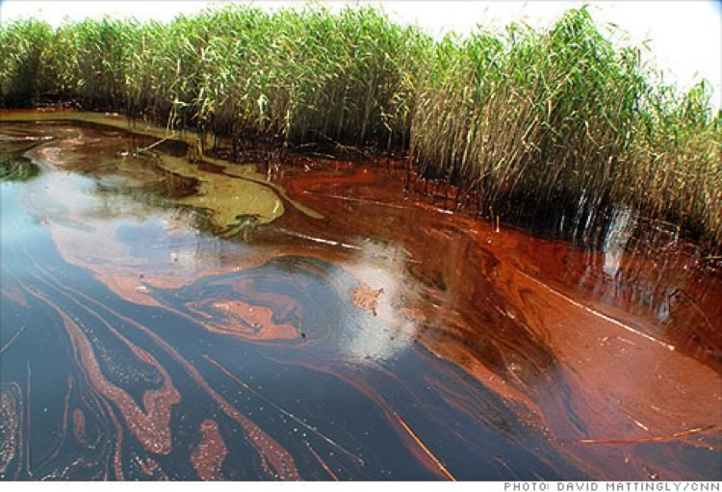
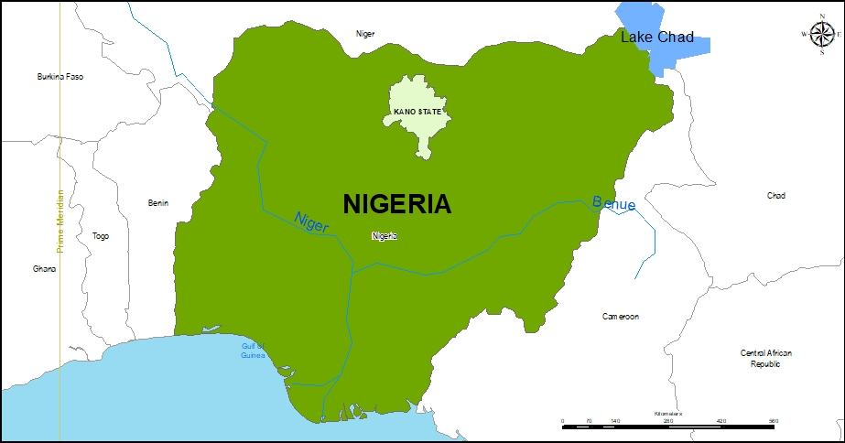
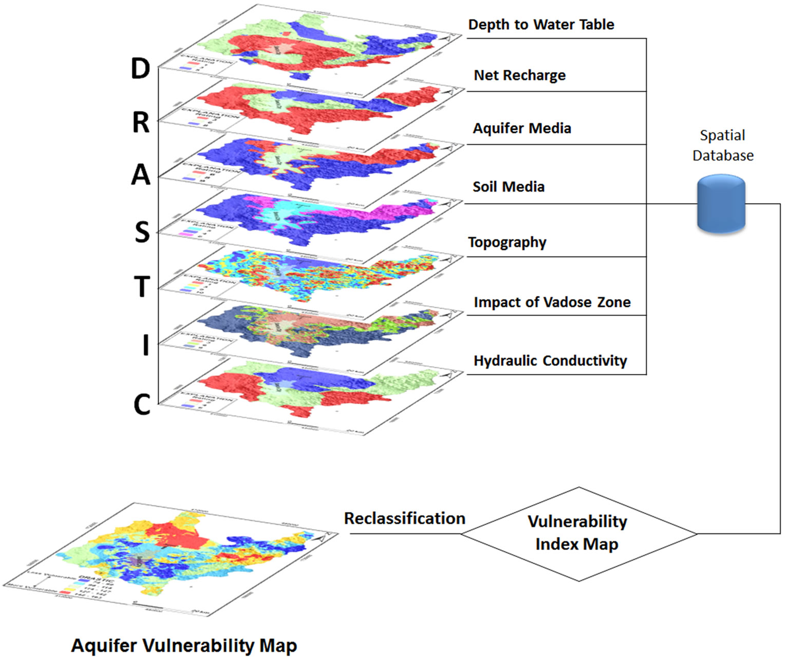
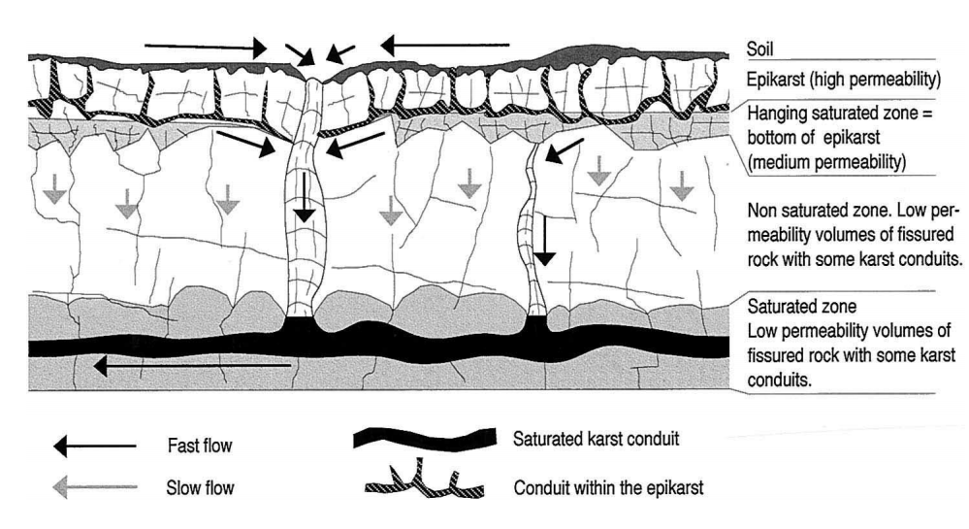
Mapping Groundwater Vulnerability Assessment in a Semi-arid Region of Northern Nigeria
Zaharatu Mohammed Babika^{1,2}, Thomas Kjeldsen¹ & Lee Bryant¹
University of Bath, United Kingdom; National Oil Spill Detection and Response Agency (NOSDRA), Nigeria²
Correspondence email: z.m.babika@bath.ac.uk; Phone number: +447767733453
1. Introduction and Motivation
3. Results
Groundwater Vulnerability Assessment
Groundwater is vulnerable to human induced pollution in Nigeria.
Threat to groundwater is compounded in urbanized settings where a diversity of pollutant sources exist:
Integrated geospatially referenced environmental information and understanding of land surface processes is an effective way to determine the relative vulnerability to contamination.
This research investigated groundwater vulnerability to contamination using Geographical Information System (GIS).
Source: Field trip 2018
Figure 1: Some Sources of Groundwater Pollution in Nigeria
Figure 5: DRASTIC Index
Figure 6: GOD Index
Figure 7: Final Vulnerability Index
Drastic values range from 90 (low) to 156 (moderate) in Figure 5. Zones of high groundwater vulnerability are indicated by red pixels and are observed at the northern axis as well as the south eastern parts of the study location.
GOD Index values range from 0.0 (low) to 0.7 (high) in Figure 6. The higher values of groundwater vulnerability are indicated by red pixels and are observed within the central and southern central area of the study location.
Map-removal sensitivity analysis was performed to find the most suitable parameters for assessing groundwater vulnerability, as shown in figure 7. For the final output of vulnerability map, water quality conducted indicated the contamination of Toluene by the red pixels within the study area.
2. Approach
STUDY AREA: Kano, Nigeria
Area:499 km²
480 Meters above the sea level
Annual Rainfall :980mm
Demography :3,333,300
2nd most populous city in Nigeria
4. Conclusion
Methodology
Figure 2: Map of Kano State, Nigeria
The vulnerability map showed that a large area is dominated by low and moderate vulnerable zones followed by high zones respectively.
The low vulnerability zone covers about 56% of the total study area. This classification is mainly due to the low permeability of the aquifer media. The second class covers about 35% of the study area and represents the moderate vulnerability zone whilst less than 10% of the area is classified as a highly vulnerability zone. This later one is distributed on the North and Northeast part of study area, while the other major portion of the district has a moderate vulnerability.
DRASTIC = f (7 variables)
Vulnerability Index = D_{R}D_{W} + R_{R}R_{W} + A_{R}A_{W} + S_{R}S_{W} + T_{R}T_{W}
+ I_{R}I_{W} + C_{R}C_{W}
Vulnerability Index = Pollution Potential
G – Groundwater confinement in the aquifer
O – Overburden lithology
D – Depth to water level
A$PV=$ G × O × D
V index = G_{r} + O_{r} + D_{r}
Figure 4: GOD Index Method
Figure 3: DRASTIC Index
Method
Acknowledgement:
This work was sponsored by the Petroleum Technology Development Fund, Abuja, Nigeria.

