Slide 1


New data on vertical structure and variability of Lake Issyk-Kul
Russian Academy of Sciences
Shirshov Institute of Oceanology
Peter O. Zavialov
EGU 2020
On-line Session, 04 May 2020

Slide 2
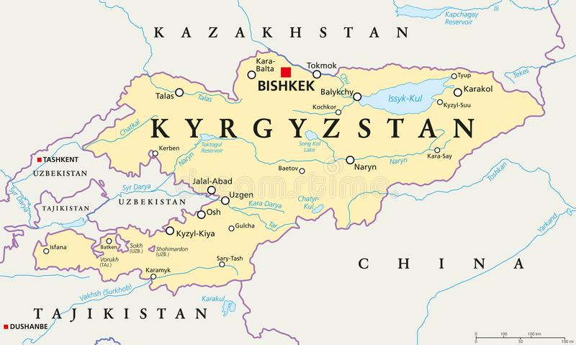
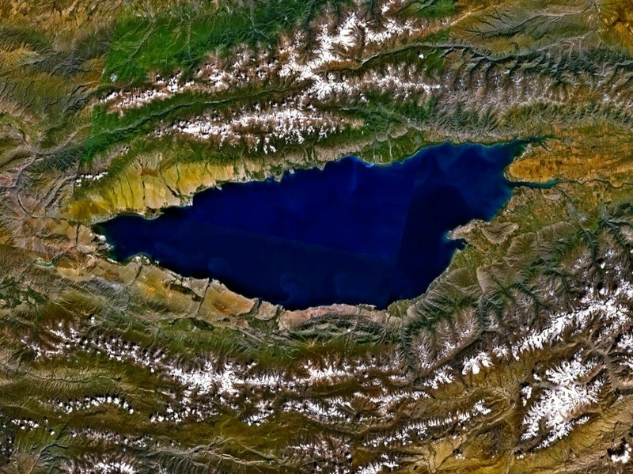
Lake Issyk-Kul
Area: 6236 км²
Length: 182 км
Width: 60 км
Volume: 1738 км³
Maximum depth: 668 м
Mean depth: 278 м
Salinity: about 6 g/kg
Altitude at surface: 1601 м a.o.l.

Slide 3
Bathymetry of Lake Issyk-Kul
[De Batist et al., 2002]

Slide 4
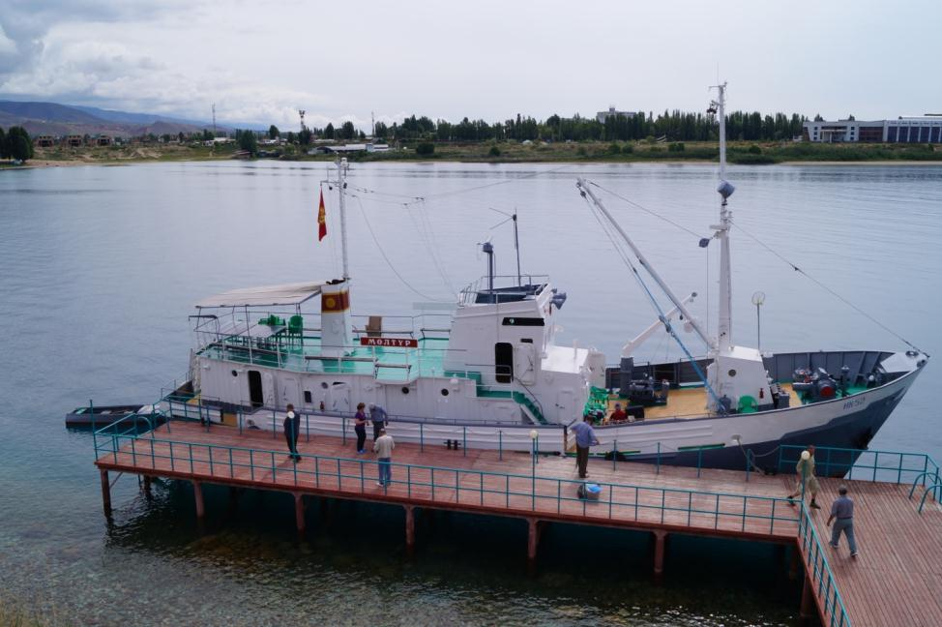
Five field trips to the Issyk-Kul (2015-2019)

Slide 5
Salinity at surface, g/kg

Slide 6
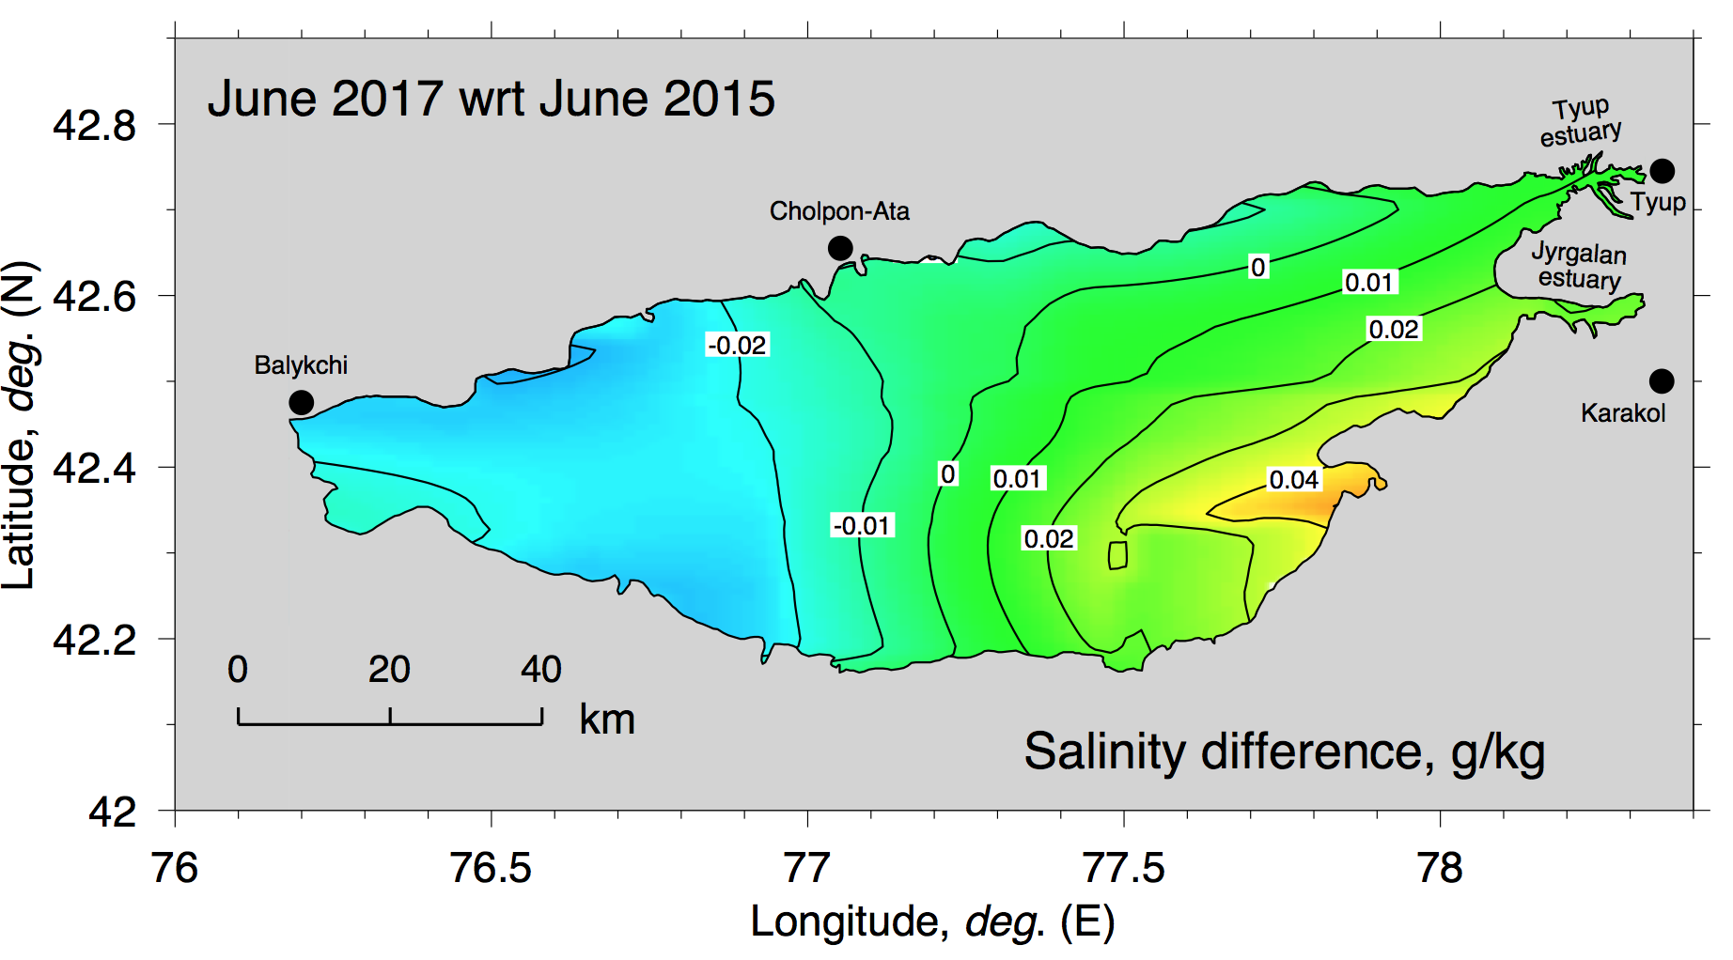
Interannual variability of salinity

Slide 7
Vertical structure and its climatic variability

Slide 8
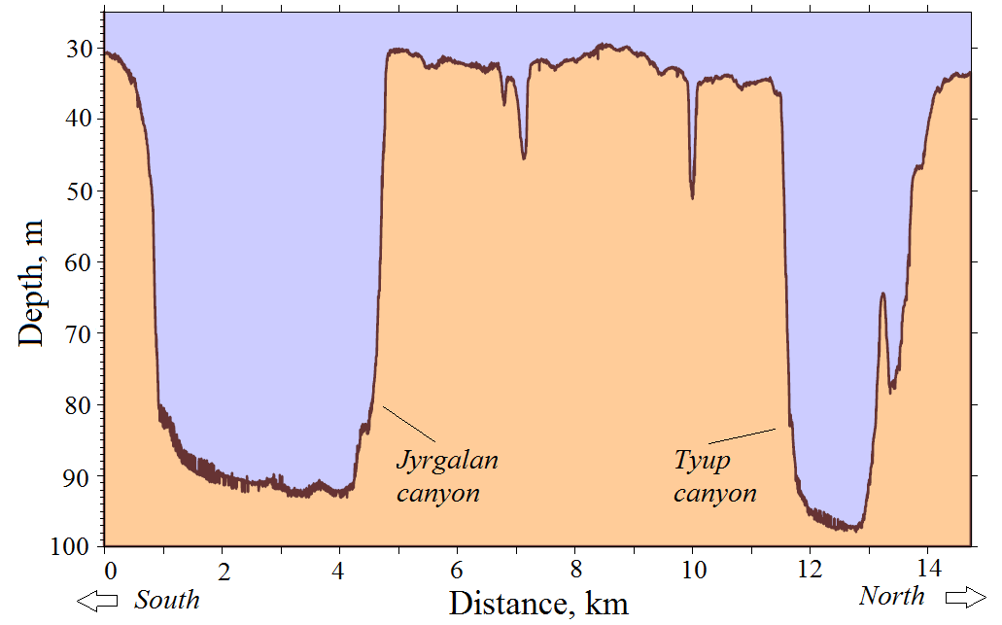
Bathymetric profile across the eastern shelf of the Issyk-Kul
Mapping by two-beam echo-sounder, October 31, 2016

Slide 9
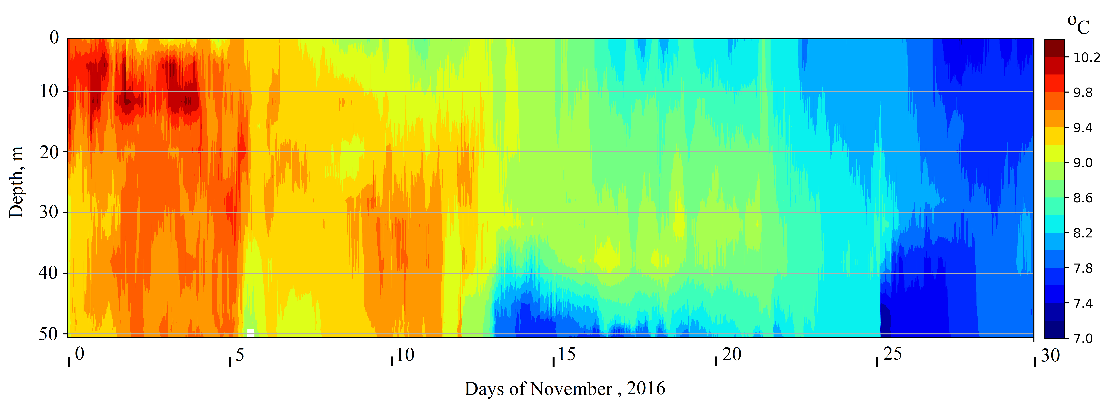
Water temperature, Jyrgalan canyon
November 2016

Slide 10
Advective and convective cooling statistics

Slide 11
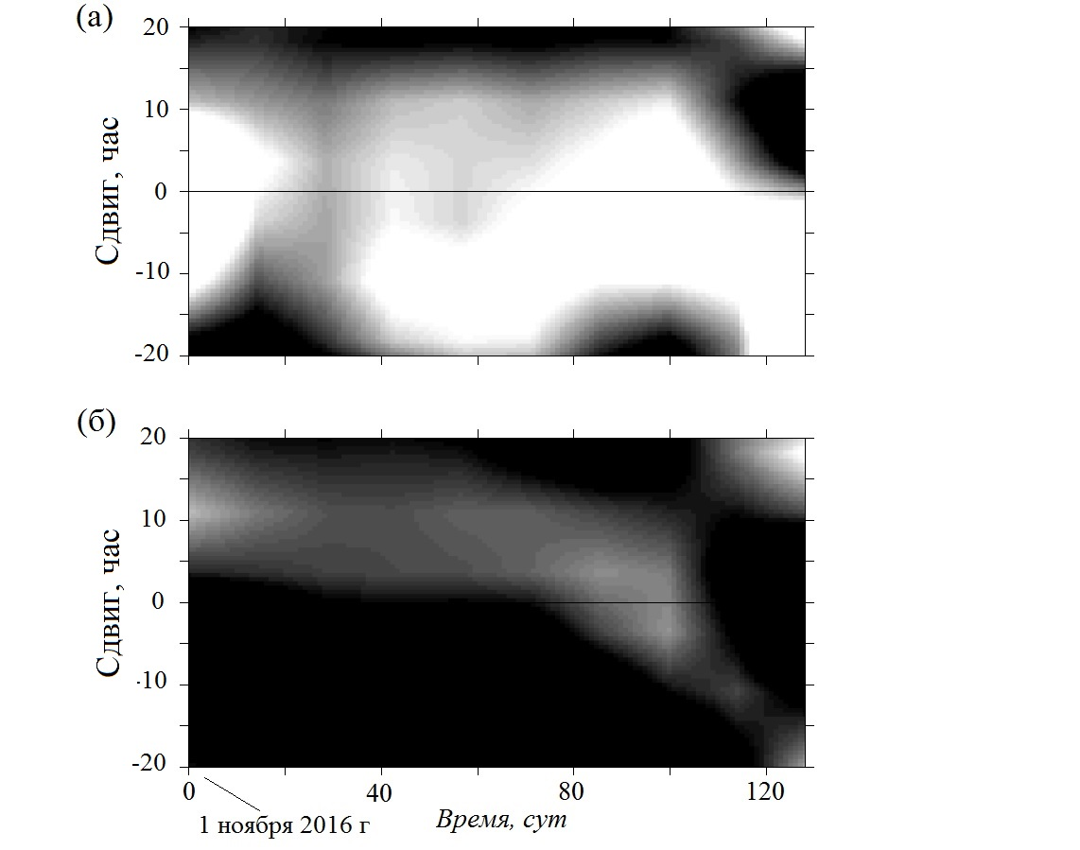
Lagged correlations between bottom velocity in Tyup and Jyrgalan canyons (b) and Jyrgalan canyon and flat shelf between the canyons (a). Significant correlations are highlighted in black.
Shift, hrs
Shift, hrs
Nov 1, 2016
Time, days
While currents in the canyons are correlated most of the time, currents in canyon and on the flat shelf are not!

Slide 12
Conclusions
•Field measurements carried out in 5 consecutive expeditions (2015-2019) made it possible to establish previously unknown features
•Salinity fields in Issyk-Kul are extremely conservative - their interannual and seasonal changes, as well as spatial variability throughout the lake (with the exception of estuarine regions), are measured only in hundredths of g kg⁻¹.
•An important result of the project is the discovery of a subsurface maximum of salinity persisting from year to year at depths from 70 to 130 m associated with the penetration of cold and fresh shelf waters through the shelf canyons during cooling period
•Our measurements do not confirm the previously reported manifestations of global warming in the form of an inter-decadal temperature increase in the deeper layers of Lake Issyk-Kul
•However, one can point to a very weak (about 0.03 g kg⁻¹) increase in the salinity of the bottom layer over the past 40 years

