Slide 1
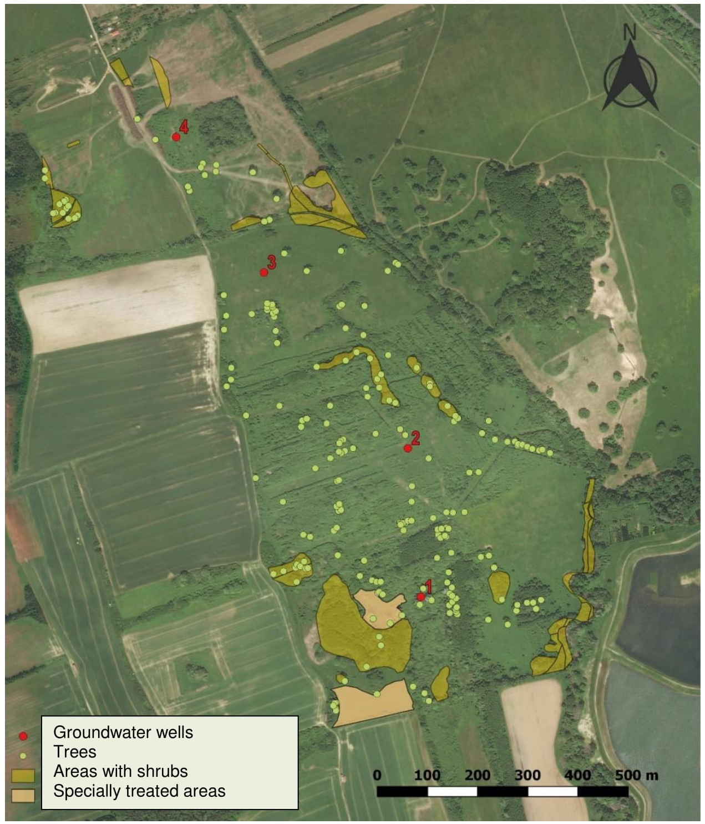
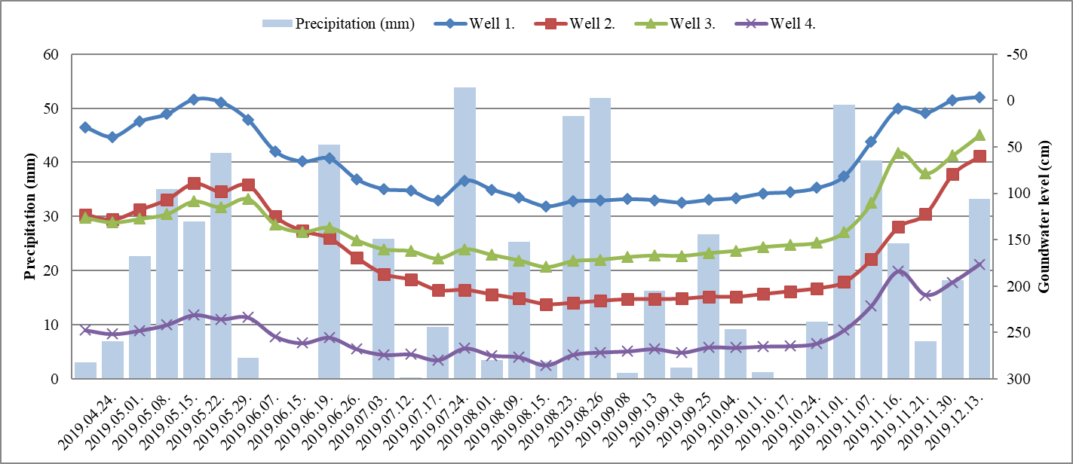
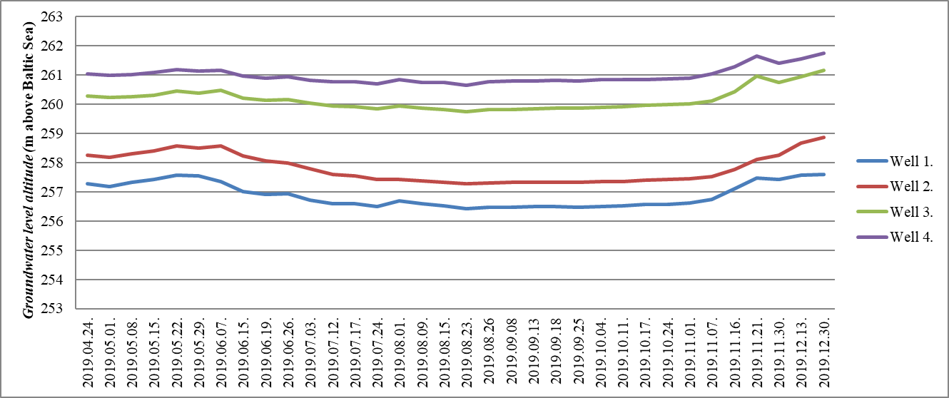
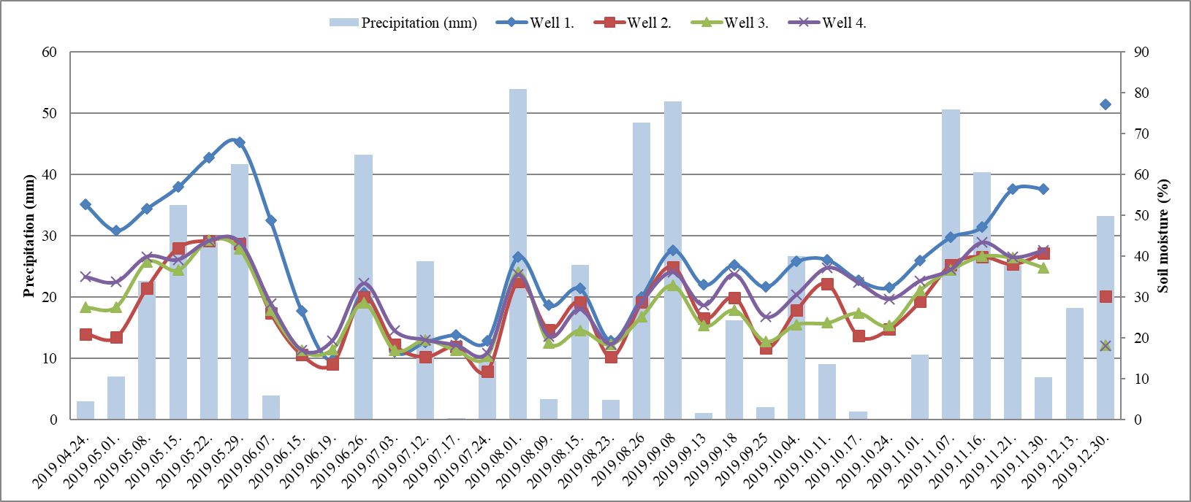
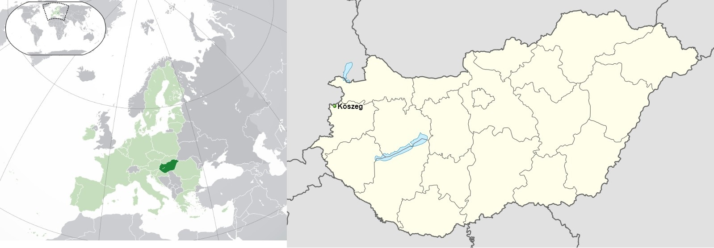
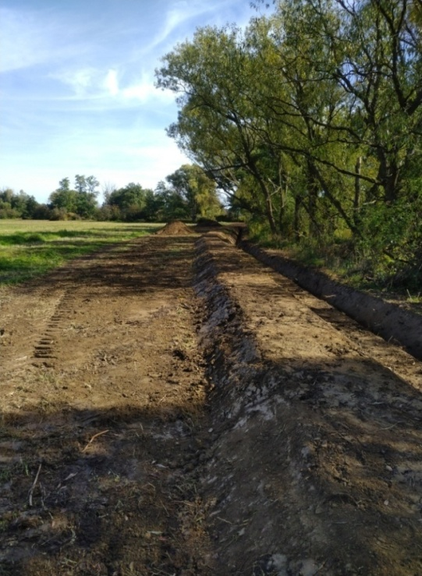
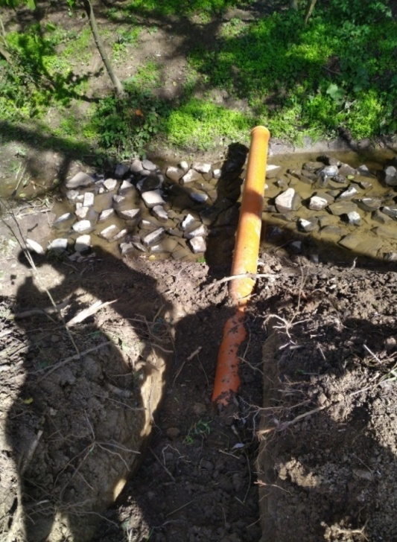
BG3.7/HS10.15/NH8.4 Complex case studies for ecosystem responses to climate and hydrological extremes
doi.org/10.5194/egusphere-egu2020-5430
Water supply of an ecologically vulnerable wood pasture area at Kőszeg (Hungary)
Előd Szőke¹, Péter Csáki¹, Péter Kalicz¹, Katalin Anita Zagyvai-Kiss¹, Péter Primusz¹, Zoltán Gribovszki¹
¹ University of Sopron, Institute of Geomatics and Civil Engineering, 9400 Sopron, Bajcsy-Zs. u. 4., Hungary
E-mail: elod0324@gmail.com
The reconstruction of a wood pasture area and a marsh meadow and thereby achieve a more complex biodiversity are the aims of an ongoing project in Western Hungary (Kőszeg Mountains, Őrség National Park Directorate). Previously, the project area (70 hectares) was used as pasture and as meadow. Later it was abandoned, resulted in an increased spread of shrubs and weeds. Climate change may harm the water balance of the vulnerable wetlands. To ensure and manage the water supply and retention in the project area several interventions are planned. The hydrological investigations started in April 2019. Groundwater levels and surface soil moisture (at the surroundings of the wells) are monitored manually once a week at the four selected points in the area. According to the initial results, the groundwater levels and the surface soil moisture values follow the typical seasonal change. A decrease can be detected during the vegetation period, while an increase started in the dormant season. Since the measurements started before the installation of the water control structures and the grazing, the current results can be interpreted as the results of the control period. Thus, the effects of the water supply and retention will be subsequently analyzed.
 | Well 1. | Well 2. | Well 3. | Well 4.
HD-72 | 461776.996 | 461760.277 | 461484.549 | 461318.371
HD-72 | 227142.530 | 227438.573 | 227797.093 | 228071.588
Edge altitude. (m.a.s.l.) | 257.561 | 259.476 | 261.543 | 263.508
Edge-ground (cm) | 58.0 | 16.0 | 44.0 | 15.0
Drilling depth (m) | 2.5 | 2.8 | 3.9 | 4.0
1. figure: The location of the groundwater wells in the habitat reconstruction project area near Kőszeg
1. table: Coordinates and basic data for groundwater wells.
2. figure: Changes in groundwater levels and precipitation patterns.
3. figure: Groundwater level altitude
4. figure: Changes in surface soil moisture and precipitation.
5. figure: Location of Kőszeg
6. figure: The interventions under construction
The research was supported by the “EFOP-3.6.1-16-2016-00018 – Improving the role of research+development+innovation in the higher education through institutional developments assisting intelligent specialization in Sopron and Szombathely” project.

