Slide 1
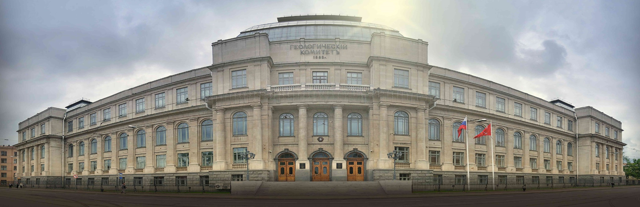
New model of two-stage seafloor spreading in the Eurasian basin (Arctic Ocean);
insights from the analysis of the sedimentary basin architecture
Pavel Rekant and Oleg Petrov
EGU2020-5527
GD7.1/CL4.49/GMPV11.3/SM4.17/TS14.4

Slide 2
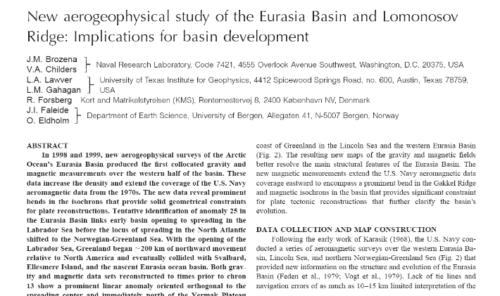
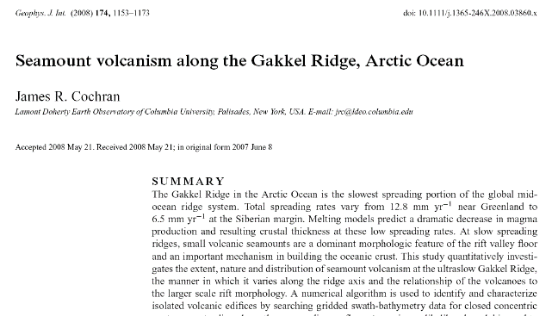
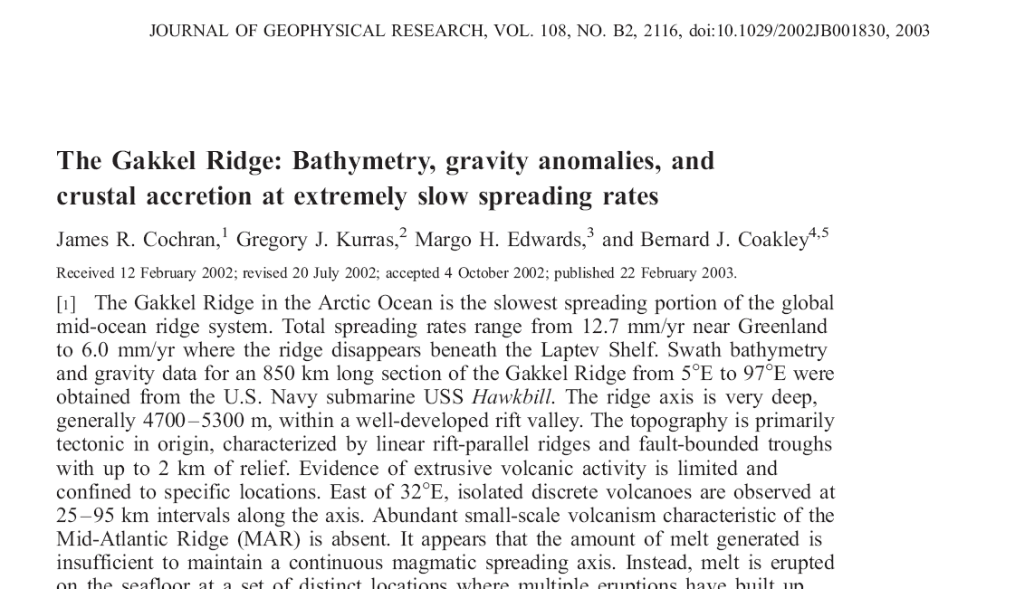
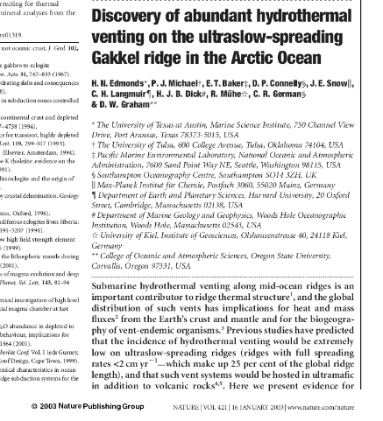
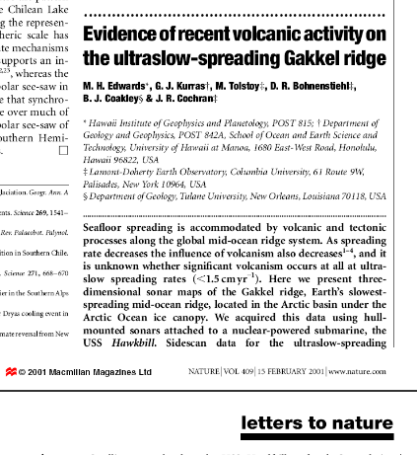
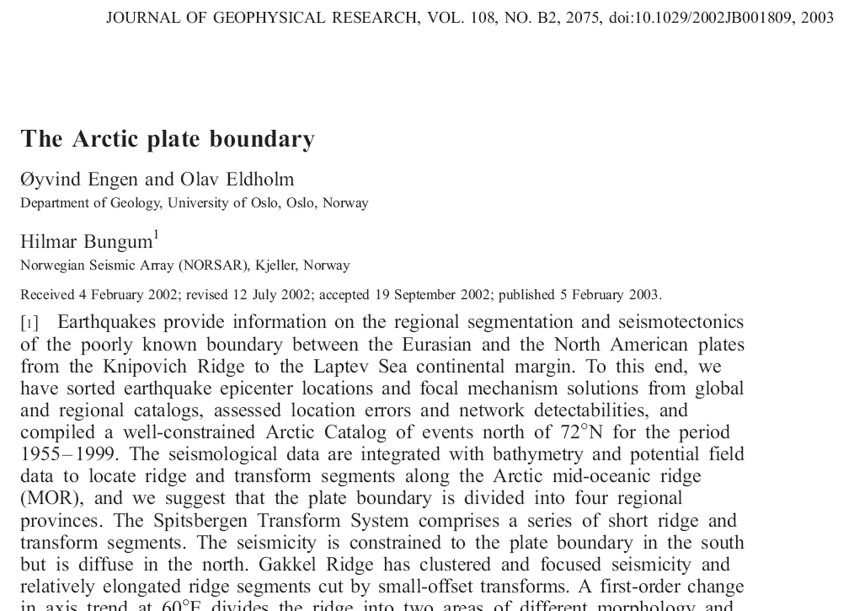
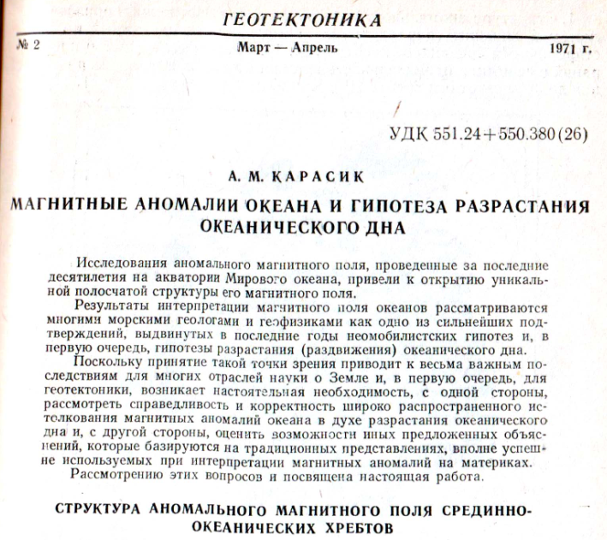
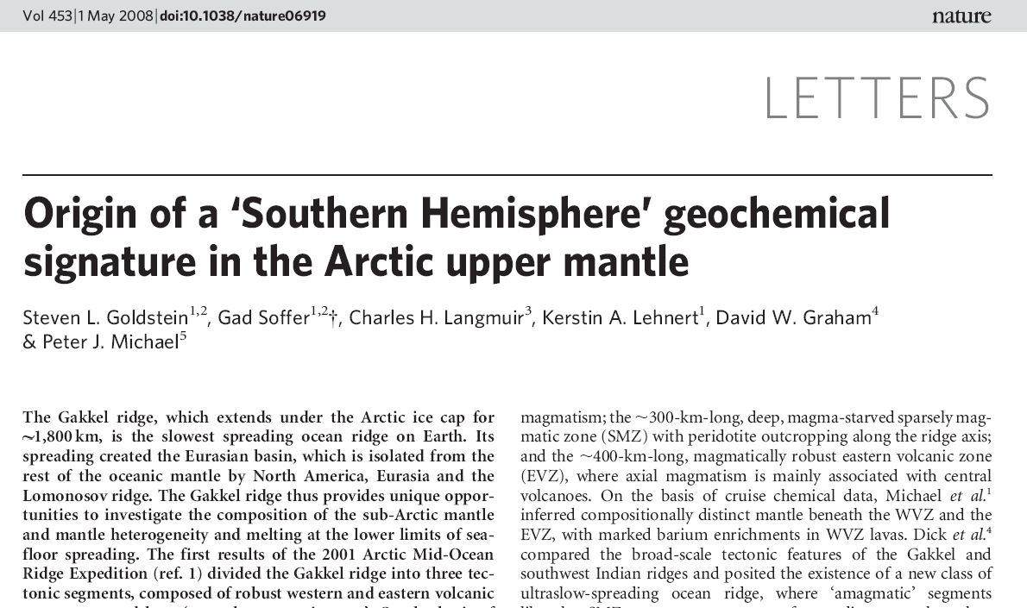
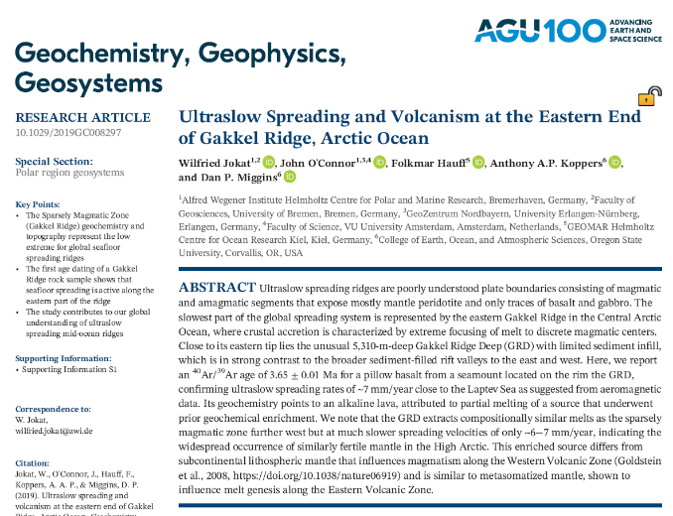
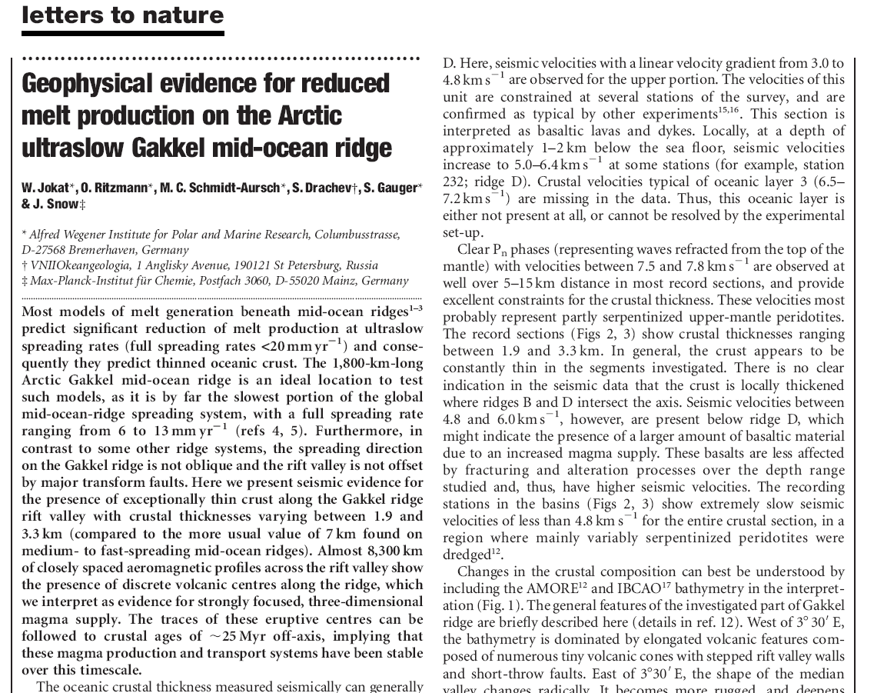
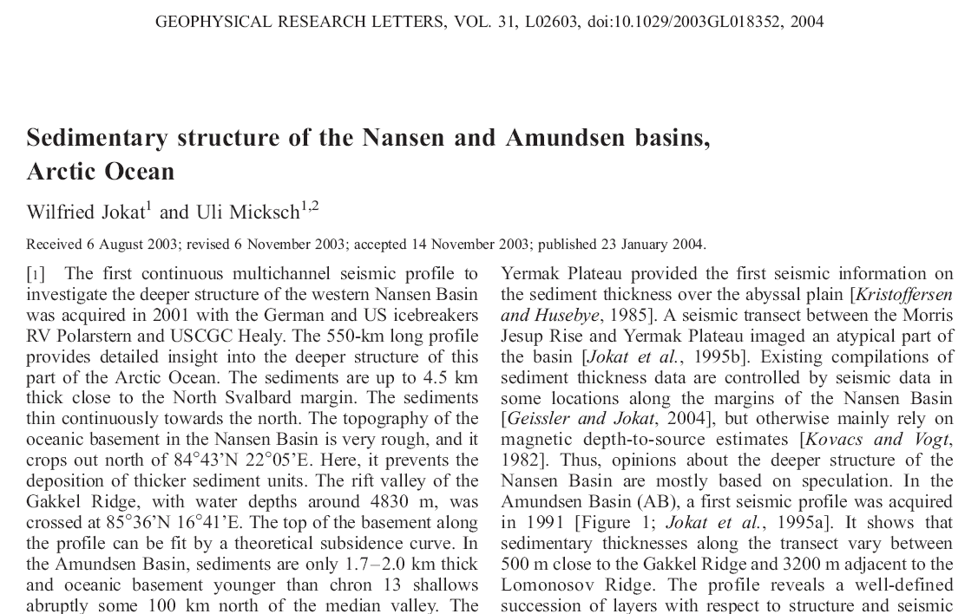
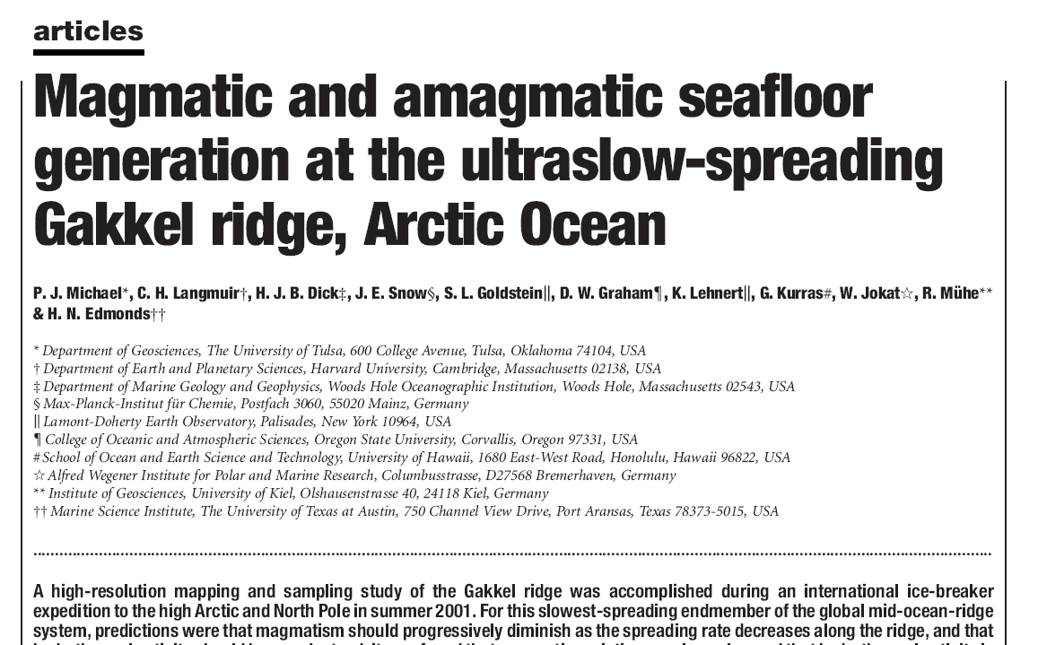
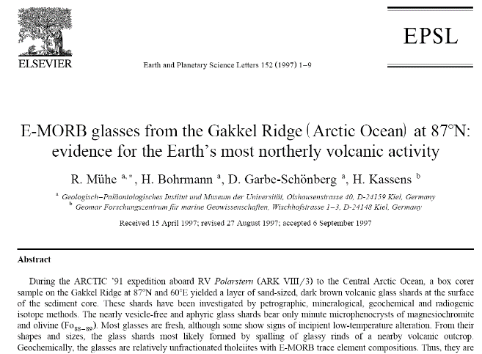
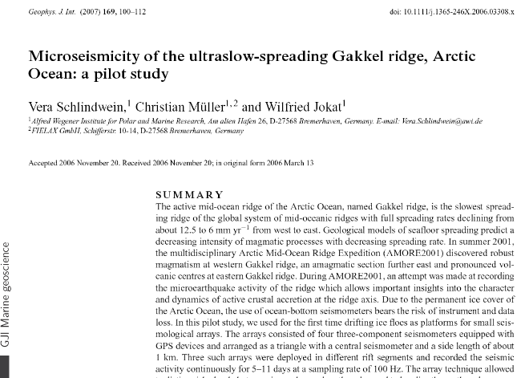
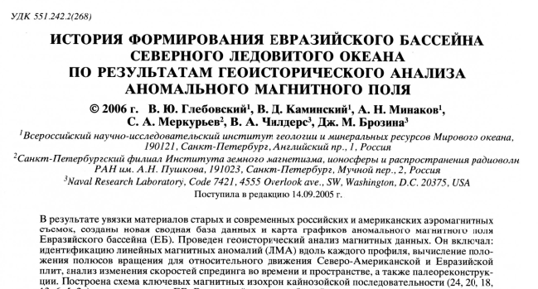
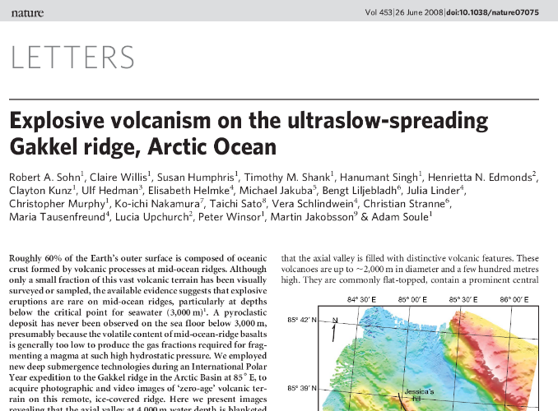
Recent publications on the topic
Notes:
С одной стороны, казалось бы чего изобретать велосипед. Стоит только открыть любую из статей зарубежных авторв и практически любую из отечественных, как буквально первая же строка работы расскажет нам, что ЕБ возник в результате ультрамедленного спрединга за последние 56 млн лет после откола хребта Ломоносова от Бара-Кара. Скорости спрединга на финальном этапе варьировали от 12 (на западе) до 6 мм год на востоке. Ссылки (карасик, вогт, Брозена, …)

Slide 3
The key notes
The evolution of sedimentary systems must inevitably be captured in the synchronous sedimentary basins structure. Therefore the sedimentary basin architecture can be considered as the key to understanding of the tectonic evolution.
Unlike the basement, the sediment structure is fairly clearly displayed by seismic data. More than 20 seismic lines crossed Eastern Eurasia Basin allow us to figure out the most common features of the basin structure and skip the random ones.
The evolution of the Nansen and Amundsen sedimentary basins is mainly determined by the sea floor spreading in the Gakkel Ridge. Consequently, study of their architecture may leads to the understanding of the spreading history.
Rekant & Petrov New model of two-stage seafloor spreading in the Eurasian basin
(Arctic Ocean); insights from the analysis of the sedimentary basin architecture

Slide 4
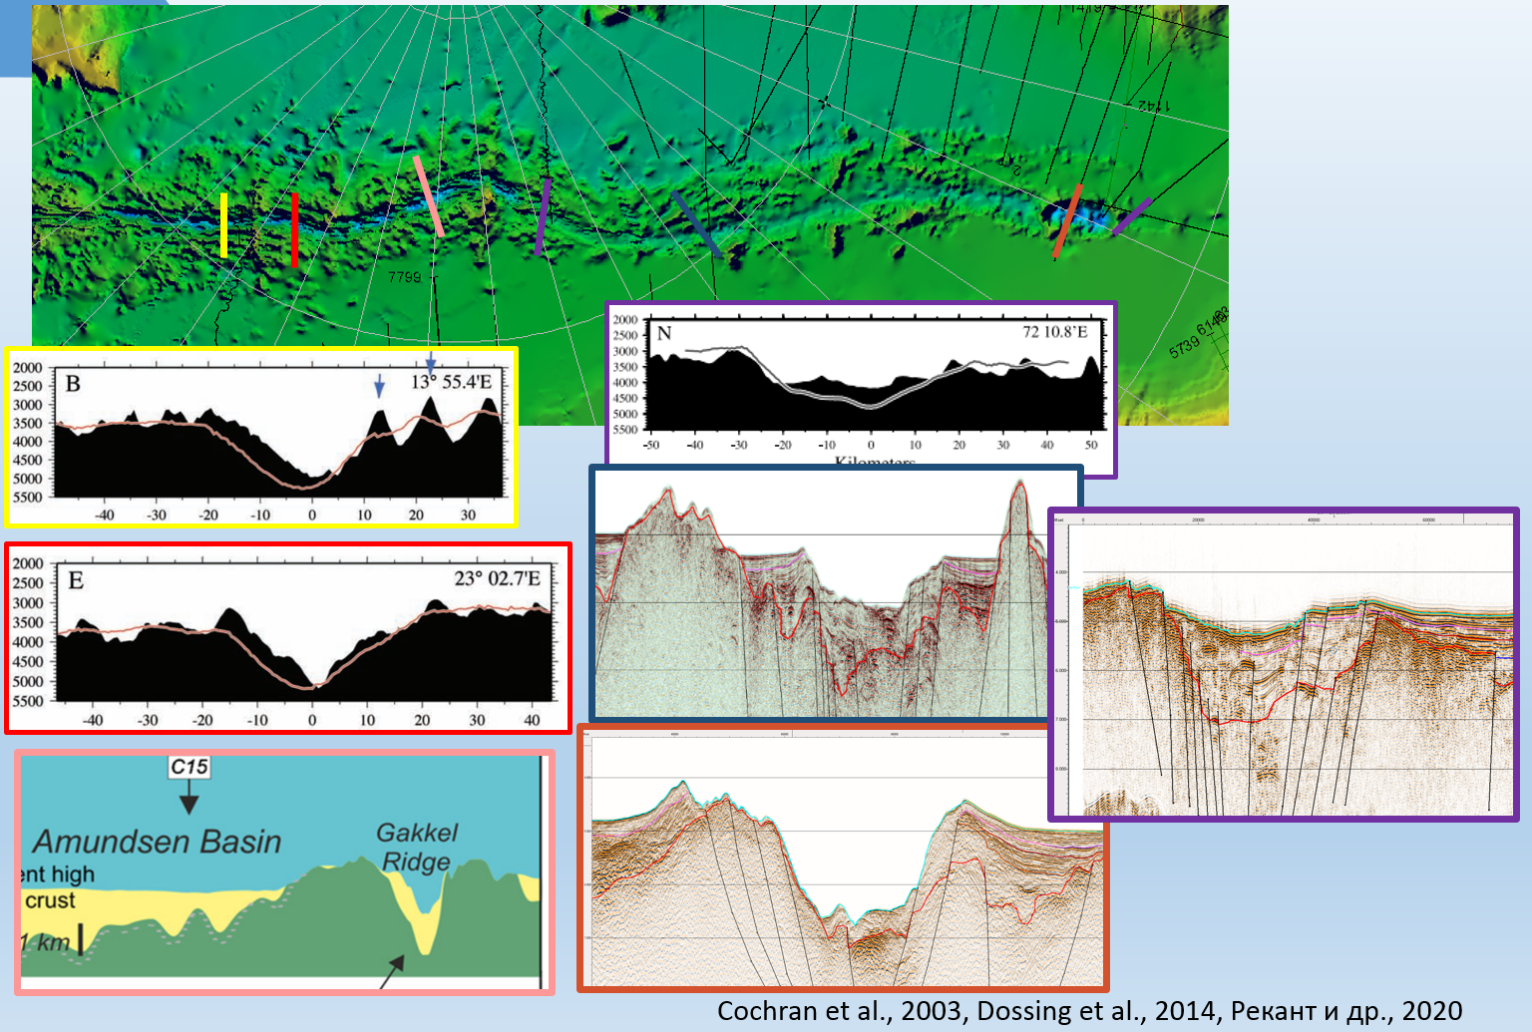
The available seismic and magnetic data show the Gakkel Ridge rift zone consisting of the Atlantic and Siberian segments divided at 70º E. The two segments have had different histories recorded in their sedimentary cover. The Siberian segment differs from the Atlantic one in its morphology and thick sediments in several deposition centers, which may represent a vast Paleogenic basin that formed prior to the Gakkel Ridge. The simple model of North Atlantic spreading fails to explain the long and complex history of the Gakkel Ridge rift and the existence of the depocenters. The particular structure of this zone may result from the growth of rift mountains by accretion of magmatic material in Neogene time, without significant sea floor spreading.
Atlantic segment
Siberian segment
Notes:
Эта часть уже опубликована и для экономии времени я расскажу сразу о выводах.

Slide 5
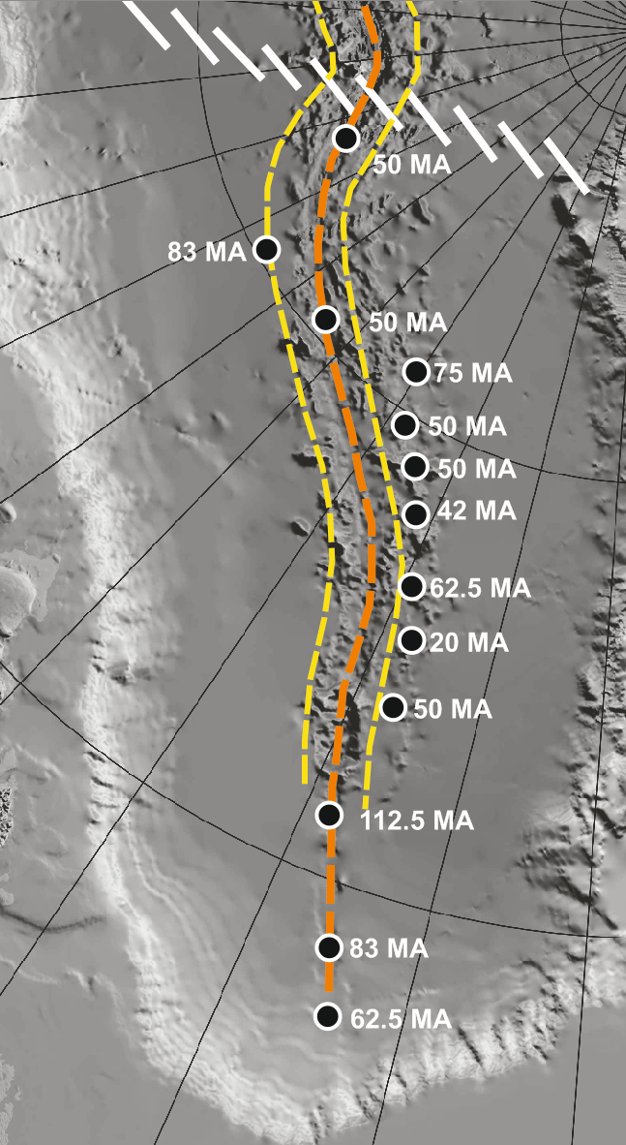
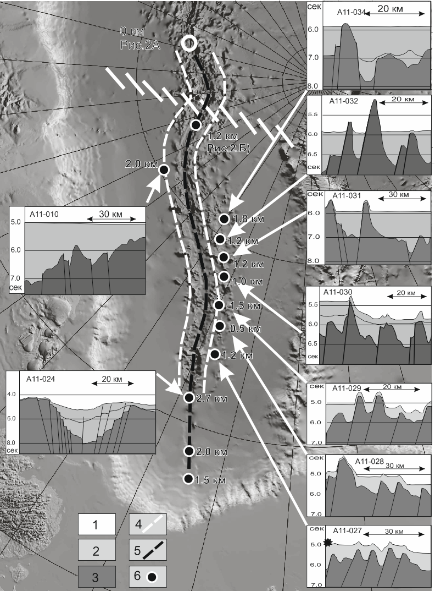
Siberian segment
The calculated age of the depocenters next to the Gakkel Ridge. Sedimentation rates according to (Backman et al., 2008; and Chernykh and Krylov 2011). Yellow line - magnetic anomaly 5
Location of the deep depocenters in the vicinity of the Gakkel Ridge. White line - magnetic anomaly 5
Notes:
Эта часть уже опубликована и для экономии времени я расскажу сразу о выводах.

Slide 6
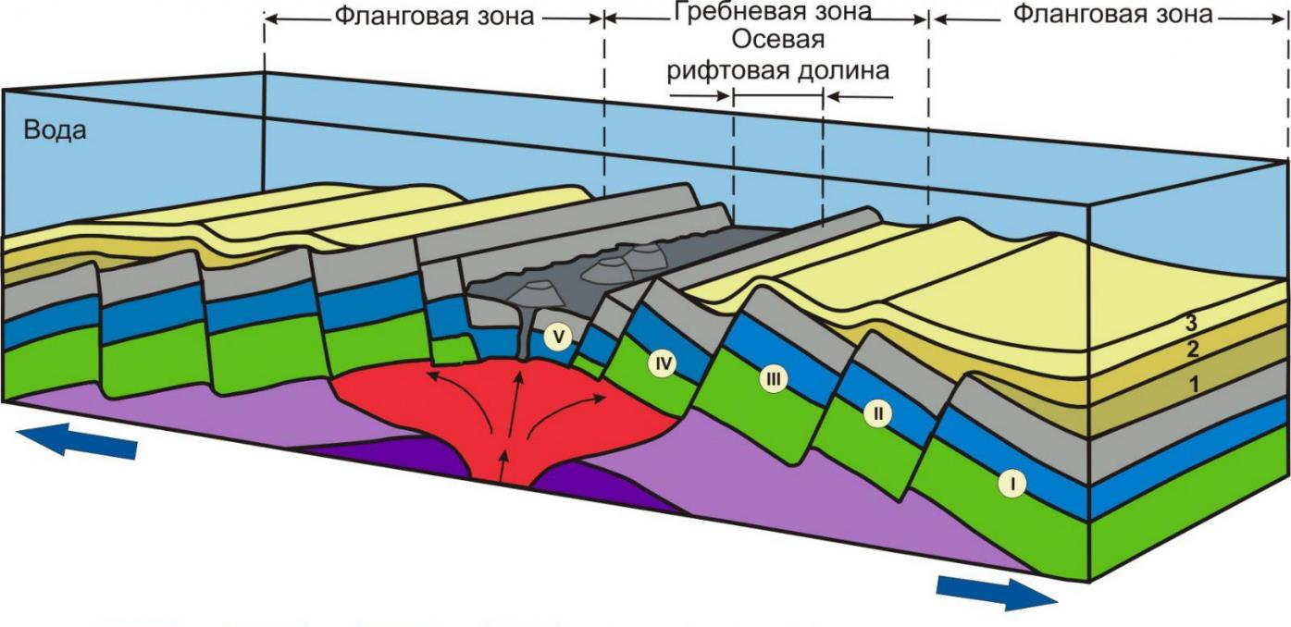
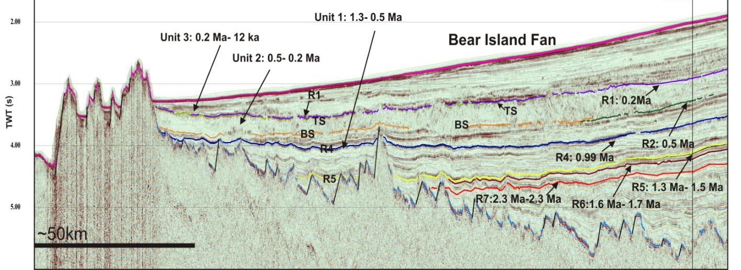
Typical architecture of the spreading basin infill
Pattern of the sedimentary basin infills
Mid oceanic ridge
Accommodation space is expanding due to seafloor spreading
The age of the basal horizons of the basin infills is gradually increasing away from the spreading axis toward the edge of the basin
The age of the deposits next to rift valley tends to zero
Thickness of the recent deposits in the rift valley tends to zero
Pattern of the sedimentary basin infills
rift valley
Accommodation space through the time
Recently
~0.2Ma
1. There is no deposits in the rift valley despite the proximity of the sediment source area on the Barents shelf and quite thick sediment cover nearby.
2. The basement surface deeps gradually away from the Knipovitch Ridge axis toward the edge of the basin
~1.0 Ma
~1.6 Ma
~2.0 Ma
B S M T i n c l i n a t i o n t r e n d
Rekant & Petrov New model of two-stage seafloor spreading in the Eurasian basin
(Arctic Ocean); insights from the analysis of the sedimentary basin architecture
Knipovitch Ridge, Line HB-96-4 (Bruvol., 2006)

Slide 7
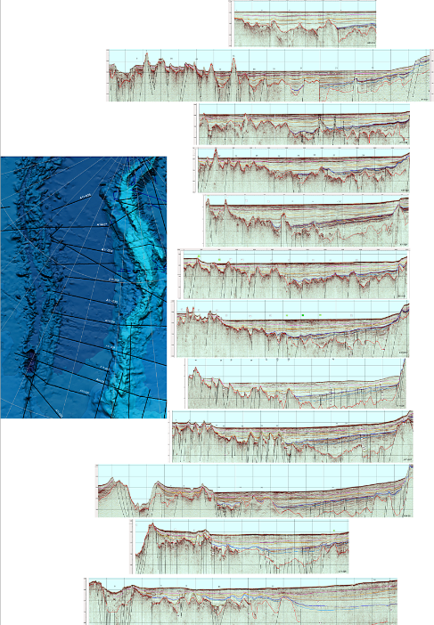
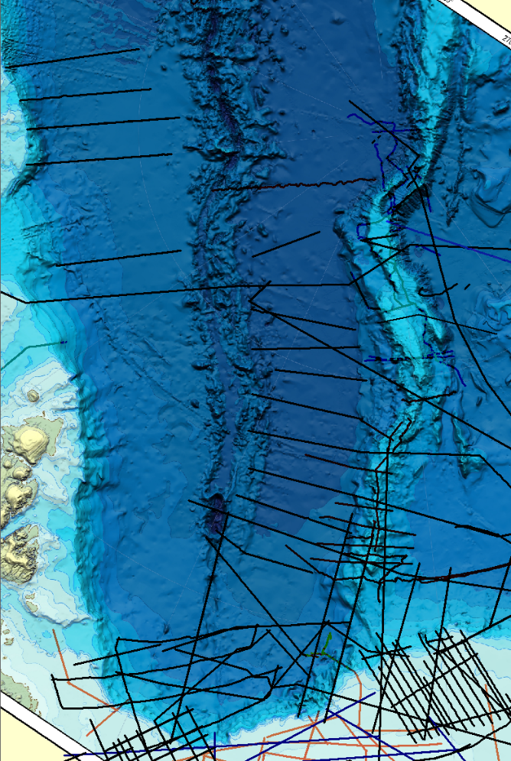
The overall seismic dataset
Russian seismic dataset used for the study
Gakkel Ridge
Main study area
Nansen Basin
Eastern Amundsen Basin
Rekant & Petrov New model of two-stage seafloor spreading in the Eurasian basin
(Arctic Ocean); insights from the analysis of the sedimentary basin architecture

Slide 8
The overall structure of the Eastern (Siberian sector) Amundsen Basin
Nansen
Basin
Gakkel Ridge
Amundsen Basin
Lomonosov Ridge
The uppermost hemipelagic sediment unit
Hor-D1
Hor-A
Line A14-07
Rift valley infilled with 1000-1500 m of deposits
Line A14-07 (Arcticheskiy…, 2017)
All seismic lines show the fairly similar structure of sediment veneer throughout the Amundsen basin that quite different from the shown above Knipovitch Ridge structure:
There are two sedimentary sub-basins, separated by regional seismic reflector Hor-A. If the lower sub-basin is traced from Lomonosov Ridge flank, then the upper one covers the entire Amundsen basin
Both sub-basins show different basement inclination trend (compare and )
Rift valley is infilled with 1000-1500 m of hemipelagic deposits
The uppermost 300-600 (!) m thick hemipelagic sediment unit covers the entire basin. The age of the unit calculated through the sedimentation rate is at least 30 Ma
Rekant & Petrov New model of two-stage seafloor spreading in the Eurasian basin
(Arctic Ocean); insights from the analysis of the sedimentary basin architecture

Slide 9
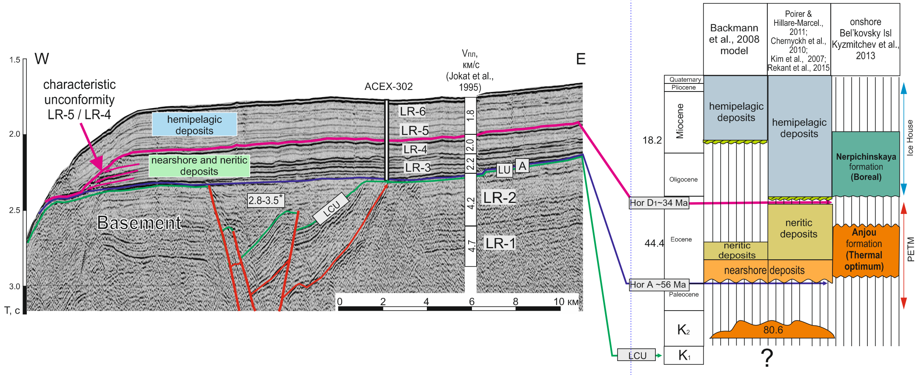
Seismic-to-borehole data correlation
The model used
in the study
Hor-D1
Hor-(LU)A
The image of the seismic line AWI-91090 courtesy of John Hall
Rekant & Petrov New model of two-stage seafloor spreading in the Eurasian basin
(Arctic Ocean); insights from the analysis of the sedimentary basin architecture

Slide 10
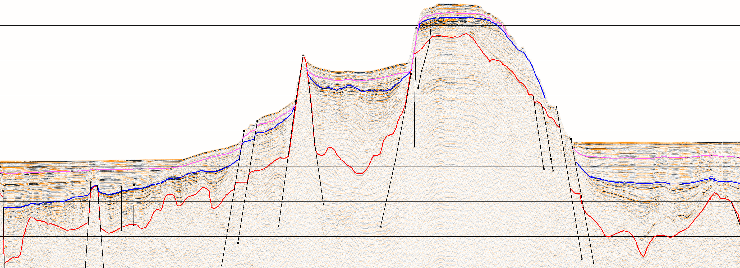
Ridge-to-Basin Hor-A (LU) correlation
Hor-A was traced from ACEX-302 drill site toward both the Makarov and the Amundsen basins along the composite seismic line “AWI-91090-91091- (courtesy of John Hall) -A14-07” (Arkticheskiy…, 2017).
Hor-(LU)A
Hor-(LU)A
Rekant & Petrov New model of two-stage seafloor spreading in the Eurasian basin
(Arctic Ocean); insights from the analysis of the sedimentary basin architecture

Slide 11
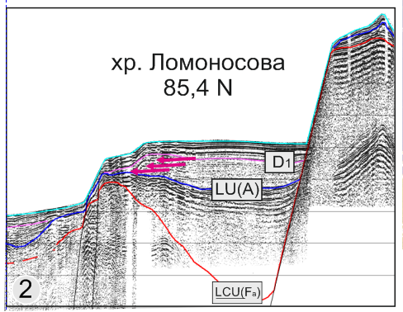
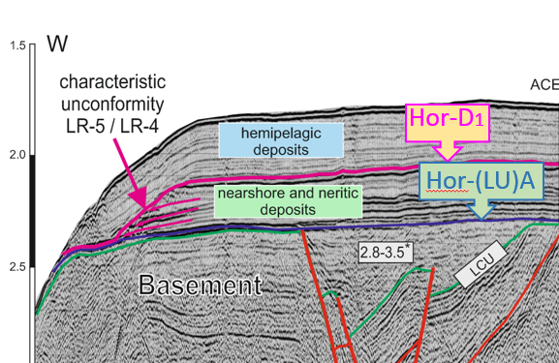
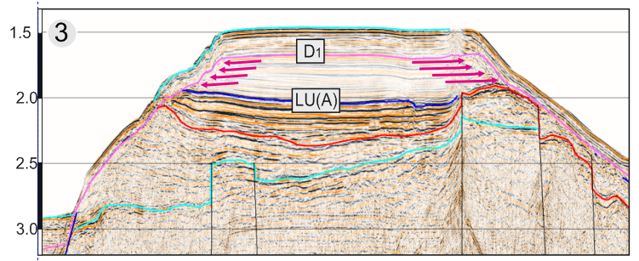
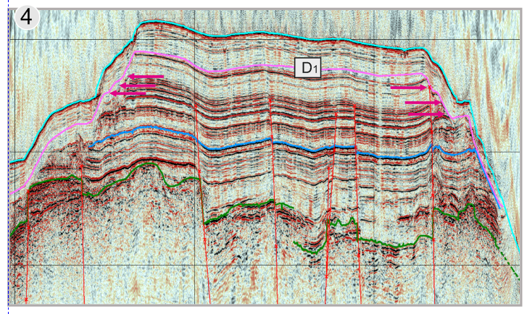
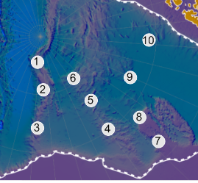
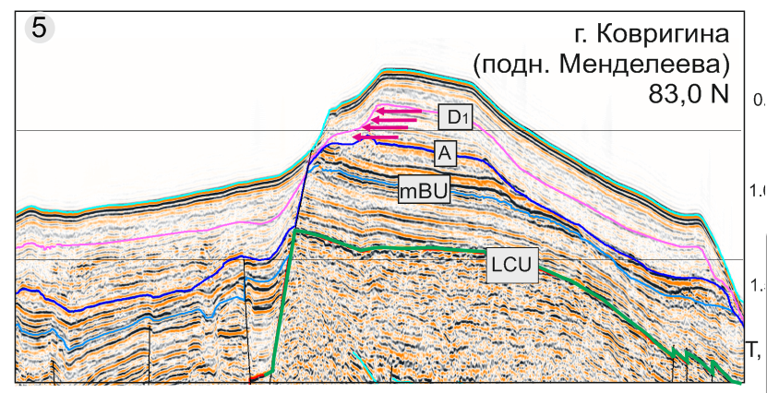
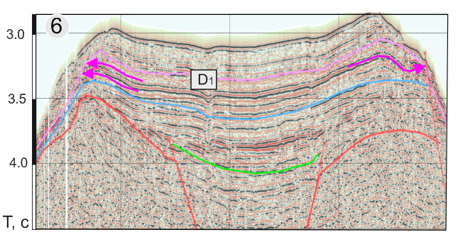
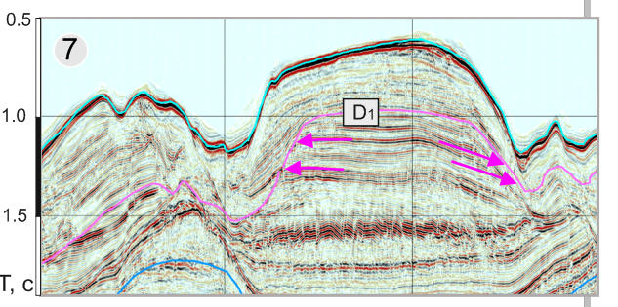
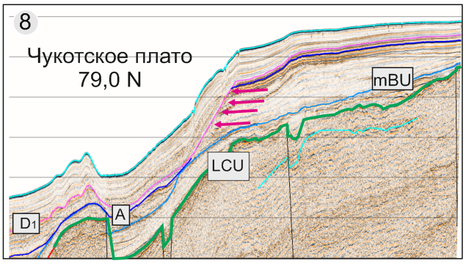
Hor- D1 regional correlations and ground truth
1
10
1
6
9
2
5
8
3
4
7
The characteristic unconformity on the boundary between LR5 and LR4 (Hor - D1) was revealed using the regional seismic dataset at most of slopes on the Lomonosov Ridge, Mendeleev Rise, Chuckchi Cap, Sever Spur.
Rekant & Petrov New model of two-stage seafloor spreading in the Eurasian basin
(Arctic Ocean); insights from the analysis of the sedimentary basin architecture

Slide 12
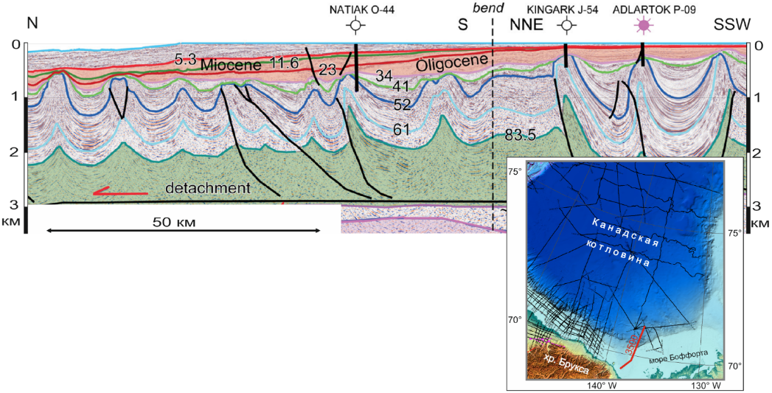
Hor- D1 regional correlations and ground truth
Beaufourt shelf.
Hor-D1 = Hor-30 =
Top Richards fm, 34 Ma
(Helwig et al., 2011; Mosher et al., 2012)
Acex-302 drill site
Hor-D1 = LR5\LR4 = 34 Ma (Rekant et al., 2015) .
Hor-D1 was assigned to 34 Ma using the on regional cross correlation throughout the comprehensive seismic dataset. Offshore Makenzie delta Hor-D1 assigned to the top of the deformed Eocene Richards fm (Helwig et al., 2011).
Bel’kovsky Isl. Hor-D1 = Nerpichinskaya/Anjou fm boundary ~34Ma
(Kuzmichev et al., 2013)
Rekant & Petrov New model of two-stage seafloor spreading in the Eurasian basin
(Arctic Ocean); insights from the analysis of the sedimentary basin architecture
Rekant et al, 2020
Helwig et al., 2011

Slide 13
Stratigraphy of the Amundsen basin sedimentary system
34 Мa
56 Мa
Evolution of the Amundsen basin sedimentary system

Slide 14
Reflection of the Amundsen basin sedimentary system evolution in the structure of the sedimentary basin.
Stage IV. Recent tectonic activation
Stage III. Accumulation of the hemipelagic deposits veneer throughout the region. There is no expansion of the accommodation space. Sedimentary basin has modern size.
Stage II. Expansion of the accommodation space, caused by seafloor spreading in the Gakkel Ridge. By the end of the stage Amundsen basin has reached its modern size
Stage I. Epicontinental sag basin, connected to the Lomonosov Ridge
Rekant & Petrov New model of two-stage seafloor spreading in the Eurasian basin
(Arctic Ocean); insights from the analysis of the sedimentary basin architecture

Slide 15
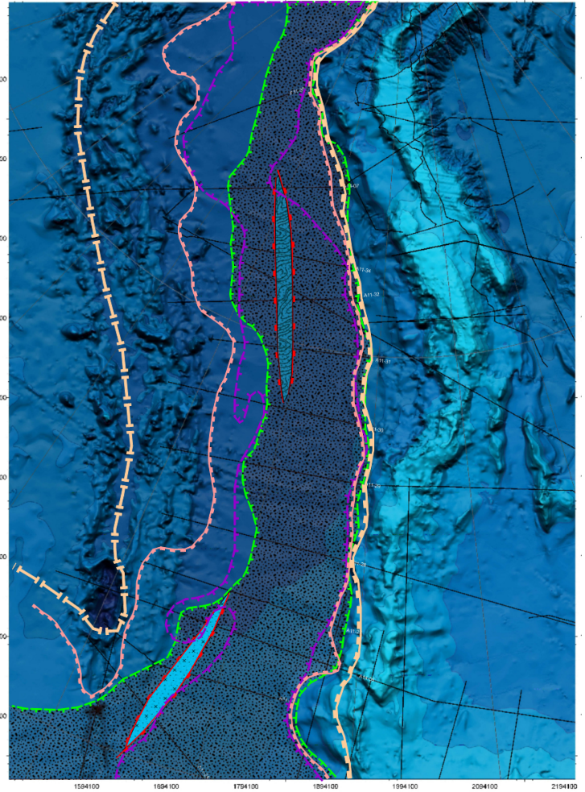
Spatial features of the Amundsen Basin sedimentary system
The axis of the Nansen-Amunsed basin by 34 Ma
120-56
Recent tectonic
53-47 (?)
40-34
120-56
47-40
53-47
1. Epi-continental sag basin formed during ~120-56 Мa was filled with ~1500-2000 m of sediments.
2. Gradually expansion of the sedimentary basin up to its modern size (53-34 Мa). The rift valley have been Infilled by sediments as thick as 1000 m.
3. The veneer of the syn-oceanic deposits was accumulated throughout the Eurasia basin since 34 Мa
4. Recent neo-tectonic activization over the past ~3Ma was caused by resumption of seafloor spreading in the Gakkel Ridge axial zone by propagation of the oceanic rift from Norwegian-Greenland basin toward the east.
47-40 (?)
Rekant & Petrov New model of two-stage seafloor spreading in the Eurasian basin
(Arctic Ocean); insights from the analysis of the sedimentary basin architecture

Slide 16
Line A14-07 (Arcticheskiy…, 2017)
Continental break-up stage I ~120-56 MA leads to formation of 120-130 km wide synrift basins both in the Eastern Amundsen and in the Western Nansen basins. Both basins were floored by extremely extended continental crust. Therefore, the hypothesized continent-ocean boundary (COB) should be placed at the seaward edges of synrift portions of Amundsen and Nansen basins, roughly along the magnetic anomaly #20.
Spreading stage II (56-34 MA) was characterized by seafloor spreading in the EB as low as 8 mm/year, which was accompanied by expansion of the Amundsen and Nansen sedimentary basins up to their current sizes. The successive expansion of the sedimentary basins which is characteristic of the seafloor spreading basin, was revealed from the architecture of only this sequence, neither underlying nor overlapping. We propose the formation of a Gakkel Ridge rift valley and its infilling with thick sediments sequence during this stage.
Synoceanic stage III (34-~3 MA) was resulted in the accumulation of the undisturbed Oligocene-Quaternary sediment sequence all over the entire EB. If the non-tectonized architecture of this sequence indicates a calm tectonic regime for the most of the Oligocene-Miocene, the existence of the sediment veneer all over the entire EB proves that sedimentation basin and consequently the oceanic crust domain of modern size were already formed by the beginning of Oligocene.
Re-spreading stage IV (~3-0 MA) is characterized by the resumption of seafloor spreading in the Gakkel Ridge axial zone by propagation of the oceanic rift from Norwegian-Greenland basin toward the east.

Slide 17
The proposed model of two-stage seafloor spreading in the EB allows us to explain most of the geological issues in this region and is of perfect relation to the known tectonic events along the Arctic periphery.
In particular: (1) thick sediments sequence in the Eastern and Central Gakkel Ridge rift valley could be explained by the Eocene age of the rift valley, (2) recent spreading resumption could be considered as the cause of the unpredictable high both the hydrothermal activity and volcanism at the Western Gakkel Ridge, (3) the consolidated sand- and siltstones, dredged from the seamount scarp in the middle part of Amundsen Basin (Gaedicke et al., 2019), which thought to be fragments of Mesozoic continental crust, confirm the suggested COB position along magnetic anomaly No.20, (4) the eastward propagation of the ocean rifting along the Gakkel Ridge leads to apparent change of the accentuated high relief morphology of the Western Gakkel Ridge to a smoother ridge morphology of the Eastern Gakkel Ridge as well as to defocusing seismicity at the Eurasia Basin– Laptev Sea transition.

Slide 18
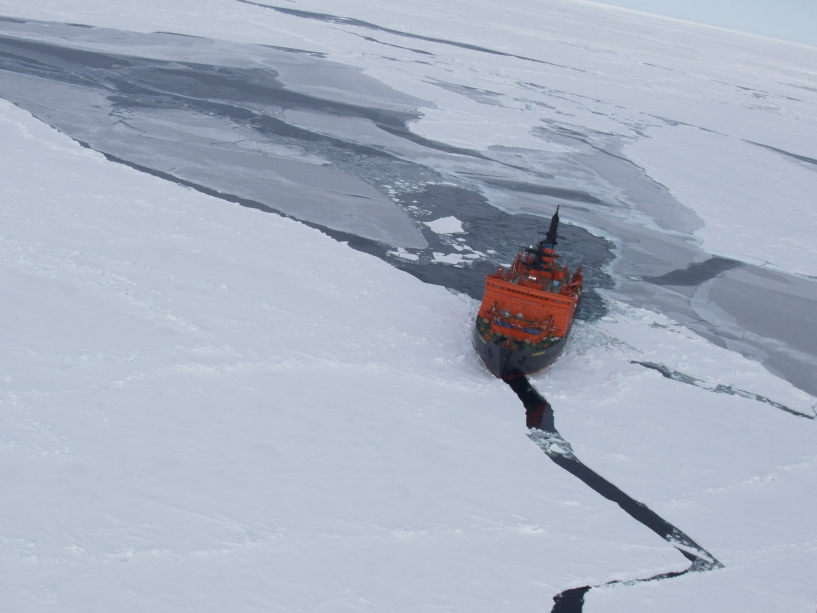
Thank you for attention
Amundsen Basin
Nansen Basin
Gakkel Ridge

