Slide 1
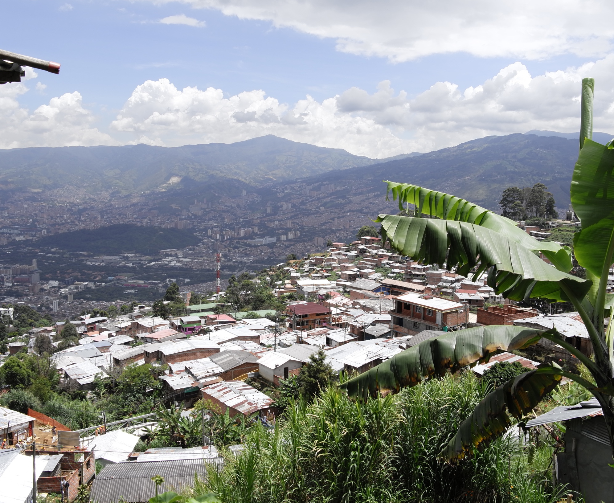

Hazard assessment of landslide-prone areas on highly weathered dunite rock in Bello Oriente, Medellín, Colombia (Project Inform@Risk)
Tamara Breuninger
Moritz Gamperl
Kurosch Thuro
Chair of Engineering Geology
Technical University of Munich
EGU General Assembly, May 7th 2020
NH3.10
Landslide Hazard and Risk in a Changing Environment
Funding code: 03G0883A-F

Slide 2
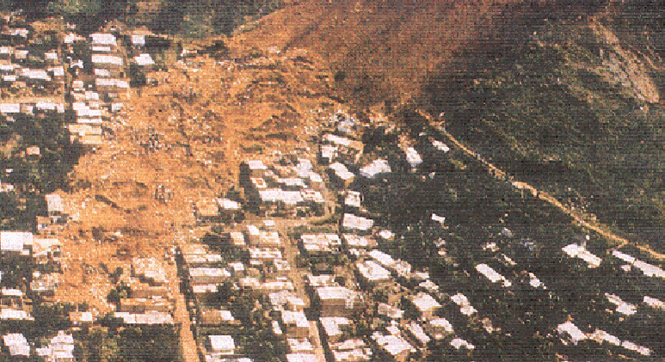
Barrio La Cruz (2007) (Departamento
Administrativo de Pleneación Medellín 2007)
Motivation
> 2000 landslides in 30 years in Medellín
> 750 casualties in the last 70 years
Most landslides appear on the eastern slopes of the city in deeply weathered dunite rock
Villa Tina Landslide (1987), killing 500 people (Ojeda & Donnelly 2006)

Slide 3
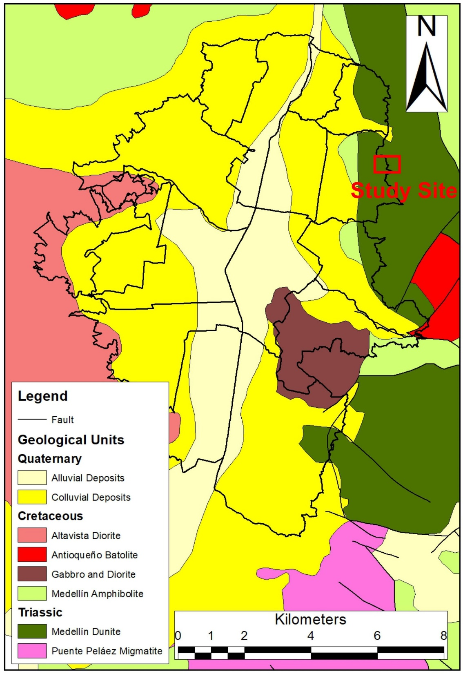
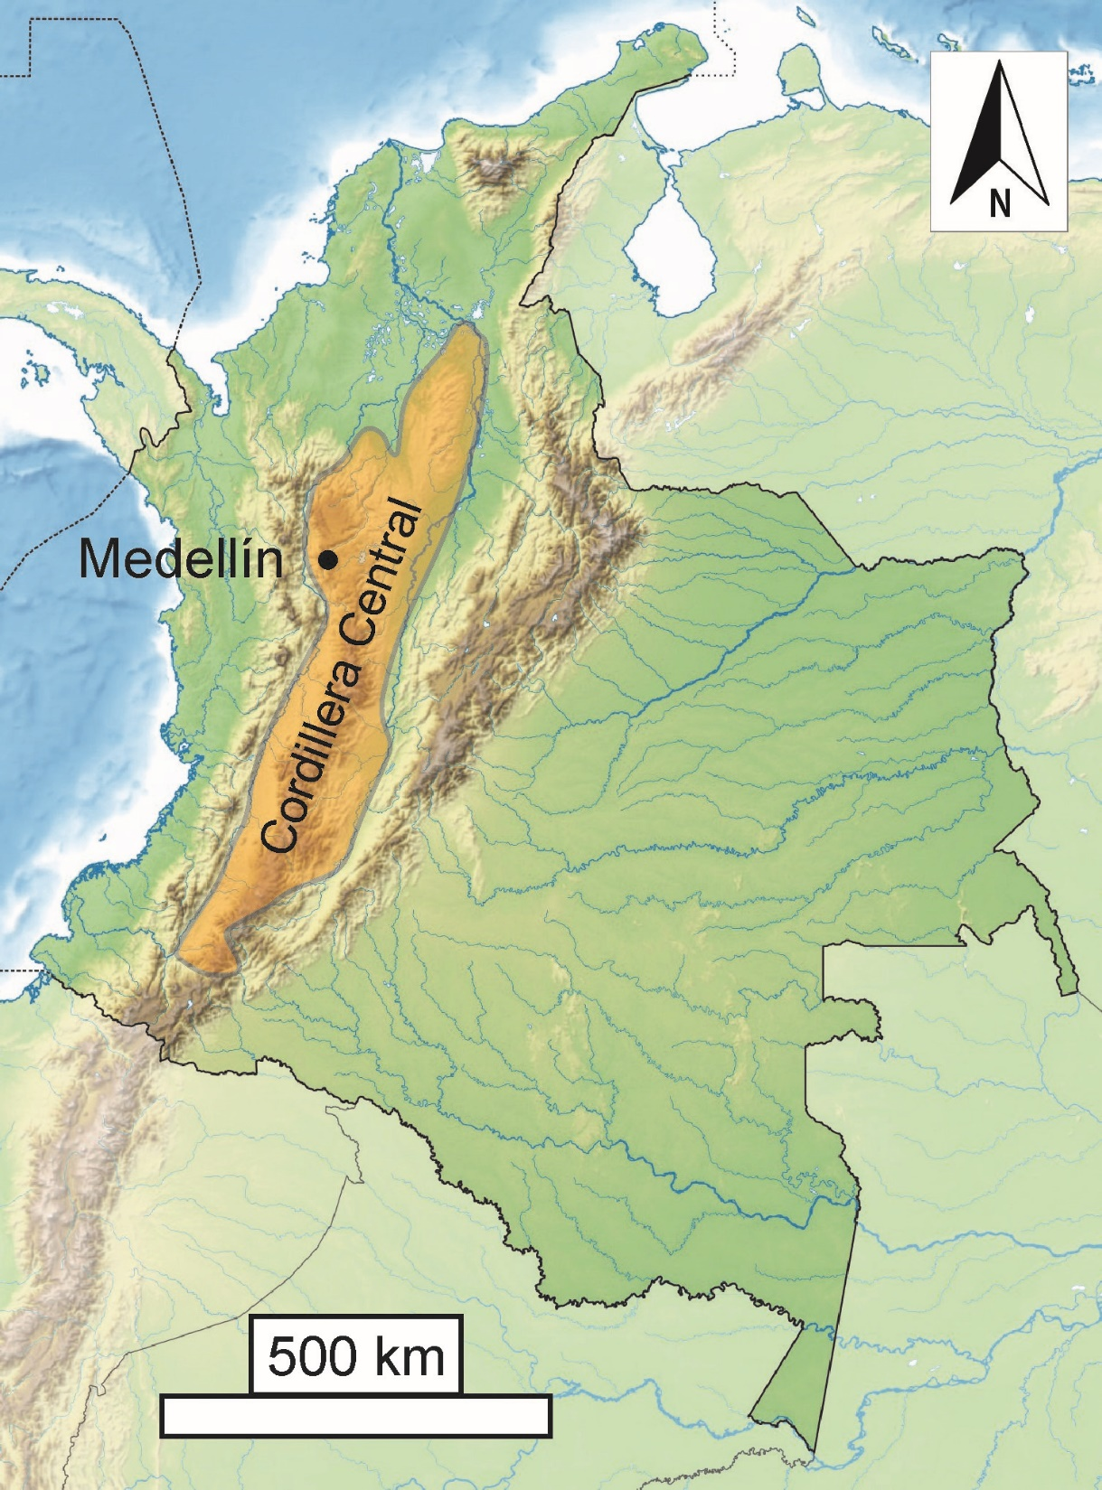
Overview
Medellín lies in the Cordillera Central of the northern Andes
The mountains around Medellín are made up of Triassic and Cretaceous ingeous and metamorphic rocks.
The study site Bello Oriente lies in the north-eastern slope in the area of the Medellín Dunite.
Notes:
Tamy

Slide 4
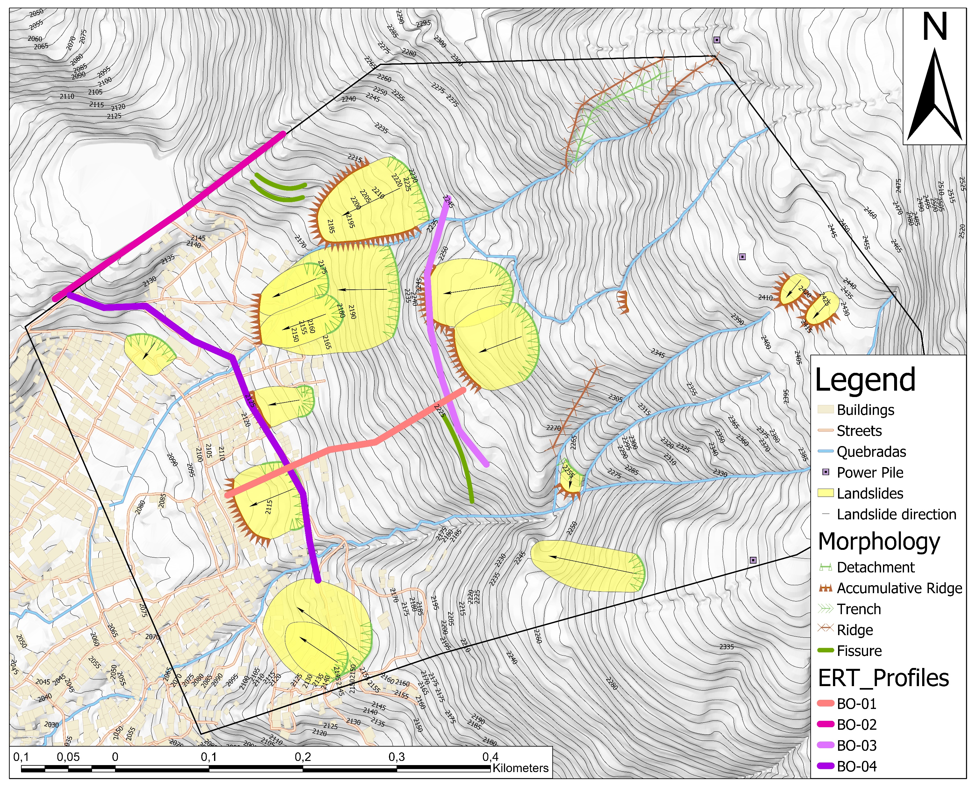
First Results Field Work
Past landslides identified
Several fissures indicate possible future landslides

Slide 5

Outlook
Second field campaign in February 2020; data still in process
Drillings and test installation planned for May 2020 -> postponed indefinitely
Backup: test installation on a small landslide in Bavaria
Completion of installation in Colombia planned in March 2020
Read more about the project:
  https://www.bmbf-client.de/projekte/informrisk
  Thuro K., Singer J., Menschik B., Breuninger T., Gamperl M. (2020): Development of an early warning system for shallow landslides in the tropical Andes (Medellín; Colombia). Geomechanics and Tunnelling.

