Slide 1
Phosphorus Substance Flow Analysis for the Northern Ireland Food System 2017
Shane A Rothwellª, Donnacha G Doody^{b}, Chris Johnson^{b}, Kirsty J Forberª, Paul J A Withersª
ª Lancaster Environment Centre, Lancaster University, Lancaster, UK
^{b} Agri Food and Biosciences Institute, Belfast, Northern Ireland
http://wp.lancs.ac.uk/rephokus/
@RePhoKUs

Slide 2
One page summary
Livestock agriculture dominates phosphorus flows in the Northern Ireland food system and are the most significant contributor to system P surplus. Managing manure P (reducing production or exporting) is key to improving P stewardship in NI.

Slide 3
Introduction
67% of NI rivers fail to meet EU Water Framework Directive targets for ‘good’ or ‘high’ water quality.
Phosphorus inputs from agriculture are the single biggest cause of failure to meet the WFD targets.
SFA can help identify hotspots for P inefficiency or loss and set priorities to redesign the system.

Slide 4
P SFA for NI food system

Slide 5
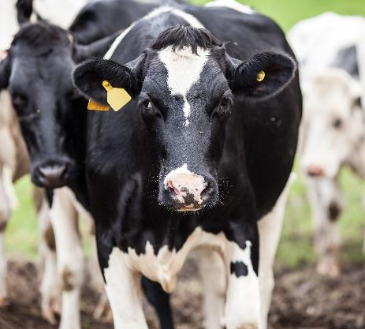
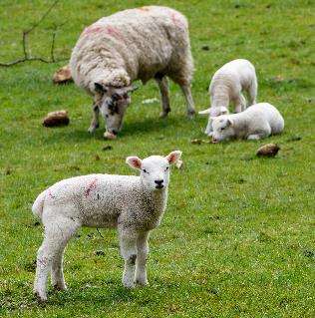
Highlights
Livestock sector is the largest import (~11,600 t feed) and internal flow (~20,400 t manure) of P in NI food system.
Soil P inputs ~25,000 t (~80% manure, ~20% fertiliser/waste recycling products).
Crop/grass P offtake ~17,000 t.
~8,000 t excess P application.

Slide 6
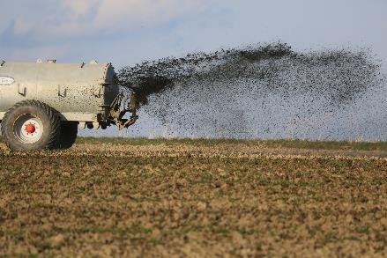
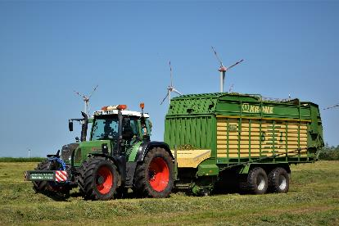
Highlights
~8.5 kg ha⁻¹ P accumulated in soil.
~950 t lost to water (62% of national total).
Livestock manure P alone exceeds crop/grass demand by ~20%.
Reduction in manure P needed to help manage system excess and loss.

Slide 7
Conclusion
Livestock system dominates P flows in NI food system.
Manure P production alone in excess of total crop/grass P demand.
Decreased livestock feed P import (reduced livestock population/lower animal feed P content) would help but unlikely to happen.
Managing manure/slurry P with new technologies that allow processing and export of excess P possible alternative.

