Slide 1
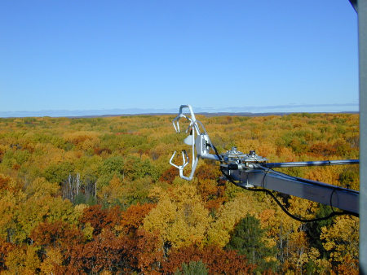


Diurnal and inter-day hysteresis of species-specific stomatal conductance from sap-flow measurements illustrates hydraulic-stress responses strategies of trees
Gil Bohrer^{1,3}
Theresia Yazbeck¹, Ana Maria Restripo Acevado², Ashley Matheny²
¹The Ohio State University, Civil Environmental & Geodetic Engineering
²University of Texas at Austin, Jackson School of Geosciences
³US-UMB, US-UMd Ameriflux Sites

Slide 2
Research Site
UMBS Ameriflux Site Cluster:
US-UMB, US-UMd
Northern Michigan
Sandy soil
LAI ~ 4
(species-specific + stem census)
Flux obs. 1999-
Soil moisture profiles (8 pits) 2010-
Sap flux obs. (~150 trees) 2011-
Stem Storage obs. (~10 trees) 2017-
SAPFLUXNET: https://zenodo.org/record/2530798#.XTdbIR5ME0M

Slide 3
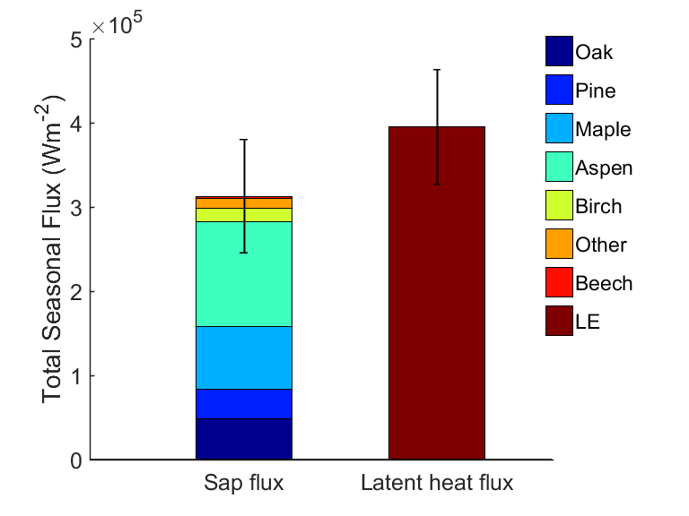
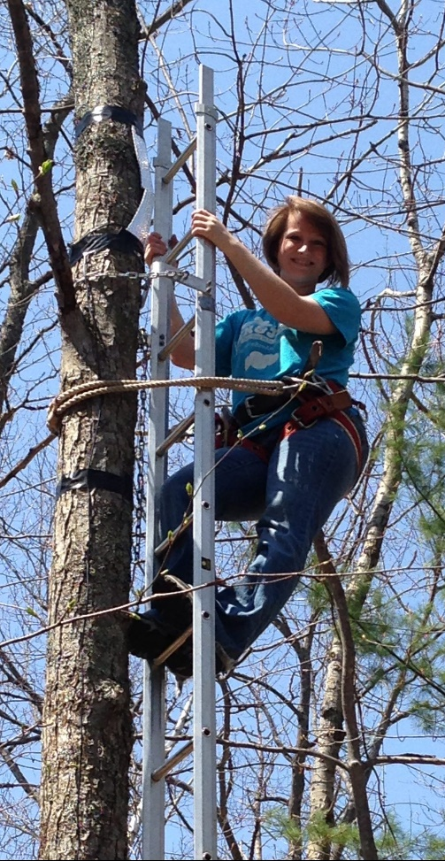
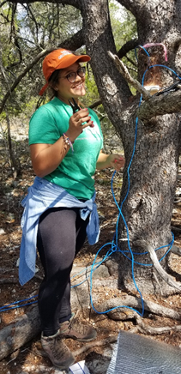
Transpiration and latent heat at the plot level
Sap flux ≈ 78% of LE
Total seasonal flux(W m⁻²)
Scaled sap flux
Latent heat flux
Matheny et al. 2014, JGR Biogeosci

Slide 4
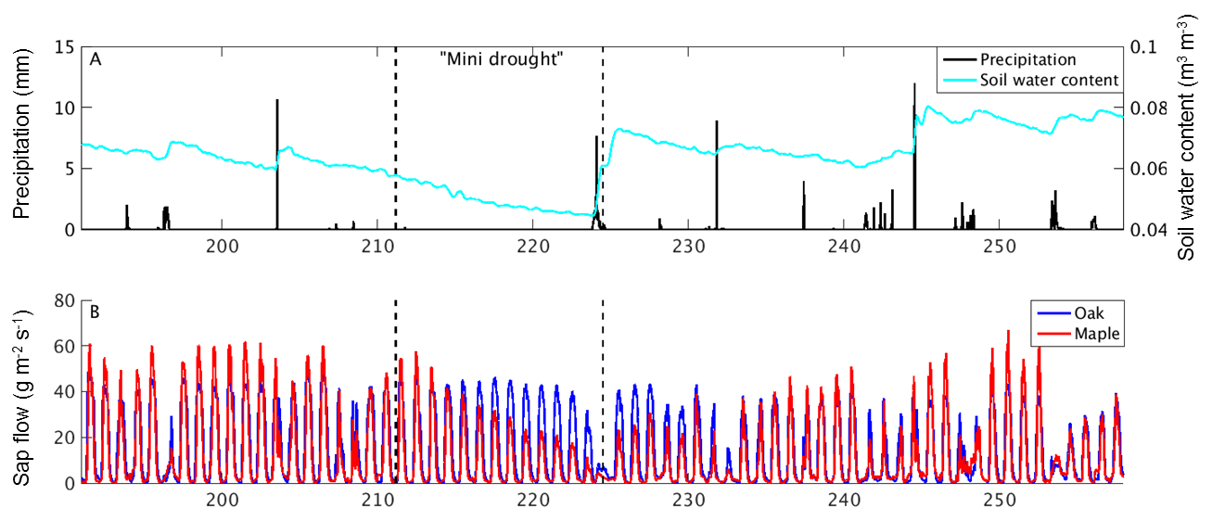
Species-specific dynamics during dry conditions
“Mini drought”
Precipitation (mm)
Soil water content(m³m⁻³)
Sap flow (g m⁻²s⁻¹)
Day of year
Matheny et al. 2016, Ecohydrology

Slide 5
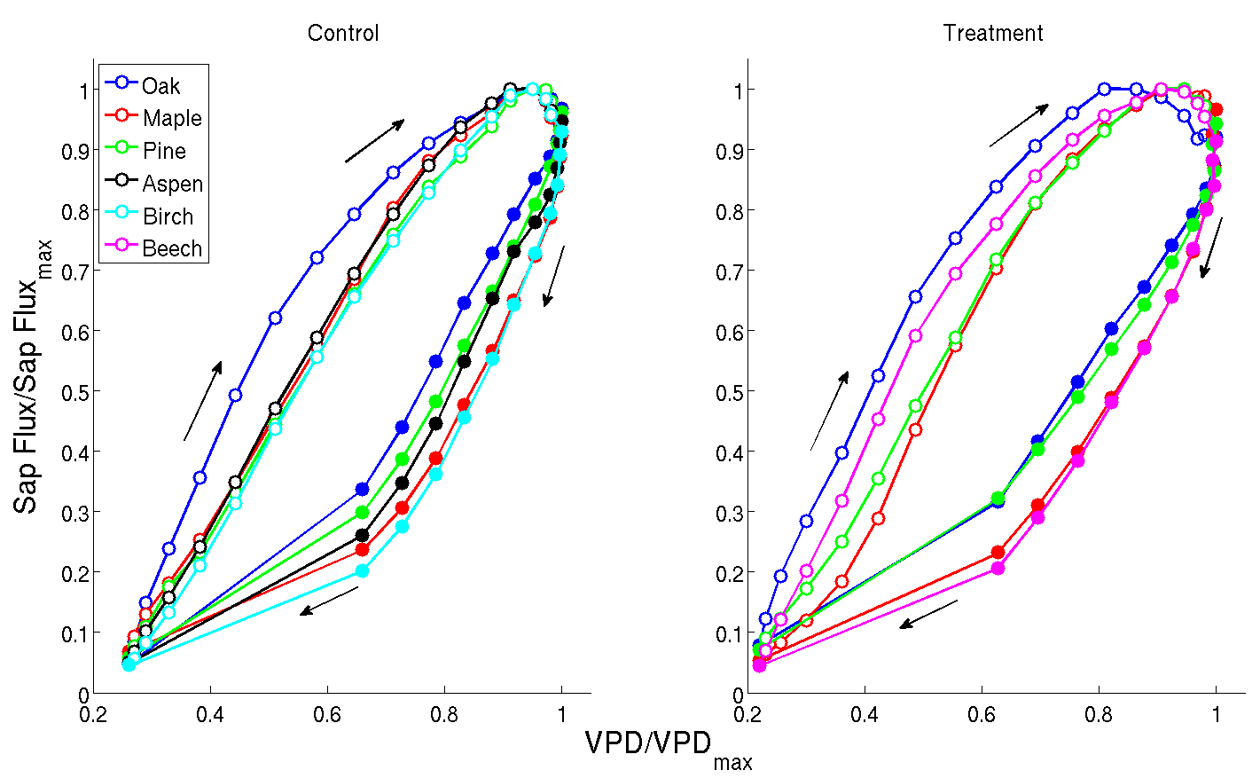
Hysteresis of transpiration
Matheny et al. 2014, JGR Biogeosci

Slide 6
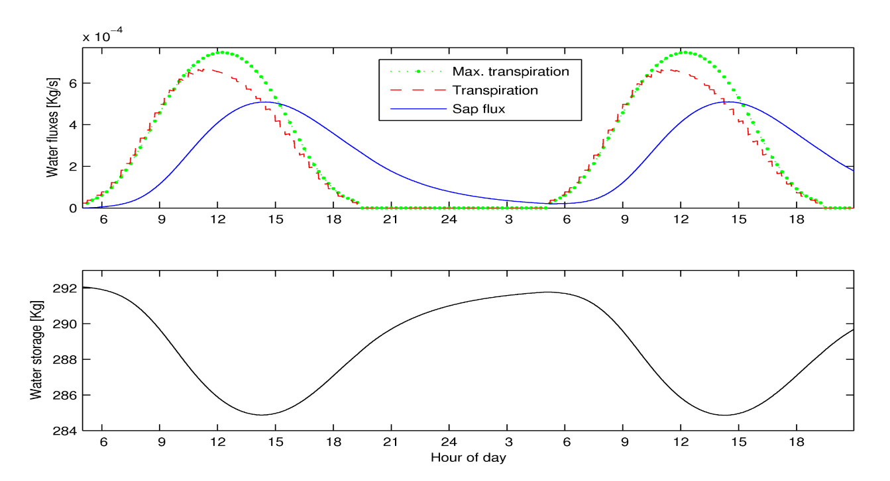
Hysteresis: Plant hydrodynamic ←→ Physical Forcing
Stomata close afternoon as stem-water storage levels decrease
Ev,max
Ev
Sap flux
Water fluxes
Water storage
Bohrer et al 2005 WRR
Hour of day

Slide 7
Hysteresis: Plant hydrodynamic ←→ Physical Forcing
Hysteresis magnitude depends on the radiation-VPD lag

Slide 8
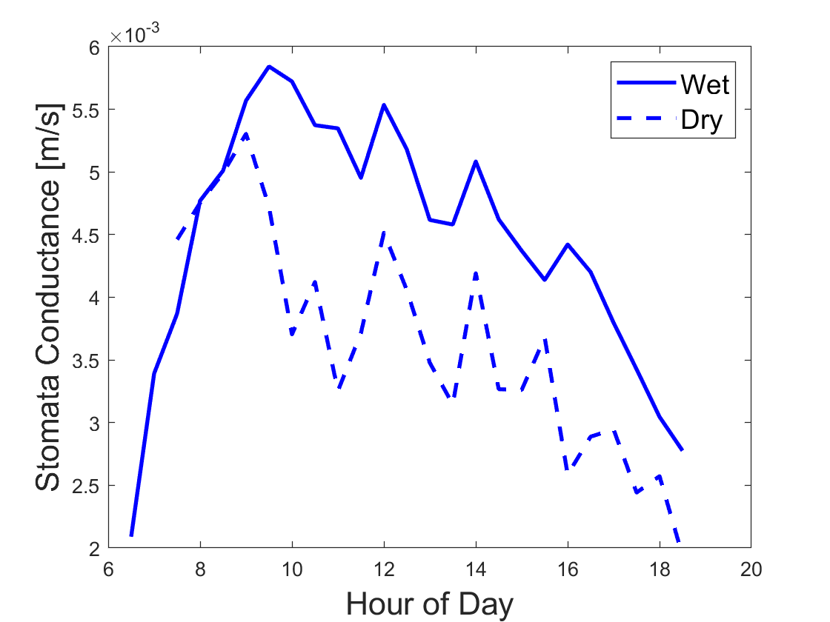

PM-based stomata conductance observations
$$λE= \frac{Δ\left(R_{n}−G\right)+ \frac{ρC_{p}VPD}{r_{ah}}}{Δ+\frac{\left.γ(r_{c}+r_{ah}\right)}{r_{ah}}}$$
Wet ← Soil Water Content > 10%
Dry ← Soil Water Content < 5.5%
Penman–Monteith definition for
Stomata conductance = 1/[r_{c}]

Slide 9
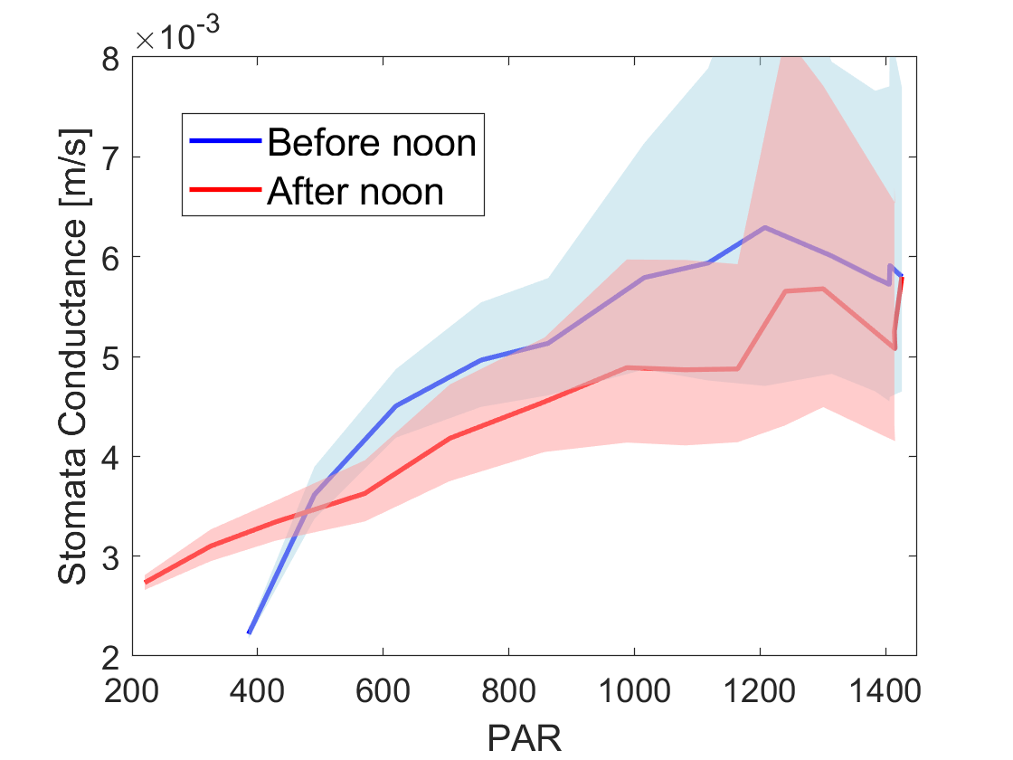
Hysteresis of stomata conductance
7-9 AM
3-5 PM
It’s hydrodynamic!!

Slide 10
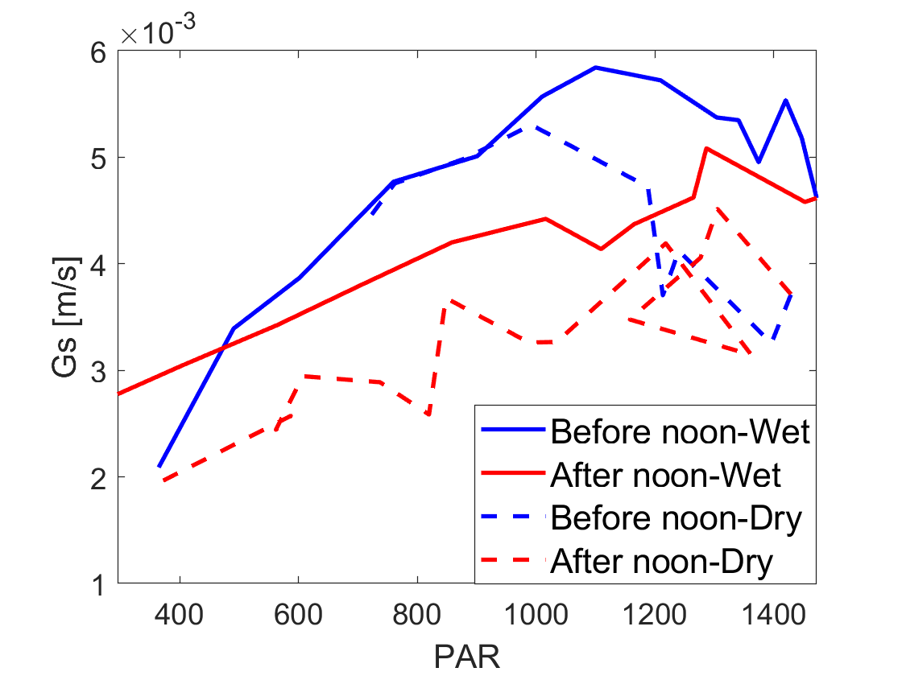
Dry soil conditions = water stress
Gs (>10 AM)
Hysteresis

Slide 11
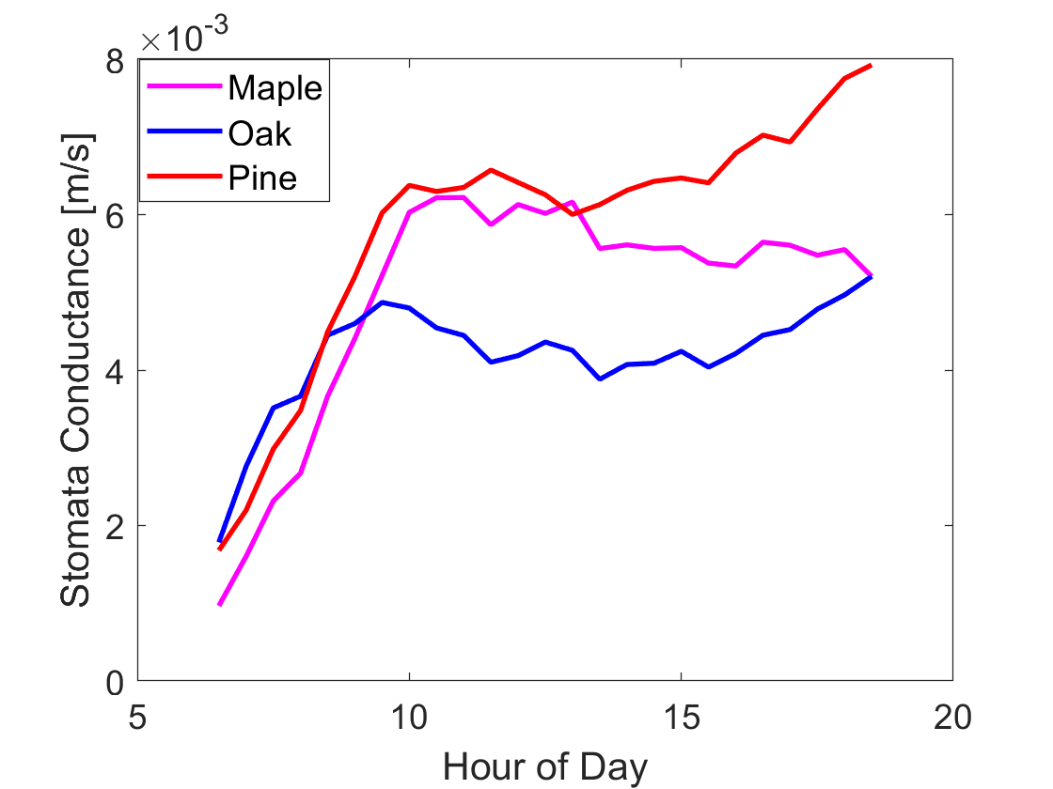
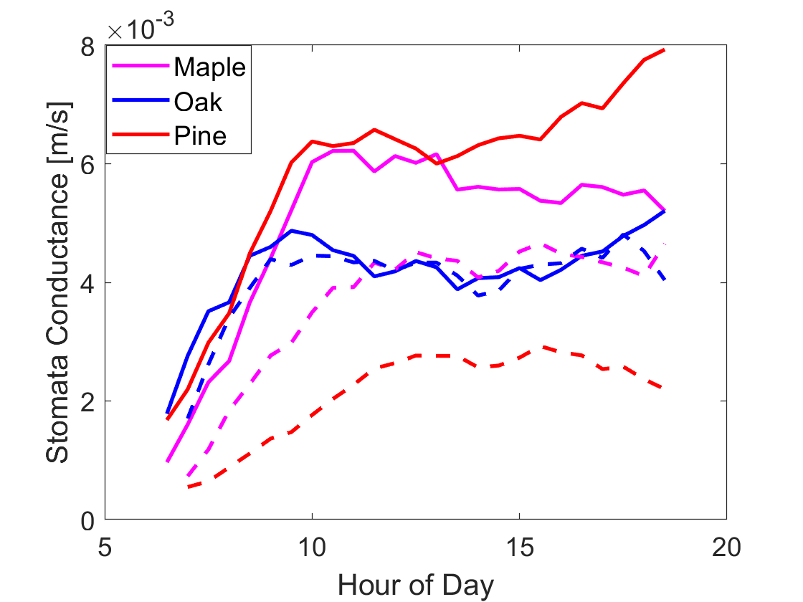
Species-Specific stomata conductance from sap flux
Dry soil
Isohydric
Anisohydric

Slide 12
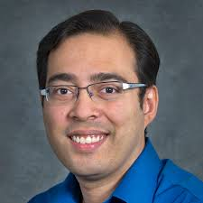
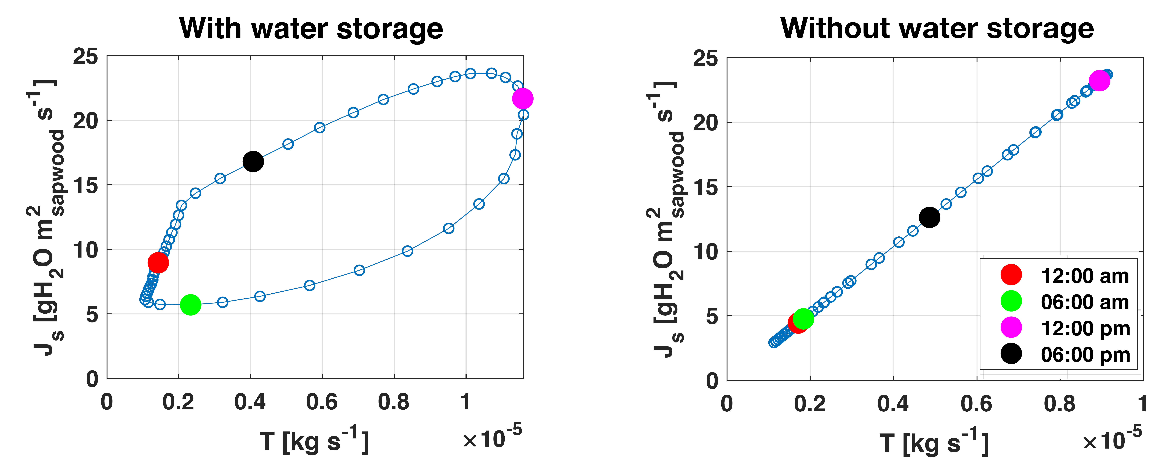
Next, in a model near you
E3SM-ELM-Hydro
ET
ET
Gautam Bisht, Bill Riley, Bohrer G, Matheny AM. Development of a tree-level hydrodynamics model for ELM to study competition for water. Oral Presentation, 11/2019. E3SM All-Hands Fall Meeting

Slide 13
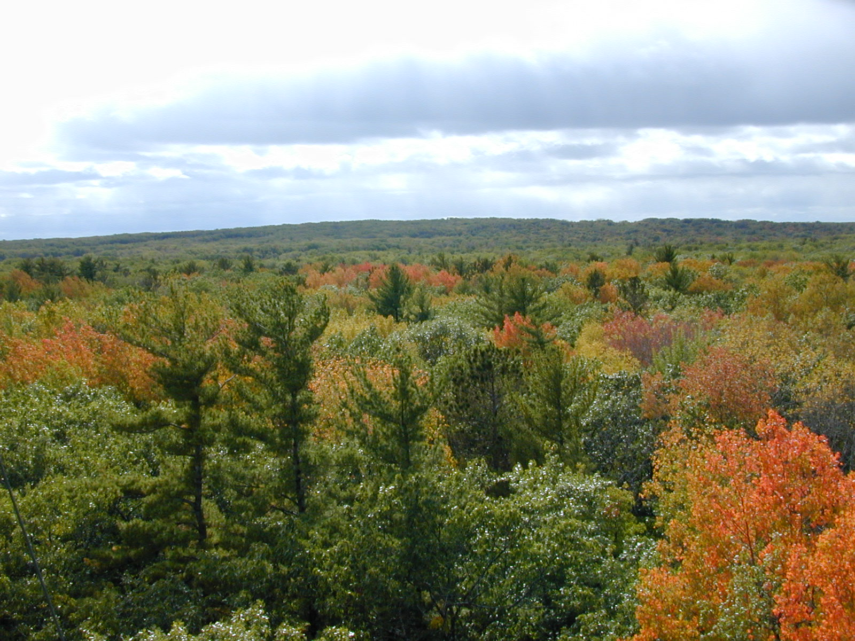





Acknowledgements
The UMBS flux-site team:
Peter Curtis (EEOB), Chris Vogel (U of M), Chris Gough (VCU),
Knut Nadelhoffer, Luke Nave (U of M)
Current grads – Yang Ju
Past grads - Andres Camilo Rey-Sanchez (Berkeley), Golnaz Mirfederesgi (OSU), Tim Morin (SUNY ESF) , William Kenny (OH EPA), Kyle Maurer (SC EPA),
Colleagues: Valeriy Ivanov (U of M), Liz Agee (ORNL), Rich Fiorella (U UT), Karina Schafer (Rutgers), Steve Garrity (Meter Devices)

