Slide 1

Challenges and opportunities in ocean modelling and data assimilation for CMEMS
Mike Bell (Met Office)
EGU, April 2020
This version of the talk contains notes on what I would say whilst giving it
Notes:
This version of the talk contains notes on what I would say whilst giving it.
I should explain my perspective before starting. As some of you will know, I was heavily involved in the development of CMEMS during the MerSea and MyOcean projects. Over the last 5-6 years, I’ve been working on aspects of the Meridional Overturning Circulation, model numerics and some ocean data assimilation issues and have been less involved in CMEMS itself. But I have helped with the coordination of NEMO development and been involved in the coordination of marine data assimilation work within Mercator Ocean International. So I’m coming at this discussion with a slightly wider perspective in mind than immediate CMEMS priorities.

Slide 2

Content
  Context: CMEMS ambition and positioning
  Ocean modelling: what can be improved; how can CMEMS contribute?
  Data assimilation: opportunities
  Monitoring of the marine (BGC) environment
  Summary
Notes:
The title of the talk is very broad. So I’m afraid most of the talk gives a management level overview rather than a discussion of scientific details. There are some scientific results towards the end.
The talk starts by reviewing the ambition of CMEMS and the position it needs to take within the oceanographic community in order to be successful. Much of the talk is about how the CMEMS team can respond to the resulting challenges.
I then discuss some of the areas where there is room to improve ocean models – both their scientific fidelity and their computational efficiency. The following section discusses some opportunities to improve our approach to marine data assimilation and to extract maximum benefit for the ocean modelling community from our investment in it.
The discussion of monitoring of the marine environment is limited by my areas of expertise. It focuses mainly on the interaction between physical data assimilation and marine biogeochemistry with some results on recent work understanding high frequency oscillations in vertical velocities and meridional overturning circulations near the equator.

Slide 3
Context: CMEMS ambition
The CMEMS ambition is to be the primary source for information on the marine environment
  monitoring and prediction
  physical and biogeochemical properties
  global ocean and European regional seas
To do this teams need scientific & technical expertise to:
  Develop, operate and assess their prediction systems
  Provide tailored products and advice
  Identify key aspects of the service to improve
Notes:
CMEMS has set itself the ambitious and wide-ranging objectives outlined in the first set of bullet points. These objectives, though stretching, are in my view coherent and it makes sense to have a concerted European effort of this sort.
This sets a high bar for the team taking on this task. In order to be credible in addressing the objectives the team need to be able to draw on a wide range of scientific and technical expertise.

Slide 4
Context: Positioning
The CMEMS team needs to be:
  Contributing to key societal issues such as:
    safe & sustainable use of the environment
    monitoring and simulation of climate changes
    weather prediction (from days to years ahead)
  Well-coordinated
    with the marine scientific community (upstream)
    internally (across many organizations & nations)
    with teams that will exploit its information (downstream)
  Exploiting its capabilities & expertise that are unique in Europe
    particularly relating to its own systems
Notes:
The team also needs to position itself properly. Maintaining CMEMS is expensive so the team needs to be contributing in some way to key societal issues. The way in which CMEMS can contribute has evolved considerably over the last 10 years. Coupled short-range weather prediction is now a reality and useful skill in seasonal predictions has also been identified. CMEMS has developed a new service reporting on the state of the ocean.
Tackling these issues is of course difficult and the CMEMS team needs to be creative in finding new ways to exploiting its unique (within Europe) capabilities and expertise to contribute to these issues. I’ll come back to that later.
The CMEMS system is complex and difficult to maintain. So the team have to coordinate efficiently with other teams both “up” and “down” stream. CMEMS has coordinated very well with NEMO, EuroGOOS, ESA, the European Commission and many other international organisations. It has also worked hard to understand the needs and develop links with potential users of its information. With the founding of Mercator Ocean International and tools for remote working there are opportunities for greater internal collaboration within CMEMS. I also come back to this later.

Slide 5
Ocean model formulations
Which issues will be most important?
    Improved parametrisation of turbulent surface boundary layer
    “Scale-aware” parametrisations compatible with the dynamical core
    Parametrisations assisted by machine learning
    Higher resolution in coastal waters
    Better representation of the interaction with bathymetry
    Reduced diapycnal mixing for climate
  CMEMS should be able to contribute by assessment of the performance of its forecasts using alternative schemes
  – see also the later slide on information on model biases
Notes:
Of course we don’t know which aspects of our ocean model formulations could be improved most – I’ve just listed a few aspects that seem important to me.
Parametrisation of the surface boundary layer is difficult and improvements could have a big impact on our model skill. Much work over the last decade has been done on the representation of Langmuir turbulence and sub-mesoscale fronts. There are also interesting developments on parametrisation of the upscale transfer of kinetic energy and ensuring that parametrisations scale correctly with grid-resolution and work together with the model numerics.
In weather forecasting and climate simulation there is a view that comparison of model forecastss with observational measurements is an excellent way to uncover infidelities and drive improvements. NEMO should benefit from this “seamless” approach to model development and prediction. The CMEMS team are uniquely placed to do this because they alone have the technology to make the predictions and these assessments. This should be one of the major contributions from CMEMS to climate simulations.

Slide 6
Ocean models on HPCs
    Performance on CPU based HPCs will be significantly improved by:
      More accurate and efficient time-stepping schemes (INRIA)
      Reducing the number of inter-node communications (BSC,CNRS,CMCC)
      Using single precision numbers where they are adequate (BSC & ECMWF)
      Avoiding cache thrashing by “tiling” the domain (Met O & CNRS)
  The architecture of future HPCs is uncertain:
    We will need to be able to transform the codes in more than one way
      Translation into a DSL (domain specific language) could assist this
      This approach is being trialled for GPUs (STFC, NOC)
Notes:
It’s quite important to ensure that the NEMO ocean model performs efficiently on modern high-performance computers (HPCs). The NEMO HPC working group has more than 20 members with at least 10 individuals devoting significant time to this work.
I’ve also included on this slide work on the reformulation of the NEMO time-stepping scheme from a leapfrog to a third-order Runge-Kutta (RK3) scheme (which has several benefits besides its efficiency). By combining these improvements we are aiming to reduce the computational cost of NEMO by a factor of between 2 and 4 over the next 2-3 years.

Slide 7
Marine data assimilation
This is an area in which CMEMS has unique capabilities and expertise
It is technically demanding and time consuming - needs a large critical mass
There is an agreed need to exploit static & dynamic (ensemble) inputs to and scale dependent localisation of background error covariances
Real-time analyses & re-analyses may need somewhat different approaches
Quality assurance depends on details
Current CMEMS systems have widely differing details
The interaction of dynamics & data increments is important (see later slides)
There are opportunities for much greater coordination and collaboration
Notes:
Mercator Ocean International (MOI) held a marine data assimilation workshop in May 2018.
It was striking that there was general agreement on the need to combine static and dynamic (ensemble) inputs to the calculation of background error covariances and to use scale dependent localisation of them during data assimilation.
Since then the groups involved in CMEMS have started to inter-compare the impacts of their assimilation schemes in more detail. It is clear that the impacts of the schemes differ considerably because of different choices in the way similar schemes have been implemented. It could well be that schemes that have been developed for real-time predictions with the current observation network need to be adjusted to work acceptably for re-analysis purposes (see later slide on the interaction between data increments and ocean dynamics).
Collaboration across teams on data assimilation systems has lagged behind that in ocean model development. There are good reasons why that happened historically. There are good opportunities to improve the quality and efficiency of new systems by much greater collaboration within MOI.

Slide 8
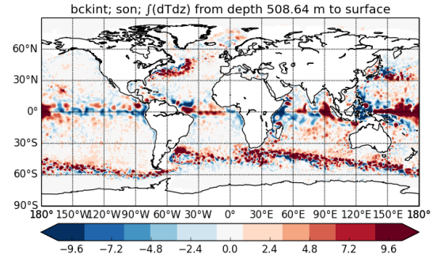
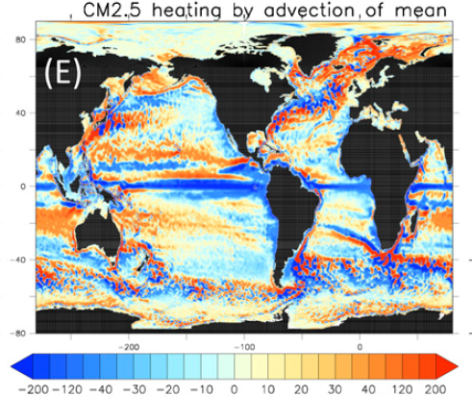
Information on model biases
The time-mean assimilation increments contain important information about the ocean model biases or the dynamical response to the increments
Inter-comparison of these increments would be very valuable
Heating (Wm⁻²) by assimilation
increments in GloSea5 1/4º reanalysis
Diagnosed heating by the
time-mean flow in a 1/4º
coupled climate model
(Griffies et al 2015)
-500
500
200
-200
Notes:
The increments made by data assimilation systems provide very interesting information either on model biases or on problems in the way the model is responding to the increments.
This information is vital to help improve either the data assimilation scheme or the ocean model.
The slide shows the rate of heating that is added by the observation increments in the GloSea5 system (when integrated over all depths). This system makes rather “aggressive” use of the altimeter data so some of the heating probably reflects problems in the way the model is responding to the increments. But the tendency of the data increments to tighten the major fronts relating to the ACC, Gulf Stream and Kuroshio may reflect a problem in the underlying ocean model.

Slide 9
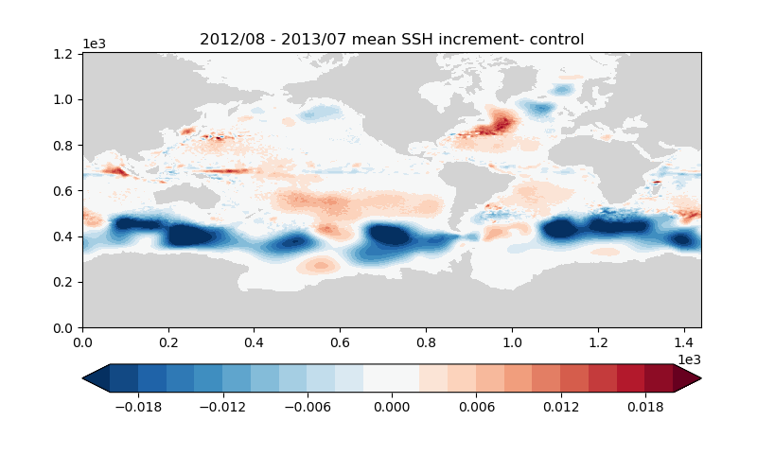
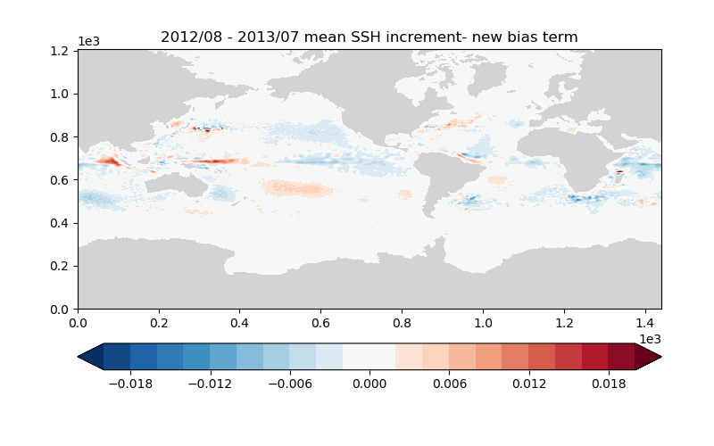
Impact of SSH assimilation on ocean heat content
Sea surface height increments
FOAM v14
FOAM v14 made large SSH increments at high latitudes
Time-mean increments are @ 2 cm in a day !
These increments propagate as external gravity waves (200 m/s) and lead to errors in ocean heat content
A new bias correction term has been introduced for assimilation of altimeter SSH observations
    Acts on barotropic scales (~4 deg. spatial scale, 20 day temporal decay scale)
    Error standard deviation varies from 1 cm equatorward of ~30 deg. to 2 / 3 cm in northern / southern extratropics
This significantly reduces the mean SSH increments (m/day) but what remains is still large in some contexts
Ocean heat content is also affected by E-P-R errors
-0.02
Metres / day
0.02
FOAM v15
Notes:
This slide shows another example of the value of using time-means of the data assimilation increments to diagnose problems with the response of the ocean model to the data assimilation increments.
For reasons that need further investigation, the NEMO model time-mean sea surface height (SSH) differed from the mean dynamic topography (MDT) used in the system by several centimetres in the Southern Ocean. When the assimilation scheme introduced these increments into the model they immediately propagate away at the speed of external gravity waves. At other latitudes the altimeter assimilation scheme then projected those displaced increments to depth causing errors in the deep ocean heat content. By adjusting our estimate of the bias in the mean sea surface height and reducing biases in evaporation minus precipitation we were able to reduce this problem in FOAM v15 (the lower plot)

Slide 10
Environmental (BGC) monitoring
Physical data assimilation within 10º of equator usually generates excessive upwelling of nutrients and disrupts the BGC over the sub-tropical gyre as well as at the equator
Physical data assimilation more than 20º from the equator does not disrupt the BGC
Because of the uncertainties & complexities of BGC modelling, validation against measurements is absolutely essential
For monitoring & prediction of the open ocean, BioArgo will be essential and provide a good basis for significant progress
In shelf seas a monitoring system needs to be designed – perhaps based on a fleet of gliders
Notes:
My main involvement in bio-geochemical work has been to support David Ford and Matt Martin in their investigations of the impact of physical data assimilation on bio-geochemistry. David has found that it physical data assimilation needs to be ramped down considerably within 20o of the equator to avoid disruption to the BGC that spreads into sub-tropical gyres. MOI and NCEP have come to similar conclusions. There is evidence that the problems are not simply related to over-excitation of vertical velocities near the equator though that is part of the problem. The excitation by wind stresses of high frequency overturning circulations near the equator is discussed in the next slide.
One does not have to be an expert in BGC modelling to realise that the uncertainties within it make validation against measurements even more essential than in physical models. The design and implementation of efficient and effective observation monitoring systems is then a key challenge. The success of the Argo system should inspire this task. BioArgo is a promising approach for the open ocean. It is very important to make progress on agreeing an approach for monitoring of the shelf seas. This is as much an organisational challenge as a technical challenge.

Slide 11
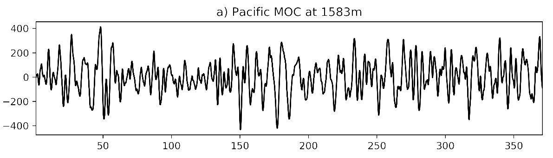
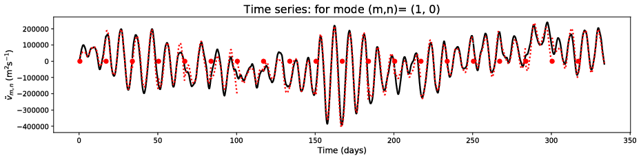
Wind driven MOC at equator in NEMO simulations
Bell, Blaker, Hirschi – submitted to JPO
400
Very large meridional
overturning circulations are found near the equator in ORCA025 NEMO simulations. They can be simulated very well as wind-driven equatorial normal modes on a stratified state of rest. The bottom figure shows the amplitude of the lowest mode
Sv
-400
NEMO solution
Idealised simulation
0
Day
300
Notes:
As the issue of the impact of physical data assimilation on BGC near the equator came up in the previous slide, I wanted to mention some recent work on the simulation of high frequency wind-driven internal gravity waves near the equator that I have been doing with Adam Blaker and Joel Hirschi of NOC. In the NEMO ORCA025 model there are very large (200 Sverdrup !) high frequency fluctuations in the MOC near the equator (upper panel). We are able to simulate them quite accurate as wind-driven oscillations about a stably stratified state of rest (lower panel). This work also gives explores slowly varying wind-driven MOCs near the equator that might help design improved data assimilation schemes near the equator.

Slide 12
  CMEMS does have capabilities & expertise that are unique in Europe to contribute to key societal issues
  CMEMS could make important contributions to the validation of the components of ocean models
  There are great opportunities to improve collaboration on ocean data assimilation
  CMEMS needs to champion feasible in situ systems for monitoring the marine (BGC) environment (e.g. BioArgo)
Summary
Notes:
In summary, I’ve reviewed the ambitions of CMEMS and its place in the oceanographic community and come to the conclusions bulleted.

