Slide 1
Session SSS9.3
Biogeosciences and wine: the management and the environmental processes that regulate the terroir effect in space and time
Distribution of Rare Earth Elements (REE) discriminates the substrate of growth in Vitis Vinifera L. ?
Marcella Barbera^{1,2} , Pierpaolo Zuddas², Filippo Saiano¹
Università di Palermo, SAAF, Viale delle Scienze ed. 4, 90128,Palermo, Italy
Sorbonne Université, METIS, 4 place Jussieu, 75005, Paris, France
marcella.barbera@unipa.it
Tuesday, 5 May 2020
SSS9.3 EGU2020-5770

Slide 2
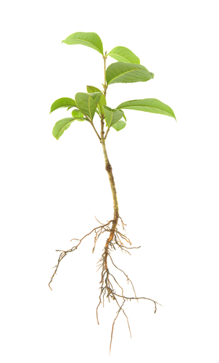
To experimentally test if REE mobilization between soil and plant in Vitis Vinifera L. could discriminate the substrate of growth:
Pristine plants grew on native soils
Spiked substrate (peat-gravel) contains an equimolar solution of REE
Blank Experiments
Spiked Experiments
[REE]
solution
Peat :gravel
substrate
Peat :gravel
substrate
[REE] = 2.5 µmol kg⁻¹ of substrate

Slide 3
The distribution of REE normalised patterns in roots
${ REE∗}_{roots}= \frac{ REE Concentration in roots}{ REE concentration in Upp.Cont.Crust}$ ${REE∗}_{native soils}= \frac{ REE Concentration in native soil}{ REE concentration in Upp. Cont.Crust }$
Blank experiments Spiked experiments
roots
∑[LREE] > ∑[HREE]
∑[LREE] <∑[HREE]
REE distribution reflects the native soil pattern
REE distribution changes compared to the native soil pattern
.

Slide 4
Conclusions
The REE relative abundance is independent from the plant development
REE distribution discriminates the substrate of growth
REE distribution patterns are potential tools discriminating the environmental conditions of Vitis Vinifera L. growth

