Slide 1
New 1.72-1.76 GA paleointensity data obtained on Proterozoic volcanic rocks from the Ukrainian Shield
V.V. Shcherbakova¹, Bakhmutov V.G², Shcherbakov V.P. ¹,Zhidkov G.V. ¹
¹Geophysical Observatory Borok IPE RAS, Russia
²Institute of Geophysics of the National
Academy of Sciences of Ukraina, Kiev

Slide 2
OBJECTS OF THE INVESTIGATION
Our detailed palaeomagnetic and palaeointensity studies has been performed on gabbro-anorthosite complexes from Ingul megablock within the Korsun-Novomirgorodsky Pluton (age interval 1.75-1.72 Ga) and the North-West megablock within the Korosten Pluton (age ca 1.76 Ga) of the Ukrainian Shield .
The Ukrainian Shield comprises the crust of the Palaeoproterozoic protocraton Volgo-Sarmatia, which together with the Fennoscandian crustal segment constitutes the East European Craton (Baltica). The different megablocks of Ukrainian Shield can be treated as one coherent unit since 1.77 Ga.

Slide 3
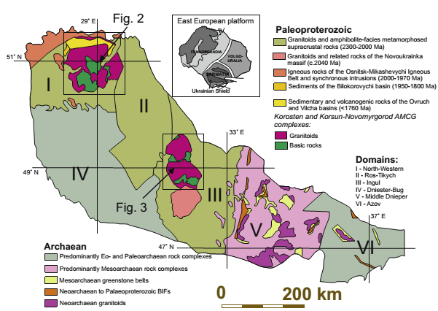
Sketch map of the Ukrainian shield
5
4
Circles show sites investigated here:
1 – Vyazivok.
2 – Kamyanka.
3 – Khlystunivka.
4 – Paromivka (PO).
5 – Syniy Kamin (NB).
6 – Subbotzi.
3
1
2
6
Sketch map of the Ukrainian shield. The North-Western Domain (I on the map) comprises two orogenic belts: (1) the Teteriv-Zhytomyr belt composed of the Teteriv Series amphibolite-facies metamorphic rocks (c. 2200–2100 Ma), and the Zhytomyr Complex granites (c. 2090–2040 Ma), and (2) the Osnitsk-Mikashevychi igneous belt (c.2000 Ma). The Ingul Domain (III on the map) is predominantly made of c. 2060–2020 Ma granites and related rocks of the Novoukrainka and Ingul (formerly Kirovograd)Complexes. The amphibolite-facies metamorphosed supracrustals of the Ingul-Ingulets Series (c. 2300 Ma) are less abundant.
(Shumlyanskyy et al., 2017)

Slide 4
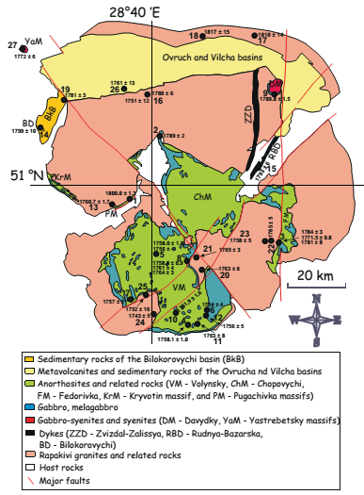
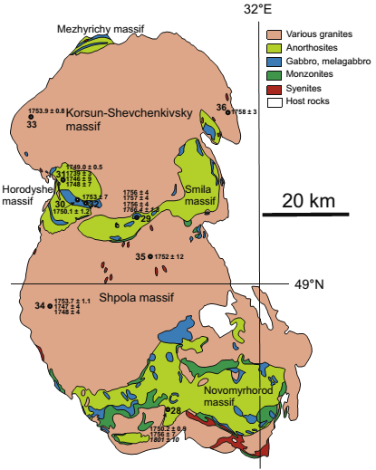
Fig. 2
Fig. 3
Korosten Pluton
Korsun-Novomirgorodsky Pluton
3
5
1
4
2
(Shumlyanskyy et al., 2017)

Slide 5
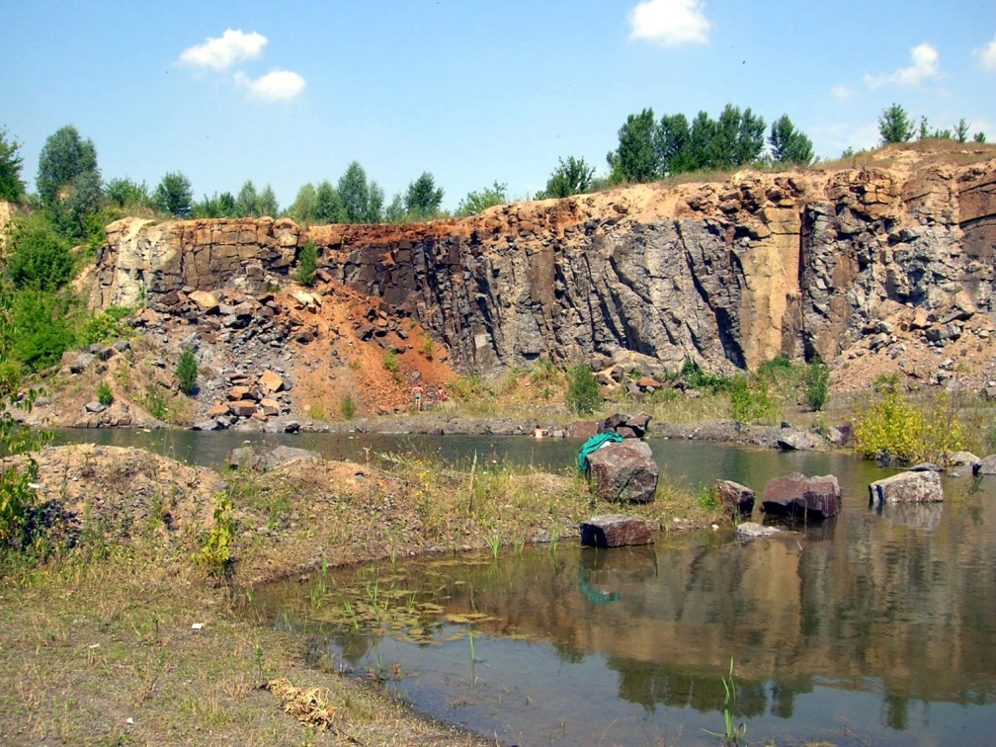
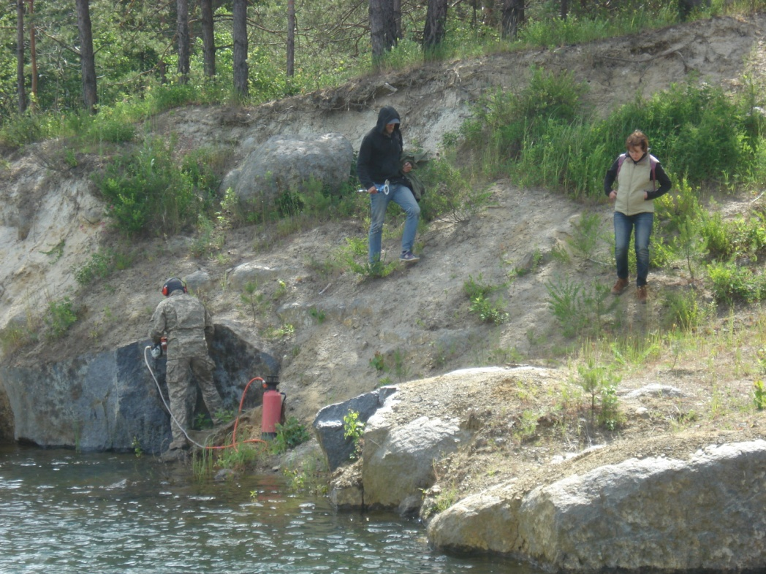
Anorthosites, Vyazivok guarry
Korsun-Novomirgorodsky Pluton
General view
Anorthosites, Syniy Kamin guarry
Korosten Pluton
sampling

Slide 6
Palaeomagnetic investigations
(Bakhmutov V., Institute of Geophysics of the NAS of Ukraine in Kyiv)
Palaeomagnetic investigations include standard palaeomagnetic experiments:
thermal demagnetization (TD) of NRM up to 600-670°C (with steps from 10° to 50°C)
b) AF demagnetization by alternating field (AF) up to 100 mT (with steps
10-20 mT)
c) measuring of the magnetic susceptibility (k) after each heating step
The procedures for the demagnetization of specimens and all measurements were made inside magnetically shielded rooms to minimize the acquisition of present-day viscous magnetization.
Demagnetization experiments were processed by multicomponent analysis of the demagnetization path (Kirschvink, 1980), using Remasoft 3.0 software (Chadima and Hrouda, 2006).
Anisotropy of magnetic susceptibility (AMS) was measured on all samples with a MFK-1 Kappabridge, and magnetic anisotropy parameters were calculated with the Aniso programme (Jelínek, 1973).

Slide 7
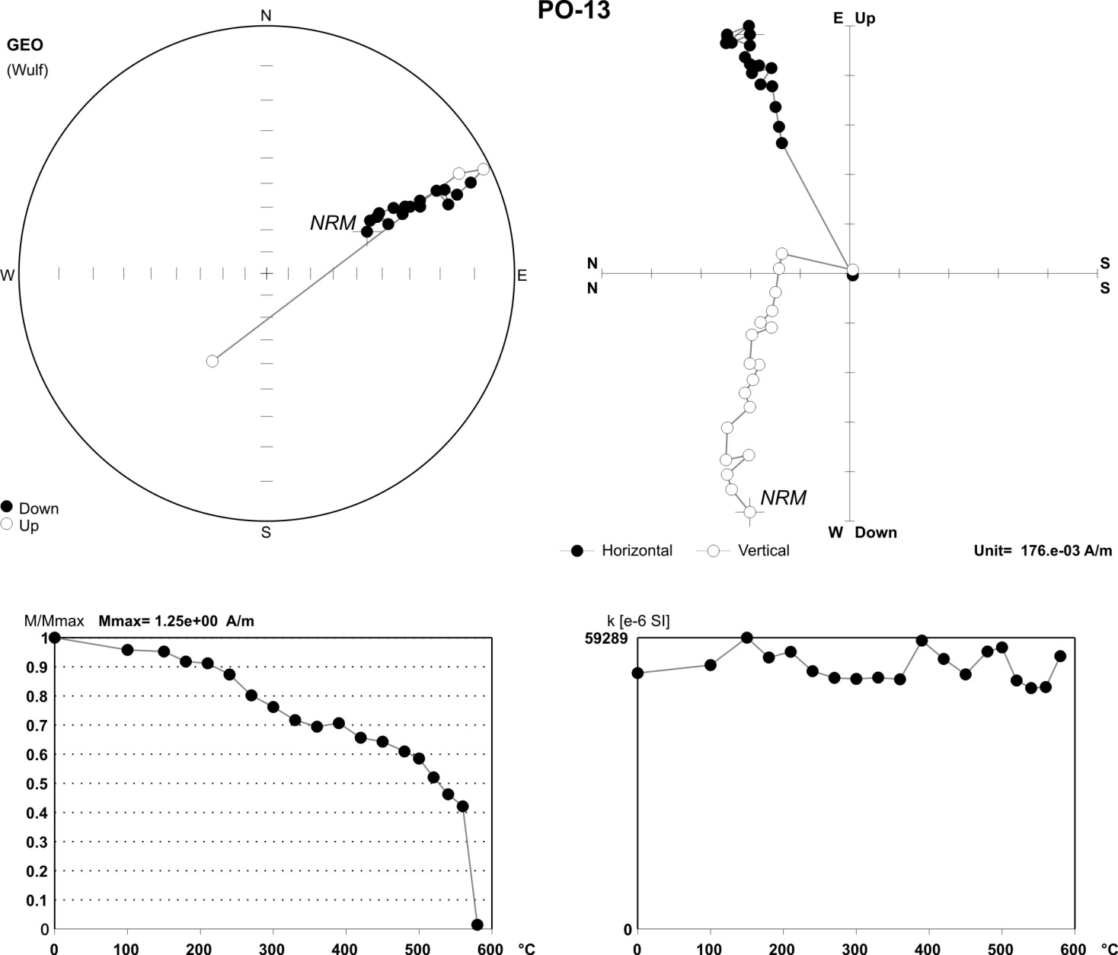
Site Paromivka, PO-13
Illustration of thermal demagnetization
(site PO,
Sample PO-13):
Top left diagram: stereographic projection of the directions (full and open circles represent projections in the lower and upper hemispheres, respectively);
top right diagram: orthogonal projections of demagnetization path (Zijderveld plot) on horizontal and vertical planes;
bottom diagram: NRM=f(T) during demagnetization (M/Mmax);

Slide 8
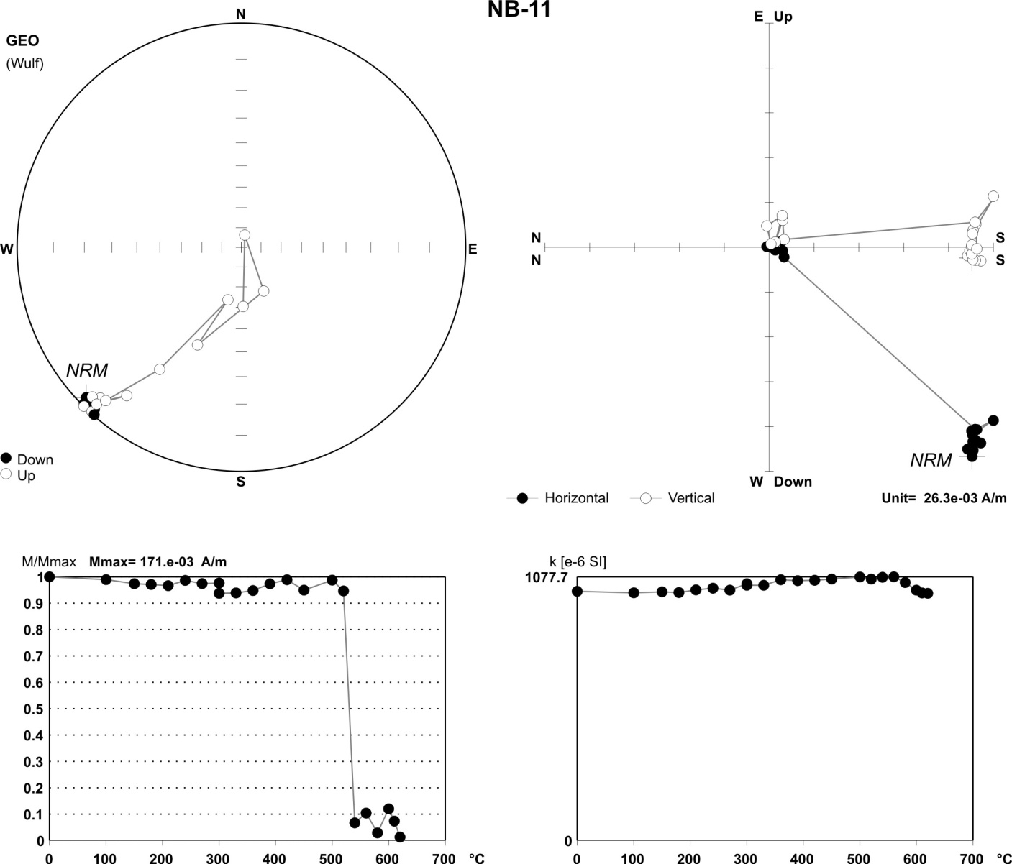
Illustration of thermal demagnetization
site NB
sample NB-11:
Top left diagrams: stereographic projection of the directions (full and open circles represent projections in the lower and upper hemispheres, respectively);
top right diagrams: orthogonal projections of demagnetization paths (Zijderveld diagrams) on horizontal and vertical planes;
bottom : NRM=f(T) during demagnetization (M/Mmax);
Site Syniy Kamin, NB-11

Slide 9
Results of paleomagnetic investigations
The high-temperature stable ChRM component was isolated in the blocking temperature intervals 500-580 °C from more than 300 samples from 7 sites.
A primary origin of ChRM is confirmed by the next points:
The presence of dual-polarity high-temperature
component
2. Lack of signs of metamorphism
3. Good coincidence of the mean palaeomagnetic pole of Ingul block ca.1.75 Ga (Φ=22.5º, Λ=167.3º, dp/dm=4.0/7.7) with previous studies of anorthosites (Elming et al., 2001).

Slide 10
Rock magnetic and thermal palaeointensity investigations
(V.V. Shcherbakova, Shcherbakov V.P., Zhidkov G.V., Borok Observatory)
Rock magnetic investigations include:
Estimation of the Curie temperature Tc and thermal stability of magnetic minerals by study of
Strong-fielthermomagnetic curves of the saturation magnetization M_{si}(T) during heating–cooling cycles to incrementally higher temperatures T_{i} in lab field B = 450 mT
Measurements of magnetic parameters: coercive force Bc, remanent coercive force
Bcr, Ms and remanent strong-field magnetization Mrs,
Estimation of domain structure:
From Day-plot (Mrs/Ms vs Bcr/Bc)
From the thermomagnetic criterion by measuring the tail of pTRM surviving the
thermal demagnetization of the given pTRM
From electronic microscopic images.

Slide 11
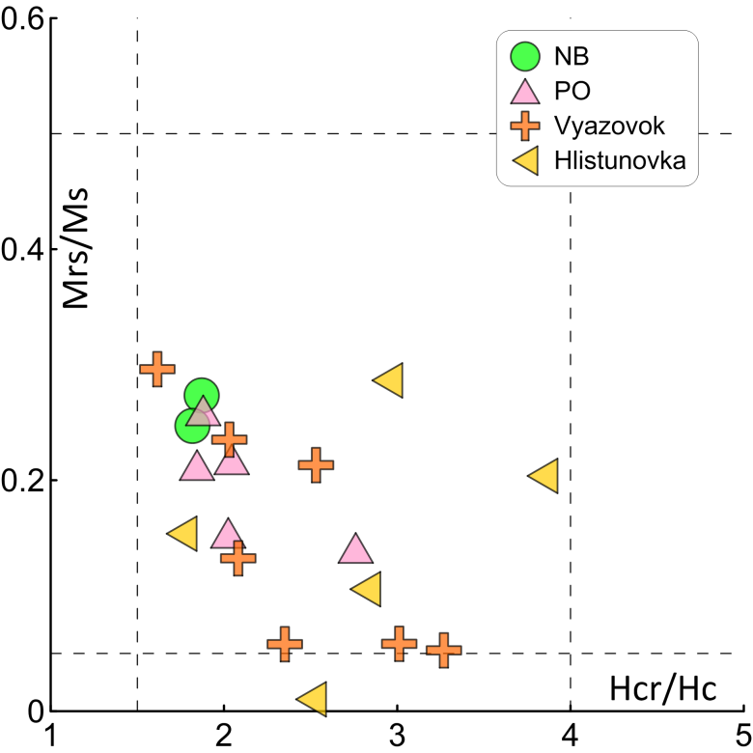
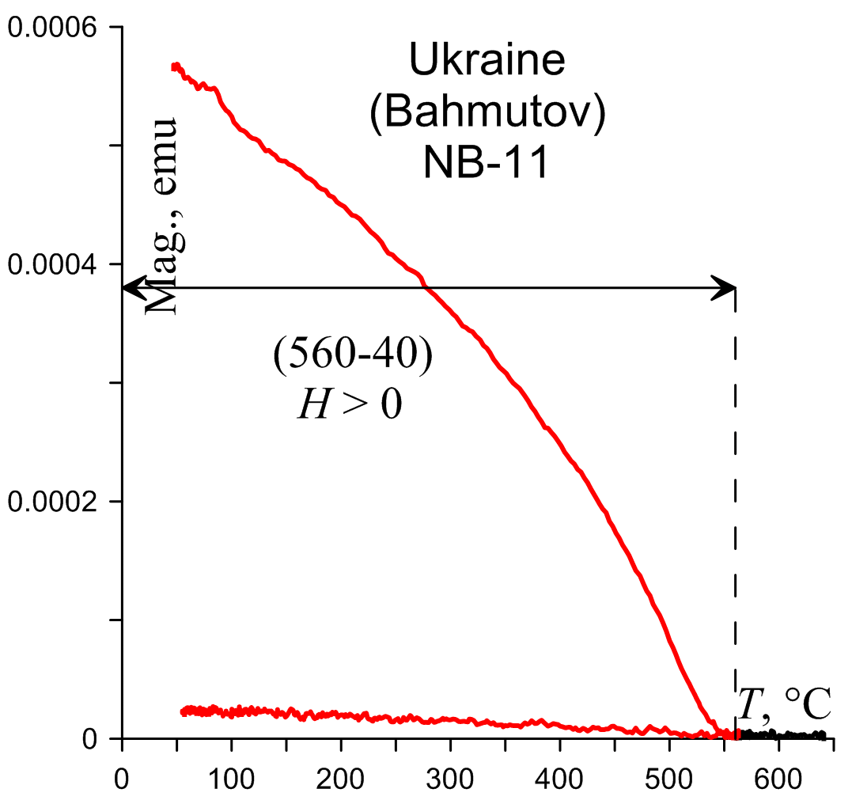
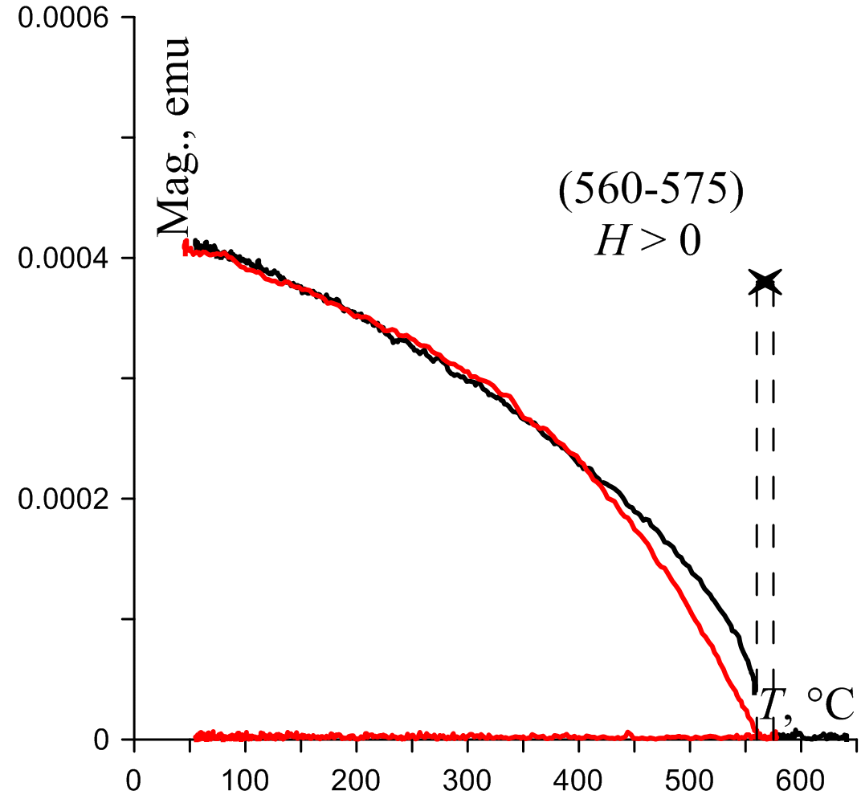
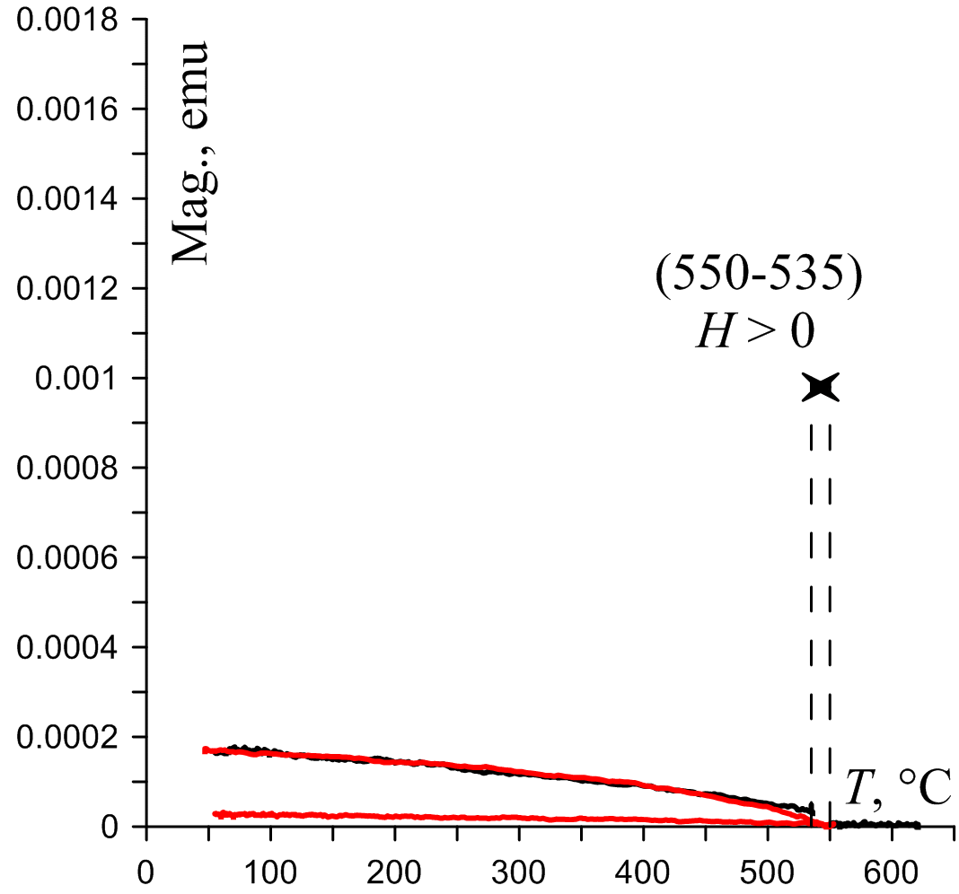
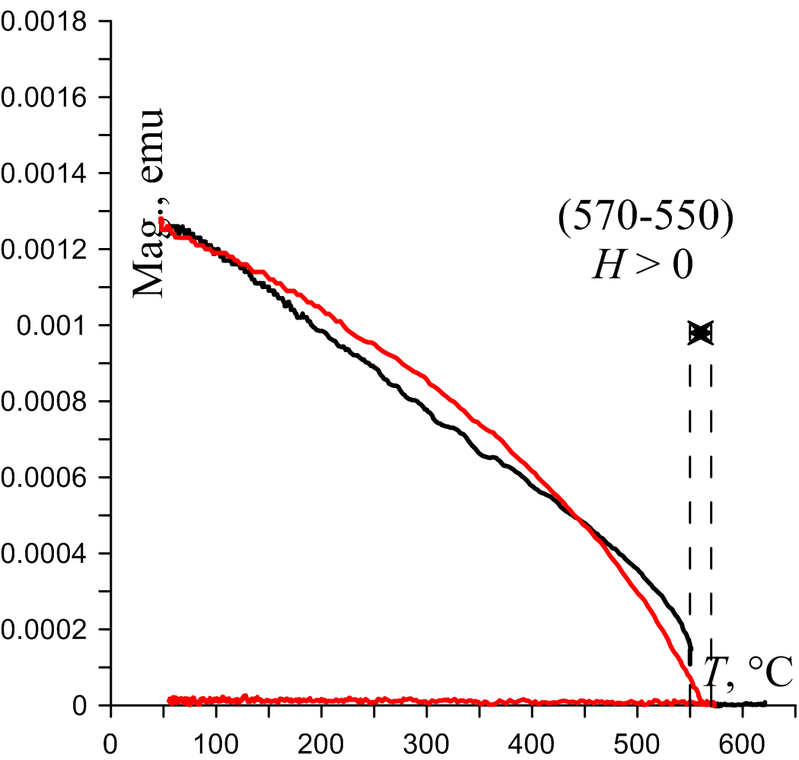
DETERMINATIONS OF DOMAIN STRUCTURE
Day-plot
Thermomagnetic criteria
pTRM(560-400)
pTRM(575-560)
pTRM(550-535)
pTRM(570-550)
Right Figures: In both samples NB-11 & PO-13 pTRMs(T₁,T₂) do not reveal tails of pTRM after heating to T₁ following cooling to T_{o} what indicates SD structure of pTRM carriers. Note that in our experiments (T₁,T₂) intervals of pTRM acquisition correspond to fit line intervals on the corresponding Arai-Nagata plots
Ukraine
(PO-13)

Slide 12
Magnetic properties of investigated rocks:
Curie temperatures Tc lie in the range (570-600) C
M_{si}(T) curves change very little on consecutive heating what prove the thermal stability of the magnetic minerals in the studied samples.
NRM carriers are of SD or small PSD sizes according to the Day plot and to the thermomagnetic criterion
Thus, these rocks are perspective for paleointensity (B_{anc}) determination experiments.
Paleointensity determinations were perfomed by the two methods:
Thellier-Coe protocol with check-point procedure
Wilson’s method
Analyze of received data was made following to a set of modern criteria

Slide 13
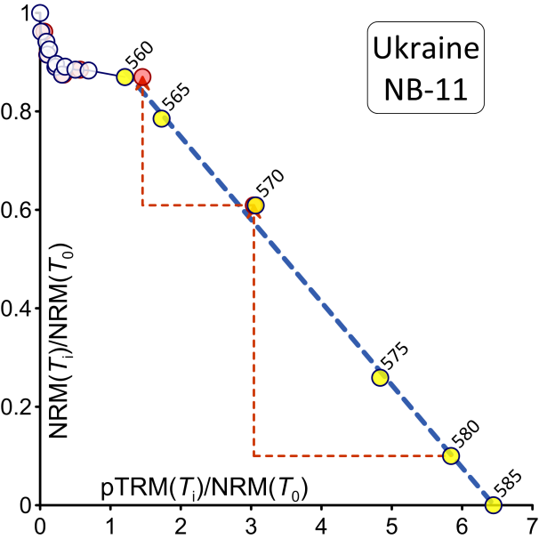
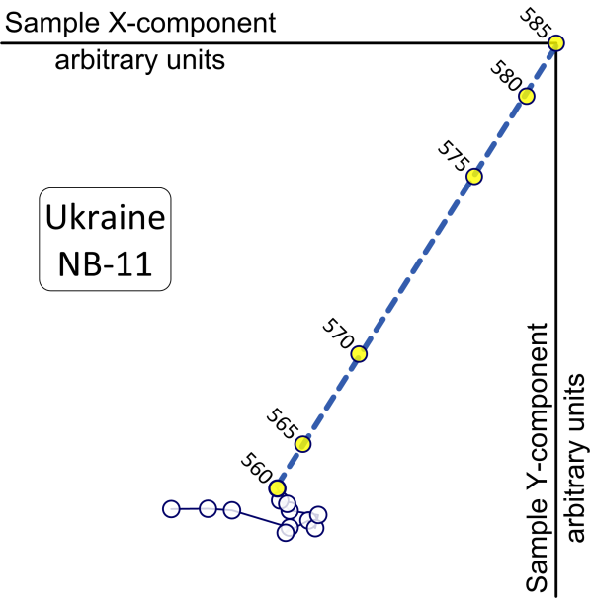
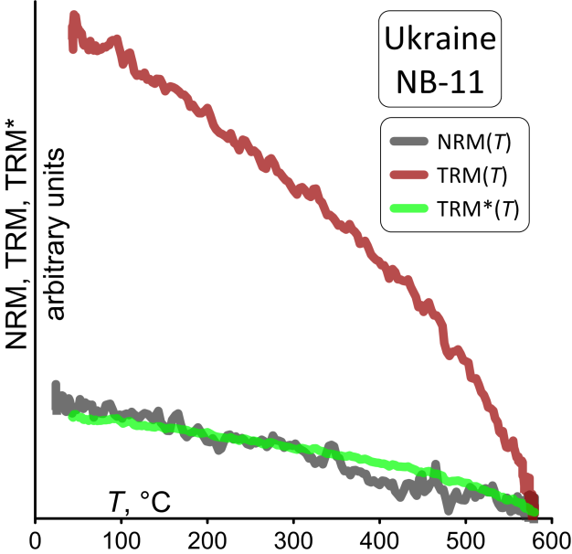
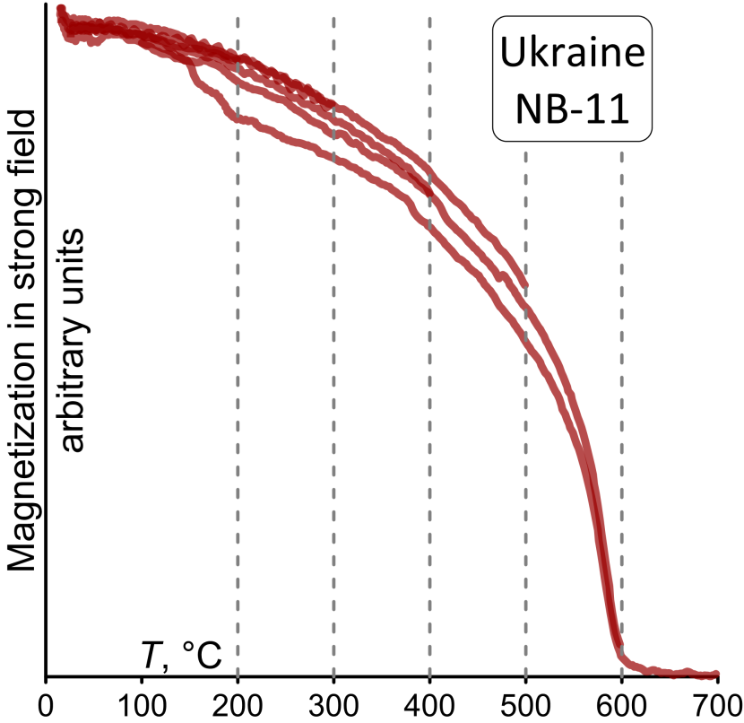
Site NB North-Western megablock within the Korosten Pluton (age ca 1.76 Ga)
Above: Arai-Nagata and orthogonal (in sample’s coordinate) plots
Bottom: Wilson’s plot and M_{si}(T)
Table: for site NB
mean paleointensity B_{anc}
(calculated with 15 sister-cubes of 5 samples)
B_{anc} = 4.12 µT
Block | Site | N of samples | n of sister-cubes | Banc µT | Banc St. error µT | Banc St. deviation µT
Korosten pluton | NB | 5 | 15 | 4.12 | 0.4 | 1.5

Slide 14
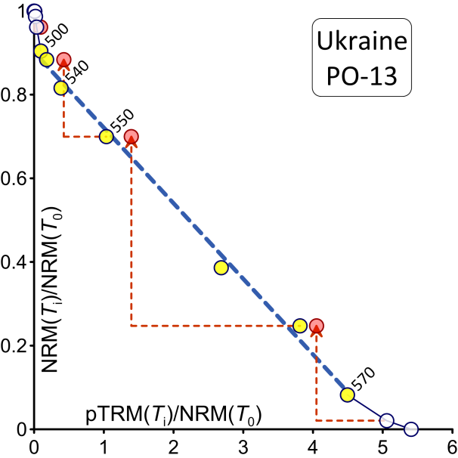
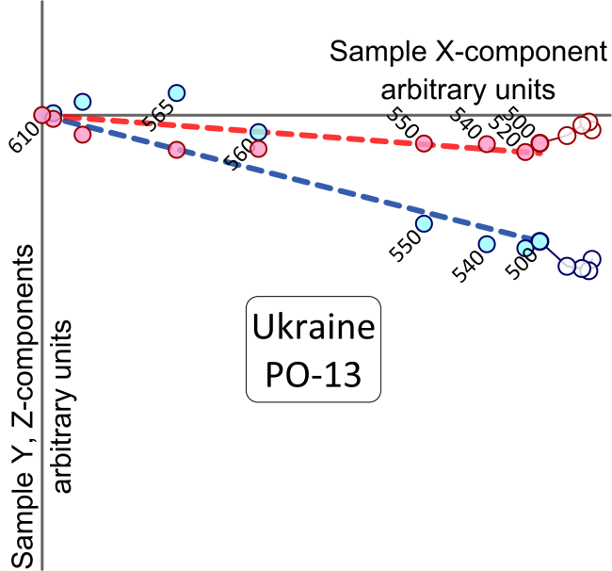
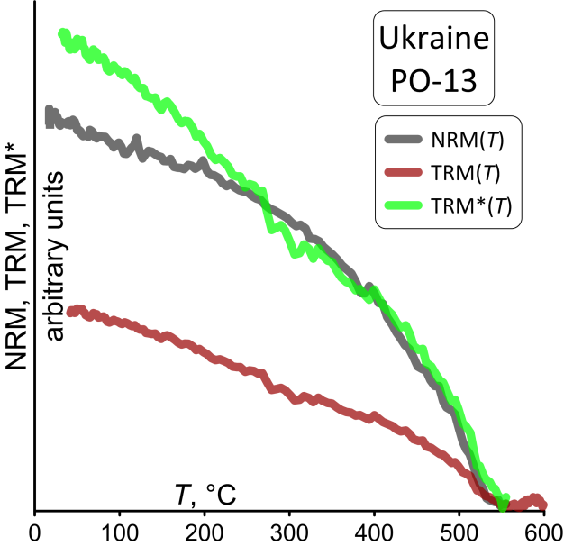
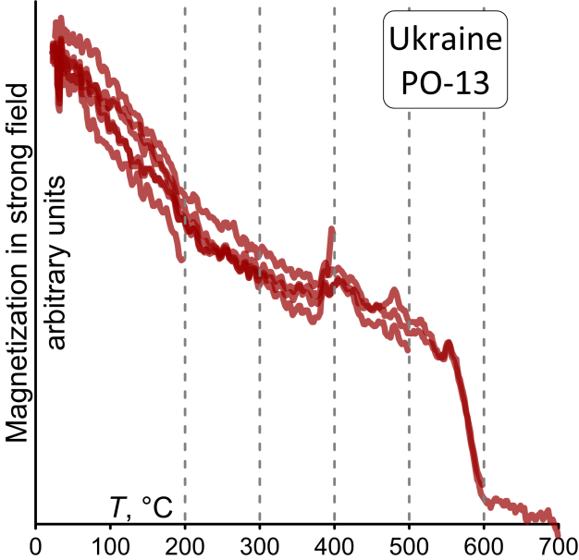
Site PO North-Western megablock within the Korosten Pluton (age ca 1.76 Ga)
Above: Arai-Nagata and orthogonal (in sample’s coordinate) plots
Bottom: Wilson’s plot and M_{si}(T)
Table: for site PO
mean paleointensity B_{anc}
(calculated with 12 sister-cubes of 6 samples)
B_{anc} = 8.9 µT
Block | Site | N of samples | n of sister-cubes | Banc µT | Banc St. error µT | Banc St. deviation µT
Korosten pluton | PO | 6 | 12 | 8.9 | 1.1 | 3.8

Slide 15
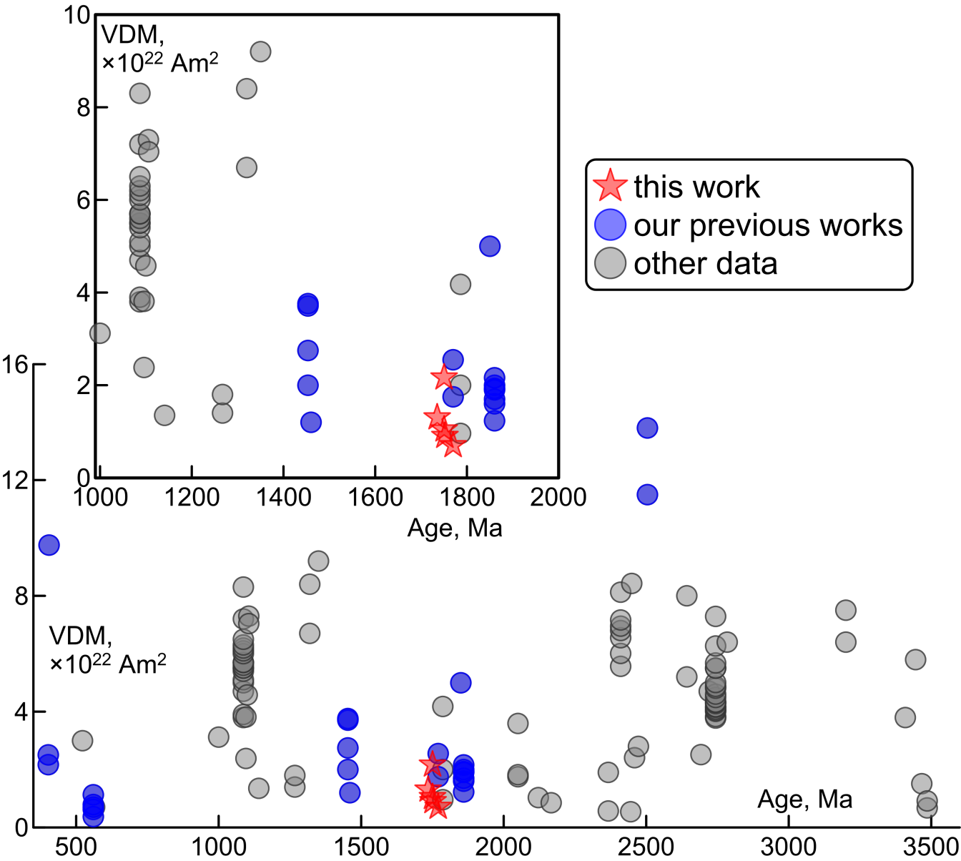
VDM on the time interval
(300-3500) Ma
following the database
wwwbrk.adm.yar.ru/palmag/
database e.html.
Data were selected by the three criteria:
a) data obtained by the Thellier method including the check- point procedure
b) ≥ 3 samples were used for calculation at each site.
c)The error of the determination ≤15%
Crosses denote the data obtained in the Borok laboratory:
Blue circles correspond to
previous Borok’s studies
Red stars correspond to this study
Pluton | Site | Age, Ma | N/n | B_{anc} (μT) | B_{anc} (μT) (standart errow) | B_{anc} (μT) (standart deviation) | Paleo inclination degrees | VDM (×10²² Am²)
Ingul megablock | Vyazovok | 1752 ± 6.5 | 5/13 | 3.49 | 0.28 | 1.27 | −6.0 | 0.90
 | Khlistunovka | 1725–1745 | 5/12 | 5.16 | 0.56 | 1.94 | −14.8 | 1.30
 | Subbotzyi | 1770 ± 9.5 | 19/26 | 3.32 | 0.27 | 1.40 | 41.2 | 0.70
Korosten Pluton | PO | ∼1750 | 6/12 | 8.90 | 1.10 | 3.80 | −23.4 | 2.16
 | NB | ∼1750 | 5/15 | 4.12 | 0.40 | 1.50 | 14.6 | 1.04
Table: Site means
for B_{anc} and VDM

Slide 16
Data references
Biggin A.J., Strik G.H.M.A., Langereis C.G. 2009. The intensity of the geomagnetic field in the late-Archaean: new measurements and an analysis of the updated IAGA palaeointensity database. Earth Planets Space. 61. 9-22
Bono R.K., J. A. Tarduno, F. Nimmo, R.D. Cottrell. 2019. Young inner core inferred from Ediacaran ultra-low geomagnetic field intensity. Nature Geoscience. 12. 143-147
Donadini F., Elming S.-A., Tauxe L., Halenius U. 2011. Paleointensity determination on a 1.786 Ga old gabbro from Hoting, Central Sweden. Earth Planet. Sci. Letters. 309. 234-248
Herrero-Bervera E., Krasa D., Van Kranendonk M.J. 2016. A whole rock absolute paleointensity determination of dacites from the Duffer Formation (ca. 3/467 Ga) of the Pilbara Craton, Australia: An impossible task?. Phys. Earth Planet. Interiors. 258. 51-62
Kulakov E.V., Smirnov A.V., Diehl J.F. 2013. Absolute geomagnetic paleointensity as recorded by ~1.09 Ga Lake Shore Traps (Keweenaw Peninsula, Michigan). Studia Geophysica et Geodaetica. 57. 565-584
Macouin M., Valet J.P., Besse J., Buchan K., Ernst R., LeGoff M., Scharer U. 2003. Low paleointensities recorded in 1 to 2.4 Ga Proterozoic dykes, Superior Province, Canada. Earth Planet. Sci. Letters. 213. 79-95
Macouin, M., Valet, J.P., Besse, J., Ernst, R. 2006. "Absolute paleointensity at 1.27 Ga from the Mackenzie dyke swarm (Canada)". Geochem., Geophys., Geosyst. 7. doi:10.1029/2005GC000960
McArdle N.J., Halls H.C., Shaw J. 2004. Rock magnetic studies and a comparison between microwave and Thellier palaeointensities for Canadian Precambrian dykes. Phys. Earth Planet. Interiors. 147. 247-254
McClelland, E., Briden, J.C. 1996. An improved methodology for the Thellier-type paleointensity determination in i8gneous rocks and its usefulness for veryfying primary thermoremanence. J. Geophys. Res. 101. 21995-22013
Muxworthy A.R., Evans M.E., Scourfield S.J., King J.G. 2013. Paleointensity results from the late-Archaean Modipe Gabbro of Botswana. Geochemistry, Geophysics, Geosystem. 14. 2198-2205
Selkin P.A., Gee J.S., Meurer W.P., Hemming S.R. 2008. Paleointensity record from the 2.7Ga Stillwater Complex, Montana. Geochem., Geophys., Geosyst. 9. doi: 10.1029/2008GC001950
Shcherbakova V. V. , N. V. Lubnina, V. P. Shcherbakov, G. V. Zhidkov, V. A. Tsel’movich. 2017. Paleointensity Determination on Neoarchaean Dikes within the Vodlozerskii Terrane of the Karelian Craton. Izvestiya, Phys. Of the Solid Earth. 53. 714-732
Shcherbakova V.V., Biggin A.J., Veselovskiy R.V., Shatsillo A.V., Hawkins L.M.A., Shcherbakov V.P., Zhidkov G.V. 2017. Was the Devonian geomagnetic field dipolar or multipolar? Palaeointensity studies of Devonian igneous rocks from the Minusa Basin (Siberia) and the Kola Peninsula dykes, Russia. Geophys. J. Int. 209. 1265-1286
Shcherbakova V.V., Lubnina N.V., Shcherbakov V.P., Mertanen S., Zhidkov G.V., Vasilieva T.I., Tsel’movich V.A. 2008. Palaeointensity and palaeodirectional studies of Early Riphaean dyke complexes in the Lake Ladoga region (North-Western Russia). Geophys. J. Int. 175. 433-448
Shcherbakova V.V., Pavlov V.E., Shcherbakov V.P., Neronov I., Zemtsov V.A. 2006. Paleomagnetic Studies and Estimation of Geomagnetic Paleointensity at the Early/Middle Riphean Boundary in Rocks of the Salmi Formation (North Ladoga Area). Izvestiya, Phys. of the Solid Earth. 42. 233
Shcherbakova V.V., Shcherbakov V.P., Didenko A.N., Vinogradov Y.K. 2006. Determination of the Paleointensity in the Early Proterozoicfrom Granitoids of the Shumikhinskii Complexof the Siberian Craton. Izvestiya, Phys. of the Solid Earth. 42. 521-529
Shcherbakova V.V., Zhidkov G.A., Pavlov V.E., Zemtsov V.A. 2004. The paleointensity determinations on Early Proterozoic rocks of South Karelia. Kazan'. . 61-66
Smirnov A.V., Evans D.A.D. 2015. Geomagnetic paleointensity at ~2.41 Ga as recorded by the Widgiemooltha Dike Swarm, Western Australia. Earth Planet. Scie. Lett. 416. 35-45
Smirnov A.V., Tarduno J.A. 2005. Thermochemical remanent magnetization in Precambrian rocks: Are we sure the geomagnetic field was weak?. J. Geophys. Res. 110. B06103
Smirnov A.V., Tarduno J.A., Pisakin B.N. 2003. Paleointensity of the early geodynamo (2,45 Ga) as recorded in Karelia: A single-crystal approach. Geology. 31. 415-418
Sprain C.J. , Swanson-Hysell N.L., Fairchild L.M., Gaastra K. 2018. A field like today’s? The strength of the geomagnetic field 1.1 billion years ago. Geophys. J. Int. 213. 1969-1983
Sumita I., Hatakeyama T., Yoshihara A., Hamano Y. 2001. Paleomagnetism of late Archean rocks of Hamersley basin, Western Australia and the paleointensity at early Proterozoic. Phys. Earth Planet. Interiors. 128. 223-241
Tarduno J.A., Cottrell R.D., Watkeys M.K., Bauch D. 2007. Geomagnetic field strength 3.2 billion years ago recorded by single silicate crystals. Nature. 446. 657-660
Tarduno J.A., Cottrell R.D., Watkeys M.K., Hofmann A., Doubrovine P.V., Mamajek E.E., Liu D., Sibeck D.G., Neukirch L., Usui Y. 2010. Geodynamo, Solar Wind, and Magnetpause 3.4 to 3.45 Billion Years Ago. Science. 327. 1238-1240
Thomas, D.N. 1993. An integrated rock magnetic approach to the selection or rejection of ancient basalt samples for palaeointensity experiments. Phys. Earth Planet. Interiors. 75. 329-342
Thomas, D.N., Piper, J.D.A. 1995. Evidence for the existence of a transitional geomagnetic field recorded in a Proterozoic lava succession. Geophys. J. Int. 122. 266-282
Valet J.-P., Besse J., Kumar A., Vadakke-Chanat S., Philippe E. 2014. The intensity of the geomagnetic field from 2.4 Ga old Indian dykes. Geochem., Geophys., Geosyst. 15. 2426-2437
Veselovskiy R.V., A. V. Samsonov, A.V. Stepanova, E.B. Salnikova, Y.O. Larionova, Shcherbakova, Shcherbakov, Zhidkov et al. 2019. "1.86 Ga key paleomagnetic pole from the Murmansk craton intrusions –Eastern Murman Sill Province, NE Fennoscandia: Multidisciplinary approach and paleotectonic applications". Precambrian Research. 324. 126-145
Yoshihara A., Hamano Y. 2000. Intensity of the Earth's magnetic field in late Archean obtained from diabase dikes of the Slave Province, Canada. Phys. Earth Planet. Interiors. 117. 295-307
Yoshihara A., Hamano Y. 2004. Paleomagnetic constrains on the Archean geomagnetic field intensity obtained from komatiites of the Barberton and Belingwe greenstone belts, South Africa and Zimbabwe. Precambrian Research. 131. 111-142
Yu Y., Dunlop D. J. 2001. Paleointensity determination on the Late Precambrian Tudor Gabbro, Ontario. J. Geophys. Res. - Solid Earth. 106. 331-343
Yu Y., Dunlop D.J. 2002. Multivectorial paleointensity determination from the Cordova Gabbro, southern Ontario. Earth Planet. Sci. Letters. 203. 983-998

Slide 17
Conclusions
A good coincidence between the positions of mean palaeomagnetic poles of Ingul block (ca.1.75 Ga) obtained here and in the previous study by Elming et al., 2001 was found.
Palaeointensity determinations were successful on samples from 5 sites carrying well-identified ChRM components using the Thellier-Coe method with pTRM checks and the Wilson protocols.
Paleointensity studies show generally low palaeoﬁeld (3.5-8.9 µT) with the corresponding VDM values ranging between 0.9 and 2.16 (10ˆ22 Amˆ2).
This ﬁnding agrees with our previous results for Proterozoic rocks of Kola Peninsula (age 1.86 GA) and with the data contained in the World paleointensity databases, which also provide a noticeably low paleoﬁeld intensity with the mean VDM = 3.2x10ˆ22 Amˆ2 for the Paleo-Proterozoic period.
Thus, our new data support the Proterozoic dipole low hypothesize suggested by Biggin et al., 2009.
The work was supported by the state assignment 17-05-00259 and the RFBR grant 19-05-00433.

Slide 18
Borok’s Observatory in autumn
Thank you!

