Slide 1
Determination of the silver concentration with ion-selective electrode potentiometry
Nataliia Chupakhina1, Oleg Novikov2, Pavel Maslennikov1, and Galina Chupakhina1
1School of Life Science, Immanuel Kant Baltic Federal University, Kaliningrad, Russian Federation
2GmbH Ecological Group, Kaliningrad, Russian Federation

Slide 2
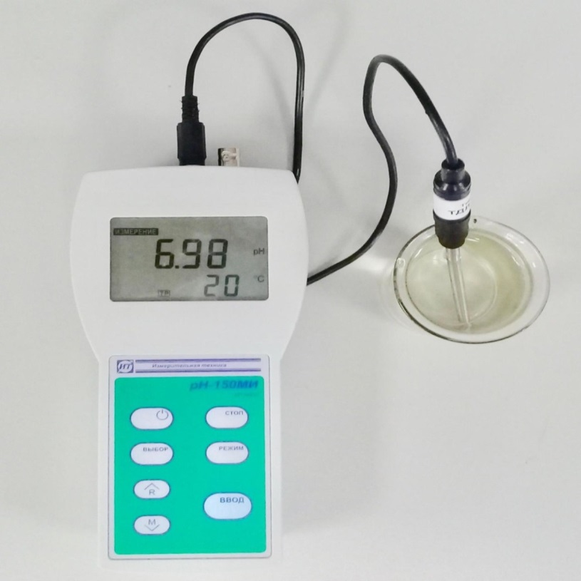
For technological control of hydrometallurgical processes, it is especially important to obtain data on element concentrations with an express method. Potentiometry on an ion-selective electrode (Fig.1) makes it possible to determine concentrations in real time. We propose a method for calculation of silver concentrations for chloride solutions.
However, in chloride solutions the cationic form of silver is present in a minimum concentration. Complexes with chloride anions have an opposite charge and are not fixed during the analysis. The total silver concentration can be estimated by measuring the total chloride content in the sample.
In chloride solutions, silver is present in several forms: the cation [Ag⁺] and the complexes [AgCl], [AgCl₂]⁻, [AgCl₃]²⁻, [AgCl₄]³⁻. The ion-selective electrode is calibrated using an AgNO₃ solution that contains exclusively Ag⁺ cations; therefore, it actually determines only the cation content.

Slide 3
Using the reference data on the stability constants and information on the concentration of silver cations obtained with potentiometry on an ion-selective chlorine-silver electrode we developed a mathematical model in order to calculate the total silver concentration.
Using this model, the total concentration of all the forms of silver was calculated. The data are summarized in Table 1.
Chlorides [Cl-] | 5 | g/mole | 177,5 | g/l
AgCl | 0,000000000177
β1=[AgCl] / [Ag+][Cl-]; | 1096,48
β2=[AgCl2-] / [Ag+][Cl-]2; | 109647,82
β3=[AgCl32-] / [Ag+][Cl-]3; | 109647,82
β4=[AgCl43-] / [Ag⁺][Cl-]⁴. | 107151,93
 | Mr(Ag) | g/mole | 107,87 | g/l
 | [Ag+] | mole/l | 0,000000000035 | g/l
[AgCl] | 0,000000194077 | mole/l
[AgCl2⁻] | 0,0000970383 | mole/l
[AgCl₃²⁻] | 0,0004851916 | mole/l
[AgCl₄³⁻] | 0,0023707365 | mole/l
Sum in solution | 0,0029531605 | mole/l | 0,320 | g/l
The actual concentration in the sample |  |  | 0,321 | g/l
Calculating the equilibrium concentration we found that in high-salinity solutions silver prevails in the form of [AgCl4]3-. All the other complexes are present in smaller quantities. This result shows that it is important to take into account the complexes formation in potentiometric measurements on ion-selective electrodes

Slide 4
Thank you for your attention!

