Slide 1




Demand-side Management of Peak Water Demands using Advanced Metering Infrastructure and Persuasive Games
Jorge E. Pesantez
Emily Zechman Berglund, Ph.D.
Monday May 4th, 2020

Slide 2
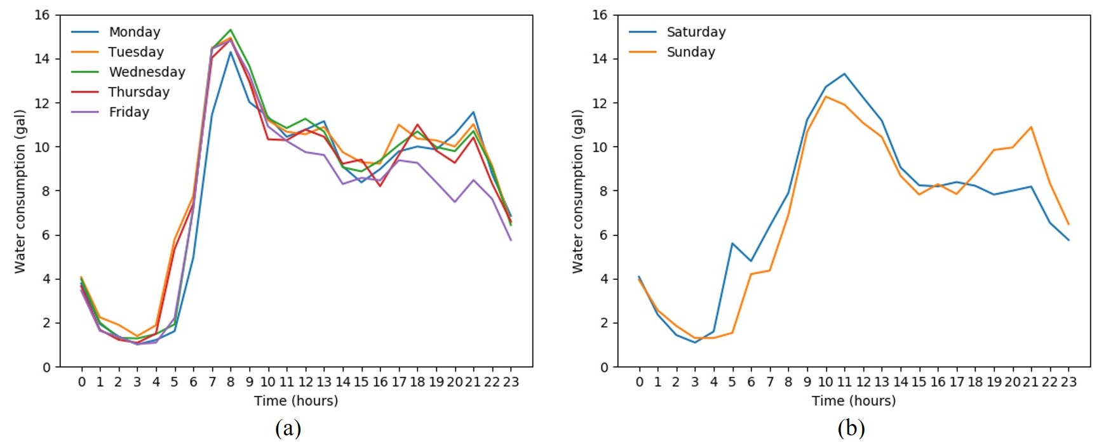
Urban water demands typically show a peak in the morning and evening
The water demand curve should be flattened:
When peak consumption coincides with high energy tariffs, water treatment and distribution pose an economic burden to a utility.
In a constrained water system, demand-side management can play an important role to avoid shortages.
AMI provides tools for shifting the system peak demand to alleviate peak demands.

Slide 3
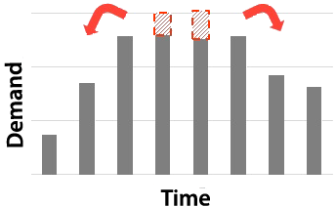
Demand-side management
Demand-side management (DSM) strategies can effectively modify consumption patterns.
DSM is widely applied in the energy sector.
DSM can be applied to shift peak consumption in water systems, but this has not been fully explored in research or practice.

Slide 4
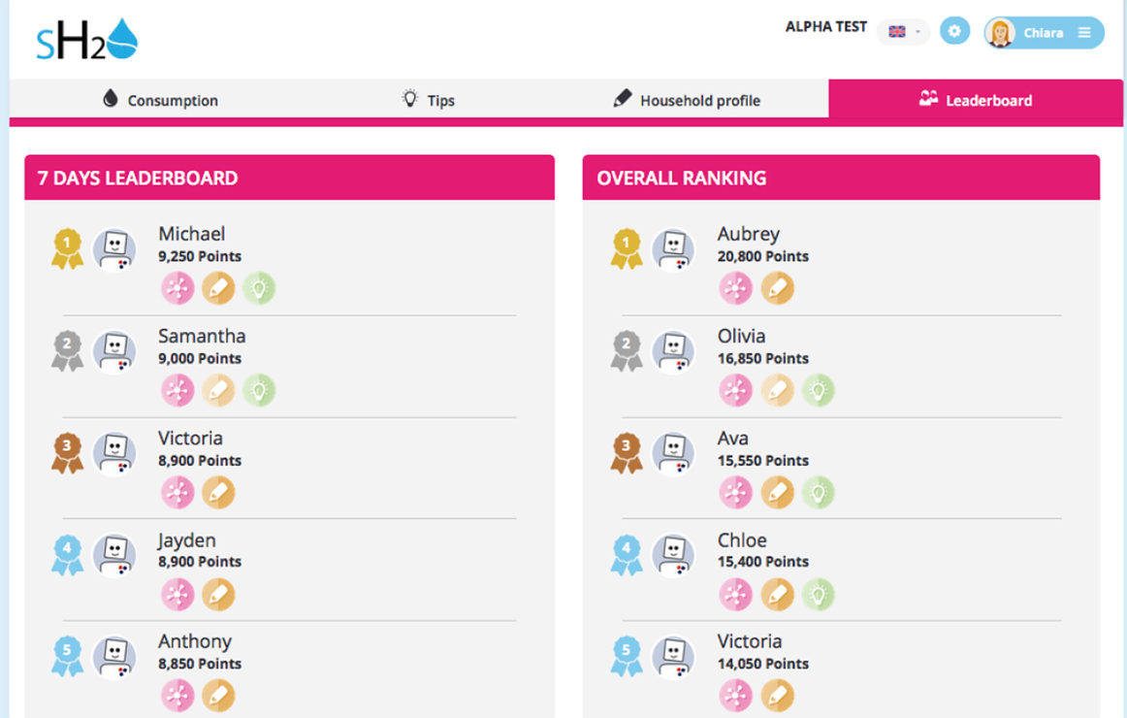
How can we promote consumer participation in DSM?
Dynamic Pricing
$$$
$$$
Smart meter data allows the implementation of dynamic pricing.
Diurnal water demand
$$
$
$
$
Serious Game
AM
NOON
PM
Online games to promote water conservation
Gamification
Leaderboard: customers earn points and improves their virtual ranking
Adapted from the SmartH2O project

Slide 5




Gamification is enabled by feedback from smart meters
Hourly demands reported at smart meters
System-level peak consumption identified by the utility
Encourage demand shifting of certain end-uses
High water use
High water use
High water use
Conservation suggestions
Conservation suggestions
Conservation suggestions
OD-Gamification:
Peer to peer communication about conservation
Drinking Water Pipes

Slide 6
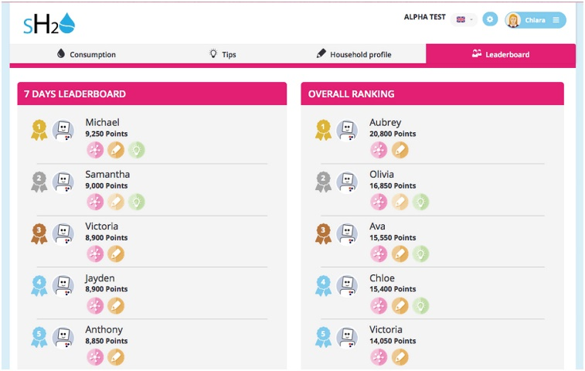
Gamification in WDS
Leaderboard game
The Leaderboard works as follows:
Users receive instructions from the utility about shifting certain uses.
Users compete against each other within a neighborhood.
Each user can see his ranking on the leaderboard.
Adapted from the SmartH2O project

Slide 7
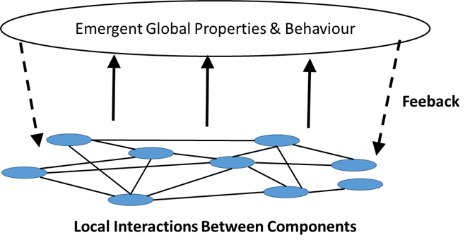
Agent-based Modeling
ABM is applied to simulate the interaction between water utility and users, and between users to shift the system’s daily peak demand.
  Complexity: agents interact in multiple ways and follow local rules
  Emergence: behavior emerges when agents interact
  Adaptive: capacity of the system to adjust or to respond to consequences

Slide 8




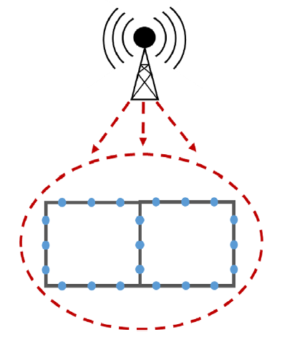
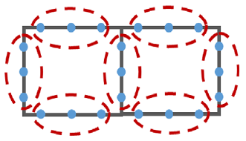
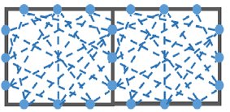
New information changes opinions, which changes behaviors
Do I change my showering time tomorrow?
What did I do yesterday?
User opinion and actions change over time
Sources of information
Global broadcast
Social media
Neighbors: word of mouth
Leaderboard

Slide 9
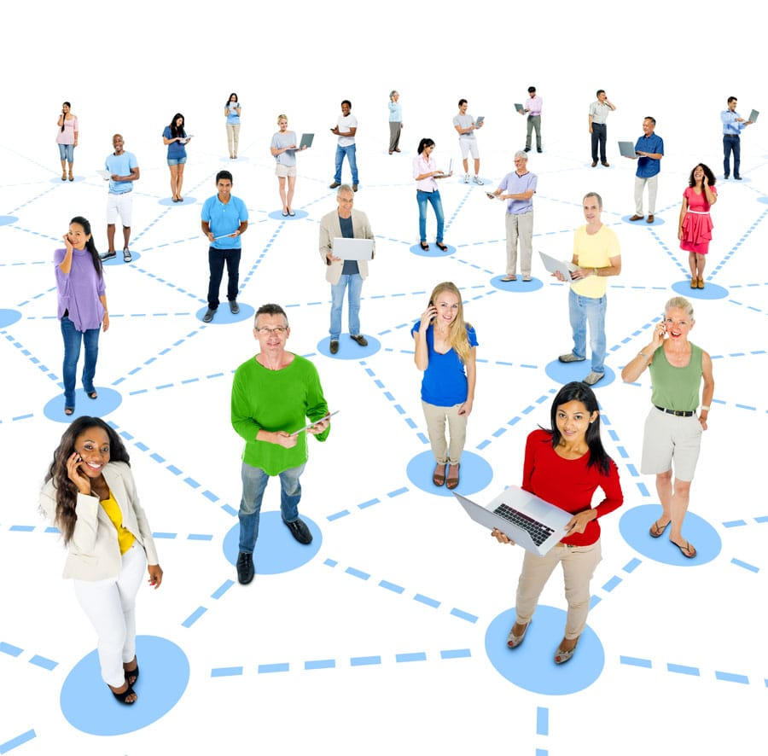
Opinion Dynamics
The opinion of a person is affected by different sources of information.
The opinion changes over time.
An opinion leads to a decision.
If the opinion is greater than resistance, the decision is to shift water demand, otherwise, the decision is not to shift.

Slide 10
Objectives
To simulate a demand-side management by the application of Opinion Dynamics (OD) and Gamification concepts through an agent-based model.
To develop an agent-based model to simulate a demand shifting program
To implement an OD model and a Gamification approach

Slide 11

Opinion Dynamics Model
The opinion of an agent (household) is a function of the information obtained from global broadcast (Utility), social media, and neighbors.
$O_{j,t}=\left(1−θ_{j}\right)O_{j,t−1}+θ_{j}\left(α_{j}I_{j,t}^{G}+β_{j}I_{j,t}^{S}+γ_{j}I_{j,t}^{N}\right)$*
*Adopted from Du, E., Cai, X., Sun, Z., & Minsker, B. (2017). Exploring the role of social media and individual behaviors in flood evacuation processes: An agent‐based modeling approach. Water Resources Research, 53(11), 9164-9180.
Where:
$O_{j,t}$: opinion of agent j at time step t, continuous variable: O ϵ [0,1]
$θ_{j}$, $α_{j}, β_{j}$, $γ_{j}$: learning rate and weighting parameters
$I_{j,t}^{G}$: information obtained from global broadcast ($I_{j,t}^{G}$=$U_{t}$, where $U_{t}$ ϵ {0, 1})
$I_{j,t}^{S}$: information obtained from social media
$I_{j,t}^{N}$: information obtained from neighbor’s actions and communication

Slide 12
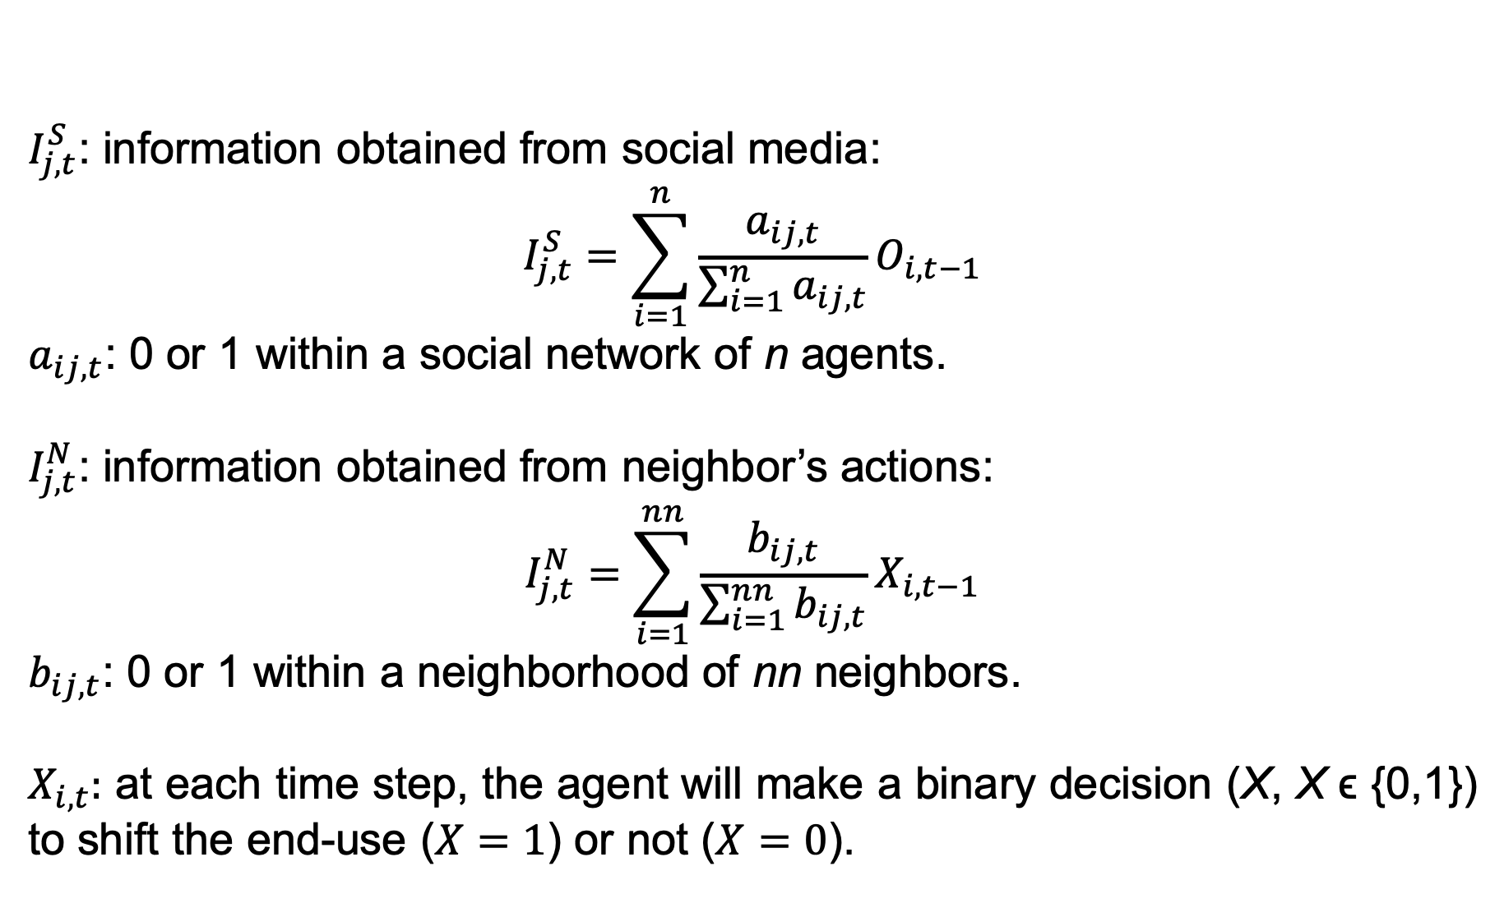
OD: Modeling the information sources
$I_{j,t}^{S}$: information obtained from social media:
$$I_{j,t}^{S}=\sum_{i=1}^{n}{\frac{a_{ij,t}}{\sum_{i=1}^{n}{a_{ij,t}}}O_{i,t−1}}$$
$a_{ij,t}$: 0 or 1 within a social network of n agents.
$I_{j,t}^{N}$: information obtained from neighbor’s actions:
$$I_{j,t}^{N}=\sum_{i=1}^{nn}{\frac{b_{ij,t}}{\sum_{i=1}^{nn}{b_{ij,t}}}X_{i,t−1}}$$
$b_{ij,t}$: 0 or 1 within a neighborhood of nn neighbors.
$X_{i,t}:$ at each time step, the agent will make a binary decision (X, X ϵ {0,1}) to shift the end-use ($X=1$) or not ($X=0$).

Slide 13
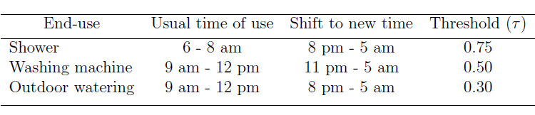
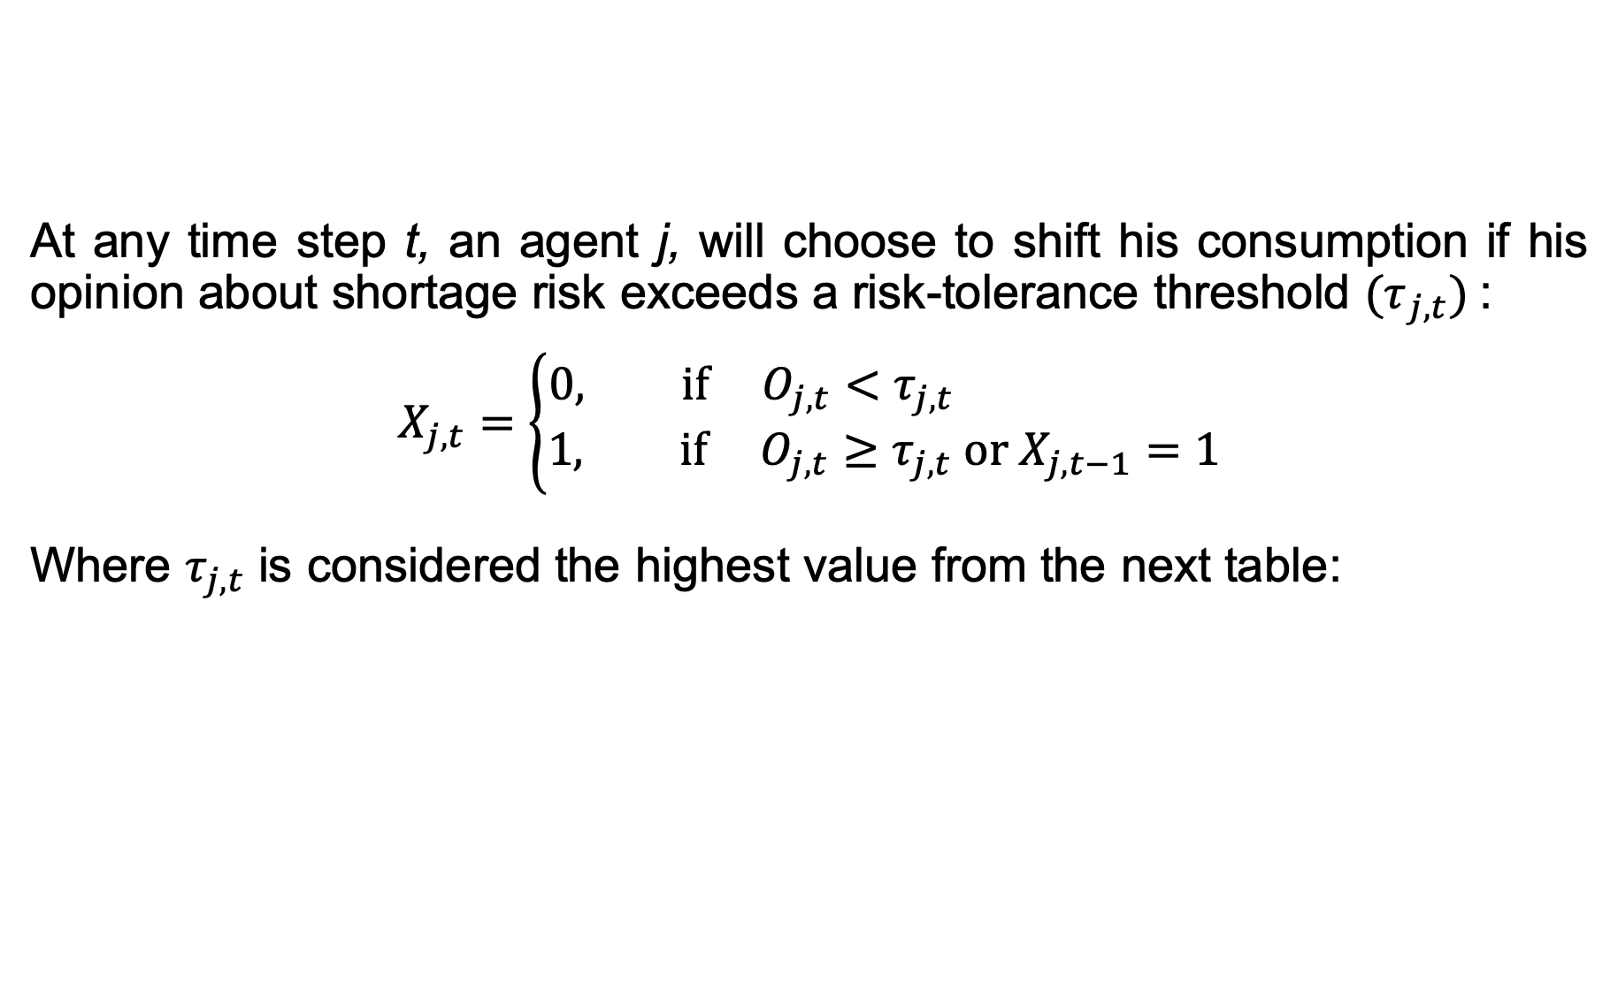
OD: Modeling information
At any time step t, an agent j, will choose to shift his consumption if his opinion about shortage risk exceeds a risk-tolerance threshold ${(τ}_{j,t})$:
$$X_{j,t}=\left\{\begin{aligned}0, if O_{j,t}<τ_{j,t} \\ &1, if O_{j,t}≥τ_{j,t} or X_{j,t−1}=1\end{aligned}\right.$$
Where $τ_{j,t}$ is considered the highest value from the next table:

Slide 14
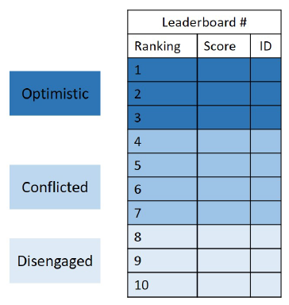
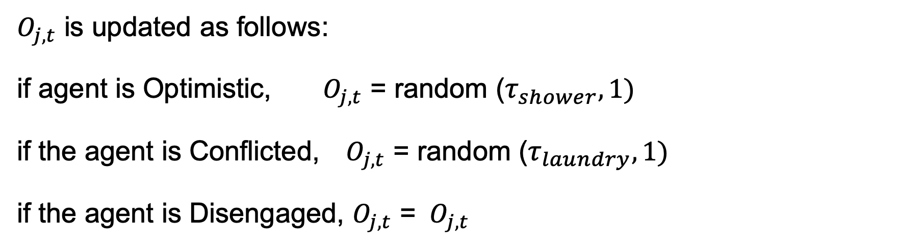
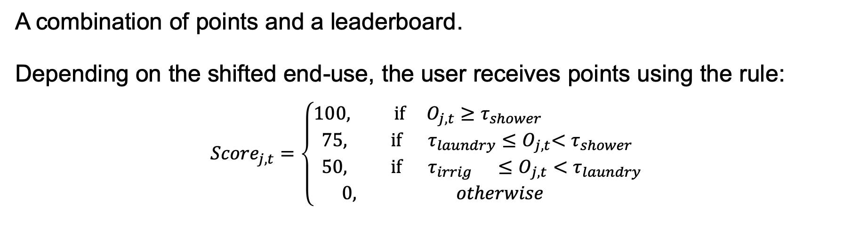
Gamification: Leaderboard
A combination of points and a leaderboard.
Depending on the shifted end-use, the user receives points using the rule:
$${Score}_{j,t}=\left\{\begin{aligned}100, if O_{j,t}≥τ_{shower} \\ &75, if τ_{laundry}{≤O}_{j,t}<τ_{shower} \\ &50, if{ τ}_{irrig}{ ≤O}_{j,t}<τ_{laundry} \\ 0, otherwise \end{aligned}\right.$$
$O_{j,t}$ is updated as follows:
if agent is Optimistic, $O_{j,t}$ = random ($τ_{shower},1)$
if the agent is Conflicted, $O_{j,t}$ = random ($τ_{laundry},1)$
if the agent is Disengaged, $O_{j,t}$ = ${ O}_{j,t}$

Slide 15
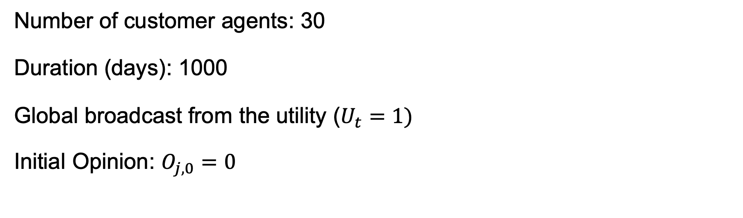
Model settings
Number of customer agents: 30
Duration (days): 1000
Global broadcast from the utility ($U_{t}=1)$
Initial Opinion: $O_{j,0}=0$

Slide 16
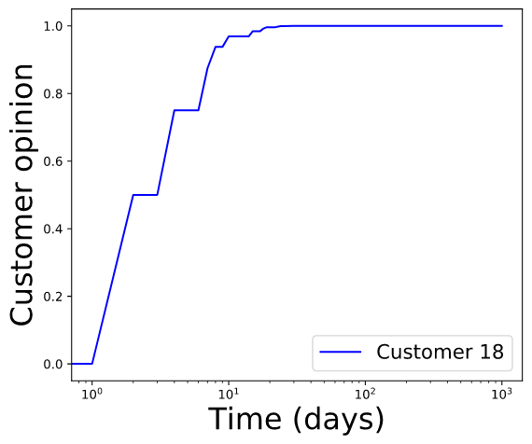
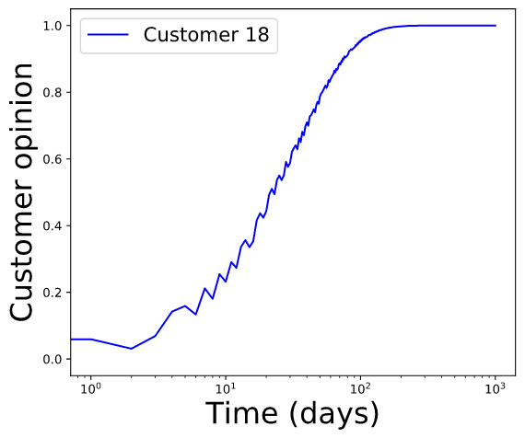
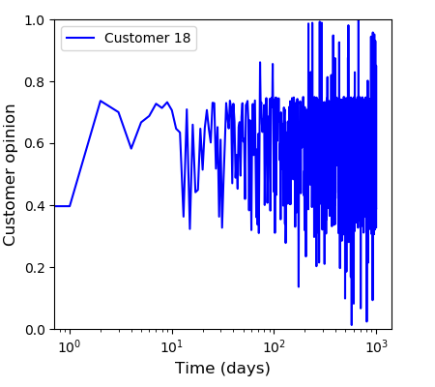
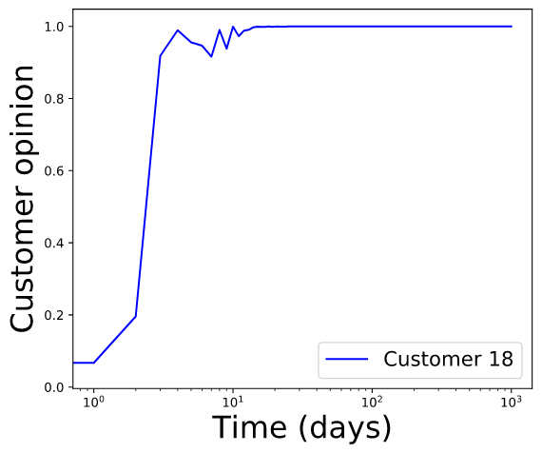
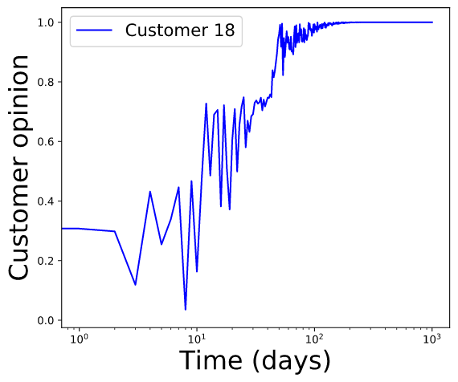
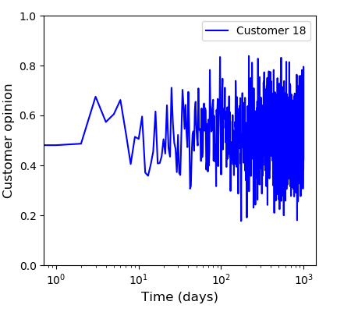
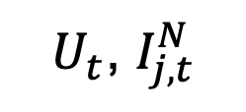
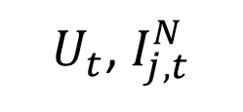
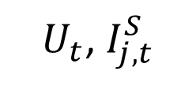
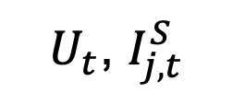


Preliminary Results
Opinion of a randomly selected agent
Without a leaderboard
$$U_{t}$$
$U_{t}$, $I_{j,t}^{S}$
$U_{t}$, $I_{j,t}^{N}$
With a leaderboard
$$U_{t}$$
$U_{t}$, $I_{j,t}^{S}$
$U_{t}$, $I_{j,t}^{N}$

Slide 17
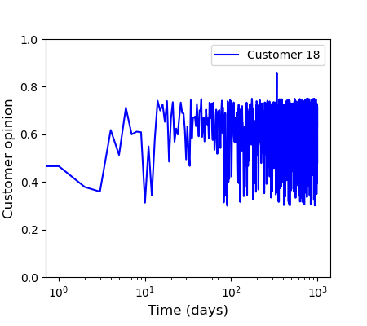
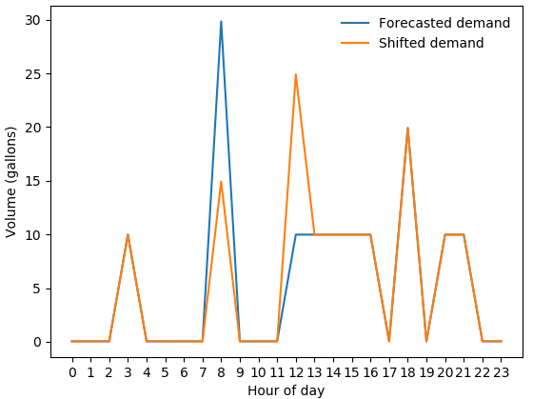
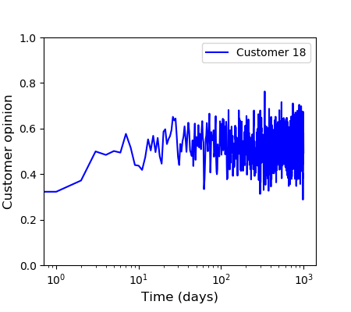
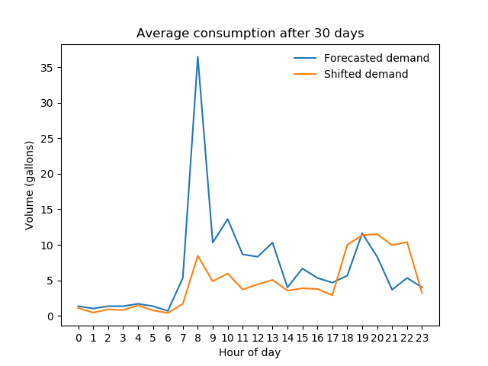
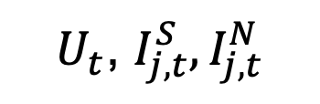
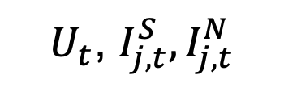
Preliminary Results
Opinion of a randomly selected agent
Demand shifted of the agent
Without a leaderboard
$U_{t}$, $I_{j,t}^{S},I_{j,t}^{N}$
With a leaderboard
$U_{t}$, $I_{j,t}^{S},I_{j,t}^{N}$

Slide 18
Conclusions
Smart metered data were used to model a demand-side management (DSM) strategy to shift the system’s daily peak demand.
An agent-based modeling was built using the concepts from Opinion Dynamics and Gamification to implement the DSM strategy.
The effect of Gamification on the model adds variability to the agents’ opinion.
The new model that aims at flattening the diurnal demand curve to assist utilities in improving water distribution system operation.

