Slide 1
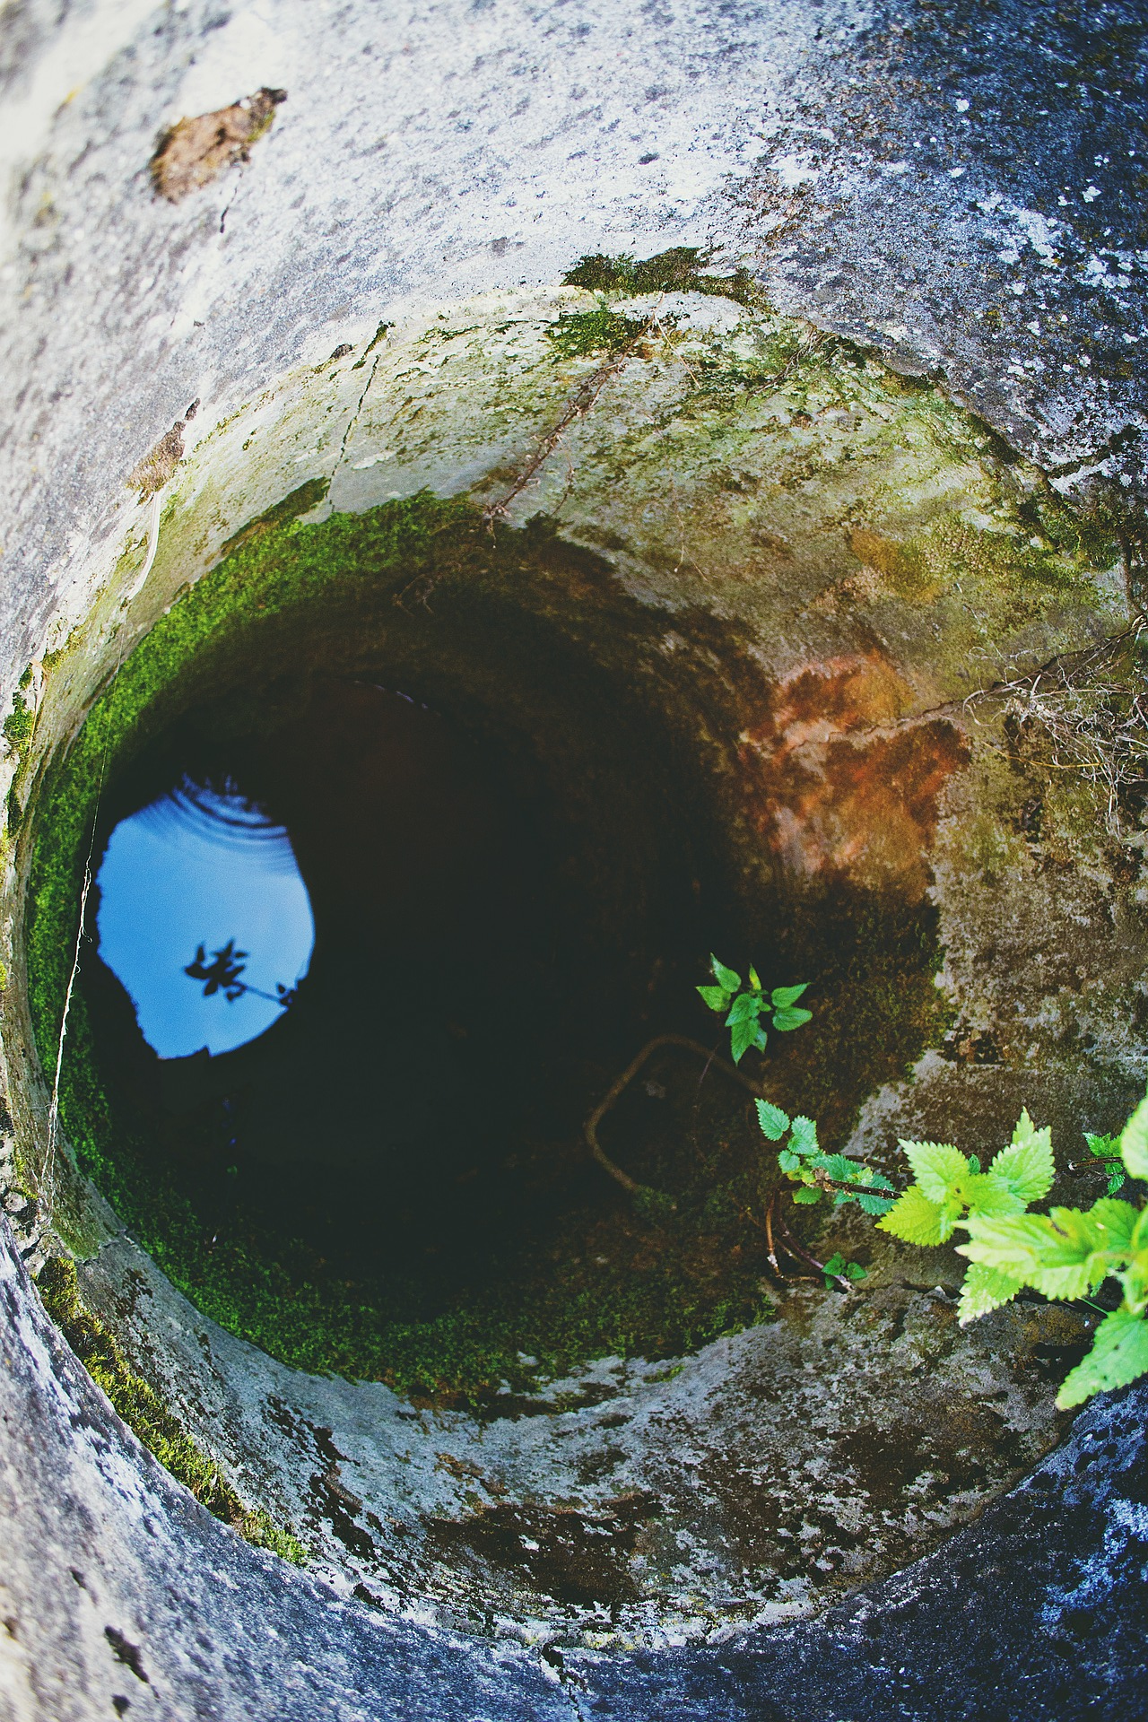
EGU General Assembly 2020, Online
Sharing Geoscience Online, 4-8 May, 2020
Understanding the importance of hydraulic head timeseries for calibrating a flow model:
Application to the real case of the Bacchiglione Basin (Veneto, Italy)
Mara Meggiorin^{1,2}, Giulia Passadore¹, Andrea Sottani², Andrea Rinaldo^{1,3}
¹ Dipartimento di Ingegneria Civile, Edile e Ambientale, Università di Padova
² Sinergeo Srl – Vicenza, Italy, info@sinergeo.it
³ Laboratory of Echohydrology (ECHO/IIE/ENAC), École Polytechnique Fédérale de Lausanne, Switzerland
!!! Session HS8.1.6 - Live chat on Monday, 04 May 2020, 08:30-10:15
Watch the video of the presentation HERE !!!
EGU2020 - Online, 4-8 May 2020

Slide 2
Calibration for groundwater models
Models need the optimization of hydrogeological properties
PEST calibrates property fields to reproduce observation data at best
Detailed soil knowledge is impossible at large scales
Groundwater moves through a heterogeneous subsoil
Intuitively,
more observations,
more the calibrated model will be reliable and preferable
It is possible to consider and fit different hydrological conditions
By calibrating in transient conditions
EGU2020 - Online, 4-8 May 2020

Slide 3
But…
Different choices on observation sampling time are possible:
By using daily data with missing values
By using monthly data that fastens also the model
Hydrogeological records often have missing values
Possible alteration of calibration process and parameters estimation
How and does it make a difference ??
EGU2020 - Online, 4-8 May 2020

Slide 4
Analysis steps
Common settings for all scenarios:
model conceptualization
daily boundary conditions
Implement a flow model for a real case
Calibrate the model with different observation timeseries:
Results comparison:
Difficulties on visually inspecting 24 heterogeneous fields, therefore, calibrated hydrogeological properties are collated by:
statistical distributions,
simulated timeseries in two points within the observation area,
sensitive analysis by estimating variation coefficients in pilot points.
Base model
(DD)
Missing data scenarios
(MDSc)
models simulating 20%, 40%, 60%, 80% and 100% missing data for each observation location
Sampling time scenarios
(STSs)
weekly data WD
monthly data MD
steady state SS
incomplete daily data
complete data
complete daily data - DD
considered the best achievable optimized model by using all available information
Calibrated properties:
Hydraulic conductivity / permeability (K)
Specific storage (S)
EGU2020 - Online, 4-8 May 2020

Slide 5
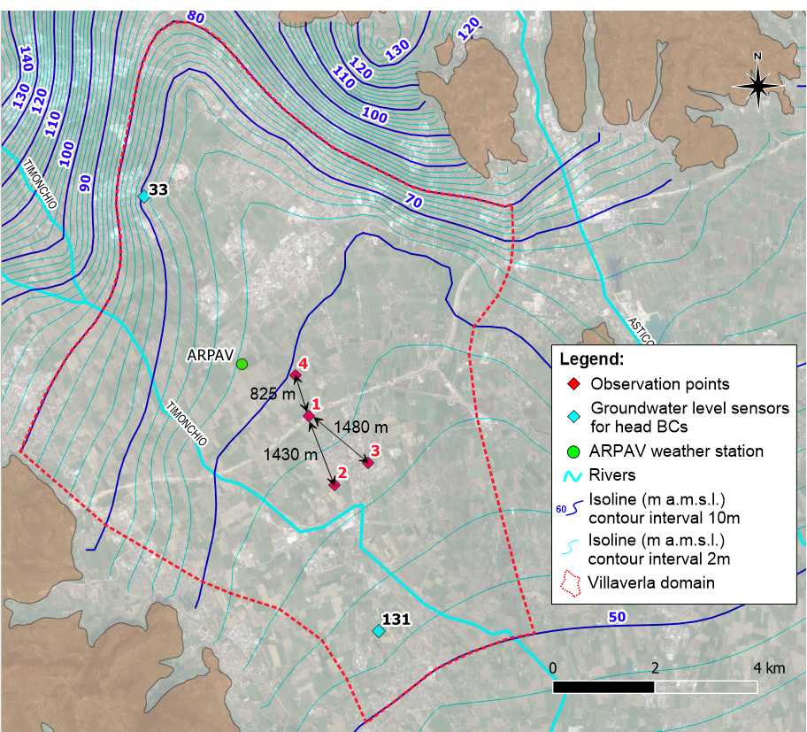
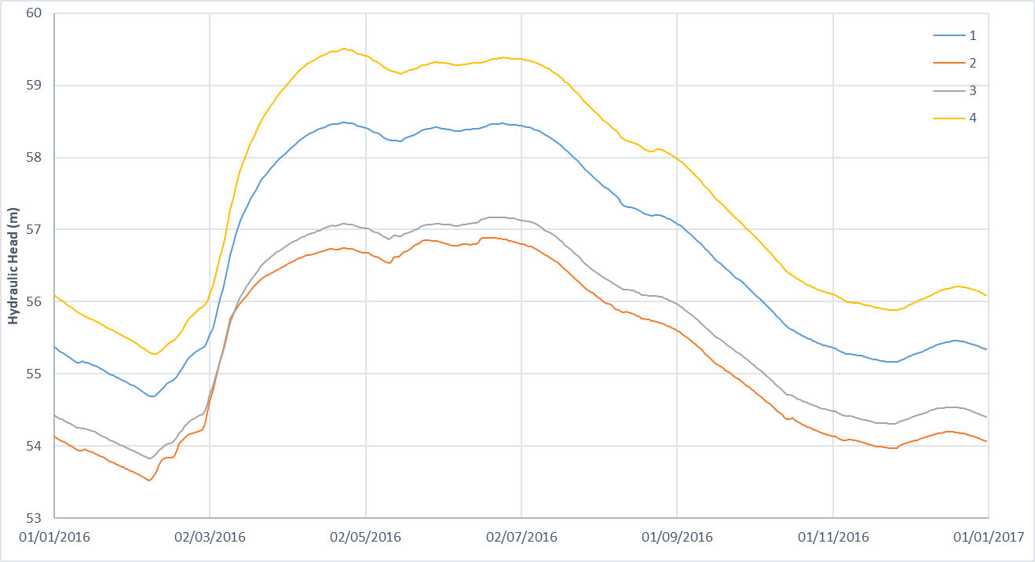
Case study – subdomain of the Bacchiglione Basin
4 sensors continuously measuring the groundwater level
Unconfined groundwater system
Boundary conditions (BCs): northern and southern boundaries
Dirichlet's conditions
eastern and western boundaries
no-flow boundaries
Records overlap for 783 days without missing data
EGU2020 - Online, 4-8 May 2020

Slide 6
Case study – Water balance
Transient inflows:
Effective precipitation
defined thanks to a local weather station
River seepage
Timonchio river crosses the domain
the flow recharging the aquifer is estimated
by empirical formulas basing on the fluvial water level
Constant in and outflows:
Irrigation
channels of the irrigation public authority
do not vary between irrigation and not irrigation periods
4 public wells
constant flow rate
Private wells
their exploitations are estimated for each municipality
EGU2020 - Online, 4-8 May 2020

Slide 7
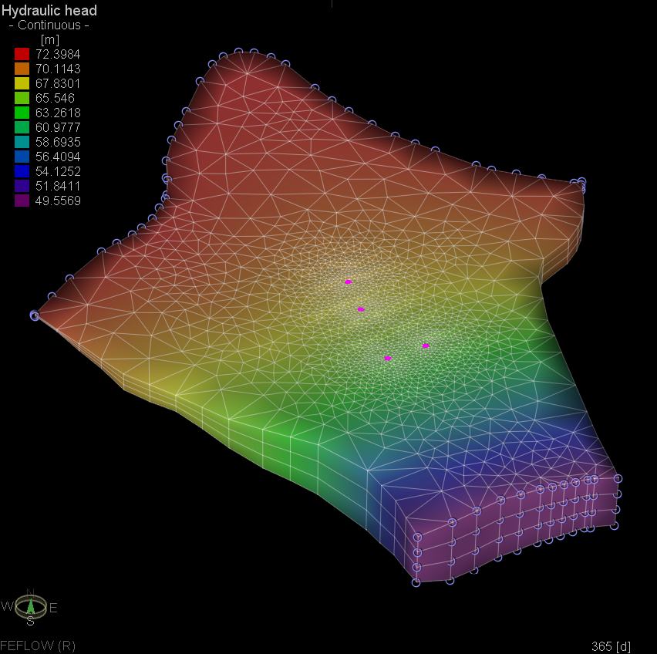
Model implementation and calibration settings
FEFLOW
Mesh: small elements close to observation points, with sides of roughly 60m, enlarging up to sides of about 600m far away
3 model layers
Daily transient BCs
FEPEST
Transient calibration : 1 year
Pilot point estimation method
pp denser close to observation points
Kriging interpolation
Thikhonov regularization
SVD-Assist is applied as a fastening tool
EGU2020 - Online, 4-8 May 2020

Slide 8
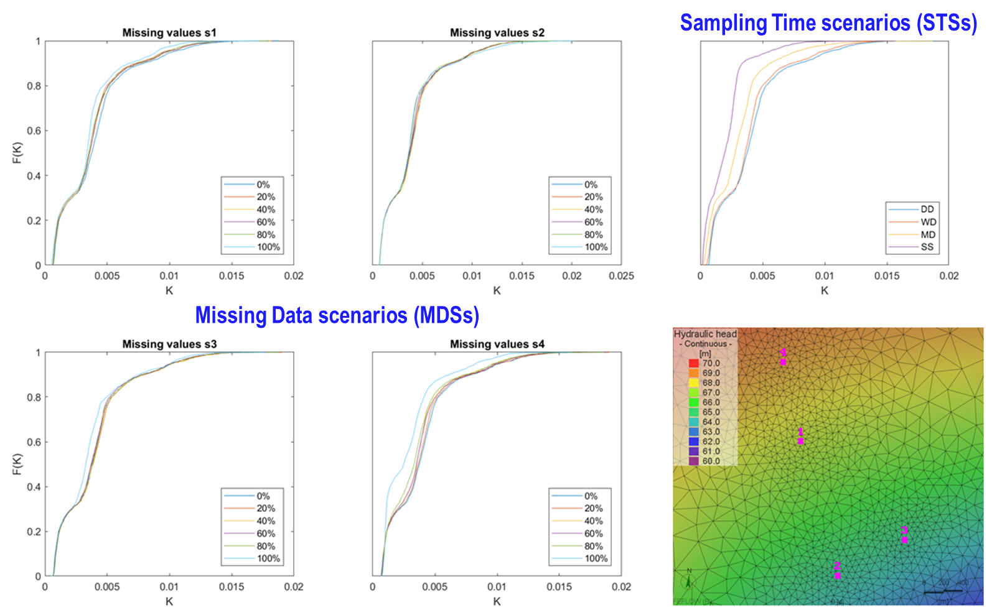
Results: Statistical descriptors – Hydraulic conductivity
Cumulative distribution functions
EGU2020 - Online, 4-8 May 2020

Slide 9
Results: Statistical descriptors – Hydraulic conductivity
Main Observations:
STSs:
Wide cumulative distribution functions (cdfs)
DD has generally highest permeability values
increasing the sampling time, cdfs move towards lower values with minimum values for the SS
However, they all show similar curve shapes
MDSs:
Their cumulative distribution functions are much more bunched up
the complete absence of one observation timeseries leads to further curves, specially one of timeseries 4
generally, there are small median discrepancies
increasing the percentage of lacking data, all sensors lower the medians
EGU2020 - Online, 4-8 May 2020

Slide 10
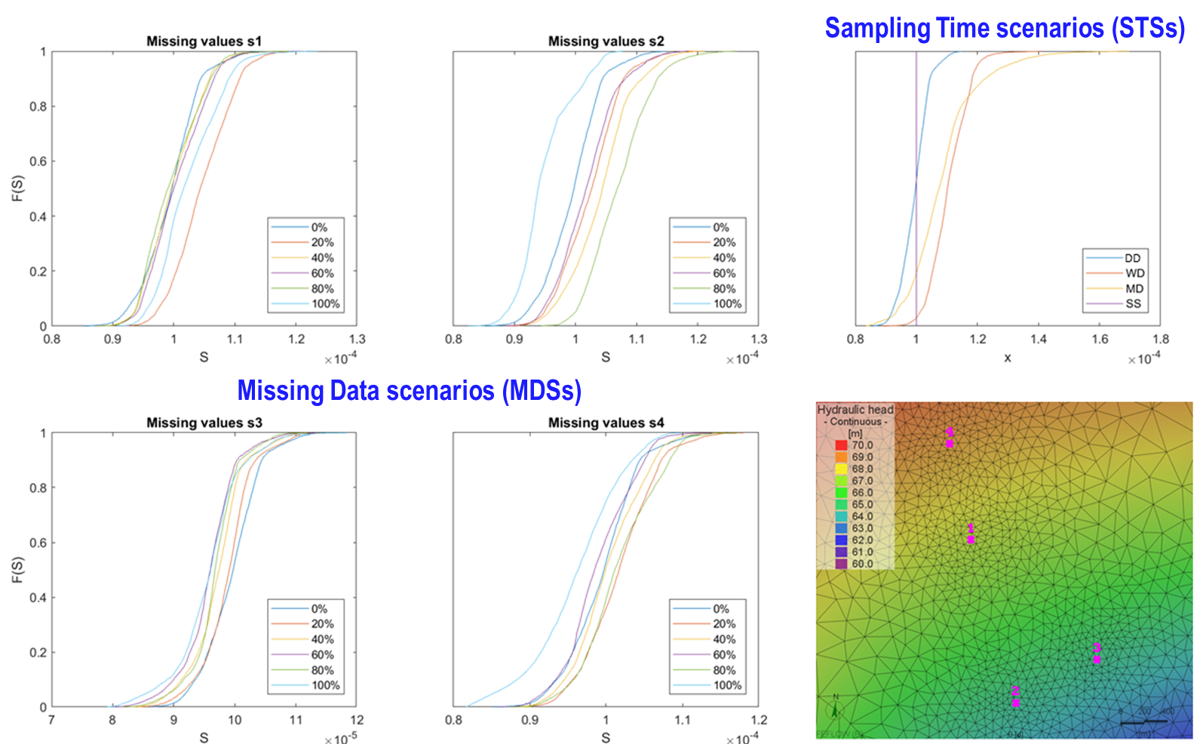
Results: Statistical descriptors – Specific storage
Cumulative distribution functions
EGU2020 - Online, 4-8 May 2020

Slide 11
Results: Statistical descriptors – Specific storage
Main Observations:
STSs:
Cumulative distribution functions move to higher values (for WD and MD)
WD has a thinner range but higher median
The optimization in steady state does not calibrate the property of specific storage, therefore SS model keeps the original homogeneous field
MDSs:
Cumulative distribution functions have all similar shapes
but they are moved in the x-axis (property values)
increasing the missing data percentage, there is not an evident movement toward higher or lower values
EGU2020 - Online, 4-8 May 2020

Slide 12
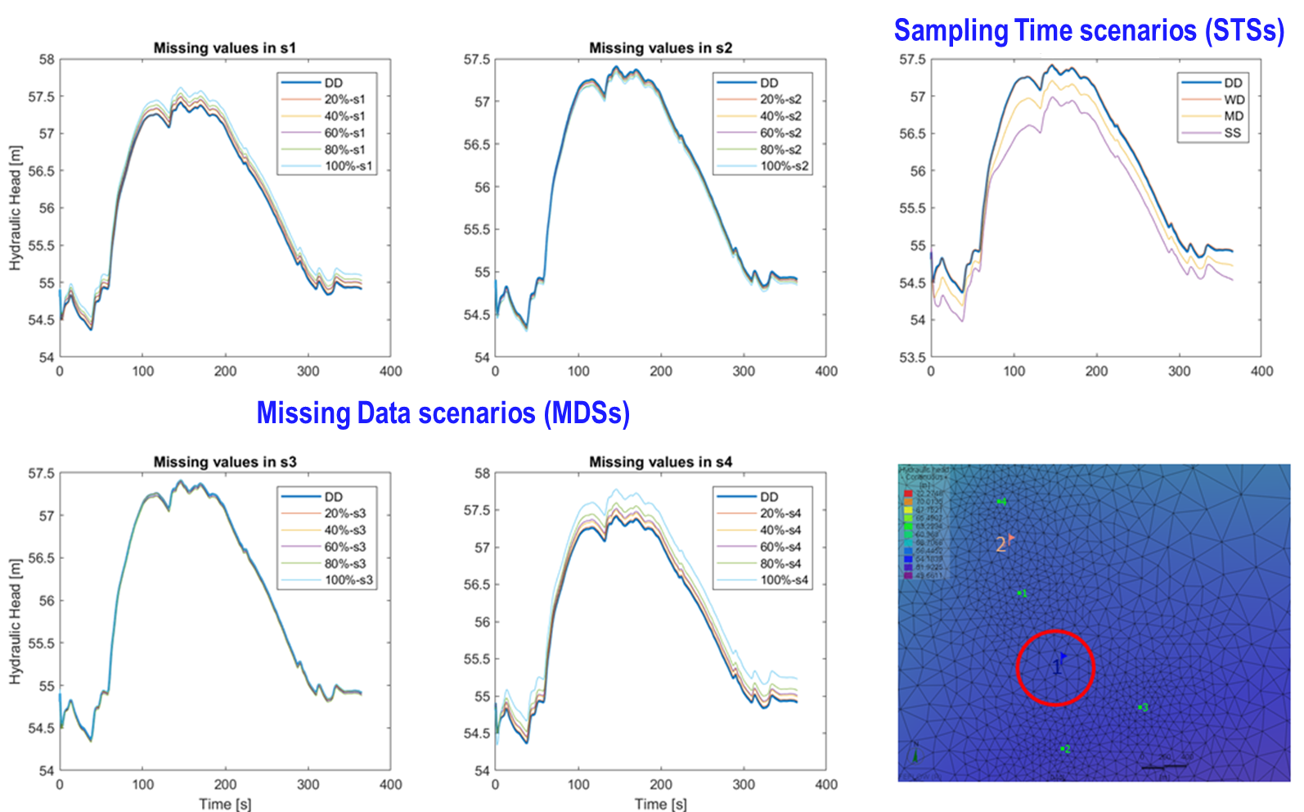
Results: Simulated hydraulic heads – point 1
EGU2020 - Online, 4-8 May 2020

Slide 13
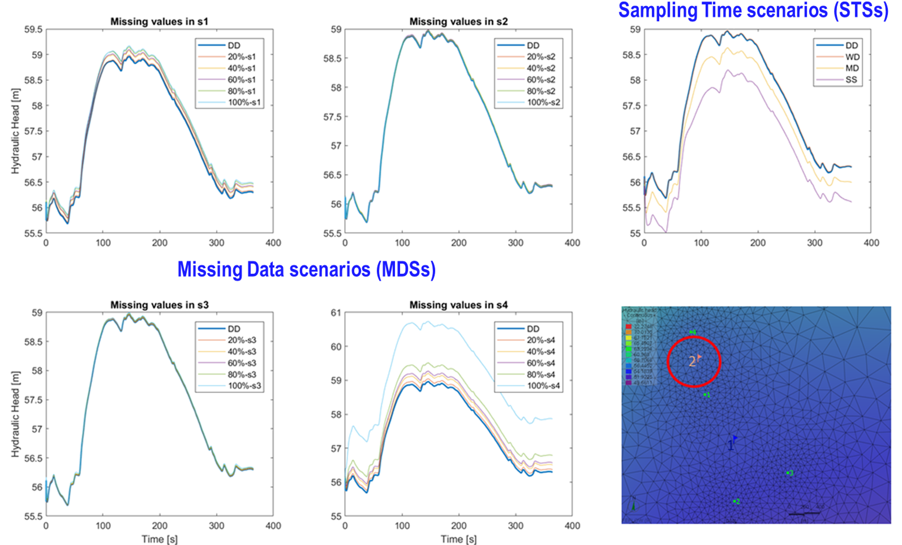
Results: Simulated hydraulic heads – point 2
EGU2020 - Online, 4-8 May 2020

Slide 14
Results: Simulated hydraulic heads
Main Observations:
STSs:
Trends of simulated heads are kept
but heads are lower for MD and SS
difference of almost 1m for SS
WD simulates very similar hydraulic heads to ones of the base model DD
an average difference of 1 cm
MDSs:
Heads in both points are not affected by lacking data in sensors 2 and 3
they can probably substitute each other
But they are much more sensitive to sensors 1 and 4
increasing the percentage of missing values, simulated hydraulic heads increase
maximum discrepancy with DD for point 2 when there are not observations in sensor 4:
heads difference of almost 2m
EGU2020 - Online, 4-8 May 2020

Slide 15
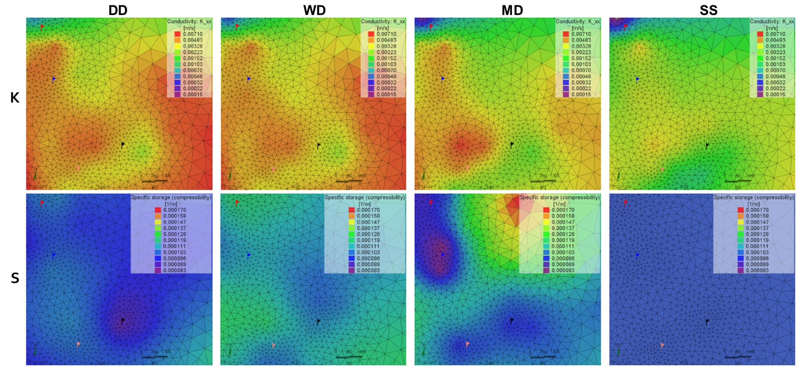
Results: Properties heterogeneity within the observation area Sampling time scenarios
EGU2020 - Online, 4-8 May 2020

Slide 16
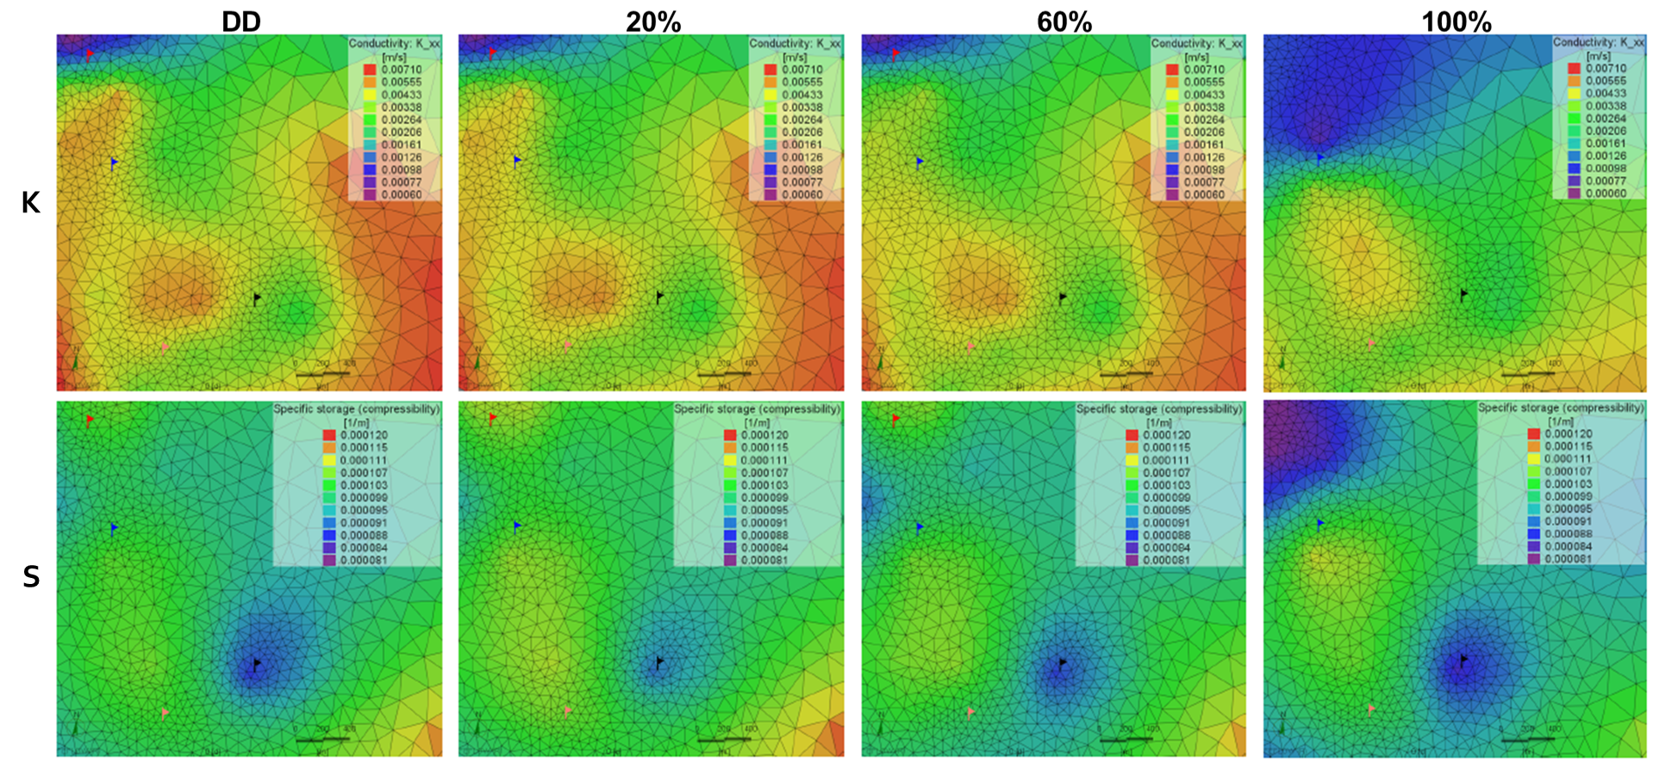
Results: Properties heterogeneity within the observation area Missing data scenarios – sensor 4
EGU2020 - Online, 4-8 May 2020

Slide 17
Results: Properties heterogeneity within the observation area
Main Observations:
STSs:
permeability fields show differences on estimated values between DD and higher sampling intervals, but the heterogeneity structure is the same
higher values are estimated by the base model
the WD property values are very close
MD and SS have the same heterogeneity but flattened
specific storage estimated fields, instead, do not even show a similar structure
MDSs:
permeability fields show similar heterogeneity structure and values
K heterogeneity slightly flattens increasing the missing data percentage
biggest difference when there is not observation in location 4
there is no information for the northern sector
the calibration process estimates a very low conductivity area
also the estimated S fields show a similar structure
EGU2020 - Online, 4-8 May 2020

Slide 18
Results: Uncertainty analysis
Goal:
understand the model uncertainty variability with different observations (optimization target)
Therefore, the focus is on the difference between estimated fields of hydrogeological properties, mainly their assigned values to pilot points
posterior Monte Carlo (pMC) analysis: calibration of 20 models starting from an almost calibrated condition
the worst two optimized models of the pMC analysis are discarded
CV evaluation: ratio between standard deviation and mean of 18 optimized values in each pilot point
$${CV}_{pp}=\frac{σ_{pp}}{µ_{pp}}$$
For each pilot point
Lower the CV
Lower the parameter variability between calibrated models
Lower the local parameter uncertainty
EGU2020 - Online, 4-8 May 2020

Slide 19
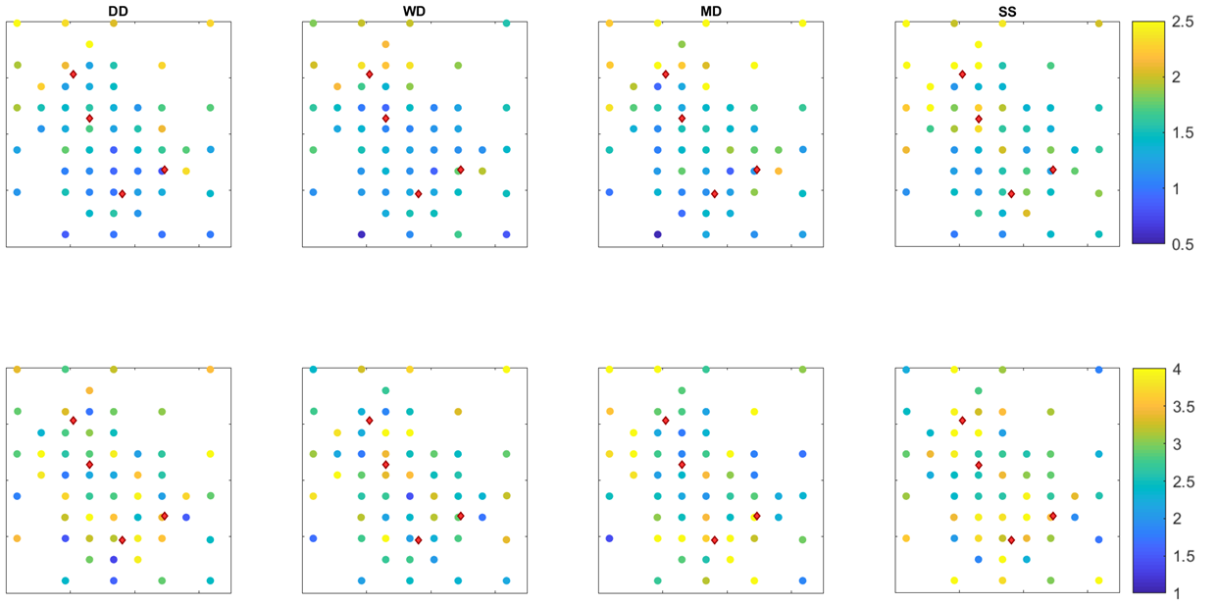
Results: Uncertainty analysis
K
S
EGU2020 - Online, 4-8 May 2020

Slide 20
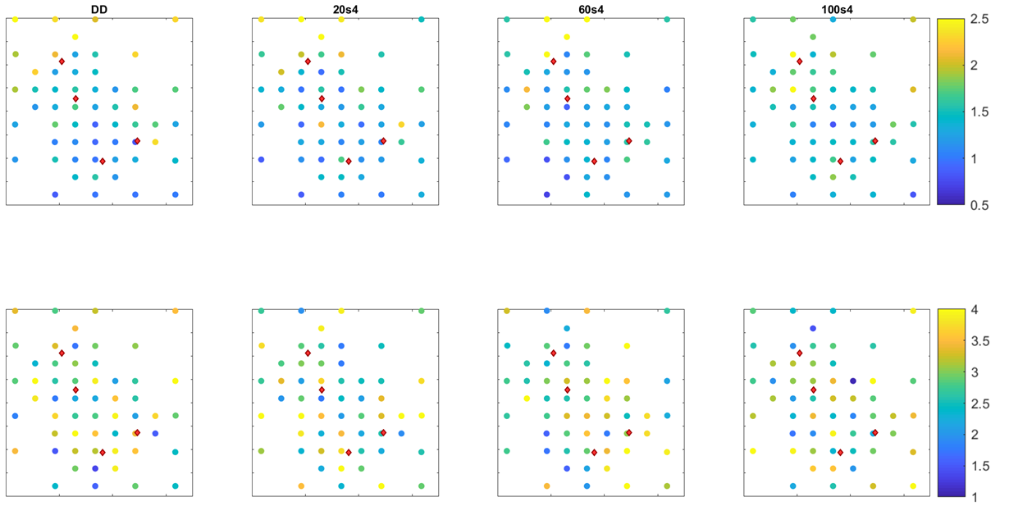
Results: Uncertainty analysis
K
S
EGU2020 - Online, 4-8 May 2020

Slide 21
Results: Uncertainty analysis
Main Observations:
different uncertainty between the two hydrogeological parameters:
all models show lower CVs for the hydraulic conductivity parameter
STSs show an increasing uncertainty for larger time intervals
MDSs instead do not see any uncertainty variation,
each pilot point has different CVs for each scenario
but there is not a recognizable general uncertainty trend by increasing the missing data percentage
EGU2020 - Online, 4-8 May 2020

Slide 22
Conclusions - Varying the timeseries sampling interval
STSs
Increasing the sampling time, there is a progressive distancing from the base model with complete daily data
Permeability cdfs move towards lower values with minimum values for the SS
Specific storage cdfs move to higher values (for WD and MD)
Trends of simulated heads are kept but heads lower for MD and SS
Permeability fields show:
Same heterogeneity structure
WD property values are very close
MD and SS have flattened values
Specific storage estimated fields, instead, do not even show a similar structure
Increasing uncertainty for larger time intervals
EGU2020 - Online, 4-8 May 2020

Slide 23
Conclusions - Missing values in one observation timeseries
MDSs
Generally, smaller variations than sampling time scenarios
Permeability cdf are much more bunched up: the complete absence of one timeseries leads to further curves
Specific storage cdfs move in the x-axis (property values) without an evident trend
Simulated heads are more sensitive to sensor 1 and 4
higher heads increasing the percentage of missing values
K and S fields show similar heterogeneity structure and values
biggest difference when there is not observation in location 4 (no information for the northern sector)
There is not any uncertainty trend by increasing the missing data percentage
The model is more sensitive to timeseries in sensor 4 than others
All estimated fields with partial daily timeseries in sensor 4 are very similar both in terms of:
statistical descriptors
heterogeneity aspects on map
Seems like most important information tracked from this sensor is its mean level:
more than its trend
only the complete absence of information on that location makes a large difference
EGU2020 - Online, 4-8 May 2020

Slide 24
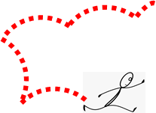
Groundwater modeling choices for observations in transient calibration
If daily timeseries are available,
it is preferable to use them even with missing data
Larger sampling times
slightly diminish the computational effort (BCs are still daily data)
But lead to loss of information and different estimated fields
the discrepancy can be acceptable or not depending on the model goal and scale
In this analysis, using weekly timeseries seems to be a good compromise,
most of results are comparable to ones of the base model
More studies are needed to confirm this
EGU2020 - Online, 4-8 May 2020

Slide 25
EGU General Assembly 2020, Online
Sharing Geoscience Online, 4-8 May, 2020
FOR FURTHER
QUESTIONS
mara.meggiorin@dicea.unipd.it
mmeggiorin@sinergeo.it
EGU2020 - Online, 4-8 May 2020

