Slide 1
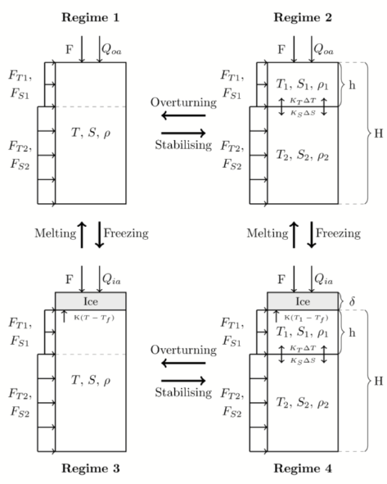
Multidecadal Polynya Formation in a Conceptual (Box) Model
Daan Boot¹, René M. van Westen¹, Henk A. Dijkstra^{1, 2}
¹Institute for Marine and Atmospheric research Utrecht, Department of Physics, Utrecht University, Utrecht, the Netherlands
²Center for Complex Systems Studies, Utrecht University, Utrecht, the Netherlands
Corresponding author: d.boot@uu.nl
Introduction
The Maud Rise Polynya (MRP) is an open-ocean polynya in the Weddell Sea and forms above the underwater seamount Maud Rise. MRPs were first observed in the 1970s and reappeared in 2016 and 2017. The main consensus is that MRPs form due to deep convection. In literature there is a contrast. Some studies view the MRP as an irregular, surface driven phenomenon (e.g. Martinson et al., 1981), while other studies view it as a periodic, subsurface driven phenomenon (e.g Van Westen and Dijkstra, 2020a, b). In this study the model of Martinson et al. (1981) is revisited and extended to look into this contrast. The aim is to look at both the formation and the reoccurrence of the MRP. Therefore this study looks into the following two questions:
What is the relative importance of subsurface forcing relative to surface forcing?
What determines the long term variability of the MRP?
Results
Martinson
Figure 3| T-S plots for the last 25 years of a 100 year run for the Martinson set up. The arrows denote the direction in time. Tee color coding denotes the year. a) Case REF.1. b) Case REF.2
Extended
Model
 | Mixed | Stable
Ice free
Sea ice covered
Figure 4| Same as Figure 3, but now for the extended set up. a) Case PFB. b) Case PFH. c) Case PFS.
Runs with noise
Figure 1| (a) A schematic representation of the different regimes of the extension of the model used in Martinson et al. (1981). Regime transitions are shown with bold arrows. (b) T-S plot with arbitrary salinity scale showing general yearly cycles. Letters denote regime changes. The contour lines are isopycnals.
Key features:
4 regimes differentiated on sea-ice cover and stratification.
Forced with heat and freshwater fluxes at the surface.
2 set ups (the original and the extended model) with 5 cases to answer our questions (Table 1).
Linear equation of state.
Main extensions:
Dynamic subsurface layer
Periodic subsurface heat and salt fluxes.
Lateral heat and salt fluxes in the surface layer.
Figure 5| Results of spectral analysis on two cases run with white noise added to the freshwater flux. a) Case PFB. b) Case REF.1.
Summary and Discussion
Based on this study and the studies of Van Westen and Dijkstra (2020a, b), we can give the following answers to our questions:
The subsurface forcing preconditions both the subsurface and the surface layer. Due to this preconditioning, deep convection can be induced due to brine rejection. It was not shown that heat accumulation is more important than salt accumulation as suggested in Van Westen and Dijkstra (2020b).
Under the influence of periodic subsurface forcing, the polynya is a periodic event with the same period as the forcing, as suggested in Van Westen and Dijkstra (2020a). Without this forcing, the model is unable to simulate multiple polynya events.
Table 1| Overview of the two set ups (‘Martinson’ and ‘Extended’) and the different cases. ‘Off’ means that the model component is excluded, ‘on’ means it is included.
References
Martinson, D.G., Killworth, P.D., and Gordon, A.L.: A Convective Model For the Weddell Polynya, J. Phys. Oceanogr., 1981.
Van Westen, R. M. and Dijkstra, H.A.: Multidecadal Preconditioning of the Maud Rise Polynya Region, Ocean Sci., in review, 2020a.
Van Westen, R.M. and Dijsktra, H.A.: Subsurface Initiation of Deep Convection near Maud Rise, Ocean Sci., in review, 2020b.
Faculty of Natural Sciences
Department of Physics
IMAU

