Slide 1
Analysis of seismicity caused by fluid injection
The Federal State Unitary Enterprise “Dukhov All-Russia Research Institute of Automatics” (VNIIA)
Sadovsky Institute of Geosphere Dynamics (IDG RAS)
Vasily Riga, Sergey Turuntaev

Slide 2
Outline
Motivation
Objectives
Formulation of the problems and results
Conclusions

Slide 3
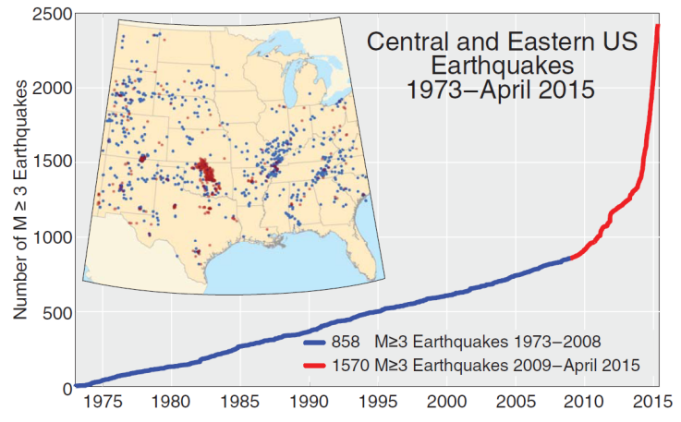
Motivation
Count of M ≥ 3 earthquakes in the central and eastern United States from 1973 to April 2015. Spatial distribution of earthquakes. Red dots represent earthquakes that occurred between 2009 and April 2015, and blue dots represent earthquakes that occurred between 1973 and 2008.¹
Seismicity induced by underground fluid injection attracts a lot of attention of the society and scientific community. This is a result of an increase of the number of induced seismicity cases. To prevent the catastrophic seismic events, so-called “traffic light” principle is used [1]. But using of this principle is not enough. The modeling is required to take into account specific features of a site and main physical processes that take place there
¹Rubinstein Justin L., Mahani Alireza Babaie. Myths and Facts on Wastewater Injection, Hydraulic Fracturing, Enhanced Oil Recovery, and Induced Seismicity // Seismological Research Letters. 2015. jun. Т. 86, № 4. С. 1060–1067.

Slide 4
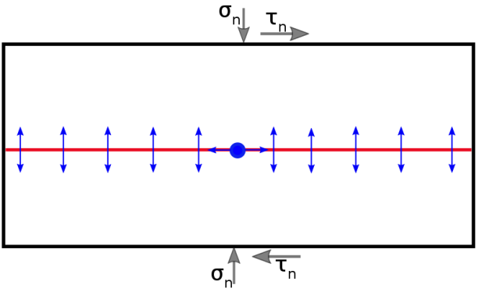
Objectives
We consider a single fault in infinite elastic homogeneous low-permeable medium (like in [F. Cappa et al., 2018]^{.2}) and injection well pass through the fault or located near the fault. By numerical modeling we investigate what is an impact of the different parameters of the model on the fault deformation and slip mode (seismic/aseismic). So our goals are:
Analyze the influence of various parameters of the fault normal stiffness, rock permeability and parameters of friction law on fault deformation if friction is velocity-strengthening (problem 1 – well inject water directly into the fault)
By variation of fault location, friction parameters and geometry of fault friction weakening zone determine conditions which promotes seismic or aseismic slip (problem 2 – well located near the fault)
²Cappa, F., Guglielmi, Y., Nussbaum, C., Birkholzer, J.: On the Relationship Between Fault Permeability Increases, Induced Stress Perturbation, and the Growth of Aseismic Slip During Fluid Injection. Geophysical Research Letters, 45, 11,11–12,20. (2018). doi: 10.1029/2018GL080233

Slide 5
Formulation of the problem 1
The fault is highly permeable, and its permeability increases with growth of the fluid pressure inside it. To link the simulation and the real conditions, we take the bottom hole pressure history from [Y. Guglielmi et al., 2015]³ and elastic modulus and initial fault aperture from [F. Cappa et al., 2018].
We consider simplified uncoupled model of the fluid filtration and stress change due to fluid injection into the fault. Fault slip was calculated with use of Displacement Discontinuity Method.
We use EDFM method to model the fluid filtration inside the fault. The main idea is that grids for matrix and for the fault are created separately, and so, the matrix grid could be structured without refinements. We have implemented EDFM in Matlab Simulation Toolbox (MRST)⁴ with some modifications
The governing equations for the system are the single-phase continuity equation and Darcy’s equation:
$\vec{v}=−\frac{K(p)}{μ}∇p$
$$\frac{∂\left(φ(p)ρ(p)\right)}{∂t}+∇∙\left(ρ\vec{(p)v}\right)={\vec{q}}^{wm}+{\vec{q}}^{fm}$$
For the fault permeability we used cubic law. The hydraulic aperture of the fault varies as a function of the change in effective normal stress (or pressure):
$${ σ}_{n}^{eff}=σ_{n}−P$$
Fracture aperture:
$k_{n}$ - fault normal stiffness
$$a=a_{0}+\frac{∆P}{k_{n}}$$
³Guglielmi, Y., Cappa, F., Avouac, J.-P., Henry, P., Elsworth, D.: Seismicity triggered by fluid injections induced aseismic slip. Science, 348(6240), pp. 1224–1226 (2015). doi: 10.1126/science.aab0476
⁴Lie, K.-A.: An Introduction to Reservoir Simulation Using MATLAB: User guide for the Matlab Reservoir Simulation Toolbox (MRST). SINTEF ICT (2016).

Slide 6
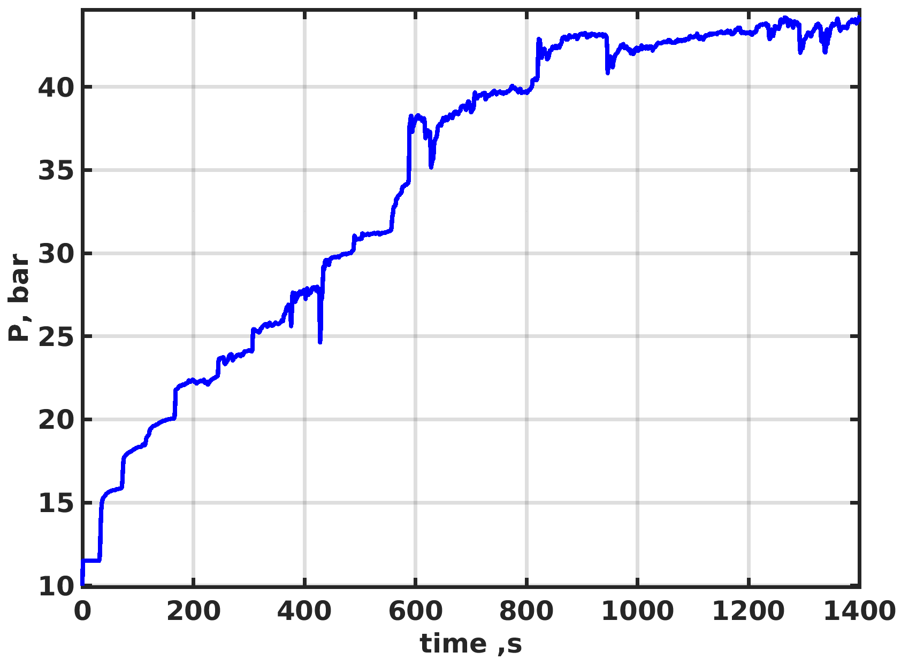
For the slip description, we use a bit more complicated form of the friction law than usually used “classical” one-parameter rate-and-state law, the advantage of the two-parameter form of the rate-and-state law was discussed in [Turuntaev, S.B., Riga, V.Yu., 2018]⁵ :
$$τ_{fr}=τ_{∗}+σ_{n}^{eff}\left(a\ln\left(\frac{\left|v\right|}{v^{∗}}\right)+θ_{1}+θ_{2}+ηv\right)$$
a-(b₁+b₂)>0 – velocity-strengthening behavior of friction
a-(b₁+b₂)<0 and K^{s}<K_{cr} – velocity-weakening behavior of friction
$$\dot{θ_{i}}=−\frac{v}{L_{i}}\left[θ_{i}+b_{i}ln\left(\frac{v}{v_{∗}}\right)\right]$$
The size of the model was $800×200$ m
We considered several cases and changed the matrix permeability from 0 to 2 µD. The initial fault aperture was 9 µm, the shear modulus G was 9 GPa. The normal stiffness of the fault was varied from $8×{10}^{11}$ to $0.25×{10}^{11}$Pa/m, that corresponds to the change of the fault maximum permeability from factor $\sim 2$ to $\sim 2$70. The initial effective normal stress $σ_{n,0}^{′}$ was 4.25 MPa, $μ_{0}$ was 0.6. We used three values of the initial shear stress $τ_{0}$ (1.65, 1.8 and MPa), different values of the friction law parameters: $b_{1}+b_{2}−a=0.002$, $a=0.015$, $\frac{b_{2}}{b_{1}}=1÷10$, $\frac{L_{2}}{L_{1}}=0.5÷10$. When we change $b_{2}/b_{1}$ , we saved the difference $b_{1}+b_{2}−a$.
BHP (relatively to
initial pressure)
⁵Turuntaev, S.B., Riga, V.Yu.: Rate-state based simulation of laboratory and natural-induced seismicity. In: SEG Technical Program Expanded Abstracts, pp. 5002-5006 (2018). doi: 10.1190/segam2018-2998197.1

Slide 7
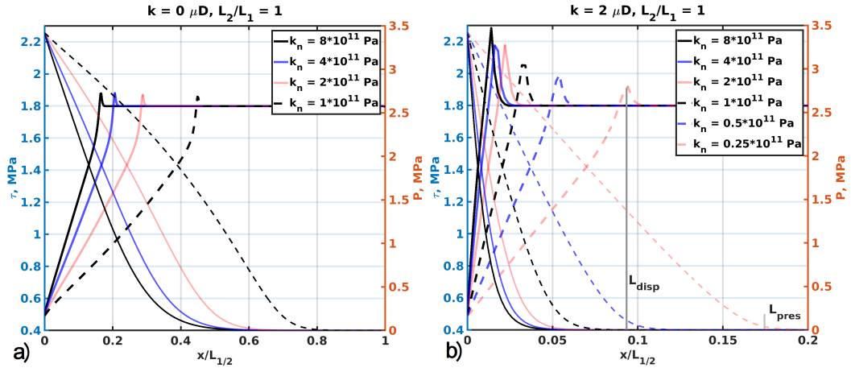
Results (problem 1)
Figure shows how the shear stress changes along the fault at $t=1400 s$ with change of the normal stiffness and permeability. The data indicates that for the impermeable matrix case, the normal stiffness almost doesn’t affect the maximum shear stress. For case of the low-permeable matrix, the growth of the normal stiffness leads to increase of the maximum shear stress and this dependency is more pronounced for larger values of the matrix permeability.
Half-profiles of shear stress and pore pressure along the fault at the end of calculation for different values of normal stiffness and matrix permeability ${(τ}_{0}=1.8 MPa)$: a) impermeable matrix b) low-permeable matrix, positions of the maximum shear stress ($L_{disp}$) and pressure front ($L_{pres})$ are shown by vertical gray lines.

Slide 8
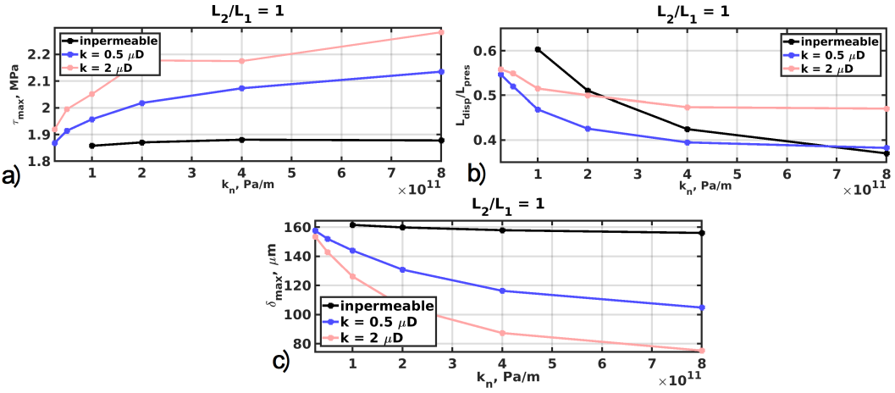
The same behavior could be seen for slip at the center of the fault: for the case of impermeable matrix, the displacement doesn’t depend on the normal stiffness, but there is strong dependence for the case of the low-permeable matrix. Relative location of maximum shear stress depends on the normal stiffness for all cases and mostly for impermeable matrix. Overall dependence of this value on the matrix permeability isn’t linear.
Influence of the fault normal stiffness, matrix permeability ${(τ}_{0}=1.8 MPa)$ on: a) maximum shear stress at the end of the calculations b) relative position of the shear-stress ($L_{disp}/L_{pres}$) c) displacement at the center of the fault.

Slide 9
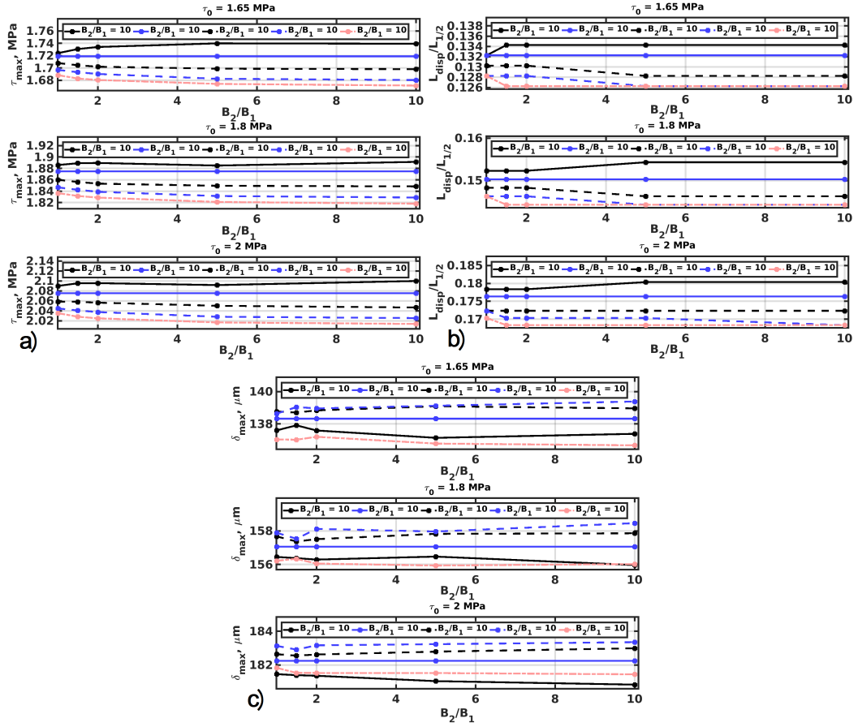
As for friction law, we see that use of the two-parameter law give a little changes to the fault deformation. The ratio of L₂ and L₁ has greatest impact on the fault deformation. Ratio of B₂ /B₁ at the fixed value of their sum has not such a matter. We could expect that these changes would be more pronounced and crucial for cases of the seismic slip than for aseismic one.
Dependences of (a) maximum shear stress, (b) its position relative to the half-length and (c) displacement in the center of the fault on the parameters of the two-parameter rate-and-state law and initial shear stress ($k_{m}=0.5$ µD, $k_{n}=0.5∙{10}^{11}$Pa/m)

Slide 10
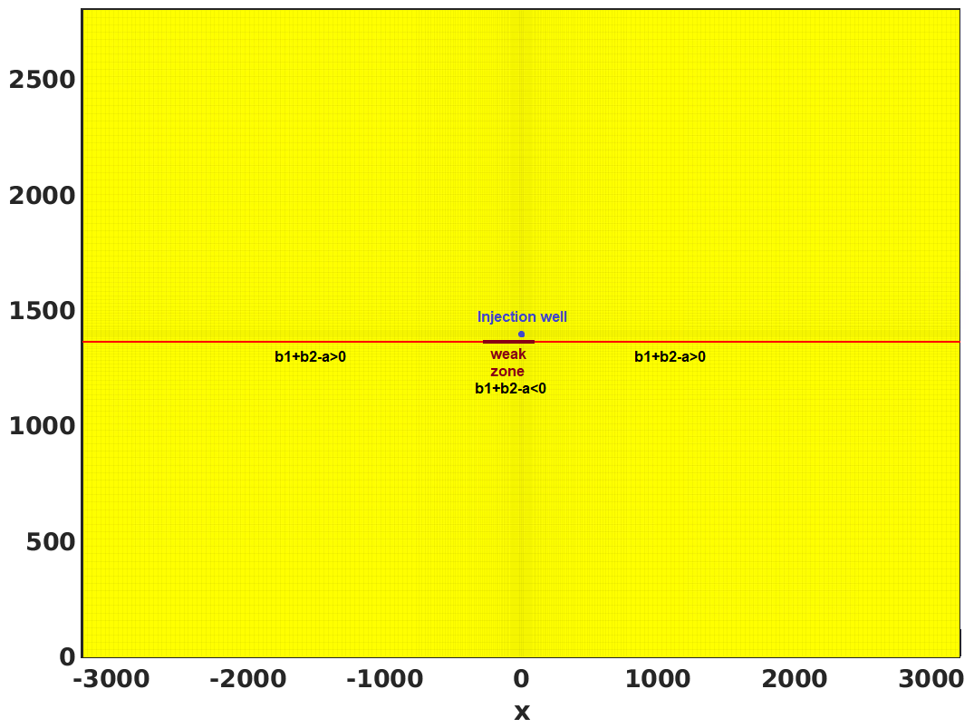
Formulation of the problem 2
Here the fault has weak zone. We vary its location and width. Also we consider different distance from injection well to the fault (dr). For 2-parameter rate and state law we consider several values of b₁+b₂-a and for different relation b₂/b₁ (b₁+b₂ remains constant). Now conditions are close to EGS. Well bottom hole pressure gradually rising to 300 atm (above initial reservoir pressure 400 atm).

Slide 11
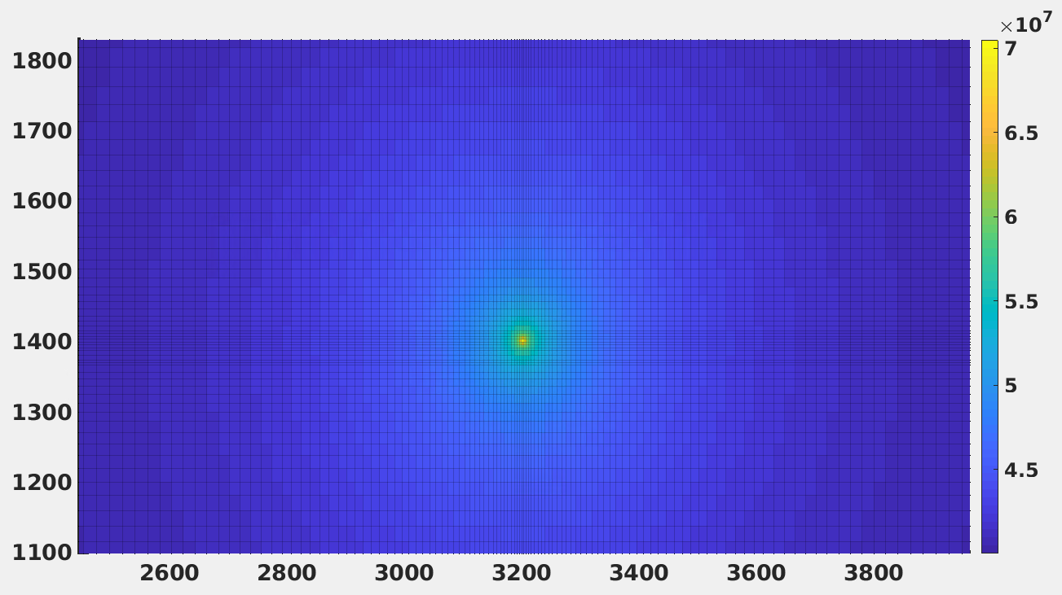
Example of pore pressure distribution (Pa)
Normal stiffness of fault is 5*10⁻¹¹ 1/Pa, fault aperture is 17 µm, rock permeability 1 mD, a=0.0015, L₁=180 µm, L₂= 20 µm. Other parameters vary.

Slide 12
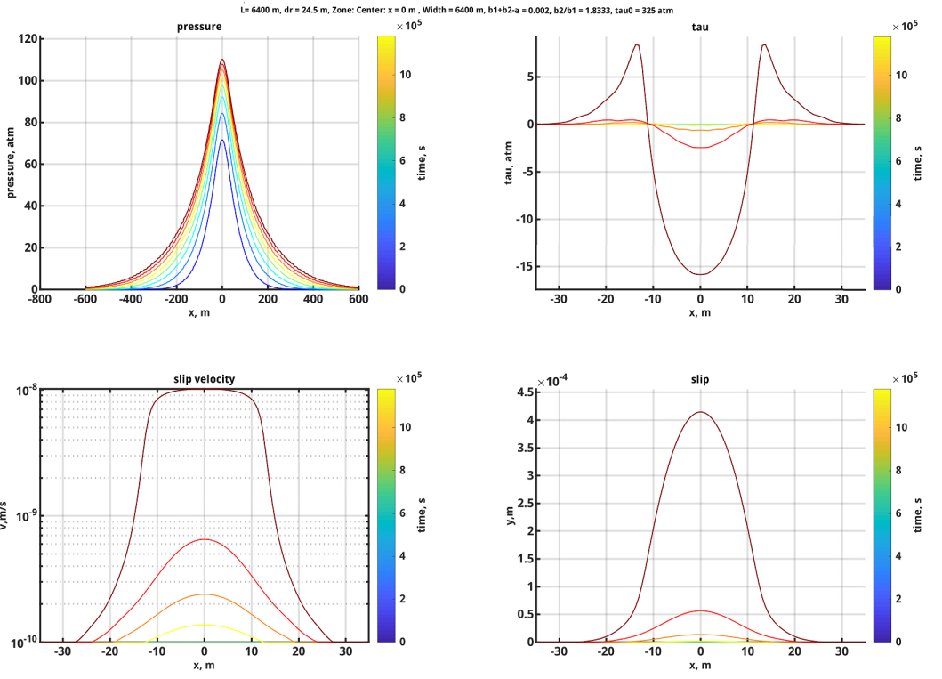
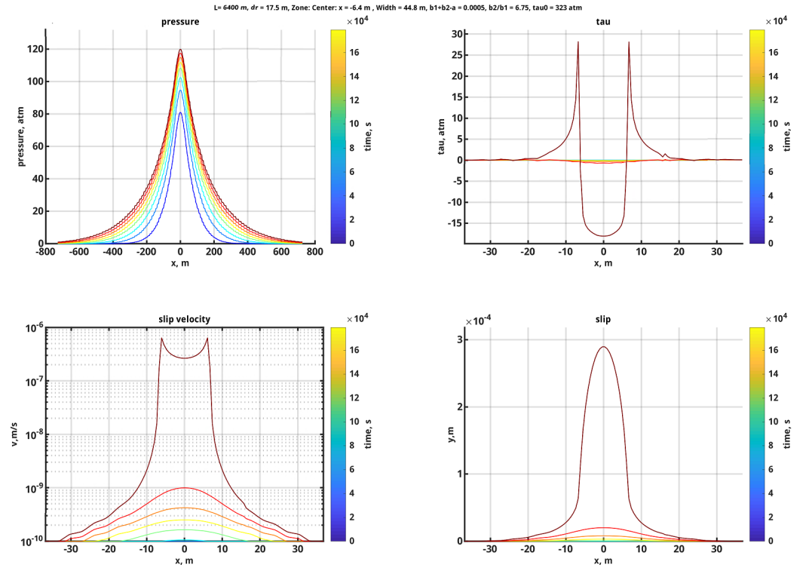
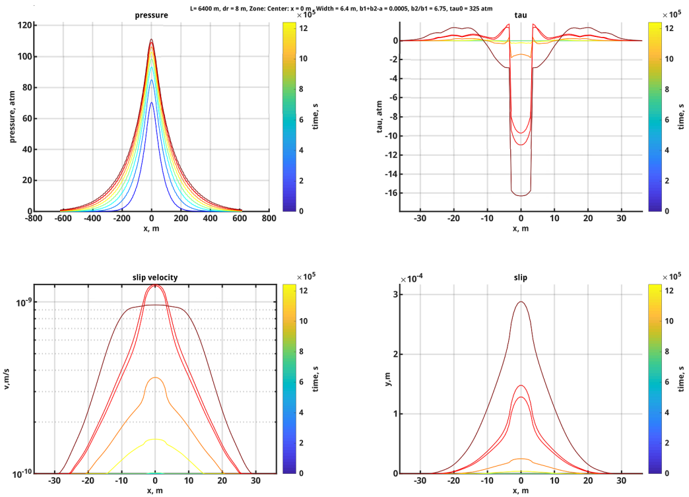
Results (problem 1)
Examples of change of pressure, $dτ$ (shear stress), slip velocity and slip across fault. Color of curve corresponds to time (indicated on color bar). It could be seen, that bigger values of slip velocity lead to concentration of shear stress on slip zone boundary

Slide 13
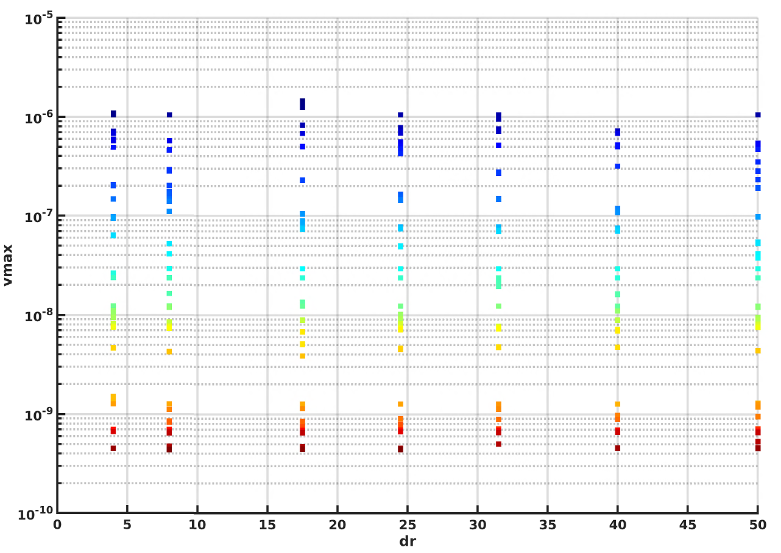
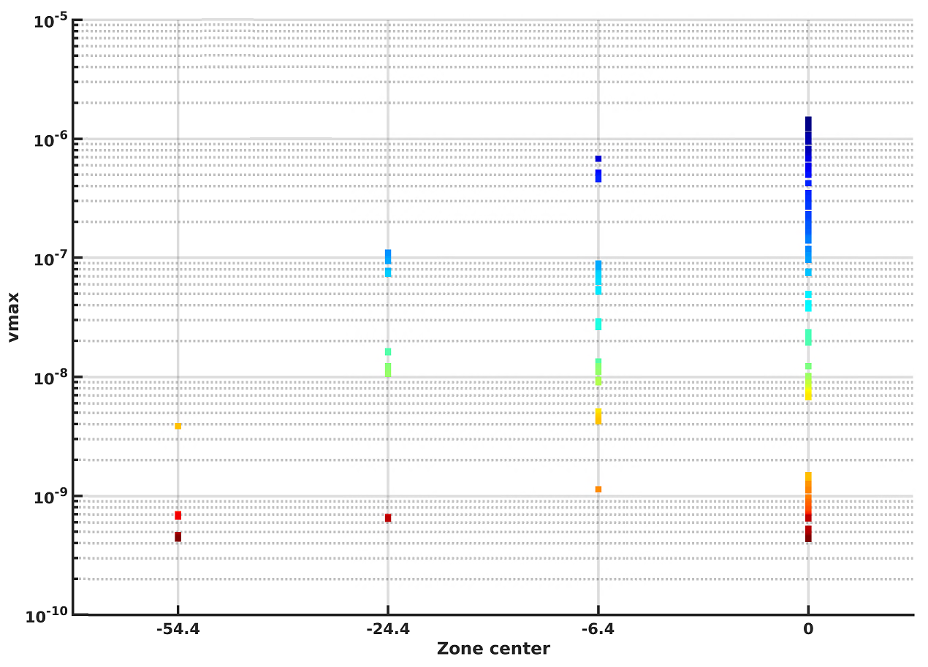
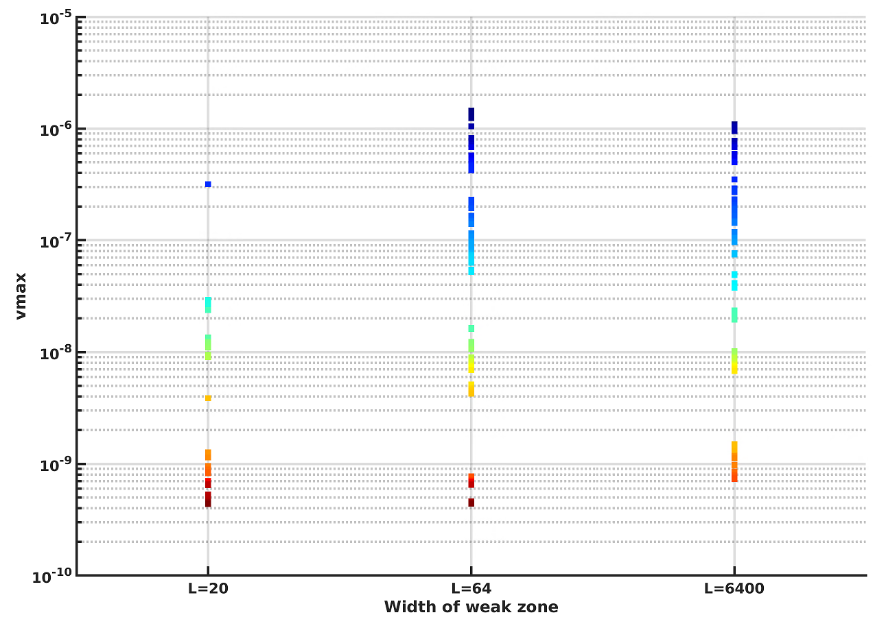
Combined data:
Dependence of maximum slip velocity on distance between the well and the fault (dr), the weak zone center and its width (one set of parameters is one case). The color indicates the case number. There is no influence of dr on fracture velocity. The farther is the weak zone center from x=0, the lesser is maximum velocity. To reach big velocities, the weak zone must be long enough

Slide 14
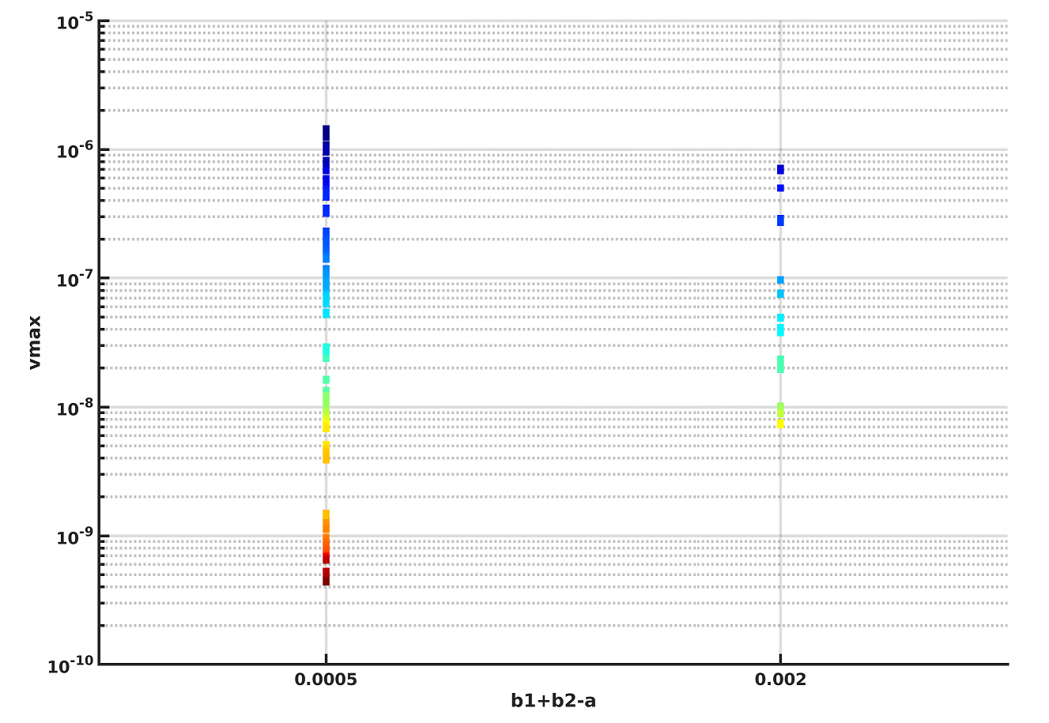
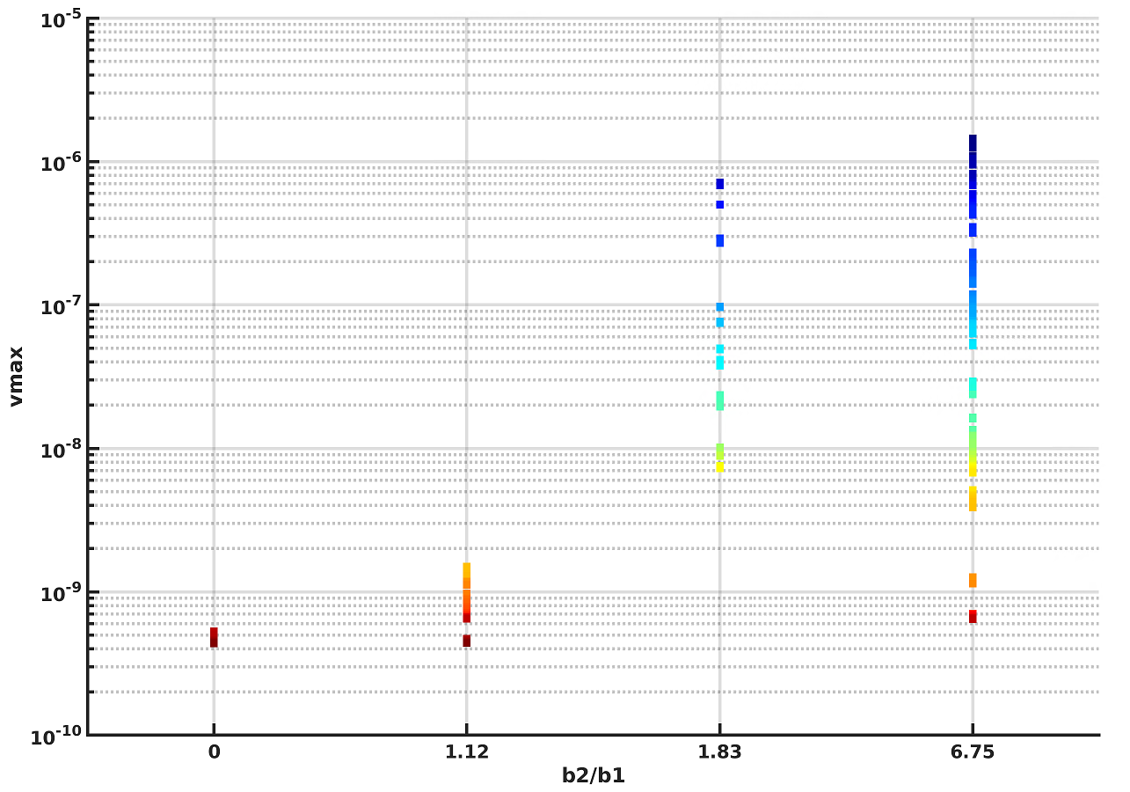
Combined data:
As weak zone become wider, the shear stiffness become lower - that provide unstable fault slip.
Figures on this slides indicates that deviation b₂/b₁ lead to higher slip velocity.

Slide 15
Conclusions
Problem 1. It was shown, that the matrix permeability influences on the dependence of the fault deformation on the normal stiffness. The fault stiffness has greater impact on the position of the slip front relative to the pressure diffusion front for cases where the matrix is less permeable. If we consider the maximum displacement of the fault or maximum shear stress, the behavior is opposite. These differences could be explained by qualitatively different profile of the pore pressure for cases of impermeable and low-permeable matrix. These results could be used for assessment of risks of induced seismicity. For example, it’s relevant for heterogeneous fault where there are less stable parts of the fault in neighboring. We can conclude that for our model the slip is mainly driven by the fluid pressure change.
Problem 2. It was shown that pressure front features do not influence on fault deformation behavior, there is an influence of relative position of weak zone and it’s width on the fault behavior. For now we couldn’t detect cases when the aseismic slip in the center of the fault reached the weak zone and led to a big seismic event. The closer is the weak zone to the center of the fault, the higher is slip velocity. Also, high slip velocity leads to concentration of the shear stress on the border of the slip zone. This situation should be investigated more carefully in the future.

Slide 16
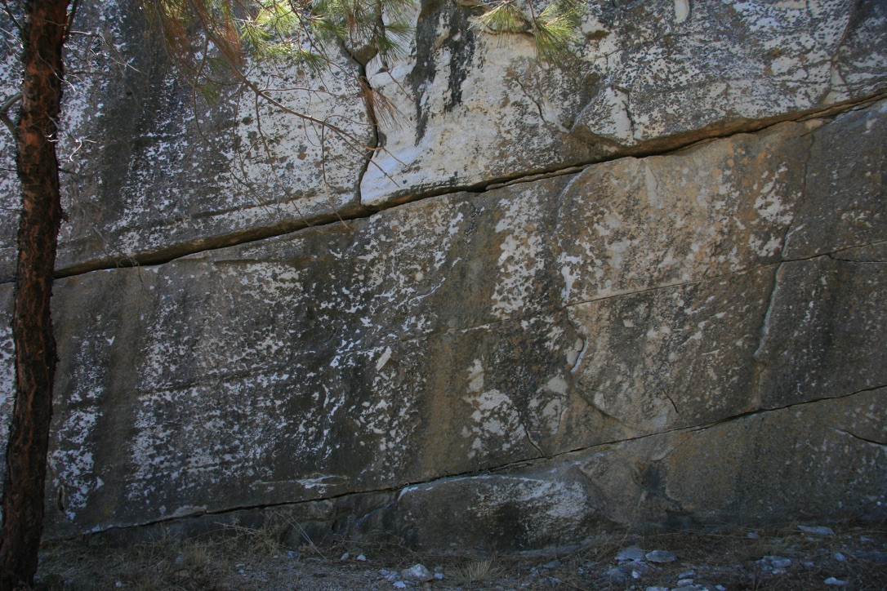
Thank you for your attention
attention

