Slide 1
Storm Xaver over Europe in December, 2013: Impacts on Energy and Societal Infrastructure Anthony Kettle Maynooth, Ireland ake3358@gmail.com
Keywords: Storm Xaver 5-6 December 2013, offshore wind energy, wind gust, significant wave height, tide gauge, meteo-tsunami

Slide 2
Outline
Overview from Internet pictures
Maps of storm impacts
Analysis of tide gauge data
to characterize the storm surge height around the North Sea
to analyze the high frequency component for seiching and wave effects.

Slide 3
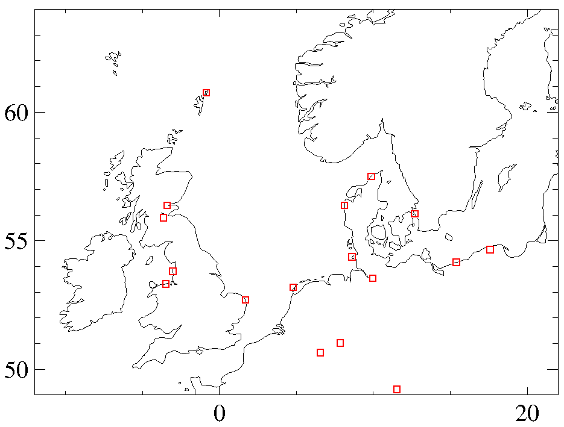
Storm Overview in Media Photos
Send an email for a version of this slide with the Internet media photos included
Photo: flooding of terp hill at Langeness during surge height
Photo: fishing cutter lying on its side on the quay in Thorsminde.
Photo: house over a sand cliff in Norlev Strand
Photo: repair crew fixing power lines in Shetland Islands
Photo: traffic jam in snow in southern Sweden.
Photo: overturned truck on bridge in Perth, Scotland
Photo: two submerged cars on flooded street in Helsingborg.
Photo: fatal accident with large truck blown on its side on two cars.
Photo: fatal traffic accident with large tree blown across car.
Photo: flooding at shoreside in Blackpool
Photo: pine trees lying on a beach after ~10m of coastline was washed away.
Photo: evacuation of people in a Zodiac from a flooded street in Rhyl, north Wales.
Photo: house over sand cliff at Hemsby, Norfolk, UK
Photo: flooded fish market in Hamburg
Photo: container ship Burak Bayraktar in trouble off the coast of Texel.
Photo: Wind turbine in northern Bavaria with blade tip cracked off.
Photo: wind turbine tower cracked off and in a field
Photo: traffic jam in snow in western Germany

Slide 4
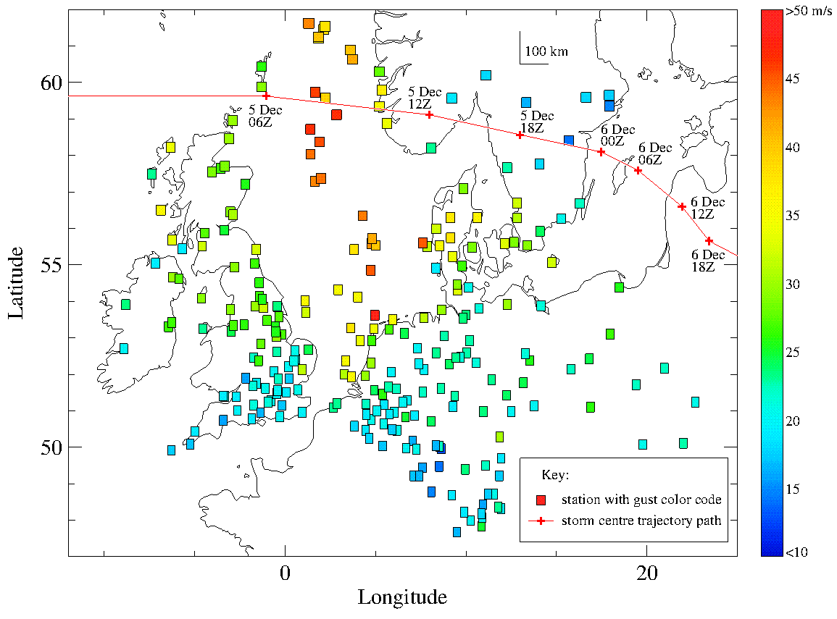
Primary Hazard: Gust
The wind field was the primary hazard associated with the storm, and wind gusts were particularly important. The trajectory of the low pressure center across the north of Scotland, through southern Scandinavia, and into the Baltic Sea led to strong northwest winds on the North Sea. There was a cold air outbreak across the North Sea and into central Europe. The combination of a cold Arctic air mass blowing southward across relatively warm seawater caused intense atmospheric convection, arranged in a pattern of open-cell cloud structures above the North Sea. There were squall lines and gust fronts. Over Germany, thunderstorms, intense rainfall, and snow showers were reported. The map shows the maximum reported gust for the two day period 5-6 Dec 2013 from airports, offshore platforms, and selected meteorological stations from the NCDC database.

Slide 5
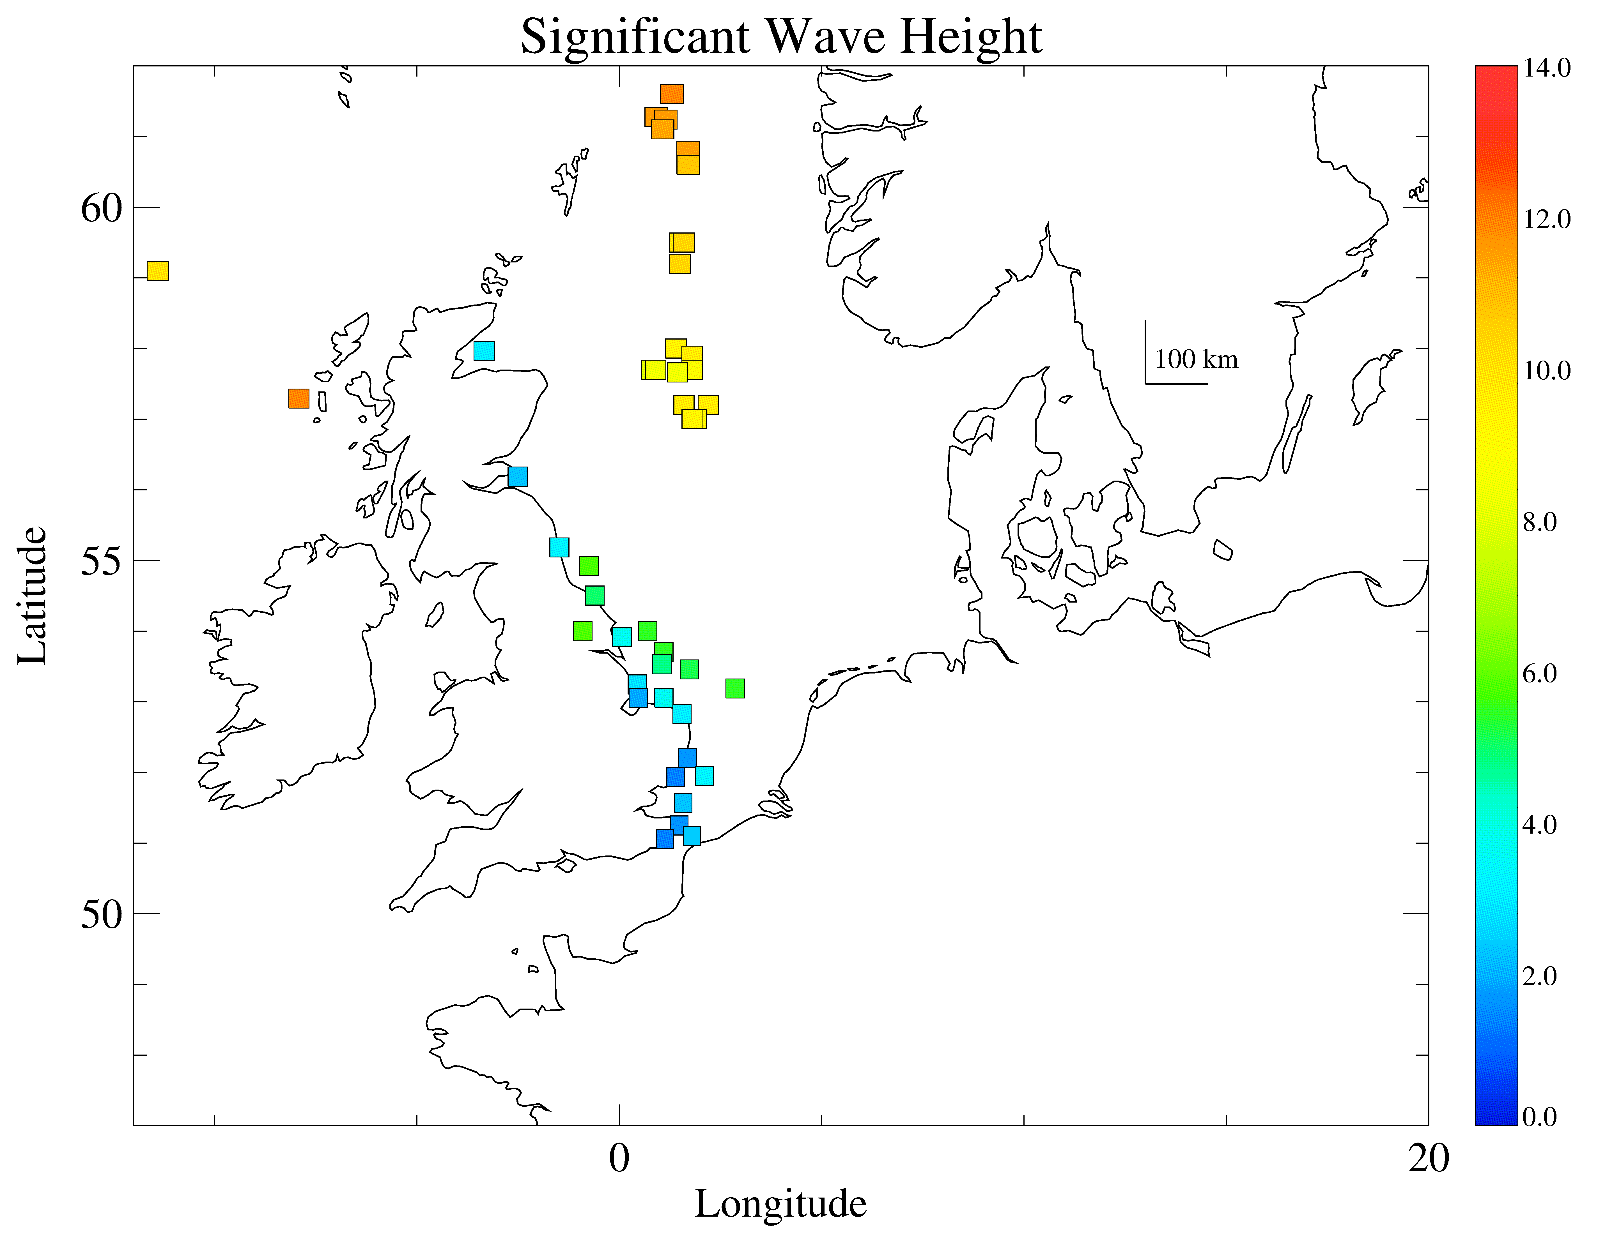
Significant Wave Height
This figure shows maximum measured significant wave heights during Storm Xaver from the CEFAS Wavenet Internet site. Significant wave height describes the severity of sea state conditions and is used to make operational decisions in the maritime sector. During Storm Xaver offshore significant wave heights exceeded 12 m in the North Sea area. Petroleum companies use a wave threshold of about 10 m to make decisions on the evacuation of offshore platforms in the central North Sea. For near shore wind farms, the threshold significant height for access and maintenance of turbines is lower.

Slide 6
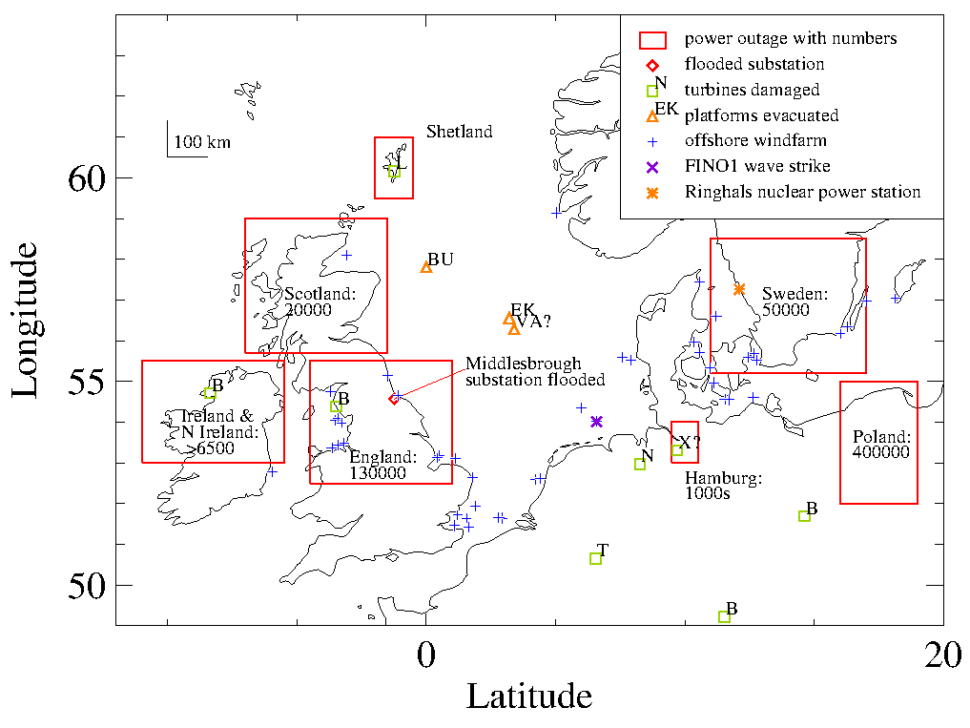
Energy Meteorology Impacts
Media reports indicate that the storm impacted different sectors of the energy industry:
Power Outages: There were large scale power outages in northern Europe affecting hundreds of thousands of people over large regions. The map shows the impacted regions outlined in red with labels indicating the number of houses/businesses affected. Most of this appears to have been due to winds and tree falls. However, coastal flooding of a power substation in Middlesbrough in the UK caused a power outage for an area of northeast England.
Wind Energy. There were a number of onshore turbine failures in northwest Europe (green squares). The damage included broken turbine blades (B), fallen nacelle (N), an exploded nacelle (X), a turbine tower cracked off (T) , and a lightning strike on a blade (L). No damage was reported for the offshore wind farms in the North Sea, Irish Sea, and Baltic Sea (shown as blue crosses). However, the German wind energy research tower FINO1 was damaged at a height of 15m above sea level, possibly by extreme waves.
Petroleum. There were some petroleum platform evacuations ahead of the storm and associated decrease of production (orange triangles). Media reports focused on the evacuation of Buchan Alpha (BU), an older floating production platform in the UK sector. Trade journals indicated that Ekofisk (EK) was partially demanned, and possibly also Valhall (VA?).
Nuclear Power. Most of the 1600 employees of the Ringhals nuclear power station (orange star) in Sweden were sent home at the height of the storm, leaving a reduced staff of 100 people to maintain operations.
Post-storm analysis reports indicate that the storm had mixed benefits for the wind energy industry. The powerful wind field led to a new record for onshore and offshore wind energy generation for Germany. On the other hand, the wind speed over the North Sea was above the 25 m/s turbine cutoff threshold for a period of time during the storm, so wind farms were shut down for safety reasons (Christakos et al, 2016). The problem mostly did not impact Baltic Sea where the wind speeds were lower. Using data from the FINO offshore platforms, Leiding et al. (2014) noted incidents where the measured winds exceeded the wind turbine design limits.

Slide 7
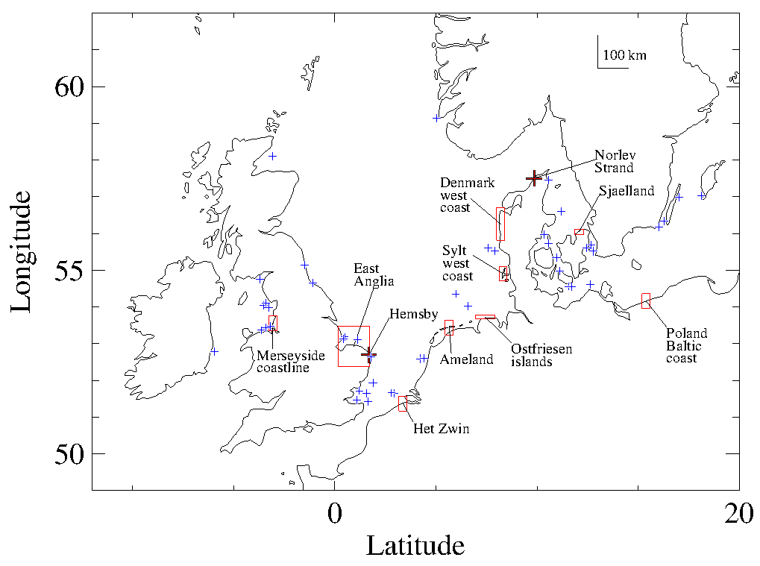
Shoreline Erosion
Enhanced shoreline erosion was noted at a number of locations around the southern North Sea and also in the Baltic Sea and Irish Sea. The coastlines of large parts of eastern England, Belgium, the Netherlands, northern Germany, Denmark, Poland are consist of sand dunes, gravel cliffs, and soft geological structures. During Storm Xaver coastline retreat of 10-20m or more was reported at a number of locations. At Hemsby in the UK and Norlev Strand in Denmark, a number houses fell over eroding gravel cliff faces. The enhanced erosion was caused by waves acting to undermine the cliff foundations during the high storm surge sea levels. Erosion was not homogeneous along the coast, and coastline retreat was more pronounced in some areas compared with others. This may highlight problems with the inhomogeneous spatial concentration of wave energy and infragravity waves.
The issue is relevant to offshore wind energy where offshore structures must be designed withstand storm wave loads. Extreme waves during North Sea storms are poorly characterized and documented, but reports of wave impact damage to shipping and offshore platforms during winter storms are not uncommon. The map shows that areas where pronounced coastal erosion was noted (red squares) were in many cases close to offshore wind farms (blue crosses), focusing attention on the wave field at these sites.
Coastal erosion and the attendant problem of the bottom sediment transport are also linked with bottom scour issues that are important for offshore wind energy . Most offshore wind farms in the region have been constructed on a sand or gravel sea bed, and there have been reports of bottom scouring uncovering and exposing power transmission cables.

Slide 8
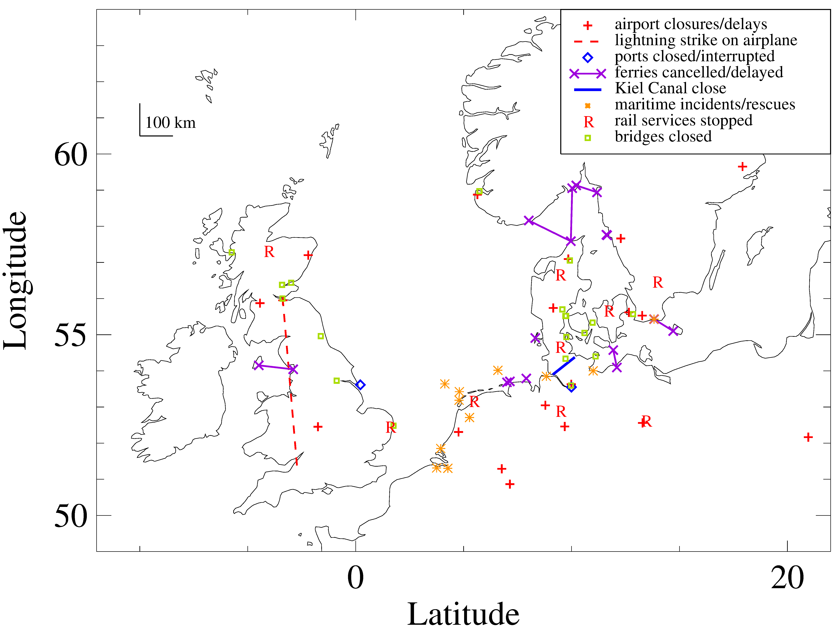
Transportation Networks
Transportation networks were impacted by the storm. High winds caused flight delays and cancellations at airports in Great Britain, the Netherlands, Germany, and Scandinavia. There was one instance of a lightning strike on a commercial airliner flying between Bristol and Edinburgh in the UK. Train services were also interrupted mostly by strong winds blowing trees and objects onto the tracks. In eastern England, rail services to Lowestoft were stopped by storm surge flooding of the rail line. Many major road bridges were closed by high winds across the region.
Storm surge flooding caused an interruption of port operations in Hamburg and Immingham in the UK. The Kiel Canal was closed by high water levels at the locks at the end of the canal in Holtenau and Brunsbuettel. Extreme weather conditions forced the delay or cancellation of a number of ferry services in the North Sea, Baltic Sea and Irish Sea.
For offshore wind energy, the transportation impacts of the storm are important for two reasons. First, access and maintenance of the offshore wind turbines would not have been possible during the storm. Secondly, the maritime incidents and accidents that occurred in proximity to offshore wind farms may have been due to rogue waves or unusual sea state conditions that would have also caused fatigue loading of the turbines.

Slide 9
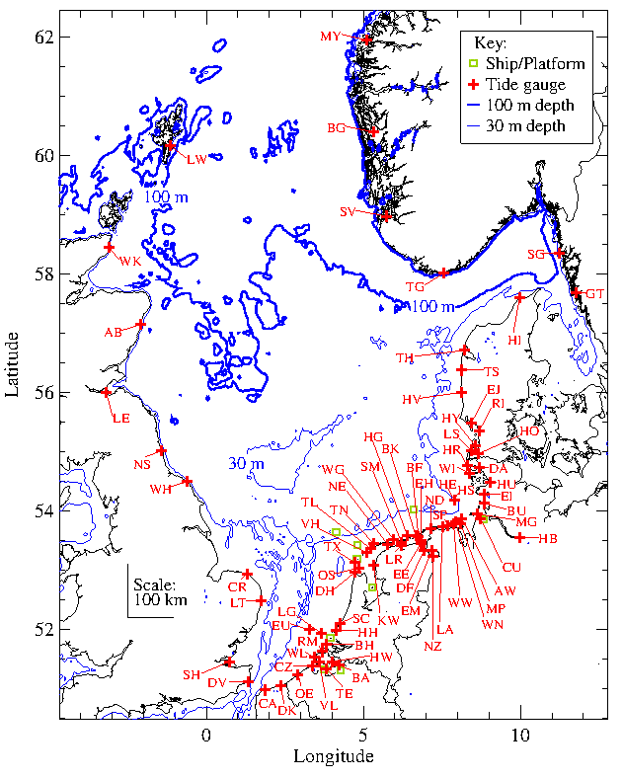
Tide Gauge Analysis of Storm Surge (1)
Tide gauge records for 77 stations around the North Sea were analyzed for this study. The time series records originated from the measurement archives of national water level monitoring agencies. The data files were downloaded from the Internet sites of the national agencies (United Kingdom, Netherlands, Denmark, Norway) or from other data websites (GESLA, International Oceanographic Commission), or obtained email contact (BAFG, Germany). Other water level data were available from the Channel Coastal Observatory and Norwegian offshore petroleum platforms but were not included in this study because of data gaps or other quality problems.
The water level measurements were mostly provided at 10-minute resolution except for Germany (1-minute resolution), the UK (15 minute resolution), and the GESLA stations for France (1-hour resolution). The 1-minute water level data for Germany were averaged on the 10-minute grid to facilitate analysis. The data were checked for outliers and instrumental problems, and short data gaps were interpolated. A preliminary analysis revealed a short list of stations that could not be used in the analysis because of more serious data problems. Notably, the Immingham tide gauge malfunctioned because of quayside flooding during the storm surge.

Slide 10
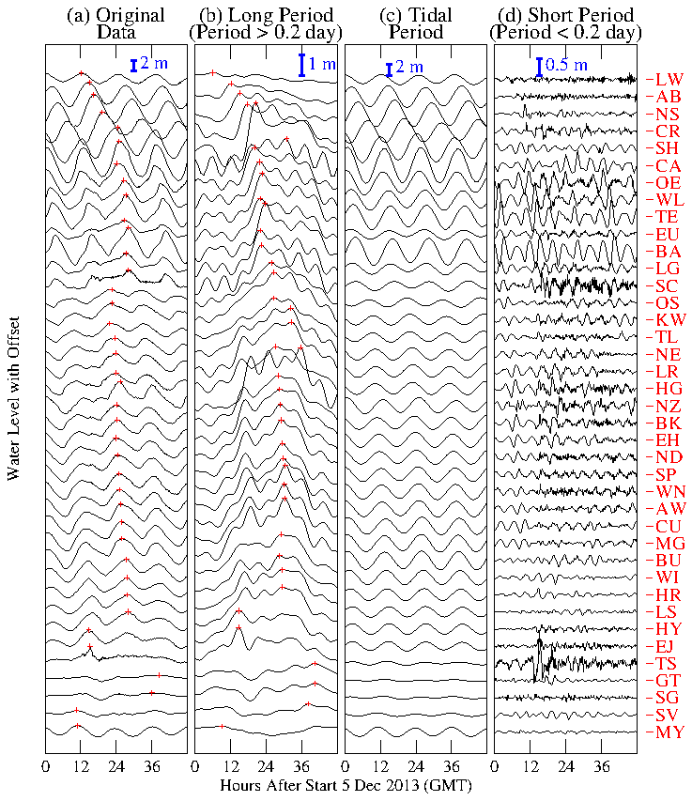
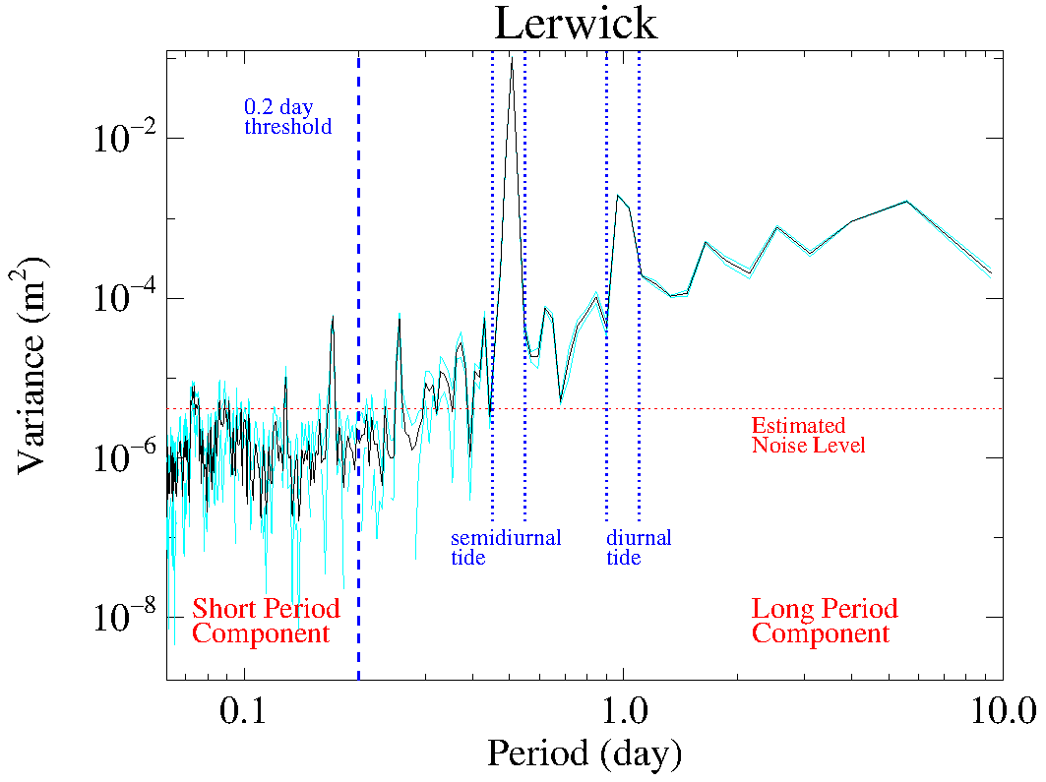
Tide Gauge Analysis of Storm Surge (2)
The tide gauge water level records were decomposed into their different characteristic periods corresponding to their semi-diurnal and diurnal tidal components, a long-period component >0.2 days (except tides), and a short period component < 0.2 days (see graph at right).
This was done using a spectral decomposition of a two week data segment across the period of the storm, followed by a time series reconstruction. A discrete Fourier transform was conducted for each station, giving spectra similar to the example for Lerwick (below). The spectra reveal that the time series data have dominate characteristic periods of the semi-diurnal and diurnal tides, as well as a longer period component mostly >1 day that make up most of the storm surge signal. Spectral peaks with periods <0.5 days may be tidal harmonics (pronounced in shallow water areas of the southern North Sea) or harbour seiches. The spectral graph was used to assess thresholds for the different component elements of the time series reconstructions.
Plots of the reconstructed time series data for the different stations around the North Sea reveal the relative magnitude of the water level components and their phase relationships. For example, the tidal wave propagates counterclockwise around the North Sea starting from Scotland. The tidal range is high in the Germany Bight and low in northern Denmark. The long-period component has a propagation characteristic that is similar the tidal wave, moving counterclockwise around the North Sea. However, this is complicated by the direct sea level response to the direct wind forcing from the northwest, especially in the German Bight. The short period component of the tide gauge record differs regionally among stations and may correspond to higher order tidal harmonics, seiching effects, or a meteo-tsunami.

Slide 11
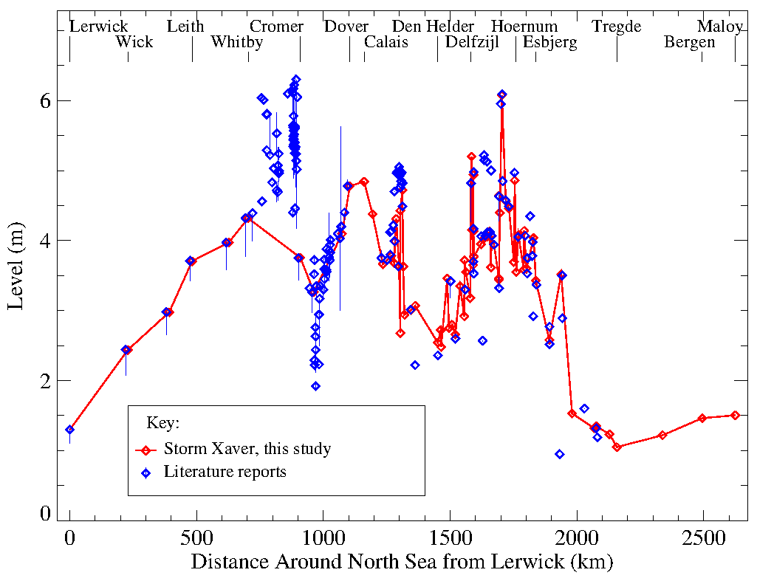
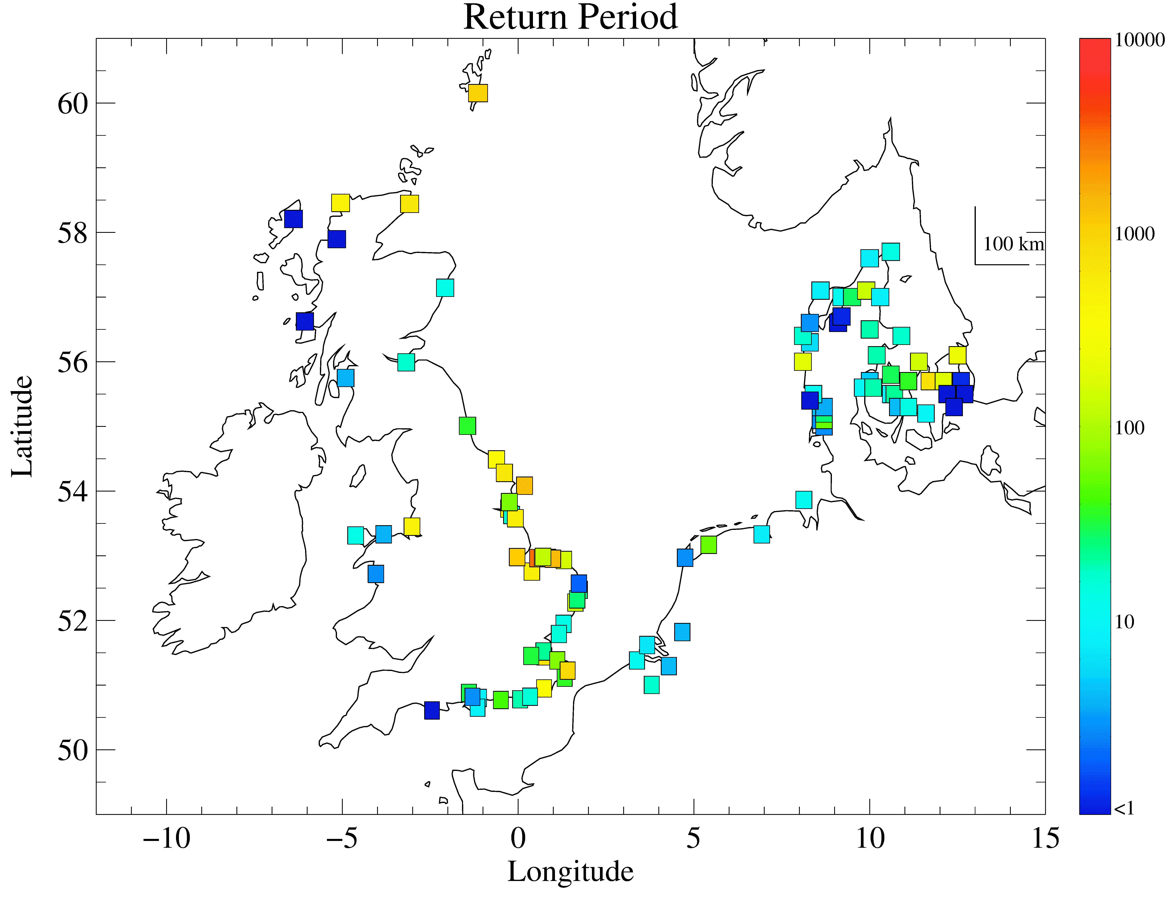
Coastal Flood (1): Measured Water Levels
Water levels reached over 6 m above mean sea level during Storm Xaver, along the North Norfolk coast and in the German Bight (right). Data collected during coastal surveys along the Norfolk coast soon after the storm revealed significant water level differences across short distances. This highlights the potential importance of wave run-up effects and spatial inhomogeneity in the concentration of wave energy.
The absolute water levels around the North Sea (shown at right) are difficult to interpret without extra information on the expected high tide, as this varies significantly around the North Sea. A more important metric to assess the importance of the storm surge is the return period of the observed maximum water levels (shown below). For several the places in on the east coast of England and in the German Bight measured water levels exceeded all previous measurement records. Extrapolating existing database records for past storm water levels enabled return periods to be assessed at approximately 1000 years for some locations for Storm Xaver. Coastal protection structures are normally designed for a hundred year event (e.g., in the UK and Denmark). Water levels exceeded these thresholds during the storm, and there were reports of flood defenses being overwhelmed.

Slide 12
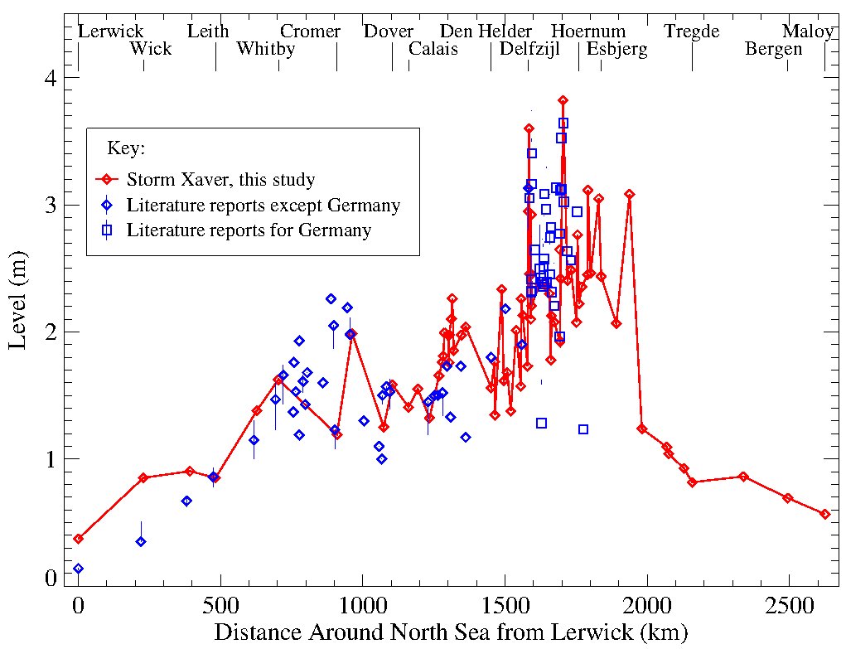
Coastal Flood (2): Skew surge
The skew surge (shown at right) is the difference between the maximum water levels during the storm surge and the expected tidal maximum as calculated from a tidal model. It is the metric that is most commonly reported in the media. . (Note in Germany, measured maximum water levels are expressed relative to a long-term average of high tide levels, so that a correction must be applied to estimate the skew surge for Storm Xaver)
The results show that some locations in the German Bight experienced skew surges approaching 4 m. There are also large differences in the skew surge for near lying stations along the coastline of the Netherlands and Germany. The skew surge information supports media reports of quayside flooding across North Sea and the interruption of operations at certain ports.

Slide 13
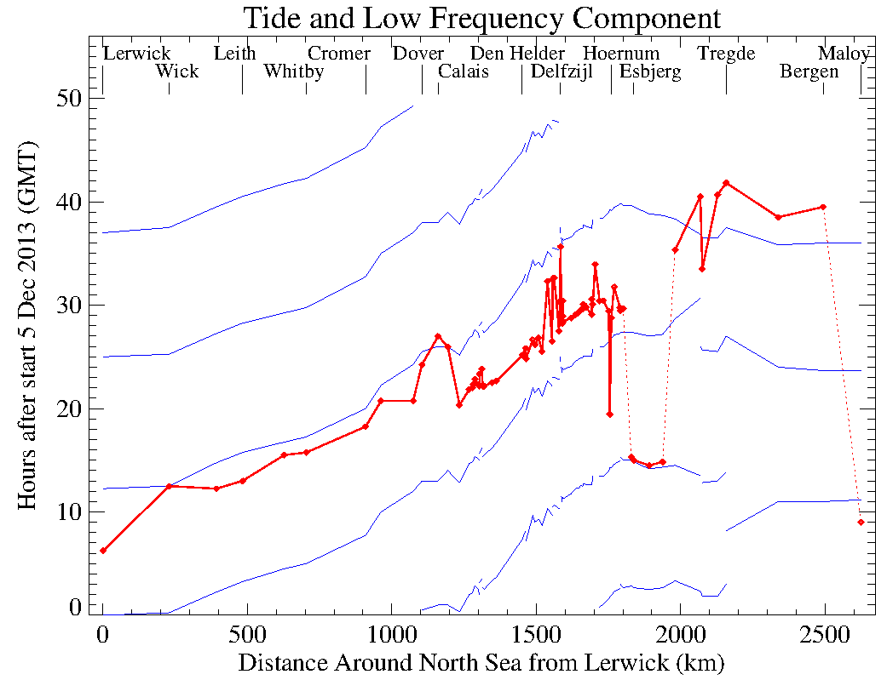
Travelling Surge and Tide Waves
Because the tides and storm surge travel as long waves counter-clockwise around the North Sea coast starting from Scotland, the progression of the wave crests can be displayed on axes of time versus coastal distance from Lerwick (see figure right). The dominant tide is semidiurnal so that a sequence of the tidal waves appear and propagate over the two day period 5-6 Dec 2013 across the height of the storm (blue lines on the figure). Their propagation speed along the east coast of England is approximately 20 m/s.
The dynamics of the travelling storm surge crest is more complicated (red line on the figure). Along the east coast of England, it travels closely with the semidiurnal tide, preceding it. Along the coast of the Netherlands, the phase relationship between the surge crest and semidiurnal tide changes, and the surge maximum is associated with the tidal minimum. Along the west coast of Denmark, the storm surge crest arrived just after mid-day on 5 Dec 2013, on a different tidal cycle from flooding events in the German Bight tide peak.
The features highlight that the maximum water levels during the storm surge are caused by the interaction of the travelling or ‘external’ surge moving counter clockwise around the North Sea and the direct effect of the surge ‘set-up’ caused by the strong northwest winds acting over long distances across the North Sea.

Slide 14
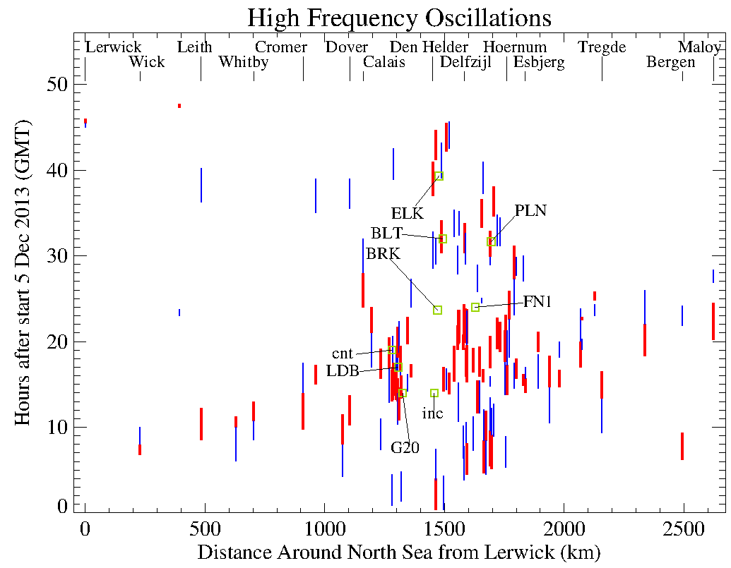
Offshore Incidents & Tide Gauge Signal
The tide gauge data show interesting short period (i.e., less than 4.8 h) features that are more pronounced during the height of the storm. Statistics of the short period characteristics were formulated in the same way as surface gravity waves: assessing the minimum, maximum, and range of each oscillation during the two day storm period and its associated time and duration. The figure shows the start and end times of the oscillations with highest (red bar) and second highest (blue bar) range versus counter-clockwise distance around the North Sea. These large oscillations mostly occur in association with the tidal wave and storm surge peaks. They may reflect higher order tidal components, harbor seiches, meteo-tsunamis, and/or other met-ocean dynamical features.
The maritime accidents that were reported during the storm (green squares) are in many cases associated with the highest short period oscillations. Because, the range of the highest short period oscillations is on the order of a meter, they would not represent the direct geophysical cause of the maritime accidents. However, the high oscillations might represent a sea level dynamical response to unusually high wind gusts or sea state. In the maritime incident reports, wave impact was only suggested for the damage on the FINO1 research tower. However, the mechanical problems and mooring failures for some of the other accidents may indicate difficult environmental conditions.
The issue is important for offshore wind energy as the maritime accidents happened in proximity to offshore wind farms. Fatigue damage to turbines accrues disproportionately during extreme met-ocean conditions.

Slide 15
Conclusions
The presentation gives a summary of a literature review for Storm Xaver 5-6 Dec 2013.
Environmental data from the storm are presented: wind speed, significant wave height, tide gauge data.
Tide gauge data are analyzed in closer detail for the storm surge and short period oscillations.
Storm Xaver had impacts on energy meteorology, and the characterization of met-ocean conditions is important for offshore wind energy.

Slide 16
References and Further Reading
Brooks SM, T Spencer, A McIvor, I Moller, Reconstructing and understanding the impacts of storms and surges, southern North Sea, Earth Surface Processes and Landforms, 41, 855-864, 2016.
Brooks, SM, T Spencer, EK Christie, Storm impacts and shoreline recovery: Mechanisms and controls in the southern North Sea, Geomorphology, 283, 48-60, 2017.
Caithness Windfarm, craigdr, Detailed accidents to 31 December 2015. Document time stamp 5Jan2016, 175pp
Christakos K, I Cheliotis, G Varlas, G-J Steeneveld, Offshore wind energy analysis of Cyclone Xaver over North Europe, 13th Deep Sea Offshore Wind R&D Conference, EERA DeepWind'2016, 20-22 January 2016, Trondheim, Norway, Energy Procedia, 94, 37-44, 2016.
Deutschlander T, K Frierich, S Haeseler, C Lefebvre, Orkantief XAVER ueber Nordeuropea von 5. bis 7. Dezember 2013, Deutscher Wetterdienst DWD, Stand 30. Dezember 2013, 19pp.
FINO1, 15-m wave damaged FINO1, 08Jan2014. http://www.fino1.de/meldungen/alle-meldungen/137-15-meter-welle-beschaedigt-fino1
Kettle AJ, The North Sea surge of 31 October-1 November 2006 during Storm Britta, Advances in Geosciences, 45, 273-279, 2018.
Kettle AJ, Storm Tilo over Europe in November 2007: storm surge and impacts on societal and energy infrastructure, Advances in Geosciences, 499, 187-196, 2019.
Kunz M, B Muehr, K Schroeter, T Bessel, S Moehrle, T Muenzberg, S Brink, H-M Schmidt, Winterstorm Xaver - Report. 06Dec2013 - Report No.1, Situation Report - 19:00CET, CEDIM Forensic Disaster Analysis Group (FDA), Center for Disaster Management and Risk Reduction Technology.
Leiding T, B Tinz, G Rosenhagen, C Lefevre, S Haeseler, S Hagemann, I Bastigkeit, D Stein, P Schwenk, S Mueller, O Outzen, K Herklotz, F Kinder, T Neumann, Meteorological and Oceanographic Conditions at the FINO platforms during the severe storms Christian and Xaver, DEWI Magazin, No.44, p16-25, 2014.
RWS, Stormvloedrapport van 5 t/m 7 december (SR91) Sint-Nicolaasvloed 2013, Watermanagementcentrum Nederland, Rijkswaterstaat, prepared by Ing. J. Kroos, 19 Mar 2014b, 48 pp
Spencer, T, S.M. Brooks, I. Moller, B.R. Evans, Where local matters: Impacts of a major North Sea storm surge, EOS, 95, 269-270, 29July2014
Spencer T, SM Brooks, BR Evans, JA Tempest, I Moeller, Southern North Sea storm surge event of Dec.5, 2013: Water levels, waves, and coastal impacts, Earth Science Reviews, 146, 120-145, 2015.
Wadey MP, JM Brown, ID Haigh, T Dolphin, P Wisse, Assessment and comparison of extreme sea levels and waves during the 2013/2014 storm season in two UK coastal regions, Nat. Hazards Earth Syst. Sci. Discuss., 3, 2665-2708, 2015b.

Slide 17
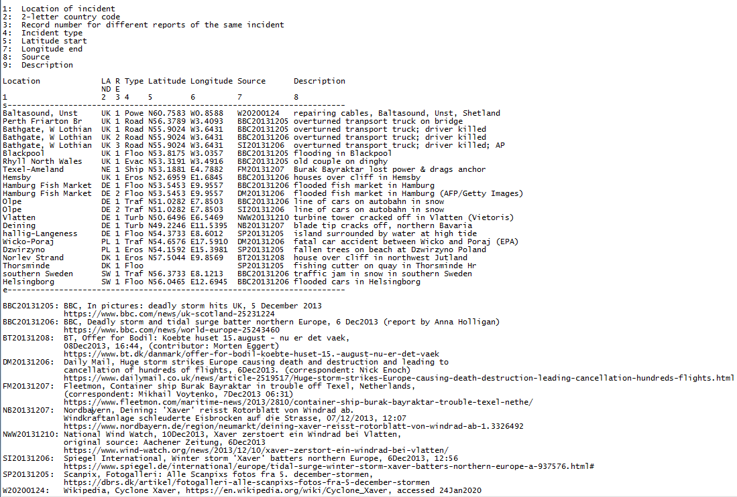
Internet photo sources

