Slide 1
Temporal impact of wildfires on PM₁₀ and human mortality in Portugal
Tarín-Carrasco, P.¹, Augusto, S.^{2,3}, Palacios-Peña, L.¹, Ratola, N.⁴ and Jiménez-Guerrero, P. ^{1,5}
1. Physics of the Earth, Regional Campus of International Excellence “Campus Mare Nostrum”, Campus de Espinardo, University of Murcia, 30100 Murcia, Spain.
2. EPIUnit - Instituto de Saúde Pública, Universidade do Porto, Porto, Portugal.
3. Centre for Ecology, Evolution and Environmental Changes, Faculdade de Ciências, Universidade de Lisboa (CE3C-FC-ULisboa), Lisboa, Portugal.
4. LEPABE-Laboratory for Process Engineering, Environment, Biotechnology and Energy, Faculty of Engineering, University of Porto, Rua Dr. Roberto Frias, 4200-465 Porto, Portugal.
5. Biomedical Research Institute of Murcia (IMIB-Arrixaca), 30120 Murcia, Spain.
Contact: pedro.jimenezguerrero@um.es
patricia.tarin@um.es
Wednesday 6 May 2020

Slide 2
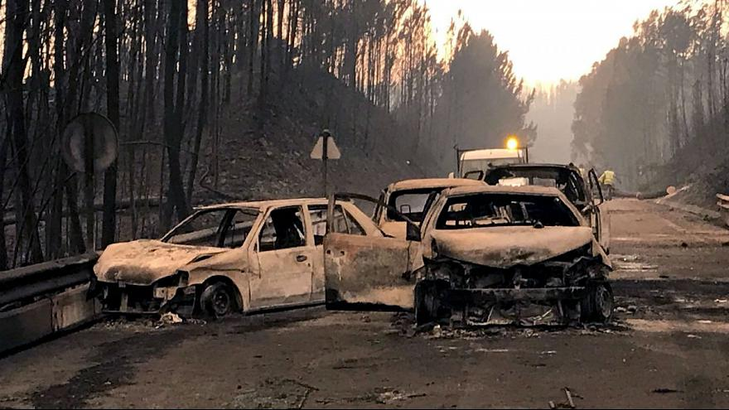
Background
Climate Change
Wildfires
Air Pollution
Impacts on Human Health??
Particulate Matter (PM)
Sulfur Dioxide (SO₂)
Nitrogen Dioxide (NO₂)
Ozone (O₃)
Carbon Monoxide (CO)
Microcontaminants
…
Wildfire in June 2017 in Pedrógão Grande (Portugal)
Notes:
2

Slide 3
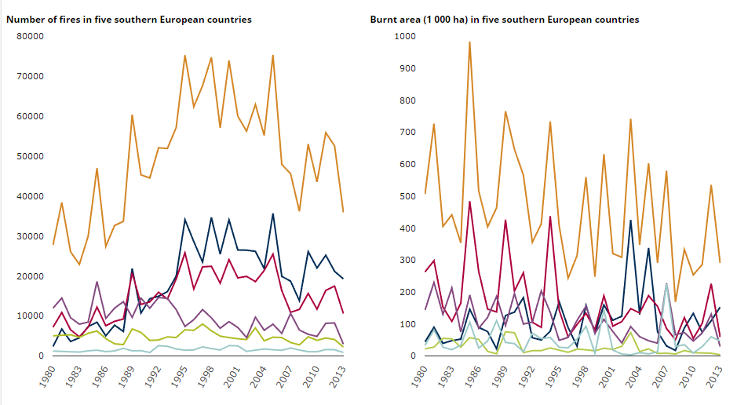
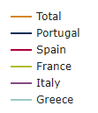
Background
Portugal is one of the countries most affected by wildfires in Europe
Data from the European Environmental Agency
Notes:
3

Slide 4
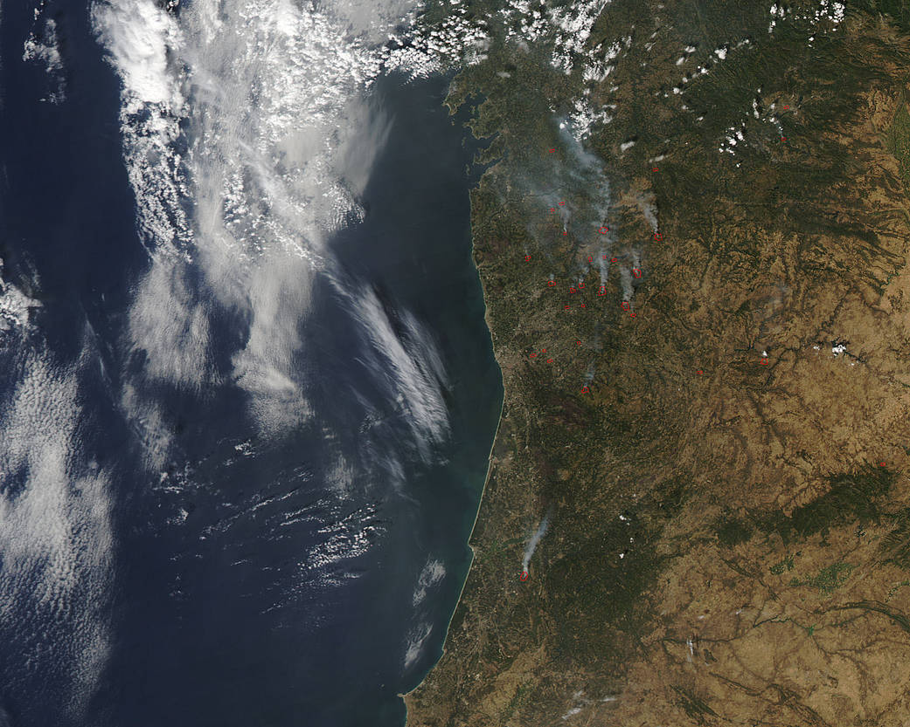
Background
In 2016…
217000 ha have burned in Europe
116000 ha in Portugal
Image from NASA: This natural-color satellite image was retrieved by the Moderate Resolution Imaging Spectroradiometer (MODIS) on-board the Aqua satellite on Sept. 06, 2016.
Notes:
4

Slide 5
Background
Year | BA total (ha) | Occurrences BA >1000 ha | BA >1000 ha | %BA >1000 ha | BA/Occurrences (>1000 ha)
2016 | 160458 | 22 | 85166 | 53 | 3871
2015 | 64978 | 8 | 16886 | 26 | 2111
2014 | 21114 | 3 | 6451 | 31 | 2150
2013 | 156688 | 26 | 71391 | 46 | 2746
2012 | 116204 | 11 | 48035 | 41 | 4367
2011 | 74686 | 6 | 9102 | 12 | 1517
2010 | 138797 | 25 | 60738 | 44 | 2430
2009 | 90541 | 9 | 21467 | 24 | 2385
2008 | 17393 | 0 | 0 | 0 | 0
2007 | 34036 | 2 | 6203 | 18 | 3102
2006 | 79536 | 7 | 21197 | 27 | 3028
2005 | 344554 | 61 | 172723 | 50 | 2832
2004 | 148194 | 32 | 75168 | 51 | 2349
2003 | 470617 | 81 | 375783 | 80 | 4639
2002 | 129731 | 17 | 30786 | 24 | 1811
2001 | 116706 | 21 | 34856 | 30 | 1660
During the studied period big differences on burned area for the studied period have been found
* BA→ Burned Area
Notes:
5

Slide 6
Background
Year | BA total (ha) | Occurrences BA >1000 ha | BA >1000 ha | %BA >1000 ha | BA/Occurrences (>1000 ha)
2016 | 160458 | 22 | 85166 | 53 | 3871
2015 | 64978 | 8 | 16886 | 26 | 2111
2014 | 21114 | 3 | 6451 | 31 | 2150
2013 | 156688 | 26 | 71391 | 46 | 2746
2012 | 116204 | 11 | 48035 | 41 | 4367
2011 | 74686 | 6 | 9102 | 12 | 1517
2010 | 138797 | 25 | 60738 | 44 | 2430
2009 | 90541 | 9 | 21467 | 24 | 2385
2008 | 17393 | 0 | 0 | 0 | 0
2007 | 34036 | 2 | 6203 | 18 | 3102
2006 | 79536 | 7 | 21197 | 27 | 3028
2005 | 344554 | 61 | 172723 | 50 | 2832
2004 | 148194 | 32 | 75168 | 51 | 2349
2003 | 470617 | 81 | 375783 | 80 | 4639
2002 | 129731 | 17 | 30786 | 24 | 1811
2001 | 116706 | 21 | 34856 | 30 | 1660
For similar Burned Area, the percentage of big fires is different
* BA→ Burned Area
Notes:
6

Slide 7
Main Objectives
Overview of the distribution of PM₁₀ in Portugal
Identify the areas most affected in Portugal by wildfires.
Study the associations between PM₁₀ and natural and cause-specific mortalities.
Study the associations between the burned area and natural and cause-specific mortalities (respiratory and cardiovascular).

Slide 8
Methodology
The datasets were obtained from:
PM10 → Agência Portuguesa do Ambiente – Qualidade do Ar (Environmental Portuguese Agency-Air Quality)
Burned Area → Instituto da Conservação da Natureza e das Florestas (ICNF) (Institute for Conservation of Nature and Forestry)
Mortality → Instituto Nacional de Estatística (INE) (National Institute of Statistics)
Period: 2001-2016. Extended summer (June, July, August, September). More than 65% of wildfires occur in summer months.
Spatial Division: NUTS III level. (Mainland Portugal).
Data is ordered by NUTS, month and year.
PM10 and Burned Area was correlated by Pearson Correlation
PM10 and Mortality data was correlated by Poisson Regresion
Portugal NUTS III level

Slide 9
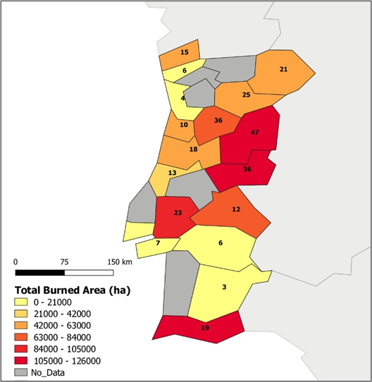
Data Treatment
Burned Area data
Burned Area (ha) and number of wildfires (2001-2016)
Forest fires with more than 1000 ha burned area are selected.
301 wildfires in Total from 2001-2016

Slide 10
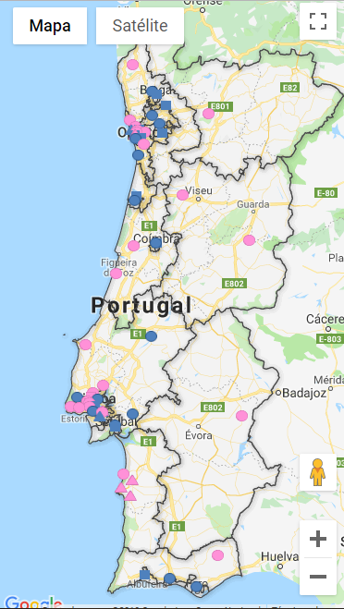
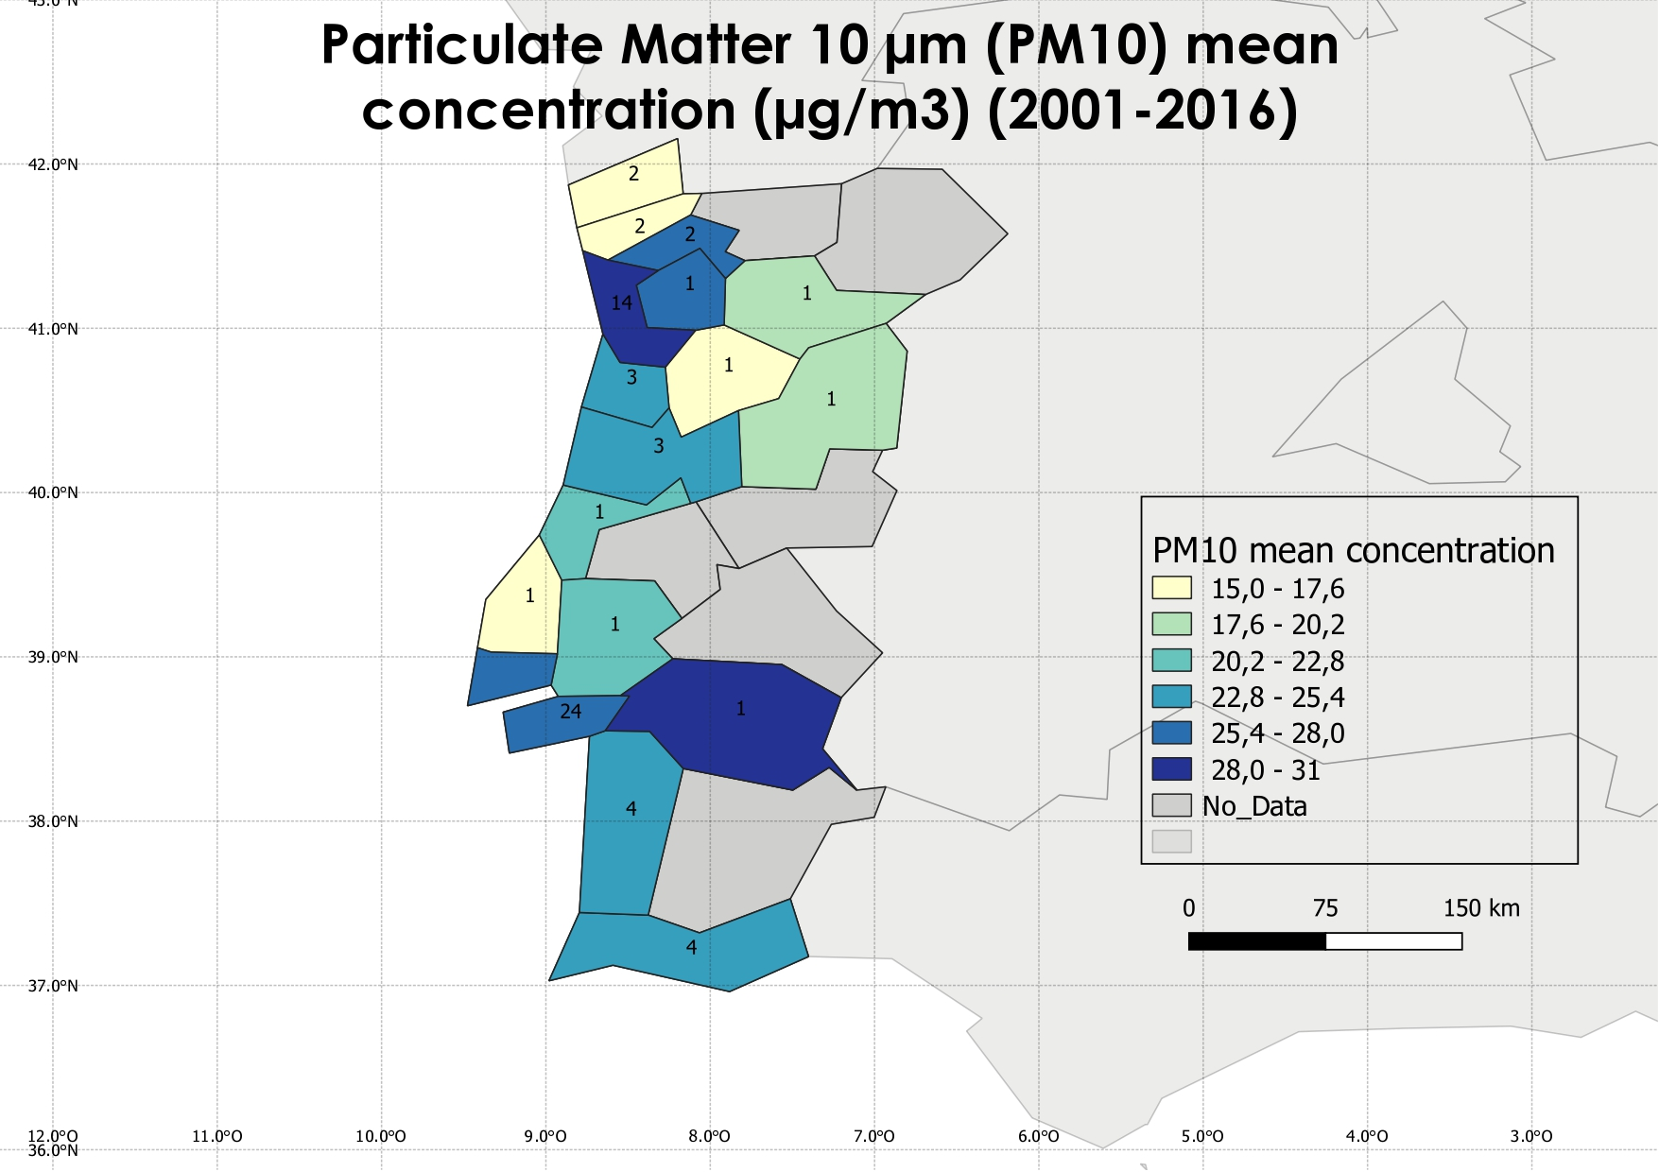
Data Treatment
PM₁₀ data
Number of Stations by NUT
Background stations (urban, suburban and rural) are selected.
Total: 66 stations
Fixed Indicative
Traffic
Background
Industry

Slide 11
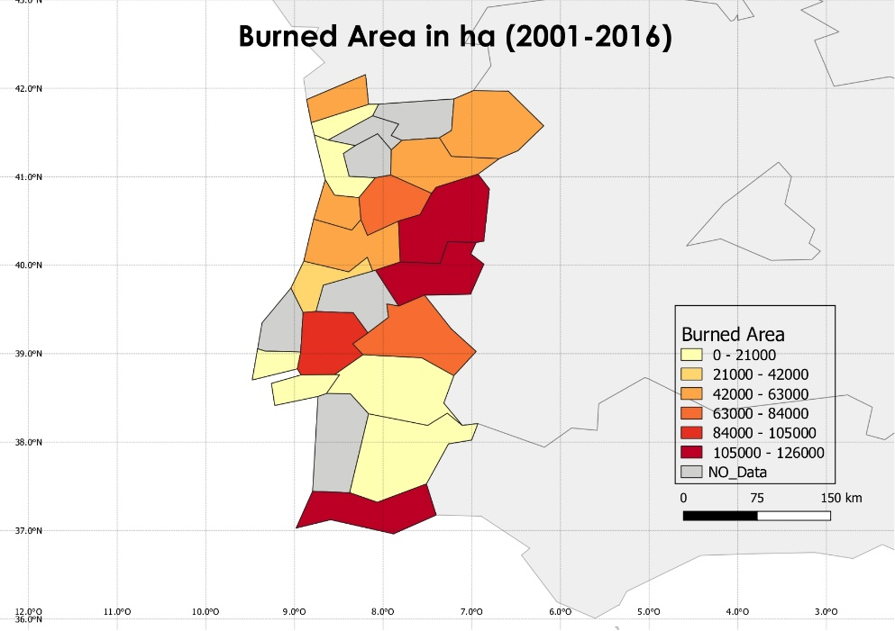
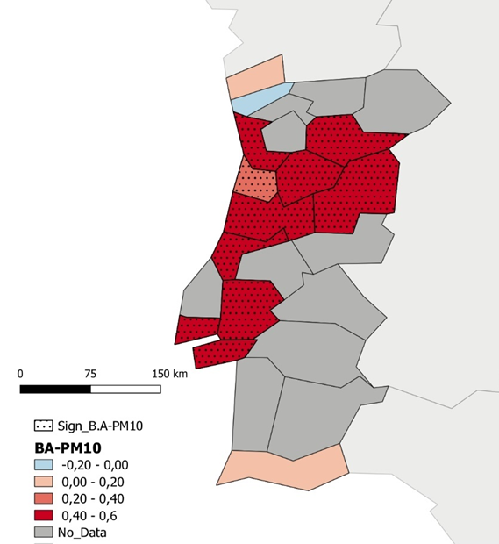
Results:
Burned Area – PM₁₀

Slide 12
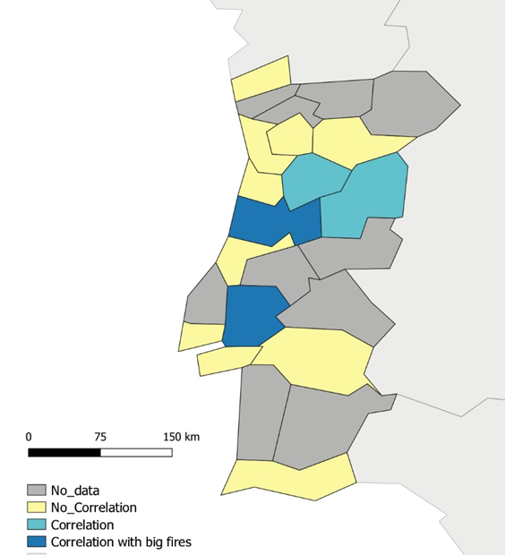
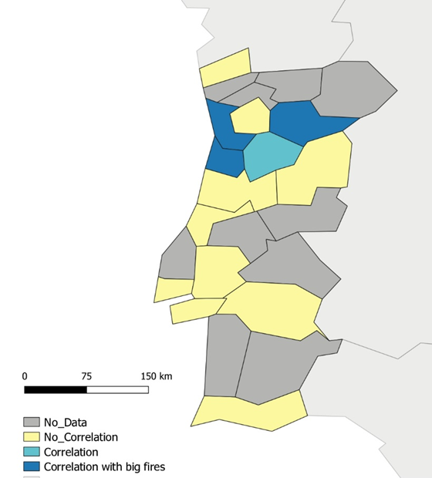
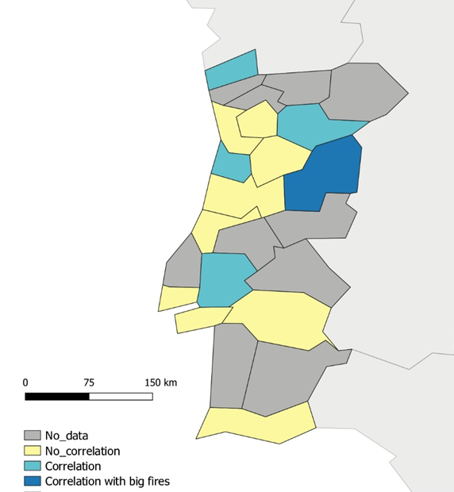
Results:
PM₁₀ - Diseases and Mortality Correlations
All Causes Mortality (2001-2016)
Cause-Specific Mortalities (2001-2016)
Respiratory diseases
Cardiovascular diseases
(*) All causes of mortality, excluding injuries, poisoning and external causes

Slide 13
Conclusions
A significant correlation is found between burned área and total mortality (excluding injuries, poisoning and external causes) in some regions of mainland Portugal (mainly inland and in the north).
A significant correlation between burned area and PM₁₀ is found in some regions of Portugal, especially on the north.
Large fires (in this studies considered above 1000 ha of burned area) have an impact on the health due to the emission of particulate matter.
These evidences were found despite the difficulties that the uneven scattering of the air monitoring stations analysing PM₁₀ in Portugal posed
The regions affected also have an aged population, poorer economy and less health care resources, which can lead to an increase in the mortality rates in general.
Notes:
13

Slide 14
Acknowledgments
We acknowledge the project ACEX (CGL2017-87921-R) of the Spanish Ministry of Economy and Competitiveness, the Fundación Biodiversidad of the Spanish Ministry for the Ecological Transition, and the FEDER European program, for support to conduct this research.
This work also had the support of: (i) Base Funding UIDB/ 00511 2020 of the Laboratory for Process Engineering, Environment, Biotechnology and Energy (LEPABE), by national funds through the FCT/MCTES (PIDDAC); (ii) Nuno Ratola thanks the Portuguese Foundation for Science and Technology (FCT) for the financial support of his work contract through the Scientific Employment Stimulus - Institutional Call - [CEECINST/00049/2018].
Sofía Augusto was supported by FCT under grant SFRH/BPD/109382/2015.
M.Turco has received funding from the European Union’s Horizon 2020 research and innovation programme under the Marie Skłodowska-Curie grant agreement No. 740073 (CLIM4CROP project)
Notes:
14

Slide 15
THANK YOU SO MUCH FOR YOUR ATTENTION
Contact: patricia.tarin@um.es
pedro.jimenezguerrero@um.es

