Slide 1
An analytical model concerning the possible initiation of subduction between the India and Africa plates, caused by the Morondova plume
Bernhard Steinberger^{1,2} and Douwe van Hinsbergen³
¹GFZ German Research Centre for Geosciences, Geodynamic Modelling Sec. 2.5, Potsdam, Germany (bstein@gfz-potsdam.de)
²Centre for Earth Evolution and Dynamics (CEED), University of Oslo, Oslo, Norway ³Department of Earth Sciences, Utrecht University, Utrecht, The Netherlands
Marion Island (46.9°S, 37.75°E) marking the putative
present-day location of the Morondova plume

Slide 2
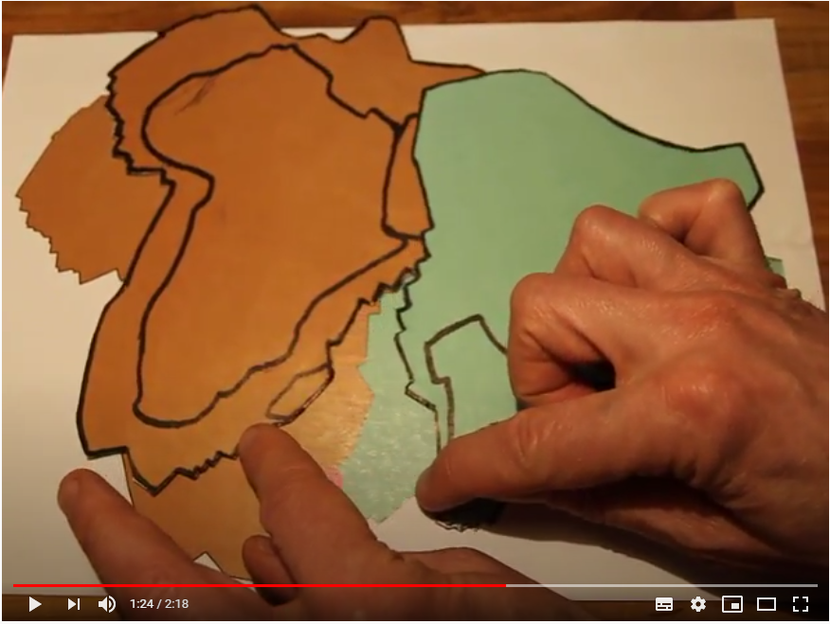
Watch this youtube video for an explanation of the proposed mechanism: Pushing plates apart at one location can actually cause convergence elsewhere along the same plate boundary
https://www.youtube.com/watch?v=1VzCzg2KRgg

Slide 3
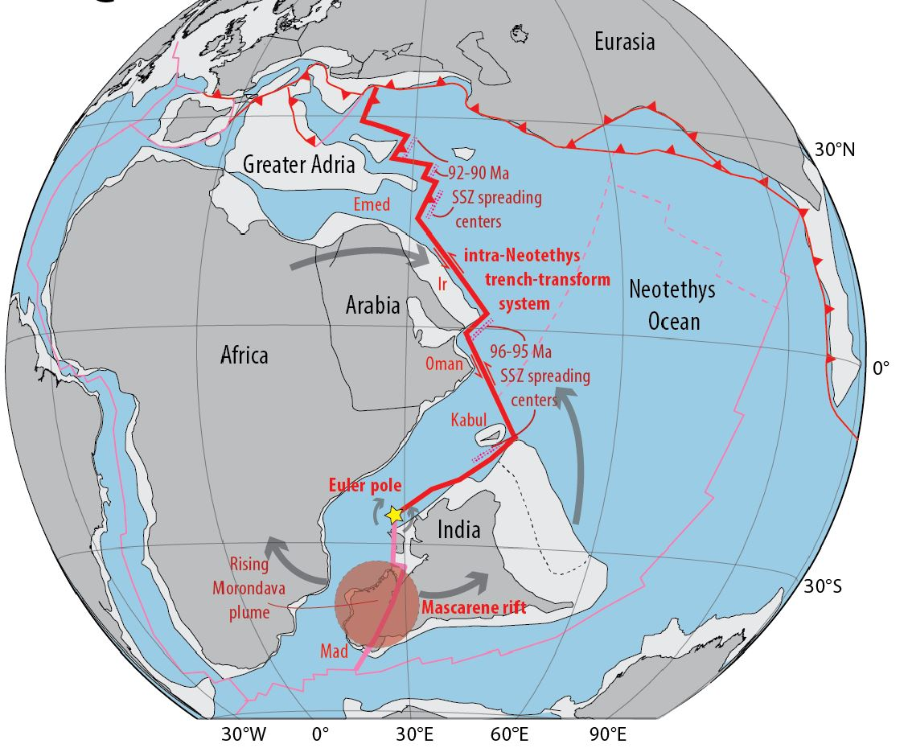
The situation at around 105 Ma:
The Morondova plume rises beneath India and Madagascar, which are next to each other
Shortly after, India and Madagascar start rifting apart, but subduction initiates along the same India-Africa plate boundary further north
Could the two processes be related, through our proposed mechanism?

Slide 4
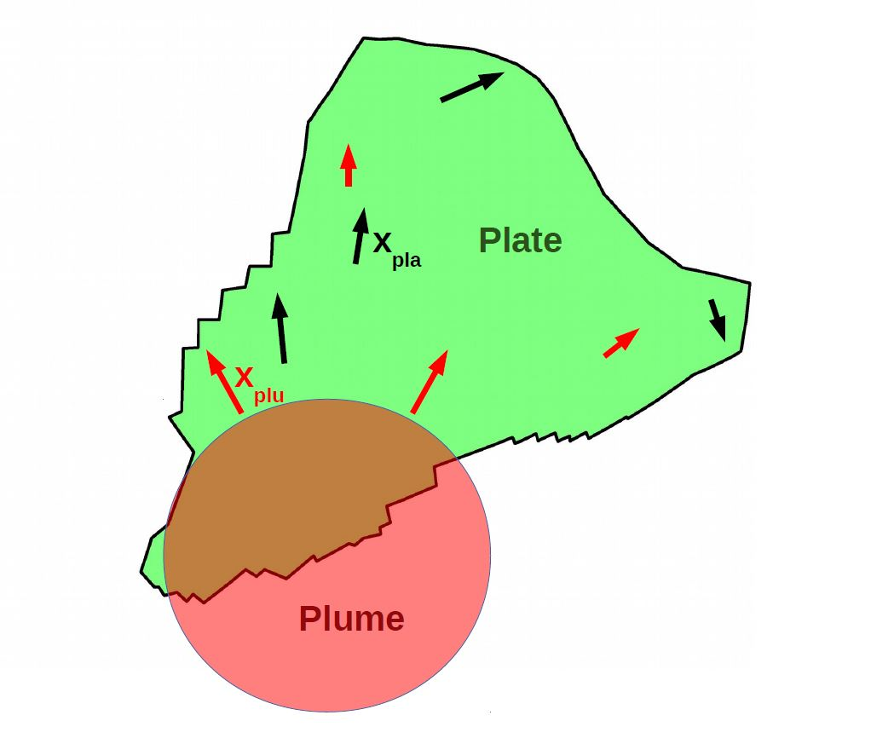
Here is a more quantitative approach, but the idea is the same as in our kitchen-counter experiment.
The rising plumehead pushes material ahead in the asthenosphere on which the plates glide (red arrows)
Top view
Africa plate
India plate
astheno- sphere
Side view
This causes the plate to move, such that the torque is balanced (black arrows)
Because the plate is rigid, local plate motion differs from motion of the asthenosphere beneath

Slide 5
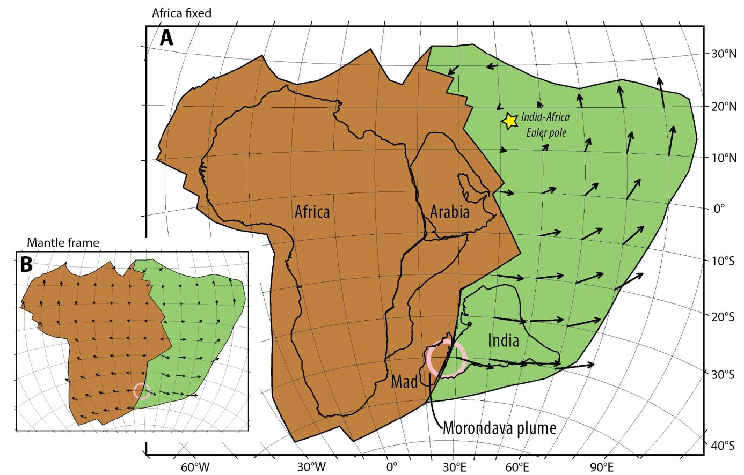
Resulting plate motion (small frame: absolute; big frame: relative), if we assume that coupling between plates and underlying mantle is the same everywhere:
The mechanism works in principle, but the part of the plate boundary where convergence is predicted is rather short (India-Africa Euler pole much further north than in reality)
Arrow length = computed total displacement

Slide 6
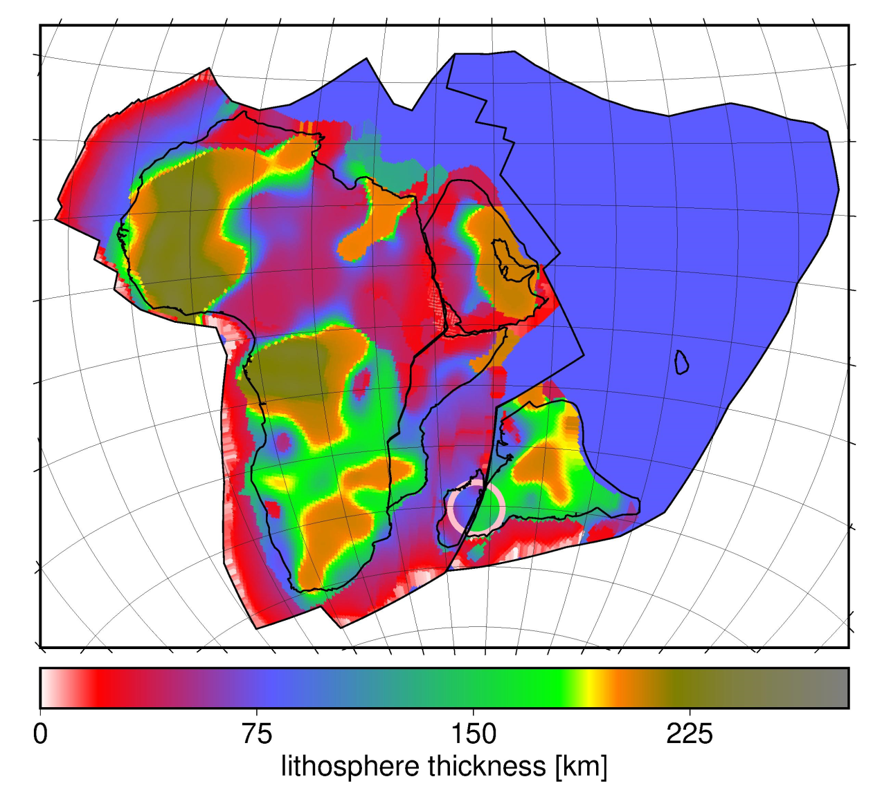
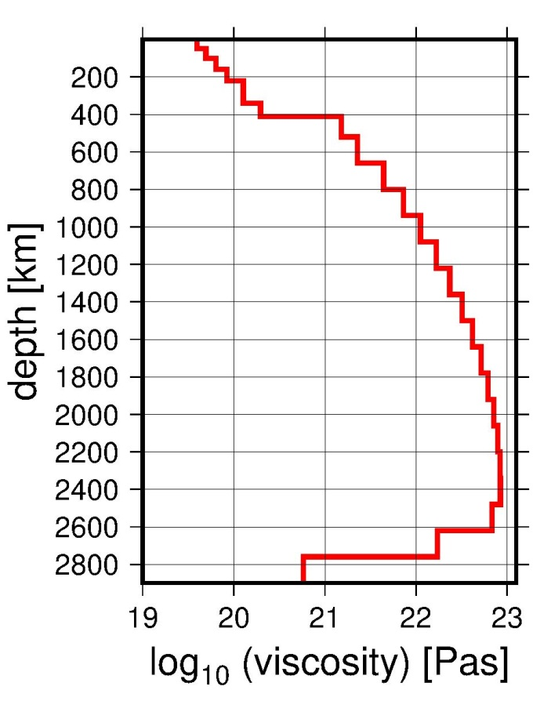
Cratons have thicker lithosphere
(here: Thickness inferred from Schaeffer & Lebedev surface tomography model – higher seismic velocities → thicker lithosphere)
Tethys
ocean floor:
subducted;
constant
thickness
assumed
West
African
craton
thin lithosphere
asth
thick lithosphere
enosphere
Congo
craton
Indian
craton
Sublithospheric
viscosity structure from Steinberger (GJI; 2016)
Kalahari
craton
Thick craton → less pronounced low-viscosity asthenosphere → better coupling to higher-viscosity mantle beneath --
Could it be that India plate is „pinned“ by India craton?
India plate
asthenosphere
Cratonic root

Slide 7
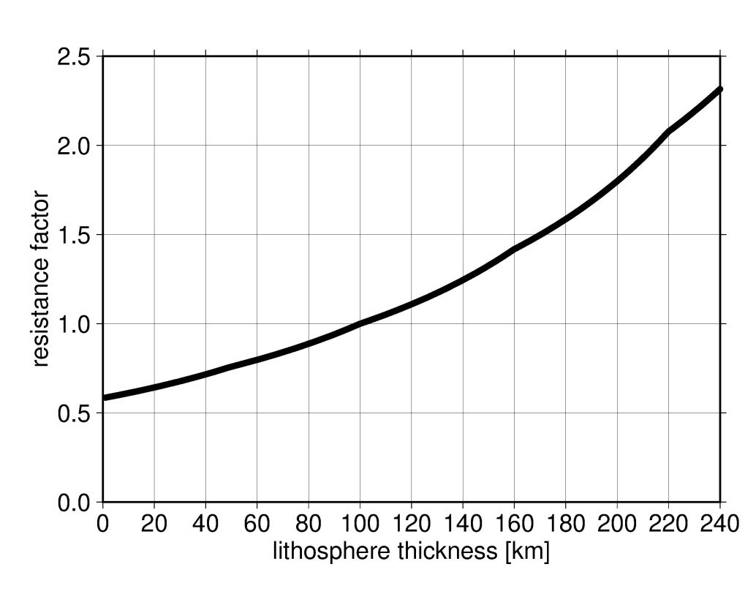
thin lithosphere
asth
thick lithosphere
enosphere
Sublithospheric
viscosity structure from Steinberger (GJI; 2016)
For this viscosity structure, the coupling (resistance factor) of cratons is about three times as much as for very thin lithosphere
This is not sufficient to substantially change plate motions

Slide 8
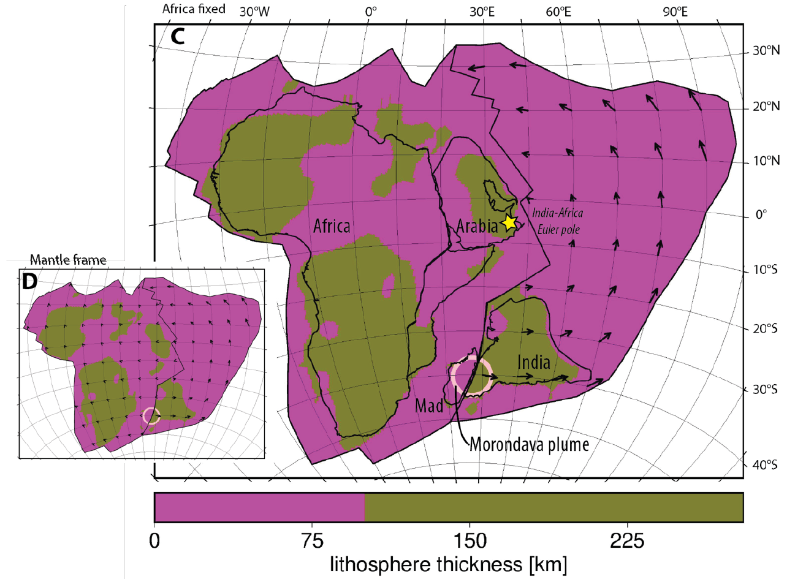
In order to have the Euler pole substantially further south, we need to assume a much more extreme variations in coupling: Here coupling is 10 x increased wherever reconstructed lithosphere thickness exceeds 100 km (brown areas) and reduced to 1/10 whereever it is less.

Slide 9
Convergence of several hundred km, sufficient to induce subduction, can be obtained.
However, this estimates neglects frictional resistance at the convergent boundary.
It becomes less if this resistance is considered.
Is the plume push force sufficient to overcome frictional resistance at all?
India plate
Assuming half the force
pushes the India plate
Torque = T = F / 2 ∙ X =
= 3 ∙ 10²⁶ Nm
w=100 km
X=4000 km
L=5000 km
Assuming the torque is
counterbalanced by a compressive stress σ acting on the convergent part of the boundary (length 5000 km, thickness 100 km)
T = σ ∙ L ∙ w ∙ L/2
σ = T / L / w / (L/2) = 240 MPa
F=1.5∙10²⁰ N
D=1000 km
Δρ=30 kg/m³
Would be sufficient to overcome frictional resistance between subducting and overriding plate, estimated in the order of 10s of MPa.
In reality only a fraction of the torque will be balanced at the convergent boundary
Plate boundary already needs to be „weak“ prior to subduction initiation

