Slide 1
Energetic Particle Environment near the Sun from Parker Solar Probe
N. A. Schwadron^{1,2}, E.R. Christian³, C.M.S. Cohen⁴, A.C. Cummings⁴, A.J. Davis⁴, M.I. Desai^{5,6}, J.Giacalone⁷, M.E. Hill⁸, C.J. Joyce², S.M. Krimigis⁸, A.W. Labrador⁴, R.A. Leske⁴, O. Malandraki⁹, W.H. Matthaeus¹⁰, D.J. McComas², R.L. McNutt Jr.⁸, R.A. Mewaldt⁴, D.G. Mitchell⁸, A. Posner¹¹, J.S. Rankin², E.C. Roelof⁸, E.C. Stone⁴, J.R. Szalay², M.E. Wiedenbeck¹², S.D. Bale^{13,14}, J.C. Kasper¹⁵, A.W. Case¹⁶, K.E. Korreck¹⁶, R.J. MacDowall³, M. Pulupa¹³, M.L. Stevens¹⁶, A.P. Rouillard¹⁷
on behalf of the
entire ISʘIS Team
EGU 2020

Slide 2
Abstract
NASA’s Parker Solar Probe (PSP) mission recently plunged through the inner heliosphere to perihelia at ~24 million km (~35 solar radii), much closer to the Sun than any prior human made object. Onboard PSP, the Integrated Science Investigation of the Sun (ISʘIS) instrument suite made groundbreaking measurements of solar energetic particles (SEPs). Here we discuss the near-Sun energetic particle radiation environment over PSP’s first two orbits, which reveal where and how energetic particles are energized and transported. We find a great variety of energetic particle events accelerated both locally and remotely. These include co-rotating interaction regions (CIRs), “impulsive” SEP events driven by acceleration near the Sun, and events related to Coronal Mass Ejections (CMEs). These ISʘIS observations made so close to the Sun provide critical information for investigating the near-Sun transport and energization of solar energetic particles that was difficult to resolve from prior observations. We discuss the physics of particle acceleration and transport in the context of various theories and models that have been developed over the past decades. This study marks a major milestone with humanity’s reconnaissance of the near-Sun environment and provides the first direct observations of the energetic particle radiation environment in the region just above the corona.

Slide 3
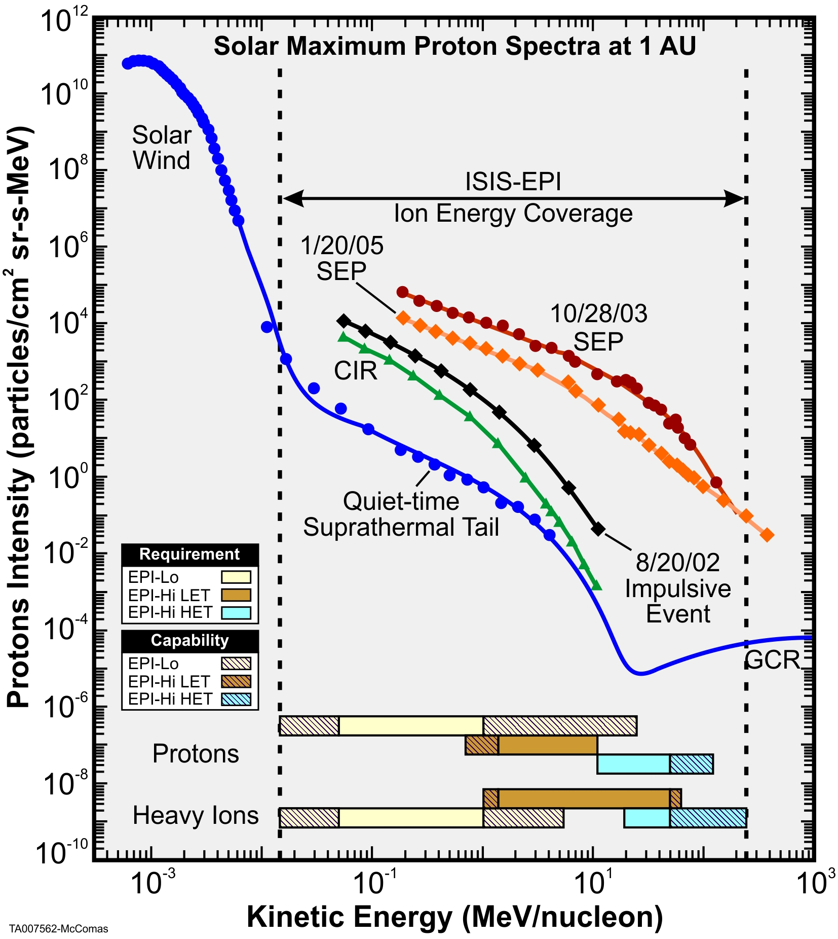
ISʘIS Measurement Summary
Determine in both gradual & impulsive Solar EP events:
  Energy spectra
  Composition (electrons, protons, major heavy elements)
  Timing
  Pitch-angle distributions
Measure ³He as a key indicator of impulsive events
Measurements of other populations (CIRs, ACRs, and GCRs) provide important new information on these particles’ radial dependences
Also measures electrons from ~0.025 to 6 MeV

Slide 4
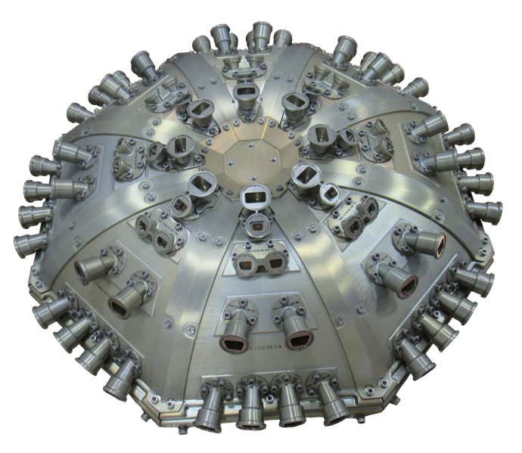
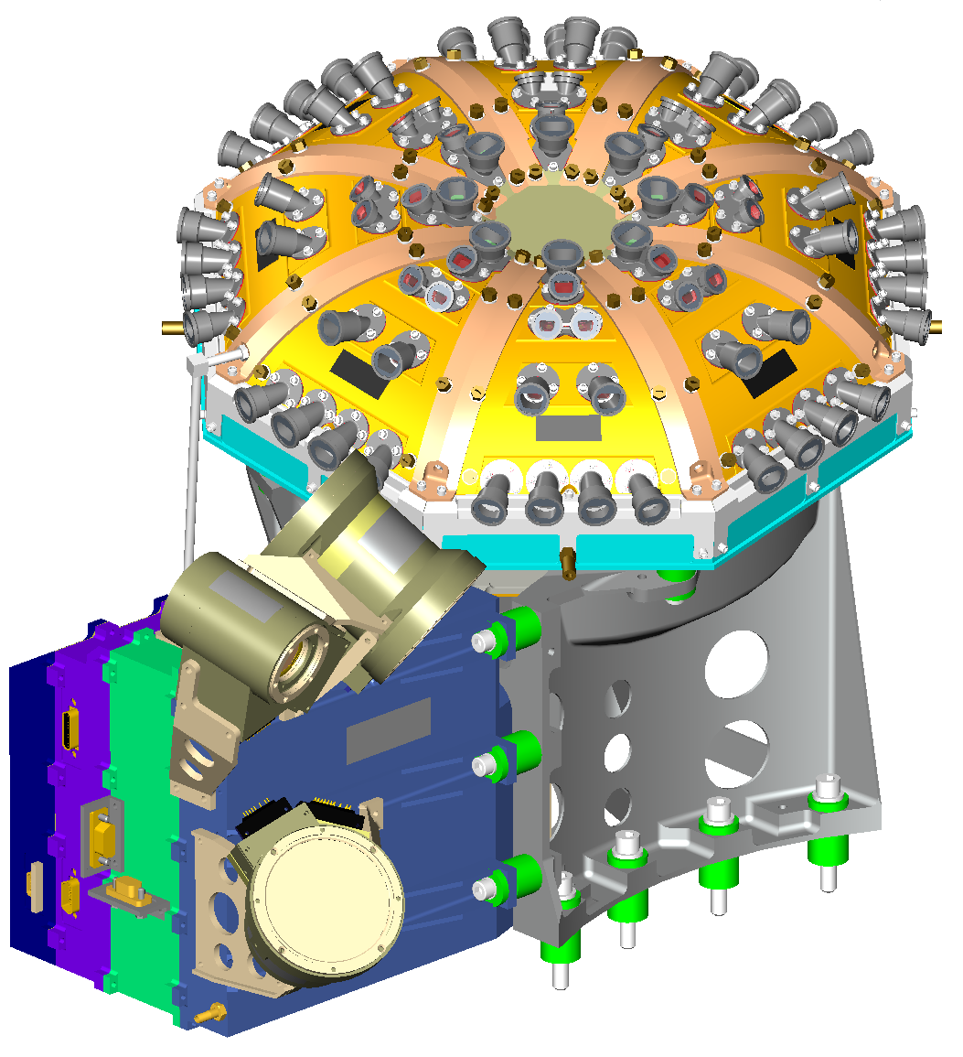
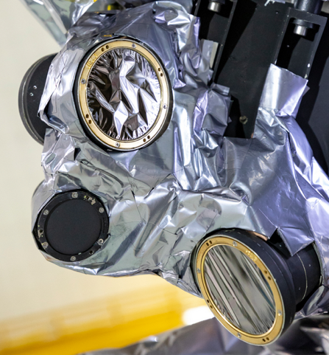
ISʘIS Instrument Suite
EPI-Lo
ISOIS
Bracket
EPI-Hi

Slide 5
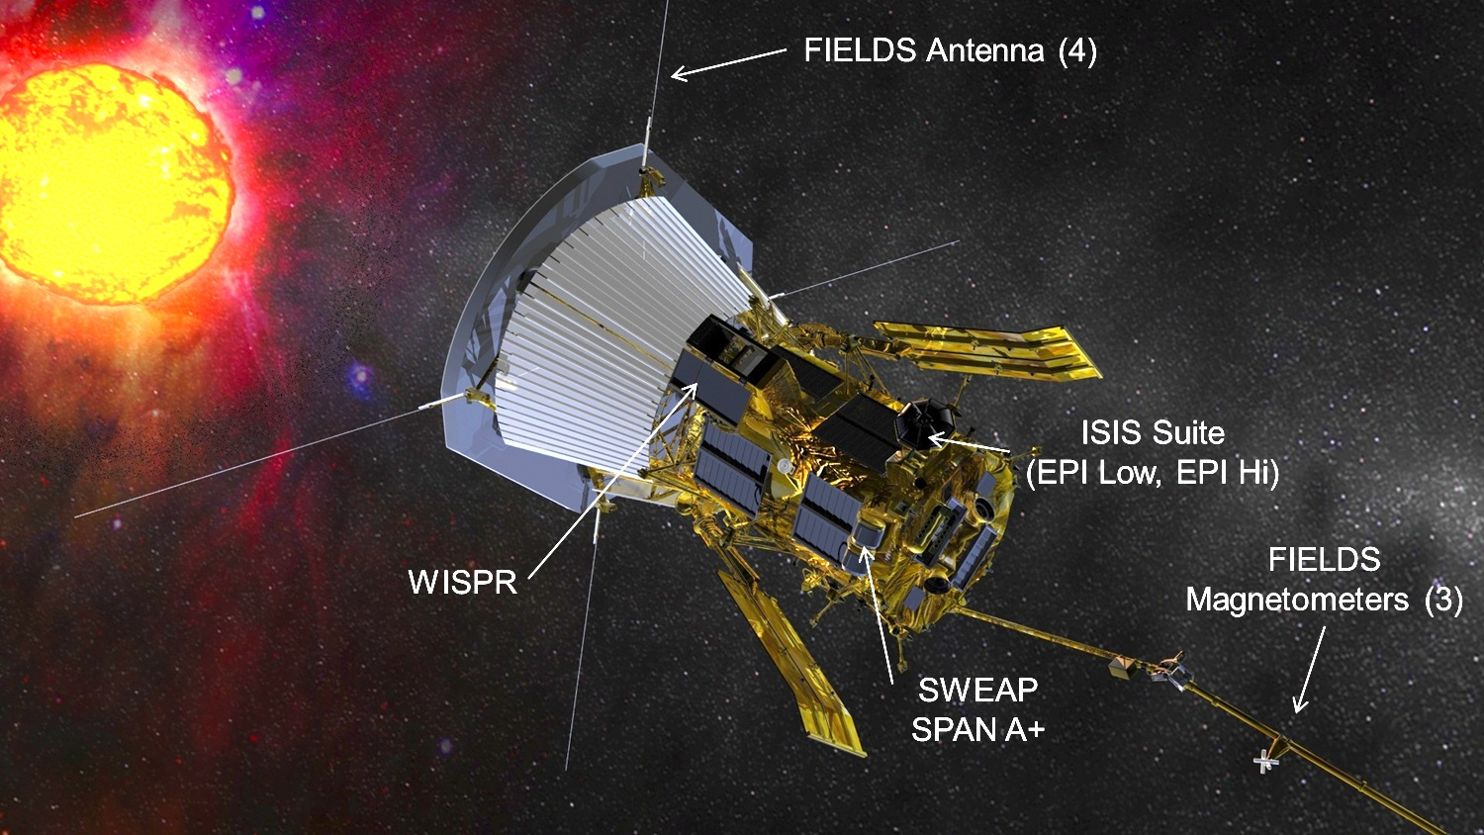
ISʘIS Ram Facing Side of S/C

Slide 6
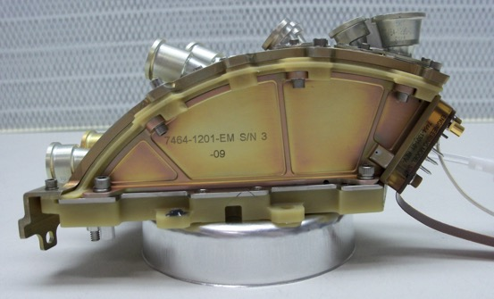
EPI-Lo Measurement Technique
Identified based on start electrons accelerated to time-delay-chained anodes. EPI-Lo measures TOF vs E (triple coincidence), TOF-only (double coincidence), and SSD-only (single or double parameter energy measurement).

Slide 7
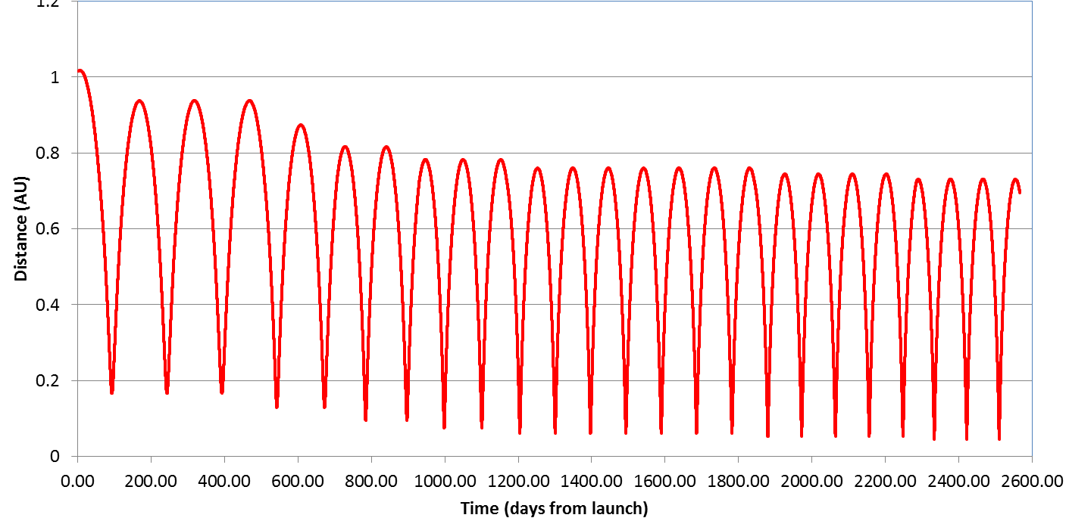

Baseline Mission Design – P1 Data
Orbit # | 1 | 2 | 3 | 4 | 5 | 6 | 7 | 8 | 9 | 10 | 11 | 12 | 13 | 14 | 15 | 16 | 17 | 18 | 19 | 20 | 21 | 22 | 23 | 24
Period (d) | 168 | 150 | 150 | 140 | 121 | 112 | 107 | 102 | 102 | 100 | 96 | 96 | 96 | 96 | 96 | 96 | 96 | 92 | 92 | 92 | 87 | 88 | 88 | 88
A1
A2
A3
A4
Venus Flyby
A5
A6
A7
A8
A9
A10
A11
A12
A13
A14
A15
A16
A17
A18
A19
A20
A21
A22
A23
A24
A25
P1
P2
P3
P4
P5
P6
P7
P8
P9
P10
P11
P12
P13
P14
P15
P16
P17
P18
P19
P20
P21
P22
P23
P24
First perihelion (P1) data
Tiny sampling of observations – most ISOIS telemetered down in April/May

Slide 8
Orbit 1: Fixed vs Rotating Coordinates

Slide 9
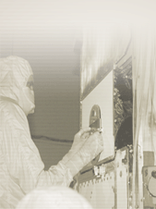
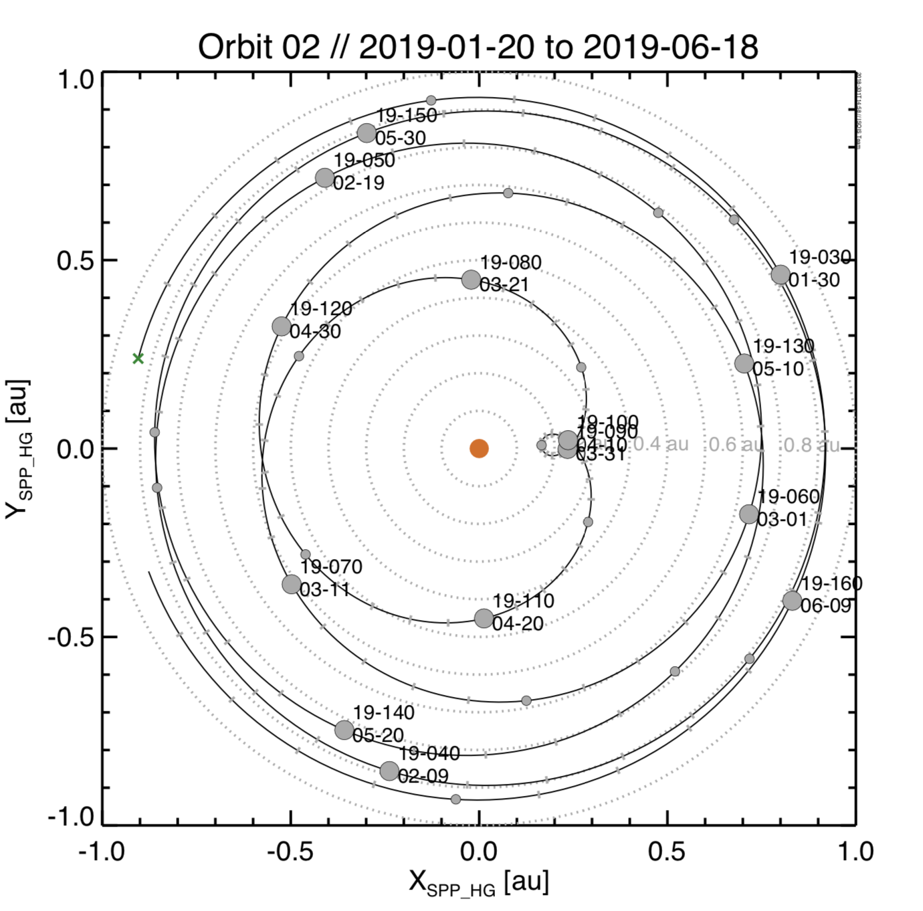
Orbit 2: Fixed vs Rotating Coordinates

Slide 10
ISʘIS EPI-Lo – Data from P1

Slide 11
ISʘIS EPI-Lo – Data from P1

Slide 12
ISʘIS EPI-Hi – Data from P1

Slide 13
ISʘIS EPI-Hi – Data from P1

Slide 14
ISʘIS EPI-Lo – Data from P1

Slide 15
PSP ISOIS data

Slide 16
During ICME
passage
Before
After

Slide 17
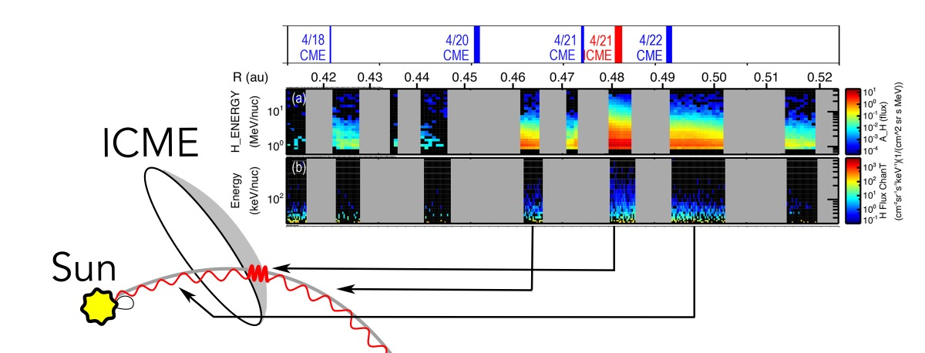
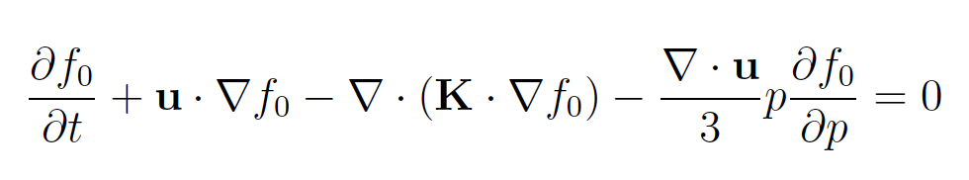
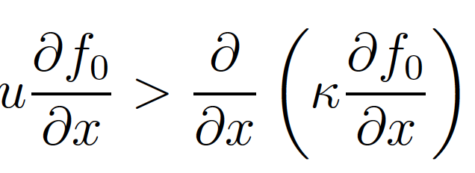
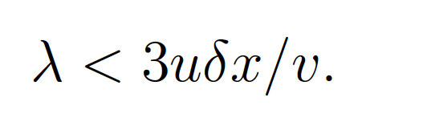
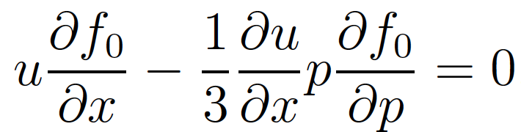
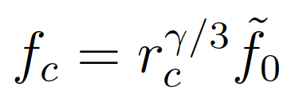
Seed Population Compression
Restricted propagation
Wave-particle interaction
Field structure within compression
~0.006 au within ICME compression
17 times smaller than 0.1 au MFP for outside ICME compression
→

Slide 19
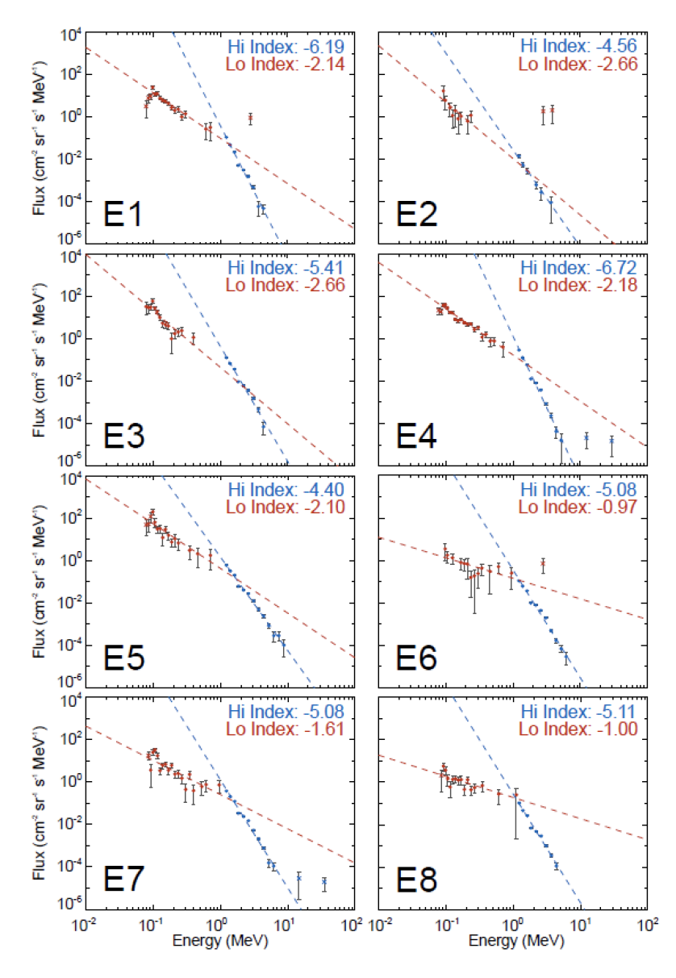
Joyce et al., 2020

Slide 20
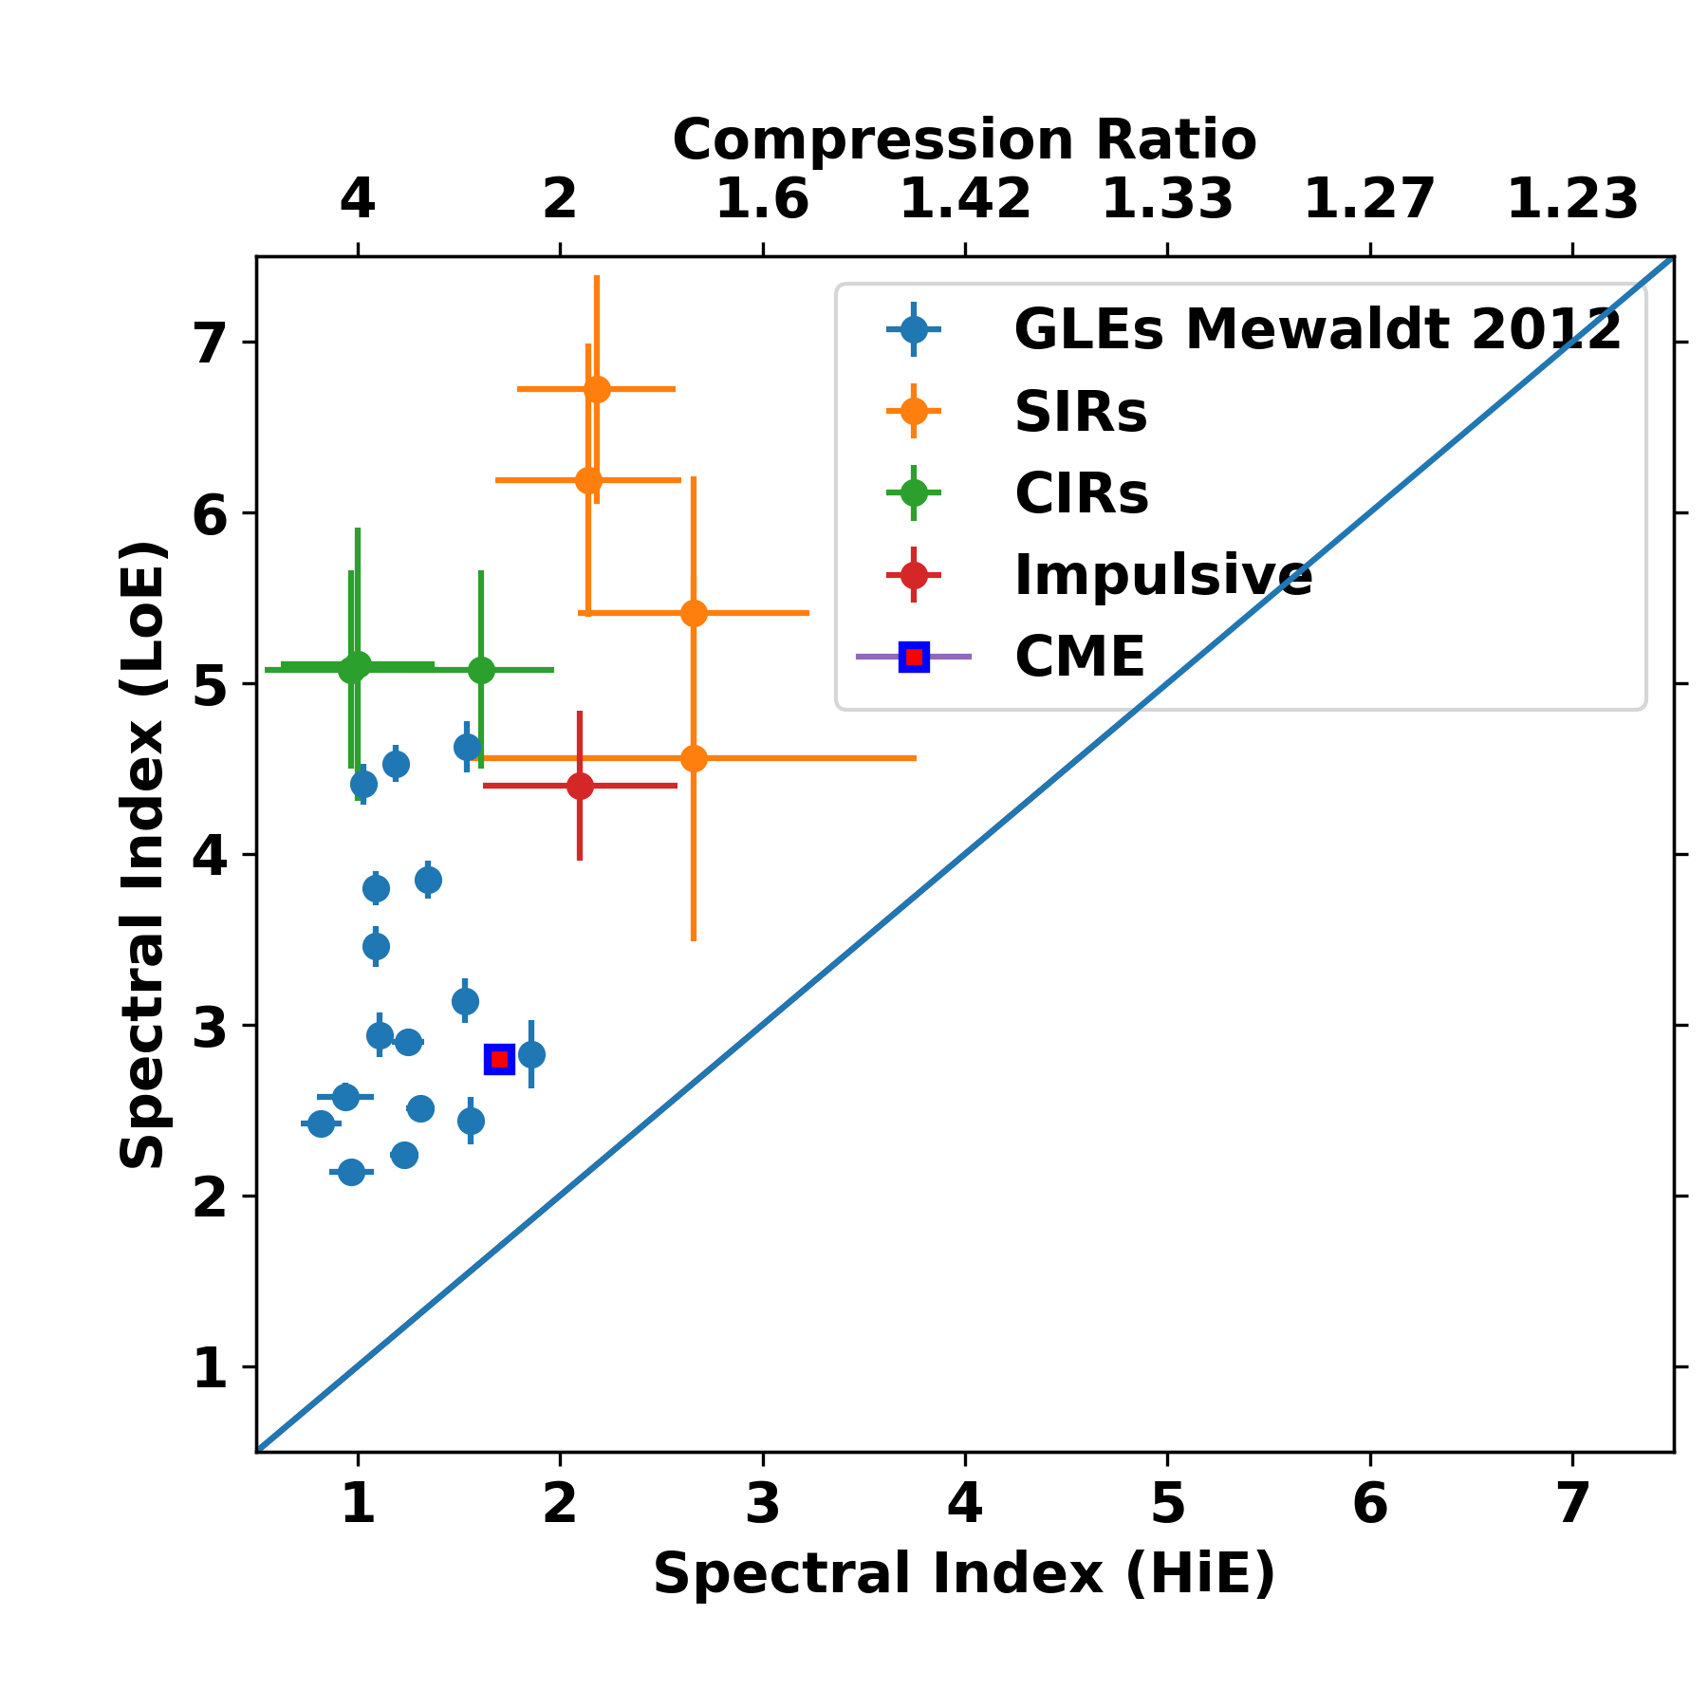

Slide 21
Conclusions
PSP ISOIS Observations show wide variety of energetic particle events
Direct Observation of Seed Populations fed into acceleration at CMEs
A variety of acceleration processes manifest in variable power-law tails
Diffusive, compressive and stochastic processes are essential in early stages of particle acceleration

