Slide 1
Intercomparison of nitrogen monoxide and nitrogen dioxide measurements in the atmosphere simulation chamber SAPHIR during the MetNO2 campaign
05th May 2020 I Robert Wegener and the MetNO2 SAPHIR intercomparison team
Franz Rohrer, Benjamin Winter, Zhaofeng Tan, Ulrich Bundke, Patrick Weber, Norbert Houben, Doreen Niether, Vaishali Vardhan, Sergej Wedel, Ralf Tillmann, Anna Novelli, Annika Kuß, Georg Stange, Robert Holla, Dagmar Kubistin, Karri Saarnio, Nicolas Sobanski, Claus Nordstroem, Jesper Nygaard, Tom Jensen, Naomi Farren, Simone Andersen, Will Drysdale, Sumin Kim, Sepyo Lee, Maitane Iturrate-Garcia, Sivan van Aswegen, David R. Worton
Contact: r.wegener@fz-juelich.de
Session AS5.11 Tuesday, 05 May 2020, 08:30-10:15

Slide 2

Motivation
The MetNO2 Project
NO₂ is one of the key pollutants worldwide. Monitoring long-term trends requires accurate and traceable standards.
The goal of the EMPIR Project MetNO2 within EMPIR is to
deliver a highly accurate SI traceable measurement of NO₂.
This will be achieved by
developing traceable static and dynamic reference standards
developing analytical methods to quantify the main impurities
Methods and standards were compared at the SAPHIR chamber in Jülich
http://empir.npl.co.uk/metno2/

Slide 3
Intercomparison SETUP
Instruments
Chemiluminescence Detectors (CLD) Photolytical converters Molybdenum converters |  | Univ of York (UK), Univ of Aarhus (DK), German Weather Service (GER), National Institute of Meteorological Sciences (South Korea) FZ Jülich (GER)
Fontijn, A. 1971Journal of the Air Pollution Control Association, 21: 428-&.., 1970)
Cavity attenuated phase shift spectroscopy (CAPS) |  | Finnish Meteorological Institute (FI), German Weather Service (GER), Univ of York (UK), FZ Jülich (GER)
Kebabian etg al., 2008. , Environmental Science & Technology, 42: 6040-45.
Quantum Cascade Laser (QCL) |  | Eidgenössische Materialprüfungs- und Forschungsanstalt (SUI) FZ Jülich (GER)
Tuzson et al., 2013. Atmospheric Measurement Techniques, 6: 927-36.
Iterative cavity-enhanced DOAS (ICAD) |  | FZ Jülich (GER)
Horbanski, et al., 2019. Atmospheric Measurement Techniques, 12: 3365-81.

Slide 4
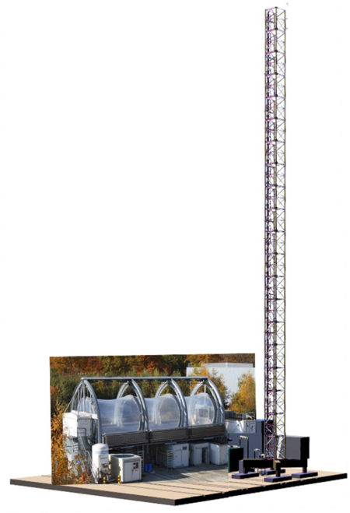
SETUP
Instruments
JULIAC
Ambient air was provides from the tip of the JULIAC tower at 50 m height above a forest.
VS
Photochemical experiments were conducted in the SAPHIR environmental chamber with a size of 270m³.
Instruments were set up in containers under the SAPHIR chamber and connected with a ½‘ PFA line.
SAPHIR

Slide 5
SETUP
Instruments
JULIAC
Sample air was provided via a common sample line either:
NOx
PTRMS
pump
Instruments
Instruments
from a calibration unit
MFC
VS
from SAPHIR
from the JULIAC tower
Instruments
CAL
Guest
Calibration
SAPHIR

Slide 6
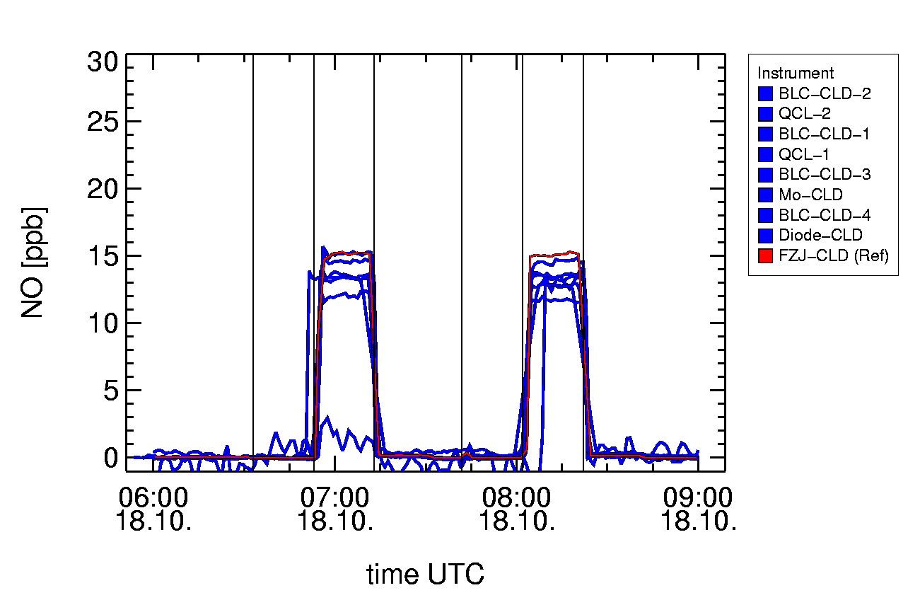
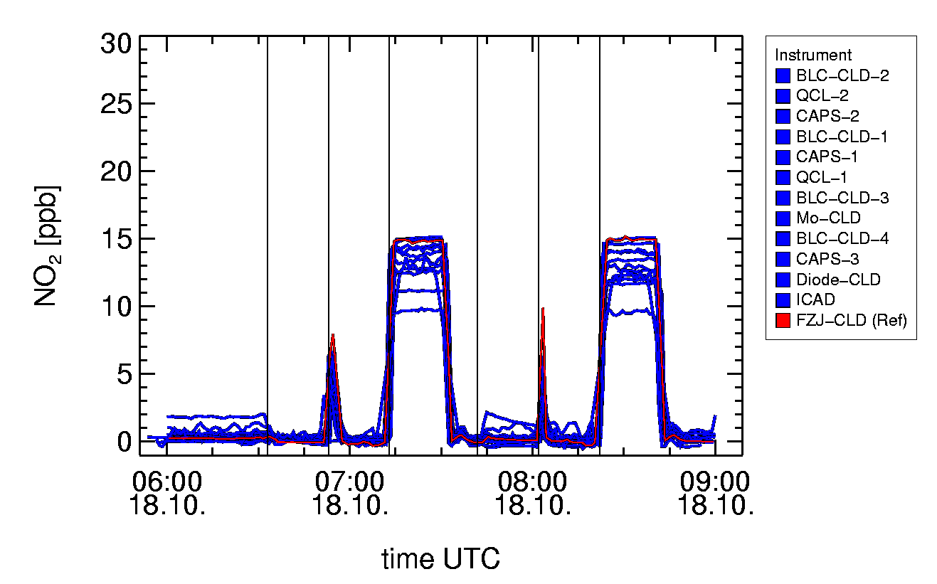
SETUP
blank
Intercomparison setup
Instruments were calibrated by the participants prior or after the campaign of two weeks.
During campaign, daily calibrations were performed via the common sampling line.
Calibration included a blank phase, an NO phase and an NO₂ phase both under dry and humid conditions.
Instruments were compared to a reference instrument calibrated with a traceable gas standard.
Preliminary data were discussed daily.
Dry
Humid
Dry
Humid
blank
NO
NO₂
blank
NO
NO₂
blank
NO
NO₂
blank
NO
NO₂

Slide 7
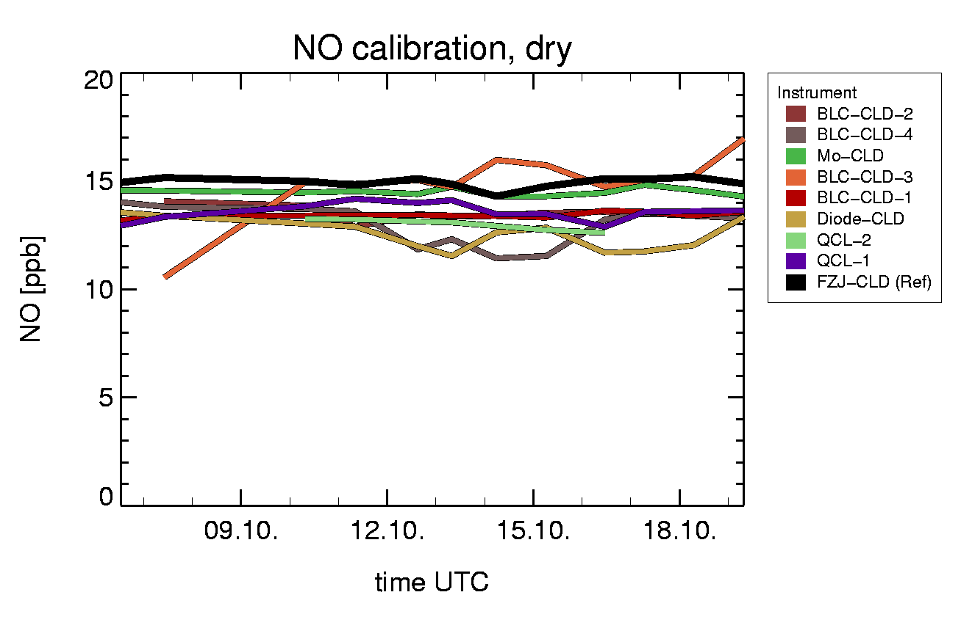
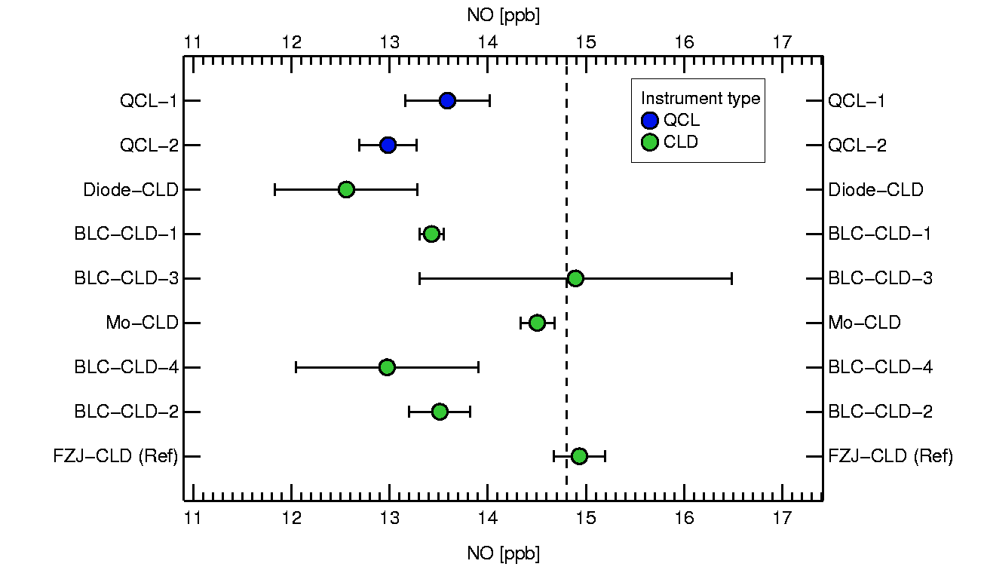
RESULTS
Instrument sensitivities for NO
During the campaign instruments measured from the same standard with a mixing ratio of 14.8 ppb NO.
Many instruments showed changes in the NO values.
The QCL and some CLDs underestimated the concentration of the standard.
Time series of NO for the daily calibration
Average NO concentration measured during daily calibration
The mixing ratio of the standard is expressed with the dashed line

Slide 8
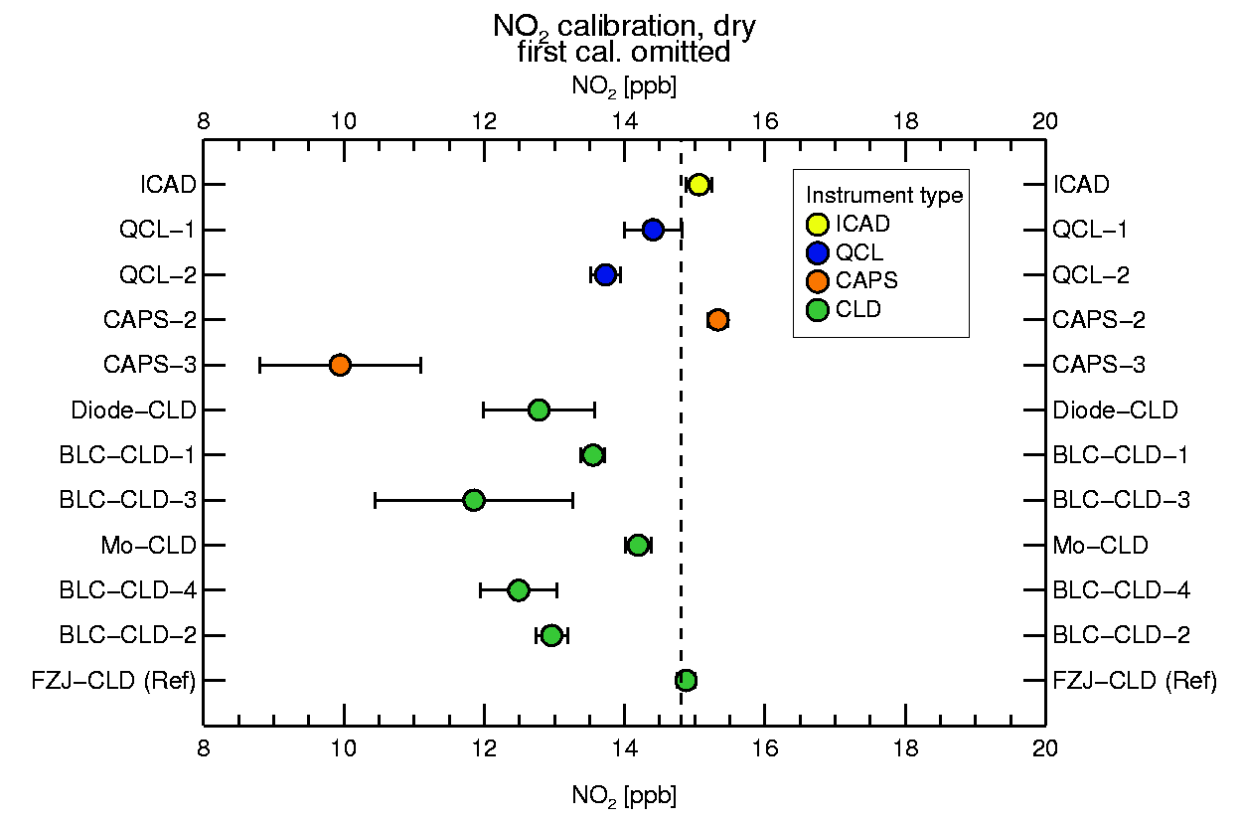
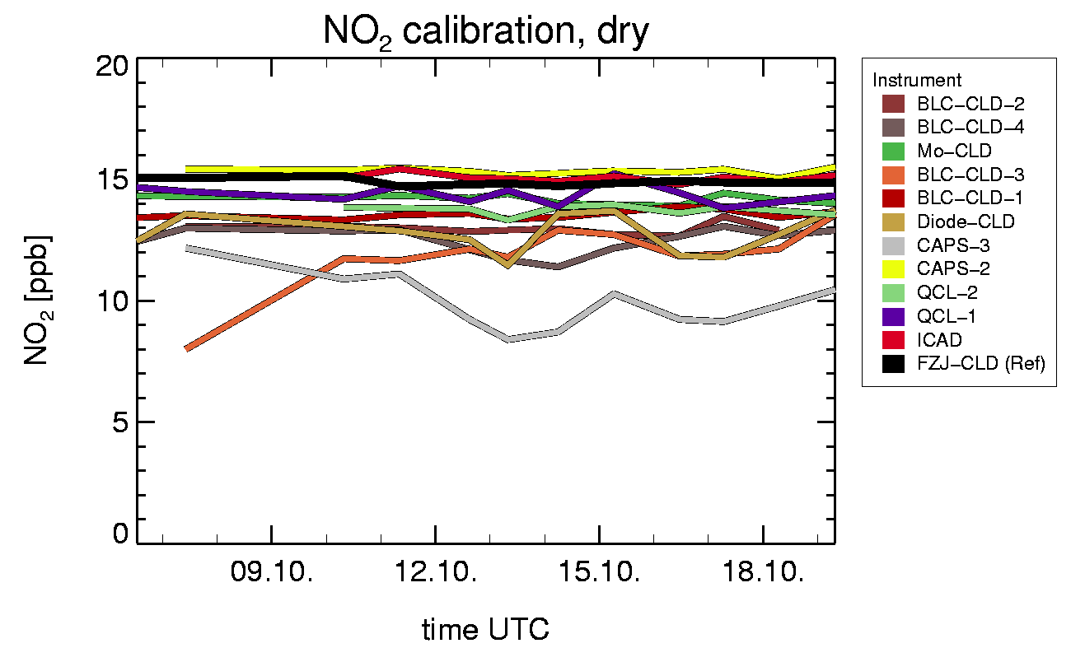
RESULTS
Instrument sensitivities NO₂
As for NO, also measured NO₂ mixing ratios changed over the 14 days.
ICAD, QCLs and one CAPS agreed well with the reference instrument.
Time series of the daily calibration for NO₂
Average NO₂ concentration measured during daily calibration

Slide 9
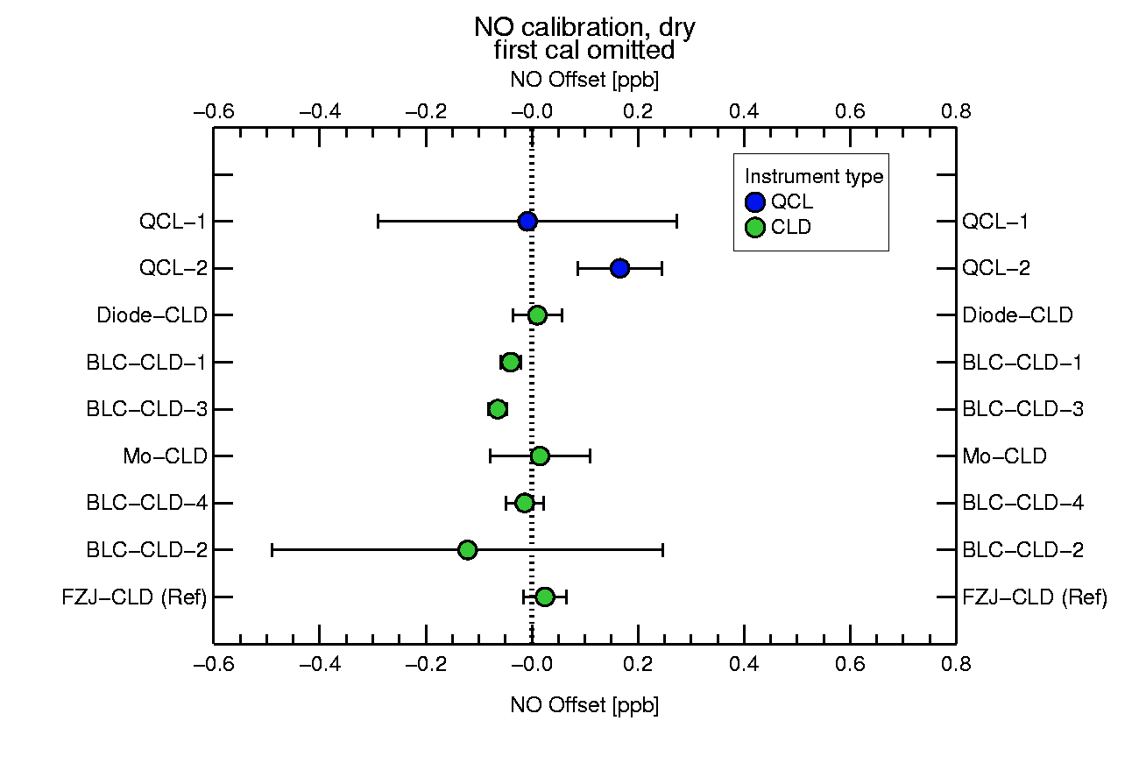
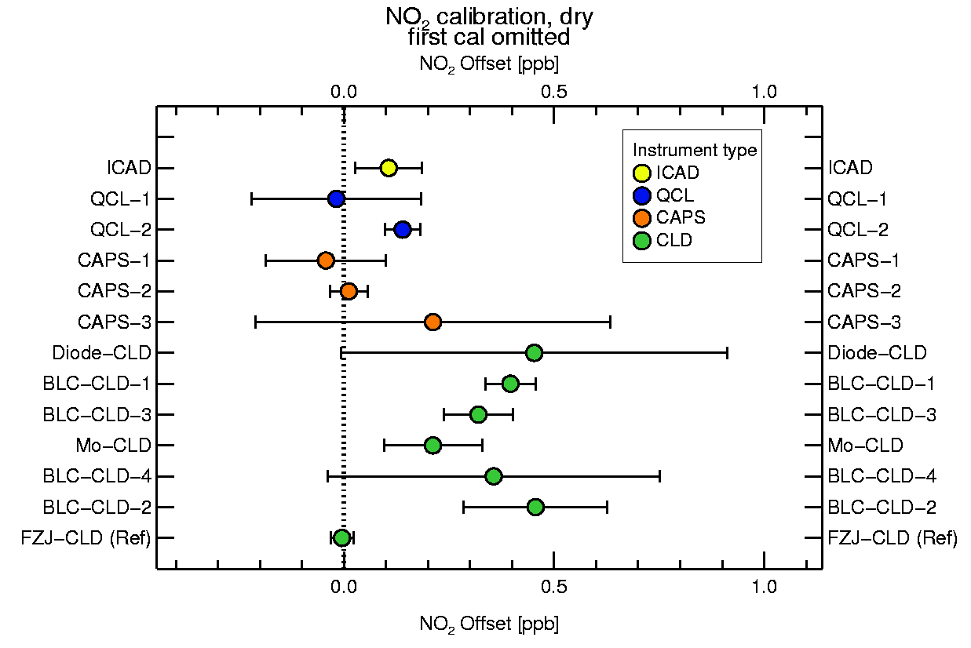
RESULTS
Instrument zero
While blank values in the NO channel of the CLDs were zero, some CLD showed a significant offset in the NO₂ channel
Average NO offset during daily calibration
Average NO₂ offset during daily calibration

Slide 10
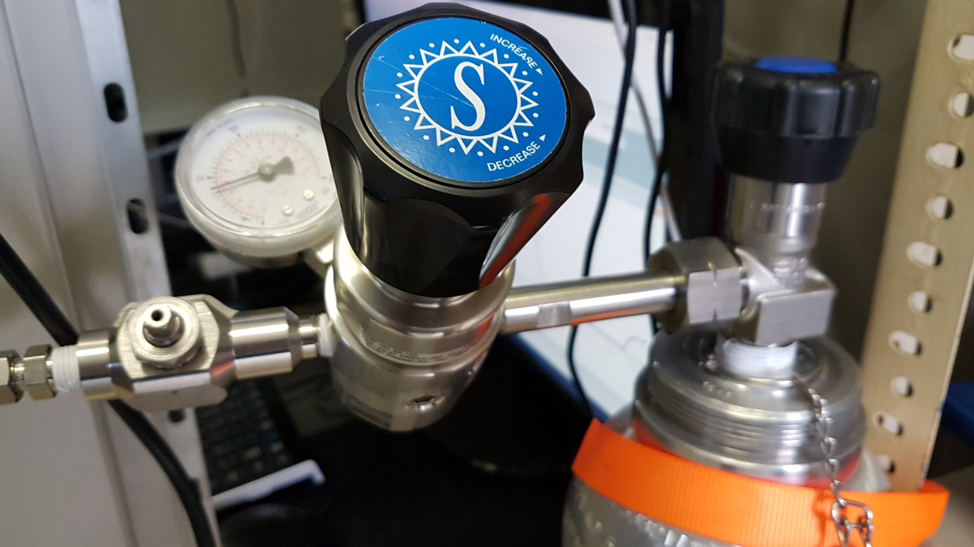
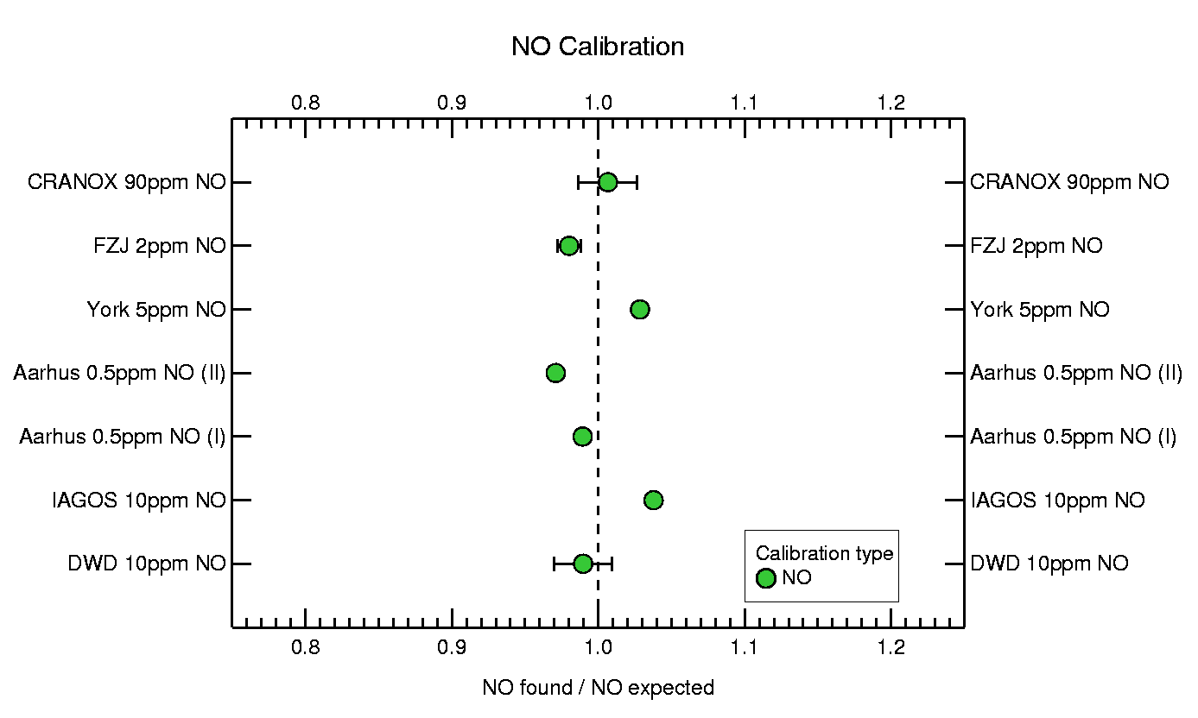
RESULTS
Standard comparisons
The standards of the participants were measured and compared to the reference instrument.
Measured and expected values agreed within ± 3 %.
Discrepancies of some instruments to the reference instrument cannot be explained with differences in the standards.
Recovery rate of the NO standards with respect to the value of the reference instrument.
Error bars show the uncertainties of the standards

Slide 11
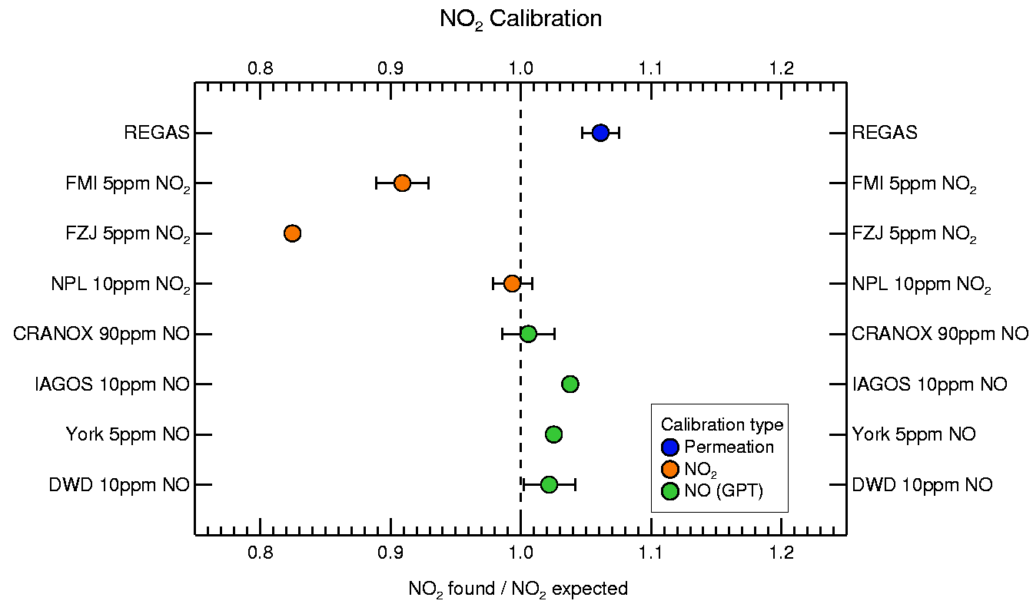
RESULTS
Standard comparisions
The provision of accurate NO₂ standards is the main goal of MetNO2 project.
NO₂ was provided from gas cylinders, produced by gas phase titration (GPT) from NO or permeation.
Two NO₂ standards which were not provided from the MetNO2 project, differed by more than 10 %.
The standards from NPL and METAS developed within the project agreed well.
Recovery rate of the NO₂ standards. Error bars show the uncertainties of the standards

Slide 12
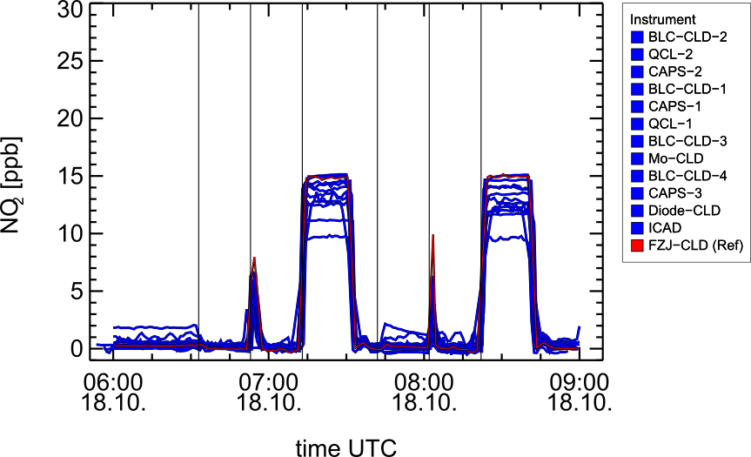
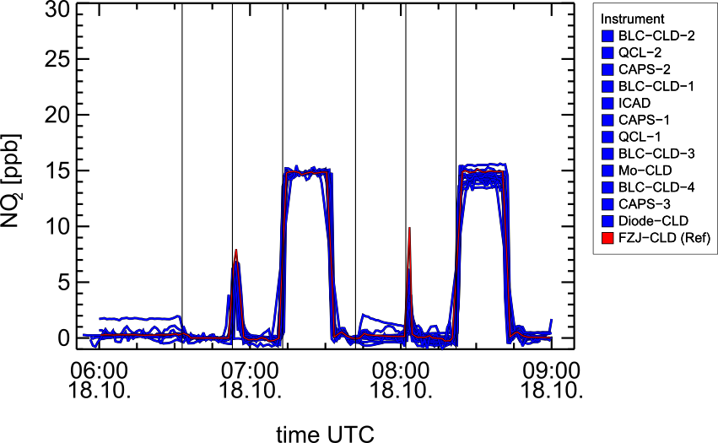
RESULTS
Influence of humidity
Dry
Humid
Water is an effective quenching substance in CLDs and reduces the sensitivity.
blank
NO
NO₂
Blank
NO
NO₂
NO₂ and NO data were scaled to the reference values at dry conditions to investigate the effect of humidity.
Data scaled to common standard

Slide 13
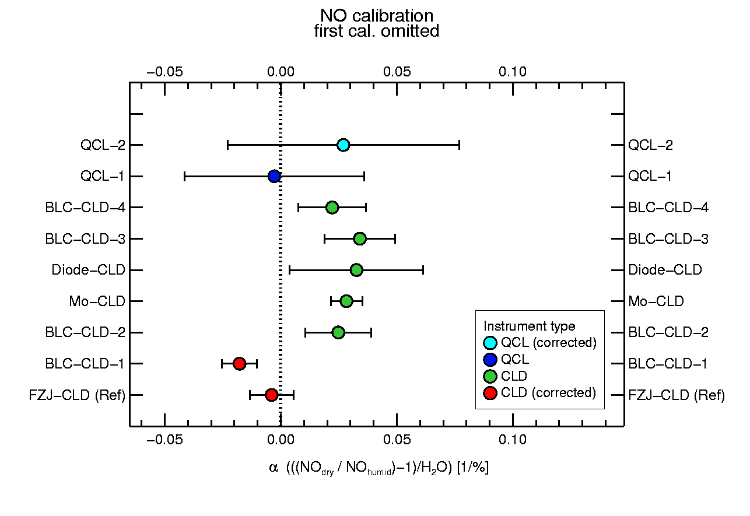
RESULTS
The influence of water on the sensitivity can be described with the α-value which is defined as:
Influence of humidity
where [NO] is the measured and [NO]_{H2Ocorr} the corrected concentration.
The value determined for the CLD is close to the value of 4.3 proposed by Parrish et al. (1991) and for suggested for the sensitivity correction in CLDs.
Parrish et al., 1991., Journal of Geophysical Research-Atmospheres, 96: 9309-20.
Recovery loss of NO standards due to water in percentage loss per absolute humidity

Slide 14
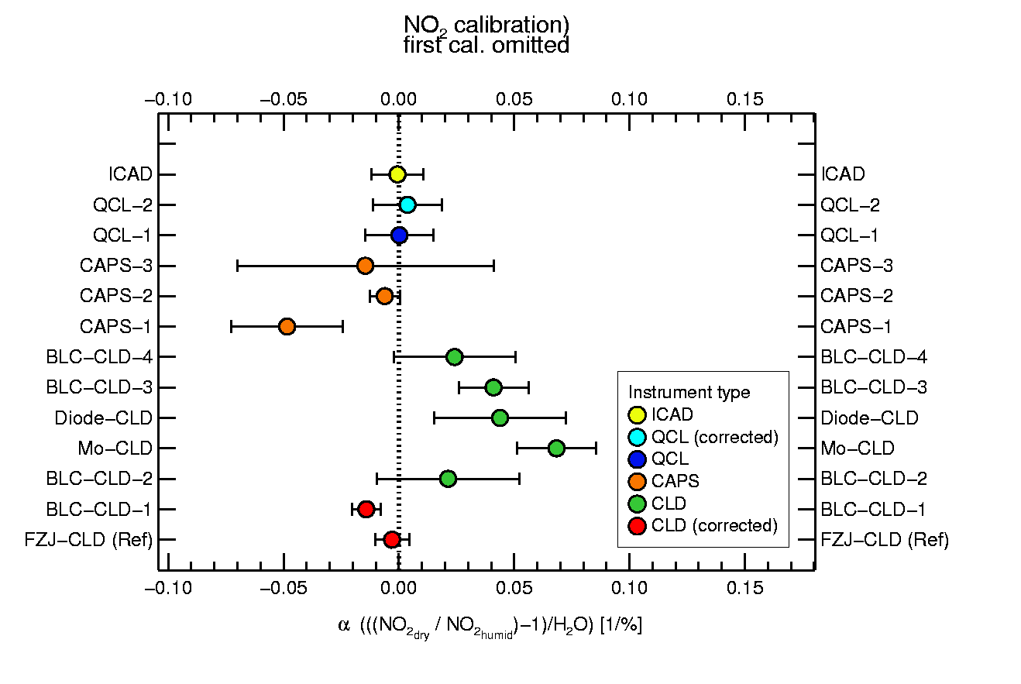
RESULTS
Influence of humidity
As the NO sensitivity, also the NO₂ sensitivity in the CLDs dropped by 3-4% per water mixing ratio in %.
In contrast, the NO₂ signal in one CAPS instrument was increased by the additional water in the cavity.
No effect was observed in the ICAD.
Recovery loss of NO₂ standards due to water in percentage loss per absolute humidity

Slide 15
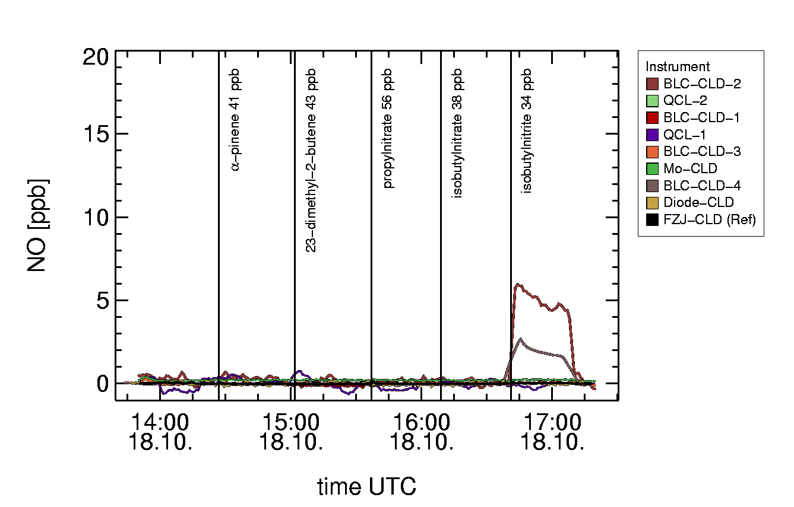
RESULTS
Interferences from alkenes, nitrates and nitrites
Alkenes, nitrates and nitrites were added to the joint sampling line.
The nitrite was used to simulate HONO interferences.
No response in the NO channels of the CLDs was observed after adding alkenes and nitrates.
Two CLDs showed interferences in the NO channel after adding isobutylnitrite.
NO time series when adding potential interfering compounds

Slide 16
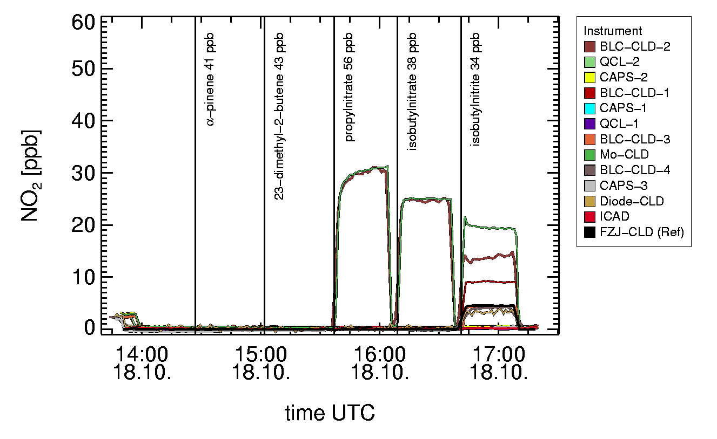
RESULTS
Interferences from alkenes, nitrates and nitrites
The CLD with the molybdenum converter and, remarkably, a CLD with a photolytical converter measured NO₂ after adding nitrates.
All CLDs showed interferences with isobutylnitrite.
The CAPS, the QCL and the ICAD did not show interferences.
NO₂ time series when adding potential interfering compounds

Slide 17
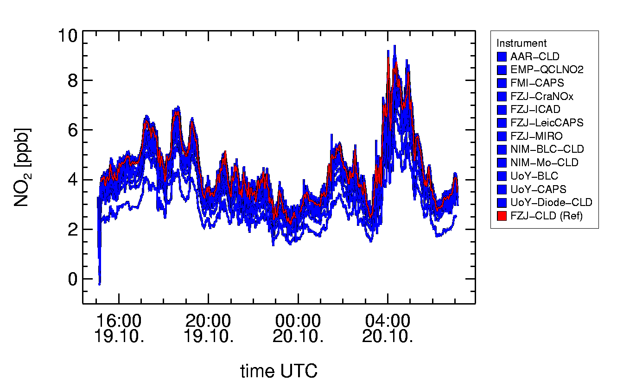
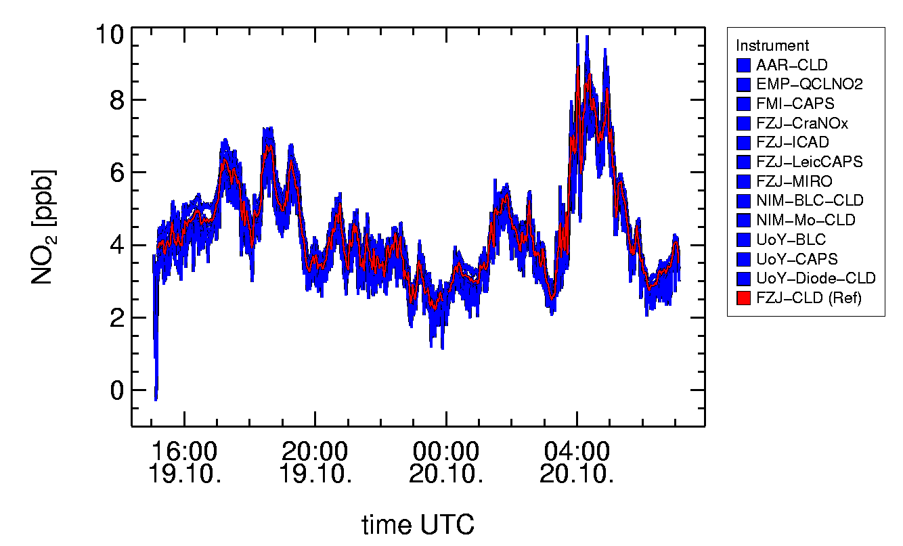
RESULTS
Ambient measurements
An Intercomparison of ambient NO₂ measurements was performed by sampling from the JULIAC tower. NO₂ values differed due to the scaling factors of the instruments. The differences could be reduced using the scaling factors from the joint calibrations.
Time series of ambient NO₂ measurements scaled to joint calibrations and corrected for humidity effects.
Time series of ambient NO₂ measurements.

Slide 18
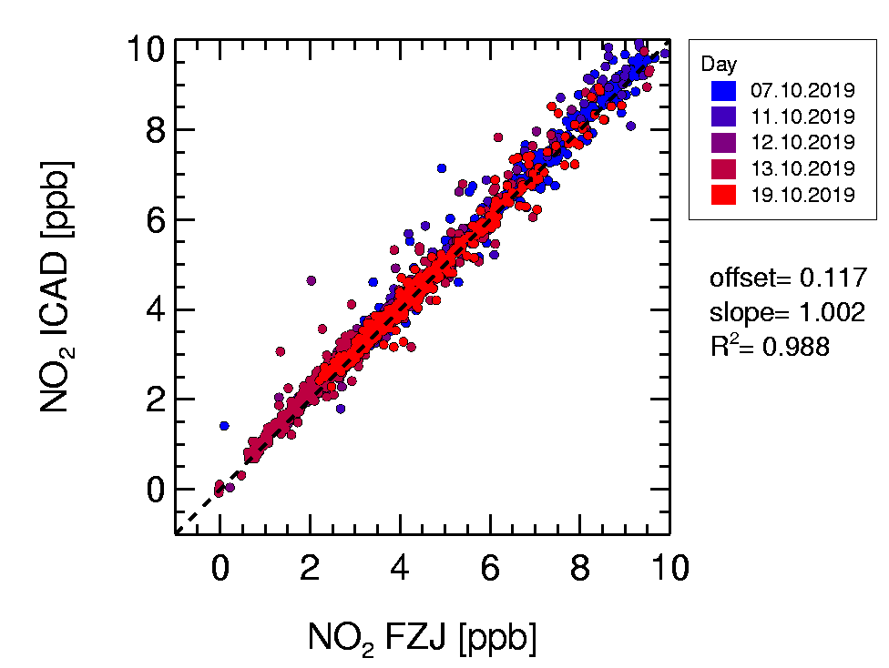
RESULTS
Ambient measurements
The ICAD showed an excellent correlation with the reference instrument with a slope of 1.
The slopes of the correlation plots of other instruments was mainly determined by the calibration and the humidity effect.

Slide 19
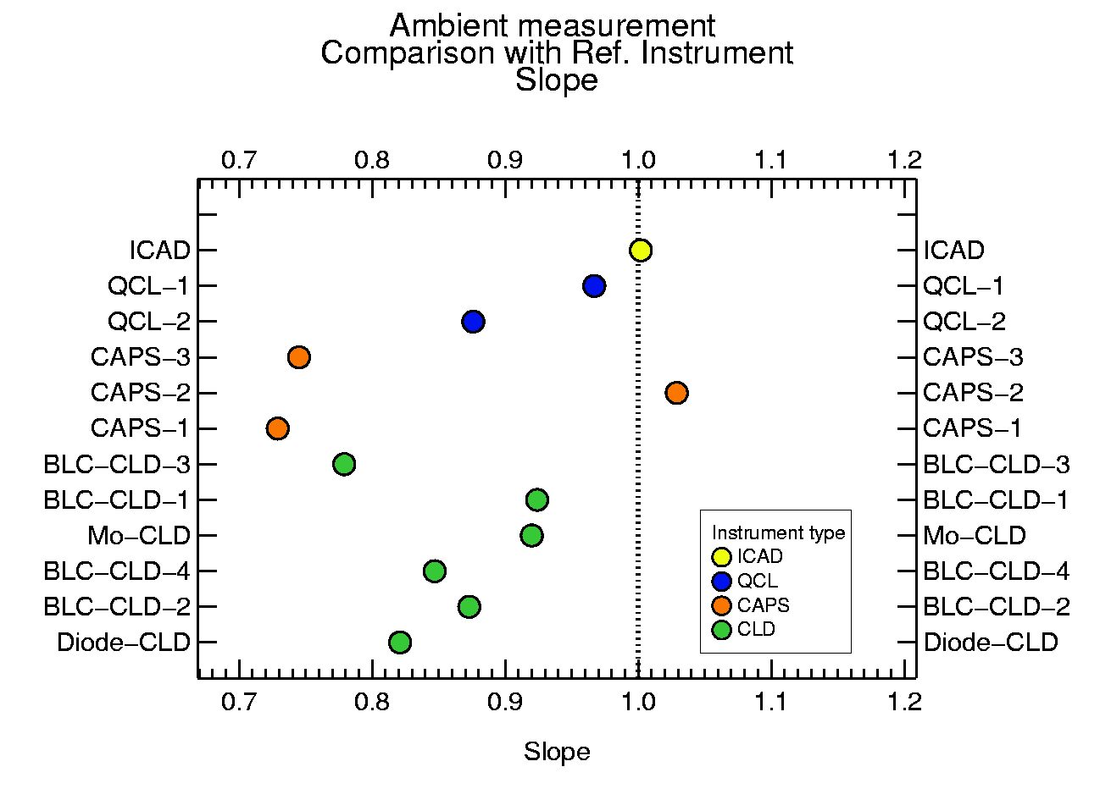
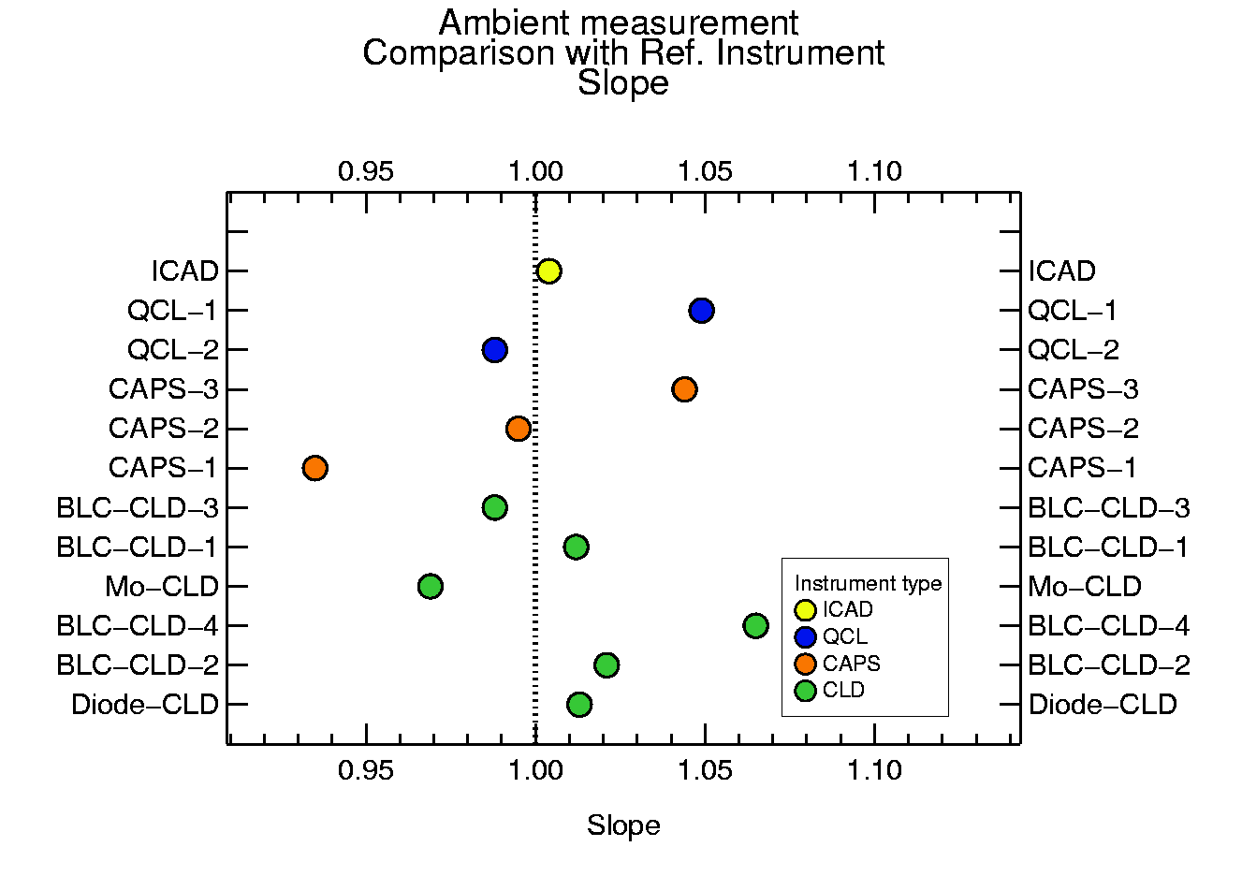
RESULTS
Ambient measurements
When comparing with the reference instrument the slope is between 0.7 and 1.05.
After scaling to the joint reference, the slope is between 0.92 and 1.07.
For all but one instrument R² is larger than 0.95.
Slope of all instruments with respect to the reference instrument. All instrumenents scaled to common standard and humidity corrected.

Slide 20
SUMMARY
Sensitivity:
When measuring the calibration standards instruments deviated between -30% and +10%.
Humidity:
CLDs showed loss of sensitivity under humid conditions, but this effect could be corrected.
Reference standards:
Calibration worked well with the NO₂ standards prepared within the MetNO2 project, but also with all the NO gas standards.
Interferences:
Not only molybdeneum but also one photolytical converter showed interferences with nitrates; all CLDs had interferences with isobutylnitrite and therefore potentially with HONO.
Ambient Measurements:
All instrument types showed good correlations with the reference instrument. Deviations can mainly be explained with the individual calibration procedures.
This intercomparison shows that the accuracy of NO and NO₂ can greatly be improved by improving the calibration procedures. Calibration Gas mixtures with NO and CO₂ should be used to track the dilution with precise CO₂ measurements.

Slide 21
THANK you
Forschungszentrum Jülich:
Franz Rohrer, Benjamin Winter, Zhaofeng Tan, Ulrich Bundke, Patrick Weber, Norbert Houben, Doreen Niether, Vaishali Vardhan, Sergej Wedel, Ralf Tillmann, Anna Novelli
German Weather Service (DWD)
Annika Kuß, Georg Stange, Robert Holla, Dagmar Kubistin
Finnish Meteorological Institute
Karri Saarnio
University of Aarhus
Claus Nordstroem, Jesper Nygaard, Tom Jensen
University of York
Naomi Farren, Simone Andersen, Will Drysdale
Eidgenössische Materialprüfungs- und Forschungsanstalt (EMPA)
Nicolas Sobanski
National Institute of Meteorological Sciences (South Korea)
Sumin Kim, Sepyo Lee
Federal Institute of Metrology METAS
Maitane Iturrate-Garcia
National Physical Laboratory NPL
Sivan van Aswegen, David R. Worton

