Slide 1

Ralph L. McNutt, Jr.¹, Mike Gruntman², Stamatios M. Krimigis^{1,3},
Edmond C. Roelof¹, Pontus C. Brandt¹, Kathleen E. Mandt¹, Steven R. Vernon¹, Michael V. Paul¹, and Robert W. Stough⁴
¹The John Hopkins University Applied Physics Laboratory, USA
²University of Southern California, USA
³Office of Space Research and Technology, Academy of Athens, Greece
⁴NASA Marshall Space Flight Center, USA
Interstellar Probe:
The Next Step
Session ST1.6
Exploration of the Heliosphere and the Interstellar Medium with IMAP and Interstellar Probe
D2818
EGU2020-6119
Live Chat
Wednesday, 06 May, 08:30–10:15 CEST
(2:30 – 4:15 AM EDT)

Slide 2
Study Status
Initial study phase awarded 13 June 2018
  Briefed to NASA HQ 7 March 2019
  Effort extended to cover presentations to workshop of the Russian Academy of Sciences in Moscow – Week of 27 May 2019
“Next Phase Concept Development” 25 July 2019
  Period of performance is 13 June 2018 through 30 April 2020
  6-month progress briefing to NASA HQ 29 January 2020
Comparable to Pre-Phase A work on “Solar Probe” 2002 – 2004
Technical Report to be delivered late 2021 for input to next Solar and Space Physics Decadal Survey

Slide 3
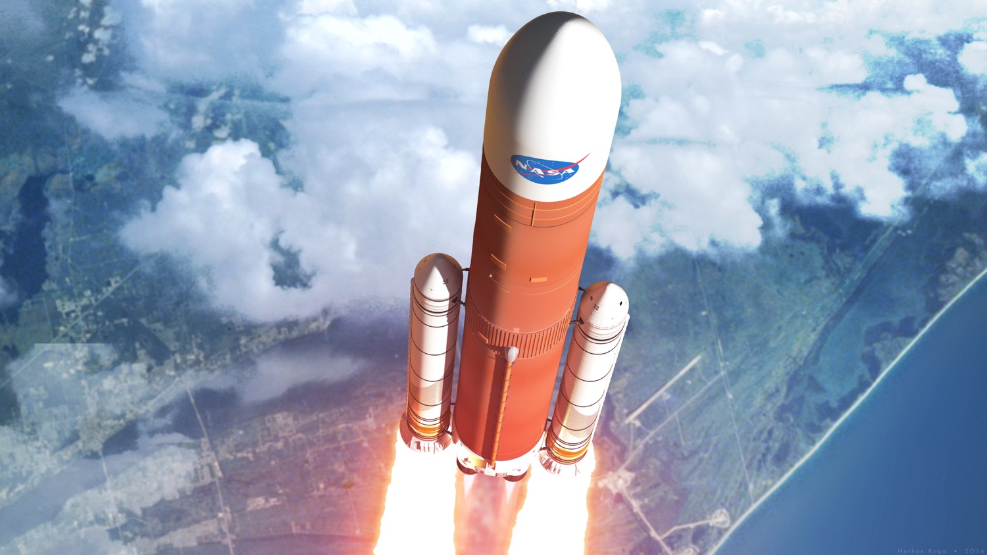
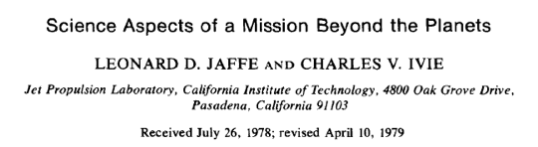
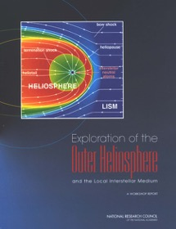
“Interstellar Probe”
… is a mission through the outer heliosphere and to the nearby “Very Local” interstellar medium (VLISM)
… uses today’s technology to take the first explicit step on the path of interstellar exploration (faster than the Voyagers – on an SLS or commercial equivalent)
… can pave the way, scientifically, technically, and programmatically for more ambitious future journeys (and more ambitious science goals)

Slide 4
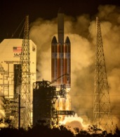
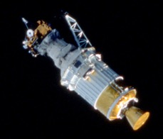
Three “Special Probes”… One Beginning
… and One To Go
Parker Solar Probe
✓
Parker Solar Probe: 12 August 2018 3:31 a.m. EDT
March 1960:
The “Simpson Committee”
Interstellar Probe
Ulysses
✓
Ulysses:
6 October 1990 11:47:16 UTC (STS-41 launch)

Slide 5
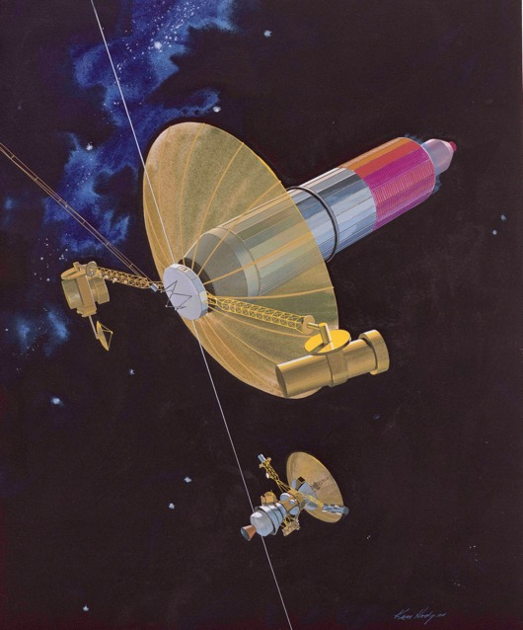
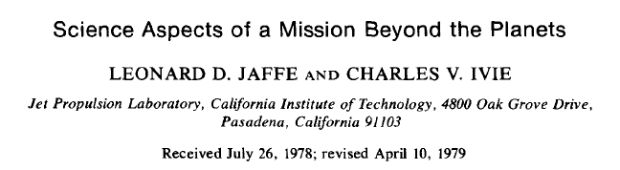
The Questions are not new…
THEN
JPL study of 1976 – 1977:
Primary Objectives
(1) Characterize the heliopause
(2) Determine characteristics of the interstellar medium
(3) Improve the stellar and galactic distance scale
(4) Determine characteristics of cosmic rays
(5) Determine characteristics of the solar system as a whole
Secondary Objectives
(1) Determine characteristics of Pluto and its satellites and rings, if any.
(2) Determine characteristics of distant galactic and extragalactic objects
(3) Evaluate problems of scientific observations of another solar system from a spacecraft
Pluto orbiter
32,000 kg launch mass
500 kWe, NEP system
20,200 kg of Hg propellant

Slide 6
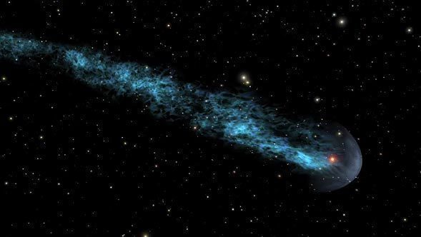
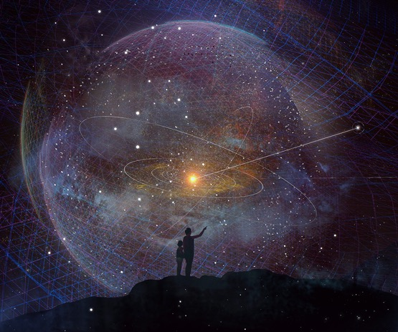
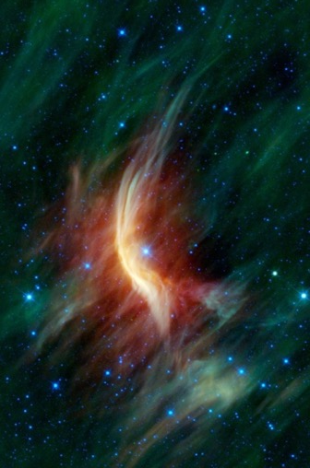
NOW: The Heliosphere: Our Habitable Astrosphere
We live in it, but we have never seen it
Mira
Red giant at 130 km/s
13 ly tail
Sol
G2V Main Sequence Star
24 km/s
Habitable
BZ Camelopardalis
Binary white dwarf and main sequence
125 km/s
LL Orionis
Pre-Main Sequence Star
Orion Nebula
IRC+10216
Carbon rich star at 91 km/s
Molecular wind and turbulence
GALEX/FUV
Zeta Ophiuchi
Run-away star at 24 km/s
Dust and gas nebula
Notes:
Our Sun carves out a magnetic bubble as it plows through the LISM – the galactic space between the stars. This “Heliosphere” (or Astrosphere) harbors all of our planets and most of the Kuiper Belt. Its solar magnetic field shields the inner planets from the so-called Galactic Cosmic Rays that are well known to affect atmospheric chemical evolution.
Of all the other “astrospheres” observed, none is like our own with a range of very different galactic environments:
Mira: A red giant traveling at 130 km/s with one of the longest tails ever observed stretching about 13 ly.
LL Orionis: A distinct bow shock formed in the strong interactions within the Orion nebula.
BZ “Cam” Camelopardalis: Binary system consisting of white dwarf and small main-sequence star. Traveling at 125 km/s forming a clear bowshock. Densities are estimated up to 35/cm3(!).
Zeta Ophiuchi: Run-away star at 24 km/s forming bow shock in a dust and gas nebula.
IRC+10216: The carbon rich star with a molecular wind expands an enormous circular astrosphere with turbulent interactions clearly seen on the down tail flanks. Its speed through the ISM has been estimated to 91 km/s.
The once we have observed are from more extreme systems than our own including run-away stars at high speeds, red giants, strong interactions with dust and molecular clouds in nebulae etc. A heliosphere like our own has never been observed due to its relatively faint UV intensities.

Slide 7
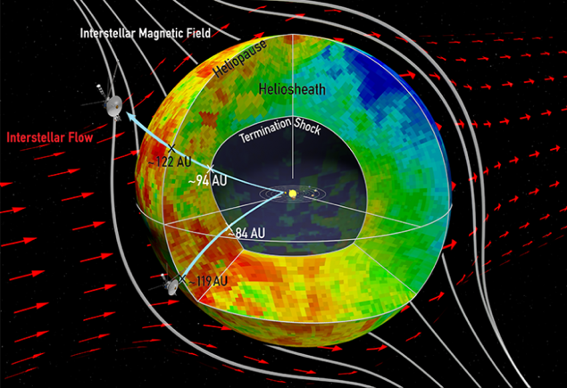
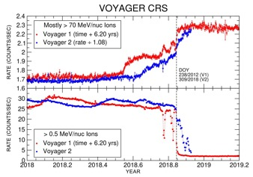
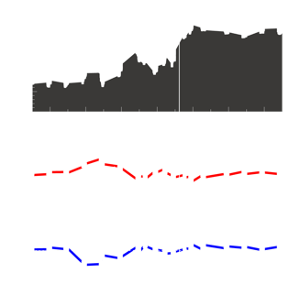
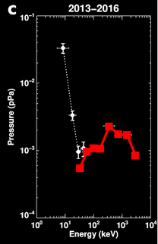
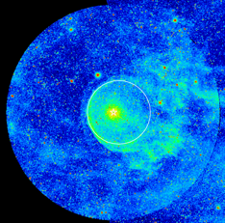
Voyager – The Accidental Interstellar Explorers
Uncovering a New Regime of Space Physics
Global Topology
Unexpected Field Direction
Cosmic Ray Shielding
Force Balance
Missing
Required
Hydrogen Wall
Measured
(Voyager)

Slide 8
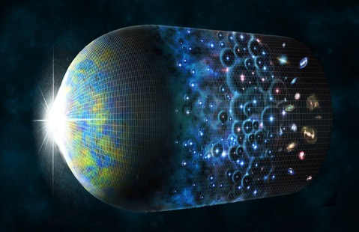
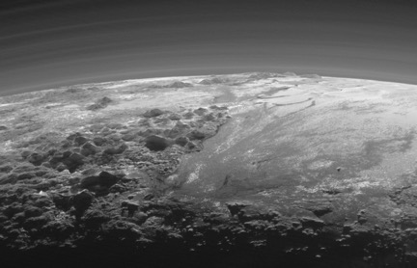
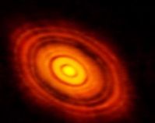
Opportunities Across Disciplines
Modest Cross-Divisional Contributions with High Return
Dwarf Planets and KBOs
Solar system formation
Extra-Galactic Background Light
Early galaxy and star formation
Big Bang
13.7 Gya
Today
Pluto
MU69
Circum-Solar Dust Disk
Imprint of solar system evolution
Sol 4.6 Ga
HL-Tau 1 Ma!
First Stars
& Galaxies ~13Gya
130 dwarf planets and over 4000 KBOs. Any direction defined by Heliophysics offers a at least one compelling flyby.
Beyond the obscuring Zodiacal cloud, IR observations can uncover the Extragalactic Background spectrum missing from our understanding of early galaxy formation.
Poppe+2019
A modest IR detector can reveal the large-scale disk structure critical for understanding the evolution of planetary systems.
Notes:
Dwarf Planets and KBOs: Kuiper Belt dwarf planets number over 120 and yet represent the least explored class of planet. Small KBOs are fossils of solar system formation and composition, and are in the thousands in the outer solar system
Before New Horizons Pluto was considered a barren body with little to no activity. Today we are talking about convecting nitrogen ice glaciers, giant migrating sand dunes, towering ice mountains and exotic geomorphology, potentially habitable sub-surface liquid water oceans, atmosphere, haze, and even clouds. Comparative planetology in the Kuiper Belt is in its infancy.
Only half the size of pluto is Quaoar, which conveniently lines up for a flyby in the 2040’s where the ribbon crosses the ecliptic. Observations indicate presence of fresh crystalline water and methane ices pointing toward cryovolcanism, and possibly a methane atmosphere, perhaps in its last stages of loss. One moonlet has been detected, weywot, whose orbital dynamics will provide insight in to how this pair formed.
Flyby observations in visible and near IR of one or more smaller KBO will compliment New Horizons’ exploration to provide leaps in our understanding of the diversity among these worlds,
Debris disks are the signposts of terrestrial planet formation and evolution. They are the remains from planet accretion and the constant collisions and grinding of between bodies. In particular, large impacts associated with the terrestrial planet accretion produce a dust remnant that prominent spectral features observable in the mid-infrared. Although a wide range of disks have been observed around other stars, the large-scale structure of our own is unknown because we are sitting inside of it. The IR emissions from the inner Zodiacal cloud completely drowns the emissions from the outer parts – It is like sitting inside a cloud trying to guess its shape.
So again, location, location, location: With a relatively modest IR detector, line-of-sight observations on an outward trajectory beyond the zodiacal cloud would enable the first retrievals of the large-scale structure.
HL Tauri: This surprisingly structured and evolved disk indicating planetary formation around a very young star.
The extragalactic background light (EBL) is the net one steradian of extragalactic (where milky way is not in the way) diffuse light in the sky, built up by the non-resolved light from all the galaxies and stars that have ever shined.
EBL consists of
Red shifted starlight (0.5-2 mm) in galaxies (z=2-5) and appearing at 1-10 µm (nearIR-CIB)
Red shifted stellar energy in galaxies (z=2-5) which has been absorbed by dust and re-emitted in the far-IR (30-100 µm) and which appears at 60-300 µm (farIR-CIB)
Light from early formation in the lesser-known “Reionization epoch” (“Reionization”: when the radiated energy from early objects reionized hydrogen in the universe).
Therefore, the EBL holds the collective knowledge of when and how galaxies and stars were formed,.
Because of the redshift, the IR emissions originating from roughly 200 million years after the big bang are obscured by our own zodiacal cloud.
Early galaxy formation is a an outstanding decadal question that several large astrophysics missions target. JWST finds and studies individual galaxies, but the diffuse EBL is impossible to detect from 1 AU since the Zodiacal Cloud completely masks the EBL in this important wavelength range. With modest measurements an Interstellar Probe uncovers the diffuse EBL on its outward trajectory with measurements starting already at 10’s AU.
So, again this is critical science enabled by location. Interstellar Probe would make pointed observations with the same dual-purpose IR detector as for the Debris Disk, supplemented with existing catalogs to remove contribution of galaxies and point sources.

Slide 9

A “Menu” Approach
Engage the science and technical communities
Assemble a “Menu” of what has been done and what can be done
“Ordering” from the menu will be a charge to a future Science Definition Team – at NASA’s discretion
But one always would like the assurance about what orders can be placed – and delivered – and what they would cost

Slide 10
Notional Science Traceability Matrix
Identifying Requirements for Mission Designs
Goal | Questions | Objectives | Measurements | Mission Requirements
Our Habitable Astropshere in Interstellar Space | What is the Global Dynamical Nature of the Heliosphere as it plows through the ISM? | Global Structure | Particles, fields, waves, ENA | Spinning, external view, ≥200 AU
 |  | Ribbon/Belt | ENA, particles, fields | Spinning, image, in-situ ribbon, ≥200 AU
 |  | Force Balance | Particles, fields, ENA | Spinning, 90-300 AU
 |  | Astrophysical Shock Acceleration | Particles, fields | Spinning/multiple heads, flanks, ≥90 AU
 |  | Nature and dynamics of Heliopause | Particles, fields, waves | Spinning, wire/rigid, ≥100 AU
 |  | GCR Shielding | Particles, fields | Spinning/multiple heads, ≥100 AU
 |  | Solar perturbations in LISM | Particles, fields | Spinning/multiple heads, ≥300 AU
 |  | Bowshock | Particles, fields, nanodust | Spinning, ≥150 AU
 |  | Hydrogen Wall | UV, particles, fields, neutrals | Near ram, spinning, ≥300 AU
 | What are the properties of the Interstellar Cloud surrounding the Heliosphere and what does it teach us about our place in the galaxy? | Cloud properties | Particles, fields, neutrals | Near ram, ≥200 AU
 |  | Gas and dust flows | Particles, neutrals, dust | Near ram, ≥200 AU
 |  | Boundary region | UV, particles, neutrals | Near ram, ≥400 AU
 |  | Governing processes of ionization | UV, particles, neutrals | Near ram, ≥200 AU
 |  | Galactic Evolution and Nucleosynthesis | Elements, isotopes, dust | Near ram, ≥400 AU
 |  | Building blocks of planetary systems | Dust | Near ram, ≥200 AU
Version 4.0
In Progress – Continuing community input encouraged!

Slide 11
An Instrument Menu (not payload)
Discoveries Enabled by Destination, not by New Measurements
Instrument | Mass (kg) | Power (W) | Data rate (bps) | Reference/Heritage
Vector Scalar Magnetometer | 1.9-2 | 3.4-4.5 | 2-3600 | In dev., Cassini
Fluxgate Magnetometer | 1.2-5.6 | 2.2-5.1 | 120-3600 | MESSENGER, Voyager, Cassini
Plasma Wave Instrument | 1.4-15.5 | 1.1-14.2 | 16-7500 | Galileo, PSP, VAP, Voyager
Solar Wind and PUI | 6-8 | 5-10.8 | 504-1500 | In dev. (PSP, IMAP, ACE)
Suprathermals and Energetic Ions | 3.3-12.6 | 2.8-30.5 | 280-10500 | In dev. (Solar Orbiter, PSP, NH, IMAP)
Cosmic-ray spectrometer | 3.6-31.6 | 5.4-12.2 | 160-464 | Solar Orbiter, Ulysses, PSP, Voyager, ACE
Dust Detector | 1.9-3.6 | 5 | 579-900 | NH, LADEE
Interstellar Dust Analyzer | 10 | 13 | 10 | In dev. (Europa Clipper, IMAP)
Neutral Ion Mass Spectrometer | 10 | 23.3-49 | 1495-20000 | In dev. (JUICE, Rosetta, Cassini)
Low-Energy ENA | 11.5-20.75 | 3.5-13.1 | 100-500 | In dev. (IMAP, IBEX, IMAGE)
Medium-Energy ENA | 7.4-13.9 | 0.7-22.5 | 99-4300 | In dev. (IMAP, IBEX, IMAGE)
High-Energy ENA | 6.9-7.4 | 3-7.6 | 500 | In dev. (JUICE, Cassini, IMAGE)
Ly-alpha Spectrograph | 13.3 | 11 | 200 | SOHO
UV (50-180 nm) | 4.5-25.4 | 3.5-28 | 600-3800 | Voyager, NH, DMSP
VisIR Instrument | 9-10.5 | 4.5-15 | 10 | NH, DART
VisIR Spectral Mapper | 4 | 3 | 10 | In dev.
Magnetometer Boom (5 m) | 4.2 | N/A | N/A | MESSENGER
Rigid PW Boom (30 m) | 7.2 | N/A | N/A | MMS
Wire PW Boom (57 m) | 4.3 | N/A | N/A | MMS
Scanning ENA Platform | 6 | N/A | N/A | Scaled from ENA missions
V4.1
In Progress – Continuing community input encouraged!

Slide 12
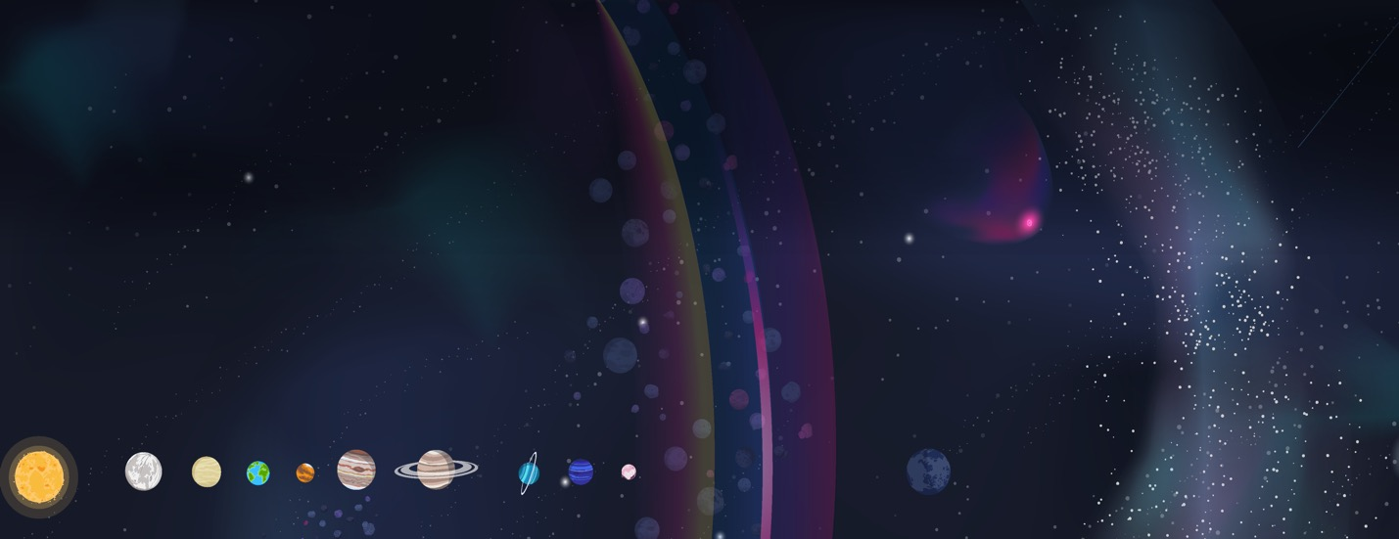
Notional Operations Scenarios
Identifying Architecture Drivers
Inner Heliosphere Phase
Helio only
Spin up after JGA/SOM then deploy wire antennas
Particles, Fields, and ENA Observations with wire antenna, possible astrophysics augmentation
Outer Solar System Phase
Helio-only
No flyby
Particles, Fields, and ENA Observations with wire antenna, possible astrophysics augmentation
Helio-focused + planetary augmentation
  Spin down for flyby and spin back up
  Flyby Observation, Particles, Fields, and ENA Observations with rigid antenna, possible astrophysics augmentation
Outer Heliosphere Phase
  Spin Stabilized
  Prime Particles, Fields, ENA, UV, IR Observations
Interstellar Phase
  Spin Stabilized
  Prime Particles, Fields, ENA, UV, IR Observations
Helio-focused + planetary augmentation
Deploy rigid antennas after JGA/SOM and spin up
Particles, Fields and ENA Observations with rigid antenna, astrophysics augmentation possible
1 AU
0 y
40 AU
5 y
70 AU
9 y
200 AU
25 y
≥500 AU
60+ y
In Progress – Continuing community input encouraged!

Slide 13
Fly-Out Directions
Highest Level Science Trades
Estimated Times:
[Terminal Shock @ 90AU / Heliopause @120AU / @500AU]
†Estimated Path
Direction | Heliophysics | Planetary | Astrophysics | Passive Option | Powered Option
~45˚ off nose | Through ribbon (~285˚ ELON) Good for imaging from outside Good for ISD | Quaoar is close wRibbon KBOs – Ixion, 2014HF200, Varda, Huya, 2002MS4 | ☺ | W2040: EJ-Helio ~7.86AU/yr [ TS 11.5yr / HP 15.3yr / 63.6yr ] 2030: EJ-Quaoar wRibbon ~ 6.8 AU/yr †2037: EJ-Orcus wRibbon ~ 7.0 AU/yr | E2037: EJ-Helio ~8.22AU/yr [ TS 10.9yr / HP 14.6 yr / 60.8 yr ] †2037: EJ- 2013FS28 ~ 8.0 AU/yr 2040: EJ-Quaoar wRibbon ~ 8.1 AU/yr
Nose | Fast way to LISM Stagnation, high-pressure region, force balance Good for ISD Not through max ribbon Not optimal for imaging from outside | KBOs – 2010ER65, 1996GQ21, Deucalion, 2015KF172 | ☺ | 2039: EJ-Nose ~7.36AU/yr [ TS 12.2yr / HP 16.3yr / 67.9yr ] E2038: EJ-Helio ~7.65AU/yr [ TS 11.8yr / HP 15.7 yr / 65.4 yr ] †2039: EJ-Sat-Deucalion ~ 7.7AU/yr | 2038: EJ-Nose ~8.08AU/yr [ TS 11.1yr / HP 14.9 yr / 61.8 yr ] E2038: EJ-Helio ~8.22AU/yr [ TS 10.9yr / HP 14.6 yr / 60.8 yr ] †2038: EJ-2015KF172 wRibbon ~ 8.1 AU/yr
Flank (~90˚) | HP data point important for shape ACR acceleration May be longer to reach LISM Not in the ribbon Dust duty cycle limited | KBOs – 2007OR10, 2014SV349, Pluto, 2014FJ12 Makemake, Haumea UL4’s – 2011QF99, 2014YX49 | ☺ | W2030: EJ-Helio ~7.94AU/yr [ TS 11.3yr / HP 15.1 yr / 63.0 yr ] †2030: EJ-Pluto ~ 7.7 AU/yr †2036: EJ-Orcus wRibbon ~ 7.0 AU/yr | W2030: EJ-Helio ~8.408AU/yr [ TS 10.7yr / HP 14.3 yr / 59.5 yr ] †2035: EJ-Sat-Varuna ~ 7.7 AU/yr †2030: EJ-2007OR10 ~ 7.7 AU/yr
~135˚ off Nose | Problematic for dust Sufficiently close to the direction of CMA Maximum outbound speed area | Ice Giants Flybys Eris (limited time in 250 years) | ☺ | W2032: EJ-Helio ~8.01AU/yr [ TS 11.2yr / HP 15.0 yr / 62.4 yr ] 2032: EJ-Nep-Eris ~7.44 AU/yr 2032: EJ-Eris ~ 8.0 AU/yr | W2032: EJ-Helio ~8.5AU/yr [ TS 10.5yr / HP 14.1 yr / 58.8 yr ] 2031: EJ-Salacia ~ 6.8 AU/yr
Tailward | Problematic for dust Sufficiently close to the direction of CMA | KBOs – Lempo, Sedna, Biden NL4’s – 2001QR322* Neptune Flybys | ☺ | 2033: EJ-Helio ~7.97AU/yr [ TS 11.3yr / HP 15.1 yr / 62.7 yr ] †2033: EJ-Biden ~ 7.7 AU/yr | 2033: EJ-Helio ~8.46AU/yr [ TS 10.6yr / HP 14.2 yr / 59.1 yr ] †2033: EJ-2018VG18 (Farout) ~ 8.3 AU/yr
Off Ecliptic (U/N) | Jets, turbulence Towards EUV ionizing stars (CMA) Not through ribbon (tailward) | Ice Giant Flybys U/N only gives ≤~10° No radial dust distribution | ☺ | †2034: EJ-Ur-2007UK126 ~ 7.5 AU/yr | †2033: EJ-Ur-2006QH181 ~ 7.7 AU/yr
In Progress – Continuing community input encouraged!

Slide 14
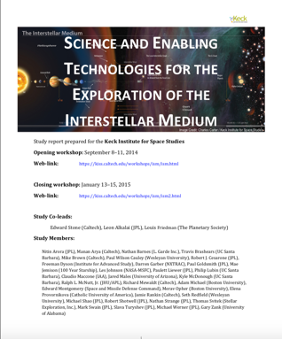
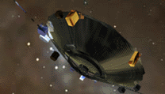
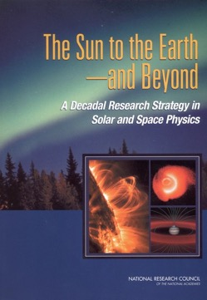
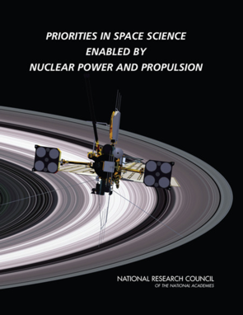
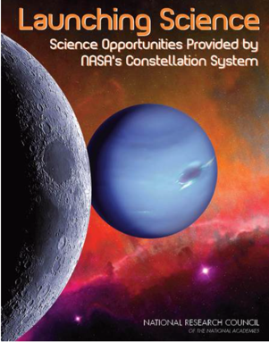
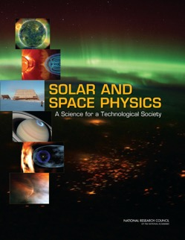
The Central Technical Question Has Always been Propulsion
“Near-future” capabilities have always been the backdrop for defining requirements
The real issue: unite compelling science with engineering and technical reality
The philosophy that led from “Solar Probe” at APL in 2002 to Parker Solar Probe launch in 2018

Slide 15
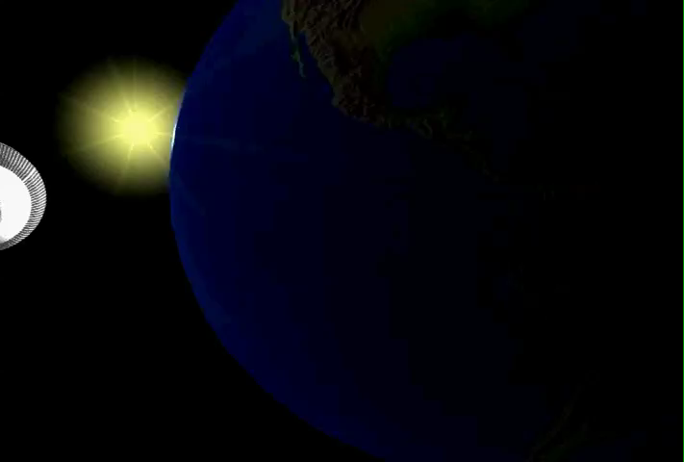
Mission Concepts are ALL Ballistic
Low-thrust, in-space concepts limited by mass to power ratio
Option 1: Unpowered Jupiter Gravity Assist (JGA)
  All propulsion at launch
Option 2: Active Jupiter Gravity Assist
  Final stage burn in Jupiter’s gravity well
Option 3: JGA + Oberth Maneuver Near the Sun
  Burn final stage at (close) perihelion
22 staging cases studied; guidance and control and thermal studies ongoing for solar Oberth scenario

Slide 16
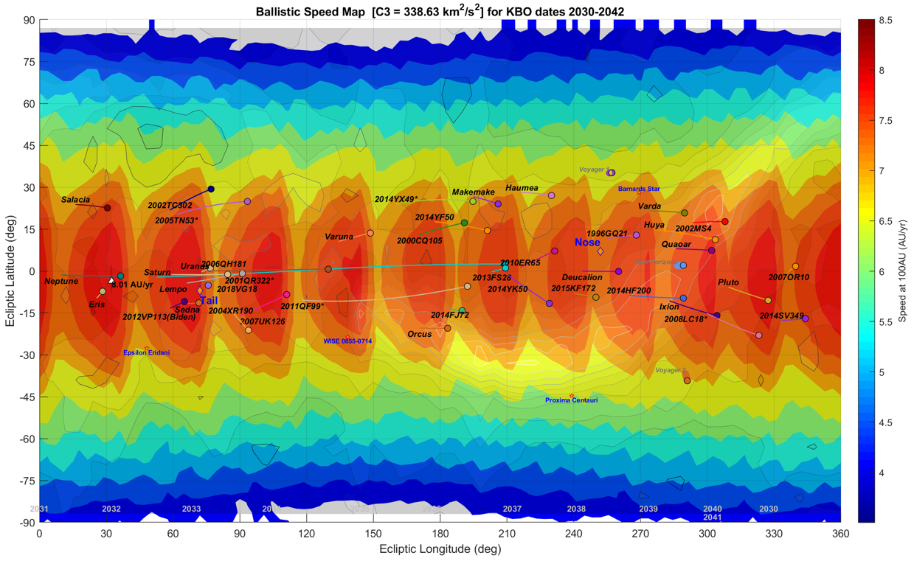
Example: Passive Flyby EJ-Direct Option
Ballistic (Passive) Jupiter Flyby Skymap (or Speedmap)
  Achievable ecliptic lat/lon from launches [2030, 2042] and solar escape speed rating with passive Jupiter flyby

Slide 17
Example Model Payloads
Mapping the Spacecraft Requirements Trade Space
Mass | Options | In-situ Plasma Physics (Particles, Mag) | Remote ENA Imaging (Low, Med, High) | Plasma Waves | ISM (Ly-a ,mass spec) | Dust (Analyzer, IR) | KBOs (UV, Vis, IR) | EBL (IR)
Option 1 (40 kg) | a) Heliophysics Core
 | b) Planetary Augmentation
 | c) Astrophysics Augmentation
Option 2 (80 kg) | a) Heliophysics Core
 | b) Planetary Augmentation
 | c) Astrophysics Augmentation
Option 3 (120 kg) | a) Heliophysics Core
 | b) Planetary and Astrophysics Augmentation
V2.2
Wire/rigid/no antenna
Flyby/No Flyby
In Progress – Continuing community input encouraged!
Notes:
Analogies for masses
NH, Cassini?, Voyager:ish

Slide 18
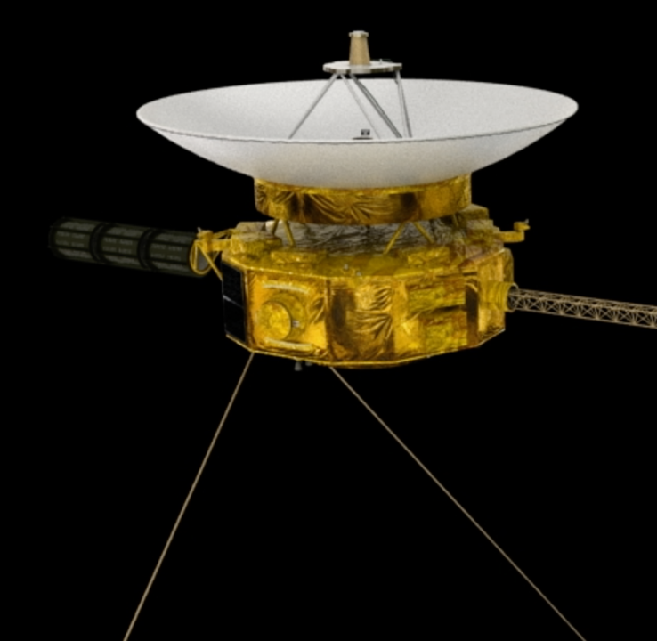
Engineering Requirements
Broad engineering requirements frame the study
(1) Readiness: Launch no later than 1 January 2030
(2) Downlink: Operate from 1000 astronomical units
(3a) Power (BOM): No more than 600 Watts required (Initially 400 W)
(3b) Power (EOM): No less than half of the BOM amount available
(5) Longevity: Lifetime of not less than 50 years
These are INDEPENDENT of each other – the starting point

Slide 19
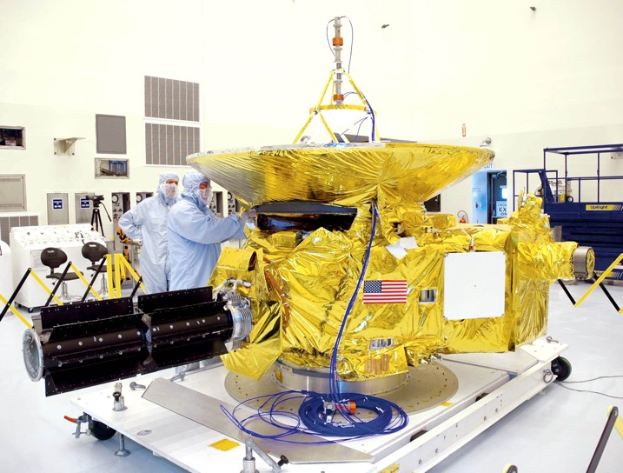
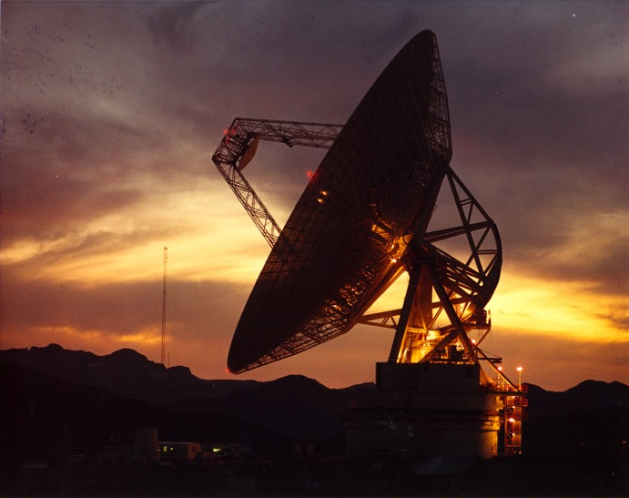
Critical Trade-Offs Are Not New
Mass: Driven by flyout speed and payload capability
Communication: Solid, near-term, tested engineering
Speed versus payload mass
Pointing versus data rate

Slide 20
Example: Telecommunications X-band versus Ka-band
Data rates limited by pointing capability of spin-stabilized spacecraft
Secondary link effects impact this trade
High accuracy secondary pointing possible, but must be traded against longevity (e.g., reaction wheels)
Link closes with low-risk assumptions
  Body-mounted HGA
  HGA Diameter = 5m (Fairing Diameter)
Current pointing capability (spin-stabilized) = 0.2°
Pointing Error of .079° required for Ka-band
HGA Optimization for Body-Mounted Design
Ka-band
Downlink
X-band Downlink
Break-Even Point: .079°
Current Capability: .2°
HGA Diameter = 5 m
6 May 2020
20

Slide 21

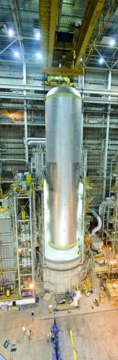
Enabling Technologies and Not New
Power: GPHS/MHW derivative RTG – efficiency and lifetime for use in vacuo
Propulsion/Launch Vehicle: Keys for implementation
SLS LH2 tank
GPHS–RTG
MHW–RTG

Slide 22
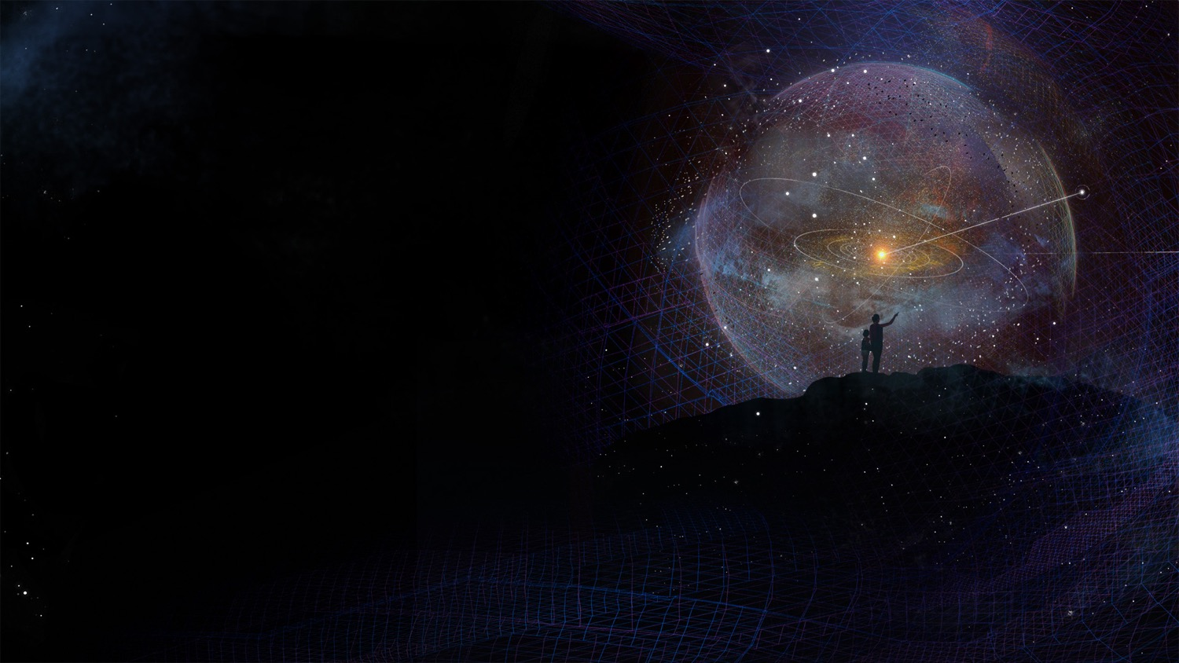
… | Oct 19 | Nov 19 | Dec 19 | Jan 20 | Feb 20 | Mar 20 | Apr 20 | May 20 | Jun 20 | July 20 | Aug 20 | Sep 20 | Oct 20 | … | Sep 21
 | Wksp 2019 |  |  |  |  |  |  |  | Prelim Results | ACE Run |  | Interim Report | Wksp 2020 |  | Final Report
Longevity
SC lifetimes/failures, long-lasting systems, failure modes
Develop process of failure modes and accelerated testing
Instruments
Candidate payload components with parameters + operating requirements
Define baseline payloads
Science
Trajectory / Launch Vehicle
ConOps
ACE Run
Interim Report
Work-shop Input
Revise Report
Final Rprt
Comm and GNC trades
Heat Shield
Attitude control at burn
High temp coating
If yes, define ConOps parameters
ACE = APL Concurrent Engineering Laboratory
Engineering requirements:
400 W
Launch-able 1/1/30
>50 years
>1000 AU
Mechanical
Design spacecraft layout
Power
Compare NG-RTG, GPHS-RTG and MHW-RTG using GPHS components

Slide 23
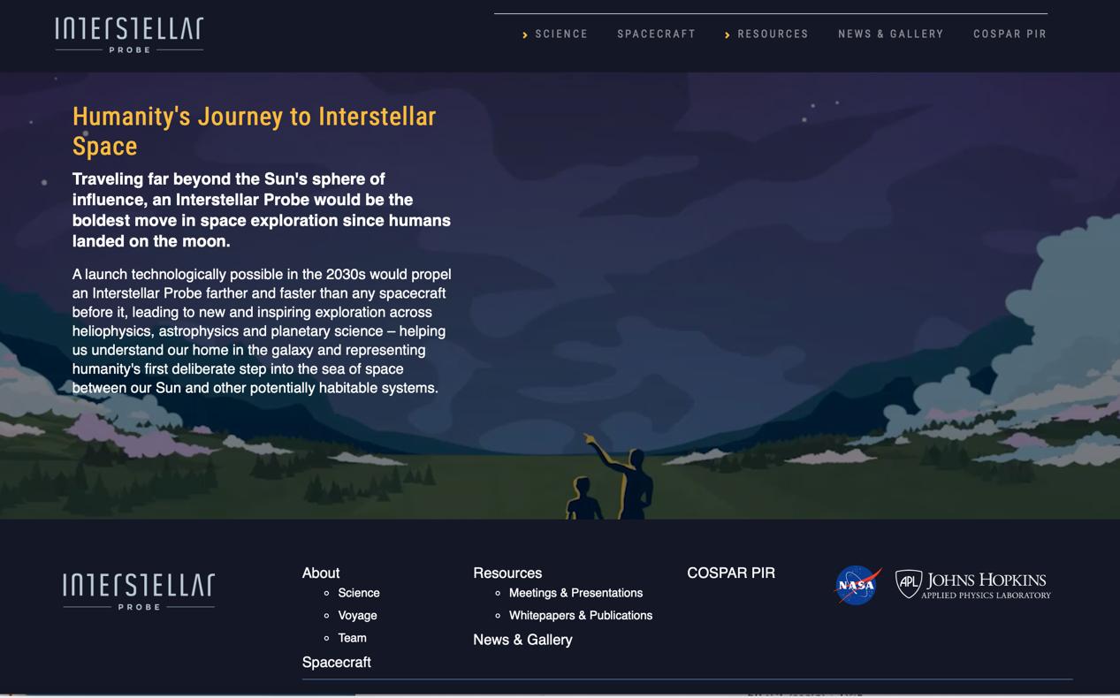
Want To Stay in Touch?
See the website http://interstellarprobe.jhuapl.edu

Slide 24

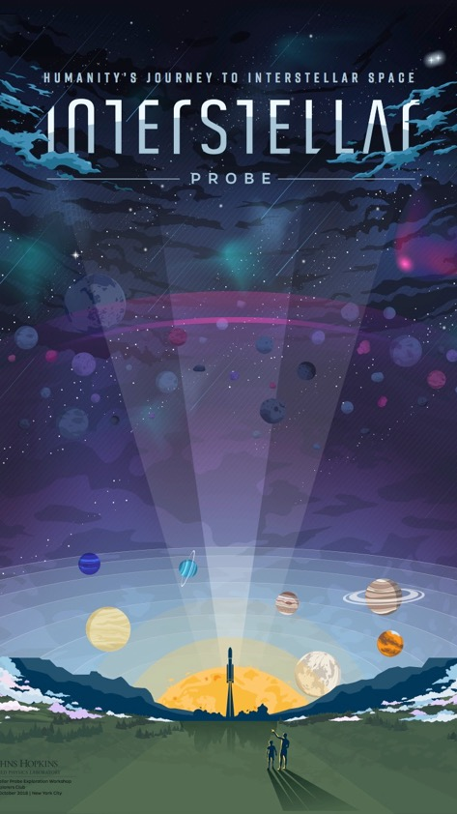
The real journey has only just begun…
From the Sun
to the Stars

