Slide 1
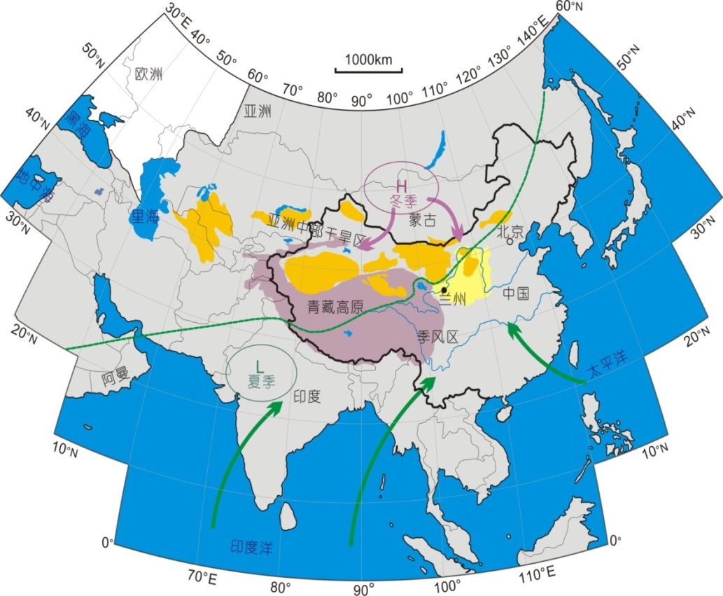
Monsoon imprints on spatiotemporal patterns of wildfires in SW China
Questions:
1) How do monsoon affect the interannual dynamics of wildfires in Yunnan ?
2) What are the teleconnection patterns between wildfires in Yunnan and two monsoon systems in southern Asia?
West Pacific
Monsoon
Indian Ocean
Monsoon
Notes:
Yunnan province in southwest China locates at the north corner of the global wildfire hotspot region of Indo-Malay Peninsula, where the climate is jointly affected by two monsoon systems, the Indian Ocean Monsoon and the West Pacific Monsoon. In the context of ocean-atmospheric interaction studies, the two monsoon systems are regulated by the corresponding ocean warm pools, and quantitative metrics were developed to measure the influence of the two warm pools on corresponding monsoon activities, i.e. Indian Ocean Warm Pool area index (IOWPAI) and strength index (IOWPSI); West Pacific Warm Pool area index (WPWPAI) and strength index (WPWPSI), respectively. Since the outbreak time and intensity determine that of the summer precipitation in Yunnan, the importance of monsoon activities have been recognized to wildfire activity in southeast Asia, as well as in Yunnan, although direct evidence and quantitative estimates are rare.

Slide 2
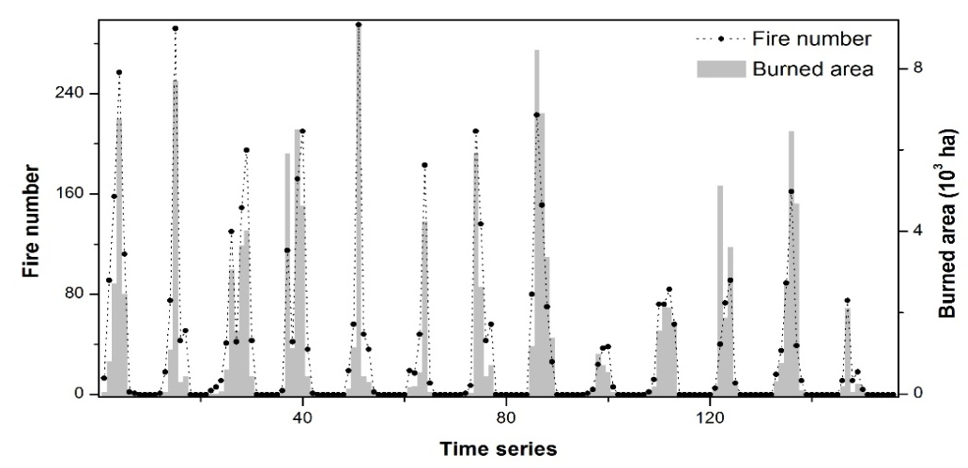
Monsoon imprints on spatiotemporal patterns of wildfires in SW China
Interannual dynamics of wildfires & warm pool indices
Wildfires in Yunnan are positively synchronized with the Indian Ocean Warm Pool Anomaly Index (IOWPAI);
and they are negatively synchronized with the West Pacific Warm Pool Anomaly Index (WPWPAI)
5146 fire events in the period of 2003-2015
In average 396 fires per year, with a burned area of 1.08×10³ha
Notes:
Our data is based on monthly ground records of forest fires in thirteen years, or 156 month in all, and the distribution of these fire events in all 136 grid cells of 50km*50km area within the range of Yunnan. The temporal autoregression model was applied to fit the time series of monthly fire numbers and burned area, and Augmented Dickey-Fuller Test was used to test the stability of the models. Results showed that the models passed the tests, and R2=35.24% and 23.96% for fire number model and burned area model, respectively.
The two area indices WPWPAI and IOWPAI revealed more prominent impacts, in contrast to the strength index, on the temporal dynamics of fire numbers and burned area, and IOWPAI and WPWPAI had opposite temporal rhythms, synchronized positively and negatively with wildfire activities in Yunnan. Zero-inflated GLM models were fitted for the effects of monsoon index on Yunnan fires, resulted in R2=54.7% for IOWPAI on fire number variability, and R2=37.8% for IOWPAI on burned area variability, with higher IOWPAI value corresponding to more intensive wildfires; R2=36.5% for WPWPAI on fire number variability, and R2=26.3% for WPWPAI on burned area variability. India Ocean Monsoon has more prominent influence than west pacific monsoon on Yunnan wildfire variability.

Slide 3
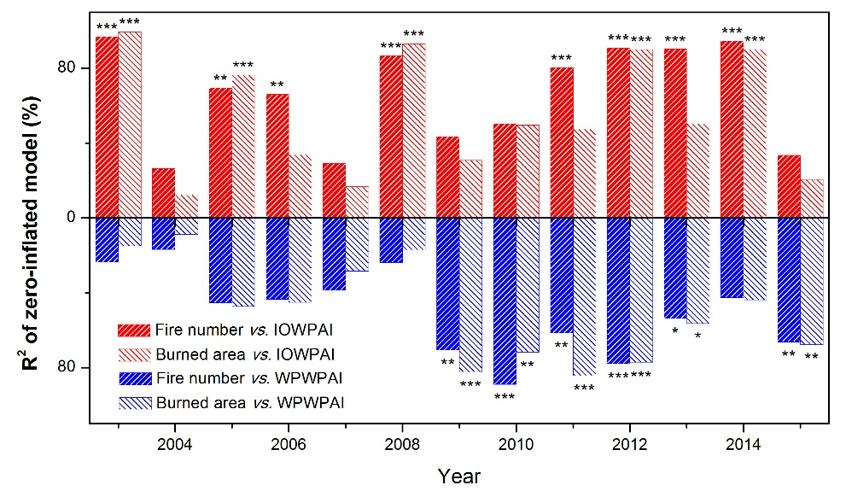
Monsoon imprints on spatiotemporal patterns of wildfires in SW China
Dynamics of contribution of two warm pool indices on wildfires in Yunnan
Notes:
However, there are interannual variation for the relative roles of two monsoon systems to wildfires in Yunnan. In eight out of thirteen years, IOWPAI outcompete WPWPAI in influencing wildfire numbers and burned areas in Yunnan, while WPWPAI dominated in the other five years.

Slide 4
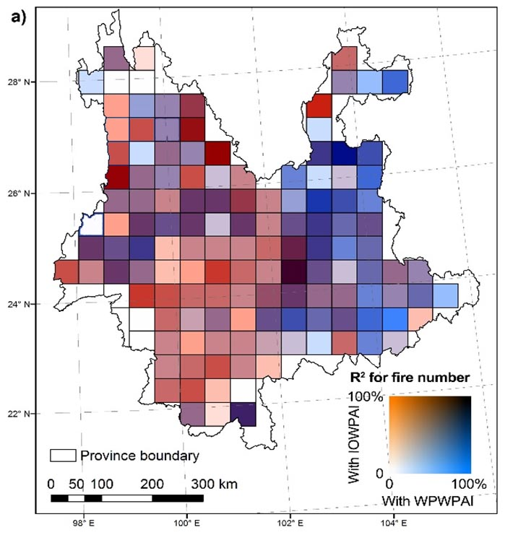
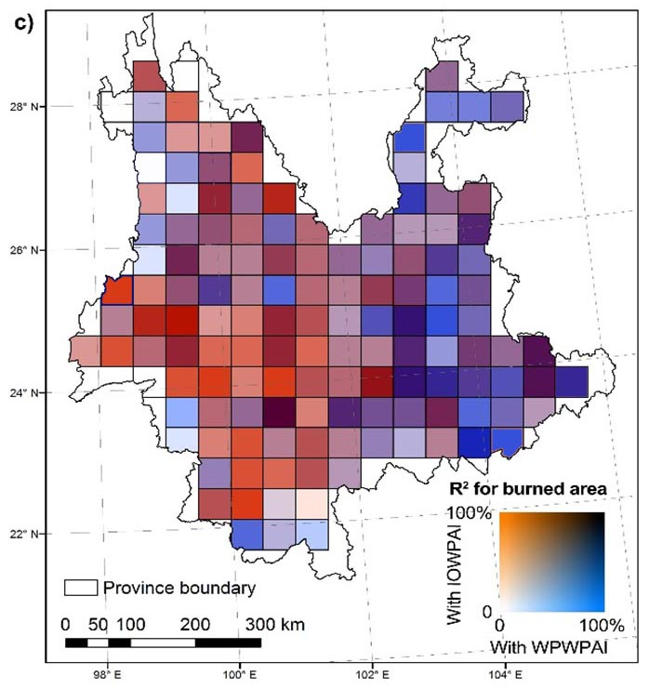
Monsoon imprints on spatiotemporal patterns of wildfires in SW China
Spatial patterns of the contributions of two monsoon warm pools on wildfires in Yunnan
Notes:
When fitted models for each of 136 grid cells of 50km*50km in Yunnnan, for both wildfire numbers and burned area, the dominant role of two monsoon systems revealed longitudinal gradients. On the western part of Yunnan, the zero-inflated GLMs has a larger R2 for IOWPAI than for WPWPAI, while on the eastern part of Yunnan, models for WPWPAI on both wildfire number and burned area had larger valus of R2 than the models for IOWPAI. This confirmed that, the wildfire activities are jointly affected by the two monsoon system, and the boundary of their influential ranges pass through Yunnan in China.

