Slide 1

Experimental determination of magnesite solubility in aqueous fluid under subduction zone conditions
Li Wancai, Wang Qinxia, Ni Huaiwei
2020.05

Slide 2
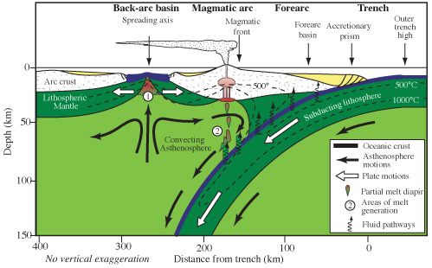
subducting slab dehydration and Volatiles migration
Dehydration of subducted oceanic slab, cause the arc magmatism, and also transfer a lot of volatiles, such as C and S, back to the surface.
Aqueous fluid, hydrous melt and supercritical fluid derive from subducted slabs are the carriers of volatites.

Slide 3
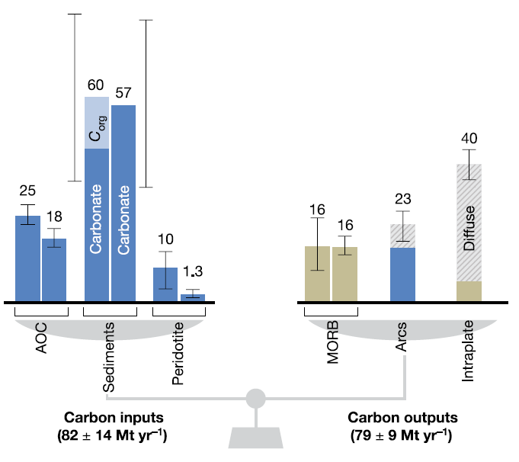
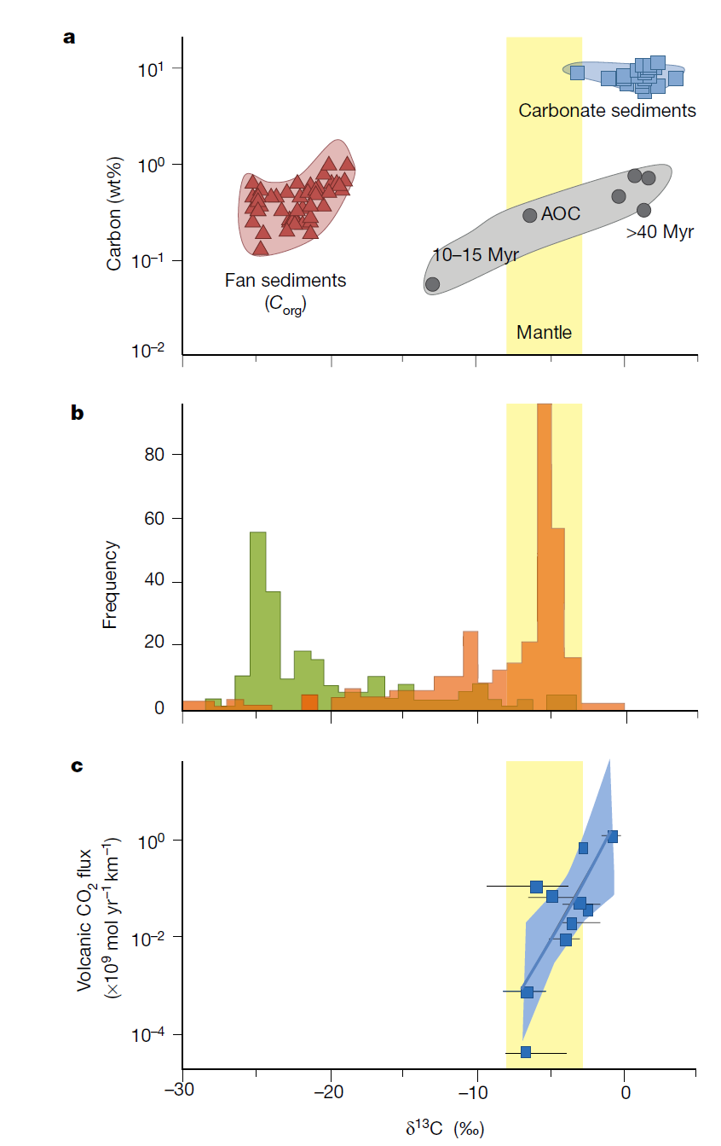
Carbon migration in subduction zone
Subducted Carbon
Diamond
Three main process remove the subducted Carbon：
Arc magma
mechanical removal
metamorphic decarbonation (Dissolution/Reaction)
Melting decarbonation
Plank and Manning, 2019 Nature

Slide 4
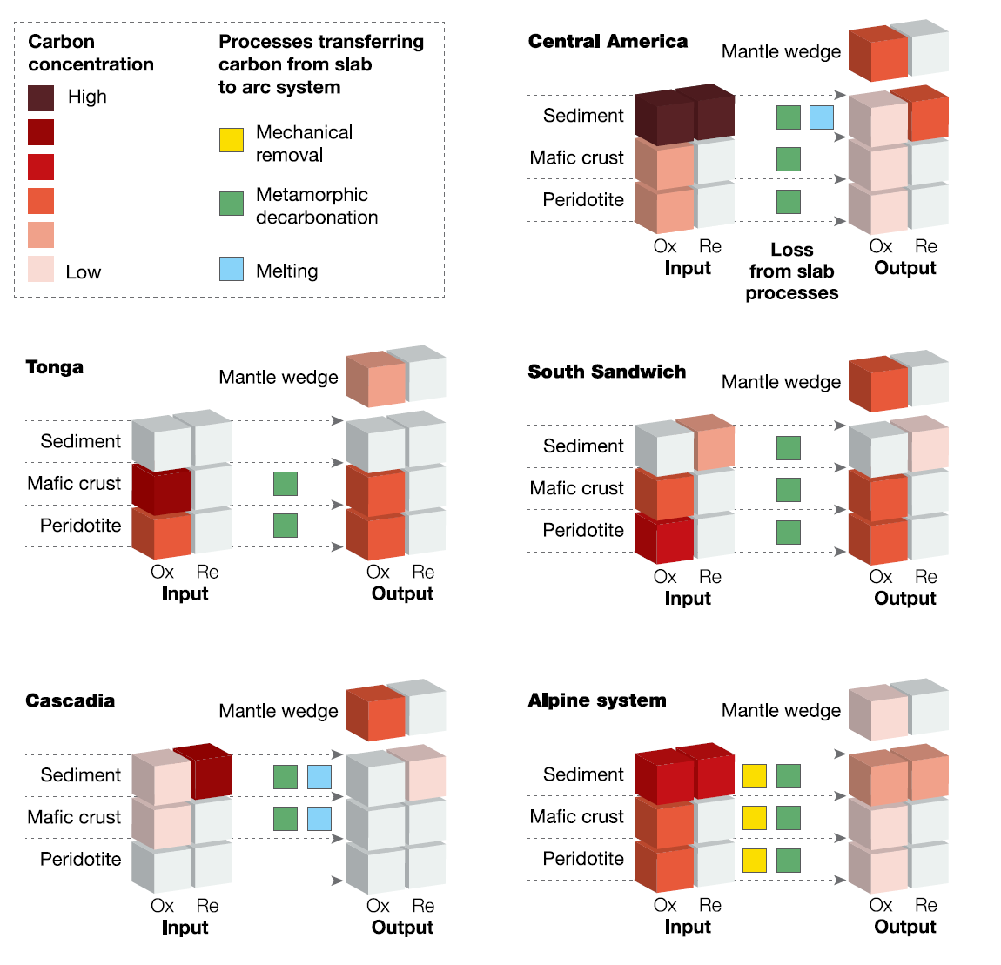
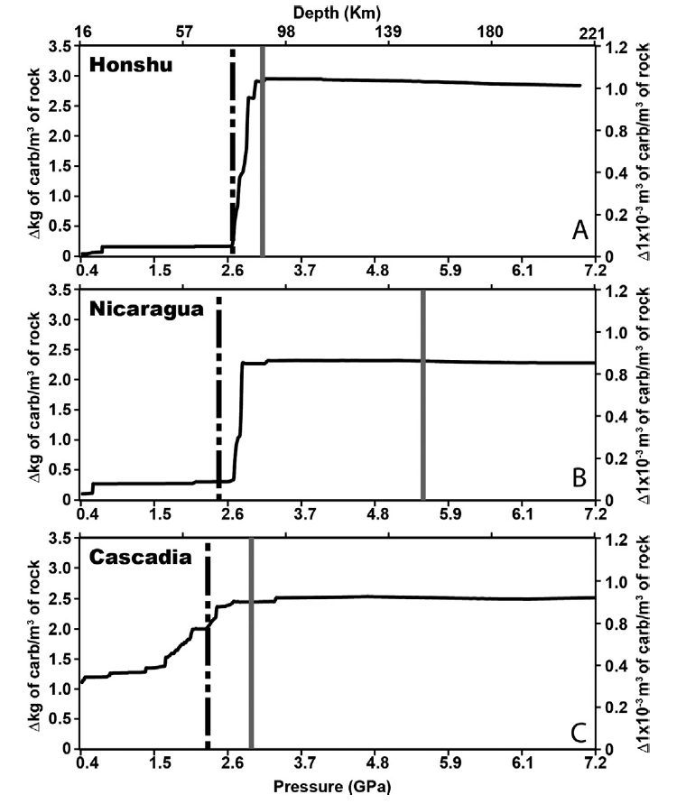
Metamorphic decarbonation
Blueschist
eclgite
Plank and Manning, 2019 Nature
Metamorphic decarbonation is the most common way, closely related to the dehydration
subarc
Gorce et al., 2019 EPSL

Slide 5
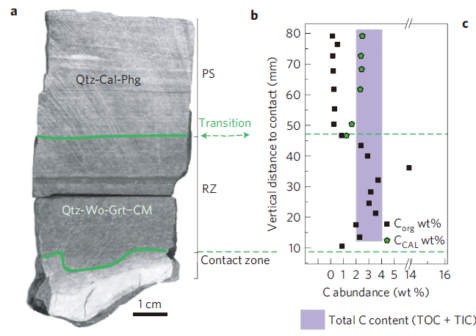
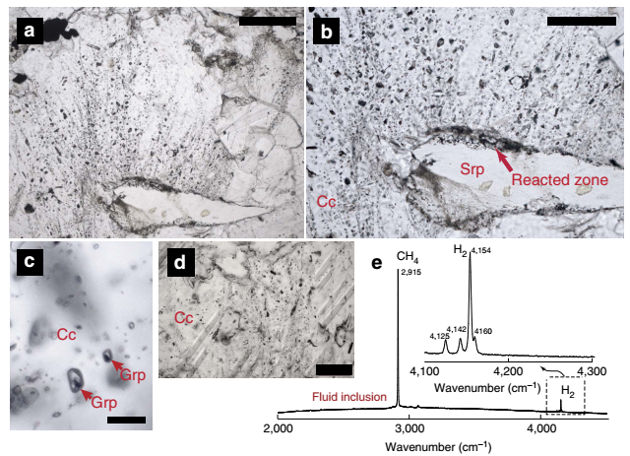
Carbonates dissolution/reaction
~0.9-1.5 GPa, ~430℃
~550–600 ℃，2–2.5 GPa
Galvez et al., 2013 NG
Brovarone et al. 2017, NC
In Alps，graphite and CH₄-H₂ bearing inclusions were found at the interface of carbonate and serpentinite, indicates the calcite was reduced, and the silicates are produced.

Slide 6
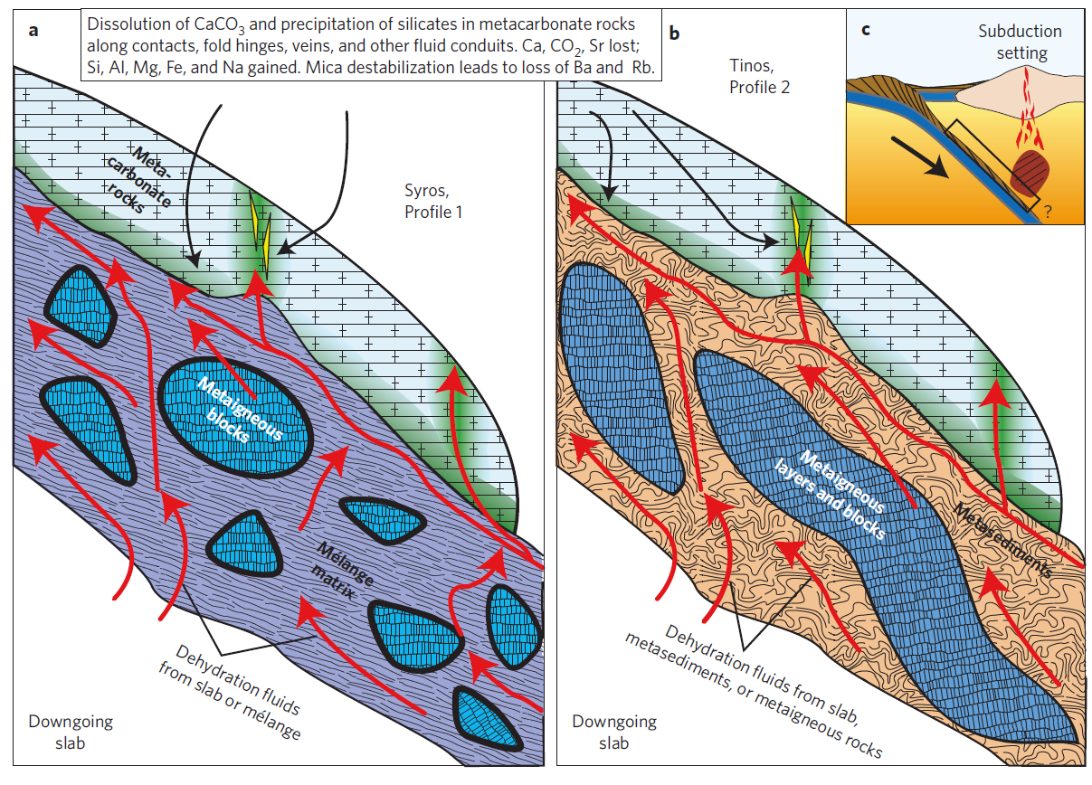
Carbonates dissolution/reaction
500-550℃，
~2.0GPa
50%-80% of initial Carbonate
Alps：at the interface of carbonate and silicate rocks, a lot of calcite dissolve，
precipitate silcates and release CO₂
Ague and Nicolescu, 2014
Piccoli et., 2016
Notes:
We suggest that
fluid-mediated carbonate mineral removal, accompanied by
silicate mineral precipitation, provides a mechanism for the
release of enormous amounts of CO2 from subduction zones.

Slide 7
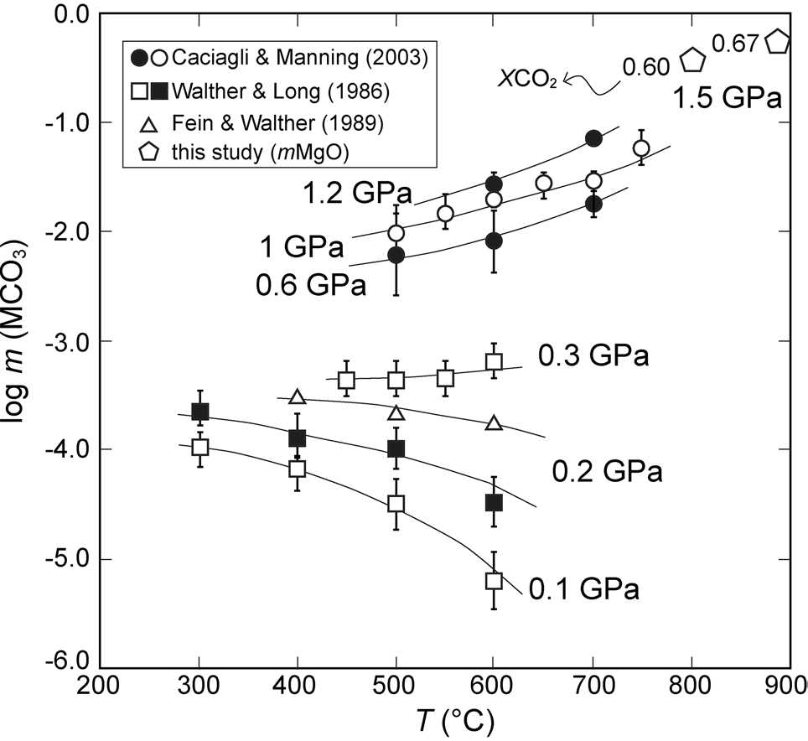
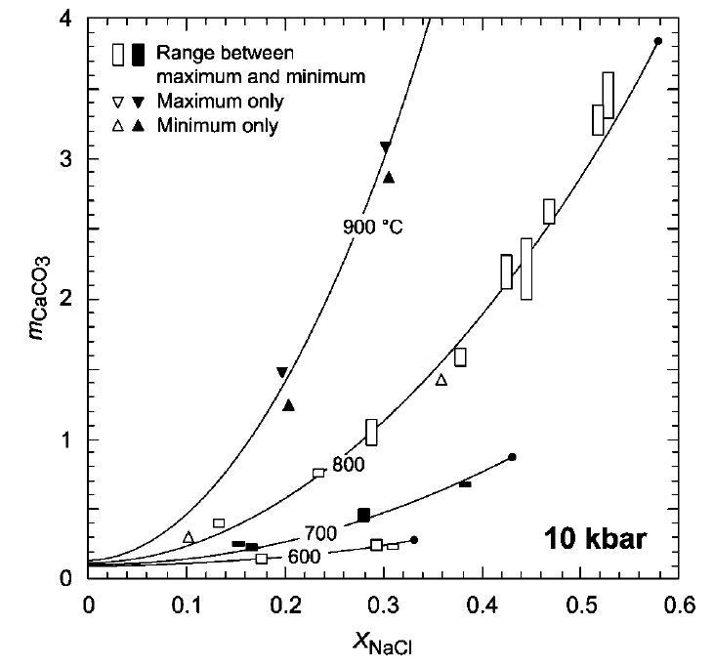
Carbonates solubility—experimental measurement
En buffer
Pure water
NaCl Solution
Tiraboschi et al., 2017
Newton and Manning, 2002
Solubility data of carbonates are very limited；
The experimental data mostly under low T high P or low T high P conditions, unable to calculate the carbon flux of subduction zone

Slide 8
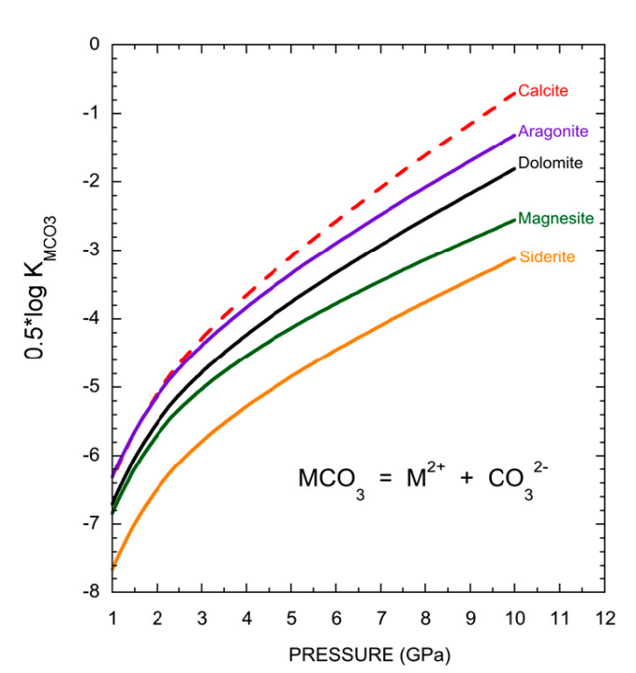
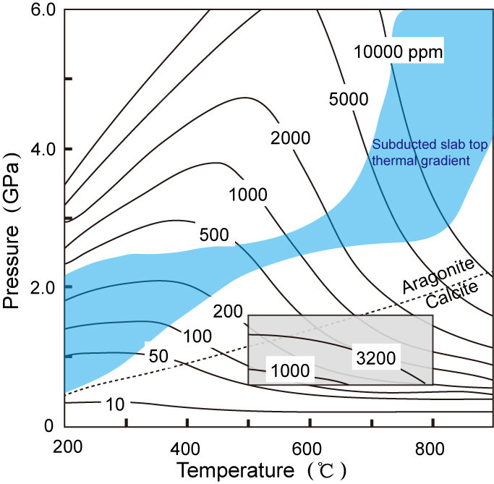
Carbonates solubility—theoretical calculation
Molecular dynamics simulations
Thermodynamic calculation
1000K
Pan et al., 2013 PNAS
Kelemen & Manning,2015 PNAS
Higher than experimental results
Kelemen & Manning: all of subducted carbonates can be dissolved in aqueous fluid, few can be going to the deep.

Slide 9
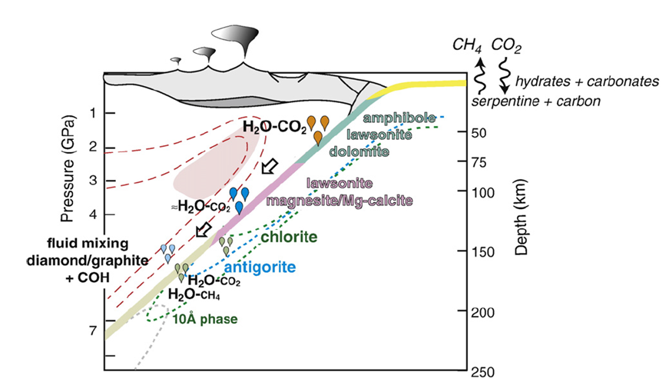
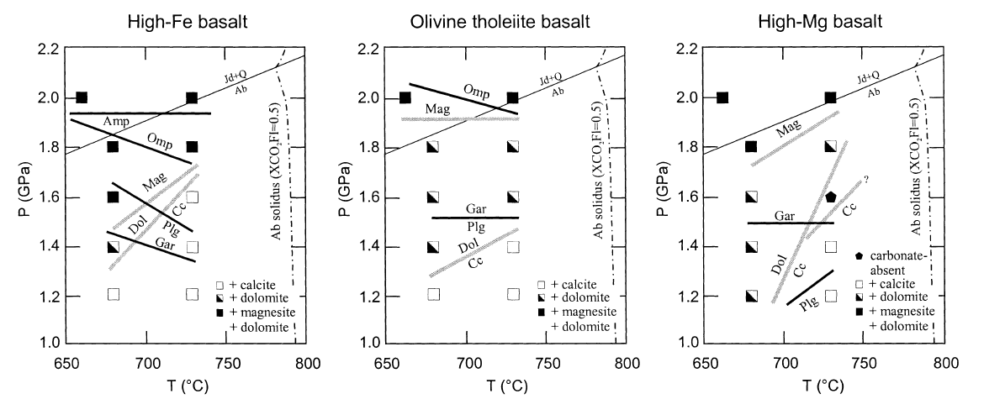
Phases of subducted carbonates
+ H₂O-CO₂ Fluid
Magnesite is one of the subarc carbonates
Molina and Poli 2000, EPSL
Poli et al. 2009, EPSL

Slide 10
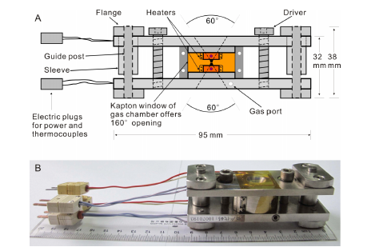
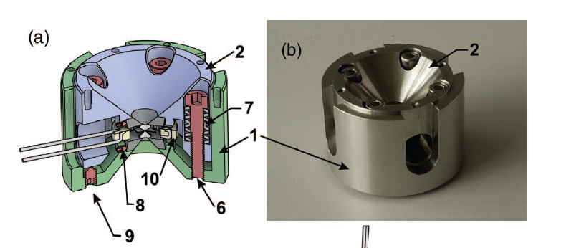
Experimental measurement of Magnesite solubility in water
In situ measure the solubility of magnesite in Hydrothermal Diamond Anvil Cell (HDAC)
Method: quantitative magnesite and water were sealed in HDAC, increasing the temperature until the magnesite totally dissolved.
P-T conditions： up to 3.0 GPa，950℃
Starting material：Natural magnesite crystal
Pressure index：¹³C diamond，magnesite
Bassett HDAC
Temperature error：in 5 ℃
Pressure error：about 0.1 GPa
Solubility relative error：20%
BX90 HDAC

Slide 11
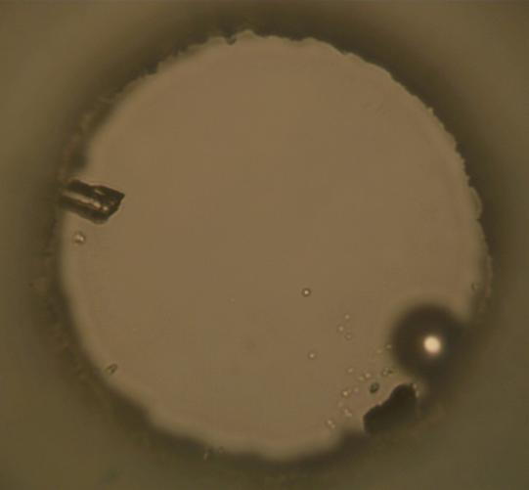
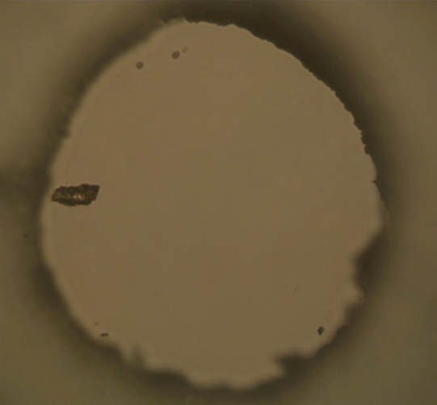
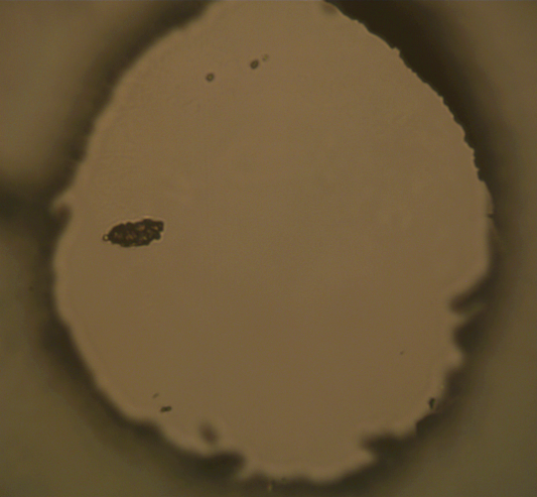
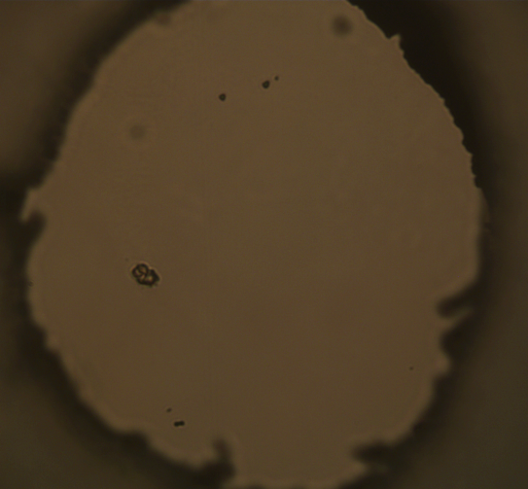
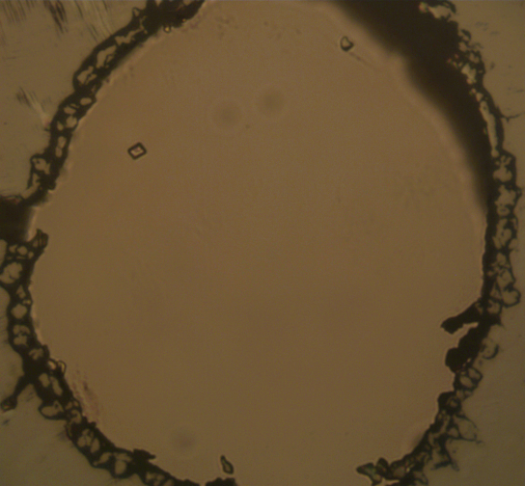
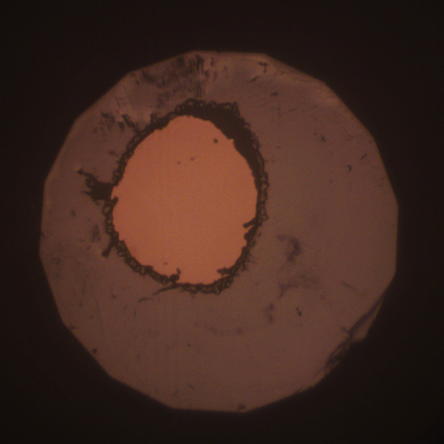
Experiment
Congruent dissolution, recrystallization in the process
24 ℃
400 ℃/1.65GPa
500 ℃/1.75GPa
Solubility：
635 ℃/2.24 GPa：
0.010 mol/Kg H₂O
(867 ppm)
600 ℃/2.02GPa
612 ℃
635 ℃/2.24GPa
Notes:
20191027 BX90-3

Slide 12
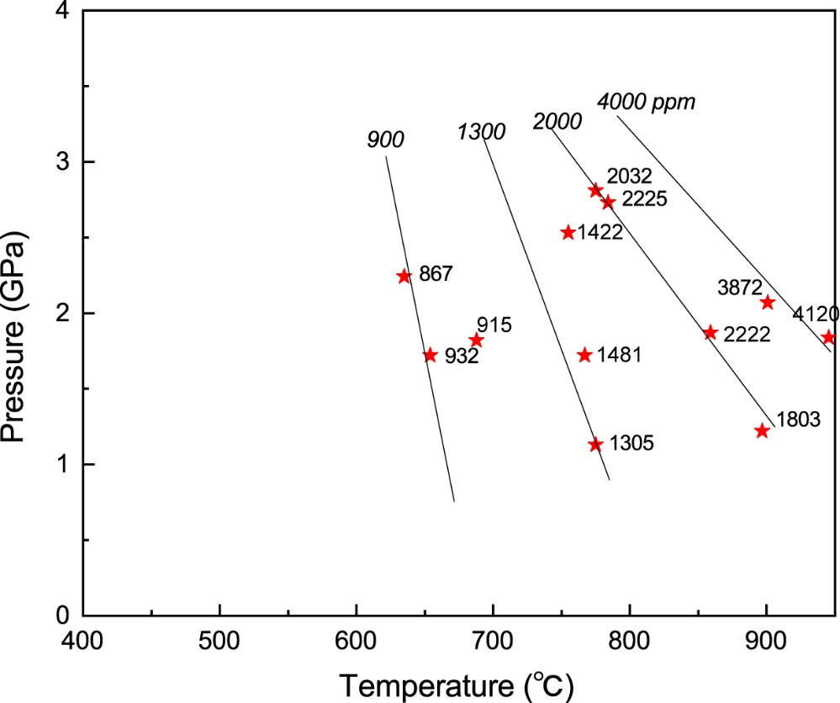
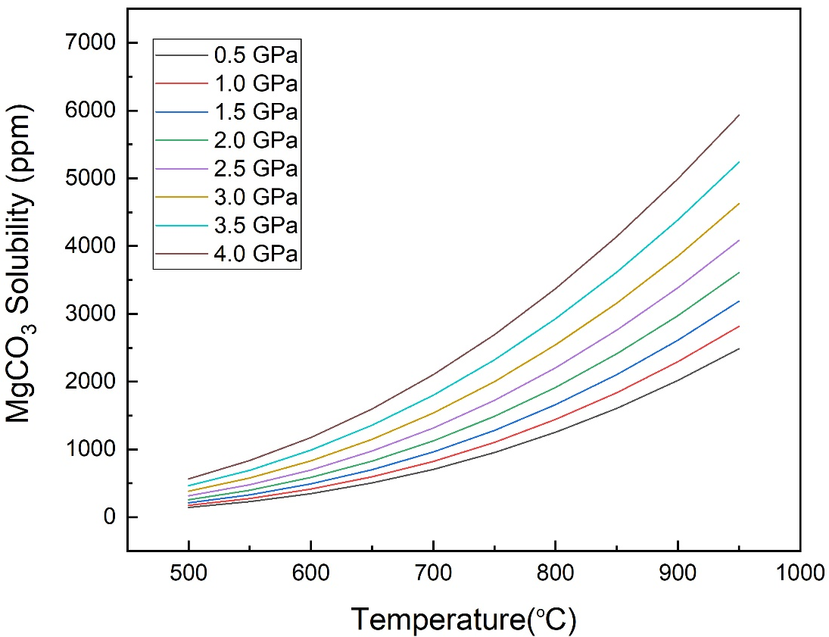
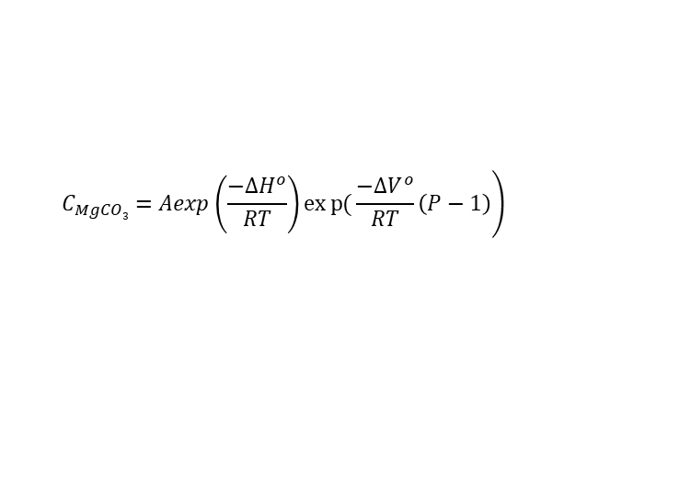



Results
Solubility of magnesite in water
$$\left.C_{MgCO3}=Aexp\left(\frac{−∆H^{o}}{RT}\right)exp{(}\frac{−∆V^{o}}{RT}\left(P−1\right)\right)$$
The solubility of magnesite affected by T and P , increases with T/P increasing.
Both temperature and pressure effects are more significant under higher P/T conditions
T (K), P(bar)
Nonlinear least square fitting of data
$$A=335304 ppm$$
R²=0.897
$$∆H^{o}=51138 J∙{mol}^{−1}$$
$$∆V^{o}=−0.2526 J∙mol^{−1}∙K^{−1}$$

Slide 13
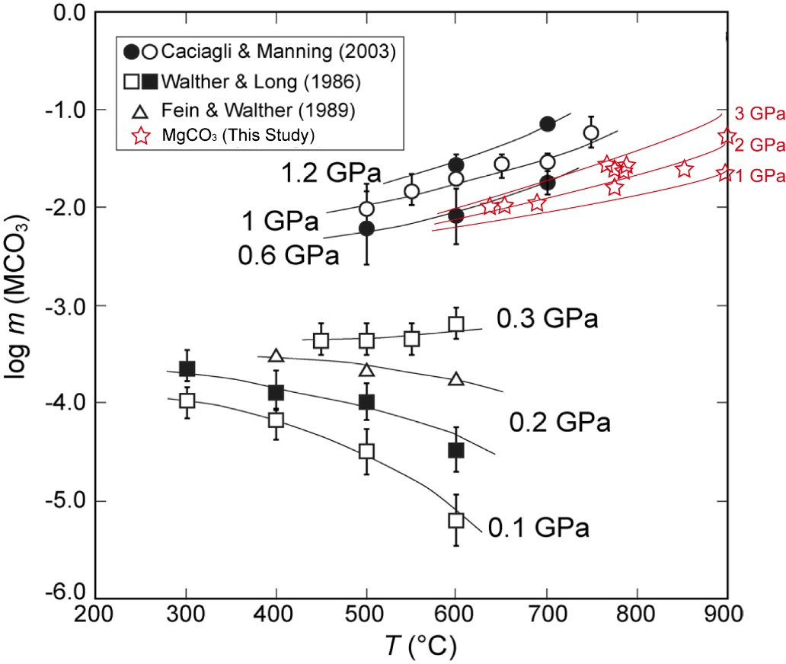
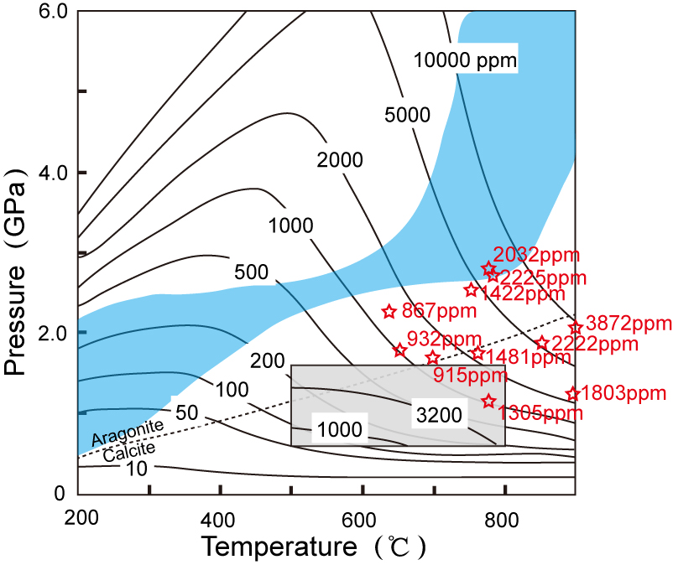
Compare with previous research
Manning et al., 2013
Kelemen & Manning,2015 PANS modified
Consist with the trend of calcite solubility,
slightly lower than the experimental and theoretical data

Slide 14
Carbon species in fluid
C-CO₂ buffer
Notes:
At temperatures
of 650 C and greater, hydrogen and carbon dioxide were detected in addition to methane
The production of abiogenic
methane, observed in all HDAC experiments where a gasket was used

Slide 15
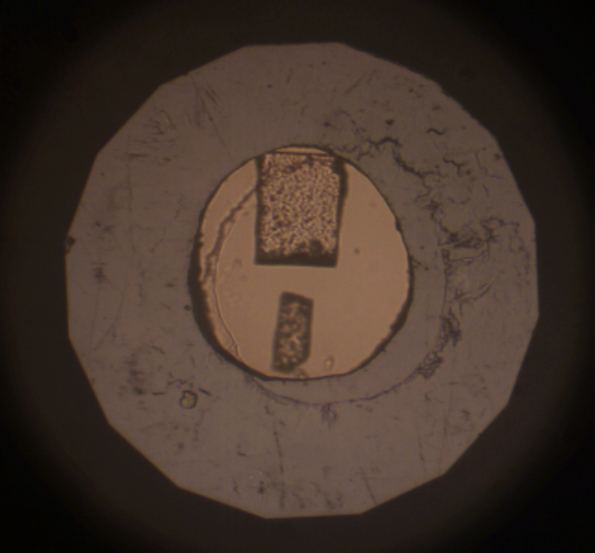
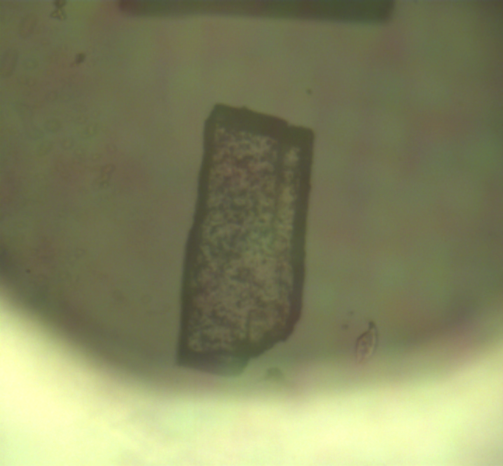
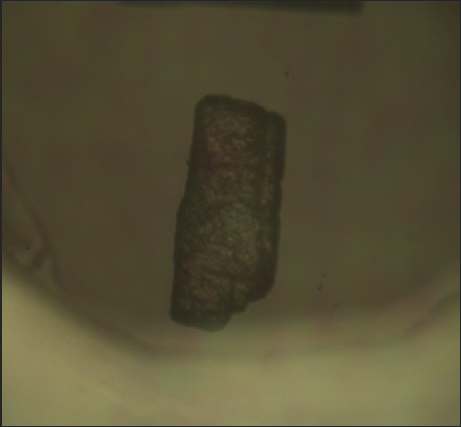
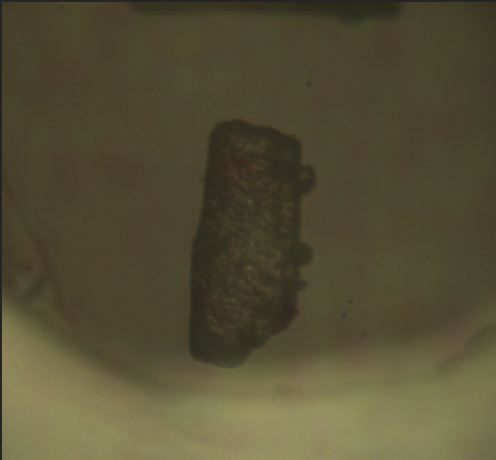
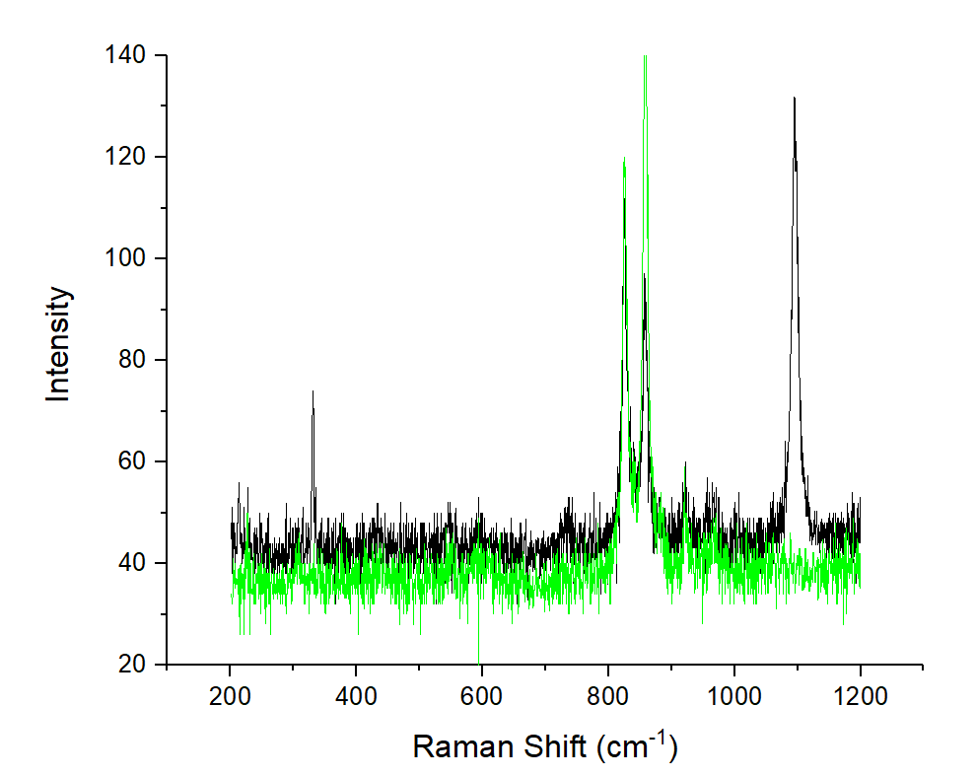
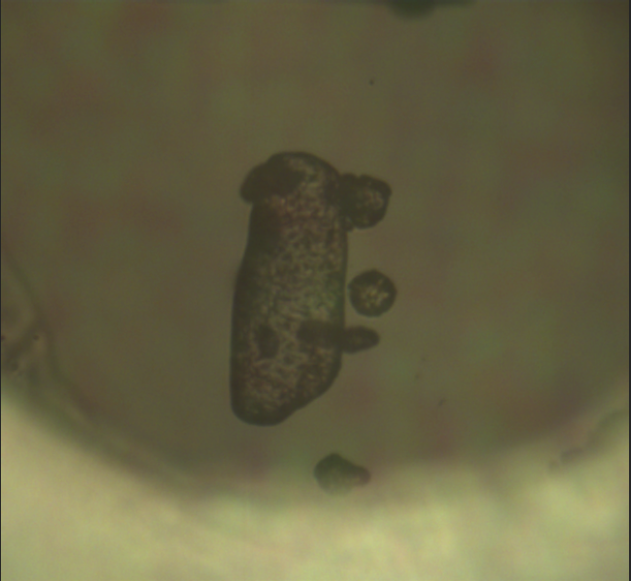
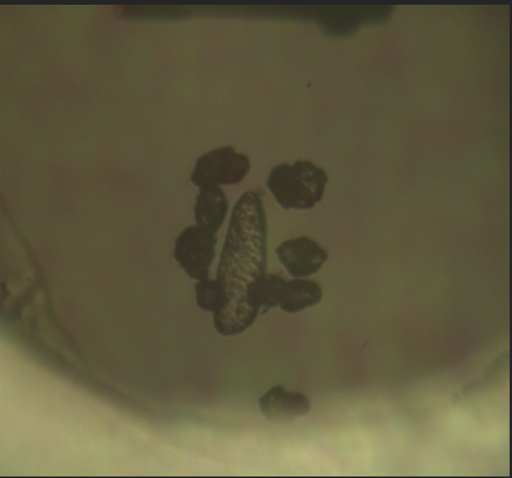
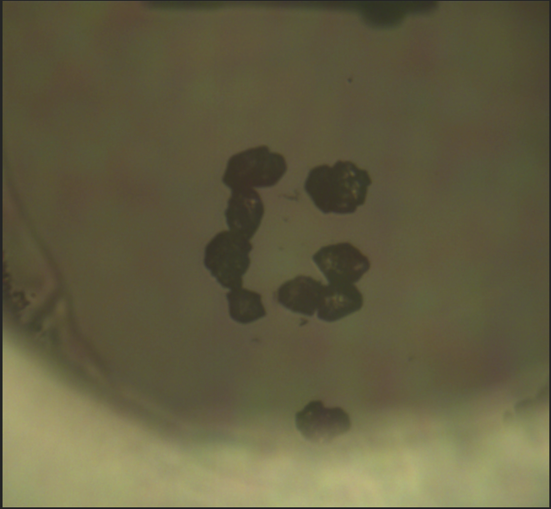
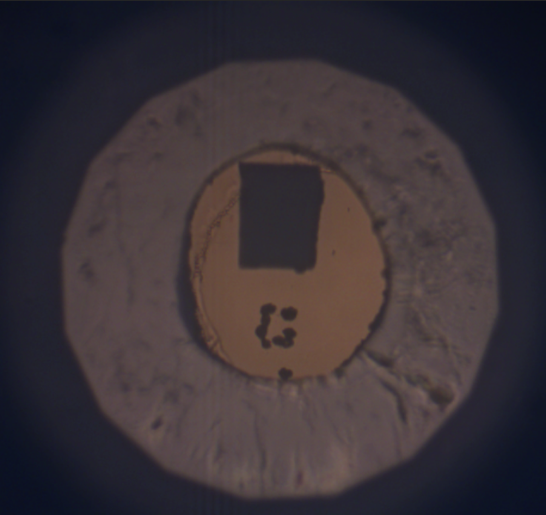
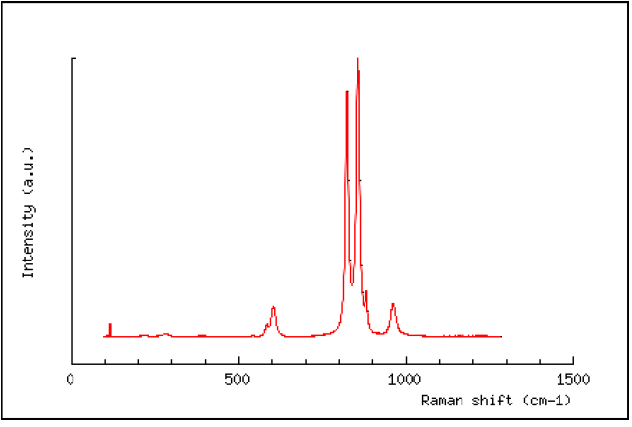
Solubility in silicate buffered NaCl solution
Magnesite + Zircon + 5 wt% NaCl Solution
26 C
100 ℃/ 0.28 GPa
500 ℃ /1.58GPa
600 ℃ / 1.69GPa
Olivine + Magnesite
Olivine
650 ℃ / 1.52 GPa
652 ℃ /1.52 GPa
680 ℃ /
710 ℃ /1.46 GPa
710 ℃，1.46 GPa most magnesite consumed，produce forsterite，few magnesite is shield by forsterite shell
Solubility：about 0.22 mol/Kg H₂O
San Carlos
Olivine ref
MgCO₃+H₂SiO₄+H₂O-------Mg₂SiO₄ +H₂CO₃(aq)
Low Silicon avtivity fluid : Forsterite
Notes:
Cell 204 20180126

Slide 16
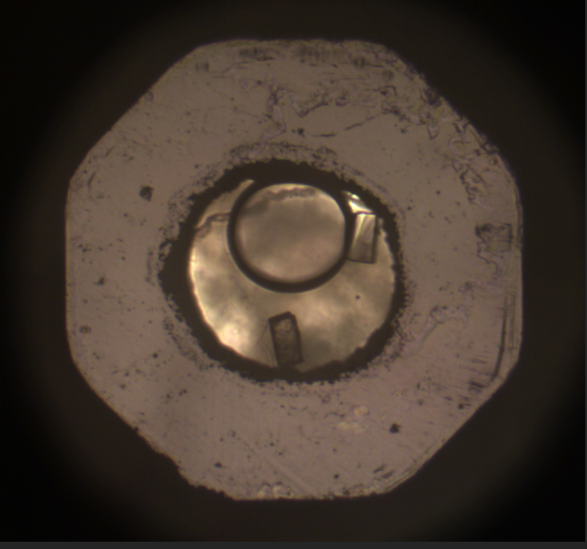
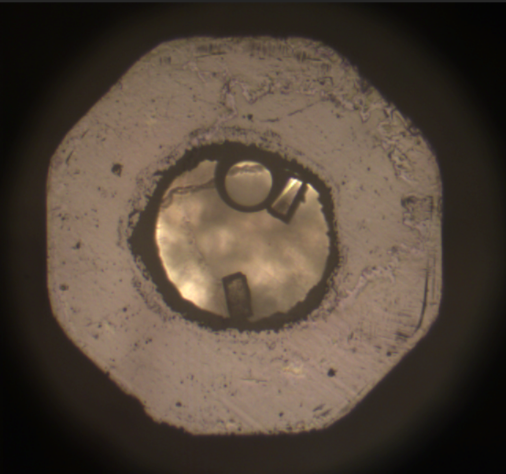
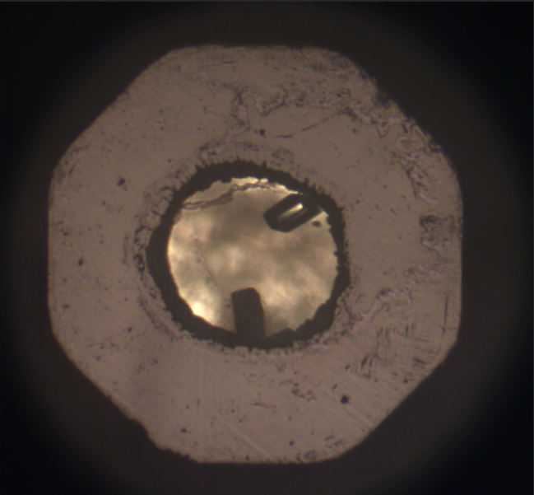
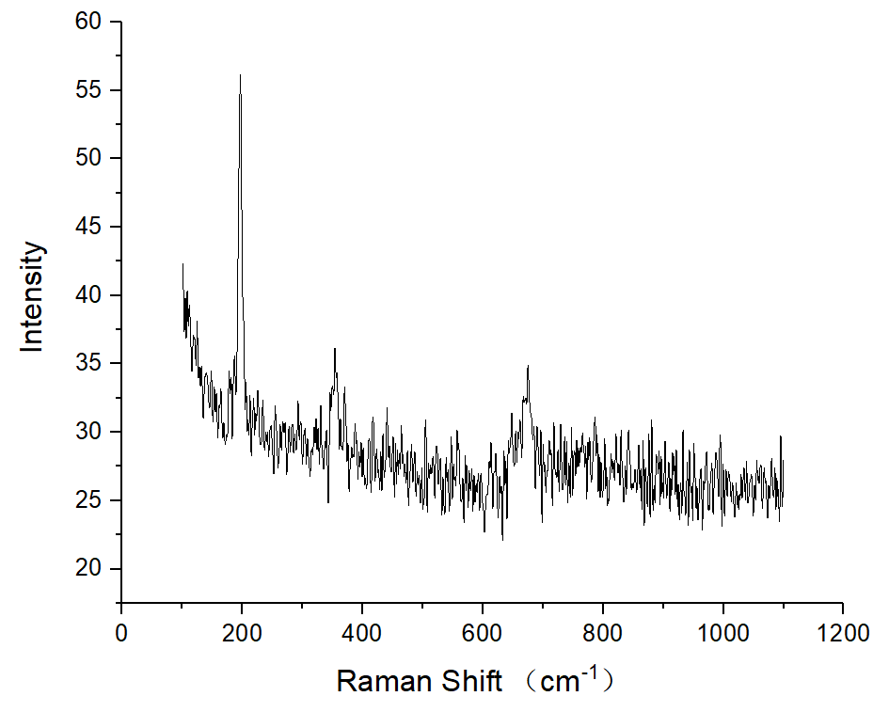
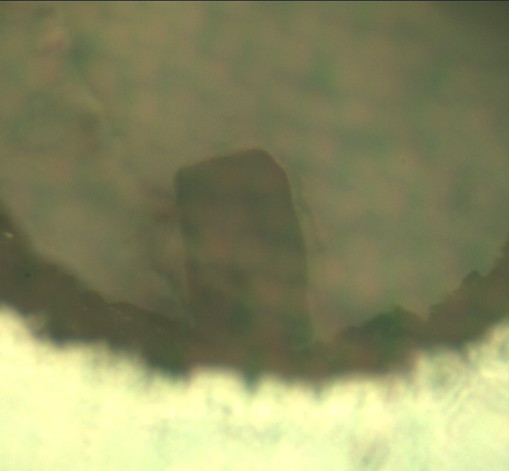
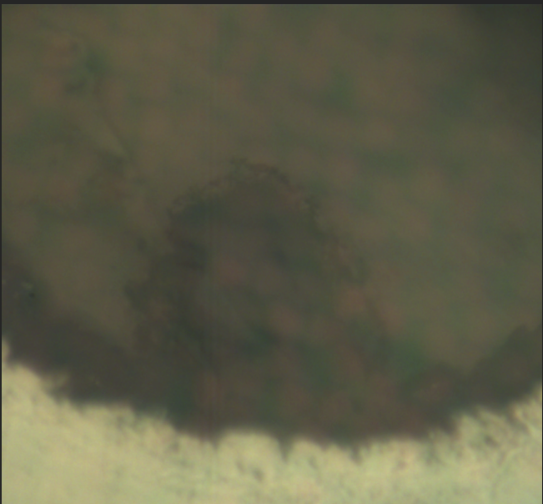
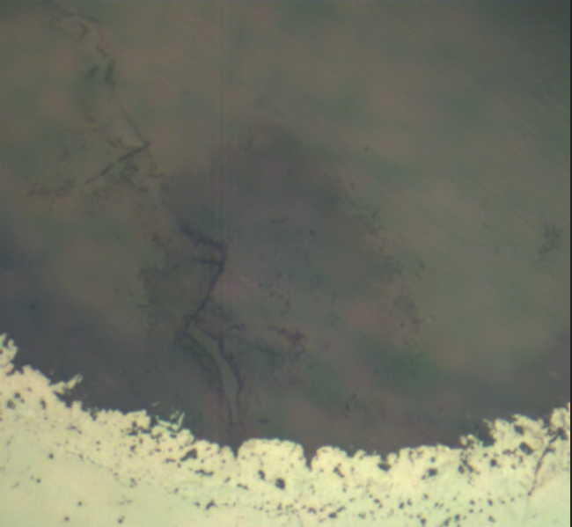
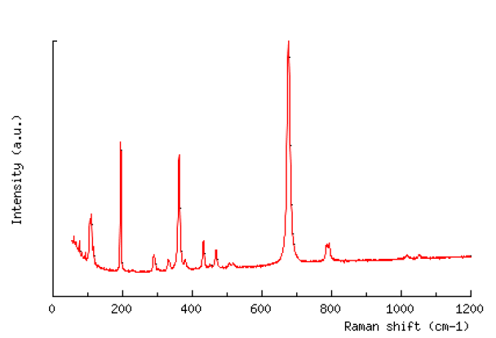
Solubility in silicate buffered NaCl solution
Magnesite + quartz + 5 wt% NaCl Solution
20 ℃
300 ℃
650 ℃ 0.75GPa
Talc
825℃
650 ℃ 0.75GPa
800 ℃ 0.97GPa
862 ℃ 1.06GPa
Talc ref
MgCO₃ + SiO₂+H₂O-------Mg₃Si₄O₁₀(OH)₂ +H₂CO₃(aq)
High Silicon avtivity fluid : Talc
Notes:
20180130 205 363 C 气泡消失，冷却至210 C 气泡出现，腔体体积变小，压力数据不可靠

Slide 17
Conclusions
The solubility of magnesite in water is 143-6948 ppm at 0.5-4 GPa，500-950 ℃, slightly lower then the solubility of calcite in water, consist with the theoretical predication.
The solubility of magnesite in water is affected by temperature and pressure，increases with temperature or pressure increasing, both temperature and pressure effects are more significant under higher P/T conditions.
The NaCl and silicon in aqueous fluid can boost the dissolution/reaction of magnesite significantly.

Slide 18
End

