Slide 1
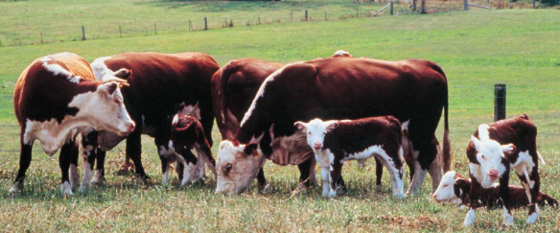
Demonstrating sustainable land management - delivering multi-functional landscapes in Australian pastoral systems
Dr. Cathy Waters, NSW Department of Primary Industries, Dubbo
Dr Susan Orgill, NSW Department of Primary Industries, Wagga Wagga
Susan Ogilvy, Australian National University, Canberra
Dr. Aaron Simmons, NSW Department of Primary Industries, Taree
Dr. David Summers, University of South Australia, Adelaide
Feedback on program scope

Slide 2
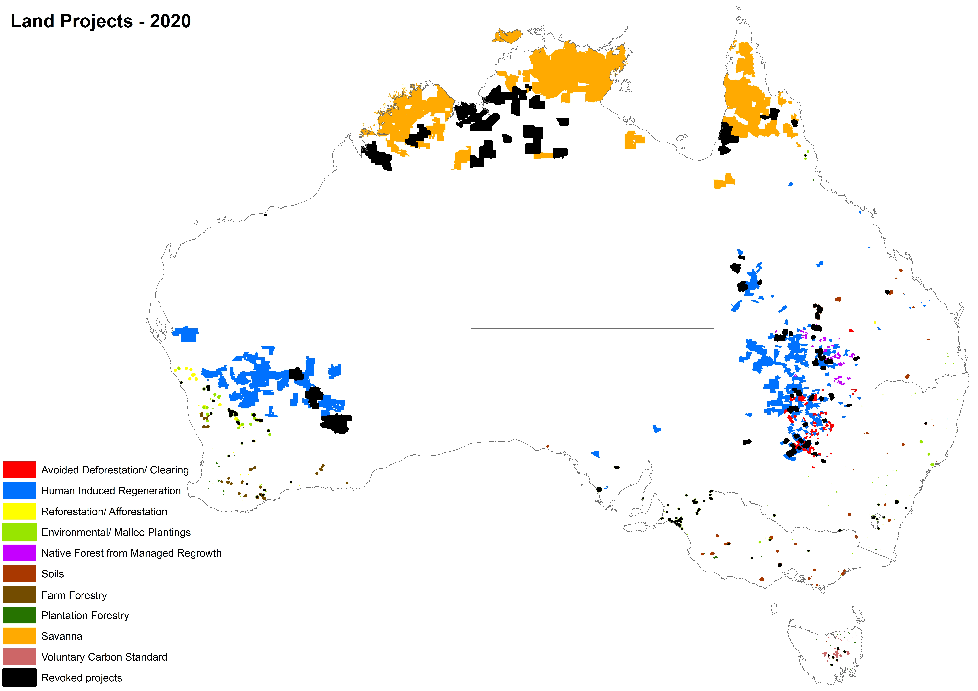
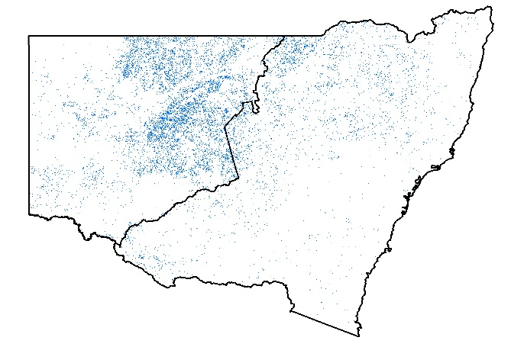
Project areas under Australia’s Emissions Reduction Fund (ERF) (2015-2020)
Future expansion
Baumber, Waters, Cross et al. (2020). The Rangeland Journal (Submitted)

Slide 3
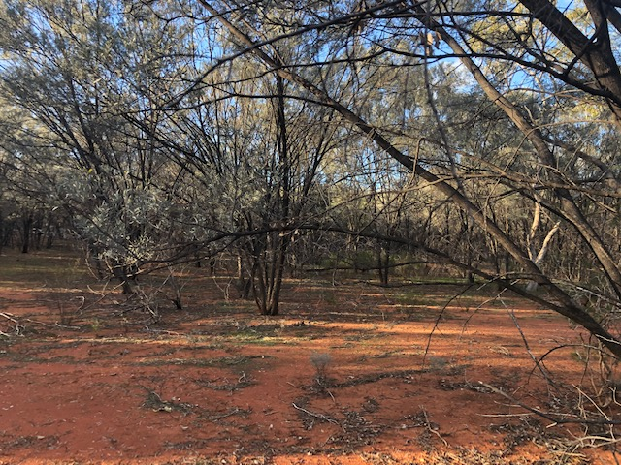
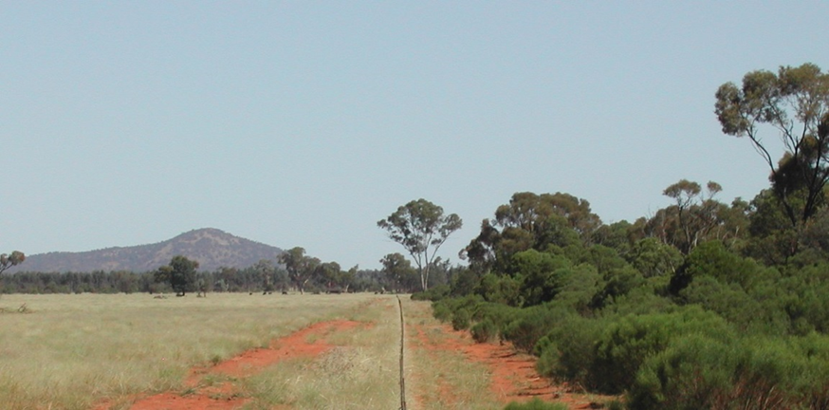
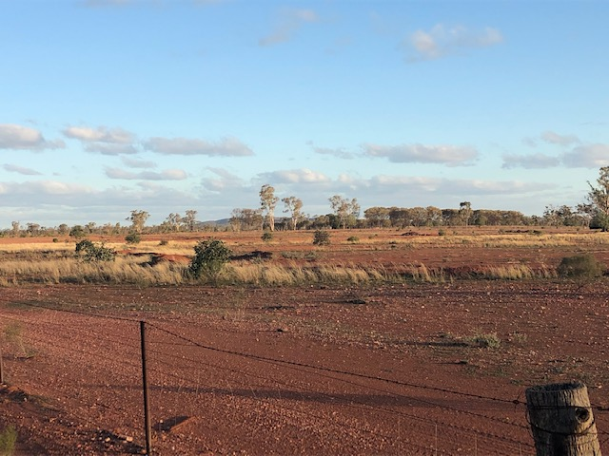
Avoided Deforestation
‘Best-practice’ to keep woodlands open and free of invasive native shrubs
Cease clearing of native vegetation
(Maintain forest cover)
Carbon farming activities
?
Human Induced Regeneration
Management that assists recruitment
(Regrow forest cover)

Slide 4
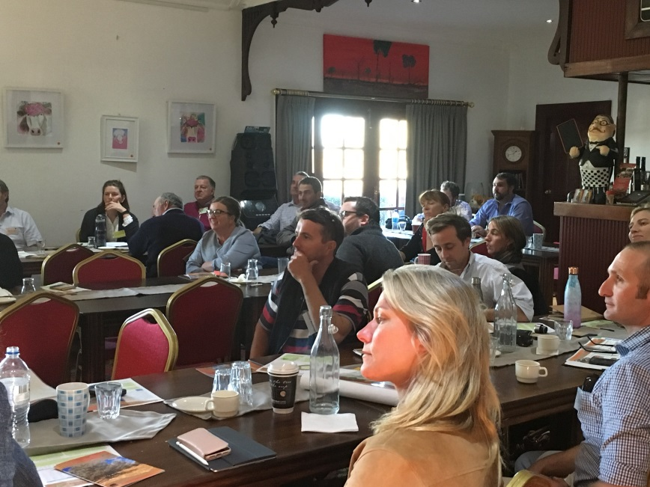
How is carbon farming contributed to the resilience of the NSW rangelands?
Risks and opportunities
Many stakeholders are uncertain about environmental impacts, and there are concerns over increased absenteeism that may limit collaborative activities such as fire, pest and weed management.
There will be trade-offs between different environmental, social and economic objectives and perspectives and individual property and regional objectives and perspectives.
Landholders with carbon farming projects and carbon service providers had stronger perceptions of carbon farming benefits than landholders without carbon farming projects, researchers, government employees and financial advisors.
Diversified farm income contributes to resilience by providing financial security (improved mental health outcomes) and better land management opportunities.
Cowie, Waters, Garland et al (2019). Environmental Science and Policy. 100:37-46

Slide 5
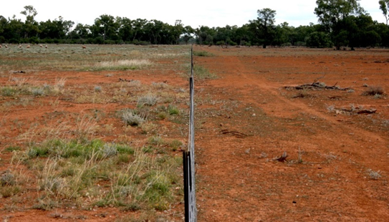
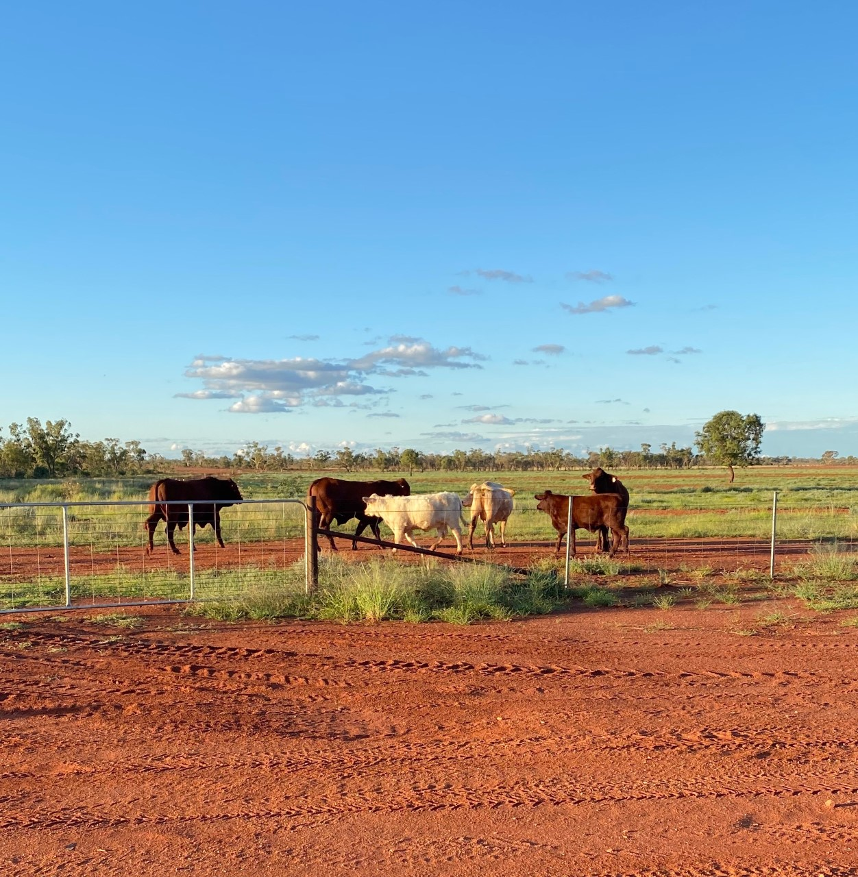
Semi-arid rangelands : links between regenerative practices, rangeland system resilience and wellbeing
Reserves, buffers and redundant capacity
Adaptive and flexible grazing management
Increased pasture rest and recovery (total grazing pressure management)
Waters, McDonald, Reseigh et al. (2020). The Rangeland Journal 41:535-556
Waters, Orgill, et al. (2017) Land Degradation & Develop. 28:1363-1375
Enhanced diversity
Land use intensification
Increased on-farm employment
Protection and enhancement of habitat for biodiversity, ground cover

Slide 6
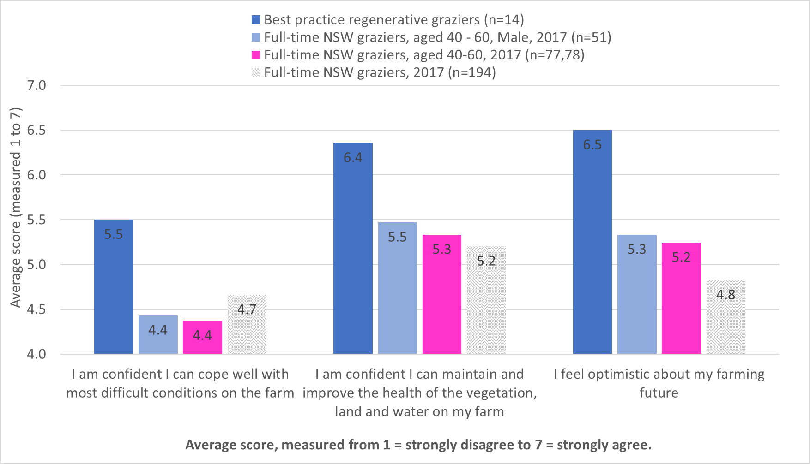
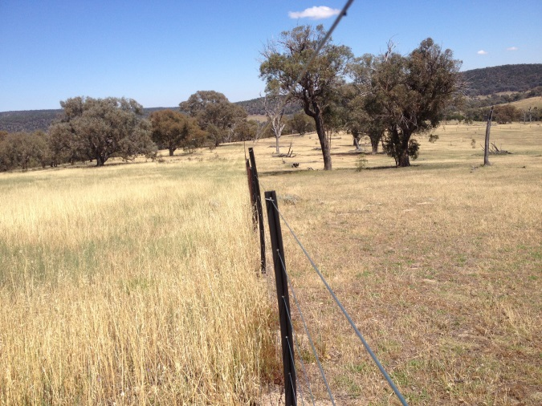
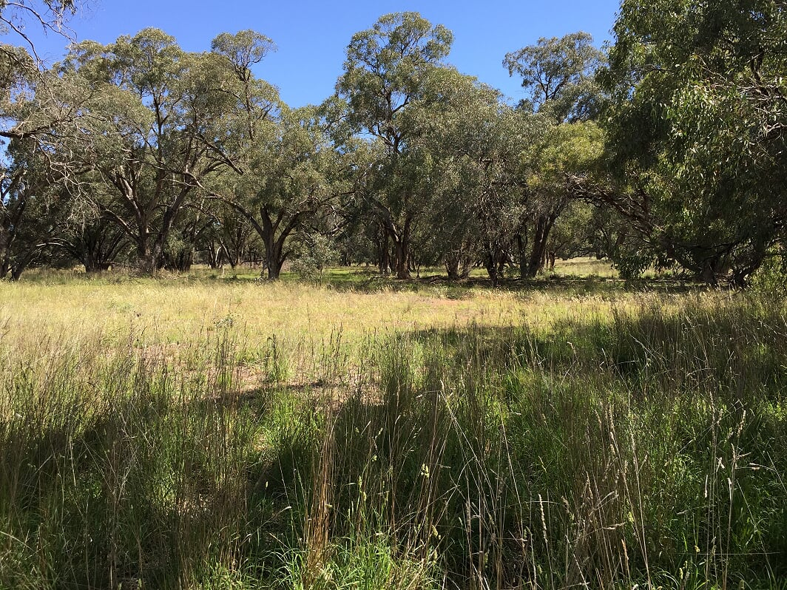
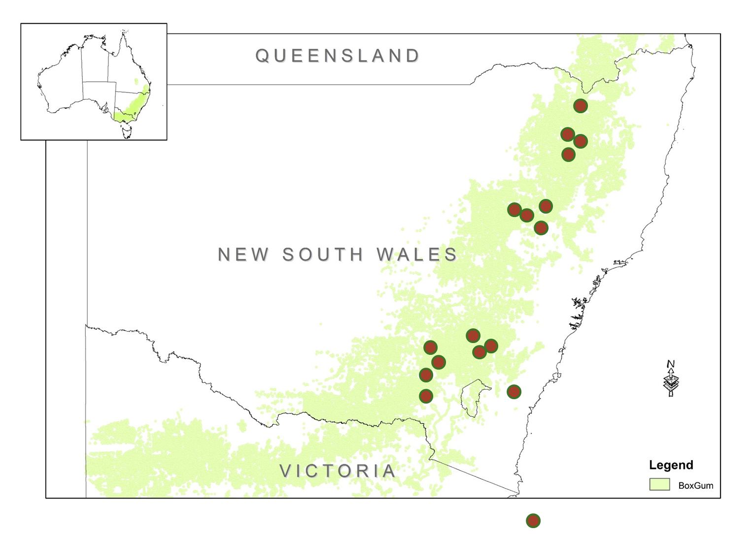
Temperate grasslands: Links between regenerative practices, wellbeing and farm profitability - Grassy-box woodland restoration
Ogilvy, Gardner, Mallawaarachichi et al. (2018) NESP-EP: Farm profitability and biodiversity project final report. Canberra Australia

Slide 7
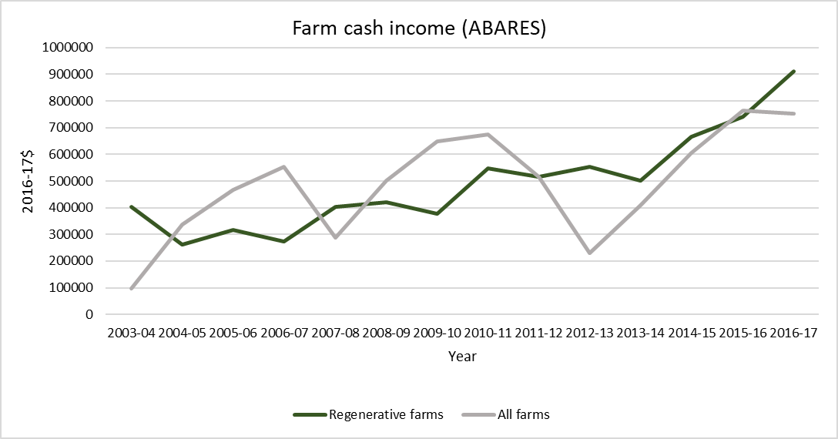
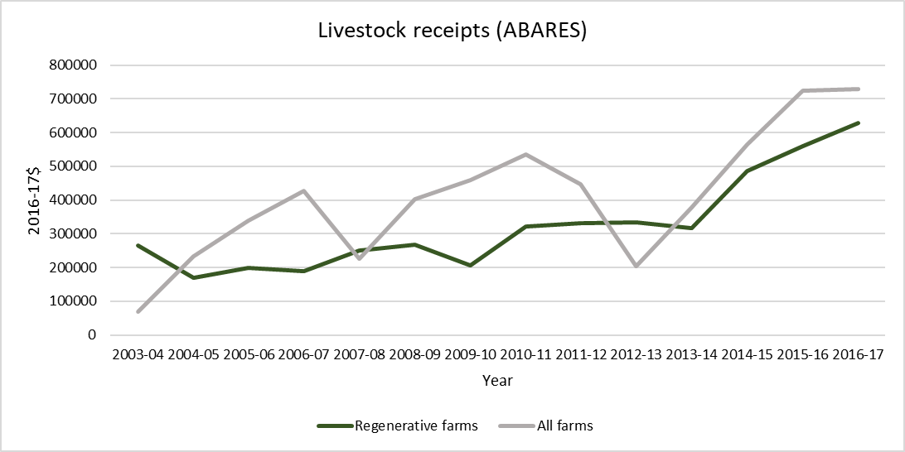
Temperate grasslands: Links between regenerative practices, wellbeing and farm profitability - Grassy-box woodland restoration
Source: Dale Ashton ABARES
Source: Dale Ashton ABARES
Ogilvy, Gardner, Mallawaarachichi et al. (2018) NESP-EP: Farm profitability and biodiversity project final report. Canberra Australia

Slide 8
Conclusions
Australian carbon farming appears to be an enabler in semi-arid pastoral systems
Contribute to net-zero targets
To manage drivers of land degradation and rehabilitate degraded lands
Contingent on the value of the carbon project (vegetation communities and the farm mix)
Uncertainty remains over the sequestration potential under climate change
Diversification of income
Decoupling (buffering) farm business from vagaries of climate
Linkages between human wellbeing and landscape condition
Notes:
Out next steps are to understand where in New South Wales carbon, agricultural production and biodiversity can be prioritised and optimised
LUTO modelling state wide
Farm-scale optimisation (to design landscapes for multiple benefits)

Slide 9
Conclusions
Australian carbon farming appears to be an enabler in semi-arid pastoral systems
Contribute to net-zero targets
To manage drivers of land degradation and rehabilitate degraded lands
Contingent on the value of the carbon project (vegetation communities and the farm mix)
Uncertainty remains over the sequestration potential under climate change
Diversification of income
Decoupling (buffering) farm business from vagaries of climate
Linkages between human wellbeing and landscape condition
Next steps
Notes:
Out next steps are to understand where in New South Wales carbon, agricultural production and biodiversity can be prioritised and optimised
LUTO modelling state wide
Farm-scale optimisation (to design landscapes for multiple benefits)

Slide 10
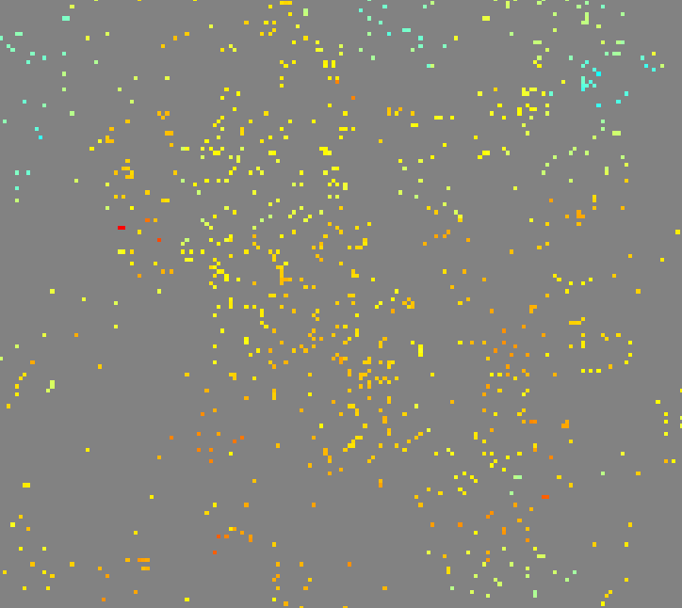
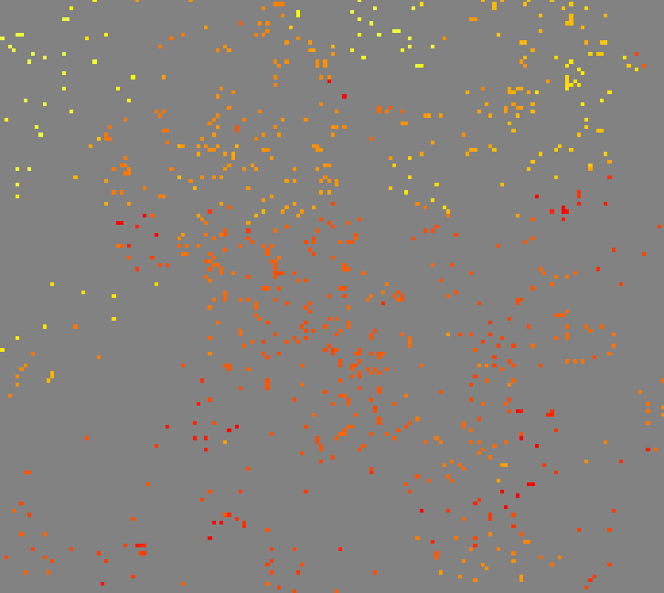
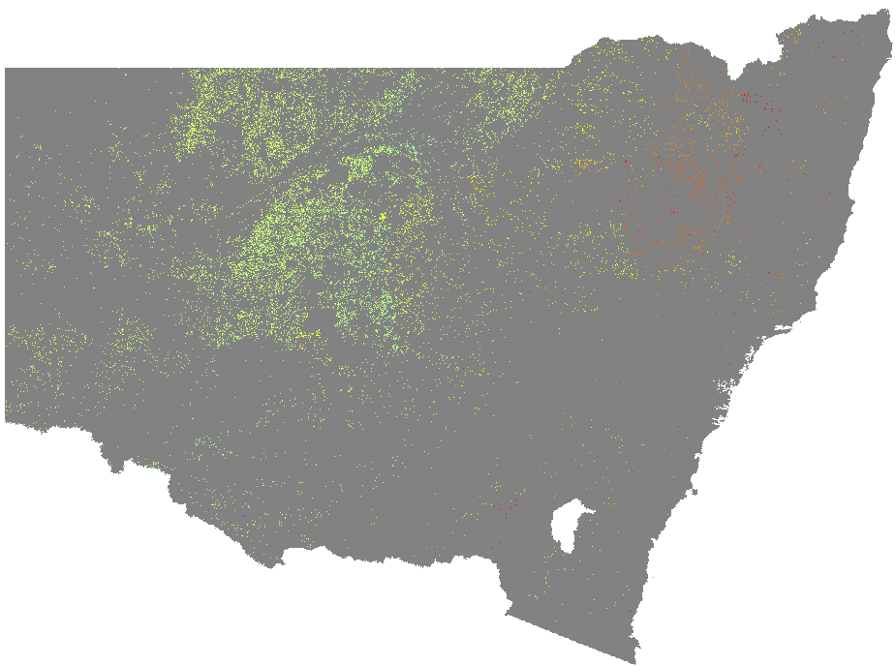
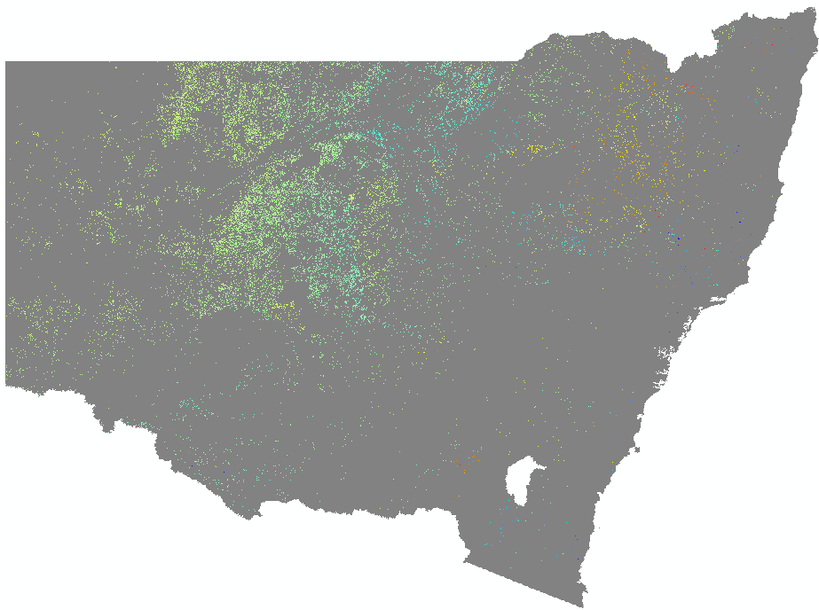
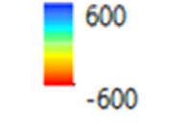
Land-use trade-offs – LUTO ^{1.2.}
^{1.}Bryan, B.A. (2013). Envir. Modelling & Software 39:295 – 303.
^{2.} Hatfield-Dodds et al. (2015). Nature 527: 49 – 53.
$12 tCO₂e⁻¹
Medium fencing costs Medium impact of trees on pasture
$30 tCO₂e⁻¹
Medium fencing costs Medium impact of trees on pasture

Slide 11
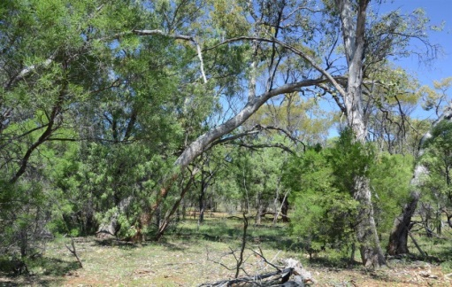
Finally….
Evidence of tangible opportunities for achieving multi-functional landscapes (abatement, production, biodiversity)
Restoration of ecological function
Greater resilience of pastoral systems
“Value stacking” carbon farming activities (linkages to carbon and ecosystem service markets)

