Slide 1
A Survey of Small-Scale Waves and Wave-Like Phenomena in Jupiter’s Atmosphere Detected by JunoCam
Glenn S. Orton¹, Fachreddin Tabataba-Vakili¹, Gerald Eichstädt², John Rogers³,
Candice J. Hansen⁴, Thomas W. Momary¹, Andrew P. Ingersoll⁵, Shawn Brueshaber ⁶,
Michael H. Wong⁷, Amy A. Simon⁸, Michael Ravine⁹, Michael Caplinger⁹, Dakota Smith¹⁰, Chloe Thepenier¹¹, Hamish Nicholson¹²
¹Jet Propulsion Laboratory, California Institute of Technology, Pasadena, California, USA; ²Independent scholar, Stuttgart, Germany; ³British Astronomical Association, London, UK; ⁴Planetary Science Institute, Tucson, Arizona, USA; ⁵California Institute of Technology, Pasadena, California, USA; ⁶Western Michigan University, Kalamazoo, Michigan, USA ⁷University of California, Berkeley, California, USA; ⁸NASA Goddard Space Flight Center, Greenbelt, Maryland, USA; ⁹Malin Space Science Systems, San Diego, California, USA; ¹⁰ National Center for Atmospheric Research, Boulder, Colorado, USA; ¹¹Glendale Community College, Glendale, California, USA; ¹²Harvard College, Cambridge, Massachusetts, USA

Slide 2
Outline
● Survey of waves and wave-like features
● Extraction from JunoCam images
● Previous detections of waves
● Types of waves and “wave-like” features
- Morphology only, we have (almost) no features with time dependence
- Include wave-like features that may not be true propagating waves
- Reference to terrestrial analogs
● Quantitative properties
● Comparison with previous measurements
● Summary
● Final remarks, doing “science in a fishbowl”

Slide 3
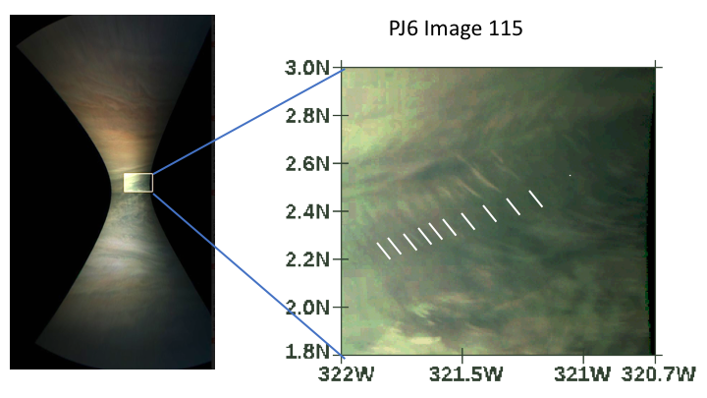
Waves Detected by Visual Search
● Every JunoCam image up to PJ20 was searched
● Anything with 3 or more repeated features was considered a “wave” candidate
● Waves always detected in all color filters
Features shown here are extracted from cylindrical maps
● Waves not detected in CH₄ (890-nm) filter (so no altitude discrimination)
● Images shown are very color-enhanced to identify and display waves and wave-like features easily

Slide 10
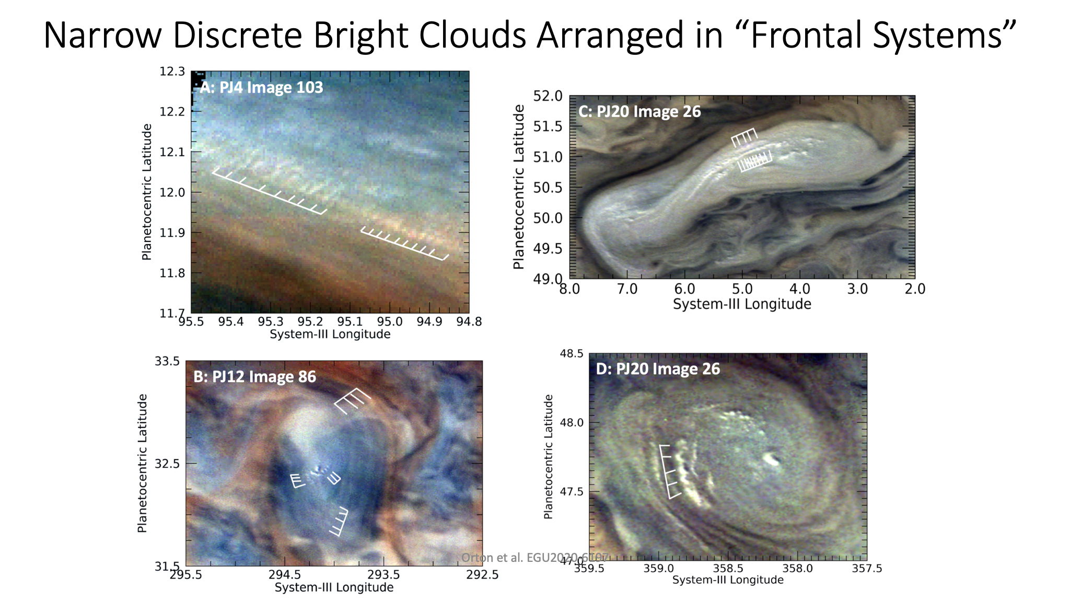

Slide 11
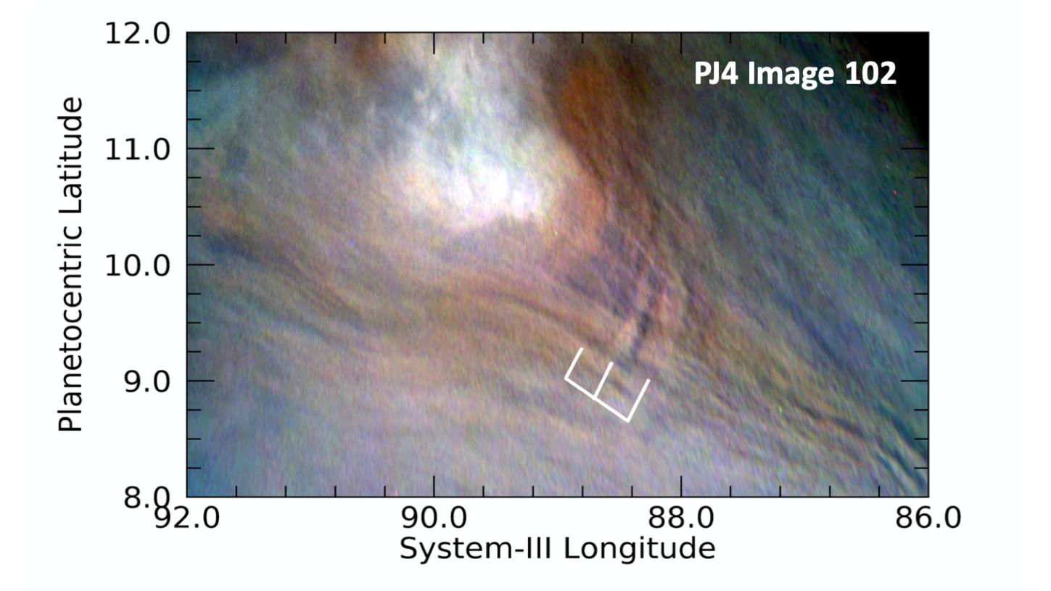
Waves around a visible object: Lee wave
Waves downwind from a bright upwelling in the NEB near the terminator. The shadow length indicates the wave cloud is ~10 km above the main cloud deck.

Slide 15
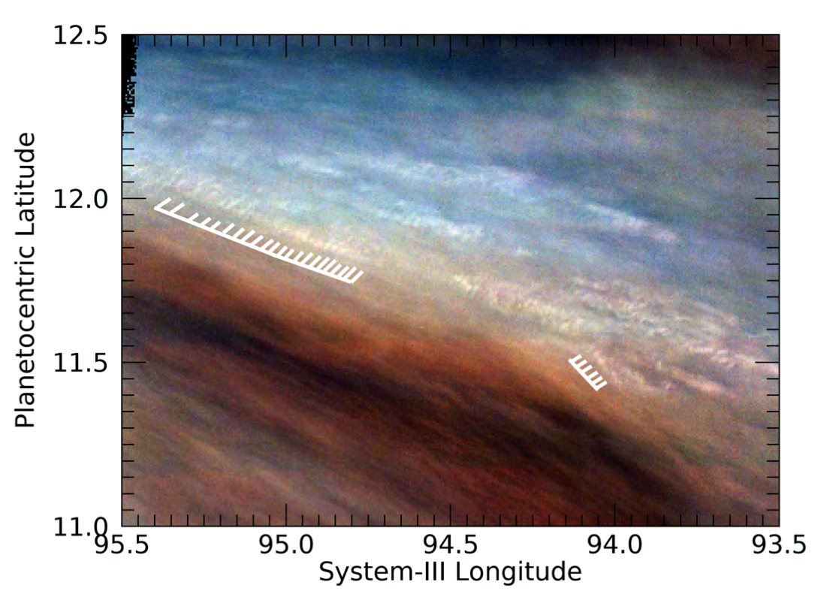
By the numbers: 157
Long packet, short crests 100 Features with wavelength < 500 km 169
Short packet, wide crests 25 Features with wavelength < 200 km 109
Curved wave packets 9 Features with wavelength < 100 km 19
Small white clouds 8
Regularly spaced dark feature 6 Shortest wavelength = 29 km
Emanating from cyclone 5 (small white clouds)
Extremely long curved features 2
Lee waves 1 Shortest wavelength for
Discrete feature 1 long-packet, short-crest clouds: 31 km

Slide 16
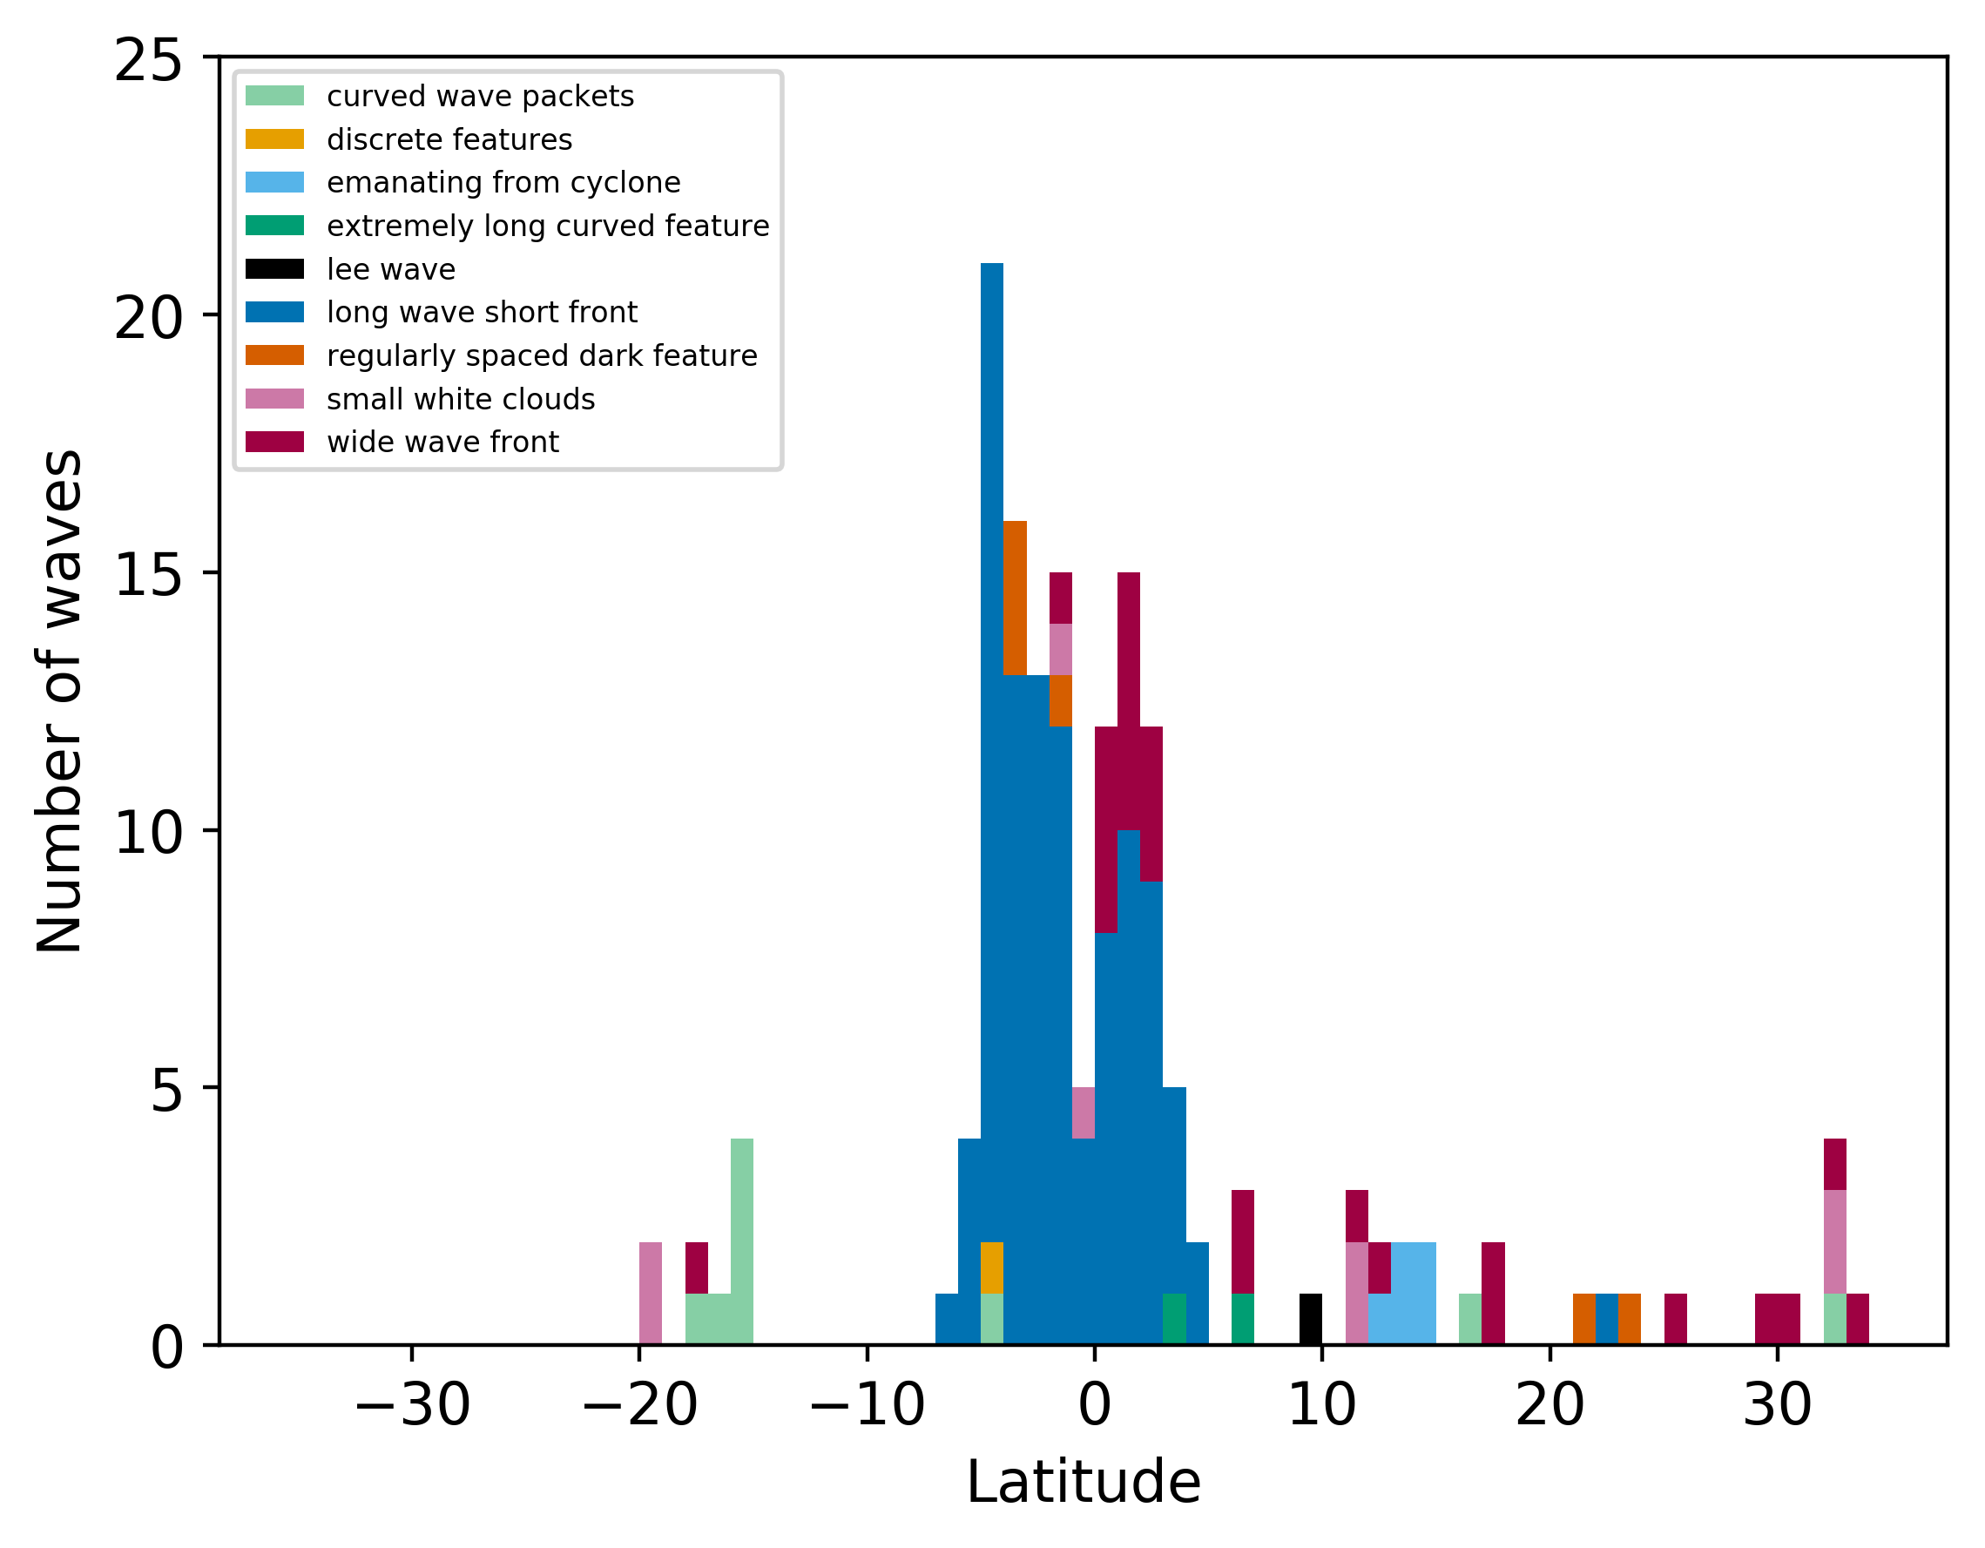
Majority of waves are located near the equator
● Predominantly long-packet,
short-crest waves

Slide 17
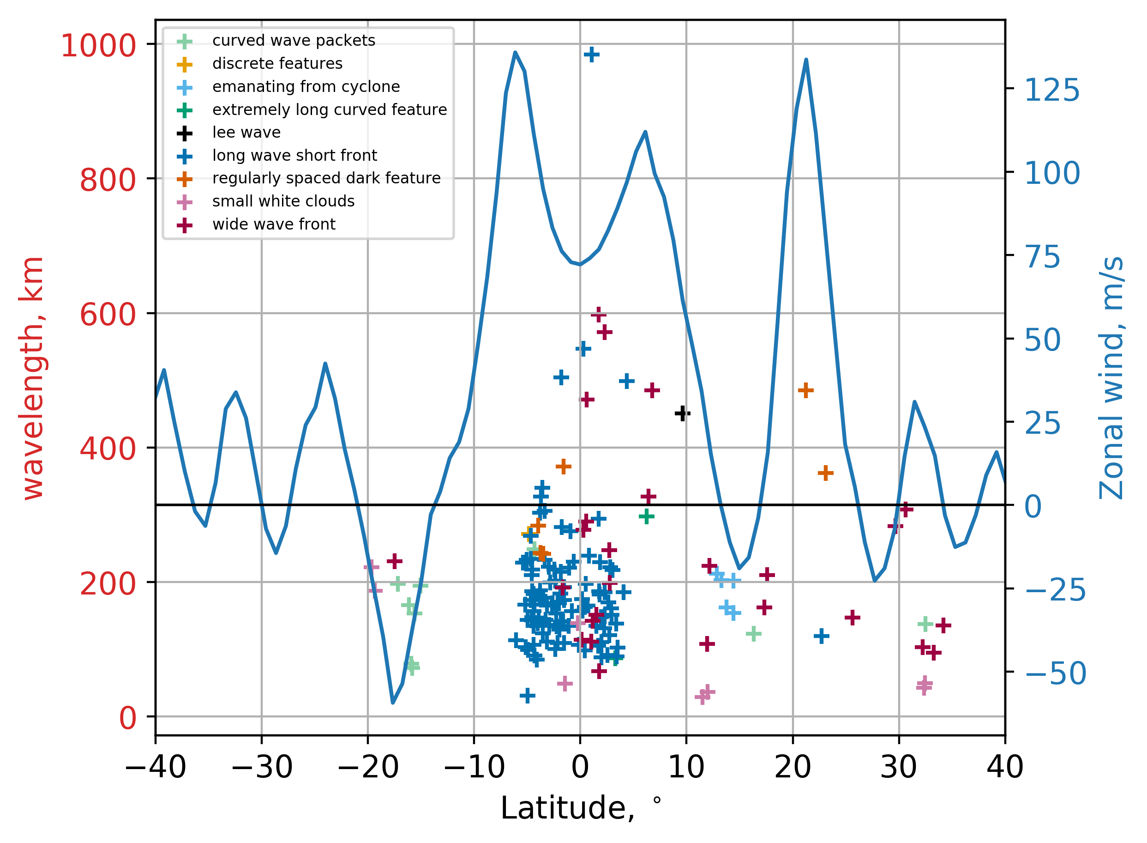
Variety of separations between crests (wavelengths)
MWR ammonia abundance

Slide 18
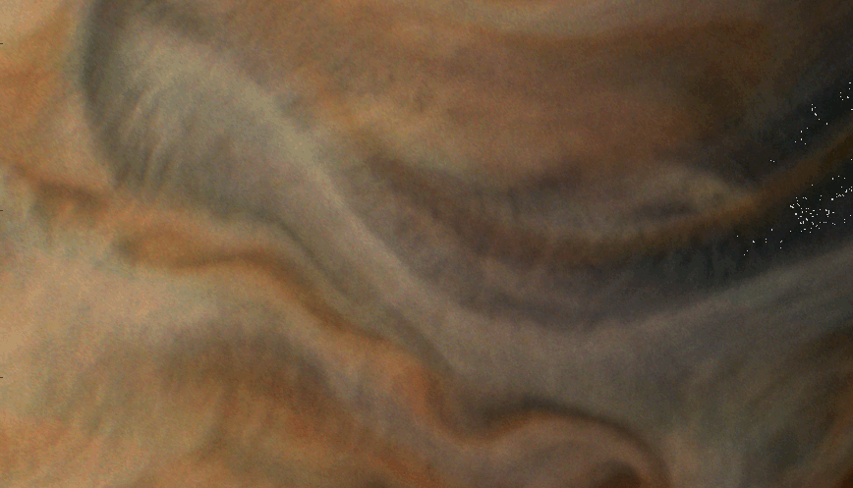
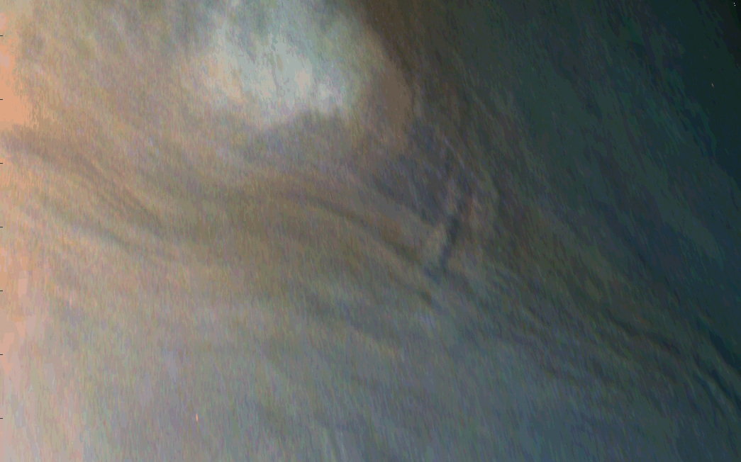
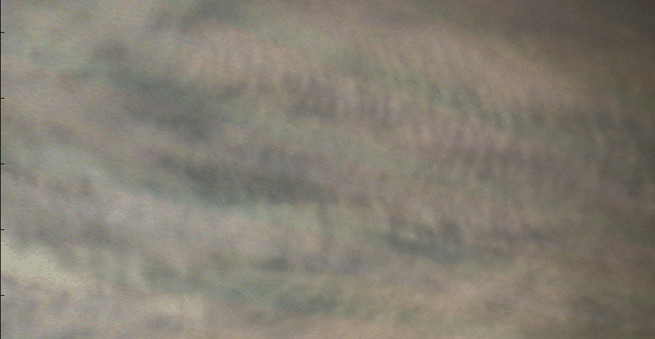
Classification of JunoCam waves
Ability to classify waves hampered by the lack of information on phase speed and duration
Exception: Sánchez-Lavega et al. (2018) determined a phase speed of 45±20 m/s for the GRS wave and deduced that its properties were consistent with a gravity wave
PJ20 measurements of Equatorial Zone wave showed no motion, implying an phase speed < 44 m/s
Those near the equator are morphologically similar to waves measured by Voyager.
Those were stationary and consistent with inertia-gravity waves
Unlike Kelvin waves measured by New Horizons at 80±5 m/s (Simon et al. 2015).

Slide 19
Summary
Over 100 different types of waves or ”repeated” features observed by JunoCam up to PJ20
Wavelengths as small as ~30 km
Several different morphologies – most not associated with larger features
Exceptions: curved wave packet near GRS, Lee waves, curved parallel lines, ‘spokes’ radiating from vortices
Very few are associated with retrograde jets
Wave packets with short wavelengths are concentrated near equator
Possibly associated with upwelling winds, using MWR NH₃ abundance as an indirect tracer
No waves in the SEB, few in the NEB

Slide 20
Final remarks
Images of all the identified wave candidates are on line as a part of the Supplementary Information file for the article reporting this work
https://www.missionjuno.swri.edu/junocam/think-tank?id=16
Part of our “Science in a Fishbowl” effort
Interesting approach to making the process of research accessible to the public (maybe not so easy if you’re a fish)
This work has been accepted in a special J. Geophys. Res. issue on Juno results midway through the Juno mission.

